Slide 1
Is It Possible To Teach Service Science?
PA194 - Introduction to Service Science
© Leonard Walletzký

Slide 2
This semester
This round is a pre-relase version
All students are asked to participate
After this round this lesson sholud be mandatory for all students of SSME
Knowledge presented here will be examined at state exam
The lessons are voluntary
Written test at the end of the semmester
  50% open and 50% optional questions

Slide 3
History
SSME master study program was founded on Faculty of Informatics in 2008
Suppoted by IBM
Moraly
Personaly
Main founder RNDr. Zdenko Staníček
2010 – EU donation to improove the programm

Slide 4
Content
Goods and Service Dominant Logic
Role of information in in GDL and SDL
Service systems and imperfect information
Service system
Dual service system
Dynamic service system
IT in SDL
Software as a Service
Marketing concepts in SDL
Service Science, Management and Engineering

Slide 5
Other topics do include
Start ups in SDL
Other implications of SDL
Suggestions from the students?

Slide 6
Introduction
What is Service Science?
  Founded by Jim Spohrer in 2004
  The reaction to the reality in IT development
  How to communicate with the customer to fulfill the right requests
Everything is a service
  Have you met Service Aprroach?

Slide 7
What is it service?
  Output is intangible, hard to quantifiable and measurable
  Nonstorable
  Lack mobile
  Consumption runs together with the supply
  The customer is presented on the production
  The customer is often co-creator
  Hardly specifiable

Slide 8
What is service?
services are processes, performances, or experiences that one person or organization does for the benefit of another
In all cases, service involves deployment of knowledge, skills, and competences that one person or organization has for the benefit of another, often done as a single, customized job (Lusch & Vargo)

Slide 9
What is science?
to help service managers to achieve standardization
assembly of standardized modular service elements in several "customizable" but highly predictable permutations.
customers seek value standardization because it reduces variability and usually helps bring prices down.
services in the digital economy employ standardization and mass customization.
a new service definition might focus on the technical nature of modern day service

Slide 10
Why Service Science and IT
IT is a service
  Outside and inside the company
The main task of IT as a Service
  To propose, impement and run the amount of tasks, suporting the realization goals of economics subjects
The graduates of FI need to know more than IT
They need to orientate in real problems

Slide 11
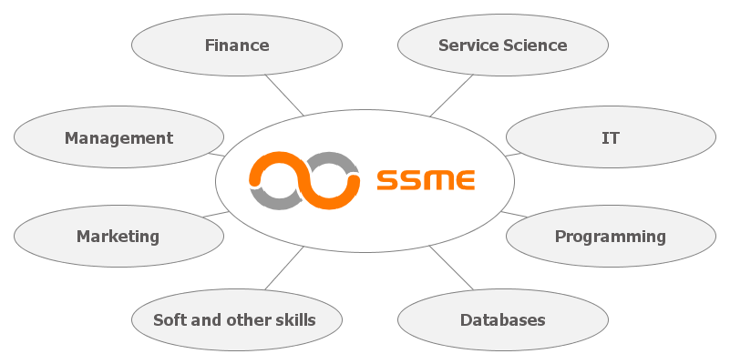
Service Science, Management and Engineering master study program

Slide 12
X – shape proffesional
I – shape
Dash – shape
T – shape
Deeply focused
Expert only in one branch
Interdisciplinary approach
Not expert, but is able to communicate with I-shapes
Multidisciplinary approach
Expert in one field, interdisciplinary in the others

Slide 13
T – shape profesionals
Business, Economics, Management, Marketing, Soft Skills
Information technologies

Slide 14
T - shape
Multidisciplinary education
Four pillars of the branch
  Information technologies
  Economics and finance
  Management and marketing
  Soft and other skills
The deep pillar (a leg of the T-shape) is IT
  Databases
  Programing
  Security
  Networking
  The leg should be more dynamics than the roof

Slide 15
Interim project
Large praxis for the students – to gain experience in reality
Business
  For business partner
  5 months, 4 days per a week
Research
  For research or university partners
  10 months, 2.5 days per a week

Slide 16
Conclusion
Service Science is strongly related with IT
Service Science changed the service market
Service Science means different aproach to the education
T-shape education is necessary for the success on labour market

