Slide 1
Management by Competencies
Strategic frame & Strategic continuum

Slide 2
Previously on MbC
Leaders
Managers
Workers

Slide 3
Agenda
System of Corporate Ideas
Strategic Frame
Strategic Continuum

Slide 4
System of Corporate Ideas
Strategic Frame
Goals & Objectives
Products, Services, Processes & Projects, Resources, Tasks, Competencies, Feedbacks, Feedforwards, HR development, ...
Strategic Frame
Notes:
Philosophical core of MbC is to continually approximate the corporate requirements and possibilities of people who work there. Therefore the System of Corporate Ideas (SCI) has to be a logical unit which starts by general thoughts and considerations, but ends by specific tasks to be performed by particular people.

Slide 5

Context of Strategic Frame
Stability
Effectiveness
Usefulness
Dynamics
Integration
Synergetization
Habilitation
Motivation
Orientation
Definition
Leaders

Slide 6
Purpose of Strategic Frame
Defines company and its business
Instrument of strategic management
Defines only boundary which delimits space for free activity of management
Submission for company management
Strategic frame ought to be an eternal source of inspiration, orientation and motivation for people working for company, for suppliers, investors, ...
Absence of strategic frame is often reason of chaos in companies which leads to their failure
Strategic frame is the seed the company ideas grow from

Slide 7
Creation of Strategic Frame
Emotional perspective
Rational perspective
wishes, intuition, instincts
unconsciousness
consciousness
measurable parameters
Environment understanding
trends, challenges, opportunities
“The future belongs to people who see possibilities before they become obvious.”
--Ted Levitt

Slide 8
The Elements of Strategic Frame
Strategic frame
Business hypothesis
Mission
Strategy
Vision
Values and Rules
(C) J. Plamínek

Slide 9
Business Hypothesis
Strategic frame
Business hypothesis
Vision
Mission
Values and Rules
Strategy
Gains trust of investors, owners, managers, workers
Identifies business opportunities in surrounding environment
Clarifies why intended business will generate sufficient income to sustain itself in the future
Includes trend estimations of target customers behavior and other subjects considering development in environment
Delimits a space where the company will operate and describes the position which company want to fill
business, market, political, technological, economical, ecological and social

Slide 10
Vision
Strategic frame
Business hypothesis
Mission
Values and Rules
Vision
Strategy
Answers the question: What the business and company will look like in a distant future?
Reflects feelings and ideas of leaders
(emotional perspective)
Includes measurable parameters and its values indicating achievement of vision
(rational perspective)

Slide 11
Vision Examples
Strategic frame
Business hypothesis
Mission
Values and Rules
Vision
Strategy
Google
to develop a perfect search engine.
Kofola
Kofola group's vision to be the preferred choice for customers, employees and shareholders. By 2012 we want to be an overall "number two" in the soft drinks market in the Czech Republic, Slovak Republic and Poland. In each of these countries, our goal is to have in the segments of cola drinks and water brands that will be 1 or 2 place in these segments. In other categories to be imaginary third place.

Slide 12
Mission
Strategic frame
Business hypothesis
Mission
Values and Rules
Vision
Strategy
Indicates the benefits for customers, suppliers, employees
Offers products and services to satisfy needs of the subjects
Appeals to wider customer groups
Attracts attention rather than explain usefulness exactly

Slide 13
Mission Examples
Strategic frame
Business hypothesis
Mission
Values and Rules
Vision
Strategy
Google
to organize the world's information and make it universally accessible and useful.
Kofola
Kofola's mission is to enthusiastically create an attractive brand of beverages, which will offer consumers a functional and emotional value that they become an important part of their lifes.

Slide 14
Values and Rules
Strategic frame
Business hypothesis
Mission
Values and Rules
Vision
Strategy
Focus on potential ways leading to achievement of goals outlined in vision
Emotionally, it is a set of shared and felt values which company ought to obey when realizing the vision
examples: Give-Take Matrix compliance, exploit any flaw in law at all costs
Shared values are rationalized into the set of clear rules which observance is measurable
example: every contract must be revised by XY from the perspective of Give-Take Matrix compliance

Slide 15
Strategy
Strategic frame
Business hypothesis
Mission
Values and Rules
Vision
Strategy
Defines specific business activities which enable to sustain success of company both in the presence and in the future
markets to operate on, customers and clients to serve, competitive advantage to gain
The parts of the strategy focused on the presence and on the future have to be clearly distinguished
to avoid confusion of managers
to prepare step changes to surprise both clients and competitors

Slide 16
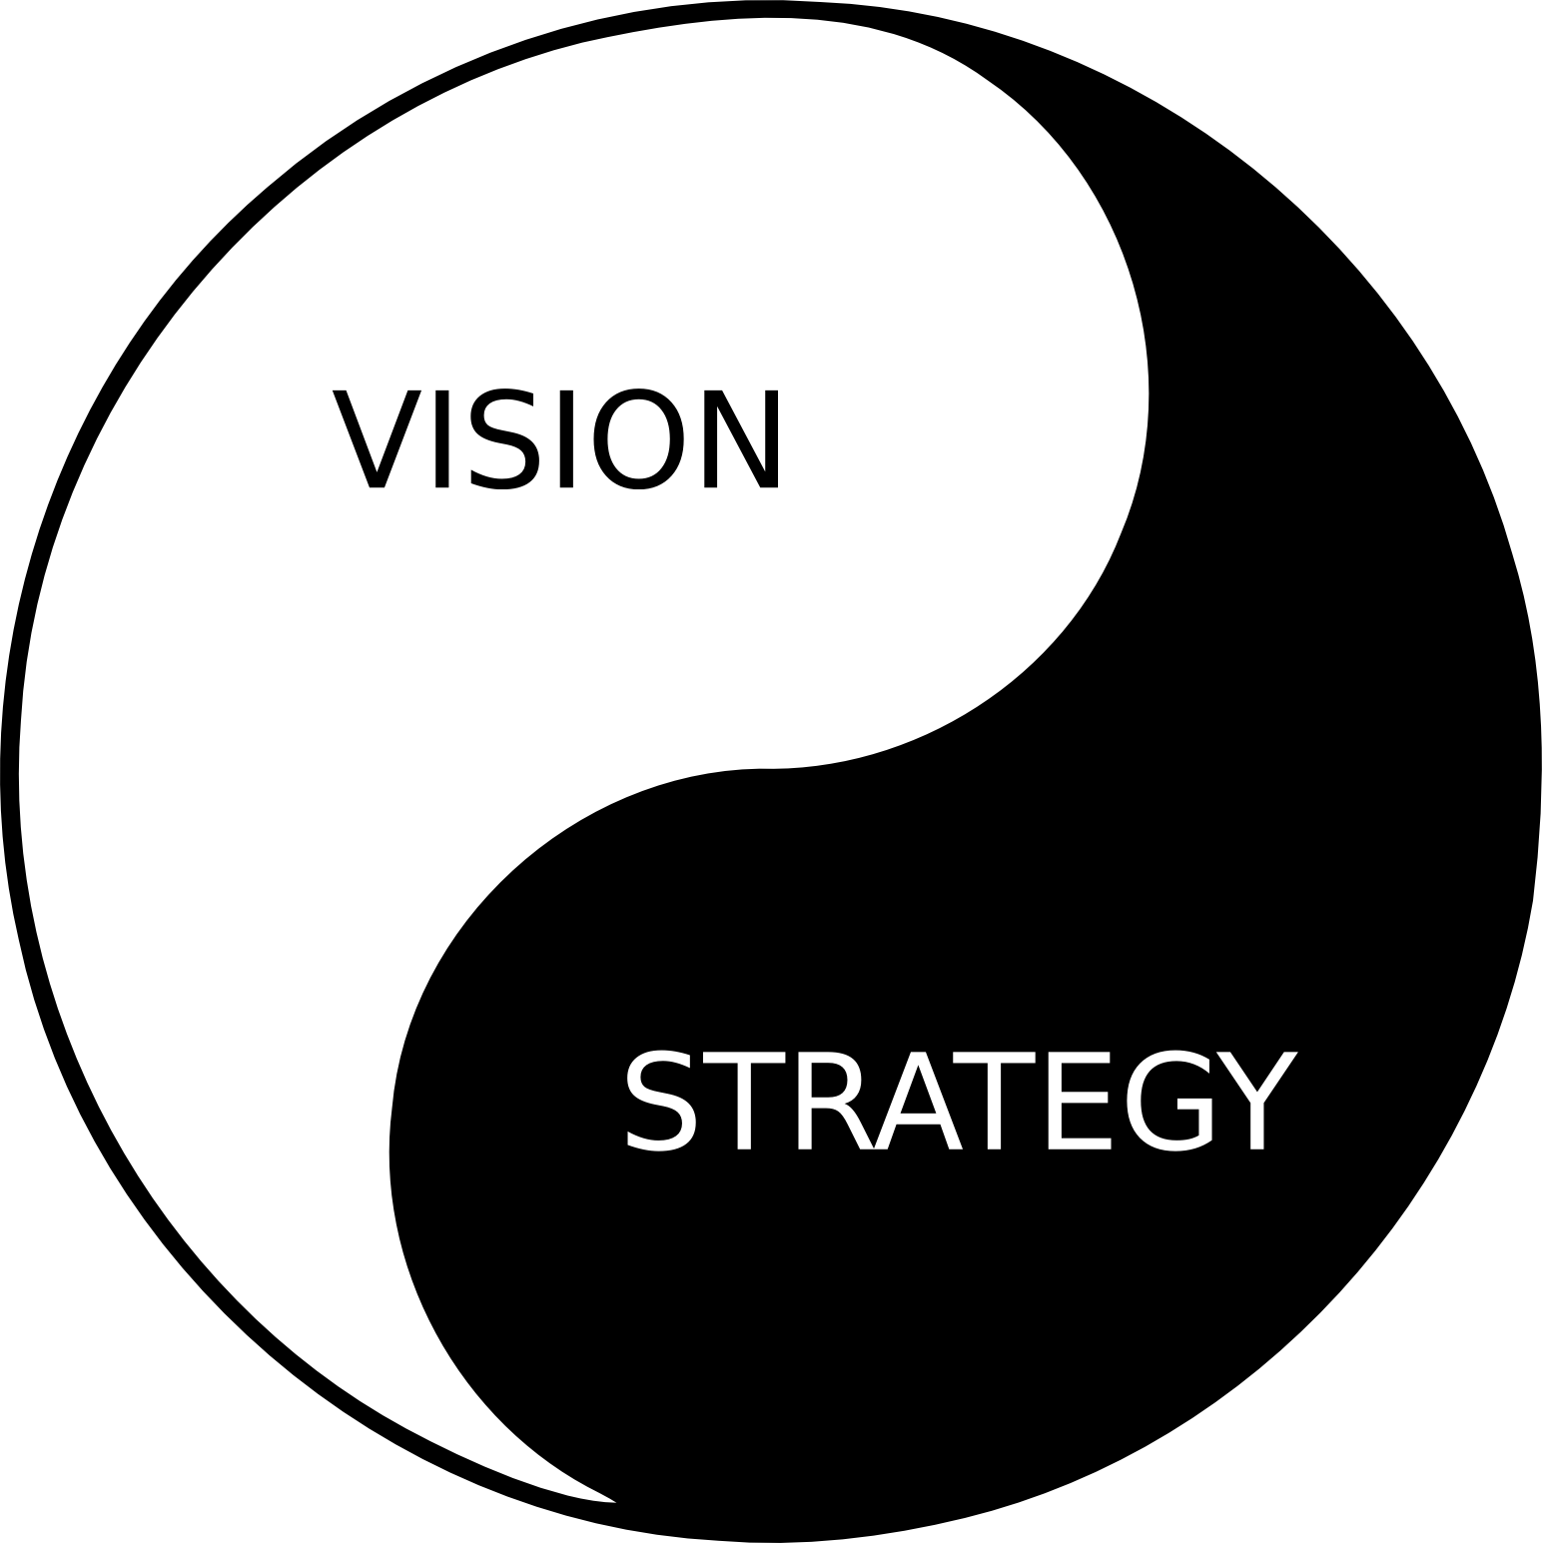
Vision and Strategy
Strategic frame
Business hypothesis
Mission
Values and Rules
Vision
Strategy
A vision without a plan
is just a dream.
A plan without a vision
is just a drudgery.
But a vision with a plan can change the world.

Slide 17
Strategic continuum
Strategic frame
Business hypothesis
Mission
Values and Rules
Vision
Strategy
 | Operational Strategic Interval | First DSI* | Second DSI* | Third DSI*
Leaders (define strategy) | defined | defined | defining | training resources
Managers (design processes) | defined | defining | training resources | -
Workers (performance) | realizing | training resources | - | -
* DSI – Developing Strategic Interval
here and now
(C) J. Plamínek

Slide 18
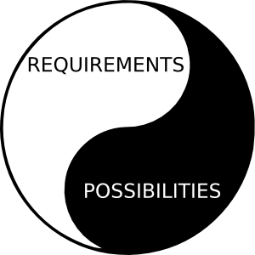
Operational Strategic
Interval (OSI)
Strategic frame
Business hypothesis
Mission
Values and Rules
Vision
Strategy
 | OSI | FDSI | SDSI | TDSI
Leaders | defined | defined | defined | resources
Managers | defined | defined | resources | -
Workers | realized | resources | - | -
Company
benefits from current competitive advantage
delivers products or services through defined processes with all necessary resources
Workers
directly realize current strategy
Managers
“only” monitor and tune the performance
generates profit for owners and further development
Leaders
practically do not interfere
Notes:
Period when company benefits from current competitive advantage
To do so, it has defined products or services, processes and secured all necessary resources
Company generates profit for owners and to secure enough resources to ensure development in other strategic continuum intervals
Workers directly realize current strategy
Managers only monitor and tune the performance
Leaders do not interfere

Slide 19
First Developing
Strategic Interval (FDSI)
Strategic frame
Business hypothesis
Mission
Values and Rules
Vision
Strategy
 | OSI | FDSI | SDSI | TDSI
Leaders | defined | defined | defined | resources
Managers | defined | defined | resources | -
Workers | realized | resources | - | -
Company
Managers
Workers
prepare their resources to meet new requirements
Leaders
consult FDSI-strategy with managers
prepares itself to realize upcoming step change bringing new competitive advantage formulated by FDSI-strategy
(re)define (new) products and services, (re)design (new) processes and projects, procure necessary resources, key performance indicators, ...
(re)define (new) requirements
validates FDSI-strategy

Slide 20
Second Developing
Strategic Interval (SDSI)
Strategic frame
Business hypothesis
Mission
Values and Rules
Vision
Strategy
 | OSI | FDSI | SDSI | TDSI
Leaders | defined | defined | defined | resources
Managers | defined | defined | resources | -
Workers | realized | resources | - | -
Company
Leaders
Managers
may help with creating feasibility studies of SDIS-strategy being newly formulated
Workers
specialists may help with creating feasibility studies of SDIS-strategy being newly formulated
seek for and design new step change bringing new competitive advantage – a core of SDSI-strategy to be
revise strategic frame
use intuition, invention, creativity in the following contexts: needs of current and potential customers, trends in society, technology, politics, economy, ...
seek for new opportunities, business hypotheses and essential competitive advantages
prepare their resources to meet new requirements

Slide 21
Attention Distribution in Strategic Continuum
 | Operational Strategic Interval | First DSI* | Second DSI* | Third DSI*
Leaders (define strategy) | defined | defined | defining | training resources
Managers (design processes) | defined | defining | training resources | -
Workers (performance) | realizing | training resources | - | -
* DSI – Developing Strategic Interval
primary focus
secondary focus

Slide 22
Living Strategic Frame
Strategic Frame shows the future of the company
Strategic Frame is key instrument to keep all involved subject oriented and motivated
Strategic Frame has to be continuously updated to always show the future
Once it stops to show the future, all its orientation and motivation potential disappears

Slide 23
Summary
System of Corporate Ideas
Strategic Frame
  business hypothesis
  vision
  mission
  values and rules
  strategy
Strategic Continuum
  OSI, FDSI, SDSI, TDSI
  to enable to seek for and define new step changes
  to prevent confusing the presence and the future strategies

