Slide 1
Semantic search-based image annotation
Petra Budíková, FI MU
CEMI meeting, Plzeň, 16. 4. 2014

Slide 2
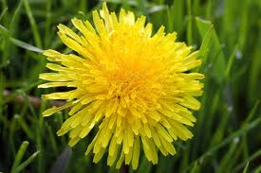
The annotation problem
Formalization
The annotation problem is defined by a query image I and a vocabulary V of candidate concepts
The annotation function f_{A} assigns to each concept c ∈ V its probability of being relevant for I
?
V = {flower, animal, person, building}
Basic possible approaches
Model-based annotation
Train classifiers
Suitable for tasks with smaller dictionaries and available training images (e.g. medical image classification)
Search-based annotation
Exploit results of similarity search in annotated images
Suitable for tasks with wide dictionaries (e.g. image annotation for web search)

Slide 3
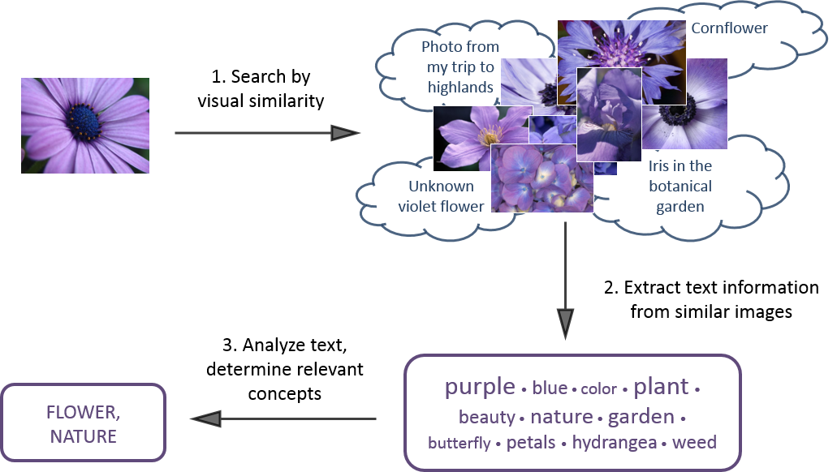
Search-based annotation in a nutshell

Slide 4
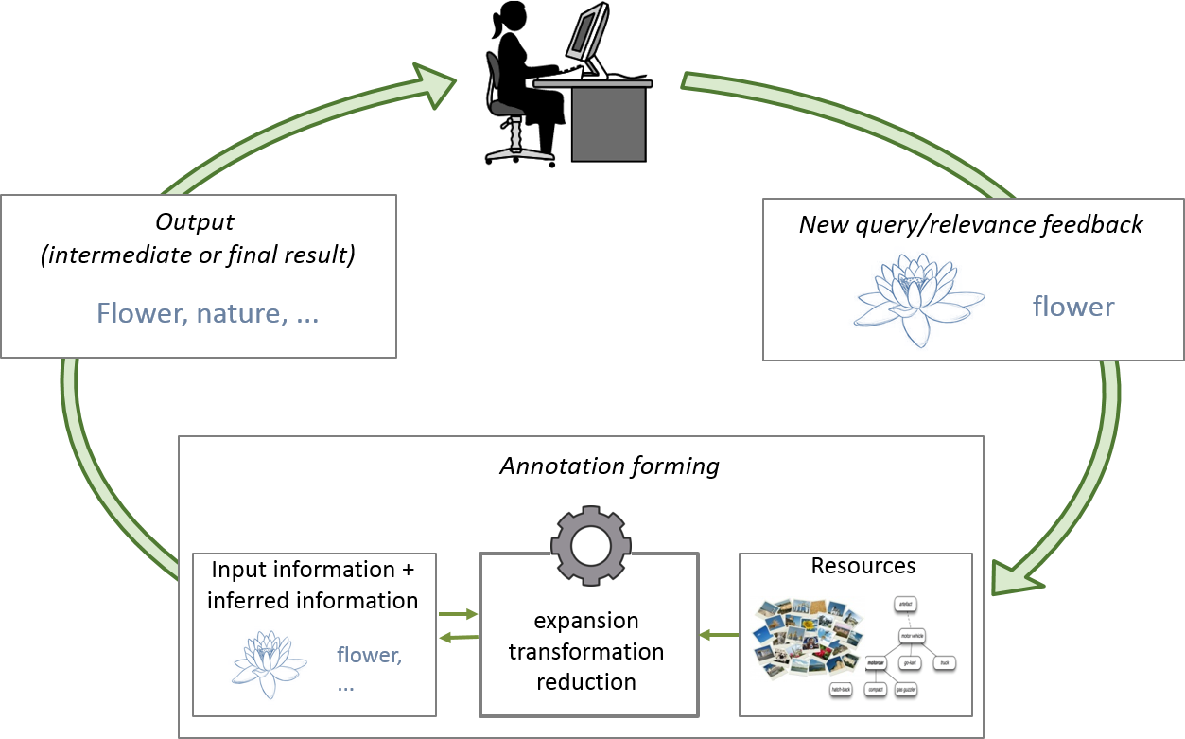
Our vision
Next generation of similarity-based annotation
Similarity searching
Text cleaning
Semantic information extraction
Classifiers
Relevance feedback

Slide 5
MUFIN Image Annotation
Already done (paper IDEAS 2013):
Modular framework for annotation processing
Implementation of basic modules
Similarity search, text cleaning, basic WordNet-based semantic processing
Working system for keyword annotation with 50-60 % precision
Vocabulary V = all English words
Problems
Not precise enough
Results too unstructured for practical use
Difficult to evaluate

Slide 6
Current focus
Hierarchical approach
Vocabulary hierarchically organized
WordNet hypernymy/hyponymy tree, ontology
Semantics-aware processing of similar images’ descriptions
Study and exploit suitable resources of semantic information
Determine the relevance of candidate concepts with respect to semantic relationships
ImageCLEF evaluation
ImageCLEF2014: scalability-oriented, no manually labelled training data
100 test concepts, provided with links to WordNet synsets

Slide 7
ConceptRank
Inspiration: PageRank
Importance of a page is derived from the importance of pages that link to it
Linear iterated process, modelled as a Markov system
Random restarts to avoid “rank sinks”
ConceptRank idea: Semantic ranking of WordNet synsets
A Markov system, nodes are formed by WordNet synsets
Links between nodes connected by some WordNet relationship
Weighted according to the type of the relationship
Random restarts are not weighted uniformly, but reflect the initial weights of synsets as determined by similarity searching

Slide 8
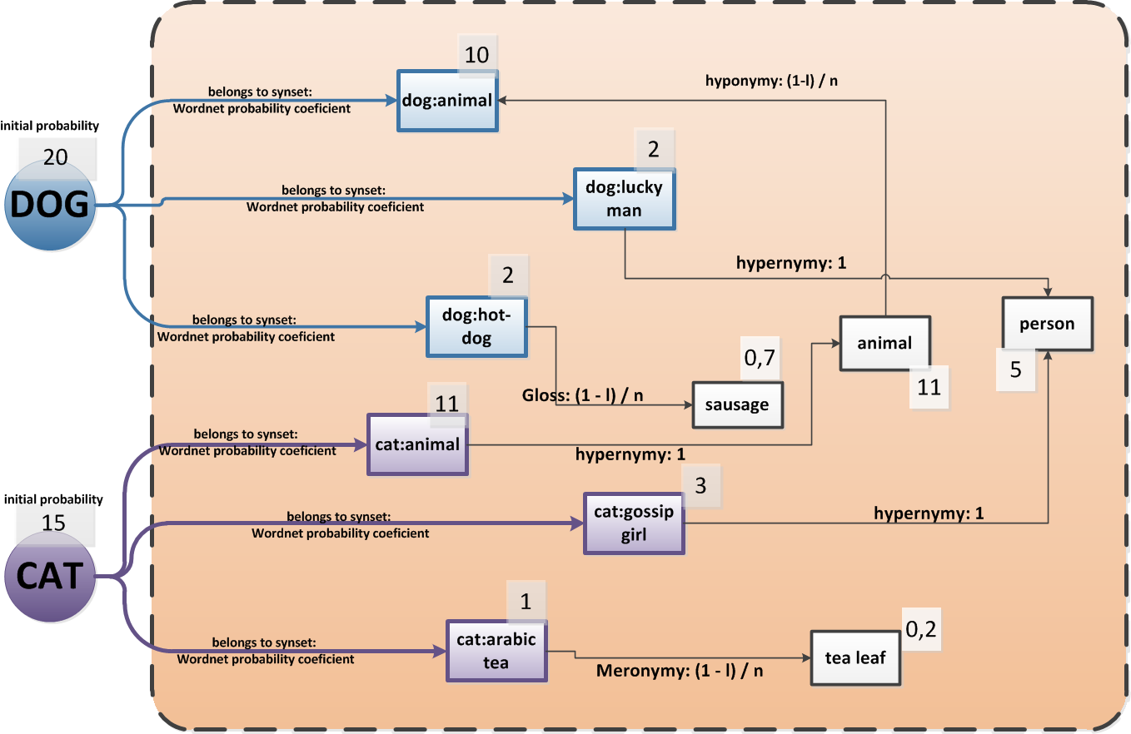
ConceptRank illustration

Slide 9
ConceptRank Resources
Content-based image retrieval
powered by MUFIN
20M Profiset collection, 250K ImageCLEF training data
WordNet
Standard relationships (hypernymy, antonymy, part-whole, gloss overlap, …)
Word similarity metrics defined on top of hyponymy/hypernymy tree
the “language” point of view
Visual Concept Ontology (VCO)
Semantic hierarchy of most common visual concepts, linked to WordNet
VCO sub-trees are used to limit the search for WordNet relationships
Co-occurrence lists for keywords from Profimedia dataset
Constructed from very large text corpus (linguists from MFF UK)
Corpus size approximately 1 billion words
“human/database” point of view

Slide 10
Cooperation with other CEMI teams
UFAL
Information about keyword co-occurrence in text corpora
Already part of MUFIN Image Annotation processing
Other semantic resources: WikiNet
Being studied at UFAL
ČVUT
High-precision classifier for 1000 ImageNet concepts
Todo: compare performance of this classifier and MUFIN search-based solution; if complementary, try to combine
Image similarity measure derived from the classifier
Todo: compare it to MPEG7 similarity utilized by MUFIN Image Annotation

Slide 11
Questions, comments?

