Slide 1
Marketing Mix
© Leonard Walletzký

Slide 2
Marketing framework
5C
Customer
STP
Segmentation
Marketing Mix
4P
Company
Context
Collaborators
Competitors
Targeting
Positioning
7P
4C
7C
4S

Slide 3
What is marketing mix?
The Marketing Mix is one of two interrelated components of strategy
The Marketing Mix is a set of controllable and interrelated variables that a company assembles to satisfy a target group better than it’s competitor.
Marketing Mix strategy is choosing and implementing the best possible course of action to attain the organization’s long-term objectives and gain competitive edge.

Slide 4
4P – basic marketing mix
Oriented on product
Developed by E. Jerome McCarthy in 1960
Used in many companies even today
  Strictly product oriented
  One way approach
Is difficult to use it in service oriented companies

Slide 5
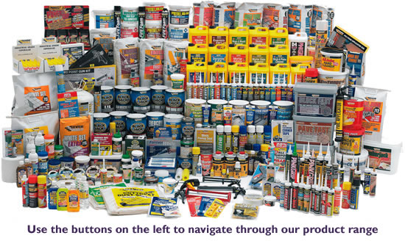
Product
To satisfy the needs and wants of the target market.

Slide 6

Price
To make the product affordable to the target market and reflect the value of benefits provided.

Slide 7
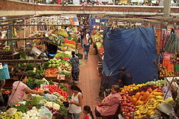
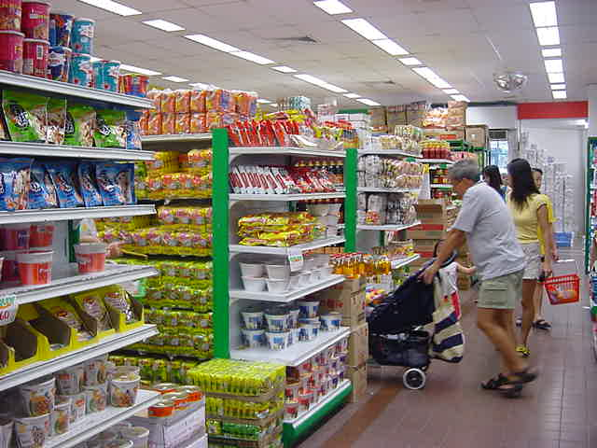
Place
To make the product conveniently available to the target market consistent with their purchasing pattern.

Slide 8


Promotions
To build and improve consumer demand. Promotions has four components called the Promotions Mix as follows:
Advertising – to effectively inform and persuade the target market
Public Relations – to offer a positive image of the company and the brand
Selling – to get the customers buy
Sales Promotions – to convince customers to buy immediately

Slide 9
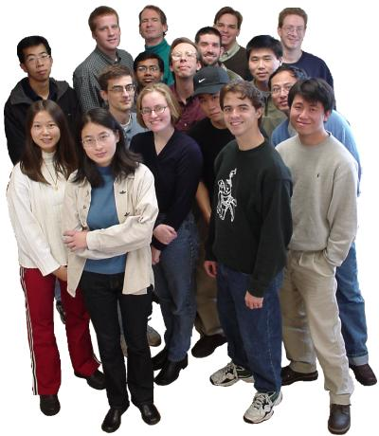
5P
People
They are the target consumers of the company. They are the ones who are the consumers
They sell the products

Slide 10
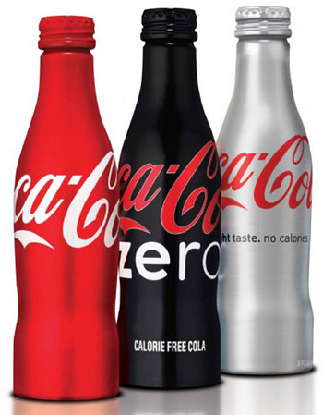
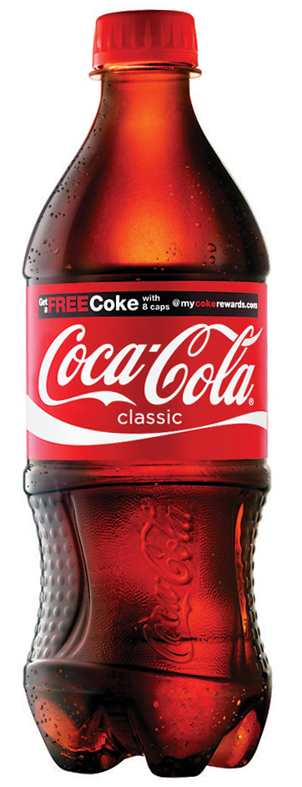
7P
Physical Appearance (Evidence)
Physical appearance is the first distinction of a product. A product could be easily recognized by it’s appearance.

Slide 11
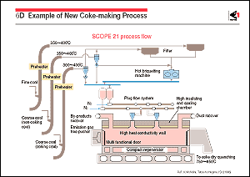
Process
The process of the product is essential in marketing. This determines the capability of the product to supply the demand of the consumers.

Slide 12
Web marketing mix
Created by Efthymios Constantinides in 2002
Oriented to the developmnet of web pages
Reaction to the independent IT industry
Used by web and IT oriented companies
Using 4S

Slide 13

Scope
What is our market?
Who are potencial customers?
What are the main roles on web?

Slide 14
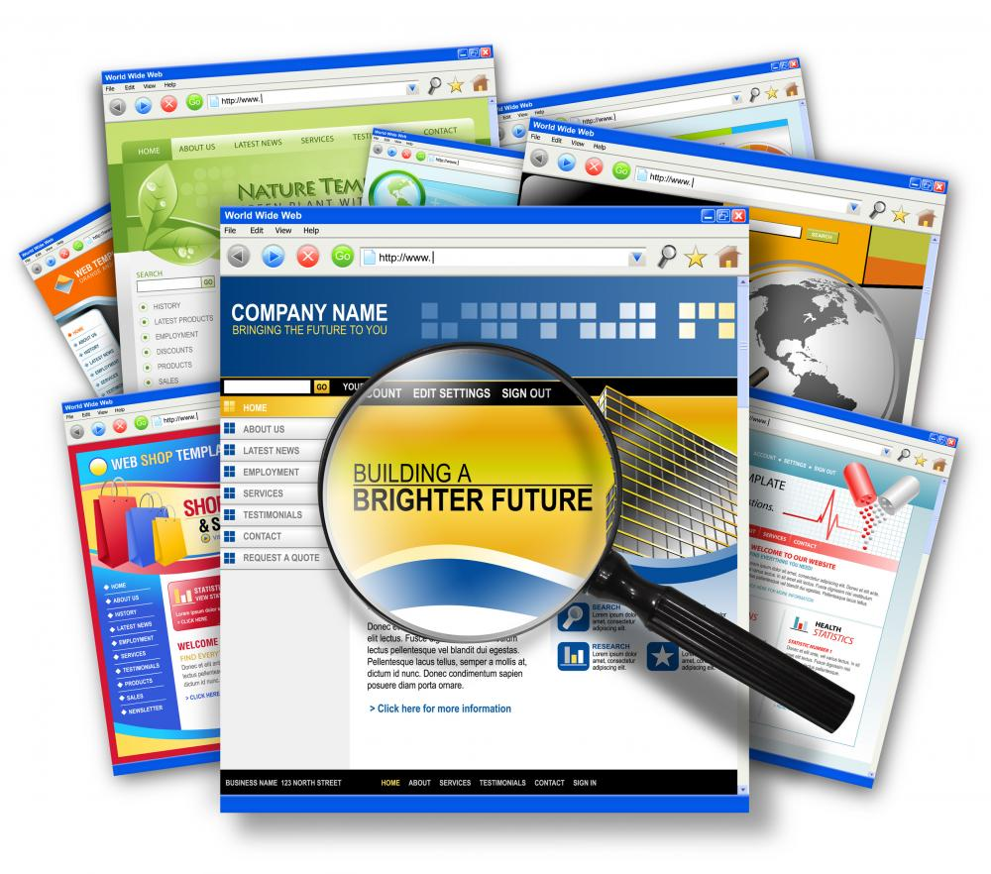
Site
What does customer expect from web?
Why will customer use the web?
What does customer motivate to come back?

Slide 15

Synergy
Relations and influence of 3 pillars
  Integration the global marketing strategy and activities
  Integration of web pages with procesess and connection to the internal information systems (CRM, ERP…)
  Integration of thirsd parties systems (Google analytics….)

Slide 16
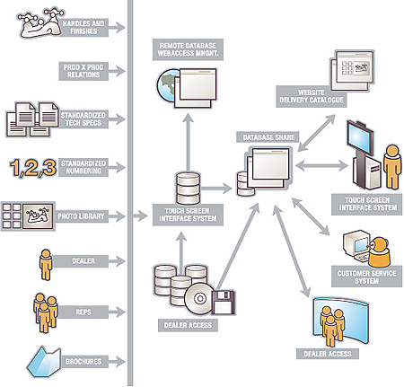
System
Technical circumstances
Administration
Used technology

Slide 17
Service oriented marketing mix
Based on customer point of view
Focused to customer satisfaction
Developed by Robert F. Lauterborn in 1990
Similarities with 4P

Slide 18
4P and 4C
Product
Price
Placement
Promotion
Customer
Costs
Convenience
Communication
Product oriented
Service oriented

Slide 19

Customer
What are customer´s needs?
What is customer´s problem?

Slide 20

Costs
Based on customer´s site!
What does customer need to invest to get our product/service?

Slide 21

Convenience
How does customer feel while purchasing the product or service?
What is his motivation to buy / come again?

Slide 22

Communication
How do we want to promote our product?
How do we get the feedback from stakeholders?
How do we involve the customers into value creation?

Slide 23
Service Science Enlargering of 4C
Based on 7P and 4S, together with Service Science experiences
Published in 2014 by Leonard Walletzký
Adds 3C more

Slide 24

Community
Based on People
Reaction to Social Networks popularity (Facebook, Linked Inn)
Consists also all from definition of the People

Slide 25
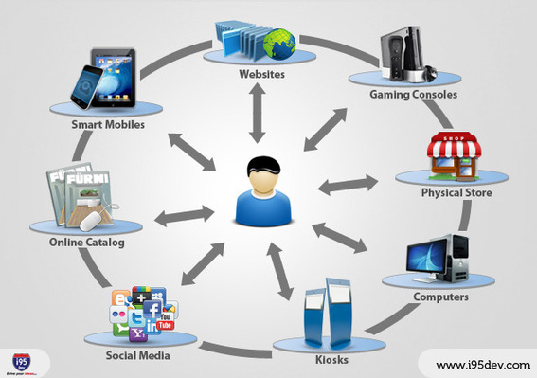
Chanels
Excluded from communication
Defining all channels (IT or non IT) to distribute information and products

Slide 26

Co-creation
What are the forms of value proposition?
How the final value of the product/service will be created?
Who participates on value creation?

Slide 27
Conclusion
Marketing mix
4P – basic product oriented
5P and 7P – enlargening of product oriented marketing
4S – web oriented marketing mix
4C – service oriented marketing mix
7C – service science marketing mix
On next presentation – Marketing strategy case studies

