Slide 1
PA181: Service Systems, Modeling and Execution
Business Models
©Leonard Walletzký

Slide 2
Key business model questions
How do you acquire customers?
After you have landed a new customer, how do you plan to relate to that customer and manage the relationship (if at all)?
How do you charge your customers? What is your revenue model?
How much do you charge your customers? Can you calculate your revenues for the next month, quarter and year?
What assets are available to you or under your control?

Slide 3
Key business model questions (cont’d)
Who are your key partners?
What key activities do you need to engage in to deliver your value proposition?
What are your fixed costs?
What are your variable costs? Can you calculate your total cost for the next month, quarter and year?
Does your revenue forecast demonstrate increased profitability towards the end of the forecast period?

Slide 4





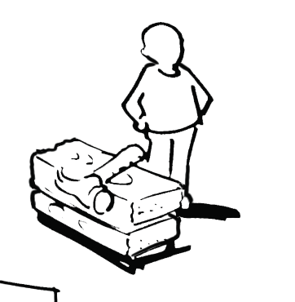
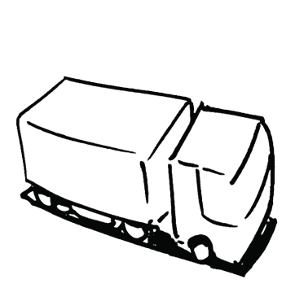


Business Model Canvas
KEY
PARTNERS
KEY
ACTIVITIES
VALUE
PROPOSITIONS
CUSTOMER
RELATIONSHIPS
CUSTOMER
SEGMENTS
KEY
RESOURCES
CHANNELS
  COST STRUCTURE
  REVENUE STREAMS

Slide 5
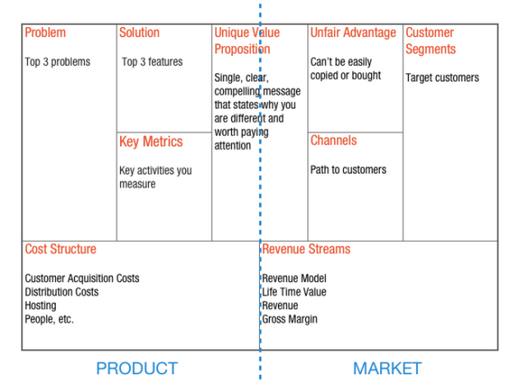
Business Model – Lean Canvas

Slide 6
Business Model versus Business Plan
Business Model
Business Plan
A single diagram of your business
A document investors make you write that they don’t read

Slide 7
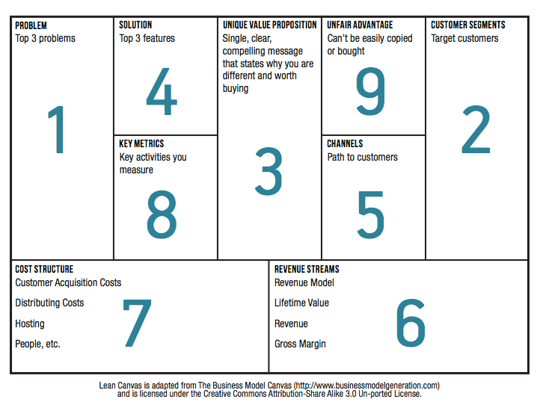
The prescribed order

Slide 8
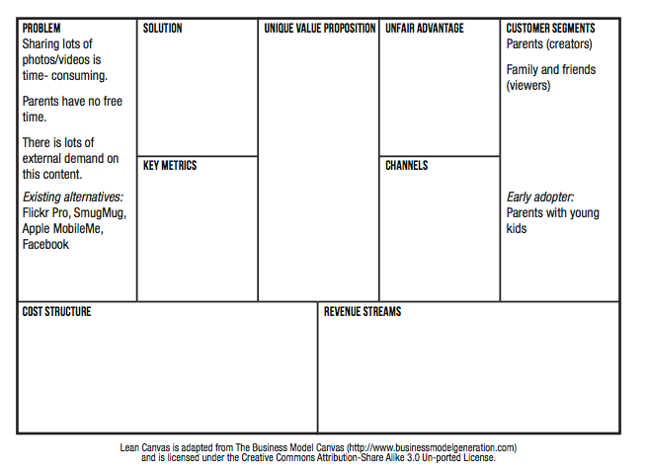
Problem and Customer Segments

Slide 9
Unique Value Proposition
Unique Value Proposition
Why you are different and worth buying/getting attention
Some Tips on how to craft a UVP
Be different, but make sure your difference matters
Target early adopters
Focus on finished story benefits
Example resume building service
A feature - “professionally designed templates”
Benefit – “eye catching resume that stands out”
Finished story benefit – “landing your dream job”
Pick your words carefully and own them
Performance – BMW
Design – Audi
Prestige – Mercedes
Picking a few key words that you consistently use also drives your search engine optimization (SEO) ranking
Answer what, who and why
Study other good UVP’s

Slide 10
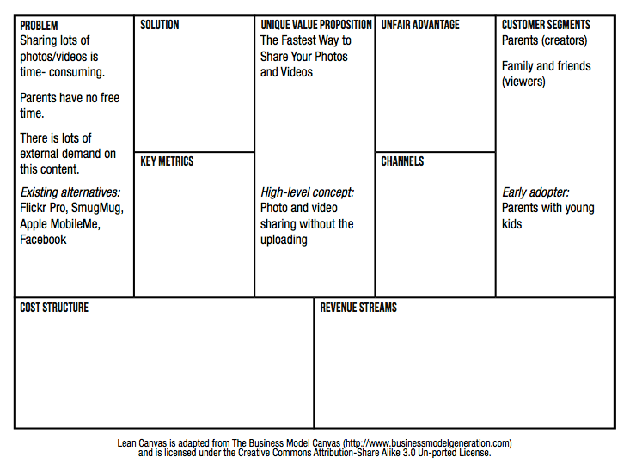
Unique Value Proposition

Slide 11
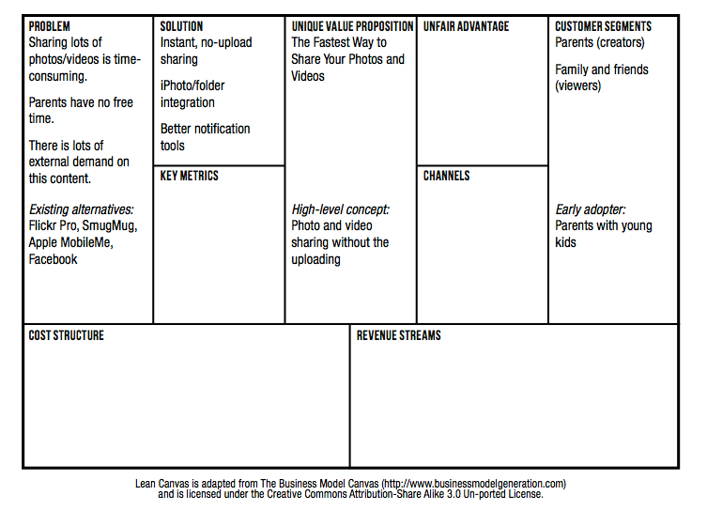
Solution

Slide 12
Channels
Freer versus Paid
Inbound versus outbound
Examples inbound channels
Blogs
SEO
Ebooks
White papers
Examples of outbound channels
Print/TV ads
Trade shows
Cold calling
Direct versus automated
Direct versus indirect
Retention before referral

Slide 13
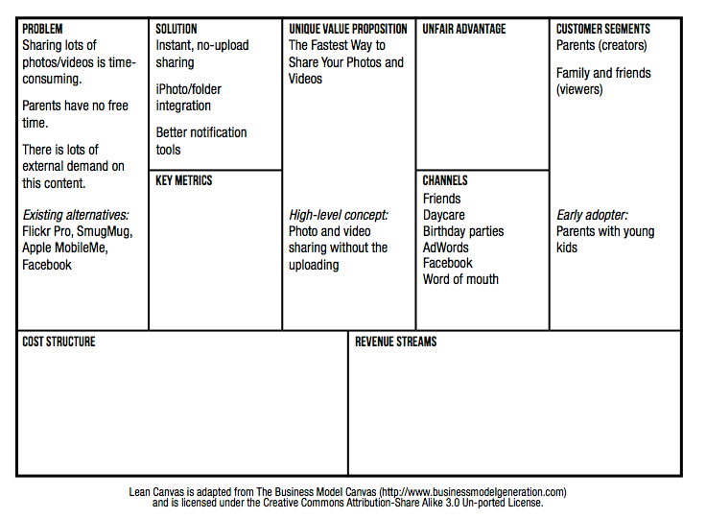
Channels

Slide 14
Revenue Streams and Cost Structure
Revenue Streams
If you intend to charge for your product you should charge from day one.
Price is part of the product
Price defines your customers
Getting paid is the first form of validation
Cost structure
It’s hard to calculate into the future. Instead, focus on the present
What will it cost you to interview 30 – 50 customers?
What will it cost you to build and launch your MVP?
What will your ongoing burn rate look like in terms of both fixed and variable costs?

Slide 15
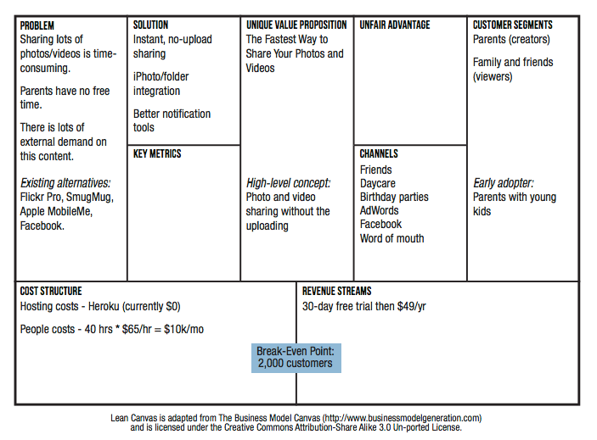
Revenue Streams and Cost Structure

Slide 16
Key Metrics
Find the key number that tells you how your business is doing in real time, before you get the sales report
How do users find you?
Aqusition
Activation
Retention
Revenue
Referral
Do users have a great
first experience?
Do users come back?
How do you make money?
Do users tell others?

Slide 17
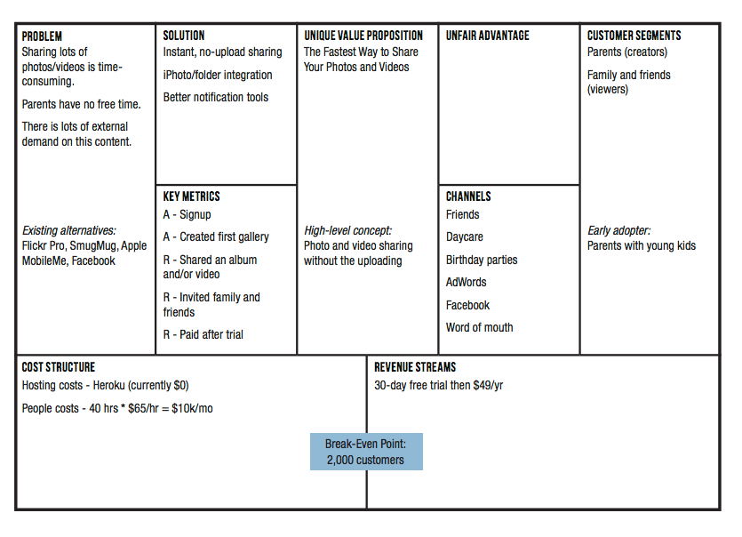
Key Metrics

Slide 18
Unfair Advantage
A real unfair advantage is something that cannot be easily copied or bought
How can/will you make yourself different and make your difference matter
Some examples
Insider information
The right “expert” endorsements
A dream team
Personal authority
Large network effects
Community
Existing customers
SEO ranking

Slide 19
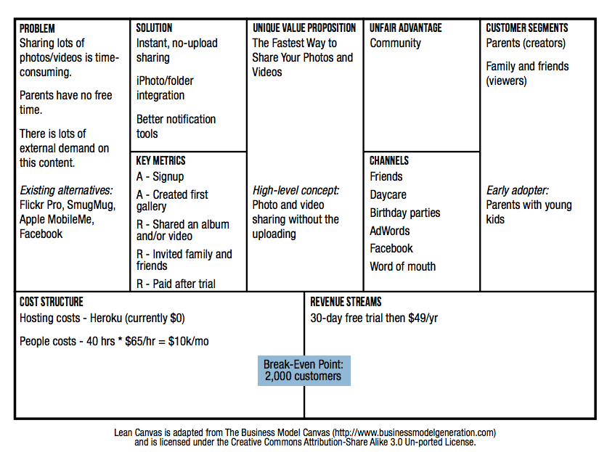
Unfair Advantage

