Slide 1
Business ecosystem
© Leonard Walletzký 2016

Slide 2
Innovations
Contracted
Investment
Licence
Alliances
Networks
Others
Business angel
Joint venture
ownership
Greenfield / Brownfield
Akvizition

Slide 3
Strategic alliances
specialization of each of the partners + exploit their strengths
add missing capabilities
= Greater flexibility and quicker response to development

Slide 4
Environmental concept of innovation
The success of innovation reaches only organization with the support of partners - members of the strategic alliance.
As well as the individual components of biological ecosystem are also individual cells of the business ecosystem mutually dependent
=
change in individual development raises the need for changes in the development of the entire ecosystem

Slide 5
Why ecosystem?
he company can not exist by itself - for its existence must be a reason
The company must be in an ecosystem helpful
For customers:
  They must solve their problem for which they are willing to pay
For suppliers:
  Must be stable and trustworthy partner
For employees
  stable income
for investors
  Delivering profit
For ?????

Slide 6
What constitutes the elements of the ecosystem?
Not only the standard chain and financial relations
The company builds relationships with other major groups
  stakeholders
All those whom the firm affects or is affected by them

Slide 7
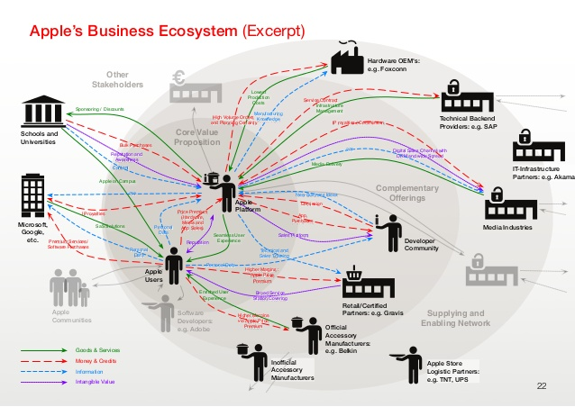
Example

Slide 8
Entrepreneurial ecosystem
Competitive competition shifts from mutual combat various entities in mutual rivalry individual ecosystems (parts)
???
Possibility of use of force combined resources to implement otherwise impossible to realize an innovative project
Loss of independence when deciding to implement their own innovative projects
The need for a conflict-free functioning of the entire business ecosystem
The division of revenues from the successful implementation

Slide 9
Approaches
INTEGRATION:
  The creator of innovation ensures its forces management of all steps (including partners) necessary for the successful commercialization of innovative ideas.
CONDUCTOR:
  Creator of innovations is coordinated use of all resources alliances, which are involved in the commercialization of innovative solutions to the processing itself contributes only partially.
LICENSE:
  Creator of innovative ideas to share in the proceeds of its commercialization, which provides other organizations; himself on the idea no part.

Slide 10
Why is the basis for ecosystem service provision?
Services can not be provided separately
At the inlet and outlet need to combine a number of resources for the successful completion of the service
The level of this combination is also a fundamental source of success and competitive advantage
Without the active cooperation of all members ecosystem can not be reached for further development
Entry of any monopoly into service causes stagnation services or their pseudo development (eg., UPC, Skylink)

Slide 11
Founding principles of own ecosystem
Inner
Outer
Mastering internal processes
Communication within the company
Stable management of financial resources
Detailed analysis of networks of stakeholders
Consistent behaviour
Clear declaration goals
Sharing common values

