Slide 1
PB173 - Tématický vývoj aplikací v C/C++ (jaro 2016)
Skupina: Aplikovaná kryptografie a bezpečné programování
Petr Švenda svenda@fi.muni.cz
Konzultace: A.406, Pondělí 15-15:50

Slide 2
Smartcards in wider system

Slide 3
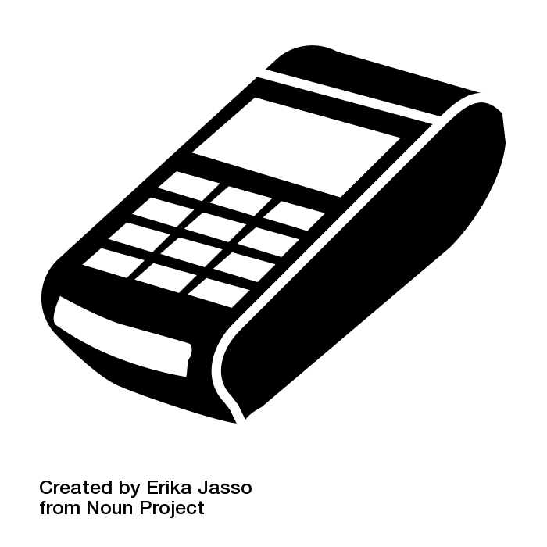
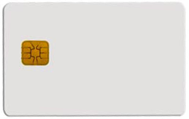
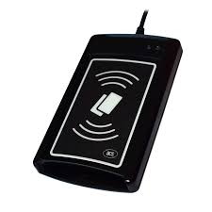
Big picture – terminal/reader and card
Merchant payment
Digital signature
What principles and standards are used?

Slide 4
Big picture - components
User application
OS smart card API
User application
Merchant terminal GUI
Banking transfer GUI
Browser TLS
…
Card application
EMV applet for payments
SIM applet for GSM
OpenPGP applet for PGP
…
smart card reader
contact(less)
transmission
Card I/O manager
Card application
Card OS

Slide 5
PC application
with direct control:
GnuPG, GPShell
PC application via library:
browser TLS, PDF sign…
Custom app with
direct control
Libraries
PKCS#11, OpenSC, JMRTD
Smartcard control language API
C/C# WinSCard.h, Java java.smartcardio.*, Python pyscard
System smartcard interface: Windows’s PC/SC, Linux’s PC/SC-lite
Manage readers and cards, Transmit ISO7816-4’s APDU
Readers
Contact: ISO7816-2,3 (T=0/1)
Contactless: ISO 14443 (T=CL)
APDU packet
API: EMV, GSM, PIV, OpenPGP, ICAO 9303 (BAC/EAC/SAC)
OpenPlatform, ISO7816-4 cmds, custom APDU
Card application 1
Card application 2
Card application 3
SC app programming:
JavaCard, MultOS, .NET, MPCOS

Slide 6
Main standards
User application
OS smart card API
ISO7816 1-4
Card physical properties ISO7816-1
Physical layer communication protocol ISO7816-2-3
Data packet format (APDU)
PC/SC, PC/SCLite (host side)
Readers/cards management
Transmission of logical APDU packets
C/C# WinSCard.h, Java java.smartcardio.*, Python pyscard
PKCS#11
standardized interface on host side
card can be proprietary
GlobalPlatform
remote card management interface
secure installation of applications
smart card reader
contact(less)
transmission
Card I/O manager
Card application
Card OS

Slide 7
Card’s programming platforms
User application
OS smart card API
MultOS
Multiple supported languages, native compilation
Often bank cards
JavaCard
open programming platform from Sun
applets portable between cards
Microsoft .NET for smartcards
Similar to JavaCard, but C#
Applications portable between cards
Limited market penetration
smart card reader
contact(less)
transmission
Card I/O manager
Card application
Card OS

Slide 8
What is the typical performance?
Hardware differ significantly
Clock multiplier, memory speed, crypto coprocessor…
Typical speed of operation is:
Milliseconds (RNG, symmetric crypto, hash)
Tens of milliseconds (transfer data in/out)
Hundreds of millisecond (asymmetric crypto)
Seconds (RSA keypair generation)
Operation may consists from multiple steps
Transmit data, prepare key, prepare engine, encrypt
→ additional performance penalty

Slide 9
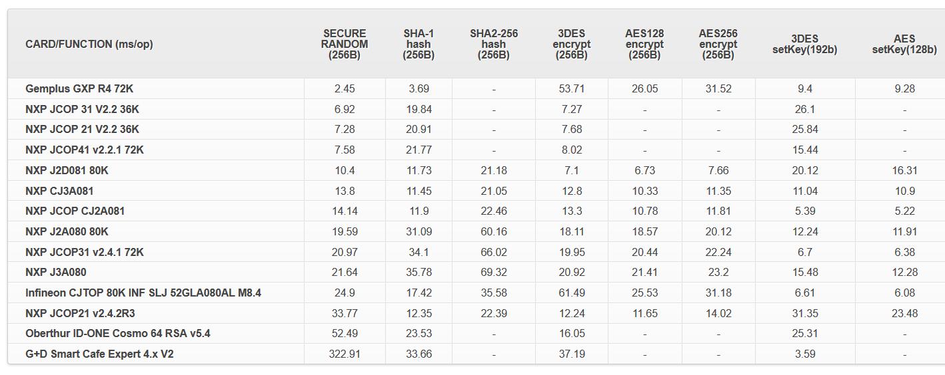
Performance tables for common cards
http://www.fi.muni.cz/~xsvenda/jcalgtest/
Visit http://www.fi.muni.cz/~xsvenda/jcalgtest/

Slide 10
Practical assignment (from last week)
Client to client network communication
Speed-up encryption of data packets between two clients with CTR mode
Divide packet into multiple parts
Use parallel threads to protect parts of data packet
number of available cores is parameter for function
(at least one thread required ;))
Document performance gains
speed before and after the optimization (can you increase speed linearly?)
What is length of packet for which multiple threads brings speedup benefit? (overhead with running threads)

Slide 11
Submissions, deadlines
Upload application source codes as single zip file into IS Homework vault (Crypto - 8. homework (Threads))
DEADLINE 2.5. 12:00
0-10 points assigned

