Slide 1
PB173 - Tématický vývoj aplikací v C/C++ (jaro 2016)
Skupina: Aplikovaná kryptografie a bezpečné programování
Petr Švenda svenda@fi.muni.cz
Konzultace: A.406, Pondělí 15-15:50

Slide 2
Refactoring
Refactoring is process of restructuralization of source code to make it easier to understand and modify in future without changing its observable behaviour.
No new functionality is added
Existing code is rewritten, split, erased and otherwise modified to improve code quality

Slide 3
Refactoring (2)
Coding can be divided into two parts
adding code for new functionality
refactoring existing code
Refactoring is necessary to keep code maintainable
spaghetti code will sooner or later consume more time to maintain than to rewrite it
Be aware – code rewrite might introduce new bugs
Proper (automated) testing is required
that’s why we have unit tests!
run these tests during refactoring

Slide 4
Refactoring – refactoring techniques
(De-)Composing methods properly
Moving code between modules/classes
Change data organization
Making conditional expressions simpler
Making API clearer
…
See http://sourcemaking.com/refactoring
detailed explanation of many techniques with examples
principles and practical tips how to solve problems

Slide 5
Code extraction into separate function
http://sourcemaking.com/refactoring/extract-method
Locate function doing multiple functionalities
Identify logical blocks of functionality
Create new function
with name describing What not How
move code there, replace by function call
think about others who also use old/new function
Take care of local variables
pass them as function arguments

Slide 6
Additional explanation variable
http://sourcemaking.com/refactoring/introduce-explaining-variable
Add additional well-named variable to hold intermediate value
even when such variable is not necessary in principle
Improve readability of code
Increase possibility for debugging
you can watch and conditionally break on variable

Slide 7
Separate work done by single module/class
http://sourcemaking.com/refactoring/extract-class
Over the time, your module/class will grow
one module/class is doing multiple functionalities
Violation of several design principles
Identify distinct functionalities
usually set of methods and attributes responsible for single functionality
Create new class(es) and move functions there
separate interfaces for separate functionalities
use multiple inheritance or aggregation to glue together

Slide 8
Refactoring - tools
Most of the work with refactoring is “manual”
find out how to refactor and write simpler code
Tools can still help
identify problematic areas (Code metrics, SourceMonitor)
provide call graph and data flow (Doxygen, VS Profiler)
apply transformation consistently in all project files

Slide 9
Refactoring – tools (2)
Refactoring support for C/C++ in VS 2015
https://visualstudiogallery.msdn.microsoft.com/164904b2-3b47-417f-9b6b-fdd35757d194
3rd party add-ons like Visual Assist X / VSCommands
not only refactoring support, but also code completition…
http://www.agile-code.com/blog/list-of-visual-studio-code-refactoring-tools/
NetBeans (and others) have refactoring support
http://wiki.netbeans.org/Refactoring
variable renaming, code extraction…

Slide 10
Source monitor
Create new project
File → New project
language, directory with sources *.c / *.cpp
initial ‘Baseline’
After code update
Checkpoint → New checkpoint
Details on particular checkpoint and file
RClick → Display Function Metrics Details...

Slide 11
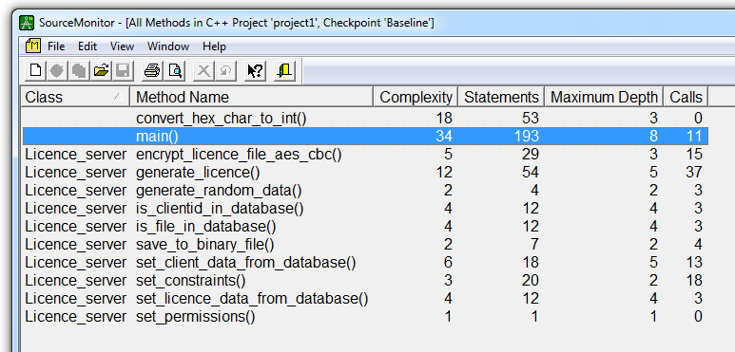
Source monitor – example outputs
Complexity: 1-10 (OK), 11-20 (sometimes), > 20 (BAD)

Slide 12
Antipatterns
Common defective process and implementation within organization
Opposite to design patterns
see http://sourcemaking.com/design_patterns
Read http://sourcemaking.com/antipatterns
good description, examples and how to solve
Not limited to object oriented programming!
Software development antipatterns
http://sourcemaking.com/antipatterns/software-development-antipatterns

Slide 13
Practical assignment - refactoring
Use code metric tool to analyze your sources
http://www.campwoodsw.com/sourcemonitor.html
Do it NOW! Discuss
Find and refactor all functions
with complexity more then 15
with Maximum Depth more then 4
Read and use refactoring techniques
http://sourcemaking.com/refactoring
Make your code nice, readable and tidy!

Slide 14
Assignment – prepare for presentation
Prepare refactored code and presentation
15 minutes presentation
Design, actual implementation
Live demo of implementation
Single zip for download (for other teams for code review)
Deadline 9.5.2016 12:00
HW Vault: Crypto - 9. homework (Presentation)

