Slide 1
PB173 - Tématický vývoj aplikací v C/C++
Domain specific development in C/C++
Skupina: Aplikovaná kryptografie a bezpečné programování
https://is.muni.cz/auth/predmety/uplny_vypis?fakulta=1433;obdobi=6384;predmet=871304
Petr Švenda svenda@fi.muni.cz
Konzultace: A406, Pondělí 15-15:40

Slide 2


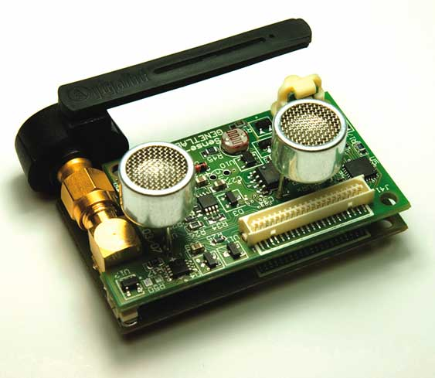
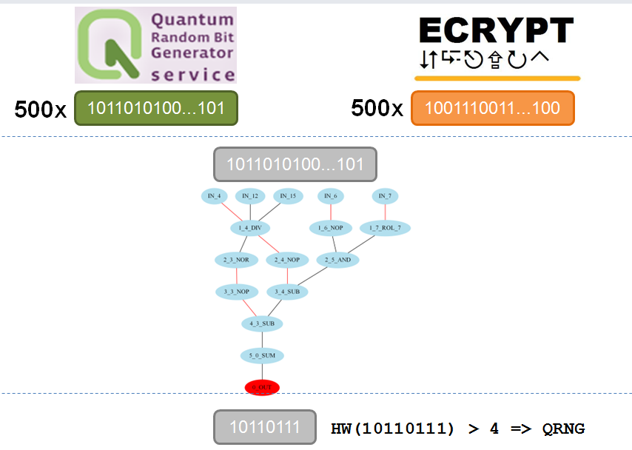
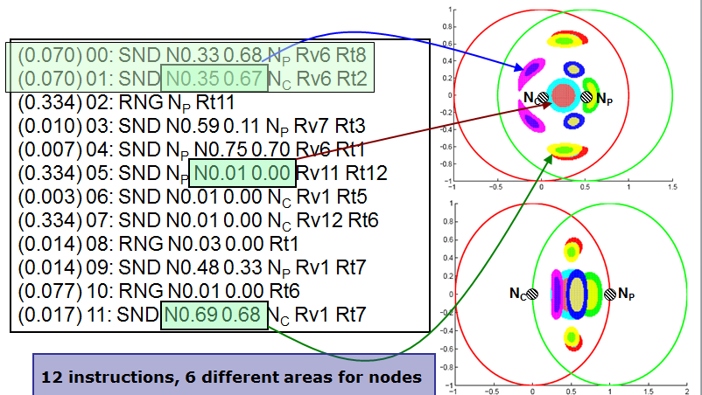
Something about me...
+
Genetic programming
Distributed computing
⇒
Secrecy amplification protocols for WSN
Random distinguisher for crypto fncs

Slide 3
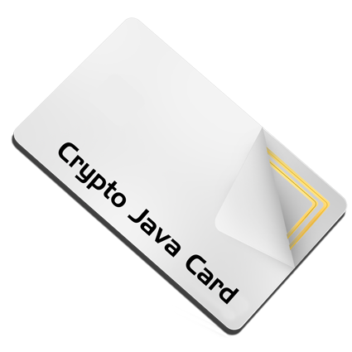
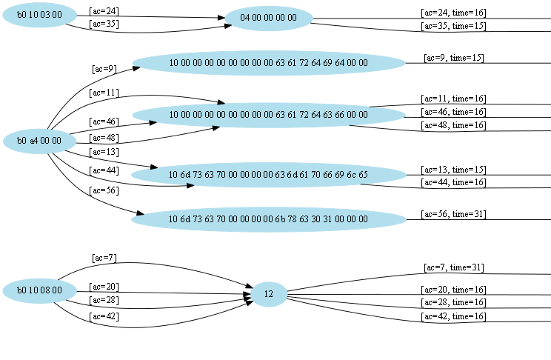
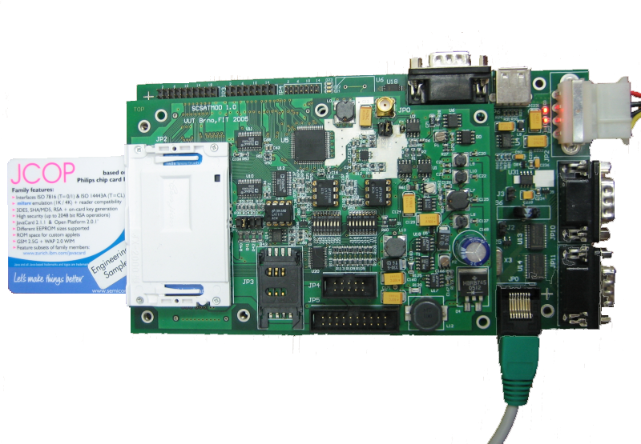
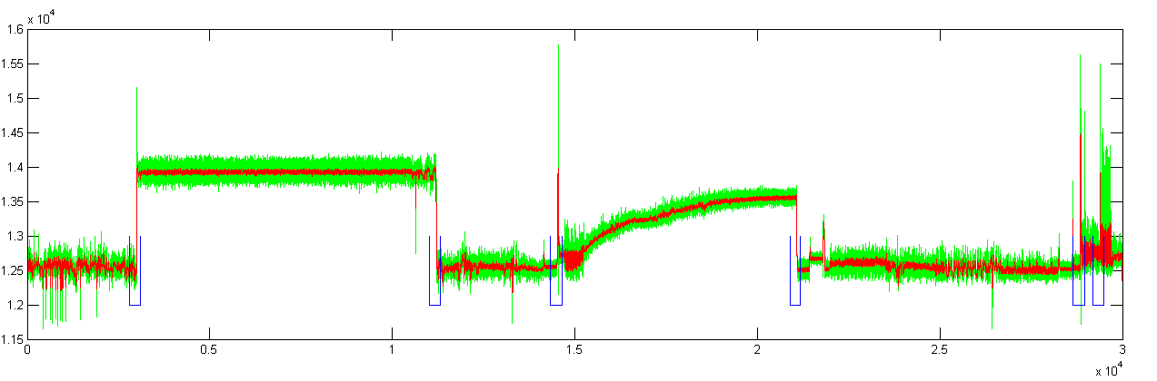
Security programming
Power analysis

Slide 4
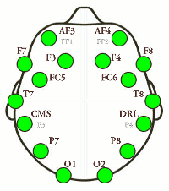
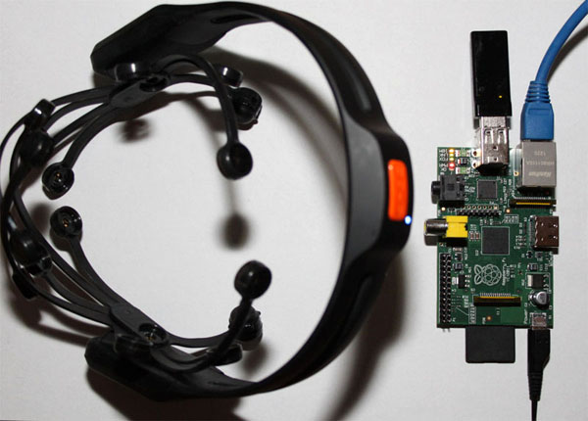
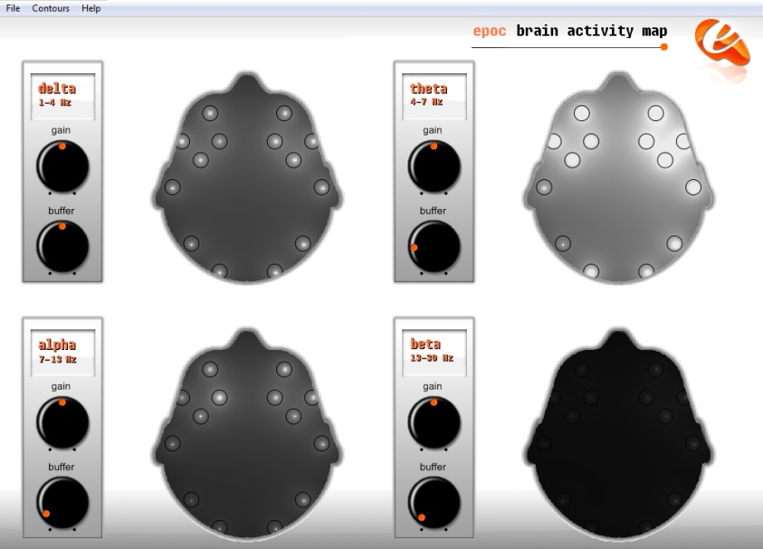
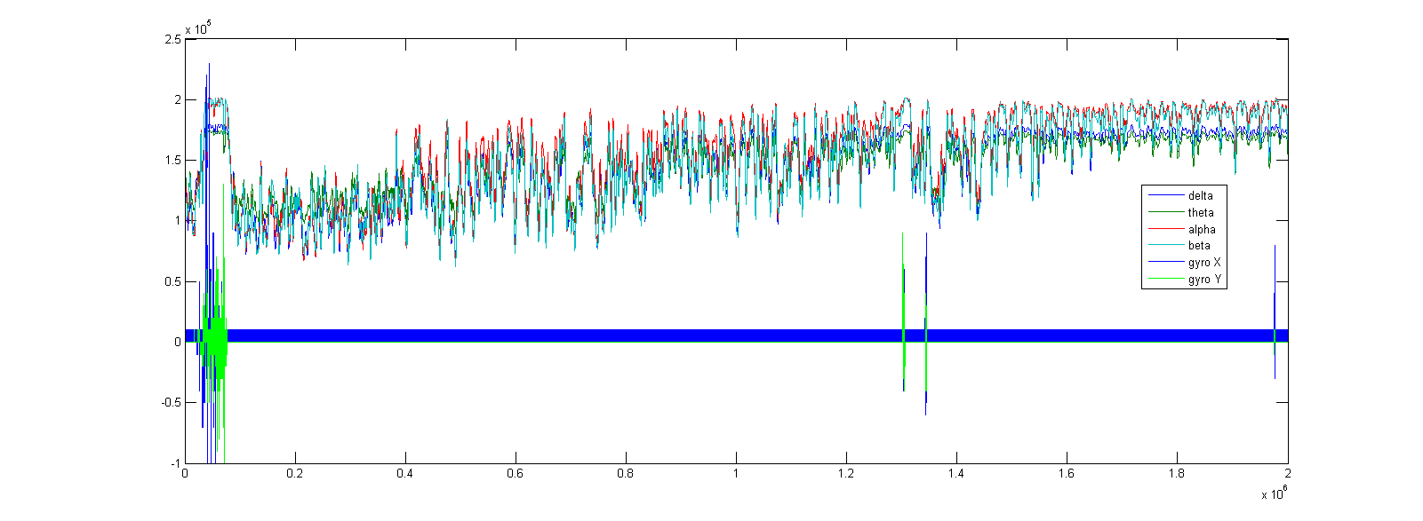

Slide 5




Something about me...
http://astrolight.cz

Slide 6
Organizační informace

Slide 7
Co je cílem předmětu
Získat zkušenosti s implementací většího programu
Používat vývojové nástroje
Naučit se dobré programátorské postupy
  programování obecně
  ale speciálně v oblasti bezpečnostních aplikací
Získat praktické postřehy z implementací kryptografických aplikací
  co nakonec ve firmě vyžadují

Slide 8
Co není cílem předmětu
Detailní ovládnutí konkrétní technologie
  zabrousíme do různých oblastí
Pokročilé zvládnutí celého vývojového procesu
  to jednoduše nestihneme
Vysvětlovat základy kryptografie nebo srovnávat všechny možné varianty řešení problému
  hlavně se budeme snažit prakticky programovat

Slide 9
Organizační
Formality výuky
  každotýdenní dvojhodinovka
  evidovaná účast, 2 neúčasti bez omluvení OK
Způsob výuky
  cca 30 min./týdně úvod do problematiky
  zbytek vaše programování přímo na hodině
  z mé strany průběžná konzultace nad vznikajícími problémy
  default Windows (ale můžete pracovat i na jiné platformě)
Samostatná práce
  v týmech, průběžná tvorba většího projektu
  dodělávání práce z hodiny
  pravidelné bodované předvádění stavu projektu (každé cvičení)

Slide 10
Organizační (2)
Používané nástroje
  IDE, verzovací nástroje (git), Doxygen, debugger, analýza a kontrola kódu (CppCheck, Coverity)
  GitHub + TravisCI + Coverity
  Ne vše je striktně dané – ptejte se a použijte svoje oblíbené
Hodnocení
  účast
  průběžná práce (10 bodů týdně)
  prezentace celého projektu (30 bodů)
  možné bonusy
  max. 150 bodů, zisk alespoň 100 bodů na kolokvium

Slide 11
Rozdělení do týmů
2-3 osoby
Společná práce, ale každý prezentuje svůj přínos
  Iniciální prezentace domácího úkolu na dalším cvičení
  zapracování připomínek, prezentace a hodnocení na dalším cvičení
Využití sdíleného repozitáře (GitHub) + CI (Travis)
Rozdělení provedeme až po 14 dnech
  Po ustálení zapsaných studentů

Slide 12
Celkový přehled
Základní podklady v ISu
Může se ale částečně měnit
  uvidíme dle reálné obtížnosti, rychlosti postupu a zájmu
Můžete otevřít vlastní řešený problém!

Slide 13
How good YOU are in English?
Apology for all my mistakes, please.

Slide 14
Organization
Seminars + assignments + project
Assignments
  Assigned regularly (nearly) every week
  Initial assigments individual work
  Most of assignments team work
  expected workload: 4+ hours/week/participant
  Network lab available to students
Project: secure videoconferencing architecture

Slide 15
Attendance
Seminars
  Attendance obligatory
  Absences must be excused at the department of study affairs
  2 absences are ok
Assignments and projects
  Partially done at seminar
  Completed during students free time (e.g. at the dormitory)
  Access to network lab and CRoCS lab is possible
  Cooperation between team members necessary

Slide 16
Course resources
Slides (PDF) available in IS
  IS = Information System of the Masaryk University
Assignments (what to do) available in IS
  Submissions done also via IS
Additional tutorials/papers/materials from time to time will also be provided in IS
  To better understand the issues discussed
Recommended literatures
  To learn more …

Slide 17
Plagiarism
Projects
  Must be worked out by a team of 3 students
  Every team member must show his/her contribution
Plagiarism, cut&paste, etc. is not tolerated
  Plagiarism is use of somebody else words/programs or ideas without proper citation
  IS helps to recognize plagiarism
  If plagiarism is detected student is assigned -5 points
  In more serious cases the Disciplinary committee of the faculty will decide

Slide 18
Short questionnaire
Do you know difference between symmetric and asymmetric cryptography?
Do you known difference between block and stream cipher?
Do you know DES and AES algorithm?
Do you know ECB and CBC encryption mode?
Do you know principle of hash functions?
Do you know MD5, SHA-1/2/3 algorithm?
Do you known concept of digital signature?
Do you know what perfect forward secrecy means?

Slide 19





"Theme" project – Secure IM
Secure instant messaging and data sharing

Slide 20
"Theme" project – Secure IM
Certification authority
  validates and issue user certificates
IM server
  register and faciliate connection between users
Client
  provides operations related to end user usage
Expected at the end: working networking application with security features

Slide 21
"Theme" project – some details
Users obtains certificate of identity from Certification authority
Users register with IM server
IM server provides list of connected users, helps to establish connection if necessary
Client maintains user identity, related keys and provides exchange of IM messages and high speed encrypted transfer of data stream

Slide 22
Cryptographic libraries

Slide 23
Cryptographic libraries - overview
Why not to implement own crypto algorithm/protocol
Adequate complexity of library
How to get authentic source code
Common libraries: OpenSSL, mbed TLS
How to use library

Slide 24
Do NOT implement your own algorithms
Time consuming (probably already done before)
Functional problems
Low performance
Security problems due to bugs
Security problems due to missing defence against implementation attacks

Slide 25
Do NOT implement your own protocols
Do not design algorithms/protocols by yourself
Try to find existing standards
  NIST, RSA PKCS, RFC, ISO/ANSI
Try not to deviate from standards
  compatibility and compliance
  no need for (time consuming) specification of detailed your scheme
  small change can have big security impacts

Slide 26
Use well-known implementations
Use well-known libraries
  OpenSSL, PolarSSL, GnuPG, BouncyCastle (Java)
Or implementation of algorithms from well-established authors (for uncommon alg)
  Brian Gladman, Eric A. Young …

Slide 27
Complexity matters
Complexity of library implementation should match your needs
  usually, you need only one or two algorithms
Multiprocessor or CPU-independent implementation can be overkill
  and just increase risk of error
Do you really need library with object-oriented design?
Large libraries are not always the most suitable ones
  OpenSSL is complex and interconnected
  e.g., AES is extractable much easier from mbedTLS (PolarSSL) than from OpenSSL

Slide 28
Code authenticity
Source code signature
  Do you really have original binary/source codes?
  MD5/SHA1 hash (where to get “correct” hash value?)
  GPG/PGP
Generate your own GPG/PGP signature keys
  use them for inter-team communication
  sign your code releases (on GitHub)

Slide 29

Which one you like more? Why?
ARM mbed TLS
/**
* \brief Output = HMAC-SHA-512( hmac key, input buffer )
*
* \param key HMAC secret key
* \param keylen length of the HMAC key
* \param input buffer holding the data
* \param ilen length of the input data
* \param output HMAC-SHA-384/512 result
* \param is384 0 = use SHA512, 1 = use SHA384
*/
void sha512_hmac( const unsigned char *key, size_t keylen,
const unsigned char *input, size_t ilen,
unsigned char output[64], int is384 );
OPENSSL
unsigned char *HMAC(const EVP_MD *evp_md, const void *key, int key_len,
const unsigned char *d, size_t n, unsigned char *md,
unsigned int *md_len);

Slide 30

Common libraries – OpenSSL
Pros:
  Very rich library
    lots of algorithms, protocols, paddings
    not “just” SSL
  well tested functionally & security over time!
  significant amount of existing examples on web
Cons:
  API is complex and sometimes harder to understand
  (started as Eric Young’s personal attempt to learn BigInts ☺)
  relatively low-level functions (can be pros!)
  code is significantly interconnected
    not suitable for extraction of single algorithm
  poor official documentation

Slide 31

Common libraries – mbed TLS
(Formely PolarSSL)
Pros:
  API is simple and clear
  Easy to extract single algorithm
  Now widely used, reasonably tested
Cons:
  fewer supported algorithms and standards
  dual licensing, but not BSD-like license

Slide 32
How to use library
Extract code and compile alone
  some work with extraction
  small, clean and self-containing result
Compile against whole library
  usually easy to do
  but dependence on possibly unused code
Link statically against dynamic library
  dll/so must be always present to run program

Slide 33
How to use library (2)
Link dynamically against dynamic library
  try to open dll file and obtain function handle
Link against service provider functions
  Cryptography Service Providers in particular
  API for listing of available service providers (CryptEnumProviders)
  standardized functions provided by providers http://msdn.microsoft.com/en-us/library/aa380252%28v=VS.85%29.aspx#service_provider_functions

Slide 34
Security implications of (dynamic) libraries
Library can be forged and exchanged
Library-in-the-middle attack easy
  data flow logging
  input/output manipulation
Library outputs can be less checked than user inputs
  feeling that library is my “internal” stuff and should play by „my“ rules
Library function call can be behind logical access controls
Library can contain bugs
  Serious development also needs 3rd party libraries control process

Slide 35
OpenSSL - problems
What is wrong with this code?
network_receive(uchar* in_packet, short &in_packet_len); // TLV
uchar* in = in_packet + 3;
short length = make_short(inpacket + 1);
uchar* out_packet = malloc(1 + 2 + length);
uchar* out = out_packet + 3;
memcpy(out, in, length);
network_transmit(out_packet);

Slide 36
OpenSSL Heartbeat – “packet repeater”
network_receive(uchar* in_packet, short &in_packet_len); // TLV
uchar* in = in_packet + 3; short length = make_short(inpacket + 1);
uchar* out_packet = malloc(1 + 2 + length);
uchar* out = out_packet + 3;
memcpy(out, in, length);
network_transmit(out_packet);
unsigned char* in
Type [1B]
length [2B]
Payload [length B]
unsigned char* out
Payload [length B]
Type [1B]
length [2B]
Payload (length B)

Slide 37

Problem?
network_receive(uchar* in_packet, short &in_packet_len); // TLV
uchar* in = in_packet + 3;
uchar* out_packet = malloc(1 + 2 + length);
uchar* out = out_packet + 3;
memcpy(out, in, length);
network_transmit(out_packet);
unsigned char* in
0xFFFF [2B]
Type [1B]
0x0001 [2B]
Payload [1B]
… Heap memory …
in_packet_len != length + 3
unsigned char* out
Type [1B]
0xFFFF [2B]
Payload (65535B)
Payload [1B]
Heap memory (keys, passwords…)
Problem!

Slide 38

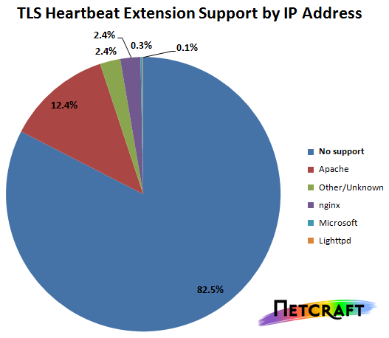
How serious the bug was?
17% SSL web servers (OpenSSL 1.0.1)
Twitter, GitHub, Yahoo, Tumblr, Steam, DropBox, DuckDuckGo…
https://seznam.cz, https://fi.muni.cz …
\
http://news.netcraft.com/archives/2014/04/08/half-a-million-widely-trusted-websites-vulnerable-to-heartbleed-bug.html

Slide 39
Ponaučení
Vždy VELMI rigidně kontrolujte vstupní argumenty
Nebezpečný není jen zápis za konec pole, ale i čtení
Nedůvěřujte informacím od klienta
  Ani když jste vy sami jeho tvůrci (změna na síťové vrstvě)
Pro síťové aplikace preferujte jiné jazyky než C
  Např. automatická kontrola mezí polí (Java, C#)
  Nenahrazuje kontrolu argumentů!
Open-source sám o sobě nezajišťuje kód bez chyb
  "given enough eyeballs, all bugs are shallow" L. Torvalds
(Nedělejte commity ve spěchu před oslavou)

Slide 40
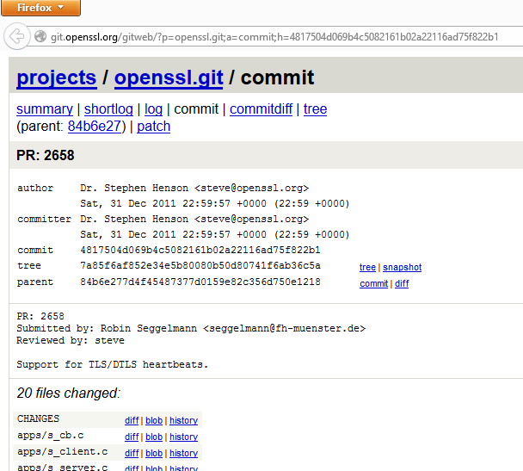

Slide 41
Reference
Všeobecné informace
  http://heartbleed.com/
Testování zranitelnosti konkrétní stránky
  https://filippo.io/Heartbleed/
Analýza problému na úrovni zdrojáku
  http://nakedsecurity.sophos.com/2014/04/08/anatomy-of-a-data-leak-bug-openssl-heartbleed
  http://blog.existentialize.com/diagnosis-of-the-openssl-heartbleed-bug.html

Slide 42
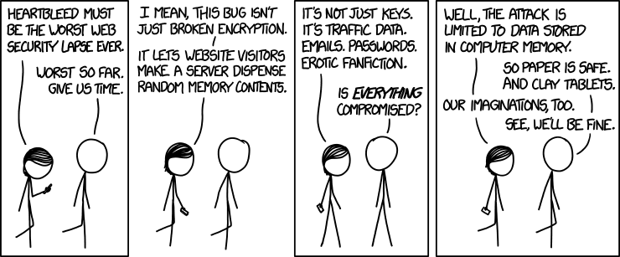
O jak závažnou chybu se jedná? ☺
XKDC (https://xkcd.com/1353/)

Slide 43
Practical assignment

Slide 44
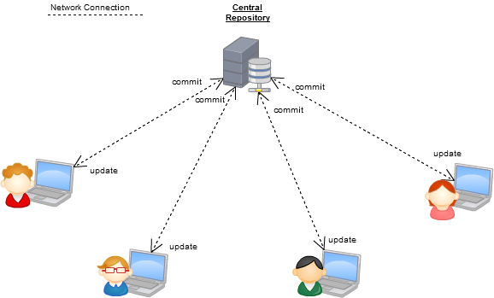
SVN style – central repository
https://programmers.stackexchange.com/questions/35074/im-a-subversion-geek-why-should-i-consider-or-not-consider-mercurial-or-git-or

Slide 45
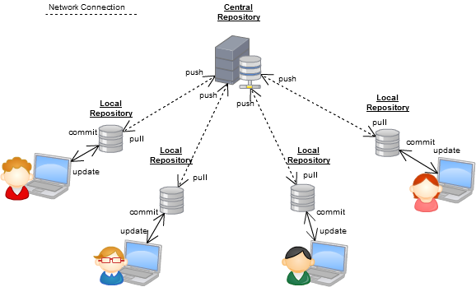


GIT-style – distributed repository
https://programmers.stackexchange.com/questions/35074/im-a-subversion-geek-why-should-i-consider-or-not-consider-mercurial-or-git-or

Slide 46

Setup your GitHub repository
Setup your GitHub account and repository
  E.g., PB173 test
  .gitignore C++
  License MIT
Create first milestone (Issues→Set milestone→Create…)
Create first issue (Labels, Milestone, Assignee)
  “Setup initial repo files”
Install git locally (GitHub client, TortoiseGit…)
Git Clone (your repository)
  Into local directory

Slide 47
Use your GitHub repository
Create small project (your favourite IDE)
  Commit, Push
Try to modify some files locally
  Commit, Push
Try to modify some files in repo via web interface
  Simulated parallel modification by other developer
  Git Pull / Sync
Close your first issue ☺

Slide 48

Practical assignment
Download mbed TLS (formerly PolarSSL) library
  and check signature (gpg --verify)
Write small project (mbed TLS based)
  read, encrypt and hash supplied file, write into out file
  read, verify hash and decrypt file
  use AES-128 in CBC mode and SHA2-512
  use PKCS#7 padding method for encryption (RFC 3852)
Start with New Project+mbedTLS+AES
Questions

Slide 49
Submissions, deadlines
Commit into your GitHub repository (frequently ☺)
Upload application source codes as single zip file into IS
  Use GitHub’s download ZIP feature
  Homework vault (Crypto - 1. homework (AES+SHA2))
DEADLINE: 29.2. 12:00 (first part)
  application capable to read, encrypt, decrypt, hash
  Text file containing description how you did PGP signature verification (whole process including import of public keys etc.)
  0-5 points assigned
DEADLINE 7.3. 12:00 (second part)
  addition of unit tests
  0-5 points assigned

