Slide 1
PB173 - Tématický vývoj aplikací v C/C++ Domain specific development in C/C++
Skupina: Aplikovaná kryptografie a bezpečné programování
https://is.muni.cz/auth/predmety/uplny_vypis?fakulta=1433;obdobi=6384;predmet=871304
Petr Švenda svenda@fi.muni.cz
Konzultace: A406, Pondělí 15:00-15:40

Slide 2
Verification of library

Slide 3
GPG verification – missing key problem
gpg --verify openssl-1.0.1i.tar.gz.asc (soubor s podpisem, ne knihovna
samotna, predpoklad existence openssl-1.0.1i.tar.gz)
GnuPG>gpg --verify openssl-1.0.1i.tar.gz.asc
gpg: Signature made 08/06/14 23:18:48 using RSA key ID 0E604491
gpg: Can't check signature: public key not found
Problem: we don’t have key used to create this signature

Slide 4
GPG – find and download key
https://www.openssl.org/about/
Matt Caswell matt@openssl.org UK 0E604491
pgp.mit.edu
http://pgp.mit.edu:11371/pks/lookup?op=vindex&search=0x8657ABB260F056B1E5190839D9C4D26D0E604491
-> matt.asc
GnuPG>gpg --keyserver pgpkeys.mit.edu --recv-key 0E604491
GnuPG>gpg --import matt.asc
gpg: key 0E604491: public key "Matt Caswell <matt@openssl.org>" imported
gpg: Total number processed: 1
gpg: imported: 1 (RSA: 1)
gpg: 3 marginal(s) needed, 1 complete(s) needed, PGP trust model
gpg: depth: 0 valid: 21 signed: 3 trust: 0-, 0q, 0n, 0m, 0f, 21u
gpg: depth: 1 valid: 3 signed: 0 trust: 3-, 0q, 0n, 0m, 0f, 0u
gpg: next trustdb check due at 2016-06-04

Slide 5
GPG verification – untrusted key problem
GnuPG>gpg --verify openssl-1.0.1i.tar.gz.asc
gpg: Signature made 08/06/14 23:18:48 using RSA key ID 0E604491
gpg: Good signature from "Matt Caswell <matt@openssl.org>"
gpg: aka "Matt Caswell <frodo@baggins.org>"
gpg: WARNING: This key is not certified with a trusted signature!
gpg: There is no indication that the signature belongs to the owner.
Primary key fingerprint: 8657 ABB2 60F0 56B1 E519 0839 D9C4 D26D 0E60 4491
We have the key, but GPG doesn’t know if it is trusted
You need to set trust (and you will need your keypair for this operation)
GnuPG>gpg --gen-key
... generate your ultimately trusted key

Slide 6
GPG edit trust on OpenSSL key
GnuPG>gpg --edit-key 0E604491 trust
gpg (GnuPG) 1.4.7; Copyright (C) 2006 Free Software Foundation, Inc.
This program comes with ABSOLUTELY NO WARRANTY.
This is free software, and you are welcome to redistribute it
under certain conditions. See the file COPYING for details.
pub 2048R/0E604491 created: 2013-04-30 expires: never usage: SC
trust: unknown validity: unknown
sub 2048R/E3C21B70 created: 2013-04-30 expires: never usage: E
[ unknown] (1). Matt Caswell <matt@openssl.org>
[ unknown] (2) Matt Caswell <frodo@baggins.org>
pub 2048R/0E604491 created: 2013-04-30 expires: never usage: SC
trust: unknown validity: unknown
sub 2048R/E3C21B70 created: 2013-04-30 expires: never usage: E
[ unknown] (1). Matt Caswell <matt@openssl.org>
[ unknown] (2) Matt Caswell <frodo@baggins.org>

Slide 7
Please decide how far you trust this user to correctly verify other users' keys
(by looking at passports, checking fingerprints from different sources, etc.)
1 = I don't know or won't say
2 = I do NOT trust
3 = I trust marginally
4 = I trust fully
5 = I trust ultimately
m = back to the main menu
Your decision? 5
Do you really want to set this key to ultimate trust? (y/N) y
pub 2048R/0E604491 created: 2013-04-30 expires: never usage: SC
trust: ultimate validity: unknown
sub 2048R/E3C21B70 created: 2013-04-30 expires: never usage: E
[ unknown] (1). Matt Caswell <matt@openssl.org>
[ unknown] (2) Matt Caswell <frodo@baggins.org>
Please note that the shown key validity is not necessarily correct
unless you restart the program.

Slide 8
GPG verification – finally correct
GnuPG>gpg --verify openssl-1.0.1i.tar.gz.asc
gpg: Signature made 08/06/14 23:18:48 using RSA key ID 0E604491
gpg: Good signature from "Matt Caswell <matt@openssl.org>"
gpg: aka "Matt Caswell <frodo@baggins.org>"

Slide 9
Continuous integration

Slide 11
+
+
+
+
=

Slide 12
Klasický způsob vývoje
Old-school styl vývoje
Zadání rozděleno do dílčích problémů oddělených rozhraními
Vývojáři pracují na separátních komponentách
Separátní větve v SVN repozitářích
Testy na úrovni dílčí komponenty
Po nějaké době chceme provést spojení dílčích částí
Stačí jen Merge & Compile?
“Integration hell” přichází
Rozhraní lehce upraveny
Sdílený kód modifikován
Chybné spojení během merge
…

Slide 13
Continuous integration (CI)
Originálně navrženo pro Extreme Programming
Nyní široce využíváno
Složení více dobrých vývojových technik a postupů
Celý produkt je stále “připraven” (night builds)
Hlavní větev je spojena, kompilována a automaticky testována i několikrát denně
CI server (Jenkins, Travis CI…)
Versioning system (SVN, GIT…)
Automatický build (make, Ant, Maven…)
Automatické testy (unit testy, integrační testy)
Dodatečná analýza (statická analýza, výkonostní testy…)
Prezentace výsledků (grafický web… )

Slide 14
CI : GitHub + Travis CI
+
Create GitHub repository
Create Makefile for automated build
Sign into Travis-CI.org with GitHub account
Add New Repository (button +)
Your GitHub repositories are listed
Activate GitHub Webhook for target repo
Add .travis.yml file to root of your repo
Fill content according your language and build process
Trigger Travis build with Git push
Results available at https://travis-ci.org/ and by email
http://docs.travis-ci.com/user/getting-started/
language: cpp
compiler:
- gcc
- clang
script: make

Slide 15
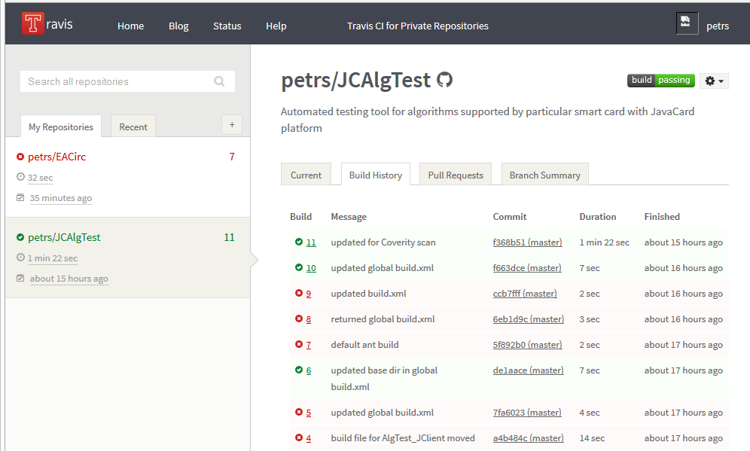
+

Slide 16
GitHub + Travis CI
+
Continuous integration
Compile and run tests after every git Push
https://github.com/crocs-muni/git-travis-demo
Makefile
Automatic compilation and test execution
Generic build script (no special dependency on GitHub)
.travis.yml
Configuration file instructing GitHub to use Travis CI

Slide 17
Makefile
# Makefile example
# Variables CC and CXX are automatically set on all UNIX systems.
CXXFLAGS=-Wall -Wextra
SOURCES_GEN=src/fact.cpp
# Source and object lists for main program
SOURCES_MAIN=$(SOURCES_GEN) src/main.cpp
OBJECTS_MAIN=$(SOURCES_MAIN:.cpp=.o)
# Source and object lists for testing binary
SOURCES_TEST=$(SOURCES_GEN) src/testing.cpp
OBJECTS_TEST=$(SOURCES_TEST:.cpp=.o)
# Most frequently used automatic variables:
# $@ (name of the target rule)
# $< (name of the first prerequisite)
# $^ (name of all the prerequisites)
# Target 'all' has 'main' and 'main-test' as dependencies.
all: main main-test
# Depends on main-test, runs the test program.
test: main-test
./main-test
# Depends on all object files and main, links the final binary.
main: $(OBJECTS_MAIN)
$(CXX) $(CXXFLAGS) -o $@ $^
# Depends on all object files and test, links the test binary.
main-test: $(OBJECTS_TEST)
$(CXX) $(CXXFLAGS) -o $@ $^
# Automatic rule for all object files in build directory
%.o: %.cpp
$(CXX) $(CXXFLAGS) -c -o $@ $<
clean:
rm -fr $(OBJECTS_MAIN) $(OBJECTS_TEST)
Basic variables
Build rule(s)
Files to be build. Can be named (main.cpp) or automatic rule for all *.cpp files (used here)

Slide 18
.travis.yml
# TravisCI build settings file
# For more info, see http://docs.travis-ci.com/user/getting-started/
# To validate your .travis.yml, go to http://lint.travis-ci.org/
# setting the project language
language: cpp
# setting compilers, do 2 separate sub-builds for gcc and clang
compiler:
- gcc
- clang
# script to run after build (run tests, etc.)
script: make all test

Slide 19
Practical assignment
Create Travis CI account (http://travis-ci.org)
Fork https://github.com/crocs-muni/git-travis-demo
Create local copy of forked repo
Enable git-travis-demo at travis-ci.org
Push updated files
Observe TravisCI build and response
Connect your repo (from last lecture) with TravisCI
Add tests (Catch)
Add Makefile (compile, run test)
Push into your repo and observe Travis CI

Slide 20
Enable GitHub repo in Travis GUI

Slide 21
Tests are initially failing

Slide 22
Fix tests to pass

Slide 23
Homework
Write following simple unit tests:
file not exists or cannot be read/written into
encrypted blob was corrupted
wrong decryption key was used
test vectors for encryption and hashing
Use UT framework you like (Catch, QTest, UnitTest++, CxxTest…)
Integrate your tests into Travis CI
Best practices
http://blog.stevensanderson.com/2009/08/24/writing-great-unit-tests-best-and-worst-practises/
http://www.levelofindirection.com/journal/2010/12/28/unit-testing-in-c-and-objective-c-just-got-easier.html
Code will be used later in architecture
will be used again and extended, so write it well ☺

Slide 24
Submissions, deadlines
Upload application source codes as single zip file into IS Homework vault (Crypto - 2. homework (UT))
Finalized codes based on the discussions during lecture
Added unit tests
DEADLINE 7.3. 12:00 (second part)
addition of unit tests
0-5 points assigned

Slide 25
Questions?

