Slide 1
PB173 - Tématický vývoj aplikací v C/C++ Domain specific development in C/C++
Skupina: Aplikovaná kryptografie a bezpečné programování
Petr Švenda svenda@fi.muni.cz
Konzultace: A406, Pondělí 15:00-15:40

Slide 2
Portability and memory restrictions

Slide 3
Memory restrictions
Size of the code vs. runtime memory requirements
Depends on the target platform
usually of little concern (RAM is big enough)
sometimes critical factor for algorithms selection
embedded devices, e.g., sensor nodes
Algorithms usually provides possibility for optimization
precomputed tables – speed vs. memory
key schedule vs. on-the-fly key schedule
optimizations may increase risk for side channel attacks
Write correct code first, then optimize
especially true in security

Slide 4
Portability – different operating systems
Usually no problems with algorithms
plain C code
Problems with additional functionality
read file, directory listing, user input, GUI
often cannot be solved by standardized functions or POSIX
abstract and separate platform-dependent functions
move them into distinct modules
easy to replace/extend for target platform later
Data generated by your application should be portable
ASN.1 encoding
TLV encoding
binary vs. text formats
Base64 encoding

Slide 5
Portability – different hardware platforms
Little vs. big endian architecture
usually problem with bit-based operations
e.g., bit rotation
problem with interpretation of binary formats
Highly optimized implementations
e.g., Brian Gladman’s AES
may use architecture specific operations and behaviour
multiple byte operations in single tick
special representation of memory data
may use macros heavily

Slide 6
Reference vs. optimized version
Double meaning of “reference” word
reference implementation from algorithm designers (Rijndael)
reference == code you should use
Reference implementation (e.g., Rijndael)
usually simple and understandable API
lower performance
may not protect against implementation attacks
typical usage is as supplementary material to algorithm description document
is used to create test vectors

Slide 7
Reference vs. optimized version (2)
Optimized version of algorithm
same results as reference implementation
portability usually impacted
Techniques used
pre-computed tables often
may use whole size of the architecture registers
e.g., AES is byte oriented, but x64 can perform eight xor of single byte per tick
may use special instruction of particular CPU
may use specifics of target architecture (e.g., cache size)
Typically for the production environment

Slide 8
Choosing the right length

Slide 9
Length of keys/block/hashes
Choose length with some reserve
many things can go wrong
Choose algorithms with corresponding lengths
key derivation by MD5 of keys for AES256?
Do not protect keys distribution by keys with lower entropy
AES key encrypted by simple DES key
Asymmetric keys length needs to be much longer
space of possible values is not continuous

Slide 10
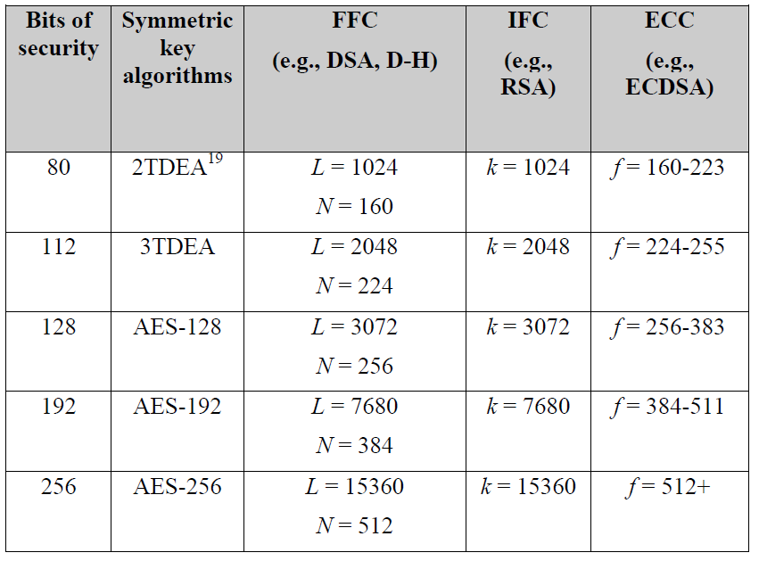
Comparable strengths of cryptosystems
Source:
NIST SP800

Slide 11
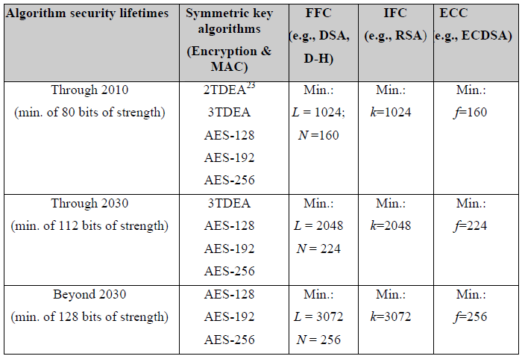
Recommended key sizes
Source:
NIST SP800

Slide 12
Symmetric key cryptography
Key length for symmetric cryptography
80 bits not secure enough against brute-force
always good to have some reserve for algorithm flaws
flaw => key can be found faster then by brute-force
AES-128 is still OK
AES-256 do not have full 256 bits of security
Take your application needs into account!

Slide 13
Making the keys
From what are you making the keys?
password must have entropy equivalent to derived key
e.g., AES-128 key derived from “hello” will not have 128 bits security
What if you create two keys from one with 128 bits of entropy?
Do you really have perfect random generator?
128 generated bits will not have 128 bits of entropy
generate more bits and use hash function to condense into 128 bits
(2013 - Seems that NSA was involved in intentional crippling of random generators – implementation and even standards)

Slide 14
Asymmetric cryptography
RSA is still gold standard
use (at least) 2048 bits keys
768 bits broken by brute-force
special number with 1024 bits broken by brute-force
1024 bits not broken yet, but…
Elliptic courve cryptography (ECC) seems cool
Currently (2013), some doubts about ECC security based on leaked Snowden documents arise
But do you really need shorter keys?
You will face harder portability, more coding problems, lower level of code testiness etc.

Slide 15
Practical assignment

Slide 16
Teams
2-3 persons
Joint work, but every one presents its contribution
Presentation on next seminar
Use GitHub + Travis CI
Form the teams now!
Team A: Kristian Jakubik, Peter Kovac, Peter Lipcak
Team B: Martina Minatova, Marek Santa, Peter Harmann
Team C: Peter Sekan, Marek Vancik, Jakub Martinka

Slide 17
"Theme" project – Secure IM
Secure instant messaging and data sharing

Slide 18
"Theme" project – Secure IM
Certification authority
validates and issue user certificates
IM server
register and faciliate connection between users
Client
provides operations related to end user usage
Expected at the end: working networking application with security features

Slide 19
"Theme" project – some details
Users obtains certificate of identity from Certification authority
Users register with IM server
IM server provides list of connected users, helps to establish connection if necessary
Client maintains user identity, related keys and provides exchange of IM messages and high speed encrypted transfer of data stream

Slide 20
Practical assignment
Select great name for your group
Setup development workflow for your group
New Github repository (separate folder for client&server), license
Add proper developer rights
Initial version of code/tests (just copy from last lecture)
Try to pull/commits together and create conflict (intentionally)
Send me link to your repo (+ members of the group)
Plan together your work
Design based on requirements gathered now
Add initial issues into separate milestones

Slide 21
Practical assignment – cont.
Prepare document and presentation with design decisions
2-3xA4 document (overview, functions, crypto used...)
4-5 slides (presentation)
UML diagrams?
Your design will be presented and discussed next week

Slide 22
Practical assignment
Design and document API to:
new user registration
user authentication to server
obtain list of other users
establish secure channel to other (online) users (ENC, MAC)
exchange instant messages (small data packets) with other user
close secure channel
disconnect user from server
...?
Document functions in JavaDoc-style (Doxygen)
CA/Client/Server are separate processes
Plan for communication over sockets or http requests

Slide 23
Principles of good API
Be minimal
Be complete
Have clear and simple semantics
Be intuitive
Be easy to memorize
Lead to readable code
read more at e.g., http://doc.trolltech.com/qq/qq13-apis.html
security API even harder: http://www.cl.cam.ac.uk/~rja14/Papers/SEv2-c18.pdf
http://blog.apigee.com/taglist/security

Slide 24
Submissions, deadlines
Upload application source codes as single zip file into IS Homework vault (Crypto - 3. homework (UT))
Initial version of project at GitHub, structure, initial code&tests
Design documents (doc folder)
Header files with documented (Doxygen) function headers (API)
Slides for presentation
DEADLINE 14.3. 12:00
Up to 10 points assigned

Slide 25
Questions?

