Slide 1
PB173 - Tématický vývoj aplikací v C/C++ (jaro 2016)
Skupina: Aplikovaná kryptografie a bezpečné programování
Petr Švenda svenda@fi.muni.cz
Konzultace: A406, Pondělí 15-15:50

Slide 2
Optimization

Slide 3
Optimization steps
Do not optimize prematurely - write clean and correct code first!
When code works, find performance bottleneck and remove it
Document optimization and test it thoroughly

Slide 4
Performance measurement - manual
Manual speed measure
Measure time before target operation
Execute operation
Measure time after target operation
Compute and print difference
clock_t elapsed = -clock();
aes256_encrypt_ecb(&ctx, buf);
elapsed += clock();

Slide 5
Manual measurement – possible problems
It is time consuming
additional code, manually inserted
less readable, error prone (use DEBUG macro)
Precision
some function returns time in seconds (e.g., time())
short operations will take 0
prefer functions returning result in ms or CPU ticks
e.g., clock()
check documentation for real precision
run operation multiple times (e.g., 1000x)
and divide the resulting time by that factor

Slide 6
Manual measurement – possible problems
Additional unintended overhead may screw the results
one-time initialization of objects
cache usage, disk swap
garbage collection (not in C/C++)
Need to know the probable bottleneck in advance
timing code is inserted manually
you are selecting what you like to measure
time consuming to localize bottleneck

Slide 7
Automatic measurement - profiling
Automatic tool to measure time and memory used
“Time” spend in specific function
How often a function is called
Call tree
what function called actual one
based on real code execution (condition jumps)
Many other statistics, depend on the tools

Slide 8
Profiling methods
Profiling method: CPU Sampling
check periodically what is executed on CPU
accurate, low overhead
Profiling method: Instrumentation
automatically inserts special accounting code
will return exact function call counter
(may affect performance timings a bit)
additional code present

Slide 9
MS Visual Studio Profiler
Visual Studio 2013 or earlier
Analyze->Launch Performance Wizard
Visual Studio 2015
Debug → Profiler → Start diagnostic tools
May require admin privileges (will ask)

Slide 10
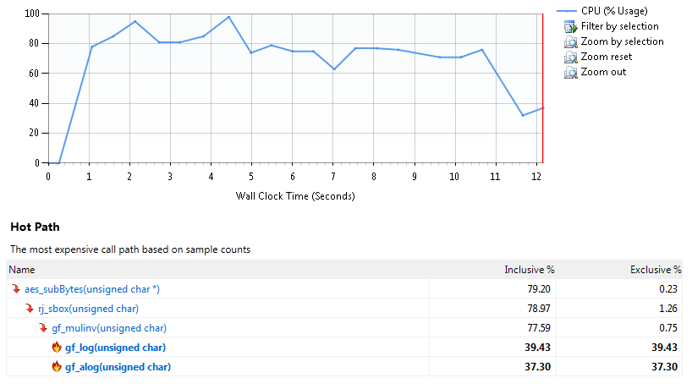
MS VS Profiler – results (Summary)
Where to start the optimization work?

Slide 11
MS VS Profiler – results (Functions)
Result given in number of sampling hits
meaningful result is % of total time spend in function
Inclusive sampling
samples hit in function or its children
aggregate over call stack for given function
Exclusive sampling
samples hit in exclusively in given function
usually what you want
fraction of time spend in function code (not in subfunctions)

Slide 12
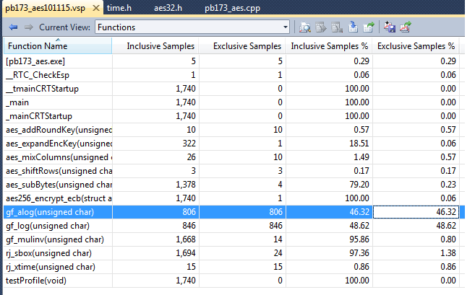
MS VS Profiler – results (Functions)
Doubleclick to move into Function Details view

Slide 13
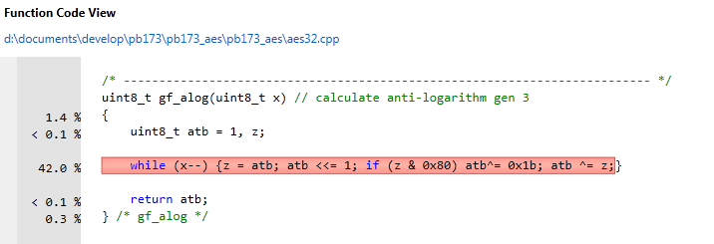
46 % of time spend in gf_alog function
How to speed up gf_alog function?

Slide 14
aestab.c
AES_RETURN aes_init(void)
{ uint_32t i, w;
#if defined(FF_TABLES)
uint_8t pow[512], log[256];
if(init)
return EXIT_SUCCESS;
/* log and power tables for GF(2^8) finite field with
WPOLY as modular polynomial - the simplest primitive
root is 0x03, used here to generate the tables
*/
i = 0; w = 1;
do
{
pow[i] = (uint_8t)w;
pow[i + 255] = (uint_8t)w;
log[w] = (uint_8t)i++;
w ^= (w << 1) ^ (w & 0x80 ? WPOLY : 0);
}
while (w != 1);
// ...

Slide 15
MS VS Profiler – save results
You can save results and compare later
To check the real impact of your optimization
Don’t forget to eventually stop the optimization ☺

Slide 16
GCC gcov tool
http://gcc.gnu.org/onlinedocs/gcc/Gcov.html#Gcov
Compile program by GCC with additional flags
gcc -Wall -fprofile-arcs -ftest-coverage main.c
gcc -Wall --coverage main.c
additional monitoring code is added to binary
Execute program
files with “.bb" ".bbg" and ".da" extension are created
Analyze resulting files with gcov
gcov main.c
annotated source code is created
Lcov - graphical front-end for gcov
http://ltp.sourceforge.net/coverage/lcov.php

Slide 17
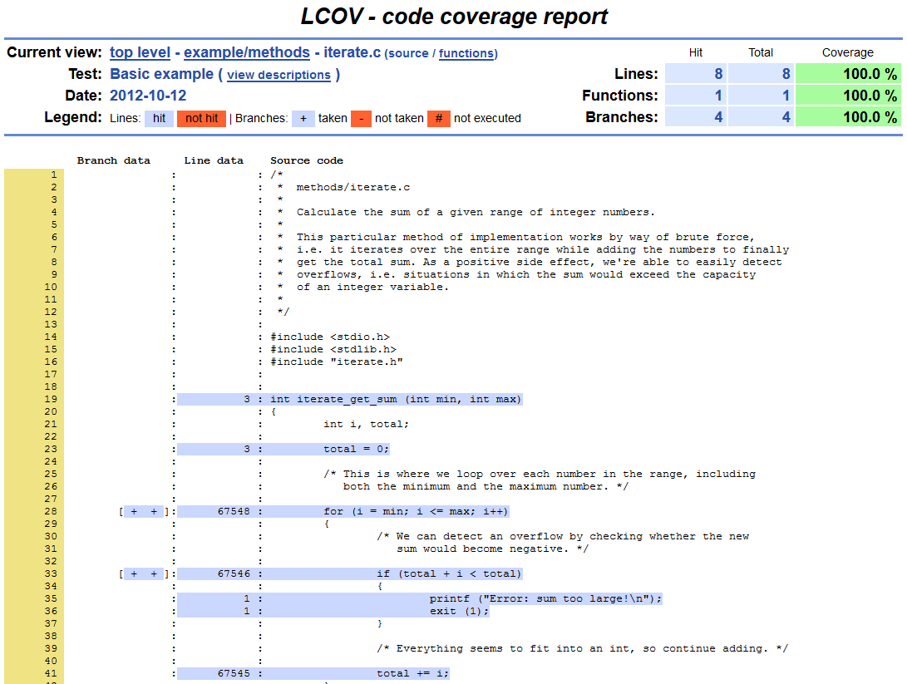
Taken from http://ltp.sourceforge.net/coverage/lcov/output/example/methods/iterate.c.gcov.html

Slide 18
Memory consumption profiling
MSVS Profiler does not provide for native apps
unfortunately, available only for managed code
Visual Studio is detecting memory leaks!
_CrtDumpMemoryLeaks()
run program in debug mode (possibly without any breakpoint)
let it finish and watch Output pane
Valgrind -v --leak-check=full
Write your own new and delete
and log the allocated/freed memory

Slide 20
Assignment – performance analysis
Produce detailed speed estimation for:
New user registration
User authentication to server
Obtain list of other users
Prepare protected message for another user
Unprotect message from another user
Which function(s) is consuming most of the CPU?
provide a list with %, discuss possible improvements
Improve performance if significant bottleneck is found

Slide 21
Submissions, deadlines
Upload application source codes as single zip file into IS Homework vault (Crypto - 6. homework (Performance))
Max. 2xA4 with performance analysis
DEADLINE 11.4. 12:00
0-10 points assigned

