Slide 1
Itil® - Information Technology Infrastructure Library
Jana Soběhrdová
Itil MU FIT

Slide 2
About lector
Mgr. Jana Soběhrdová
Original profession – Teacher of German & History
Almost 10 years in IBM
Positions - started as 1st level technician/helpdesk agent (Services Desk), supporting big international, industrial customer in German & English; moved into junior position of Client Support Manager for the same customer and continuing in senior role as Service Availability Manager until now (all roles within GTS – Global Technology Services division)
ITIL Expert certification

Slide 3
Agenda
ITIL – Basic Overview - Lifecycle Approach
SS,SD,ST,SO,CSI
Components of each lifecycle stage
Processes & Functions
ITIL Service Management & IBM Alignment
Examples
Core Tools
Ticketing tool, CMDB

Slide 4
Information Technology Infrastructure Library
IT Service Management ~ ITSM covers IT services, processes, technology, and staffing and personnel practices that contribute to the management of IT infrastructure
ITIL® represents the best practices in IT Service Management
Becoming international standard
Adopt & Adapt to your business needs
The Client’s business enablement is the main focus – not the technology

Slide 5
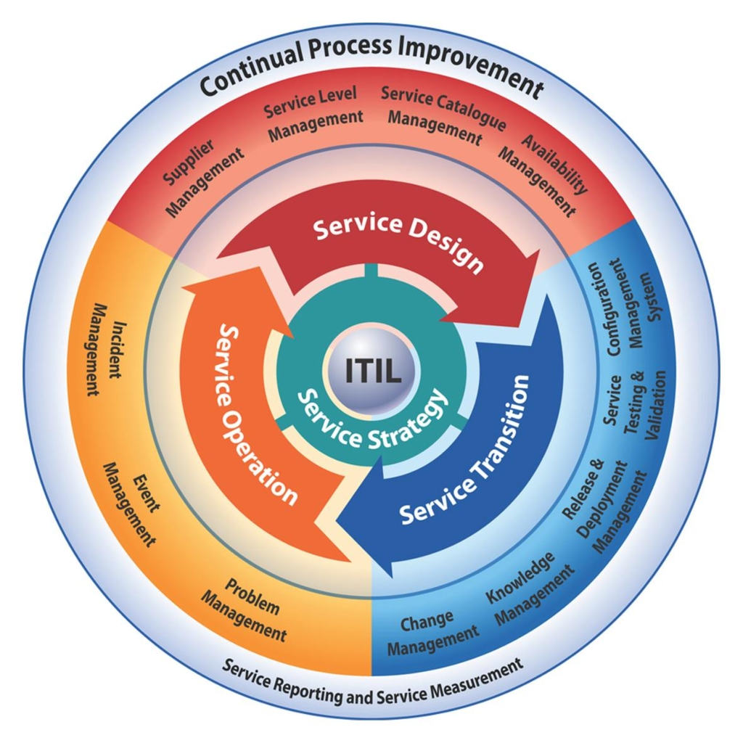
ITILv3 (2011 Edition) Lifecycle approach

Slide 6
Notes:
A pot file is a Design Template file, which provides you the “look” of the presentation
You apply a pot file by opening the Task Pane with View > Task Pane and select Slide Design – Design Templates.
Click on the word Browse… at bottom of Task Pane and navigate to where you stored BlueOnyx Deluxe.pot (black background) or BluePearl Deluxe.pot (white background) and click on Apply.
You can switch between black and white background by navigating to that pot file and click on Apply.
Another easier way to switch background is by changing color scheme. Opening the Task Pane, select Slide Design – Color Schemes and click on one of the two schemes. All your existing content (including Business Unit or Product Names) will be switched without any modification to color or wording.
Start with Blank Presentation, then switch to the desired Design Template
Start a new presentation as Blank Presentation
You can switch to Blue Onyx Deluxe.pot by opening the Task Pane with View > Task Pane and select Slide Design – Design Templates.
Click on the word Browse… at bottom of Task Pane and navigate to where you stored BlueOnyx Deluxe.pot (black background) and click on Apply.
Your existing content will take on Blue Onyx’s black background, and previous black text will turn to white.
You should add your Business Unit or Product Name by modifying it on the Slide Master
You switch to the Slide Master view by View > Master > Slide Master.
Click on the Title Page thumbnail icon on the left, and click on the Business Unit or Product Name field to modify it.
Click on the Bullet List Page thumbnail icon on the left, and click on the Business Unit or Product Name field to modify it.
Click on Close Master View button on the floating Master View Toolbar
You can turn on the optional date and footer fields by View > Header and Footer
Suggested footer on all pages including Title Page: Presentation Title | Confidential
Date and time field can be fixed, or Update automatically. It appears to the right of the footer.
Slide number field can be turned on as well. It appears to the left of the footer.

Slide 7
Why is ITIL important to IBM and our clients?
Reduced disruption to IT Services
Greater control of IT infrastructure & changes to it
Lower IT cost – centralized & standardized services
Connects the IT infrastructure to the business it supports so that IT investment is focused on the highest priority business needs
Single point of contact for end-users for incidents, service requests, and information – reduces multiple help desks
Vendor-neutral language to describe IT service management – helps to manage IT support across multiple suppliers
End-to-end integration of IT management processes
Supports business controls compliance
…..Results in better quality, lower TCO, IT alignment to business, and easier outsourcing

Slide 8
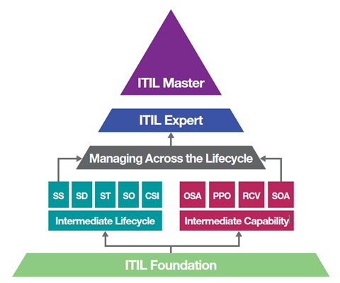
ITIL Qualification System
100 %

Slide 9
What problems are our customers trying to solve with outsourcing and ITIL
Establish baseline of process/process supporting tools/knowledge
Some customers don’t have processes established in some areas – like problem management
Stabilize/Standardize/Centralize infrastructure
Process/ITSM tools standardization
Either across customer internal lines of business or across suppliers
Integration of infrastructure and application management
Want to be able to improve infrastructure stability by integrating applications & infrastructure
Right size infrastructure to support critical business services
Link IT investment and support to business strategies and priorities

Slide 10
ITIL is the foundation upon which IBM IT processes are built
 | Strengths
ITIL | Wide ranging, narrative treatment of the lifecycle of Service Management Largely consistent style across the set of books Introduction of key new concepts Provides process objective, goals, activities, high level responsibilities
PRM-IT | Process Reference Model for IT Coherent, consistent model and downstream items such as assessment matrixes Integrated set of rigorously defined inputs, outputs and controls – essential for process automation Covers the full range of IT – includes governance
ITUP | IBM Tivoli Unified Process Builds on PRM-IT Simple web navigation and visualization of processes Is built on Rational Method Composer – provides simple tool to customize & tailor processes Provides roles and responsibilities at the task level – key for process automation Provides detailed activity flow
Notes:
Summary – we have talked about operationalizing ITIL.
Cover each point on slide.
Migration to ITIL V3 is a journey. Includes migration from paper-bound processes to ITUP.
Notes for previous clients who know EOPs:
Enterprise Operational Process (EOP) set, which is an IBM worldwide strategic solution. EOPs are IBM’s Strategic Outsourcing Delivery template processes. They cover an end-to-end scope and a depth of detail that takes them beyond the high-level 'what' needs to be done descriptions in ITIL and into the low-level 'how' to do it. They have been built upon our global process experience and initiatives to verify that delivery by IBM meets the ‘world-class’ standards that our clients have come to expect.
ITUP is in the process of replacing the Enterprise Operational Process (EOPs) with ITUP content.

Slide 11
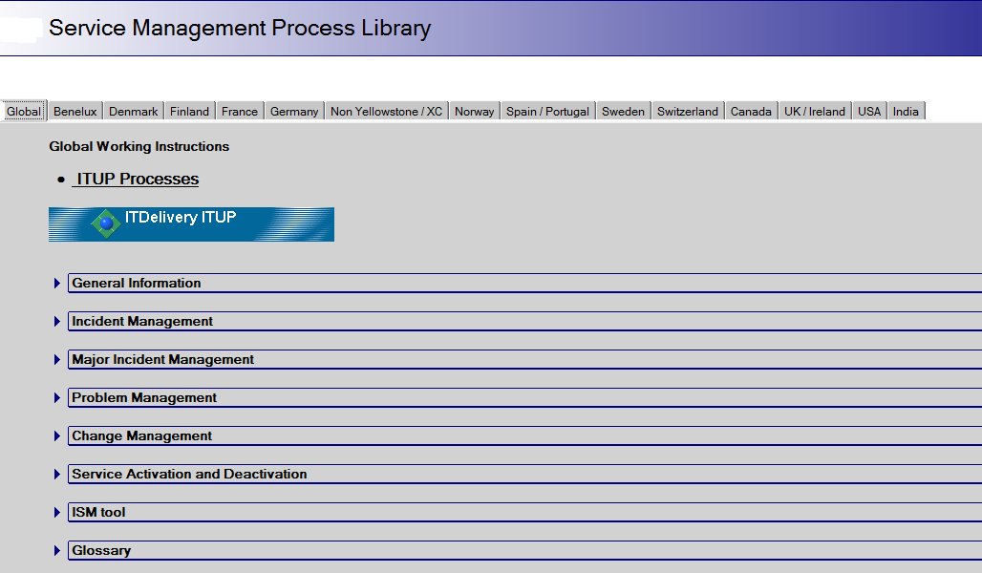
Process Overview – Example

Slide 12
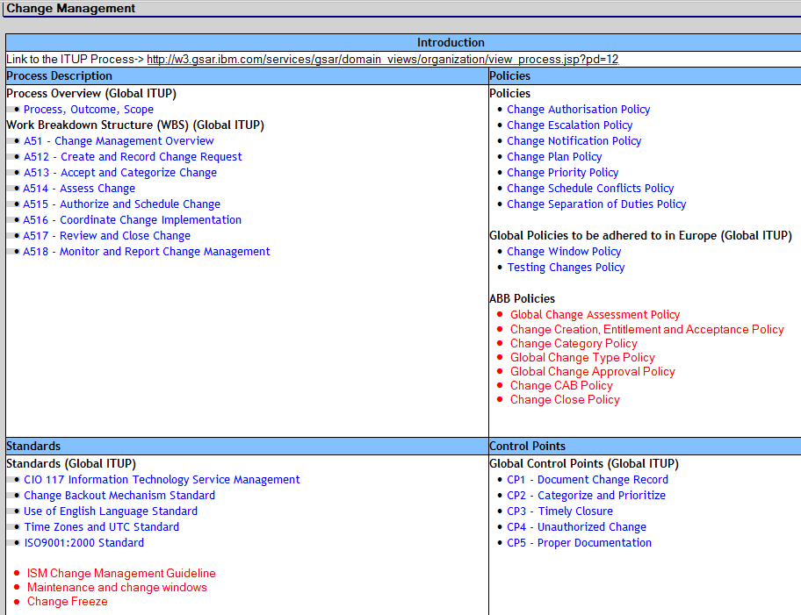
Process Overview – Example continued

Slide 13
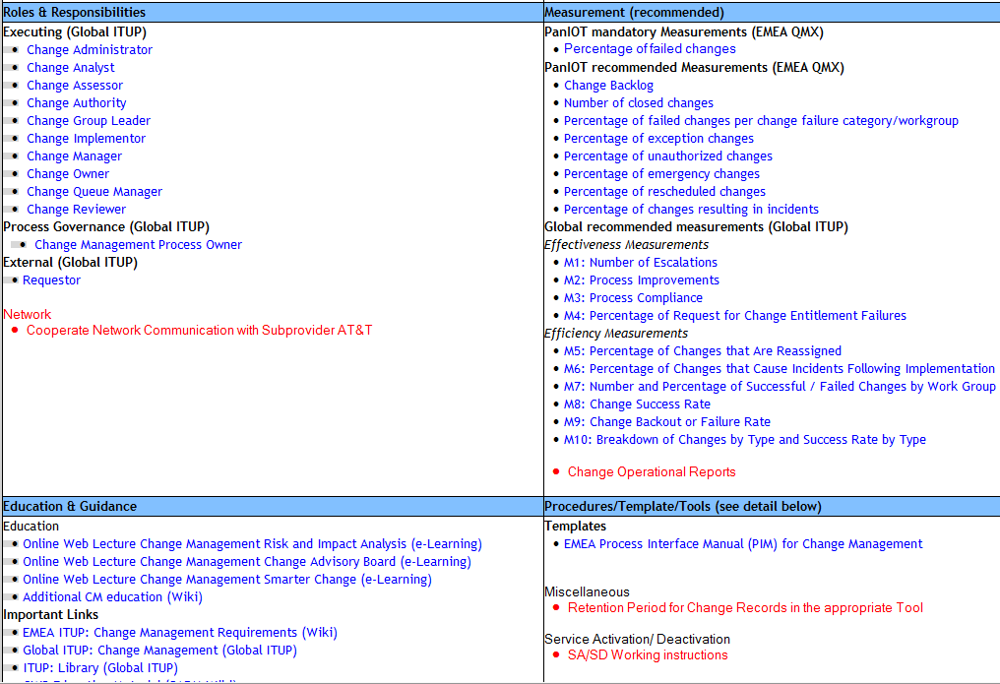
Process Overview – Example continued

Slide 14
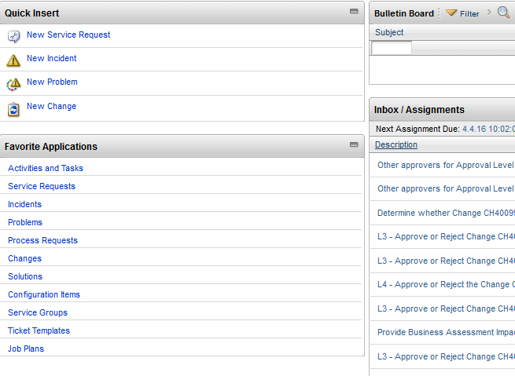
Ticketing tools - Example
Ticket/Case/Call/Situation record – documentation and linkage to CMDB
IBMs Original tool ISM/Maximo/SCCD

Slide 15
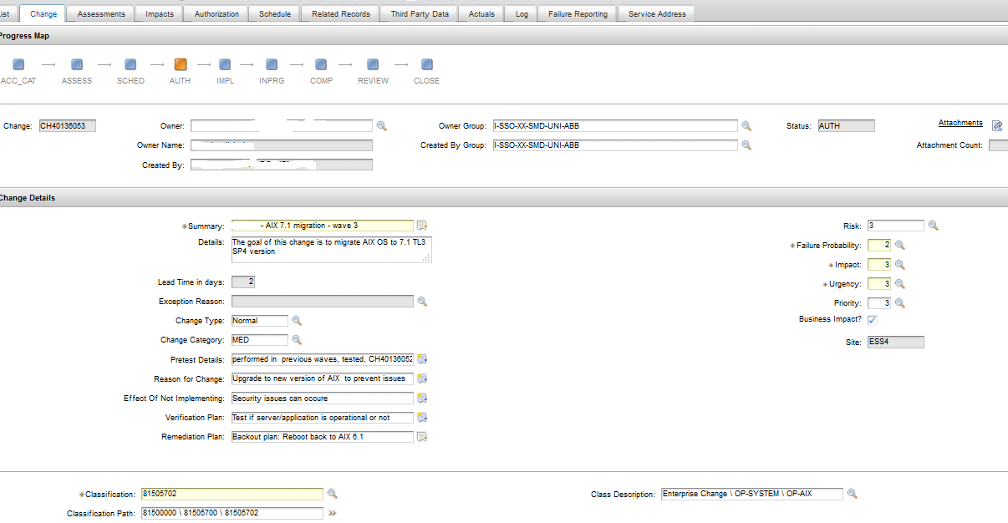
Change record flow

Slide 17
Questions ?

