Slide 1

Outsourcing Infrastructure Services
Ing. Vladimír Vágner

Slide 2

About the lecturer
Ing. Vladimír Vágner, M.B.A.
Graduated – Vysoká Škola Báňská, Ostrava 1987
Career
    Production Operations manager
    AT&T Complex Solutions mngr
    HP European Configuration center mngr
    IBM IT Service management Manager

Slide 3
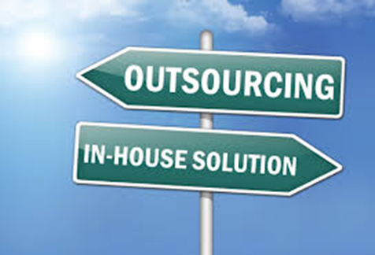
Agenda
Outsourcing business
IT Outsourcing
Delivery models
Service Level Agreement

Slide 4
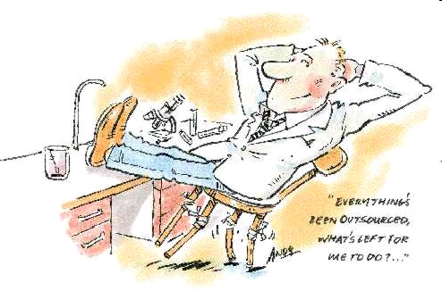
Outsourcing business
The outsourcing is the process of engaging the services of a provider to manage essential tasks that would otherwise be managed by in-house personnel.

Slide 5
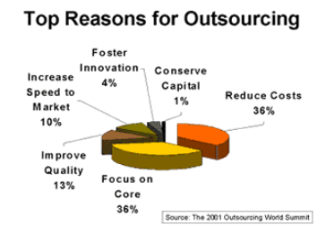
Reason for outsourcing
Cost saving
Focus on Core Business
Access to Skills
Access to Technology
Flexibility
Accountability

Slide 6
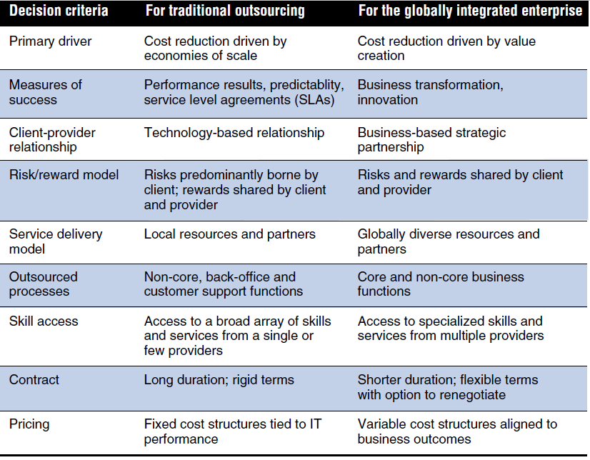
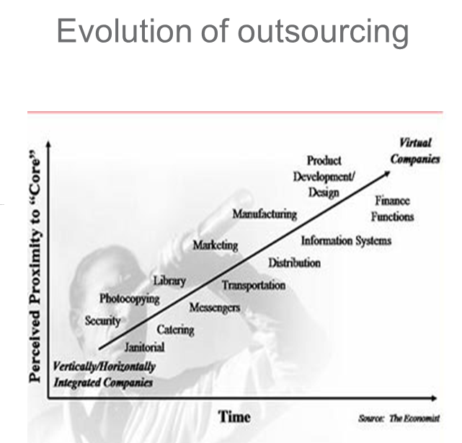
Outsourcing decision criteria comparison

Slide 7

Outsourcing IT
The concept "outsourcing" came from American Glossary 'outside resourcing' and it dates back to at least 1981.
The term itself is an artificial construction composed of the words “outside”, “resource” and “using”
IT/IS Outsourcing is the ITC operations, management and development delegation
IT/IS Outsourcing is the basic requirement for the services industrialization/standardization

Slide 8
Outsourcing map
Client
Special
Interactive
Cultural
Literature
Theater
Basic
Web site
Advanced
Web sites
Product
Design
Education
Technical
Hot-line
Medical
Diagnosis
Technical
Research
Graphic
Arts
Call Center
Legal
Research
System Admin
Document
Mgt
Custom
Software
Comodity
Standards
Technology
Off-line
Data
Management
Technical
Publishing
Data entry
Hardware
Network
Simple
Complex

Slide 9
A bit of history …
Old model – IT Organization centralized, locally outsourced – EDS early 60s ( Frito-Lay, Blue Cross & Blue Shield).
IBM – step into in late 80s – ISSC division => 1989 Eastman Kodak deal = IBM “invented” Strategic Outsourcing.
80s and 90s – many new big deals – industry prospers with globalization of the world economy
In 2005, the IT services outsourcing market was beginning to show signs of maturing: growth was flattening and margins were narrowing as new low-cost competitors from India were proving themselves both nimble and aggressive. At the same time, clients looked to traditional vendors like IBM to offer top value, but at competitive prices.
IBM, Accenture, EDS, HP as traditional vendors faces new global competition – e.g. TCS, Wipro, Infosys and HCL.

Slide 10

0 – 1982 The proprietary solutions era
1982 – 1999 The standard solutions era
1999 – The outsourcing solutions era

Slide 11
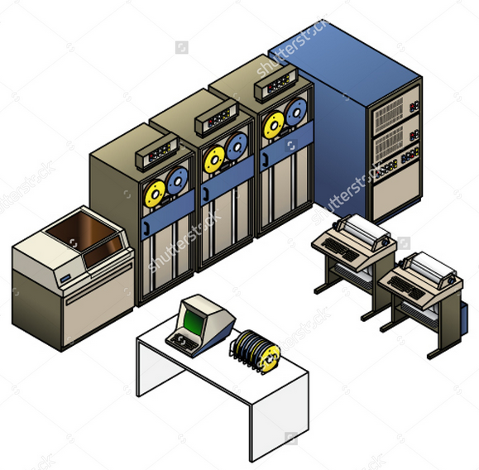
0 – 1982 The proprietary solutions era
  Characteristics
    Mainframes and terminals
    Data centers to input, collect and store data
    Batch processing, internal applications development
  “The Era of Fixed Costs”
    High costs of the application development and maintenance
    High dependence on qualified and deficient labor force
    High availability costs

Slide 12
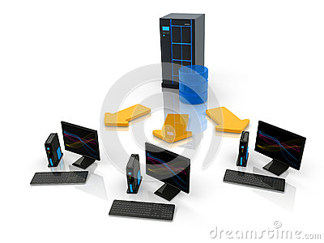
1982 – 1999 The standard solutions era
  Characteristics
    PC and PC Servers
    Standard interactive aplications
    Data entered by single users
  “The Era of Internal and external cost (variable and fixed costs)”
    High investment to HW a SW
    Low return on investment (ROI)
    High availability and security costs

Slide 13

1999 – The outsourcing solutions era
  Characteristics
    HW independence (shared data centers)
    Standard services introduction
    Distributed infrastructure
  “The External costs (variable costs) era”
    Variable costs only – pay for “delivery”
    Independence on qualified and deficient labor force
    High availability and security

Slide 14
Market dynamics are changing and we continue to adapt our business model to execute on our strategy
1999 - 2005
Market Dynamics
2006 - (current)
Customized offerings
Standardized offerings
Industry/technical expertise and innovation are replacing cost as primary differentiators
Labor-based models
Intellectual Property-based models
Clients are moving to a multiple location delivery model
Full-scope outsourcing
Emerging economies are growing fast with expanded requirements for language and culture
Selective out-tasking
Local labor sources
Global delivery
Service Providers are growing a global presence and expanding their offering portfolio
Innovation and insight as key differentiators
Notes:
As always, we start with the client and their needs - as we examined client behaviors, we found that their IT requirements have changed.
Client preferences are shifting from customized to standardized solutions, and clients are looking to providers, like IBM, to integrate technology for them. As a result, clients can focus their attention on their core competency and capabilities that differentiate them from their competition, and redirect their savings in new capabilities to generate growth and shareholder return.
Clients are also looking for 24x7 operational support, which relies heavily on an Intellectual Property, or IP-based model of delivering services, rather than a labor and location-based model of delivering services. This shift relies on re-useable IP rather than creating solutions from scratch for each client engagement.
The third and fourth trend on this chart are very relevant in our SO business. While you may not be hearing about the mega-deal signings as you did in the 1990s – the market is still there – just constructed differently. We see a movement towards more -- smaller contracts.
And what we are finding is that great delivery opens doors to multiple deals in the same account. For example, when clients trust us to handle their infrastructure – it leads to us managing their applications as well. And finally we see the need for continued expansion of global delivery capabilities.
Gartner has published longstanding research analyzing the competitive landscape of service providers offering delivery through global delivery models. The silo approach of comparing vendors premised on heritage is quickly disappearing.
Long-term views indicate a new category of globally capable providers will emerge . . . based on buyer success stories and business results.
Gartner predicts that a set of global players will emerge that can execute the global delivery model via sourcing the right skills at the right time at the best – not necessarily the cheapest – prevailing global price.
Key factors that will determine the top global players during the next five years include: Relationships (trust/brand factor); Strategic deals – market share that matters; Service categories; Global Footprint; Depth, breadth and size
Clients want a multi-location/country sourcing model to mitigate risk.
Gartner predicts: by 2010, 30% of Fortune 500 will source from 3 or more countries *
By 2012, India’s dominant position as an offshore location will be significantly diluted by effective alternative destinations *
Increased participation from ASEAN markets - Indonesia, Malaysia, Philippines, Singapore, Thailand, and Vietnam - now ranked among the top 20 locations in AT Kearney’s index ranking
While unlikely to rival India in scale or cost, Language and culture are cited as key business drivers for sourcing from regions like Eastern Europe *
The supply of talent in India remains a major concern with demand for growth exceeding supply.
Costs of Operation in India are growing while other locations improving productivity. India’s cost advantage may be further diluted by strength of the Indian Rupee and introduction of new taxes.
Most of the IT Service Providers that Gartner tracks have recognized that offshore services and proof of a sound global delivery model is a necessity to deliver the cost benefits, skills and scalability of resources that clients demand.
The degree to which service providers invest in, prioritize, and develop their offshore strategies, services offerings, infrastructure, people, processes, methodologies and sales/marketing capabilities will determine their success.

Slide 15
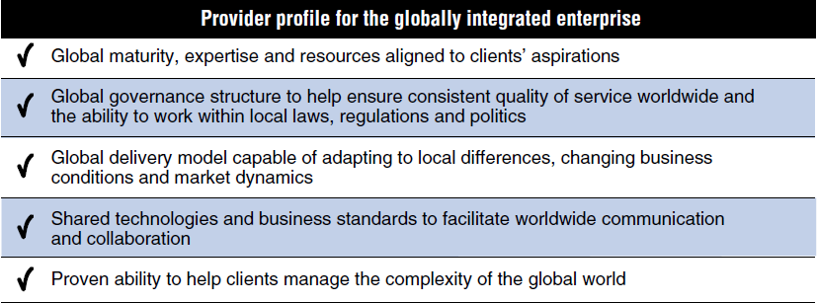

Slide 16
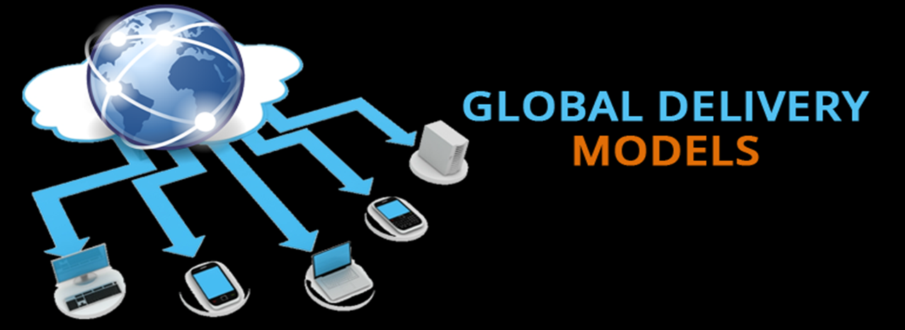

Slide 17

Outsourcing business models
Staff augmentation - This model provides specialized resources, cost flexibility and satisfies short-term time-to-market demands.
Out-tasking - This model is suitable for short-term business needs, to fill skill gaps. However the integration of different out-tasked outcomes may not be a seamless one.
Project-based outsourcing - Vendors and clients share risks and rewards through this collaborative model. This model has high client benefits as it holds the vendor accountable for an entire project, and allows the application of industry best practices in the outsourcing process. On the other hand, working from project-to-project is a piecemeal approach to outsourcing. A more consolidated view of the outsourcing initiative is required, within a unified governance framework. This is provided by the multi-year managed services model.
Managed services model - This model fosters the development of long-term, multi-year, SLA-based relationships to provide integrated solutions across the enterprise. The service provider takes responsibility and accountability for agreed- upon strategic business outcomes. Projects typically have a large scope and scale and the knowledge gained by the vendor is invested back into the system so that the client's benefits increase year on year. These partnerships allow the sharing of risks and rewards, encourage innovation, embrace business change and contribute significantly to the strategic goals of both partners.

Slide 18





Basic steps of the managed services model
Outsourcing is not just the delivery
Account Life Cycle
Opportunity Mgmt (Pre-Engagement)
Solution Design & Proposal Development
Close Sale
Transition &
Transformation
Steady State Operations
 |  |  | Who delivers the services? From where will they be delivered? How do we build and use the solution? What processes and service flows do we follow? | How do we fulfill our contracted services? How do we add or improve existing services?
What services do we sell?
What are typical client wants and needs?
How is the solution designed?
What are the cost drivers?
What is the transition & transformation plan?
Notes:
A key question new standards authors and owners often ask is “who will be using my content?”
When we think about an e2e standard solution, we realize there are several different aspects and components, where each is important to particular roles performing specific functions. For that reason, GSAR users span a variety of roles and its content applies to the entire scope of the account lifecycle, from sales & engagement, to transition & transformation to steady state, both for new and incremental business.
Let’s look at a broad view of the ITD account life cycle to see how GSAR fits into this picture. The life cycle begins as sales teams present clients with high-level information of what IBM has to offer. During this phase, the intellectual capital in GSAR helps answer questions such as:
“What services do we sell?” and “What are typical client wants and needs?”
Later during engagements, Technical Solution Managers (TSMs) and Architects (TSAs) develop solution designs and proposals describing the service(s) we can deliver, how we deliver them, and at what costs. The standards in GSAR provide a foundation for them to work from, and answer questions such as:
“How is the solution designed?” and “What are the cost drivers?”
Once clients have signed the contract with IBM, ITD Competency leaders, architects, Delivery Project Executives (DPEs), and Subject Matter Experts (SMEs) work to transition IBM into assuming the IT responsibilities for the client. Finally, delivery and account teams take over operational responsibilities during the “steady state” period. GSAR content is used during both of these phases as well.

Slide 19
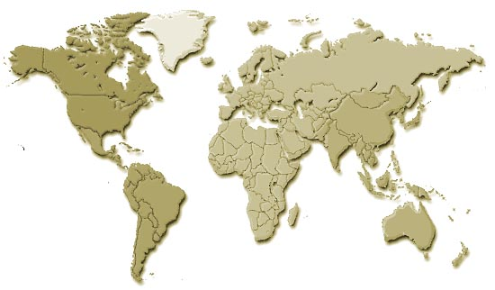
We differentiate on the basis of HOW we deliver services and apply IBM assets, data, and insights to client’s challenges
Standardize through Process and Work Design:
  ITIL consistent processes componentized and described in a services catalog
  Embed dispatching that routes work to the right pool of skilled resources
  Defect prevention and best practice sharing across pools
Globally Integrate through Flexible Skill Deployment:
  Labor and skills sourced globally at optimal performance and cost to match client needs
  Scalable pools to meet demand changes
  Strong management systems in place to drive continuous improvement
Automate through Applied Assets and Tools:
  Assets from other parts of GTS and IBM integrated in our delivery (SPL offerings, virtualization, Systems Technology Group, Software Group)
  Incorporate our Research capabilities
  Invest in world-class data center capabilities
Notes:
We will differentiate by applying IBM assets through automation, our work practices and processes that we reflect our point of view on the optimal way to deliver specific services and through sourcing the right skills you need globally. We will discuss most of these bullets in the next pages specifically.

Slide 20
The 3 key levers to drive quality and productivity
Standardize: Implement standard solutions for all services, maximizing economies of scale and ease of enhancement
Globally Integrate: Source the right skills at the right time globally
Automate: Eliminate manual tasks to drive up quality and reduce error
Transform
We are continually investing in key innovations and intellectual property to differentiate our services through exceptional quality outcomes
In Delivery, we execute on our strategy by investing in innovative technologies, processes and skill portfolios
Notes:
We utilize three key levers to drive quality and productivity…
The first, standardization, is all about industrializing service delivery. We have embarked on the quality journey long time ago and have made significant progress with our quality methods, focusing on process simplification and eliminating non-value add steps. We have broadened our continuous quality roll-out across all geographic locations ...
The second lever is Automation. Here we leverage IBM hardware, software and Research assets extensively. A great example is our deployment of Maximo to implement standard best practice workflows ... leveraging this tool from SWG allows us to pool delivery resources and drive skill depth for quality and productivity gains…
Lastly, skills are critical in a delivery business ...and as over 50% of our delivery costs are labor, leveraging the right talent globally, at the best cost, is vital. Equally as vital is continually looking at the skills we have, where we may have gaps and the training/certifications that are needed to fill those gaps ... I'll also cover this in a little more detail...
So, let's look at some specifics on how we execute on these three levers…

Slide 21

We have the broadest and deepest talent in the business working together to fulfill our client delivery commitments
Onsite
Local
Regional
Global
Service that requires a physical presence at the client location
Consulting
Front-end analysis
Service that needs to be delivered from the same country
Processing of sensitive data
Legal restrictions
Service that needs to be delivered from the same continent
Similar time zone
Similar culture
Service that can be standardized to achieve maximum savings
Ongoing operations
Monitoring
Development
Client
Global
Onsite
Local
Regional
Central Europe
Brno
Székesfehérvár
Wroclaw
North America
Boulder
Dubuque
East Fishkill
Toronto
Columbia
China
Shenzhen
Shanghai
Dalian
Global
Regional
India
Bangalore
Pune
Delhi
Gurgaon
Hyderabad
Latin America
Buenos Aires
Hortolandia
Sao Paulo
All follow uniform, best-practice service management processes

Slide 22
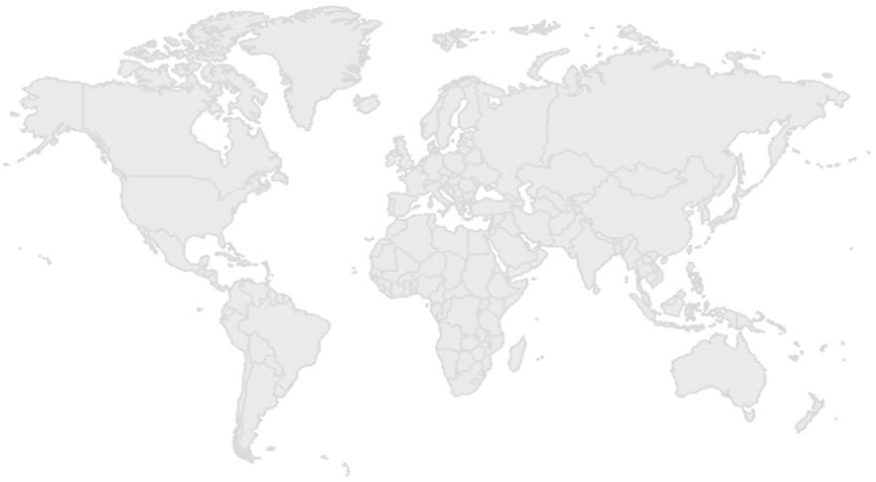



We can dynamically create work groups/pools across the globe to best meet clients’ business needs
Account Focal Point
Pool creation considerations
Account Focal Point
Technology
Workload/FTE
Skill set
Location
Regulations
SLAs
Tools
Problem tickets
Other
Client 2
Client 1
Global skills resources
750+ pools
~ 50 types of pools by competency (e.g., service line, component)
Specialized pools: HIPAA, FDA, ITAR, MDI

Slide 23

The outsourcing relationships
Accounts and delivery providers benefit most from an IT transformation based on shared, reusable assets. The message here is how important our standardization strategy is in our outsourcing relationships.
Client Account
IBM IT Delivery
Client’s Existing Standards
IBM Standards
CTO
PE
Service Owner
Service Architect
DPE
Delivery Teams
Architect (Client)
Architect
(IBM)
Business Units (Client)
Service Catalog
Deployment Portfolio
Here are the solutions we provide to meet the required service levels and functions
We have chosen these services to meet the client’s business needs
Solution
Repository
Reference Architecture
Clear and specific roles, processes and proven solutions are essential to the success of these relationships.
Notes:
On this slide, you see the client account and IBM account team roles on the left, our Delivery organization on the right -- including the Service Owner roles -- and the two parties coming together in the middle.
The message here is how important our standardization strategy is, in our outsourcing relationships. With this strategy, IBM is able to clearly articulate our company's IT standards, particularly, what standard services we offer and how they are delivered. Clients have IT standards of their own: such as existing applications, roles and processes. For an effective IBM integration into the client's existing environment, it’s essential to have clear communication and knowledge sharing.
Therefore, the Account Team and the Service Provider (Delivery) need to be working from the same, shared information. Four (4) key assets we use to facilitate our collaboration are: a Service Catalog, a Solution Repository, a Deployment Portfolio, and a Reference Architecture.

Slide 24
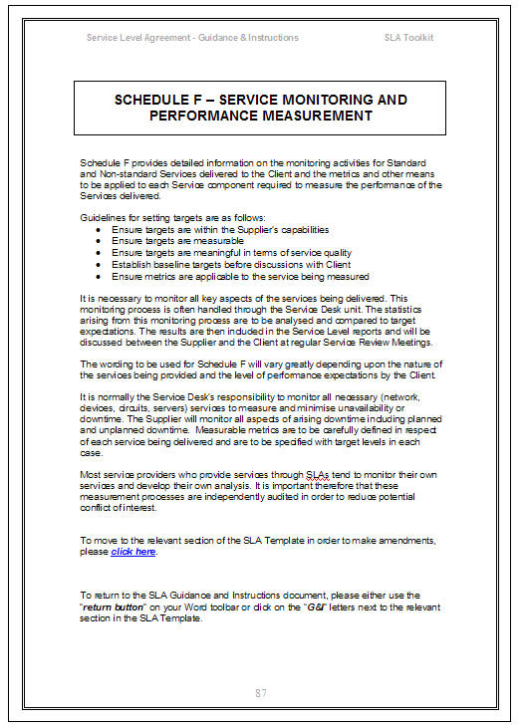
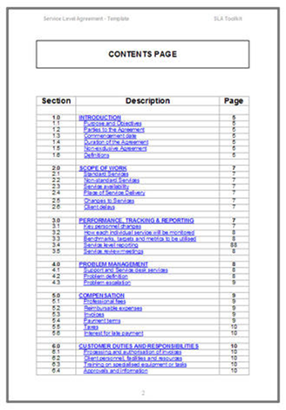
What is the Service Level Agreement (SLA)
An SLA is a negotiated agreement between two or more parties designed to create a common understanding about the service
It is :
    A communications tool
    A conflict resolution tool
    A living document
    A method for gauging service efectivness

Slide 25



Service Elements and Management Elements
Service Elements cover the „WHATs“
Management Elements cover the „HOWs“

Slide 26
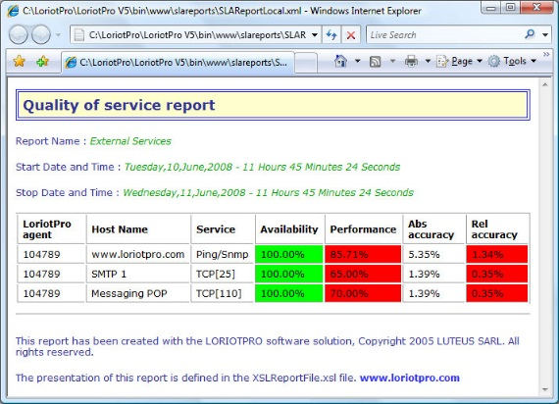

Service Elements
Service Elements communicate :
  What services will be provided
  What are the conditions of service availability
  What are the service standards
  What are the responsibilities of both parties

Slide 27
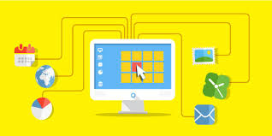

Management Elements
Management Elements communicate:
  How service effectiveness will be tracked
  How information about service effectiveness will be reported and addressed
  How service-related disagreements will be resolved
  How the parties will review and revise the agreement

Slide 28
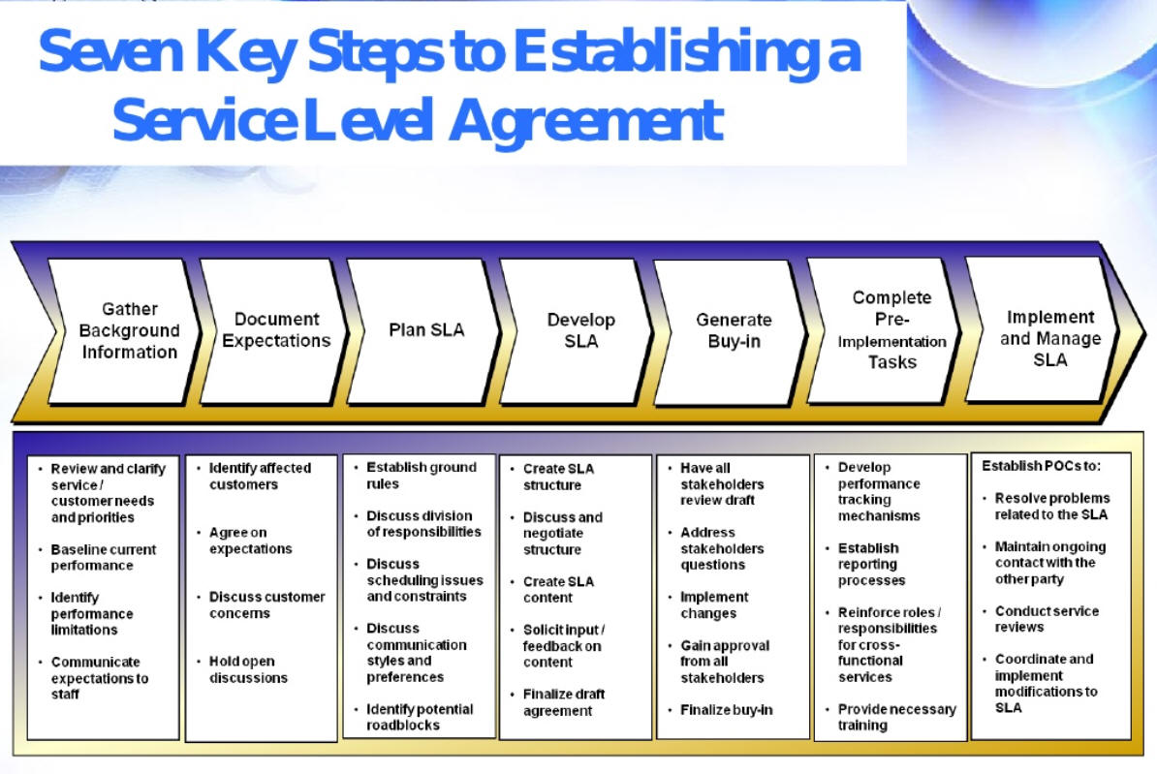

Slide 29
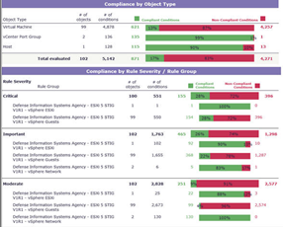
Factors that Affects The Timeline of SLA Implementation
The service environment
The proximity of the parties
The span of impact of the SLA
The relationship between the parties
The availability of a model
Prior SLA experience

Slide 30
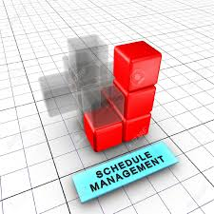
The SLA should address the following …
  A brief service description
  Validity period and/or SLA change control mechanism
  Authorisation details
  A brief description of communications, including reporting
  Contact details of people authorized to act in emergencies, to participate in incidents and problem correction, recovery and workaround
  Business or service hours (e.g. 08:00 to 17:00), date exceptions (e.g. weekends, public holidays), critical business definitions, ..
  Scheduled and agreed service interuptions, including notice to be given and number per period
  Customer responsibilities (e.g. security)

Slide 31
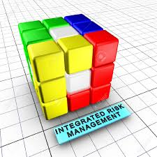
The SLA should address the following …
  Service provider liability and obligations (e.g. security)
  Impact and priority guidelines
  Escalation and notification process
  Complaints procedure
  Service targets
  Workload limits (upper and lower), e.g. the ability of the service to support the agreed number of users/volume of work, system throughput
  High level financial management details, e.g. charge codes etc.
  Actions to be taken in the event of service interruption
  Housekeeping procedures
  Glossary of terms
  Supporting and related services
  Any exceptions to the terms given in the SLA

Slide 32
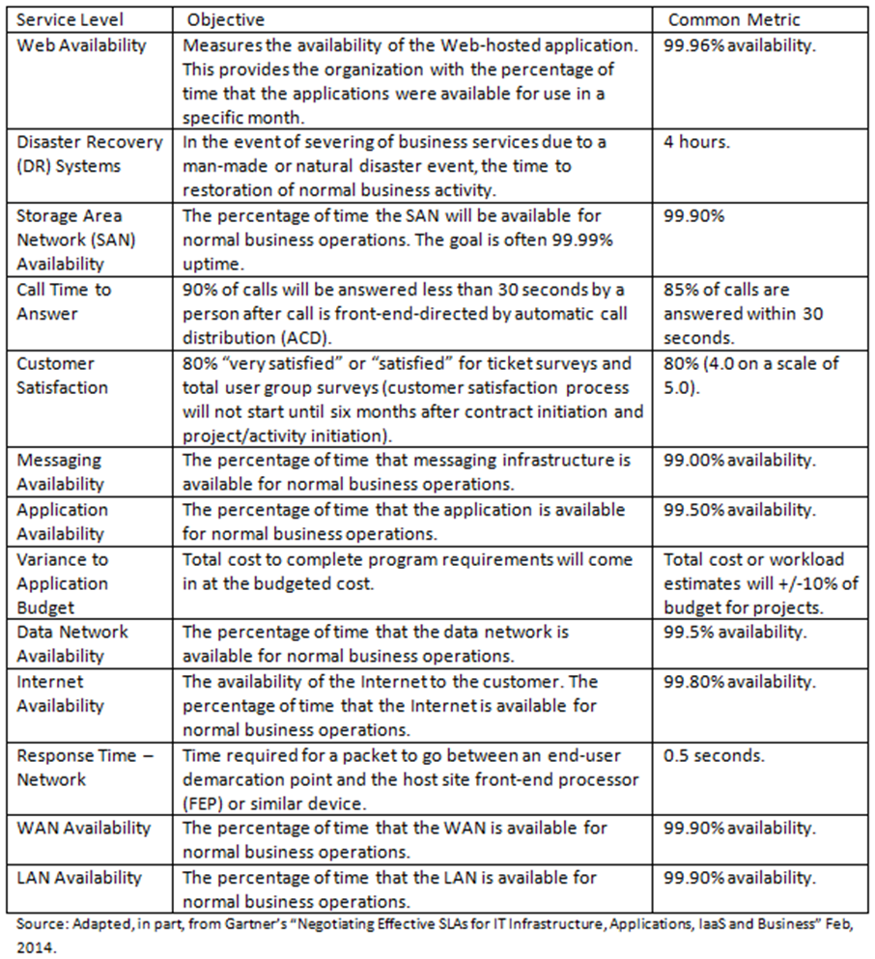
SLA Objectives example

Slide 33
Example : IT Help Desk SLA

Slide 34

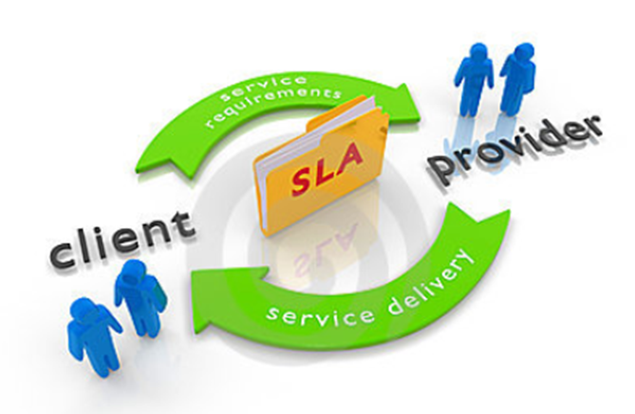
Will IT Outsourcing Continue to Grow in the Years to Come?
Outsourcing will definitely survive in the future.
To know more come next week again.

Slide 35
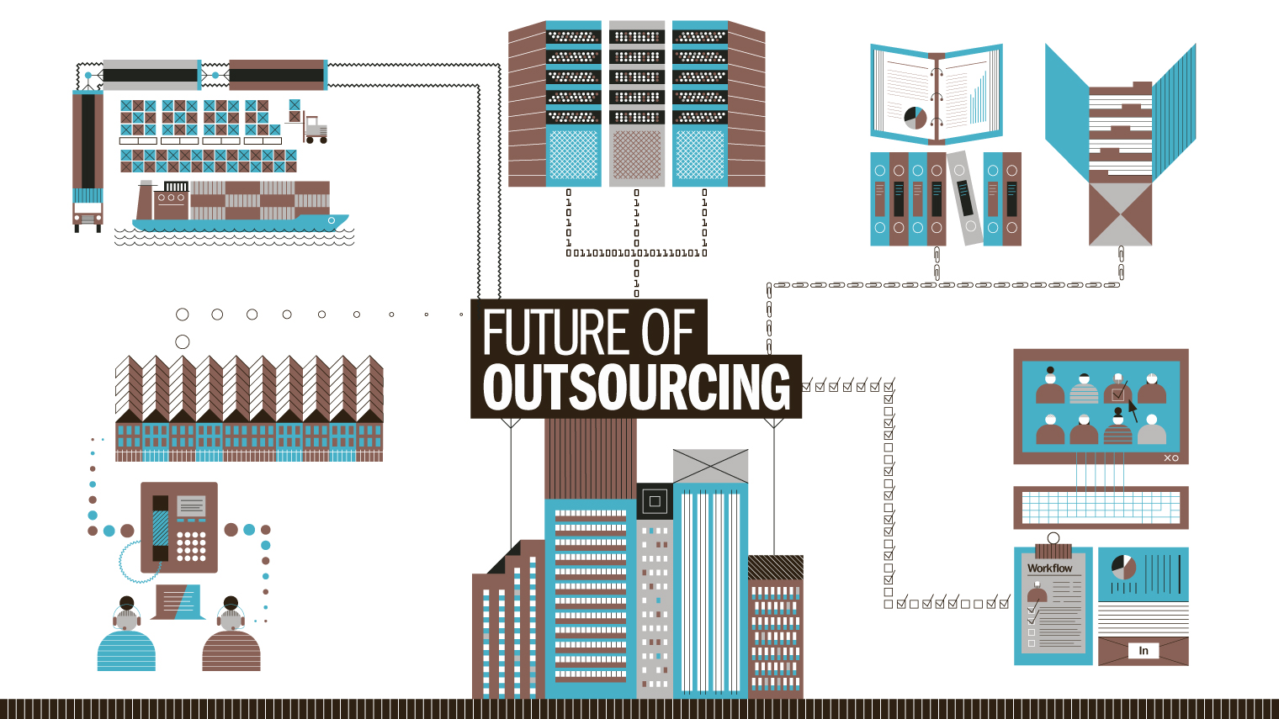

Slide 36
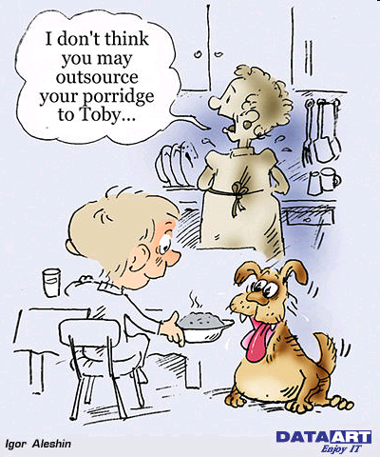
Thank you.

Slide 37

IBM’s strategy to deliver this value is through differentiation with innovation and insight – for GTS this means delivery of the highest quality services to clients.
IBM’s Strategy
GTS Strategy
Delivery Strategy
Sustain the position of the world’s premier IT services provider by delivering the highest quality solutions at the most competitive prices. We’ll differentiate IBM with our integrated, IP-based solutions.
Focus on open technologies and high-value solutions
Standardize
Deliver integration and innovation to clients
Globally Integrate
Automate
Become the premier Globally Integrated Enterprise
Drive increased value to customer through high quality delivery
Notes:
IBM’s strategy is clear.
We will differentiate with innovation and insight
GTS and Delivery strategy center around delivering value through highest quality solutions.
For our clients – quality can be achieved four ways:
Delivering consistent high-quality service
Eliminating low-value process steps
Automating and therefore reducing manual tasks to increase efficiencies
Integrating globally with the right skills in the right place at the right cost.
We utilize three key levers to drive quality and productivity
Let’s spend some time to understand HOW we deliver the services and where we inject innovations into delivery of services to you

Slide 38
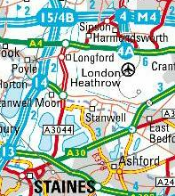
MOTIVATIONS:
Why… a process model?
Think of a process model as being like a map of your country. It shows:
  The places
    In a process model, processes and activities
  The connections between them – roads, paths, railways, rivers, canals, power lines
    Representing the inputs and outputs between activities
Without a map, you can still establish – by trial and error, or from a set of directions – a reasonably efficient journey routing between point A and point B
… and then between point B and point C
What happens if you now need to travel between point A and point C?
You can not build the map from a collection of journey directions
BUT you can build the directions for many journeys from a map.
Remember, though, that every map is limited by its scale. What is your purpose?

Slide 39
MOTIVATIONS (2005):
Why… this process model?
Market
  There are a number of industry-based developments in IT Management topics, which have achieved (or are close to) the status of de facto “standard”
    ITIL® has significant following in the area of service management
    Control Objectives for Information and related Technology (COBIT) and Capability Maturity Model Integration (CMMI) can be seen as complementary, covering related aspects
Content
  Previous IT Process Model (ITPM) was created early in the distributed computing era
  The reach and range of “IT” activities has grown
  “On demand” IT introduces new activities and changes the emphasis and priorities of existing ones
Capability
  The direction is towards “model-driven architecture and design”
  The goal is choreographed workflows which directly link processes with technology, using a “packaged application” approach
ITIL® is a Registered Trade Mark, and a Registered Community Trade Mark of the Office of Government Commerce, and is Registered in the U.S. Patent and Trademark Office

Slide 40
IBM Process Reference Model for IT (PRM-IT) :
Sequencing the DNA of IT management
Purpose
  Provide an integrated collection of the processes involved in using IT to help businesses carry out many or all of their fundamental purposes
  Be the basis for process assessment, design and implementation
    But is not itself directly implementable
Viewpoint
  Consider the processes for all IT activities – so equivalent to the CIO’s vantage point:
    Control over IT’s activities
    Represent IT to the owning business(es) and to other stakeholders
Packaging
  A rigorously engineered IDEF0 process model
  IDEF0 = Integration Definition for Function Modeling

Slide 41
THE PRM-IT MODEL: Categories – high-level groupings of related processes, covering everything within the CIO’s scope

Slide 42





THE PRM-IT MODEL: The CIO and IT function do not operate in isolation; there are interactions with “external agents.”
Direction
Business
Regulation
Customer Relationships
Realization
Transition
Resilience
Operations
IT Customers
IT Users
Administration
IT Suppliers
Governance &Management System

Slide 43
THE PRM-IT MODEL:
Processes – 46 processes across eight categories

