Slide 1
PV204 Security technologies
Introduction to smart cards as secure elements
Petr Švenda svenda@fi.muni.cz
Faculty of Informatics, Masaryk University

Slide 2
Smart cards
Lecture:
  PC/SC communication framework, APDU
  Basic platforms – JavaCard & .net card & MULTOS, comparison
  Secure channel protocol (authentication, session keys, APDU protection), SCP
  Attacks against two-factor authentication
Lab
  Creating secure channel protocol
  Communicating with smart cards

Slide 3
Mind path for lecture
Smart cards are typical example of secure element → what smart card can be → what smart card is capable of
Current variance on cards side → current variance on host side → how smart cards fits into bigger system
How to communicate with cards
  Contact (ISO7816-2) / contactless (ISO/IEC 14443)
  Low level transmission (T=0/T=1, ISO 7816-4)
  Logical packets (APDU)
  Standardized API on card (OpenPlatform, PIV, OpenPGP, ePassport)
  Standardized API on host (PC/SC, PKCS#11/15)
  Secure channel with card (OpenPlatform SCP’03, BAC, EAC)
What are cards capable of – supported algorithms, speed
What sc can be used for
  Digital signatures – generate and use private key (+ attacks), key encryption on card
  Two-factor authentication, access control (challenge-response protocol) (+attacks)
  Secure environment (code protection, trusted element - tokenization) (+attacks)

Slide 4
Overview
What smart cards are?
What smart cards are capable of?
How to manage smart cards?
Secure channel protocols
Two-factor authentication and attacks

Slide 5
What A Smart card is?
Smart card basics

Slide 6
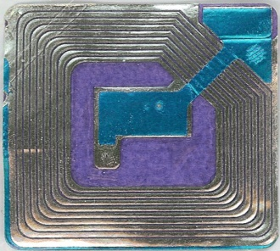
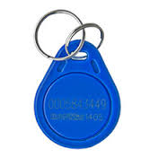
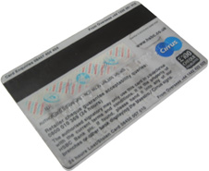
Basic types of (smart) cards
Contactless “barcode”
  Fixed identification string (RFID, < 5 cents)
Simple memory cards (magnetic stripe, RFID)
  Small write memory (< 1KB) for data, (~10 cents)
Memory cards with PIN protection
  Memory (< 5KB), simple protection logic (<$1)

Slide 7
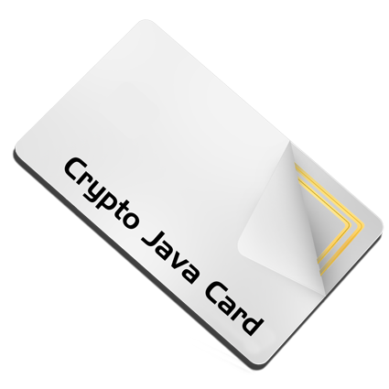

Basic types of (smart) cards (2)
Cryptographic smart cards
  Support for (real) cryptographic algorithms
  Mifare Classic ($1), Mifare DESFire ($3)
User-programmable cryptographic smart cards
  JavaCard, .NET card, MULTOS cards ($5-$30)
Chip manufacturers: NXP, Infineon, Gemalto, G&D, Oberthur, STM, Atmel, Samsung...
We will mainly focus on these two categories

Slide 8
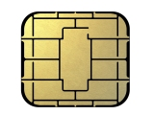
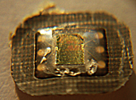
Cryptographic smart cards
CRYPTO
RNG
CPU
ROM
SRAM
EEPROM
SC is quite powerful device
  8-32 bit processor @ 5-20MHz
  persistent memory 32-150kB (EEPROM)
  volatile fast RAM, usually <<10kB
  truly random generator
  cryptographic coprocessor (3DES,AES,RSA-2048,...)
8.05 billion units shipped in 2013 (ABI Research)
  mostly smart cards
  telco, payment and loyalty...
  1 billion contactless estimated for 2016 (ABI Research)
chip
contacts
contacts

Slide 9

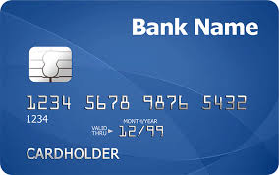

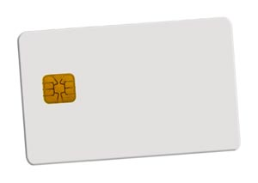
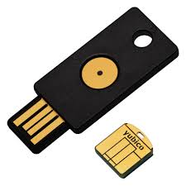
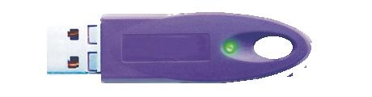
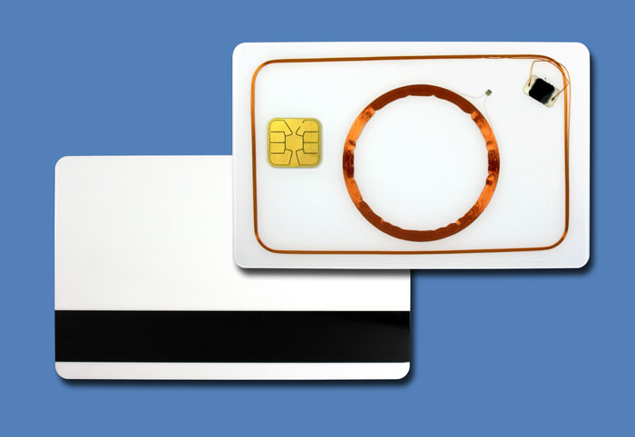
Smart cards forms
Many possible forms
  ISO 7816 standard
  SIM size, USB dongles, Java rings…
Contact(-less), hybrid/dual interface
  contact physical interface
  contact-less interface
  hybrid card – separate logics on single card
  dual interface – same chip accessible contact & c-less

Slide 10
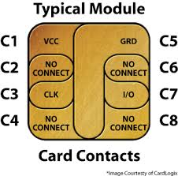

  Contact vs. contactless
Contact cards (ISO7816-2)
  I/O data line, voltage and GND line
  clock line, reset lines
Contactless cards
  ISO/IEC 14443 type A/B, radio at 13.56 MHz
  Chip powered by current induced on antenna by reader
  Reader → chip communication - relatively easy
  Chip → reader – dedicated circuits are charged, more power consumed, fluctuation detected by reader
  Multiple cards per single reader possible

Slide 11
Smart cards are used for…
GSM SIM modules
Digital signatures
Bank payment card (EMV standard)
System authentication
Operations authorizations
ePassports
Multimedia distribution (DRM)
Secure storage and encryption device
…

Slide 12

Smart card is highly protected device
  Intended for physically unprotected environment
  NIST FIPS140-2 standard, security Level 4
  Common Criteria EAL4+/5+
Tamper protection
  Tamper-evidence (visible if physically manipulated)
  Tamper-resistance (can withstand physical attack)
  Tamper-response (erase keys…)
Protection against side-channel attacks (power,EM,fault)
Periodic tests of TRNG functionality
Approved crypto algorithms and key management
Limited interface, smaller trusted computing base
  http://csrc.nist.gov/groups/STM/cmvp/documents/140-1/140val-all.htm

Slide 13
Main advantages of crypto smart cards
High-level of security (CC EAL5+, FIPS 140-2)
Fast cryptographic coprocessor
Programmable secure execution environment
Secure memory and storage
On-card asymmetric key generation
High-quality and very fast RNG
Secure remote card control

Slide 14
Smartcards in wider system

Slide 15
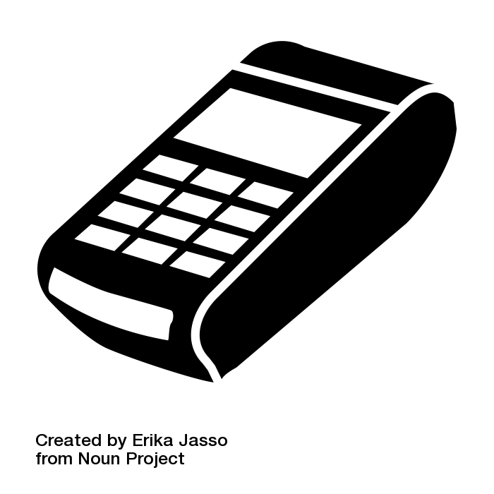
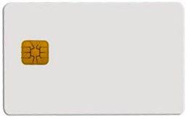

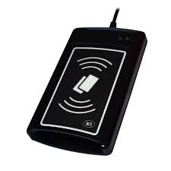

Big picture – terminal/reader and card
Merchant payment
Digital signature
What principles and standards are used?

Slide 16

Big picture - components
User application
OS smart card API
User application
  Merchant terminal GUI
  Banking transfer GUI
  Browser TLS
  …
Card application
  EMV applet for payments
  SIM applet for GSM
  OpenPGP applet for PGP
  …
smart card reader
contact(less)
transmission
Card I/O manager
Card application
Card OS

Slide 17
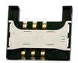
PC application
with direct control:
GnuPG, GPShell
PC application via library:
browser TLS, PDF sign…
Custom app with
direct control
Libraries
PKCS#11, OpenSC, JMRTD
Smartcard control language API
C/C# WinSCard.h, Java java.smartcardio.*, Python pyscard
System smartcard interface: Windows’s PC/SC, Linux’s PC/SC-lite
Manage readers and cards, Transmit ISO7816-4’s APDU
Readers
Contact: ISO7816-2,3 (T=0/1)
Contactless: ISO 14443 (T=CL)
APDU packet
API: EMV, GSM, PIV, OpenPGP, ICAO 9303 (BAC/EAC/SAC)
OpenPlatform, ISO7816-4 cmds, custom APDU
Card application 1
Card application 2
Card application 3
SC app programming:
JavaCard, MultOS, .NET, MPCOS

Slide 18
Main standards
User application
OS smart card API
ISO7816 1-4
  Card physical properties ISO7816-1
  Physical layer communication protocol ISO7816-2-3
  Data packet format (APDU)
PC/SC, PC/SCLite (host side)
  Readers/cards management
  Transmission of logical APDU packets
  C/C# WinSCard.h, Java java.smartcardio.*, Python pyscard
PKCS#11
  standardized interface on host side
  card can be proprietary
GlobalPlatform (details in 3rd lecture)
  remote card management interface
  secure installation of applications
smart card reader
contact(less)
transmission
Card I/O manager
Card application
Card OS

Slide 19
Card’s programming platforms
User application
OS smart card API
MultOS
  Multiple supported languages, native compilation
  Often bank cards
JavaCard (details in 3rd lecture)
  open programming platform from Sun
  applets portable between cards
Microsoft .NET for smartcards
  Similar to JavaCard, but C#
  Applications portable between cards
  Limited market penetration
smart card reader
contact(less)
transmission
Card I/O manager
Card application
Card OS

Slide 20
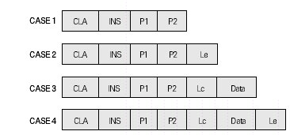
APDU (Application Protocol Data Unit)
APDU is basic logical communication datagram
  header (5 bytes) and up to ~256 bytes of user data
Format specified in ISO7816-4
Header/Data format
  CLA – instruction class
  INS – instruction number
  P1, P2 – optional data
  Lc – length of incoming data
  Data – user data
  Le – length of the expected output data
Some values of CLA/INS/P1/P2 standardized
Custom values used by application developer

Slide 21
Selected software components
PC/SC (MS API: SCardxx, Java: java.smartcardio.*)
PC/SCLite (implementation of PC/SC for Linux/MAC)
OpenSC – proxy component between proprietary tokens and PKCS#11 interface
SoftHSM – virtual PKCS#11-compliant card

Slide 22
Smartcard algorithms and performance

Slide 23
Common algorithms
Basic - cryptographic co-processor
  Truly random data generator
  3DES, AES128/256
  MD5, SHA1, SHA-2 256/512
  RSA (up to 2048b common, 4096 possible)
  ECC (up to 192b common, 384b possible)
  Diffie-Hellman key exchange (DH/ECDSA)
Custom code running in secure environment
  E.g. HMAC, OTP code, re-encryption
  Might be significantly slower (e.g., SW AES 50x slower)

Slide 24
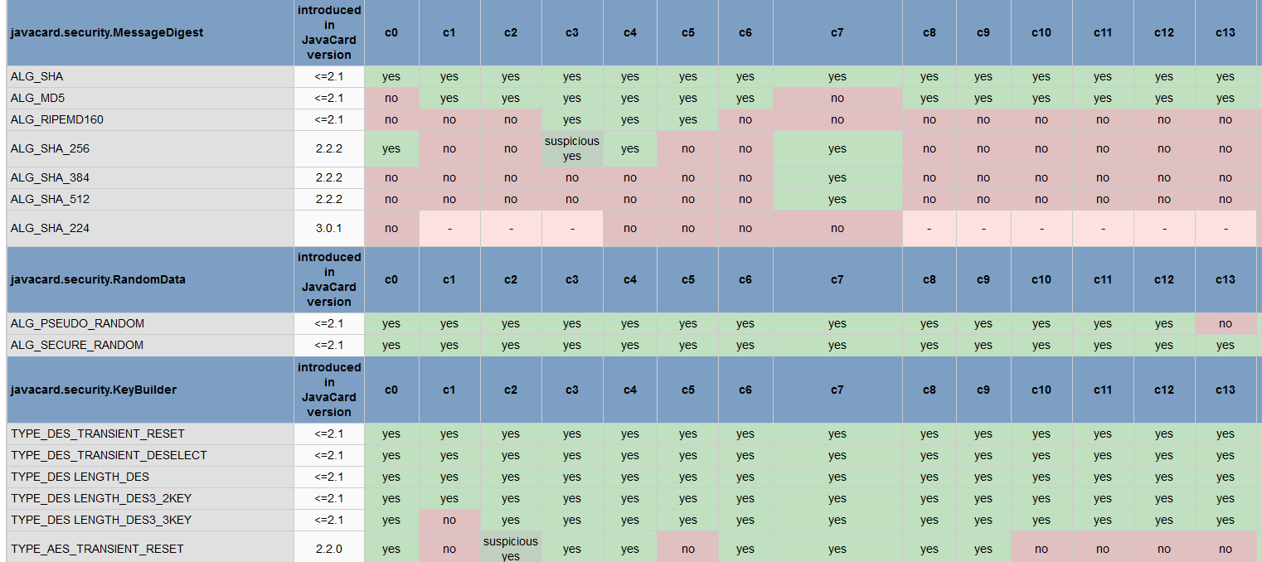
Cryptographic operations
Supported algorithms (JCAlgTester, 48+ cards)
  https://github.com/crocs-muni/JCAlgTest
  https://www.fi.muni.cz/~xsvenda/jcsupport.html

Slide 25
What is the typical performance?
Hardware differ significantly
  Clock multiplier, memory speed, crypto coprocessor…
Typical speed of operation is:
  Milliseconds (RNG, symmetric crypto, hash)
  Tens of milliseconds (transfer data in/out)
  Hundreds of millisecond (asymmetric crypto)
  Seconds (RSA keypair generation)
Operation may consists from multiple steps
  Transmit data, prepare key, prepare engine, encrypt
  → additional performance penalty

Slide 26
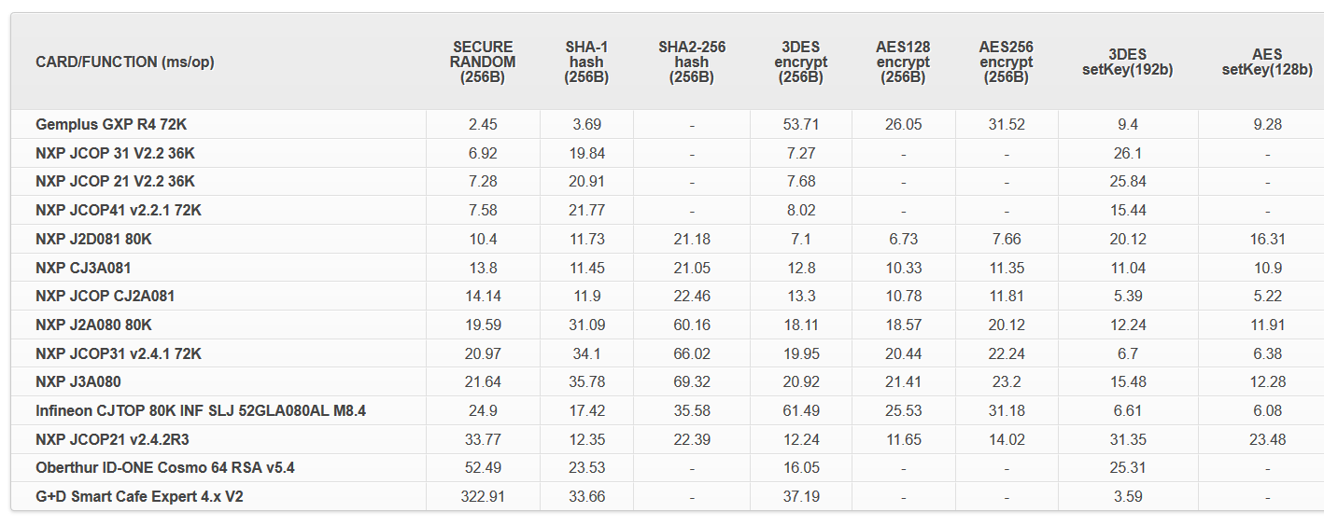
Performance tables for common cards
http://www.fi.muni.cz/~xsvenda/jcalgtest/
Visit http://www.fi.muni.cz/~xsvenda/jcalgtest/

Slide 27
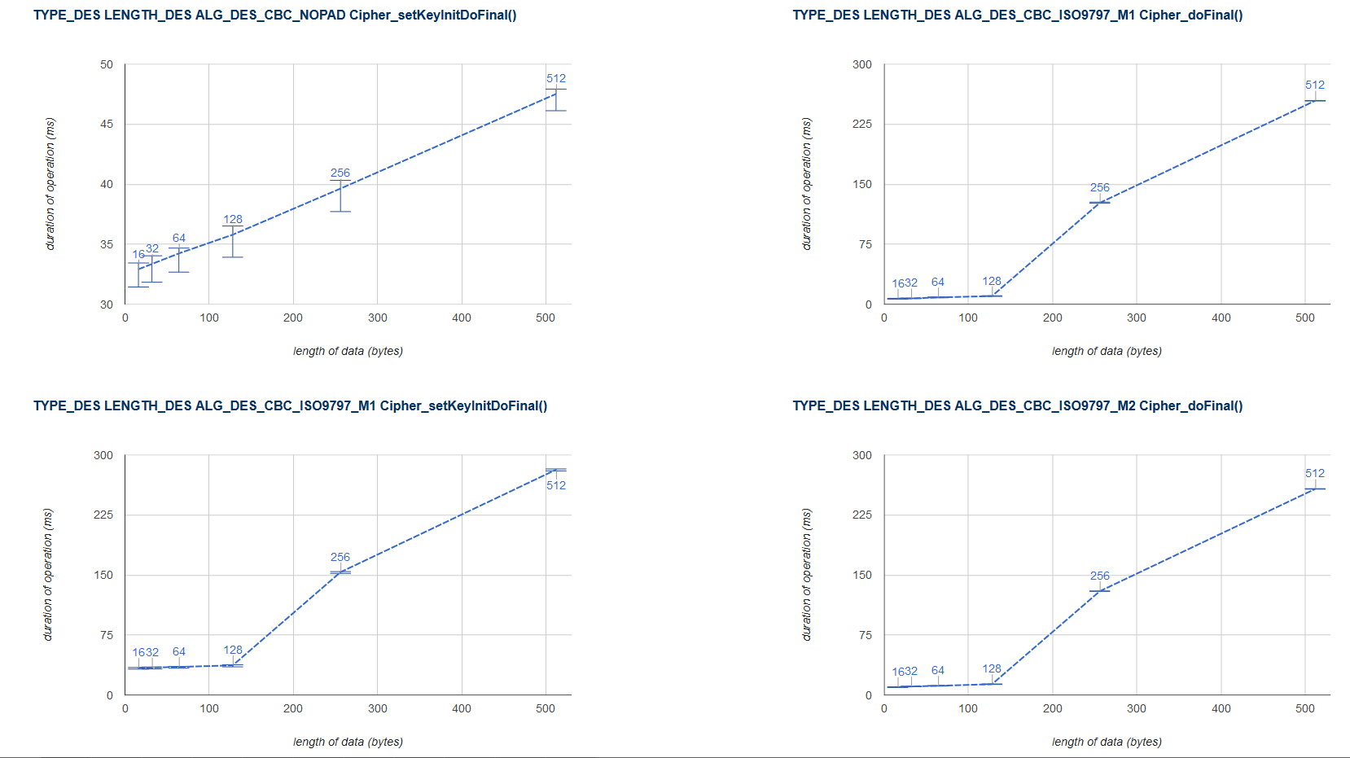
Performance with variable data lengths
http://www.fi.muni.cz/~xsvenda/jcalgtest/
Limited memory and resources
may cause non-linear dependency on a processed data length

Slide 28
Smart card management

Slide 29
Motivation
How to upload, install and remove applications?
Who should be allowed to upload/remove apps?
What if multiple mutually distrusting apps on card?
How to update application in already issued card?
Need for cross-platform interoperable standard
  Many manufactures and platform providers

Slide 30

Globalplatform

Slide 31
GlobalPlatform
Specification of API for card administration
  Upload/install/delete applications
  Card lifecycle management
  Card security management
  Security mechanisms and protocols
Newest is GlobalPlatform Card Specification v2.2.1
  January 2011
  Previous versions also frequently used
  http://www.globalplatform.org/specificationscard.asp

Slide 32

GlobalPlatform – main terms
Card Manager
Security
Domain 1
Security
Domain 2
Smart card life cycle
  OP_READY, INITIALIZED (prepared for personalization)
  SECURED (issued to user, use phase)
  CARD_LOCKED (temporarily locked (attack), unlock to SECURED)
  TERMINATED (logically destroyed)
Card Manager (CM)
  Special card component responsible for administration and card system service functions (cannot be removed)
Security Domain (SD)
  Logically separated area on card with own access control
  Enforced by different authentication keys

Slide 33
GlobalPlatform – main terms
Card Manager
Security
Domain 1
Security
Domain 2
Applet 2
Applet 3
Applet 1
Card Content (apps,data) Management
  Content verification, loading, installation, removal
Security Management
  Security Domain locking, Application locking
  Card locking, Card termination
  Application privilege usage, Security Domain privileges
  Tracing and event logging
Command Dispatch
  Application selection
  (Optional) Logical channel management

Slide 34
Smart card life cycles
The smart card passes various logical life cycle states between manufacture and final destruction
Life cycle states define which operations can be performed with the card
The card Life Cycle States OP_READY and INITIALIZED are intended for use during the Pre-Issuance phases of the card’s life.
The states SECURED, CARD_LOCKED and TERMINATED are intended for use during the Post-Issuance phase of the card although it is possible to terminate the card at any point during its life.

Slide 35
Smart card life cycles
OP_READY –card is ready for uploading of key diversification data, any application and issuer specific structures.
INITIALIZED – card is fully prepared but not yet issued to card holder.
SECURED – card is issued to card holder. Card management is possible only throw Security domain in secure sense (installation of signed applets etc.).
CARD_LOCKED – card is locked due to some security policy and no data management can be performed. Card can be locked by Security domain and later unlocked as well (switch back to SECURED state).
TERMINATED – card is logically “destroyed“ due to card expiration or detection of the severe security thread.

Slide 36
Global Platform APDU commands
DELETE – delete uniquely identifiable object (e.g. JavaCard applet)
STORE_DATA – upload content of single data object
GET_DATA - used to retrieve a single data object
SET_STATUS – set Life Cycle status
GET_STATUS – return Life Cycle status
INSTALL – initiate installation, typically (JavaCard) applet
LOAD – upload file from PC to smart card, e.g. JavaCard cap file
PUT_KEY – update value of specified key

Slide 37
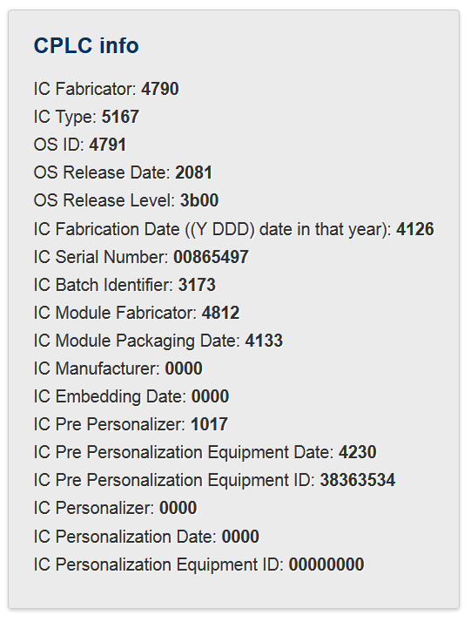
Card Production Life Cycle (CPLC)
Manufacturing metadata
Dates (OS, chip)
Circuit serial number
Not mandatory
GlobalPlatform APDU
  80 CA 9F 7F 00
  gppro --info
ISO7816 APDU
  00 CA 9F 7F 00

Slide 38
Secure channel Protocol
How to authenticate and communicate securely?

Slide 39
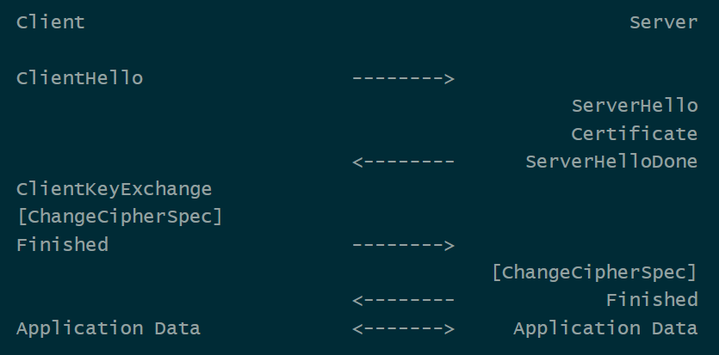
Transport Layer Security (TLS) Protocol
Full TLS handshake (RFC 5246)

Slide 40
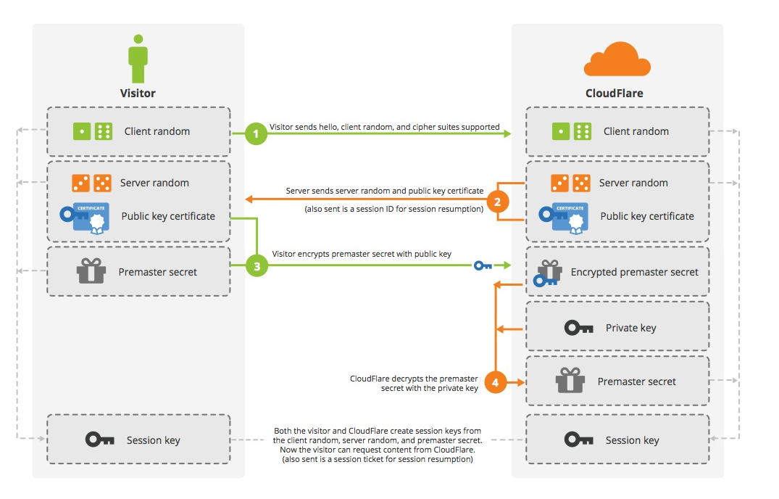
TLS handshake
Credit: Cloudflare

Slide 41
Why not to use TLS all the time?
Requires asymmetric cryptography
  Unsuitable for slower devices
Requires long keys
  Unsuitable for devices with small memory
Requires significant data overhead (~6.5KB)
  http://netsekure.org/2010/03/tls-overhead/
More lightweight protocols exist
  RFID / smartcards / IoT…
Note: TLS can be fully implemented on smartcards
  https://github.com/gilb/smart_card_TLS

Slide 42
Secure channels – questions to ask
Integrity protection? Encryption? Authentication?
What attacker model is assumed?
One-side or mutual authentication?
What kind of cryptography is used?
What keys are required/pre-distributed?
Additional trust hierarchy required?
Is necessary to generate random numbers/keys?
What if keys are compromised? Forward secrecy?

Slide 43
Secure channel protocol (SCP) requirements
What would you expect from SCP?
  Entity authentication (mutual)
  Fresh session keys derivation (session freshness)
  Message integrity and authentication (MAC)
  Message confidentiality (sym. crypto encryption)
  Fresh messages (counters, hash chaining)
  Forward secrecy (asym. crypto + ephemeral keys)
  …

Slide 44
Secure channel – typical composition
Exchange basic (public) parameters
Generate random challenges (freshness)
Use pre-distributed secrets and challenges to generate session keys (protect long term secrets)
Compute and verify authentication cryptograms (entity authentication)
Encrypted&MAC message(s) (Secure Messaging)
End secure channel (erase session keys)

Slide 45
Common lightweight SCPs
OpenPlatform SCP’01,’02 (3DES-based)
OpenPlatform SCP‘10 (RSA-based)
OpenPlatform SCP’03 (AES-based)
ISO/IEC 7816-4 Secure Messaging
ePassports Basic Access Control (3DES-based)
ePassports Extended Access Control (3DES,RSA,DH,SHA1/2-based)

Slide 46
SCP – what to take into account
Usage scenario and expected attackers
Confidentiality and integrity of command data
Network level attacks (replay…)
Atomicity of critical operations
Robustness against side channel attacks (power analysis, fault attacks)
Robustness against incorrect attempts (limit, delay retries )
Resilience against traffic analysis
API and implementation attacks

Slide 47
SCP – usage scenario and attacker model
What are the sensitive objects (keys, data, functions)?
What are these sensitive objects used for and what is the data flow of these objects?
What are the capabilities of the attackers (funding, tools, knowledge)?
What are the points where an attacker can observe the system (dump of exchanged messages, debugging, ...)?
Which parts of the system must be trusted to achieve required functionality (less the better)?

Slide 48
SCP – network attacks
Use HMAC or OMAC instead of simple hash only
Include command header/metadata into MAC
Pre-share two keys (encryption, mac) or derive from master instead of using only one
Use pre-shared keys only to derive session keys. Session keys are used than to generate cryptograms etc.
Session keys must be dependent on contributions from both parties. One party cannot force resulting key into specific value

Slide 49
SC – network attacks
Replay attack – hash chain better than counter only
Encrypt then MAC: MAC(ENC(data))
Close channel on error
Use CBC rather than ECB
Be aware of block swap in ECB mode, cut attack in CBC
Do not use XOR for combination of values – use hash/HMAC instead
Reflection attack: Do not use symmetric protocol messages (A→B cannot be reflected as B→A)

Slide 50
Example: GlobalPlatform SCP’03
Mutual authentication (based on symmetric crypto)
Session key derivation (based on long-term keys)
  NIST SP 800-108
Message (APDU) confidentiality and integrity MAC
INITIALIZE UPDATE
  Random challenge, card’s computations
EXTERNAL AUTHENTICATE
  Terminal response
Secure messaging

Slide 51
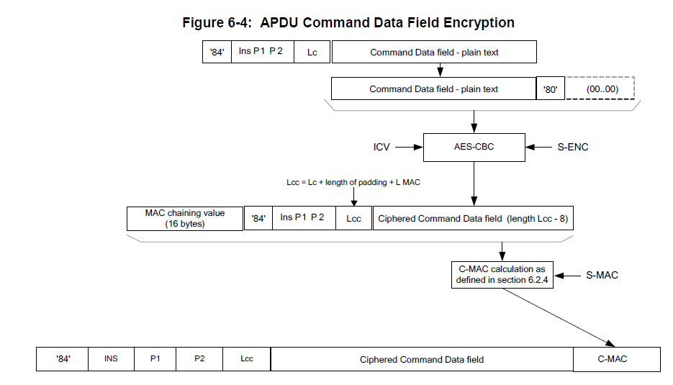
Secure Channel Protocol '03‘, Card Specification v2.2 – Amendment D, GPC_SPE_014

Slide 52
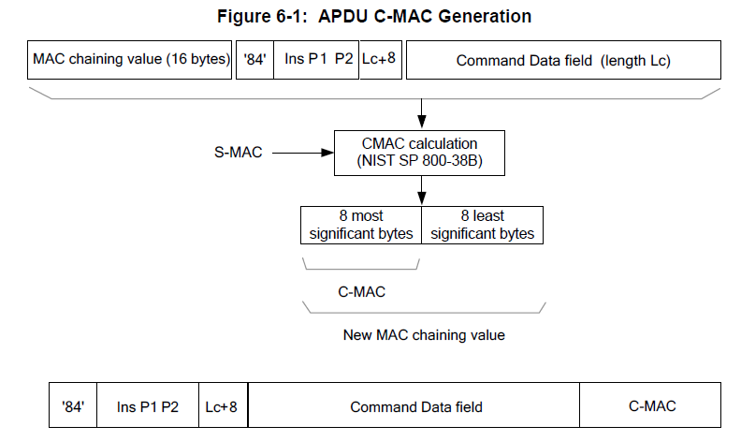
Secure Channel Protocol '03‘, Card Specification v2.2 – Amendment D, GPC_SPE_014

Slide 53
ePassport protocols (ICAO 9303)
Significantly more complex trust model
  Passport, Inspection terminal, Trusting countries, Distrusting countries
  Multiple sensitivity levels (basic info / fingerprint / iris)
  Combination of symmetric and asymmetric cryptography
Basic Access Control (BAC) protocol
  SCP-like protocol, static key is content from MRZ
Extended Access Control (EAC) protocol
  Terminal authentication (RSA/ECDSA, SHA-1/2)
  Chip authentication (DH/ECDSA key)
  PACE protocol to establish session keys
Active Authentication (AA) protocol
More in 4th lecture

Slide 54
Two factor authentication

Slide 55
Two-factor authentication
Two factors with tokens/smart cards
  Token (smart card, phone) + Knowledge (PIN, Password)
Authorize transaction with card and PIN
Authenticate with password and SMS
Authenticate user with One-Time Password (OTP) generated on mobile phone (stored secret key) after screen unlock (pattern)
…
How to attack two-factor?

Slide 56

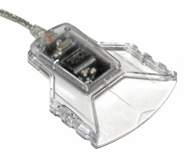
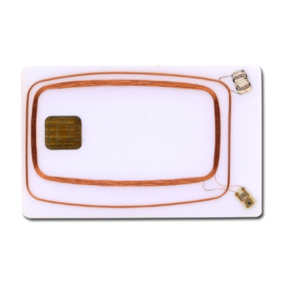
Application uses PC/SC interface (SCardxx)
User application
winscard.dll
reader driver
USB driver
APDU

Slide 57
Where to log communication?
In-application logging
User application
winscard.dll
“Stub” winscard.dll logging
reader driver
Virtual reader
In-card logger
USB driver
HW USB sniffer
APDU
SW USB sniffer

Slide 58

APDUPlay project (https://www.fi.muni.cz/~xsvenda/apduinspect.html)
based on ApduView utility (by Fernandes)
User application
[begin]
SCardTransmit (handle 0xEA010001)# apduCounter:0#
totalBytesINCounter:1#
transmitted:00 a4 04 00 0a a0 00 00 00 28 80 10 30 01 ff
responseTime:31#
SCardTransmit result:0x0#
received:6a 81
SCardTransmit (handle 0xEA010001)# apduCounter:1#
totalBytesINCounter:16#
…
winscard.dll (stub)
original.dll

Slide 59
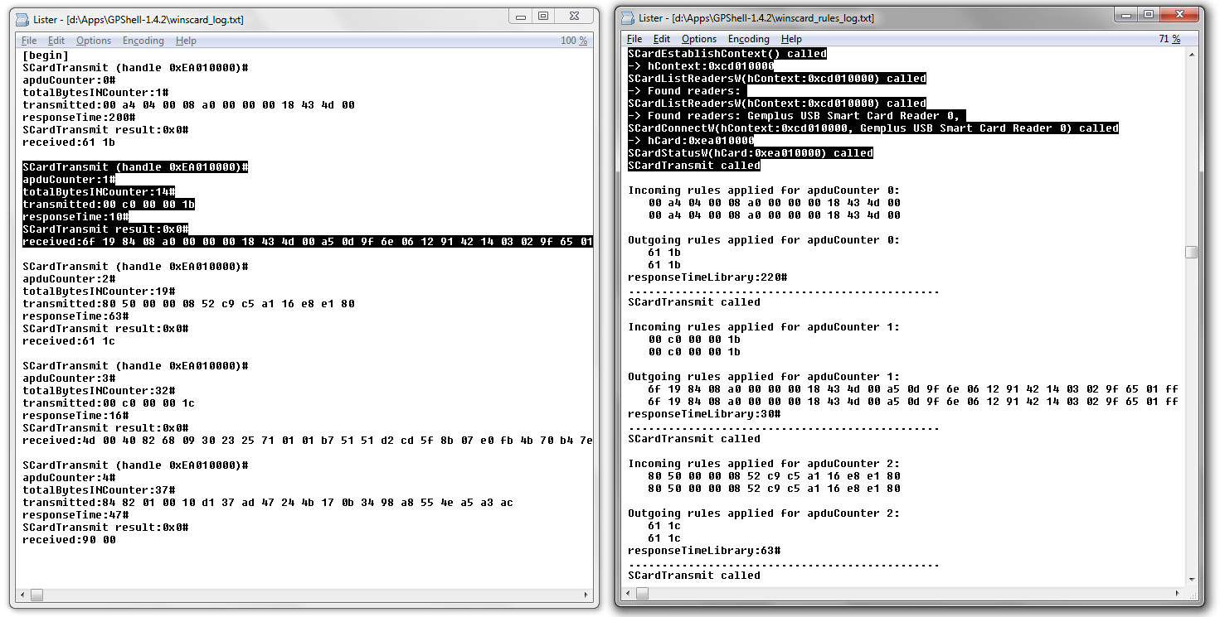
What can you do then…
Log all APDU send via SCardTransmit()
Log all SCardXXX function calls

Slide 60
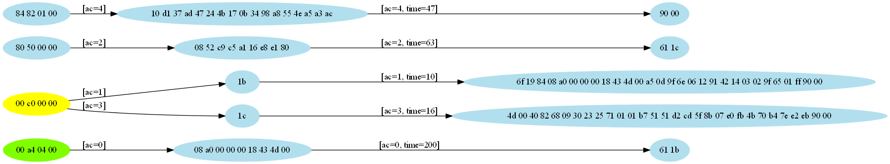
Visualize logged APDU’s

Slide 61
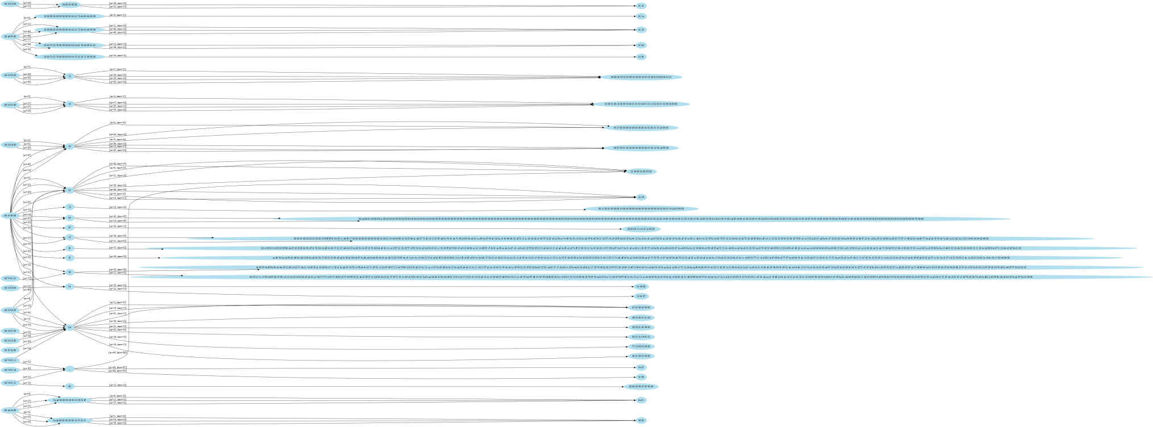
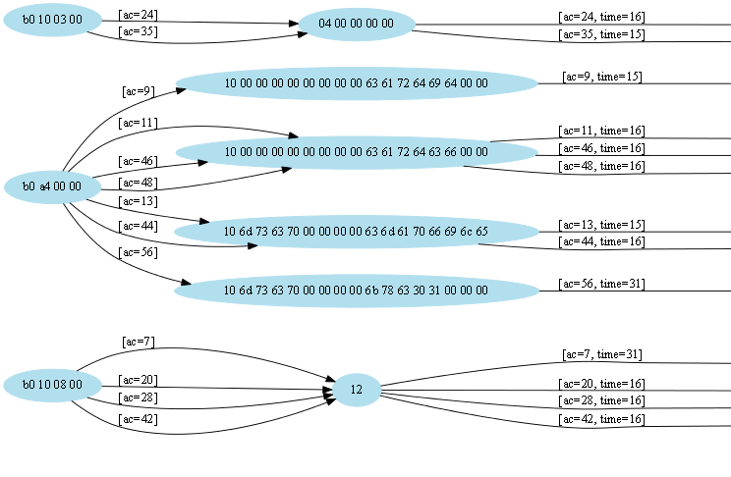

Slide 62

For two-factor, logging is usually not enough
Manipulate incoming/outgoing APDUs
  modify packet content (change receiver account number)
  replay of previous packets (pay twice)
  simulate presence of smart card
  …
00 a4 04 00 08 01 02 03 04 05 06 07 08
winscard.dll (stub)
90 00
[RULE1]
MATCH1=in=1;t=0;cla=00;ins=a4;p1=04;
ACTION=in=0;data0=90 00;le=02;

Slide 63
German banking malware (2009)
Two-factor authorization of transactions (chipTAN/cardTAN)
Application code injection
  modifies info about transaction and balance shown to user in browser
  intercepts/modifies transaction data for signature by smart card
  http://www.cio.com/article/2429854/infrastructure/german-police--two-factor-authentication-failing.html
The Fairy Tale of “What You See Is What You Sign” - Trojan Horse Attacks on Software for Digital Signatures (2001)
  http://www.hanno-langweg.de/hanno/research/scits01p.pdf
  Importance of physical PIN-pad and display of transaction amount independently

Slide 64
German banking malware
User application
Code inject application
winscard.dll
reader driver
USB driver
APDU

Slide 65
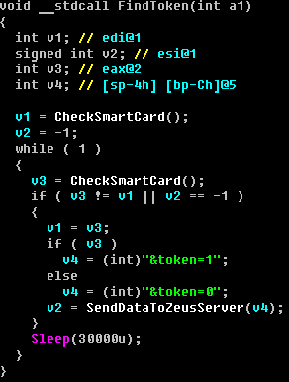
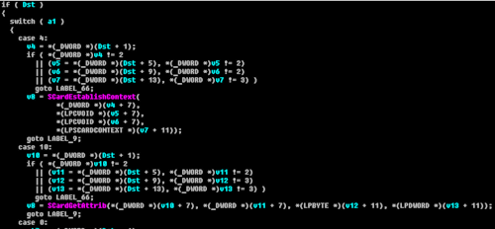
ZeuS smartcard support module
ZeuS Banking Trojan (2010, 2012)
  Analysed by A. Matrosov, Group-IB and others
  http://www.welivesecurity.com/2010/11/05/dr-zeus-the-bot-in-the-hat/
  http://www.secureworks.com/cyber-threat-intelligence/threats/zeus/
Smart card controlled via PC/SC interface

Slide 66
ZeuS smartcard support module
User application
Malicious app
Malicious application
winscard.dll
reader driver
USB driver
APDU

Slide 67
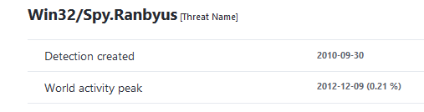
Win32/Spy.Ranbyus
Analysed by A. Matrosov
  http://www.welivesecurity.com/2012/06/05/smartcard-vulnerabilities-in-modern-banking-malware/
Scans for available smart cards, info send to C&C
  uses PC/SC SmartCard API for scan
  later redirects communication on USB level (FabulaTech USB for RD installed)

Slide 68
Win32/Spy.Ranbyus
User application
Malicious app
Malicious application
winscard.dll
reader driver
USB driver
APDU
Remote USB redirection

Slide 69

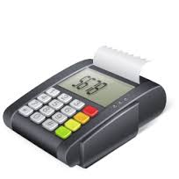

Skimmers, PoS hacks
Manipulated PoS firmware:
Magnetic skimmer (+GSM)
MitM: chip→verified by signature
APDU

Slide 70
Mandatory reading
When Organized Crime Applies Academic Results
  A Forensic Analysis of an In-Card Listening Device
  https://eprint.iacr.org/2015/963.pdf
Which academic attacks is of concern?
What system is targeted?
How is attack carried out? Is it protocol flaw?
What can prevent this attack vector?

Slide 71

Conclusions
Smartcards are highly secure and capable modules
  Programmable
  Accessible (cost, API…)
Many aspects of Secure Channel Protocols
  Requirements
  Attacker model
  Overheads
Two-factor authentication is not silver bullet
Questions

