Slide 1
PV204 Security technologies
JavaCard platform
Petr Švenda svenda@fi.muni.cz
Faculty of Informatics, Masaryk University

Slide 2
JavaCard platform
Lecture
  JavaCard algorithms, secure usage, performance
  JCVM mode of operation
  On-card, off-card code verification
  OpenPlatform – applet installation
Lab:
  Programming of simple communication application (Java)
  Programming basic JavaCard 2.x applet (JavaCard)

Slide 3
Organizational
Homework submit time
  Deadline for full number of points is Friday 6am
  Every additional day (24h) means 3 points penalization
    Therefore some delay is tolerated, but penalized
Bonus points may be awarded
  Exceptional solution
  Bonus extension (e.g., this week)

Slide 4
Overview
JavaCard programming platform
Skeleton of JavaCard applet
How to upload and communicate with
Best practices – performance, security
Simple signature applet
Simple symmetric cryptography applet

Slide 5
Old vs. multi-application smart cards
One program only
Stored persistently in ROM o EEPROM
Written in machine code
  Chip specific
Multiple applications at the same time
Stored in EEPROM
Written in higher-level language
  Interpreted from bytecode
  Portable
Application can be later managed (remotely)

Slide 6

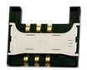


PC application
with direct control:
GnuPG, GPShell
PC application via library:
browser TLS, PDF sign…
Custom app with
direct control
Libraries
PKCS#11, OpenSC, JMRTD
Smartcard control language API
C/C# WinSCard.h, Java java.smartcardio.*, Python pyscard
System smartcard interface: Windows’s PC/SC, Linux’s PC/SC-lite
Manage readers and cards, Transmit ISO7816-4’s APDU
Readers
Contact: ISO7816-2,3 (T=0/1)
Contactless: ISO 14443 (T=CL)
APDU packet
API: EMV, GSM, PIV, OpenPGP, ICAO 9303 (BAC/EAC/SAC)
OpenPlatform, ISO7816-4 cmds, custom APDU
Our focus today
Card application 1
Card application 2
Card application 3
SC app programming:
JavaCard, MultOS, .NET, MPCOS

Slide 7

JavaCard basics

Slide 8
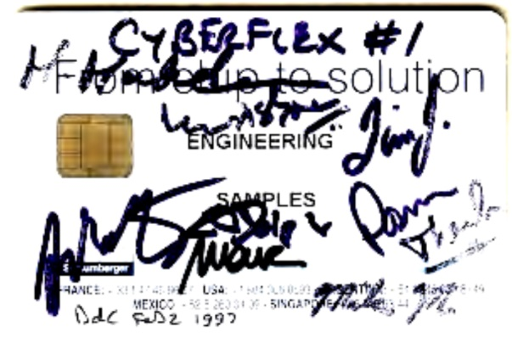
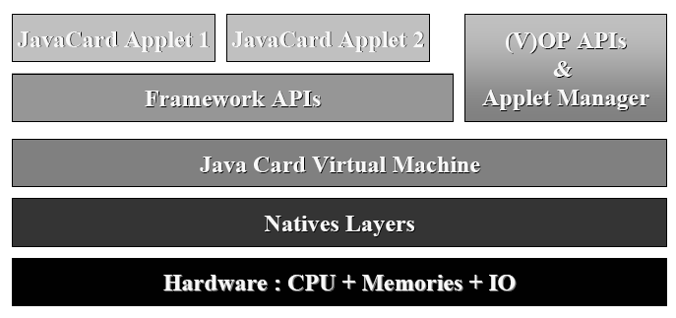
JavaCard
Maintained by Sun Microsystems (now Oracle)
Cross-platform and cross-vendor applet interoperability
Freely available specifications and development kits
  http://www.oracle.com/technetwork/java/javacard/index.html
JavaCard applet is Java-like application
  uploaded to a smart card
  executed by the JCVM

Slide 9

JavaCard applets
User Application
Written in restricted Java syntax
  byte/short (int) only, missing most of Java objects
Compiled using standard Java compiler
Converted using JavaCard converter
  check bytecode for restrictions
  can be signed, encrypted…
Uploaded and installed into smartcard
  executed in JC Virtual Machine
Communication using APDU commands
  small packets with header
PC/SC library
Applet1
Applet2
JCVM

Slide 10
JavaCard versions
JavaCard 2.1.x/2.2.x (2001-2003)
  widely supported versions
  basic symmetric and asymmetric cryptography algorithms
  PIN, hash functions, random number generation
  transactions, utility functions
JavaCard 2.2.2 (2006)
  last version from 2.x series
  significantly extended support for algorithms and new concepts
    long “extended” APDUs, BigNumber support”, biometrics
    external memory usage, fast array manipulation methods…
JavaCard 3.x (2009)
  classic and connected editions, later

Slide 11
JavaCard 2.x not supporting
Dynamic class loading
Security manager
Threads and synchronization
Object cloning, finalization
Large primitive data types
  float, double, long and char
  usually not even int (4 bytes) data type
Most of std. classes
  most of java.lang, Object and Throwable in limited form
Limited garbage collection
  Newer cards supports, but slow and unreliable

Slide 12
JavaCard 2.x supports
Standard benefits of the Java language
  data encapsulation, safe memory management, packages, etc.
Applet isolation based on the JavaCard firewall
  applets cannot directly communicate with each other
  special interface (Shareable) for cross applets interaction
Atomic operations using transaction mode
Transient data (buffer placed in RAM)
  fast and automatically cleared
A rich cryptography API
  accelerated by cryptographic co-processor
Secure (remote) communication with the terminal
  if GlobalPlatform compliant (secure messaging, security domains)

Slide 13
JavaCard 3.x (most recent is 3.0.4 (2011))
Relatively recent major release of JavaCard specification
  significant changes in development logic
  two separate branches – Classic and Connected edition
JavaCard 3.x Classic Edition
  legacy version, extended JC 2.x
  APDU-oriented communication
JavaCard 3.x Connected Edition
  smart card perceived as web server (Servlet API)
  TCP/IP network capability, HTTP(s), TLS
  supports Java 6 language features (generics, annotations…)
  move towards more powerful target devices
  focused on different segment then classic smart cards

Slide 14
Version support
Need to know supported version for your card
  convertor adds version identification to package
  If converted with unsupported version, upload to card fails
Supported version can be obtained from card
  JCSystem.getVersion() → [Major.Minor]
  See https://www.fi.muni.cz/~xsvenda/jcsupport.html
Available cards supports mostly 2.x specification or 3.x (newer cards)

Slide 15
Developing JavaCard appS

Slide 16
Desktop vs. smart card
Following slides will be marked icon based on where it is executed
Process executed on desktop
Process executed inside smart card

Slide 17
package example;
import javacard.framework.*;
public class HelloWorld extends Applet {
protected HelloWorld() {
register();
}
public static void install(byte[] bArray, short bOffset, byte bLength) {
new HelloWorld();
}
public boolean select() {
return true;
}
public void process(APDU apdu) {
// get the APDU buffer
byte[] apduBuffer = apdu.getBuffer();
// ignore the applet select command dispached to the process
if (selectingApplet()) return;
// APDU instruction parser
if (apduBuffer[ISO7816.OFFSET_CLA] == CLA_MYCLASS) &&
apduBuffer[ISO7816.OFFSET_INS] == INS_MYINS)) {
MyMethod(apdu);
}
else ISOException.throwIt( ISO7816.SW_INS_NOT_SUPPORTED);
}
public void MyMethod(APDU apdu) { /* ... */ }
}
include packages from javacard.*
extends Applet
Called only once, do all allocations&init HERE
Called repeatedly on application select, do all temporaries preparation HERE
Called repeatedly for every incoming APDU, parse and call your code HERE

Slide 18
JC development process
6. Write user Java app
(javax.smartcardio.*)
Extends
javacard.framework.Applet
7. Use applet on
smart card (APDU)
2. Compile Java→*.class
(Java 1.3 binary format)
3. Convert *.class→*.jar/cap
(JavaCard Convertor)
5. Install applet
(GPPro/GPShell)
4. Upload *.jar/cap
→ smart card (GPPro/GPShell)

Slide 19
JavaCard application running model
Uploaded package – application binary
Installed applet from package – running application
Applet is “running” until deleted from card
Applet is suspended when power is lost
  Transient data inside RAM are erased
  Persistent data inside EEPROM remain
  Currently executed method is interrupted
When power is resumed
  Unfinished transactions are rolled back
  Applet continues to run with the same persistent state
  Applet waits for new command (does not continue with interrupted method)
Applet is deleted by service command

Slide 20
On-card, off-card code verification
Off-card verification
  Basic JavaCard constraints
  Possibly additional checks (e.g., type consistency when using Shareable interface)
  Full-blow static analysis possible
  Applet can be digitally signed
On-card verification
  Limited resources available
  Proprietary checks by JC platform implementation

Slide 21
Quick and dirty start

Slide 22
Quick and dirty start – OpenPGP applet
Get JavaCard smart card and reader
  Our example card: NXP JCOP J2A081 80K
Install Java SDK and ant build environment
  Don’t forget to set proper paths (javac, ant)
Download AppletPlayground project
  https://github.com/martinpaljak/AppletPlayground
Download GlobalPlatformPro uploader
  https://github.com/martinpaljak/GlobalPlatformPro

Slide 23
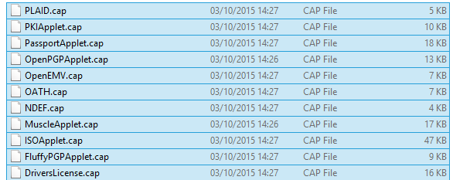
1. Compile and convert applets
> ant toys
  Compiles source with Java compiler (javac)
  Convert with javacard convertor
(for all projects, use ant simpleapplet during lab)

Slide 24
2. Manage applets on smart card
GlobalPlatformPro tool
  Authenticates against CardManager
  Establish secure channel with CM
  Manage applets (list/upload/delete)
Auto-detected ISD AID: A000000003000000
Host challenge: BD525E5585006202
Card challenge: 05211C9591C58232
Card reports SCP02 with version 255 keys
Master keys:
Version 0
ENC: Ver:0 ID:0 Type:DES3 Len:16 Value:404142434445464748494A4B4C4D4E4F
MAC: Ver:0 ID:0 Type:DES3 Len:16 Value:404142434445464748494A4B4C4D4E4F
KEK: Ver:0 ID:0 Type:DES3 Len:16 Value:404142434445464748494A4B4C4D4E4F
Sequence counter: 0521

Slide 25
>gp -list –verbose
Reader: Gemplus USB SmartCard Reader 0
ATR: 3BF81300008131FE454A434F5076323431B7
More information about your card:
http://smartcard-atr.appspot.com/parse?ATR=3BF81300008131FE454A434F507632343
1B7
Auto-detected ISD AID: A000000003000000
Host challenge: 10FFA96848D9EB62
Card challenge: 0520E372F35B4818
Card reports SCP02 with version 255 keys
Master keys:
Version 0
ENC: Ver:0 ID:0 Type:DES3 Len:16 Value:404142434445464748494A4B4C4D4E4F
MAC: Ver:0 ID:0 Type:DES3 Len:16 Value:404142434445464748494A4B4C4D4E4F
KEK: Ver:0 ID:0 Type:DES3 Len:16 Value:404142434445464748494A4B4C4D4E4F
Sequnce counter: 0520
Derived session keys:
Version 0
ENC: Ver:0 ID:0 Type:DES3 Len:16 Value:654E72AAADA31F0A7B5567160DE4C5A7
MAC: Ver:0 ID:0 Type:DES3 Len:16 Value:C6883A00AB6E56384B845A5A6F68CA6C
KEK: Ver:0 ID:0 Type:DES3 Len:16 Value:3875213C9F2123EB01AA420DC83C18F0
Verified card cryptogram: 62CBE443B3F4FB80
Calculated host cryptogram: 9AAC671F9B1E0630
AID: A000000003000000 (|........|)
ISD OP_READY: Security Domain, Card lock, Card terminate, Default selected, CVM (PIN) management
AID: A0000000035350 (|.....SP|)
ExM LOADED: (none)
A000000003535041 (|.....SPA|)

Slide 26
3. Upload applet to smart card
(already converted applet *.cap is assumed)
> gp --instal OpenPGPApplet.cap –verbose
Hint: test with gpg --card-edit
CAP file (v2.1) generated on Sat Oct 03 15:13:58 CEST 2015
By Sun Microsystems Inc. converter 1.3 with JDK 1.8.0_60 (Oracle Corporation)
Package: openpgpcard v0.0 with AID D27600012401
Applet: OpenPGPApplet with AID D2760001240102000000000000010000
Import: A0000000620101 v1.3
Import: A0000000620201 v1.3
Import: A0000000620102 v1.3
Import: A0000000620001 v1.0
Cap loaded

Slide 27
OpenPlatform Package/applet upload
Security domain selection
Secure channel establishment – security domain
Package upload
  Local upload in trusted environment
  Remote upload with relayed secure channel
Applet installation
  Separate instance from package binary with unique AID
  Applet privileges and other parameters passed
  Applet specific installation data passed

Slide 28
4. Communicate with smart card
> gp --apdu apdu_in_hex --debug
Example for SimpleApplet.java
  gp –-apdu B0541000 -d (generate random numbers)
>gp --apdu B0541000 -d
[*] Gemplus USB SmartCard Reader 0
SCardConnect("Gemplus USB SmartCard Reader 0", T=*) -> T=1, 3BF81300008131FE454A
434F5076323431B7
SCardBeginTransaction("Gemplus USB SmartCard Reader 0")
A>> T=1 (4+0000) B0541000
A<< (0016+2) (32ms) 801D52307393AC0AB1CC242F6905B7C5 9000

Slide 29
5. Delete applet
> gp --delete D27600012401 --deletedeps
(Verify that applet was deleted by gp –list)

Slide 30
Developing simple applet

Slide 31
JavaCard – My first applet
Desktop Java vs. JavaCard
  PHP vs. C ☺
No modern programming features
  No threads, no generics, no iterators…
Limited type system
  Usually no ints (short int and byte only), no floats, no Strings
Fun with signed 16-bits values
  JavaCard is usually 16-bit platform (short)
  (short) typecast must be performed on intermediate results
  Shorts are signed => to obtain unsigned byte
    Convert to short with & 0x00ff

Slide 32
Necessary tools
Several tool chains available
  both commercial (RADIII, JCOPTools, G&D JCS Suite)
  and free (Sun JC SDK, AppletPlayground…)
We will use:
  Java Standard Edition Development Kit 1.3 or later
  Apache Ant 1.7 or later, JavaCard Development Kit 2.2.2
  JavaCard Ant Tasks (from JC SDK 2.2.2)
  NetBeans 6.8 or later as IDE
  GlobalPlatformPro for applets management

Slide 33
package example;
import javacard.framework.*;
public class HelloWorld extends Applet {
protected HelloWorld() {
register();
}
public static void install(byte[] bArray, short bOffset, byte bLength) {
new HelloWorld();
}
public boolean select() {
return true;
}
public void process(APDU apdu) {
// get the APDU buffer
byte[] apduBuffer = apdu.getBuffer();
// ignore the applet select command dispached to the process
if (selectingApplet()) return;
// APDU instruction parser
if (apduBuffer[ISO7816.OFFSET_CLA] == CLA_MYCLASS) &&
apduBuffer[ISO7816.OFFSET_INS] == INS_MYINS)) {
MyMethod(apdu);
}
else ISOException.throwIt( ISO7816.SW_INS_NOT_SUPPORTED);
}
public void MyMethod(APDU apdu) { /* ... */ }
}
include packages from javacard.*
extends Applet
Called only once, do all allocations&init HERE
Called repeatedly on application select, do all temporaries preparation HERE
Called repeatedly for every incoming APDU, parse and call your code HERE

Slide 34
Simple JavaCard applet - code
Subclass javacard.framework.Applet
Allocate all necessary resources in constructor
Select suitable CLA and INS for your method
Parse incoming APDU in Applet::process() method
Call your method when your CLA and INS are set
Get incoming data from APDU object (getBuffer(), setIncomingAndReceive())
Use/modify data
Send response (setOutgoingAndSend())

Slide 35
Sending and receiving data
javacard.framework.APDU
  incoming and outgoing data in APDU object
Obtaining just apdu header
  APDU::getBuffer()
Receive data from terminal
  APDU::setIncomingAndReceive()
Send outgoing data
  APDU::setOutgoingAndSend()

Slide 36
Sending and receiving data – source code
private void ReceiveSendData(APDU apdu) {
byte[] apdubuf = apdu.getBuffer(); // Get just APDU header (5 bytes)
short dataLen = apdu.setIncomingAndReceive(); // Get all incoming data
// DO SOMETHING WITH INPUT DATA
// STARTING FROM apdubuf[ISO7816.OFFSET_CDATA]
// ...
// FILL SOMETHING TO OUTPUT (apdubuf again)
Util.arrayFillNonAtomic(apdubuf, ISO7816.OFFSET_CDATA, 10, (byte) 1);
// SEND OUTGOING BUFFER
apdu.setOutgoingAndSend(ISO7816.OFFSET_CDATA, 10);
}

Slide 37
select() method
Method called when applet is set as active
  for subsequent APDU commands
  begin of the session
  use for session data init (clear keys, reset state…)
deselect()
  similar, but when applet usage finish
  may not be called (sudden power drop) => clear in select
public void select() { // CLEAR ALL SESSION DATA
chv1.reset(); // Reset OwnerPIN verification status
remainingDataLength = 0; // Set states etc.
// If card is not blocked, return true.
// If false is returned, applet is not selectable
if (!blocked) return true;
else return false;
}

Slide 38
Communication with smart card

Slide 39
JavaCard communication lifecycle
(Applet is already installed)
PC: Reset card (plug smart card in, software reset)
PC: Send SELECT command (00 0a 04 00 xxx)
  received by Card Manager application
  SC: sets our applet active, select() method is always called
PC: Send any APDU command (any of your choice)
  SC: received by process() method
SC: Process incoming data on card, prepare outgoing data
  encryption, signature…
PC: Receive any outgoing data
  additional special readout APDU might be required
PC: Repeat again from step 4
PC: (Send DESELECT command)
  SC: deselect() method might be called

Slide 40

Java javax.smartcardio.* API
List readers available in system
  TerminalFactory::terminals()
  identified by index CardTerminal::get(index)
  readable string (Gemplus GemPC Card Reader 0)
Connect to target card
  Check for card (CardTerminal::isCardPresent())
  connect to Card (CardTerminal::connect("*"))
  get channel (Card::getBasicChannel())
  reset card and get ATR (Card::getATR())
Already used in labs last week – SimpleAPDU project

Slide 41
Java javax.smartcardio.* API (2)
Select applet on card
  send APDU with header 00 a4 04 00 LC APPLET_AID
Send APDU to invoke method
  prepare APDU buffer (byte array)
  create CommandAPDU from byte array
  send CommandAPDU via CardChannel::transmit()
  check for response data (getSW1() == 0x61)
  read available response data by 00 C0 00 00 SW2
Process response
  status should be ResponseAPDU::getSW() == 0x9000
  returned data ResponseAPDU::getData()

Slide 42
Response APDU (R-APDU)
Response data + status word (2 bytes)
  0x9000 - SW_NO_ERROR, OK
  0x61** - SW_BYTES_REMAINING_**
  see javacard.framework.ISO7816 interface
  other status possible (GlobalPlatform, user defined)
May require special command to read out
  first response is just status word (0x61**)
  00 C0 00 00 ** or C0 C0 00 00 ** APDU
    ** is number of bytes to read out

Slide 43
Debugging applet

Slide 44
Debugging applets: simulator
The smartcard is designed to protect application
  Debugger cannot be connected to running application
Option 1: use card simulator (jcardsim.org)
  Simulation of JavaCard 2.2.2 (based on BouncyCastle)
  Very helpful, allows for direct debugging (labs)
  Catch of logical flaws etc.
  Allows to write automated unit tests
Problem: Real limitations of cards are missing
  supported algorithms, memory, execution speed…

Slide 45
Debugging applets: real cards
Option 2: use real cards
  Cannot directly connect debugger, no logging strings…
Debugging based on error messages
  Use multiple custom errors rather than ISO7816 errors
  Distinct error tells you more precisely, where problem happened
Problem: operation may end with unspecific 0x6f00
  define specific error code and use ISOException.throwIt(0x666);
  Insert into method causing 0x6f00, compile, convert, upload, run
  Localize exact line where 0x6f00 is emitted
Debugging based on additional custom commands
  Output current values of arrays, keys…
  Important: Don’t forget to remove it from release!

Slide 46
Possible causes for unspecific 0x6f00
Writing behind allocated array
Using Key that was Key.clear() before
Insufficient memory to complete operation
Cipher.init() with uninitialized Key
Import of RSA key into real card generated by software outside card (e.g., getP() len == 64 vs. 65B for RSA1024)
Storing reference of APDU object localAPDU = origAPDU;
Decryption of value stored in byte[] array with raw RSA with most significant bit == 1 (set first byte of array to 0xff to verify)
Set CRT RSA key using invalid values for given part - e.g. setDP1()
… and many more ☺

Slide 47
Best practices

Slide 48
Execution speed hints (1)
Difference between RAM and EEPROM memory
  new allocates in EEPROM (persistent, but slow)
    do not use EEPROM for temporary data
    do not use for sensitive data (keys)
  JCSystem::getTransientByteArray() for RAM buffer
  local variables automatically in RAM
Use API algorithms and utility methods
  much faster, cryptographic co-processor
Allocate all resources in constructor
  executed during installation (only once)
  either you get everything you want or not install at all

Slide 49
Execution speed hints (2)
Garbage collection limited or not available
  do not use new except in constructor
Keep Cipher or Signature objects initialized
  if possible (e.g., fixed master key)
  initialization with key takes non-trivial time
Use copy-free style of methods
  foo(byte[] buffer, short start_offset, short length)
Do not use recursion or frequent function calls
  slow, function context overhead
Do not use OO design extensively (slow)

Slide 50
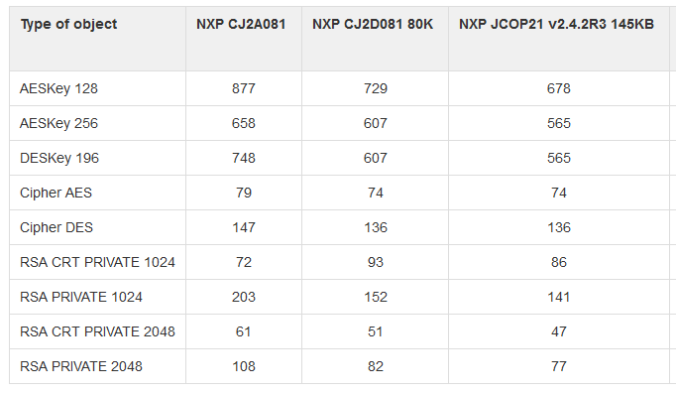
How many cryptographic engines?

Slide 51
Security hints (1)
Use API algorithms/modes rather than your own
  API algorithms fast and protected in cryptographic hardware
  general-purpose processor leaking more information
Store session data in RAM
  faster and more secure against power analysis
  EEPROM has limited number of rewrites (10⁵ - 10⁶ writes)
Never store keys and PINs in primitive arrays
  use specialized objects like OwnerPIN and Key
  better protected against power, fault and memory read-out attacks

Slide 52
Security hints (2)
Erase unused keys and sensitive arrays
  use specialized method if exists (Key::clearKey())
  or overwrite with random data (Random::generate())
Use transactions to ensure atomic operations
  power supply can be interrupted inside code execution
  be aware of attacks by interrupted transactions - rollback attack
Do not use conditional jumps with sensitive data
  branching after condition is recognizable with power analysis

Slide 53
Security hints (3)
Allocate all necessary resources in constructor
  applet installation usually in trusted environment
  prevent attacks based on limiting available resources
Use automata-based programming model
  well defined states (e.g., user PIN verified)
  well defined transitions and allowed method calls
Some additional hints
  Gemalto_JavaCard_DevelGuide.pdf
  http://developer.gemalto.com/fileadmin/contrib/downloads/pdf/Java%20Card%20%26%20STK%20Applet%20Development%20Guidelines.pdf

Slide 54
JavaCard applet firewall issues
short[] array1, array2; // persistent variables short[] localArray = null; // local array JCSystem.beginTransaction(); array1 = new short[1]; array2 = localArray = array1; // dangling reference! JCSystem.abortTransaction();
Main defense for separation of multiple applets
Platform implementations differ
  Usually due to the unclear and complex specification
If problem exists then is out of developer’s control
Firewall Tester project (W. Mostowski)
  Open and free, the goal is to test the platform

Slide 55
Summary
Smart cards are programmable (JavaCard)
  reasonable cryptographic API
  coprocessor for fast cryptographic operations
  multiple applications coexist securely on single card
  Secure execution environment
Standard Java 6 API for communication exists
PKI applet can be developed with free tools
  PIN protection, on-card key generation, signature…
JavaCard is not full Java – optimizations, security

Slide 57
Supplementary materials

Slide 58
Developing simple PKI applet

Slide 59
PKI-relevant JavaCard API
Access controlled by PIN
  javacard.security.OwnerPIN
Asymmetric cryptography keys
  javacard.security.KeyPair, PublicKey, PrivateKey
Digital signatures
  javacard.security.Signature
Asymmetric encryption
  javacard.security.Cipher

Slide 60
PIN verification functionality
javacard.framework.OwnerPIN
Management functions (available for “admin”)
  Create PIN (new OwnerPIN())
  Set initial PIN value (OwnerPIN::update())
  Unblock PIN (OwnerPIN:: resetAndUnblock())
Common usage functions (available to user)
  Verify supplied PIN (OwnerPIN::check())
  Check if was verified (OwnerPIN::isValidated())
  Get remaining tries (OwnerPIN::getTriesRemaining())
  Set new value (OwnerPIN::update())

Slide 61
PIN code
// CREATE PIN OBJECT (try limit == 5, max. PIN length == 4)
OwnerPIN m_pin = new OwnerPIN((byte) 5, (byte) 4);
// SET CORRECT PIN VALUE
m_pin.update(INIT_PIN, (short) 0, (byte) INIT_PIN.length);
// VERIFY CORRECTNESS OF SUPPLIED PIN
boolean correct = m_pin.check(array_with_pin, (short) 0, (byte) array_with_pin.length);
// GET REMAING PIN TRIES
byte j = m_pin.getTriesRemaining();
// RESET PIN RETRY COUNTER AND UNBLOCK IF BLOCKED
m_pin.resetAndUnblock();

Slide 62
Digital signature
Management functions
  Generate new key pair (KeyPair()::genKeyPair())
  Export public key (KeyPair()::getPublic())
  (export private key) (KeyPair()::getPrivate())
  create Signature object (Signature::getInstance())
  init with public/private key (Signature::init())
Common usage functions
  sign message (Signature::update(), Signature::sign())
  verify signature (Signature::update(),verify())

Slide 63
On-card asymmetric key generation
javacard.security.KeyPair
Key pair is generated directly on smart card
  very good entropy source (TRNG)
  private key never leaves the card (unless you allow in code)
  fast sign/verify operation
But who is sending data to sign/decrypt?
  protect signature method by PIN::isValidated() check
  use secure channel to prevent injection of attacker’s message
  terminal still must be trustworthy

Slide 64
Key generation - source code
// CREATE RSA KEYS AND PAIR
m_keyPair = new KeyPair(KeyPair.ALG_RSA_CRT, KeyBuilder.LENGTH_RSA_1024);
// STARTS ON-CARD KEY GENERATION PROCESS
m_keyPair.genKeyPair();
// OBTAIN REFERENCES TO PRIVATE AND PUBLIC KEY OBJECT
m_publicKey = m_keyPair.getPublic();
m_privateKey = m_keyPair.getPrivate();
Example shows RSA 1024b – not recommended
Use KeyBuilder.LENGTH_RSA_2048 instead
(But 2 APDUs are required to transmit signature back)

Slide 65
Public (private) key export/import
Obtain algorithm-specific key object from KeyPair
  e.g., RSAPublicKey pubKey = keyPair.getPublic();
  get exponent and modulus
    getExponent() & getModulus() methods
  send it back to terminal via APDU
Similar situation with key import
  setExponent() & setModulus() methods
Private key export
  It is up to you if your code will allow private key export (usually not)
  Otherwise similar as for RSAPublicKey
  more parameters with RSAPrivateCrtKey (CRT mode)

Slide 66
javacard.security.Signature
Both symmetric and asymmetric crypto signatures
  RSA_SHA_PKCS1 (always), ECDSA_SHA (JCOP), DSA (uncommon)
  DES_MAC8_NOPAD (always), ISO9797 (common), AES (common)
  check in advance what your card supports
Message hashing done on card (asymmetric sign)
  message received in single or multiple APDUs
  Signature::update(), Signature::sign()
If you need just sign of message hash
  use Cipher object to perform asymmetric crypto operation

Slide 67
Signature – source code
// CREATE SIGNATURE OBJECT
Signature m_sign = Signature.getInstance(Signature.ALG_RSA_SHA_PKCS1, false);
// INIT WITH PRIVATE KEY
m_sign.init(m_privateKey, Signature.MODE_SIGN);
// SIGN INCOMING BUFFER
signLen = m_sign.sign(apdubuf, ISO7816.OFFSET_CDATA, (byte) dataLen,
m_ramArray, (byte) 0);

Slide 68
Asymmetric encryption
javacardx.crypto.Cipher
Usage similar to Signature object
  generate key pair
  export/import public key
  initialize Key and set mode (MODE_ENCRYPT/DECRYPT)
  process incoming data (Cipher::update(), doFinal())
Supported algorithms
  RSA_NOPAD (always), RSA_PKCS1 (almost always)

Slide 69
Demo - symmetric cryptography applet

Slide 70
Random numbers
javacard.security.RandomData
Two versions of random generator
  ALG_SECURE_RANDOM (truly random)
  ALG_PSEUDO_RANDOM (deterministic from seed)
Generate random block
  RandomData::generateData()
Very fast and high quality output
  bottleneck is usually card-to-terminal link

Slide 71
RandomData – source code
private RandomData m_rngRandom = null;
// CREATE RNG OBJECT
m_rngRandom = RandomData.getInstance(RandomData.ALG_SECURE_RANDOM);
// GENERATE RANDOM BLOCK WITH 16 BYTES
m_rngRandom.generateData(array, (short) 0, ARRAY_ONE_BLOCK_16B);

Slide 72
Key generation and initialization
Allocation and initialization of the key object (KeyBuilder.buildKey())
Receive (or generate random) key value
Set key value (AESKey.setKey())
// …. INICIALIZATION SOMEWHERE (IN CONSTRUCT)
// CREATE AES KEY OBJECT
AESKey m_desKey = (AESKey) KeyBuilder.buildKey(KeyBuilder.TYPE_AES,
KeyBuilder.LENGTH_AES_256, false);
// Generate random data to be used as key
m_rngRandom.generateData(array, (short) 0,
(short) KeyBuilder. KeyBuilder.LENGTH_AES_256/8);
// SET KEY VALUE
m_aesKey.setKey(array, (short) 0);

Slide 73
Symmetric cryptography encryption
javacard.security.Cipher
Allocate and initialize cipher object
  Cipher::getInstance(), Cipher::init()
Encrypt or decrypt data
  Cipher.update(), Cipher.doFinal()

Slide 74
Encryption with 3DES – source code
// INIT CIPHER WITH KEY FOR ENCRYPT DIRECTION
m_encryptCipher.init(m_desKey, Cipher.MODE_ENCRYPT);
//….
// ENCRYPT INCOMING BUFFER
void Encrypt(APDU apdu) {
byte[] apdubuf = apdu.getBuffer();
short dataLen = apdu.setIncomingAndReceive();
// CHECK EXPECTED LENGTH (MULTIPLY OF 64 bites)
if ((dataLen % 8) != 0) ISOException.throwIt(SW_CIPHER_DATA_LENGTH_BAD);
// ENCRYPT INCOMING BUFFER
m_encryptCipher.doFinal(apdubuf, ISO7816.OFFSET_CDATA, dataLen, m_ramArray, (short) 0);
// COPY ENCRYPTED DATA INTO OUTGOING BUFFER
Util.arrayCopyNonAtomic(m_ramArray, (short) 0, apdubuf, ISO7816.OFFSET_CDATA, dataLen);
// SEND OUTGOING BUFFER
apdu.setOutgoingAndSend(ISO7816.OFFSET_CDATA, dataLen);
}

Slide 75
Message authentication code (MAC)
javacard.security.Signature
Usage similar to asymmetric signatures
Create signature object for target MAC algorithm
Initialize with symmetric cryptography key
Supported algorithms
  DES_MAC8 (always), AES_MAC8 (increasingly common)

Slide 76
MAC – source code
Example based on 3DES, can be AES as well
private Signature m_sessionCBCMAC = null;
private DESKey m_session3DesKey = null;
// CREATE SIGNATURE OBJECT
m_sessionCBCMAC = Signature.getInstance(Signature.ALG_DES_MAC8_NOPAD, false);
// CREATE KEY USED IN MAC
m_session3DesKey = (DESKey) KeyBuilder.buildKey(KeyBuilder.TYPE_DES, KeyBuilder.LENGTH_DES3_3KEY, false);
// INITIALIZE SIGNATURE DES KEY
m_session3DesKey.setKey(m_ram, (short) 0);
// SET KEY INTO SIGNATURE OBJECT
m_sessionCBCMAC.init(m_session3DesKey, Signature.MODE_SIGN);
// GENERATE SIGNATURE OF buff ARRAY, STORE INTO m_ram ARRAY
m_sessionCBCMAC.sign(buff, ISO7816.OFFSET_CDATA, length, m_ram, (short) 0);

Slide 77
Data hashing
javacard.security.MessageDigest
Create hashing object for target algorithm
  MessageDigest.getInstance()
Reset internal state of hash object
  MessageDigest::reset()
Process all parts of data
  MessageDigest::update()
Compute final hash digest
  MessageDigest.doFinal()
Supported algorithms
  MD5, SHA-1 (always), SHA-256 (increasingly common)
  related to supported Signature algorithms

Slide 78
Data hashing – source code
// CREATE SHA-1 OBJECT
MessageDigest m_sha1 = MessageDigest.getInstance(
MessageDigest.ALG_SHA, false);
// RESET HASH ENGINE
m_sha1.reset();
// PROCESS ALL PARTS OF DATA
while (next_part_to_hash_available) {
m_sha1.update(array_to_hash, (short) 0, (short) array_to_hash.length);
}
// FINALIZE HASH VALUE (WHEN LAST PART OF DATA IS AVAILABLE)
// AND OBTAIN RESULTING HASH VALUE
m_sha1.doFinal(array_to_hash, (short) 0, (short) array_to_hash.length,
out_hash_array, (short) 0);

Slide 79
GPPro – M. Paljak
gp.exe -install applet.cap -verbose -emv
Reader: OMNIKEY AG Smart Card Reader USB 0
ATR: 3BF81800008031FE450073C8401300900092
More information about your card:
http://smartcard-atr.appspot.com/parse?ATR=3BF81800008031FE450073C8401300900092
Auto-detected ISD AID: A000000003000000
Host challenge: 764D6A0982DC5E17
Card challenge: 0005112D5C02E152
Card reports SCP02 with version 1 keys
Master keys:
Version 0
ENC: Ver:0 ID:0 Type:DES3 Len:16 Value:404142434445464748494A4B4C4D4E4F
MAC: Ver:0 ID:0 Type:DES3 Len:16 Value:404142434445464748494A4B4C4D4E4F
KEK: Ver:0 ID:0 Type:DES3 Len:16 Value:404142434445464748494A4B4C4D4E4F
Diversififed master keys:
Version 0
ENC: Ver:0 ID:0 Type:DES3 Len:16 Value:8D16CDB90D9A1BCB9C3B208FB491DFF6
MAC: Ver:0 ID:0 Type:DES3 Len:16 Value:D3A3DD0DB2C1F84F79E3BC0EF4B0A78E
KEK: Ver:0 ID:0 Type:DES3 Len:16 Value:F80C3E807D4C57293B651693ED999448
Sequnce counter: 0005
Derived session keys:
Version 0
ENC: Ver:0 ID:0 Type:DES3 Len:16 Value:6BCC8856C64D5A6090A603C5FFBA7F4F
MAC: Ver:0 ID:0 Type:DES3 Len:16 Value:3BDCE52AE932EFF43E506C498BAC9F21
KEK: Ver:0 ID:0 Type:DES3 Len:16 Value:FFC30797EFA7EC37A28E4485052EA21D
Verified card cryptogram: 37C4139407A2F0DD
Calculated host cryptogram: A9376B4721194AFA
CAP file (v2.1) generated on Tue Aug 04 14:34:51 CEST 2015
By Sun Microsystems Inc. converter 1.3 with JDK 1.8.0_31 (Oracle Corporation)
Package: AlgTest v1.0 with AID 6D797061636B616731
Applet: JCAlgTestApplet with AID 6D7970616330303031
Import: A0000000620001 v1.0
Import: A0000000620102 v1.2
Import: A0000000620101 v1.2
CAP loaded

Slide 80
GPShell script – another tool for upload
# Install & configure script for Gemalto TOP IM GX4, mother key
mode_201
gemXpressoPro
enable_trace
establish_context
card_connect
select -AID A000000018434D00
open_sc -security 3 -keyind 0 -keyver 0 -key 47454d5850524553534f53414d504c45
delete -AID ${jc.applet.AID_GPShell}
delete -AID ${jc.package.AID_GPShell}
install -file ${jc.package.shortName}.cap -sdAID A000000018434D00
-nvCodeLimit 4000 -priv 0
# test selection
select -AID ${jc.applet.AID_GPShell}
card_disconnect
release_context
Connect to reader and card
Select Card Manager application
Authenticate and establish secure channel (OpenPlatform)
Delete previous version of our applet (instance first, package second)
Upload and install file *.cap with applet
Try to select newly installed applet

Slide 81
Demo: OpenPGP applet

Slide 82
OpenPGP
Standard for PGP/GPG compliant applications
Includes specification for card with private key(s)
  openpgp-card-1.0.pdf
Supported (to some extend) in GnuPG
Pre-personalized OpenPGP cards available
  http://www.g10code.de/p-card.html
Open source Java Card applet available
  JOpenPGPCard
  http://sourceforge.net/projects/jopenpgpcard/
  our card can be used

Slide 83
JOpenPGPCard applet
Main parts
  two level of PIN protection
  on-card keys generation, public key export
  on-card encryption/signature
Compilation and upload
  Project settings (preconfigured)
  AID (given in OpenPGP specification)
  GPShell script
Compile and upload applet to card

Slide 84
Compilation and upload
gpg --card-edit
Command> admin
Command> help
Command> generate
  follow the instructions (default PINs)
  signature, decryption and authentication key
  private keys generated directly on the card
  public keys exported to GPG keyring
Change your PIN by Command> passwd

Slide 85
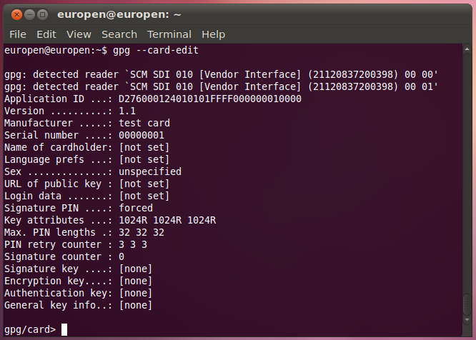
GPG --card-edit
No keys generated yet

Slide 86
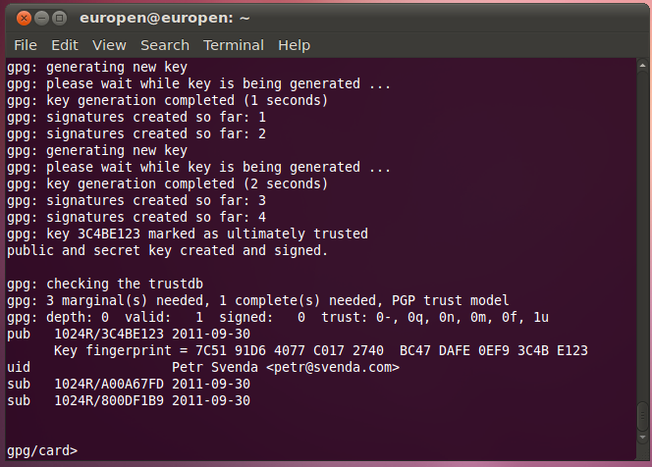
GPG – keys generation finished

Slide 87
What we have…
Card with OpenPGP-compliant applet
GPG generated private&public keypairs
  sign, enc, auth
Public keys exported from card and imported to local keyring
Can be used to sign, encrypt message on command line
Can be further integrated into applications
  Thunderbird + Enigmail + GPG

Slide 88
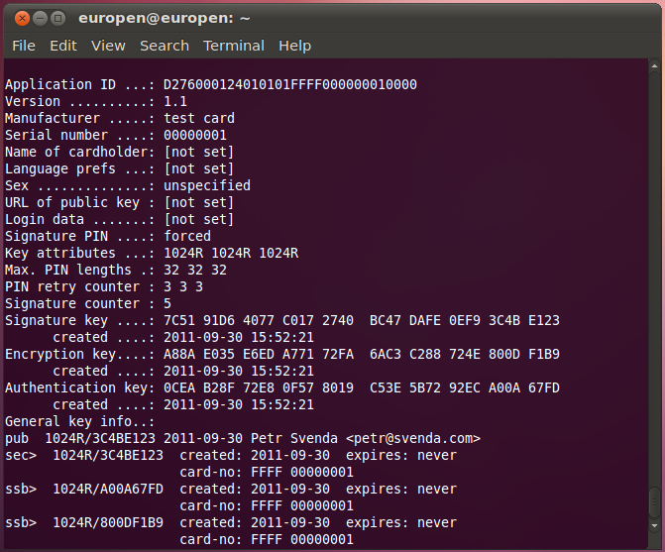
(gpg –card-edit) Command> list

Slide 89
Using GPG with smart card
gpg --clearsign --output myfile.sig --sign myfile
  our public key is already imported to keyring
  PIN is required to sign (notice signature count so far)
  --clearsign causes output in BASE64
gpg --verify myfile.sig
  smart card not required, public key in keyring
gpg --output gpshell.log.gpg --recipient petr@svenda.com --encrypt gpshell.log
  smart card not required, public key in keyring
gpg --decrypt gpshell.log.gpg

Slide 90
More details about JavaCard

Slide 91
JavaCard – more to be discovered
function f(…) { byte a[] = new byte[10]; byte b[] = JCSystem.makeTransientByteArray(...); byte c; }
Recursion is slooow...
Memory allocation issues
  EEPROM vs. RAM allocations, new operator
  No (real-time) garbage collector!
Persistent objects
Transactions, atomic operations
JavaCard applet firewall

Slide 92
GPShell upload&install
Upload and install converted *.cap file
  GPShell tool with script specific for target card
  GP SCP channel version (mode_201, mode_211)
  select CardManager by AID (various AIDs)
  authenticate and open secure channel (open_sc)
  delete previous applet version (1. applet, 2. package)
  load and install (install command, many params)
  install may pass personalization data (master key…)
Check applet functionality
  from GPShell script, no need for secure channel
  select your applet by AID (select –AID xxx)
  send test APDU (send_apdu -APDU xxx)

Slide 93
JavaCard – PIN verification
public class OwnerPIN implements PIN { byte triesLeft; // persistent counter boolean check(...) { ... triesLeft--; ... } }
Image/code for PIN verification
  Vulnerable to transaction rollback

Slide 94
JavaCard – PIN verification done better
public class OwnerPIN implements PIN { byte[] triesLeft = new byte[1]; // persistent counter byte[] temps = JCSystem.makeTransientByteArray(1, JCSystem.CLEAR_ON_RESET); boolean check(...) { ... temps[0] = triesLeft[0] - 1; // update the try counter non-atomically: Util.arrayCopyNonAtomic(temps, 0, triesLeft, 0, 1); ... } }
Non-atomic operations

Slide 95
JavaCard – Atomic vs. Non-Atomic
Persistent memory updates
  Two ways of updating
  FillArrayNonAtomic, CopyArrayNonAtomic
Code refactoring
  Original short/byte values have to be converted to arrays[1]

Slide 96
JavaCard – Atomic vs. Non-Atomic
a[0] = 0 beginTransaction() a[0] = 1; arrayFillNonAtomic(a,0,1,2); // a[0] = 2; abortTransaction() | a[0] = 0; beginTransaction(); arrayFillNonAtomic(a,0,1,2); // a[0] = 2; a[0] = 1; abortTransaction();
Non-deterministic variable rollback
Result dependency on the commands order
  a[0] == 0 vs. a[0] == 2

