Slide 1
PV204 Security technologies
Authentication and passwords
Petr Švenda svenda@fi.muni.cz
Faculty of Informatics, Masaryk University

Slide 2
Organizational – points per homework
Incorrect penalization was listed last week
Every additional day (24h) after soft deadline means 1.5 points penalization (instead of 3 points )
Homework points: 5 points per homework
  6x5 points => 30
  + Bonus assignment(s)

Slide 3
How to approach homework I.
What you should listed about your configuration (replication)
  live vs. dedicated machine -> impact on measurement
  list platform configuration, compilation flags used (for replication)
Analysis
  good to print only shape of histogram (or KDE) instead of bars (visibility)
  good to print multiple histograms in single graph - better visibility
  don't compare only non-blinded to blinded version. More sense makes to compare different data/exponent for given version
Good to test also with medium hamming weight
  more spread of histogram with same data => harder to use Template attacks
  but be aware what is included in timing - e.g., generation of masking r? Network jitter (attacker can model and subtract)?

Slide 4
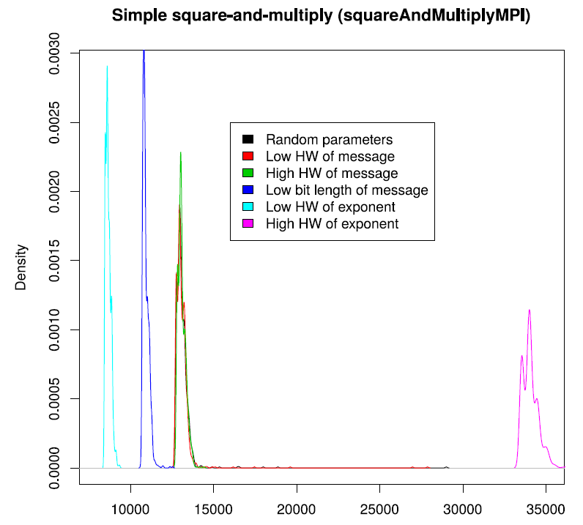
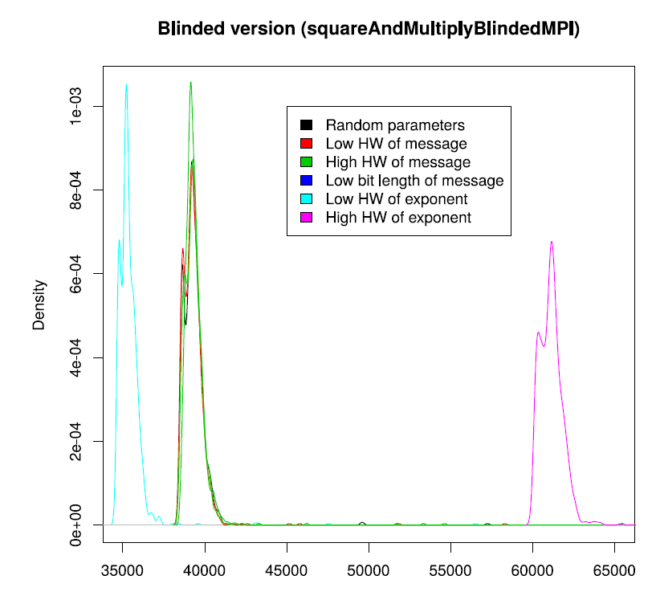
Example solution (O. Mosnacek)

Slide 5
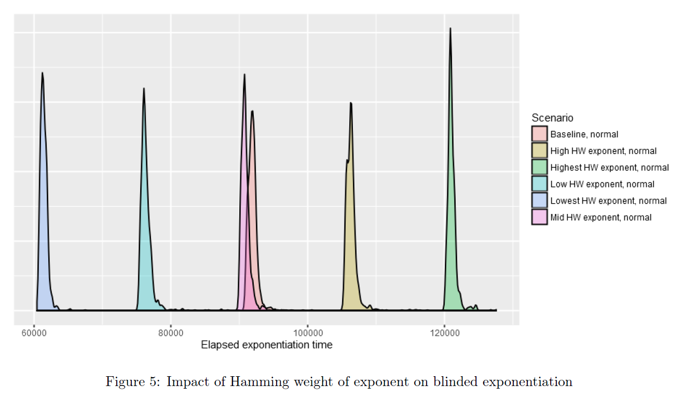
Example solution (L. Obratil)

Slide 6
Conclusions for homework I.
Variability for same data and key => noise in measurement (=> potentially harder to attack)
Difference between any measured values => possibility to use template attack
Difference between data with low/mid/high hamming weight => some information is leaking
Dependency of time on HW of private exponent may be possible to detect even for blinded RSA

Slide 7
Authentication & Authorization

Slide 8
Basic terms
Identification
  Establish what the (previously unknown) entity is
Authentication
  Verify if entity is really what it claims to be
Authorization (access control)
  Define an access policy to use specified resource
  Check if entity is allowed (authorized) to use resource
Authentication may be required before entity allowed to use resource to which is authorized

Slide 9
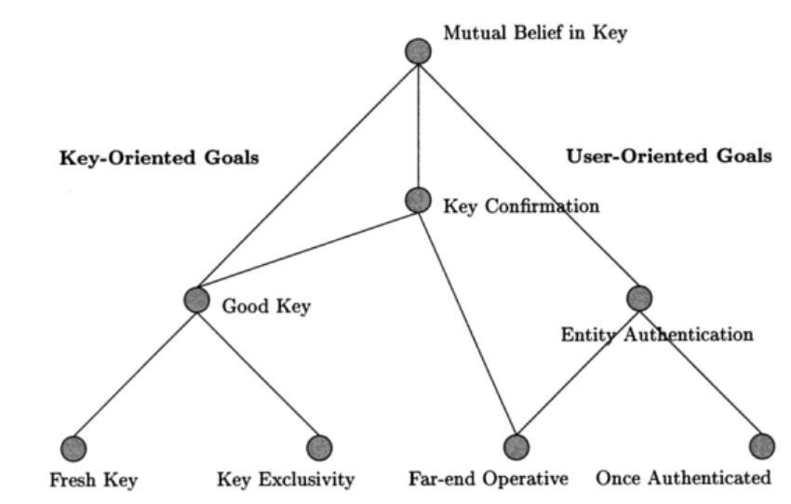
Hierarchy of authentication and key establishment goals
Protocols for Authentication and Key Establishment By Colin Boyd, Anish Mathuria

Slide 10
Passwords

Slide 11
Mode of usage for passwords
Verify by direct match
  provided_password == expected_password?
  Example: HTTP basic access authentication
  Be aware of potential side-channels
Verify by derived value (hash(password))
Derive key: Password → cryptographic key
  Example: key = PBKDF2(password)
Use to establish authenticated key
  Example: Password + Diffie-Hellman → authenticated key
…

Slide 12
Problems associated with passwords
How to create secure password?
How to use password securely?
How to store password securely?
Same value is used for the long time (exposure)
Value of password is independent from target operation (e.g., authorization of request)
…

Slide 13
Where passwords can be compromised?
Database storage
  Cleartext storage
  Backup data (tapes)
  Server compromise
Host machine (memory, history, cache)
Network transmission (network sniffer, proxy logs)
Hardcoded secrets (inside app binary)
  Difficult to change after exposure

Slide 14
Password (hash) cracking
Scenario: dump of passwords hash database
Password cracking attacks
  Brute-force attack (up to 7-8 characters)
  Dictionary attack (inputs with higher probability)
  Dictionary + brute-force (Password[0-9]*)
  Rainbow tables (time-memory trade-off)
  Parallelization (many parallel cores)
  GPU/FPGA/ASIC speedup of cracking
Tools
  Generic: John the Ripper, Brutus, RainbowCrack…
  Targeted to application: TrueCrack, Aircrack-NG…

Slide 15
Password cracking defenses
Don’t transmit or store in plaintext
Process password on client, transmit only digest
Don’t encrypt, hash instead
Use salt to prevent rainbow tables attack
Use memory-hard KDF algorithms
  To slow down custom build hardware
  Use strong KDF to derive keys (PBKDF2/Argon2)

Slide 16
Handling passwords in source code
Limiting memory exposure
  Load only when needed
  Erase right after use
  Pass by reference / pointer to prevent copy in memory
  Derive session keys
Don’t hardcode password into application binary
Nice presentation (K. Kohli, examples how not to): http://www.slideshare.net/amiable_indian/insecure-implementation-of-security-best-practices-of-hashing-captchas-and-caching-presentation

Slide 17
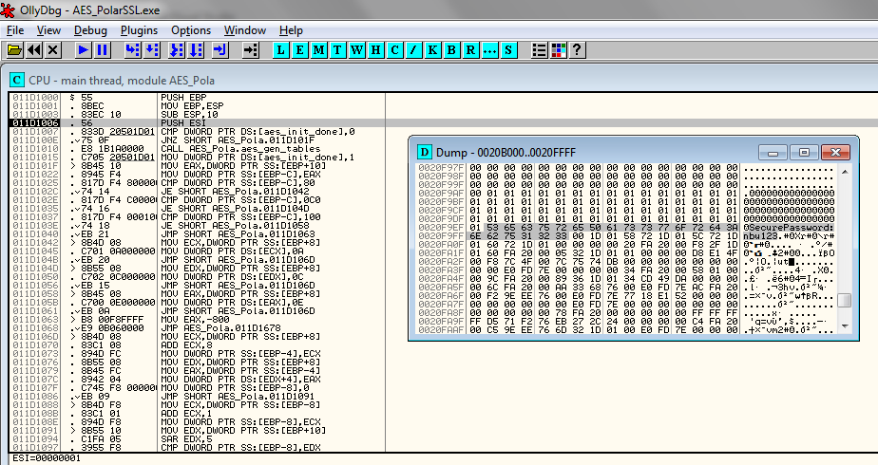
Hard-coded password might be visible both in application binary and memory

Slide 18
Alternatives to hardcoded passwords
Don’t use passwords ☺
Ask the user for a password
Keep secrets in a separate file
Encrypt stored secrets
Store secrets in protected database
Use already existing authentication credentials
Cern guidelines
  https://security.web.cern.ch/security/recommendations/en/password_alternatives.shtml

Slide 19
Possible password replacements
Cambridge’s TR – wide range of possibilities listed
  The quest to replace passwords: a framework for comparative evaluation of Web authentication schemes
  https://www.cl.cam.ac.uk/techreports/UCAM-CL-TR-817.pdf
Many different possibilities, but passwords are cheap to start with, lot of legacy code exists and no mechanism offers all benefits
Mandatory reading: UCAM-CL-817
  At least chapters: II. Benefits, V. Discussion
  Whole report is highly recommended

Slide 20
One-time Passwords

Slide 21

Recall: Problems associated with passwords
How to create secure password?
How to use password securely?
How to store password securely?
Same value is used for the long time (exposure)
Value of password is independent from target operation (e.g., authorization of request)
…
One-time passwords tries to address these issues

Slide 22
HMAC-based One-time Password Algorithm
HMAC-based One-time Password Algorithm (HOTP)
  Secret key K
  Counter (challenge) C
  HMAC(K,C) = SHA1(K ⊕ 0x5c5c… ∥ SHA1(K ⊕ 0x3636… ∥ C))
  HOTP(K,C) = Truncate(HMAC(K,C)) & 0x7FFFFFFF
  0x7FFFFFFF mask to drop most significant bit (portability)
  HOTP-Value = HOTP(K,C) mod 10^{d} (d … # of digits)
Many practical implementations
  E.g., Google authenticator
https://en.wikipedia.org/wiki/HOTP

Slide 23
HOTP – items, operations
Logical operations
  Generate initial state for new user and distribute key
  Generate HOTP code and update state (user)
  Verify HOTP code and update state (auth. server)
Security considerations of HOTP
  Client compromise
  Server compromise
  Repeat of counter
  Counter mismatch tolerance window

Slide 24
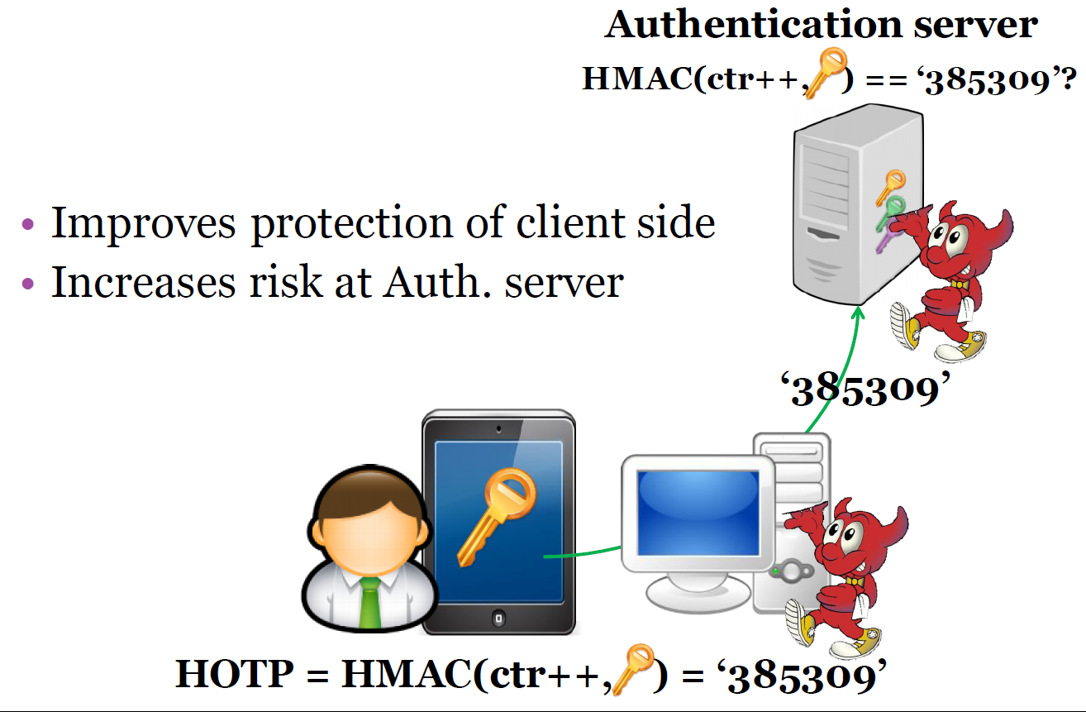

Slide 25
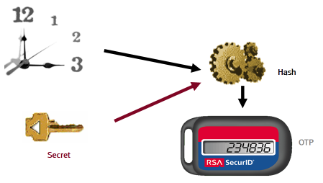
Time-based One-time Password Algorithm
Very similar to HOTP
  Time used instead of counter
Requires synchronized clocks
  In practice realized as time window
Tolerance to gradual desynchronization possible
  Server keeps device’s desynchronization offset
  Updates with every successful login
Sylvain Maret

Slide 26
OCRA: OATH Challenge-Response Algorithm
Initiative for Open Authentication (OATH)
OCRA is authentication algorithm based on HOTP
OCRA code = CryptoFunction(K, DataInput)
  K: a shared secret key known to both parties
  DataInput: concatenation of the various input data values
    Counter, challenges, H(PIN/Passwd), session info, H(time)
  Default CryptoFunction is HOTP-SHA1-6
  https://tools.ietf.org/html/rfc6287
Don’t confuse with OAuth
  The OAuth 2.0 Authorization Framework (RFC6749)
  TLS-based security protocol for accessing HTTP service

Slide 27
Increased risk at *OTP verification server
Better authentication
  Using OTP instead of passwords, KDF(time|key),
But what if server is compromised?
  database hacks, temporal attacker presence
  E.g., Heartbleed – dump of OTP keys
Possible solution
  Trusted hardware on the server
  OTP code verified inside trusted environment
  OTP key never leaves the hardware

Slide 28
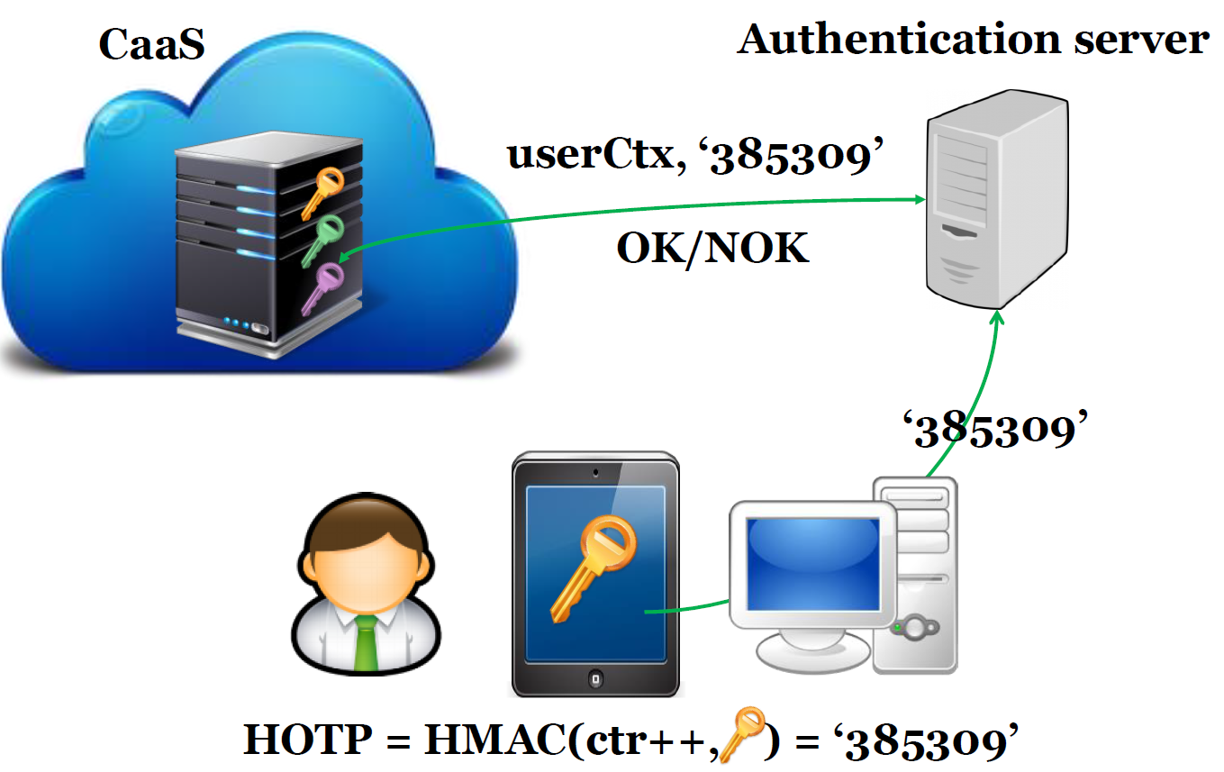

Slide 29

Methods of derivation of secrets from password
H(‘Password’) →

Slide 30
Problems when password used as a key
Passwords are usually shorter / longer than key
If password as a key => low number of distinct keys
Password does not contain same amount of entropy as binary key (only printable characters…)
K = SHA-2(“password”)
  Same passwords from multiple users => same key
  Large pre-computed “rainbow” tables allow for quick check
  Solved by addition of random (potentially public) salt
    K = SHA-2(pass | salt)
Dictionary-based brute-force still possible

Slide 31
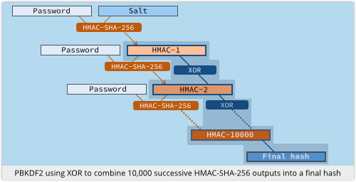
Derivation of secrets from password
PBKDF2 function, widely used
  Password is HMAC “key”
  Iterations to slow derivation
  Salt added
Problem with custom-build hardware (GPU, ASIC)
  Repeated iterations not enough to prevent bruteforce
  (or would be too slow on standard CPU – user experience)
Source: https://nakedsecurity.sophos.com

Slide 32
scrypt – memory hard function
Design as a protection against cracking hardware (usable against PBKDF2)
  GPU, FPGA, ASICs…
  https://github.com/wg/scrypt/blob/master/src/main/java/com/lambdaworks/crypto/SCrypt.java
Memory-hard function
  Force computation to hold r (parameter) blocks in memory
  Uses PBKDF2 as outer interface
Improved version: NeoScrypt (uses full Salsa20)

Slide 33
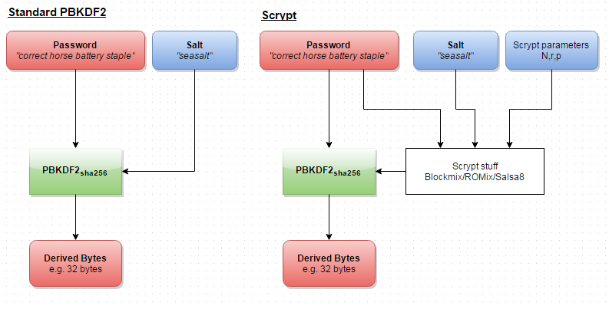
Reuse of external PBKDF2 structure
https://www.reddit.com/r/crypto/comments/3dz285/password_hashing_competition_phc_has_selected/

Slide 34
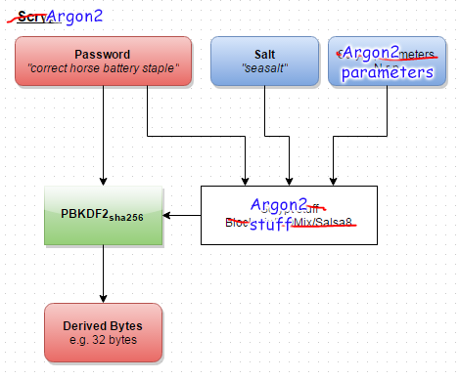
Argon2
Password hashing competition (PHC) winner, 2013
https://www.reddit.com/r/crypto/comments/3dz285/password_hashing_competition_phc_has_selected/

Slide 35
Password managers

Slide 36








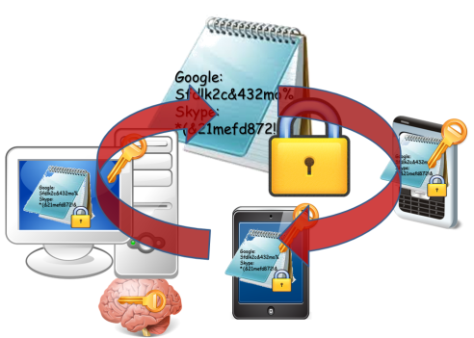

Evolution of password (managers)
Pαs$w0rd
Human memory only
Write it down on paper
Write it into file
Use local password manager
Pαs$w0rd01
Google:
Sfdlk2c&
Skype:
*(&21mefd
Google:
Sfdlk2c&432mo%
Skype:
*(&21mefd872!&
Google:
Sfdlk2c&432mo%
Skype:
*(&21mefd872!&

Slide 37





Remote password managers
KeePass+Dropbox
LastPass
1Password
MozillaSync
…
Google:
Sfdlk2c&432mo%
Skype:
*(&21mefd872!&

Slide 38
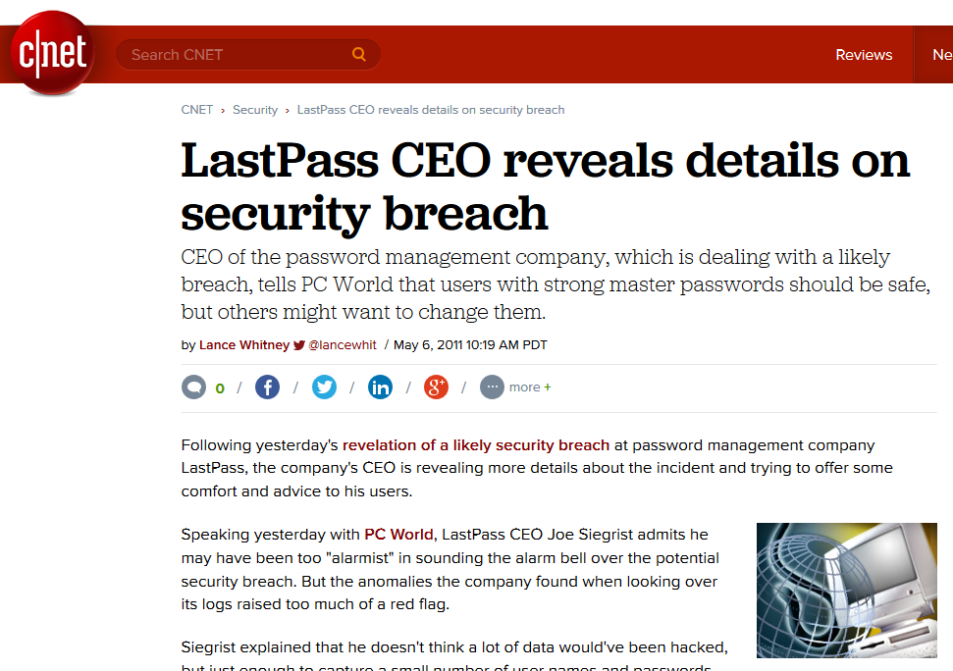
But passwords are encrypted, right?

Slide 39



Human is still the weakest link
Google:
Sfdlk2c&432mo%
Skype:
*(&21mefd872!&
Google:
Sfdlk2c&432mo%
Skype:
*(&21mefd872!&
More than 60% of users have weak passwords
password123

Slide 40
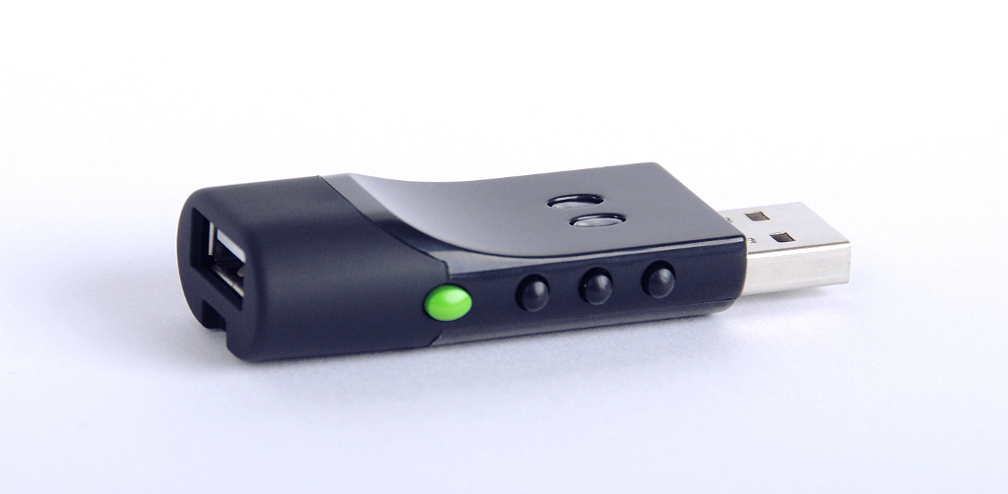
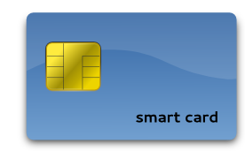
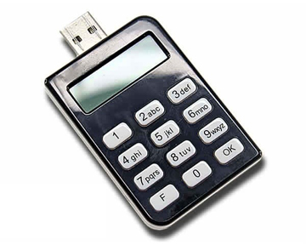
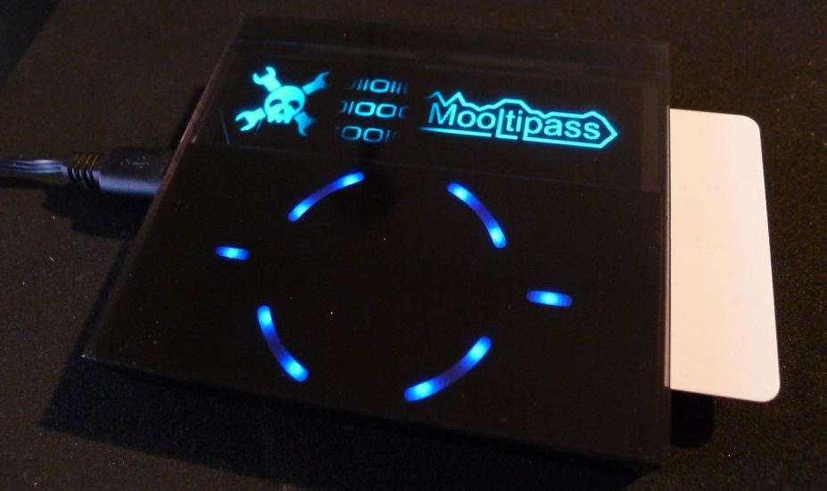
Hardware tokens
SmartArchitects’s Password sCrib
Evergreen password lock
Price, usability, compatibility…
Hack-a-Day’s Mooltipass

Slide 41
Common (mis-)Assumptions
User has strong password
Server/service is hard to compromise
User have unique passwords
Different authentication channels are independent
Recovery

Slide 42
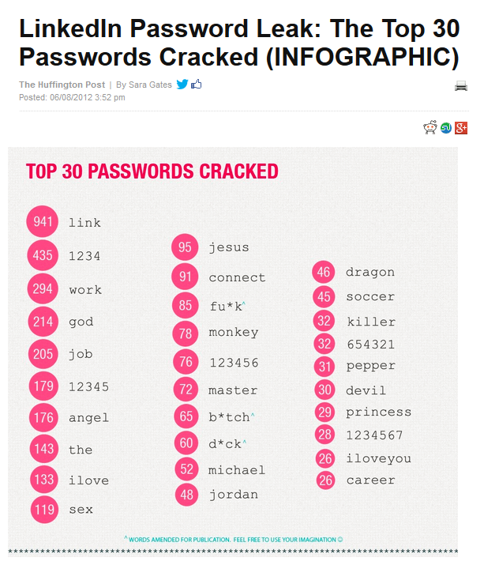
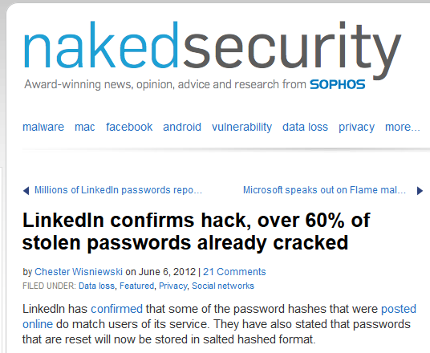
User has strong password

Slide 43
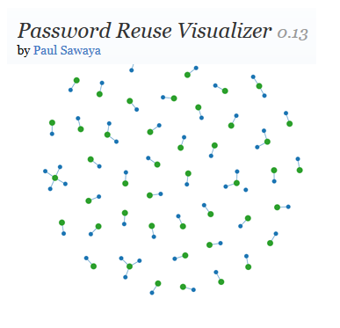
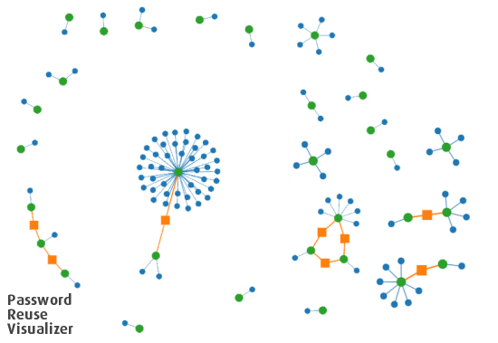
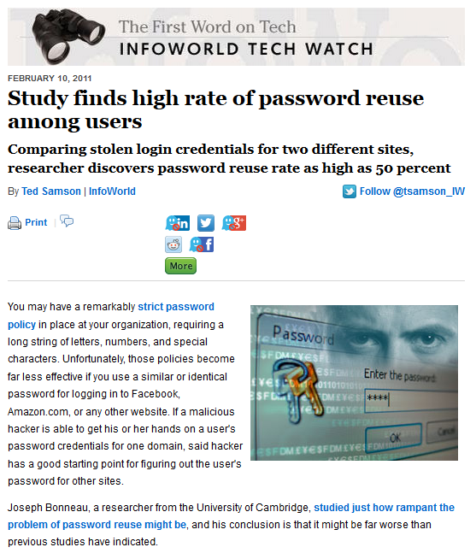
User have unique passwords…
Study: Gawker vs. root.com passwords leak
“…[from successfully cracked passwords] 76% used the exact same password. A further 6% used passwords differing by only capitalisation or a small suffix (e.g. ‘password’ and ‘password1′).”, J. Bonneau
http://www.lightbluetouchpaper.org/2011/02/09/measuring-password-re-use-empirically/

Slide 44
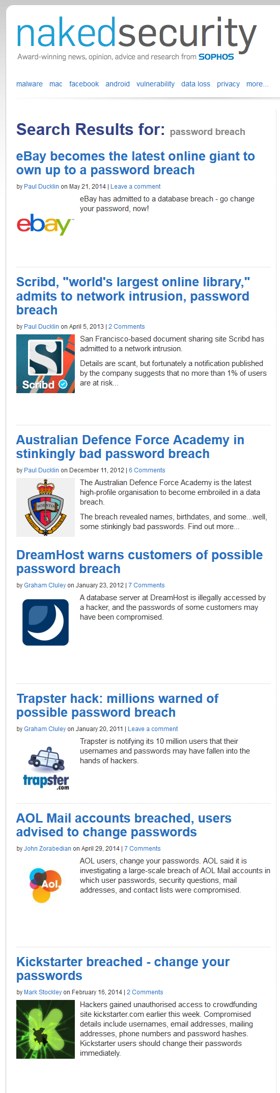
Service is hard to compromise?

Slide 45
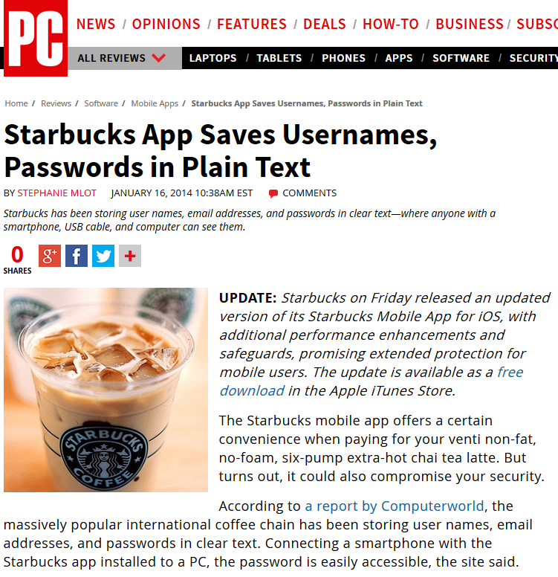
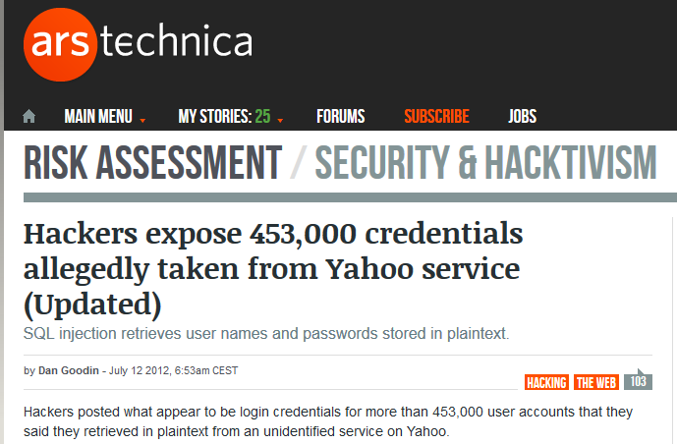

Services follow the best security principles
Service implementation is correct and bug-free

Slide 46



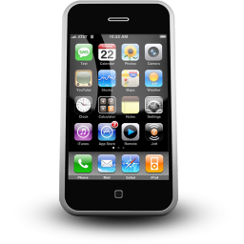


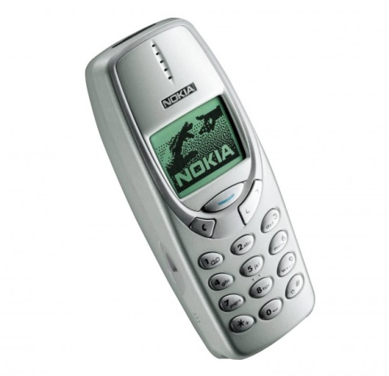
Different authentication channels are independent

Slide 47





Security can be maintained “forever”
Allow for some form of risk management

Slide 48
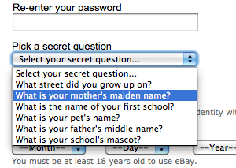
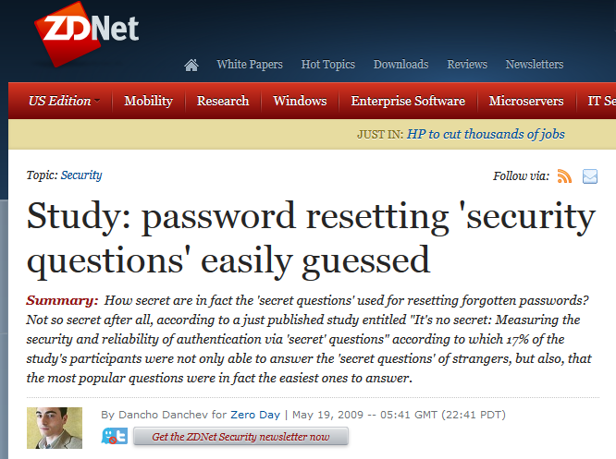
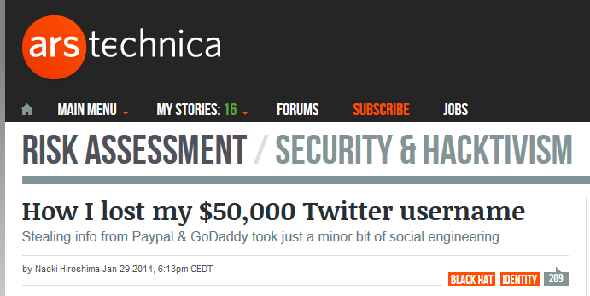
Access recovery is as secure as primary one
Recovery info shared over multiple services…

Slide 49
Password manager for multiple devices
Case study

Slide 50
Assumptions
Functional
  User stores fixed secrets (passwords…)
  User has multiple connected devices
  Easy to use ☺
Security
  Service can’t be trusted
  User chooses weak password
  Devices can be lost (and later revoked)
  User has independent channel (phone)

Slide 51
Main security design principles
Treat storage service as untrusted and perform security sensitive operations on client
Make necessary trusted component as small as possible
Prevent offline brute-force, but don’t expect strong password from user
  add entropy from other source
Make transmitted sensitive values short-lived

Slide 52
Public-key cryptography indirection
Google:
Sfdlk2c&432mo%
Google:
Sfdlk2c&432mo%
Skype:
*(&21mefd872!&
K
K
K
Priv_U
Pub_U
KEK
K = H(‘Password’)
KEK = H(‘Password’)
Password
Password

Slide 53


Public-key crypto indirection
Google:
Sfdlk2c&432mo%
K’,K’’,K’’’…
K
[K’]Pub_U
K
Priv_U
Pub_U
KEK
Public-key crypto indirection allows for asynchronous change of K
KEK = H(‘Password’)
Long private key can be also stored on Service
Password

Slide 54
Weak password?
Google:
Sfdlk2c&432mo%
Google:
Sfdlk2c&432mo%
K
Users tend to have weak passwords…
K
Priv_U
K
Priv_U
K
Pub_U
KEK
KEK
Attacker has motivation for attacking the Service!
KEK = H(‘Password’)
KEK = H(‘Password’)
Password
Password

Slide 55

Trusted element
Google:
Sfdlk2c&432mo%
K
User1:SecretData
User2:SecretData’
…
K
Priv_U
Pub_U
KEK
SecretData1,
SecretData2,
SecretData3…
Threshold crypto
SecretData
KEK = H(‘Password’
| SecretData)
Separate Trusted entities provide additional data
Password

Slide 56


Google:
Sfdlk2c&432mo%
K
SecretData
User1:SecretData
User2:SecretData’
…
K
Priv_U
Pub_U
KEK
SecretData
SMS:
KEK = H(‘Password’ | SecretData)
Password

Slide 57
Multiple devices
Google:
Sfdlk2c&432mo%
K
K
Priv_U
Pub_U
KEK
KEK
KEK
KEK
Dev1
Dev2
Dev3
Dev3
Dev1
Dev2

Slide 58

Other operations
Device management (new, remove, revocate)
Device authentication
Group management (users, boards, secrets)
Password change, private key change
Access recovery
…
Devil is in the details…

Slide 59
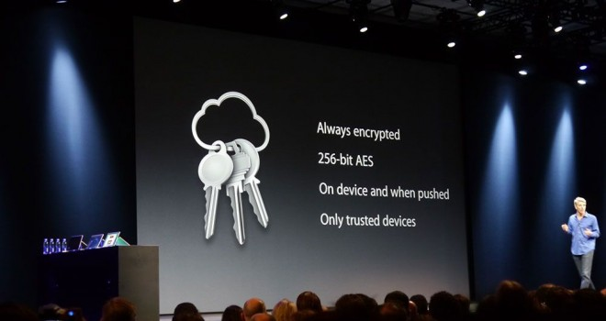
Do we have some implementations?
New Apple’s service showcased in 2013
Lack of details until iOS Security report 02/2014
  https://www.apple.com/business/docs/iOS_Security_Guide.pdf
Apple iCloud Keychain

Slide 60
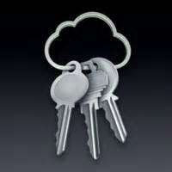
Apple’s iCloud Keychain
Multiple similarities to described example
  Layer of indirection via asymmetric cryptography
  Support for multiple devices
  Asynchronous operations via application tickets
  Authorization and signature of additional devices
  User phone registered and required
Still reliance on user’s (potentially weak) password
  But limited number of tries (recall recent FBI 10 password attempts)
Trusted component of iCloud realized via internal HSM
  Recovery mode with 4 digit code (default, can be longer)
  HSM will decrypt recovery key only after
  4 digits length is not an issue – HSM enforce limited # retries

Slide 61
Summary
Passwords have multiple issues, but are hard to be replaced
Important to use passwords securely (guidelines)
One-time passwords getting more used
Password manager with synchronization over multiple devices is not straightforward
Mandatory reading: UCAM-CL-817
  At least chapters: II. Benefits, V. Discussion
  Whole report is highly recommended

