Slide 1
PV204 Security technologies
Secure authentication and authorization
Petr Švenda svenda@fi.muni.cz
Faculty of Informatics, Masaryk University

Slide 2
Overview
Authentication and key exchange protocols
Problems and design principles
Authentication protocols in electronic passports

Slide 3
Security protocols

Slide 4
Security protocols
Security protocol = composition of cryptoprimitives
“Security protocols are three line programs that people still manage to get wrong.” (R. Needham)

Slide 5
Basic terms
Identification
Establish what the (previously unknown) entity is
Authentication
Verify if entity is really what it claims to be
Authorization (access control)
Define an access policy to use specified resource
Check if entity is allowed (authorized) to use resource
Authentication may be required before entity is authorized to use resource

Slide 6
Authentication (AUTH) vs. Key establishment (KE)
Early literature called protocols used to establish session keys as “authentication protocols”
Authentication is also possible without session keys
Example: Challenge-response, active authentication
Session keys can be established without authentication
Example: non-authenticated Diffie-Hellman

Slide 7
User vs. key-oriented goals
User-oriented authentication goals
Entity authentication
Strong entity authentication – fresh entity authentication
Mutual authentication
Key-oriented goals
Key establishment
Key derivation
Implicit key establishment
Key confirmation
Mutual belief in the key

Slide 8
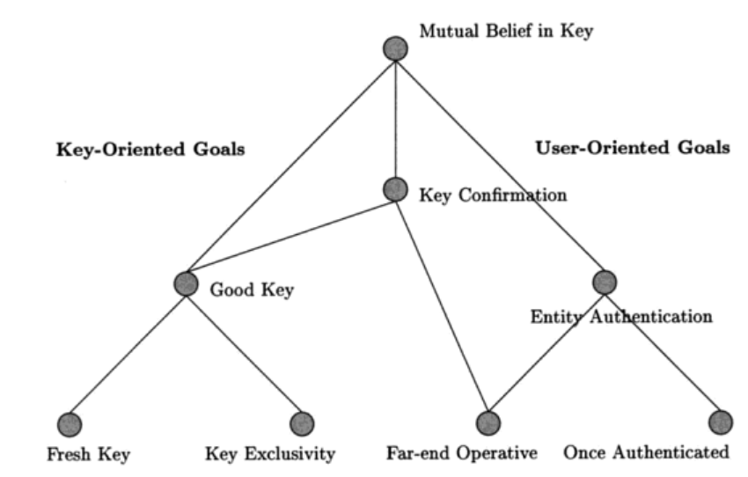
Hierarchy of AUTH&KE goals
Protocols for Authentication and Key Establishment By Colin Boyd, Anish Mathuria

Slide 9
Entity authentication
Entity = user, machine/device
Something entity knows (password, key…)
Something entity is (biometrics…)
Something entity have (smartcard…)
Multi-factor authentication
More than one factor (password + smartcard)
Aim to increase attacker’s cost to compromise multiple security layers (factors)

Slide 10
Methods for key establishment
Derive from pre-shared secret (KDF)
Establish with help of trusted party (Kerberos, PKI)
Establish over insecure channel (Diffie-Hellman)
Establish over other (secure) channel
Establish over non-eavesdropable channel (BB84)
…

Slide 11
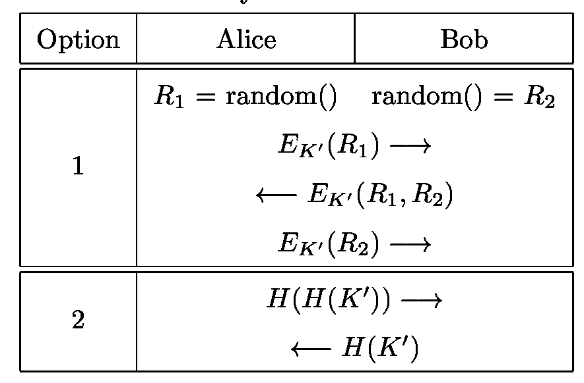
Methods for key confirmation
Goal: ensure that parties use same key value(s)
Implicit confirmation by use of valid key
E.g., MAC by session key on future message is valid
Explicit confirmation by challenge-response
Dedicated steps in protocol
http://www.themccallums.org/nathaniel/2014/10/27/authenticated-key-exchange-with-speke-or-dh-eke/

Slide 12
Protocol message components
Keys
Long-term keys
Session keys
Identifiers
Protocol principals (Alice, Bob…)
Nonce(s)
Random values, timestamps, counters
Components are combined by crypto mechanism(s)

Slide 13
Protocols and attacks

Slide 14
Typical models of adversary
Adversary controls the communication
Between all principals
Observe, alter, insert, delay or delete messages
Adversary can obtain session keys
used in previous runs
Malicious insider
adversary is legitimate protocol principal
Attacker can obtain partial knowledge
Compromise or side-channels
…

Slide 15
Replay and reflection attack
Attacker resends already intercepted messages
Message is neither modified nor understood by attacker
Prevented by inclusion of freshness nonce
Reflection attack
Variant of replay attack
Attacker replay intercepted message from A to B back to A
Prevented by inclusion of party identifiers into protocol messages
Consequences for authentication
Authentication messages are not fresh
Consequences for key exchange
Used session keys are not fresh (possibly compromised)

Slide 16
Needham–Schroeder protocol: symmetric
Basis for Kerberos protocol (AUTH, KE), 1978
Two-party protocol (A,B) + trusted server (S)
Session key K_{AB} generated by S and distributed to A together with part intended for B
Parties A and B are authenticated via S
A → S: A, B, N_{A}
S → A: {N_{A}, K_{AB}, B, {K_{AB}, A}K_{BS}}K_{AS}
A → B: {K_{AB}, A}K_{BS}
B → A: {N_{B}, A}K_{AB}
A → B: {N_{B} - 1}K_{AB}
Which part ensures:
Authentication
Key confirmation
Freshness
Can you spot problem?

Slide 17
N-S symmetric: Problem?
Vulnerable to replay attack (Denning, Sacco, 1981)
If an attacker compromised older K_{AB} then
{K_{AB}, A}K_{BS} can be replayed to B (step 3.)
B will not be able to tell freshness
Attacker will then impersonate A using old (replayed, compromised) key K_{AB}
Fixed by inclusion of nonce/timestamp N’_{B} generated by B (two additional steps before step 1.)
Bob can now check freshness of {K_{AB}, A, N’_{B}}K_{BS}
What is required attacker model?

Slide 18
What is required attacker model?
Able to capture valid communication ({K_{AB}, A}K_{BS})
Able to compromise older K_{AB}
Actively communicate with B (reply ({K_{AB}, A}K_{BS})
But is assumption of compromise
of old key realistic?

Slide 19
How (not) to reason about potential compromise
NO: all my (many) keys are in secure hardware and therefore I’m secure (no compromise possible)
Nothing like perfect security exists
YES: assume compromise and evaluate impact
Where are sensitive keys
How hard is to compromise them
What will be the impact of the compromise
Can I limit number/exposure of keys? For what price?

Slide 20
What if key is compromised?
Prevention, detection (hard), reaction
Prevention of compromise
Limit usage of a key
master key → session keys
Use PKI instead of many symmetric keys in trusted terminals
Limit key availability
Erase after use, no/limited copy in memory, trusted element
Limited-time usefulness of keys (key update)
(Perfect) forward secrecy: Information before is secure
Reaction on compromise
stop using key, update and let know (revocation)

Slide 21
Needham–Schroeder protocol: asymmetric
Simple asymmetric AUTH & KE protocol
Designed by R. Needham and M. Schroeder (1978)
A → B: {A, N_{A}}PK_{B}
B → A: {N_{A}, N_{B}}PK_{A}
A → B: {N_{B}}PK_{B}
Which part ensures:
Authentication
Freshness
Key establishment
Can you spot the problem?

Slide 22
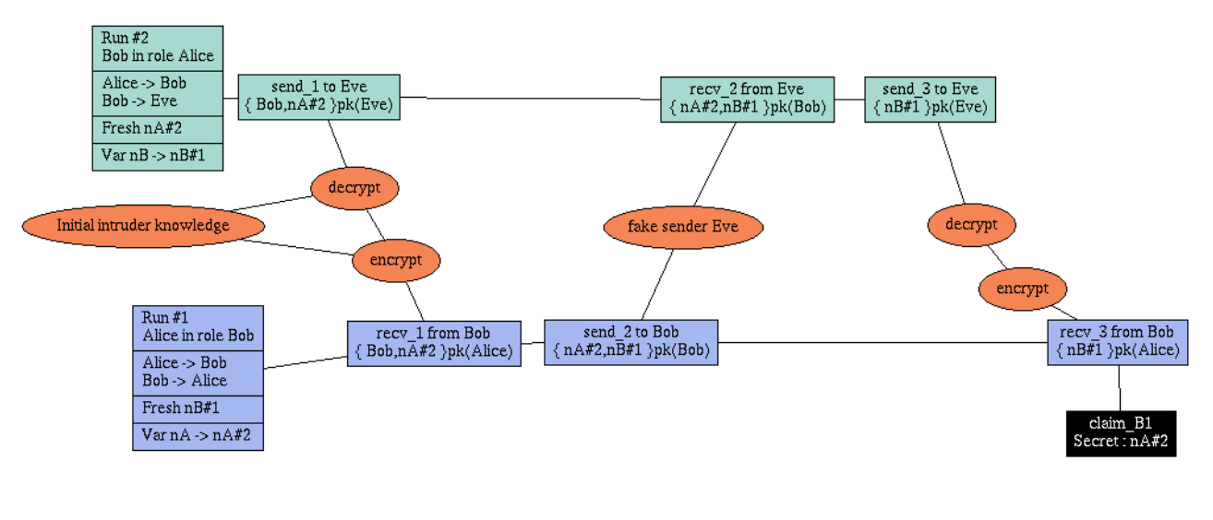
N-S asymmetric: Problem?
Discovered by G. Lowe 17 years after using formal verification method/tool

Slide 23
Formal verification of protocols
Negatives
Specific attacker model
Different attacker (e.g., side-channels) => attack possible
Assumes perfect crypto-primitives
Sensitive to precise specification
Hard to express real-world complex protocols
Search space too large
Positives
Automated process
Prevents basic and some advanced design flaws
Favours simple solutions
Complexity is enemy of security
Is formal verification
panacea?

Slide 24
References
Security Protocols Open Repository
http://www.lsv.ens-cachan.fr/Software/spore/
C. Cremer, Scyther tool
https://github.com/cascremers/scyther/
Cas Cremer’s exercise sheet
https://www.cs.ox.ac.uk/people/cas.cremers/scyther/scyther-exercises.html

Slide 25
N-S asymmetric: Fix
Fixed by addition of B’s identity into second step
A → B: {A, N_{A}}PK_{(B)}
B → A: {B, N_{A}, N_{B}}PK_{(A)}
A → B: {N_{B}}PK_{(B)}

Slide 26
Authenticated Key Exchange

Slide 27
Diffie-Hellman key exchange
Which part ensures:
Key establishment
Key confirmation
Authentication
http://www.themccallums.org/nathaniel/2014/10/27/authenticated-key-exchange-with-speke-or-dh-eke/

Slide 28
Diffie-Hellman in practice
K is not used directly, but K’ = KDF(K) is used
Original K may have weak bits
Multiple keys may be required (K_{ENC}, K_{MAC})
Is vulnerable to man-in-the-middle attack (MitM)
Attacker runs separate DH with A and B simultaneously
(Unless a and b are authenticated)
DH can be used as basis for Forward secrecy
DH can be used as basis for Password-Authenticated Key Exchange

Slide 29
Forward secrecy - motivation
Assume that session keys are exchanged using long-term secrets
Pre-distributed symmetric cryptography keys (SCP’02)
Public key cryptography (TLS_RSA_...)
What if long-term secret is compromised?
All future transmissions can be read
Attacker can impersonate user in future sessions
All previous transmissions can be compromised if traffic was captured
Can III. be prevented? (Forward secrecy)

Slide 30
Forward secrecy – how to achieve
(Perfect) Forward Secrecy
Compromise of long-term keys does not compromise past session keys
Solution: ephemeral key pair (DH/RSA/…)
Fresh keypair generated for every new session
Ephemeral public key used to exchange session key
Ephemeral private key is destroyed after key exchange
Captured encrypted transmission cannot be decrypted
Long-term key is used only to authenticate ephemeral public key to prevent MitM

Slide 31
Use of forward secrecy: examples
TLS (DHE-RSA, DHE-DSA, ECDHE-RSA, ECDHE-ECDSA…)
SSH (RFC 4251)
Off-the-Record Messaging (OTR) protocol
Axolotl protocol (TextSecure)
…

Slide 32
Example: Off-The-Record Messaging (OTR)
Protocol for protection of instant messaging
Perfect forward secrecy (via use of DH)
OTR ratcheting (new DH generated and advertised for every message)
Plausible deniability of messages (via MAC key broadcast)
Read more
M. Green, http://blog.cryptographyengineering.com/2014/07/noodling-about-im-protocols.html
TextSecure: https://whispersystems.org/blog/advanced-ratcheting/

Slide 33
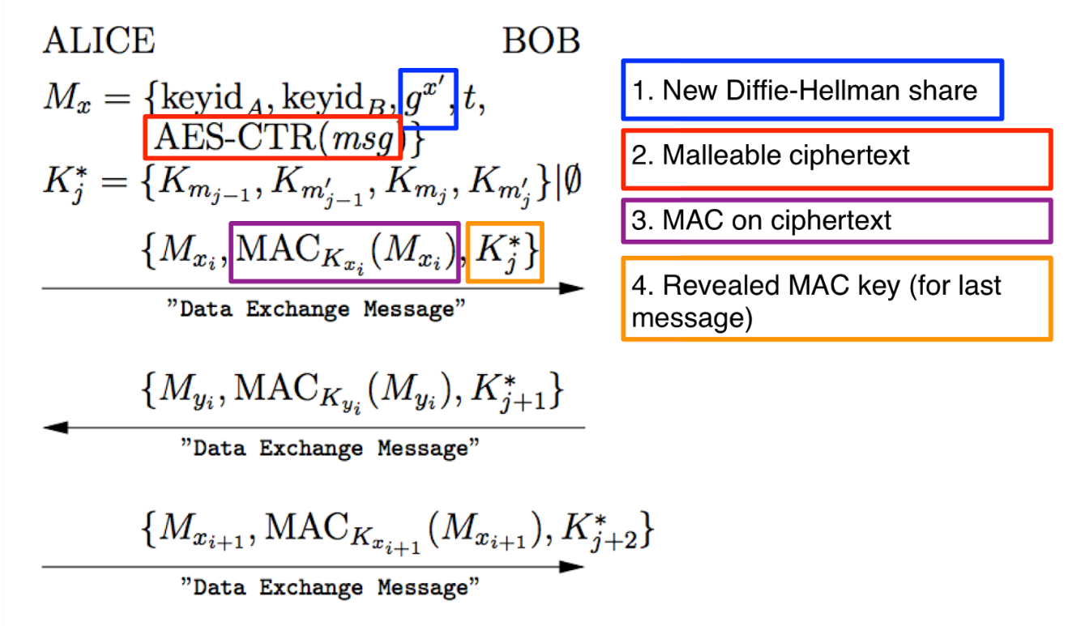

Slide 34
Password-Authenticated Key Exchange (PAKE)

Slide 35
PAKE protocols - motivation
Diffie-Hellman can be used for key establishment
Authentication ca be added via pre-shared key
But why not directly derive session keys from pre-shared instead of running DH?
Compromise of pre-shared key => compromise of all data transmissions (including past) => no forward secrecy
Pre-shared key can have low entropy (password) => attacker can brute-force
Password-Authenticated Key Exchange (PAKE)
Sometimes called Escalation protocols

Slide 36
PAKE protocols - principle
Goal: prevent MitM and offline brute-force attack
Generate asymmetric keypair for every session
Both RSA and DH possible, but DH provides better performance in keypair generation
Authenticate public key by (potentially weak) shared secret (e.g., password)
And limit number of failed authentication requests!
Exchange/establish session keys for symmetric key cryptography using authenticated public key

Slide 37
Diffie-Hellman Encrypted Key Exchange
http://www.themccallums.org/nathaniel/2014/10/27/authenticated-key-exchange-with-speke-or-dh-eke/

Slide 38
Simple Password Exponential Key Exchange (SPEKE)
http://www.themccallums.org/nathaniel/2014/10/27/authenticated-key-exchange-with-speke-or-dh-eke/

Slide 39
Design of protocols

Slide 40
Design of cryptographic protocols
Don’t design own cryptographic protocols
Use existing well-studied protocols (TLS, EAC-PACE…)
Don’t remove “unnecessary” parts of existing protocols
Don’t implement on your own (if possible)
Potential for error, implementation attacks…
Follow all required checks on incoming messages

Slide 41
Design principles (Abadi & Needham) I.
The conditions for a message to be acted should be clearly set out so reviewer can judge if they are acceptable.
Documentation, diagrams, formal specification
Every message should say what it means, message interpretation should depend only on its content.
“This is 2nd message of SCP’02 from A to B”
No assumptions like next random chunk number should be encrypted 2nd message because I just received 1st message
Mention name of principal (“Alice01”)
Prevents (if checked) unintended parallel runs of protocol
Prevents reflection attack

Slide 42
Design principles (Abadi & Needham) II.
Be clear about why encryption is being done
For confidentiality, not to “somewhat” ensure integrity
When signing encrypted data, it should not be inferred that signing entity knows data content
No knowledge of encryption key
Be clear about properties of nonce
random, never repeated, unpredictable, secret
Random → almost never repeated unintentionally

Slide 43
Design principles (Abadi & Needham) III.
If predictable quantity is to be effective, it should be protected so that an intruder cannot simulate a challenge and later replay the message
Counter as challenge → counter freshness verification necessary → state
If timestamps are used as freshness guarantees, then difference between local clocks at various machines must be much less then allowable age of message
Otherwise an attacker can replay within time window
Key may have been used recently and yet be old and possibly compromised
Clear session state after session end, check freshness

Slide 44
Design principles (Abadi & Needham) IV.
It should be possible to deduce which protocol and which run of that protocol a message belongs to including order number in the protocol
Danger of parallel runs of same protocol
MAC and chaining with fresh session keys prevents message mixing
Trust relation should be made explicit and there should be good reason for its necessity.
Less trust needed → better security achieved

Slide 45
Electronic passports and citizen ID cards
Credit: Slides partially based on presentation by Zdenek Říha

Slide 46
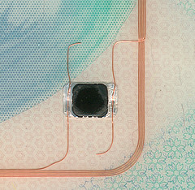
Passports of the first generation
Electronic passport
Classical passport booklet + passive contactless smartcard (ISO14443, communication distance 0-10 cm)
Chip & antenna integrated in a page or cover
Technical specification standardized by ICAO
Standard 9303, 6th edition
References many ISO standards
Data is organised in 16 data groups (DG) and 2 meta files
DG1-DG16, EF.COM, EF.SOD
Mandatory is DG1 (MRZ), DG2 (photo), EF.COM and EF.SOD (passive authentication)

Slide 47
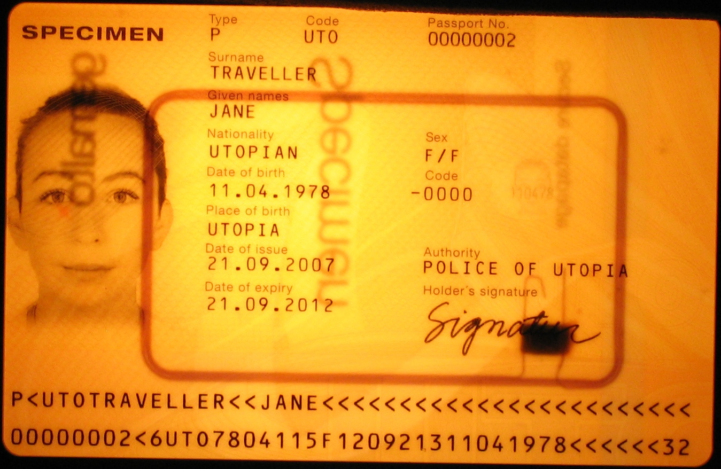
Chip and antenna

Slide 48
Data groups
Data group | Stored data
DG1 | Machine readable zone (MRZ)
DG2 | Biometric data: face
DG3 | Biometric data: fingerprints
DG4 | Biometric data: iris
DG5 | Picture of the holder as printed in the passport
DG6 | Reserved for future use
DG7 | Signature of the holder as printed in the passport
DG8 | Encoded security features – data features
DG9 | Encoded security features – structure features
DG10 | Encoded security features – substance features
DG11 | Additional personal details (address, phone)
DG12 | Additional document details (issue date, issued by)
DG13 | Optional data (anything)
DG14 | Data for securing secondary biometrics (EAC)
DG15 | Active Authentication public key info
DG16 | Next of kin

Slide 49
Protocols used in ePassports I.
SG: security goal, S: solution used
Authentication of inspection system to chip [BAC]
Read basic digital data from chip (MRZ, photo)
SG: Passport provides basic data only to local terminal with physical access to passport
S: Auth. SCP, sym. crypto keys derived from MRZ [BAC]
Authorized access to more sensitive chip data
SG: Put more sensitive data on chip (fingerprint, iris), but limit availability only to inspection systems of trustworthy countries
S: Challenge-response auth. protocol [EAC,EAC-PACE], PKI + cross-signing between trustworthy states [EAC]

Slide 50
Protocols used in ePassports II.
SG: security goal, S: solution used
Genuine data on passport
SG: Are data on passport unmodified?
S: digital signatures, PKI [passive authentication]
Authentication of chip to inspection system
SG: Is physical chip inside passport genuine?
S: Challenge-response authentication protocol [AA, EAC-PACE]
Transfer data between chip and IS securely
SG: attacker can’t eavesdrop/modify/replay
S: secure channel [EAC, EAC-PACE]

Slide 51
Authorization in passports
Inspection terminal to read basic info from chip
Inspection terminal to read biometric data from chip
You to enter country based on chip data

Slide 52
Basic Access Control (BAC) protocol
Authentication&secure channel between inspection terminal and chip
Based on symmetric crypto (3DES), similar to SCP’0x protocols
Low computational requirements
Problem: anyone with access to MRZ can authenticate
Problem: MRZ has insufficient entropy
Document number, birth date, expiration date used
Theoretically 58/74 bits, but in practice about 32 bits
Offline attack (eavesdrop then crack)
Eavesdrop valid communication between chip and reader
Brute-force attack in less then hour (2³² ops, offline attack)
Online attacks against chip (att. model: found passport)
Significantly slower, ~20 ms for every attempt

Slide 53
EAC – motivation
EU passports stores fingerprints (from 2009)
More sensitive than facial photo => better protocol needed
Goal: not everyone with access to passport (and MRZ for BAC) should be able to read out fingerprint
Issuing country decides who else can access
Stronger authentication than BAC required

Slide 54
Mind exercise: symmetric crypto
What if only symmetric crypto is used?
Every chip has own unique symmetric key
Large number of keys in inspection terminals
Compromise of single terminal breach security
=> impractical and insecure => not used

Slide 55
Extended Access Control (EAC) protocol
Based on asymmetric cryptography (RSA/DH/ECDSA)
Chip Authentication (CA) based on PACE protocol
Password Authenticated Connection Establishment (PACE)
Uses chip’s static DH/ECDSA key and terminal’s ephemeral DH key pair (perfect forward secrecy)
Both parties combines chip’s public static and ephemeral public key into same key K
Keys for encryption and MAC (K_{ENC}, K_{MAC}) are derived from exchanged K
How can be Terminal sure of authenticity of chip’s static key?
Signed by Issuing country
Terminal Authentication (TA)
Based on challenge-response protocol (RSA/ECDSA, SHA-1/2)
Hash of the ephemeral DH key from previous step hashed with challenges

Slide 56
Terminal authentication I.
Only authorized border authorities can read the secondary biometric data (fingerprints and iris)
The inspection system must prove to the chip it is authorized
The chip stores a trust point – root certificate
Inspection system presents a valid certificate chain (starting from the passport’s trust point) specifying the IS’s authorizations (e.g. to read DG3)
Challenge-response where IS proves knowledge/access of a secret key (whose public part is certified)
Certificates in Card-verifiable (CV) format

Slide 57
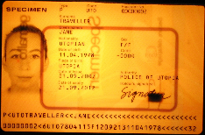
Terminal Authentication II
Country A
Country B
Country C
CV CA
CV CA
CV CA
DV
DV
DV
DV
IS
...
IS
IS
...
IS
IS
...
IS
IS
...
IS
Root public key of issuing country: CV CA

Slide 58
Terminal Authentication III
Supported algorithms
RSA PKCS#1 v1.5 with SHA-1 or SHA-256
RSA PSS with SHA-1 or SHA-256
ECDSA with SHA-1, SHA-224 or SHA-256
Key lengths
For ECDSA allowed 160, 192, 224, 256 bits
For RSA allowed 1024, 1280, 1536, 2048 and 3072 bits
In practice ECDSA is more common, key lengths 192 and 224 bit most popular, existing implementations also support 256 and 384 bits.
For RSA the PKCS#1 v1.5 padding is much more popular than PSS, key lengths are between 512 (test only) and 2048 bits.

Slide 59
Active Authentication (AA) protocol
Motivation: Prevent cloning of passport
Is chip inside passport authentic?
Passport-specific asymmetric key stored on chip
Public key freely readable (DG15 file, hash signed)
Authentication against terminal
Terminal generates 8 random bytes
Chip adds additional 8 random bytes, hash and sign
Terminal verifies signature
Privacy attack: terminal’s challenge is date → signed
PACE protocol replaces Active Authentication

Slide 60
EAC Chip authentication
Verifies the authenticity of the chip
Replaces Active Authentication
Improves the security of Secure Messaging
Keys with higher entropy than for Basic Access Control (BAC)
Diffie-Hellman key pair (passport’s chip)
Public key and domain parameters stored in DG14
Private key never leaves the chip
Diffie-Hellman key pair (inspection system – IS)
Key pair generated according to passport’s domain parameters
Private key kept secret, public key sent to chip
Both the parties (passport, IS) now share a secret
The secret is used to derive the SM keys, the ability to communicate proves the authenticity of the chip

Slide 61
Chip authentication II
Algorithms supported by the EAC specification
Diffie-Hellman (PKCS#3)
Elliptic Curve Diffie-Hellman (ISO 15946, BSI TR-03111 )
Both DH and ECDH popular with chip manufacturers
DH with 1024 or 1536 bit prime
ECDH with mostly 224 bit curves, some implementations use 256 or 384 bits
No challenge semantics
Coexistence of CA and AA

Slide 62
Passive Authentication
CSCA
Goal: are data in chip unchanged?
The list of the hashes (SHA-1/2) of all present data groups is digitally signed by the issuing organisation (Document Signer)
State printing house, Embassy, Etc.
The X.509 certificate of the Document Signer issued by the CA of the issuing country (Country Signing CA – e.g. the ministry of interior) is included.
The CSCA certificates must be exchanged bilaterally
ICAO PKD for DS certificates, CSCA CRL and cross certificates
Passive authentication is a mandatory security feature of all ePassports
DS1
DS2
ePassport 1
ePassport 2
ePassport 3

Slide 63
Passive Authentication – the details
The file EF.SOD contains a CMS (PKCS#7) SignedData structure (file is read and validated by inspection system)
The signed data is the list of hashes of the present data groups
The DS certificate is included (ICAO optional, EU mandatory)
Data is signed by the DS
Signature schemes
RSA with PKCS#1 v1.5 padding (min. 3072 bits for CSCA, 2048 bits for DS)
E.g. Hungary, France, Spain, Portugal, Italy: RSA 4096 bit key with SHA-1
E.g. Austria, Netherlands: RSA 3072 bit key with SHA-256
RSA with PSS padding (min 3072 bits for CSCA, 2048 for DS)
E.g. Czech Republic, Norway, Denmark, Japan and Australia – all with SHA-256
DSA (not standardized for key lengths > 1024)
ECDSA (domain parameters must be specified, min. 256 bits for CSCA, 224 bits for DS)
E.g. Switzerland, Germany, Russia – all with SHA-1
Message Digest algorithms (for signature schemes and hashes of Data Groups)
SHA-1 and all SHA-2 algorithms

Slide 64
Conclusions
Design of (secure) protocols is very hard
Understand what are your requirements
Use existing protocols, e.g., TLS or EAC-PACE
Strong session keys established with weak passwords
Password-Authenticated Key Exchange
Electronic passport uses variety of protocols
Interesting and complex usage scenarios
Mandatory reading
M. Green, Noodling about IM protocols, http://blog.cryptographyengineering.com/2014/07/noodling-about-im-protocols.html

