Slide 1
PV204 Security technologies
Hardware Security Modules (HSM), PKCS#11
Petr Švenda svenda@fi.muni.cz
Faculty of Informatics, Masaryk University

Slide 2
Team projects
Please refer to PV204_Projects_2016.ppt

Slide 3
Homework 2 – typical issues
Missing protection of OwnerPIN.update() method [major]
If not protected, an attacker can set own PIN value and use signature functionality after
New keypair is generated for every signature call [major]
Does not make sense in most scenarios (changing key)
Makes signature method very slow
Missing public key export [medium]
Not possible to verify created signature
Unused code was not removed [medium]
Requirement, unclear if you understand what is relevant to keep
System.out.print() called [minor]
Will not compile&convert for real cards
Signature.getInstance() called for every signature [minor]
Slow, possibility to exhaust memory (if no Garbage Collection)

Slide 4
Overview
Usage scenarios for HSMs
Available hardware, security certifications
Available security APIs (PKCS#11…)
Known API-level attacks

Slide 5
Motivation usage scenarios
Protection against trusted insiders
bank PIN processor
Device with high impact of compromise
Private key of root certification authority
Device in untrusted environment (ATM, PoS)
DRM application (paid satellite TV)
Smart grids (privacy of users)
Intelligent transport systems…

Slide 6
Hardware Security Module
Hardware Security Module

Slide 7
Hardware Security Module - definition
HSM is trusted hardware element
Contains own physical and logical protection
May provide increased performance (compared to CPU)
Attached to or put inside PC/server/network box
Provides in-device:
Secure generation (and entry)
Secure storage (and backup)
Secure use (cryptographic algorithms)
Should never export sensitive data in plaintext
Especially keys

Slide 8
Many HSM forms possible
Stand-alone Ethernet boxes (1U/2U)
PCI cards
Serial/USB tokens
SmartCards, TPMs…
Note: we will focus on more powerful devices (smart cards already covered)
https://www.thales-esecurity.com/products-and-services/products-and-services/hardware-security-modules

Slide 9
Hardware Security Module - specification
Common functions
Generate functions (generate new key)
Load functions (import key, plain/wrapped by other key)
Use key functions (various cryptographic algorithms)
Export key functions (wrapping)
Access control functions (public, login user, login admin)
Destroy secrets functions
Possibility to write custom “plugins”
Custom code running inside HSM
(usually invalidates certification)

Slide 10
Hardware Security Module - protection
Protections against physical attacks (tamper)
Invasive, semi-invasive and non-invasive attacks
Protection against logical attacks
API-level attacks, Fuzzing…
Preventive measures
Statistical testing of random number generator
Self-testing of cryptographic engines (encrypt twice, KAT)
Firmware integrity checks
Periodic reset of device (e.g., every 24 hour)
…

Slide 11
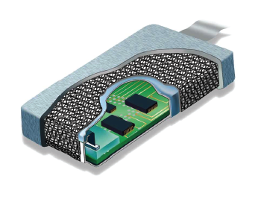
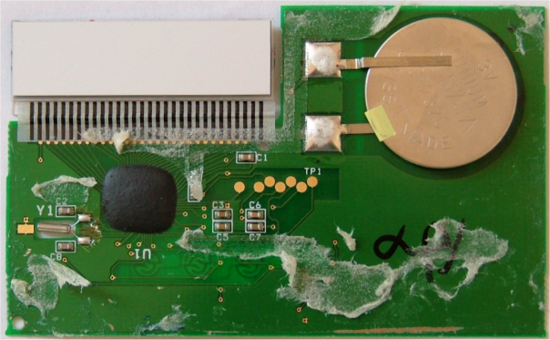
HSM – tamper security
www.techbriefs.com
Protection epoxy
Wiring mesh
Temperature sensors
Light sensors
Variations in power supply
Erasure of memory (write 0/random)
After tamper detection to mitigate data remanence
…
Which one is tamper resistance,
evidence, detection and/or reaction?

Slide 12
HSM – logical security
Access control with limited/delayed tries
< 1:1000 000 probability of random guess of password
< 1:100 000 probability of unauthorized access in one minute
Integrity and authentication of firmware update
Signed updates
Logical separation of multiple users (memory)
Additional protection logic for separate memory regions
Audit trails
…

Slide 13
Certifications

Slide 14
Certifications: NIST FIPS 140-2
Requirements on hardware and software components of security modules to be used by US government
Verified under Cryptographic Module Validation Program (CMVP)
Testing against a defined cryptographic module, provides a suite of conformance tests to required security level
List of validated devices http://csrc.nist.gov/groups/STM/cmvp/validation.html
Common levels for HSMs
NIST FIPS 140-2 Level 1+2 – basic levels, tamper evidence (broken shell, epoxy), role-based authentication (user/admin))
NIST FIPS 140-2 Level 3 – addition of physical tamper-resistance, identity-based authentication, separation of interfaces with different sensitivity

Slide 15
Certifications: NIST FIPS 140-2 (cont.)
Common levels for HSMs (cont.)
NIST FIPS 140-2 Level 4 + additional physical security requirements, environmental attacks
http://csrc.nist.gov/publications/fips/fips140-2/fips1402.pdf
Only very few devices certified to FIPS 140-2 Level 4
NIST FIPS 140-3 (2013, but still draft)
Additional focus on software security and non-invasive attacks

Slide 16
NIST FIPS 140-2 and RNG
Truly random number generators (TRNG)
No approved FIPS 140-2 TRNG
Pseudorandom number generators
ANSI X9.31 Appendix A.2.4, 3DES/AES-based
FIPS 140-2 requires testing of RNG
Known-answer-tests (KAT), Diehard battery

Slide 17
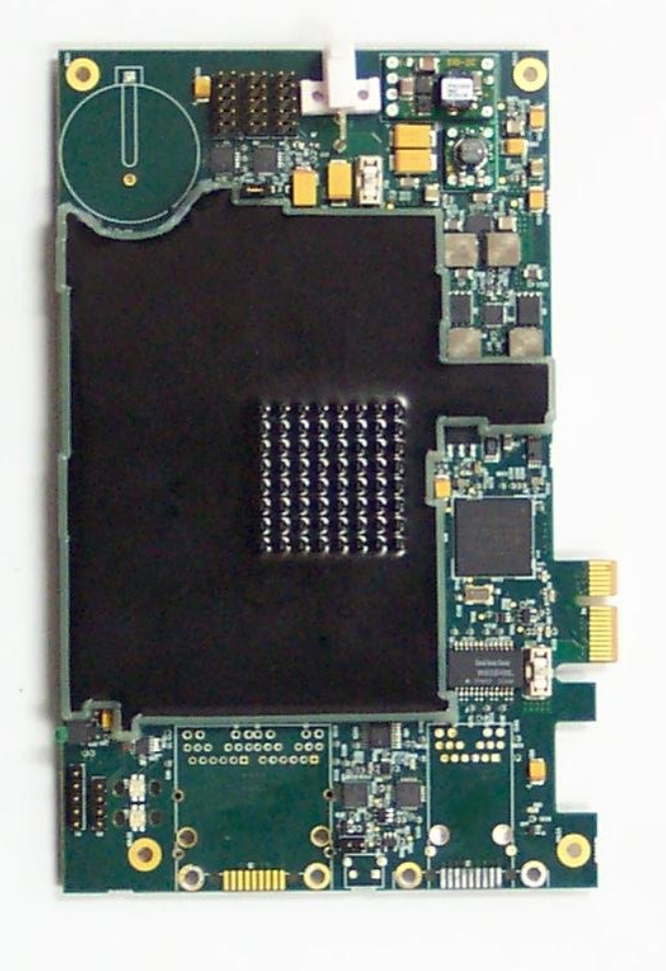
“Random” FIPS 140-2 example
EXP9000 Hardware Security Module (07/2011)
http://csrc.nist.gov/groups/STM/cmvp/documents/140-1/140sp/140sp1577.pdf
FIPS140-2, security level 3
Approved algorithms
Non approved algorithms
Roles and authentication
Critical Security Parameters (CSP)
Physical security mechanisms
…

Slide 18
Certifications: Common Criteria EAL 4-5+
CC does not directly measure the security of the system/device itself
only states level on which the system/device was tested
and against what Security Target
To achieve particular level, system must meet assurance requirements
Documentation, design analysis, functional/penetration testing
CC certifies that system followed certain rules when implementing target goals
Broader than FIPS 140-2

Slide 19
Certifications: Common Criteria (cont.)
Common levels for HSMs
EAL4: Methodically Designed, Tested and Reviewed
EAL5: Semi-formally Designed and Tested
Protection profiles
Specifies generic security evaluation criteria to substantiate vendors' claims (more technical)
Crypto Module Protection Profile
https://www.bsi.bund.de/cae/servlet/contentblob/480256/publicationFile/29291/pp0045b_pdf.pdf
+ means “augmented” version (current version + additional requirements, e.g., EAL4+)

Slide 20
Certifications: PCI HSM version 1,2
PCI HSM v1 (2009), v2 (2012)
https://www.pcisecuritystandards.org/security_standards/documents.php
Focused on area of payment transactions
Payment terminals, backend HSMs…
Payment transaction processing
Cardholder authentication
Card issues procedure
Set of logical and physical requirements relevant to payment industry
Closer to NIST FIPS 140-2 then to CC (more concrete requirements)

Slide 21
Cost of certification
Certification is usually done by commercial “independent” laboratories
Laboratories are certified by governing body
Quality and price differ
Usually payed for by device manufacturer
Certification pre-study
Verify if product is ready for certification
Full certification
Checklist if all required procedures were followed

Slide 22
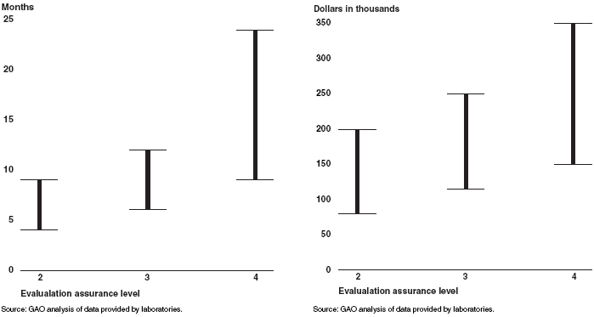
Cost of CC EAL (US GAO, 2006)

Slide 23
Be aware what is actually certified
Certified != secure
Satisfies defined criteria, producer claims are verified to be valid
Usually certified bundle of hardware and software
Concrete underlying hardware
Concrete version of firmware, OS and pre-loaded application
Certification usually invalidated when:
New hardware revision used (less common)
New version of firmware, OS, application (common)
Any customization, e.g., user firmware module (very common)
Pragmatic result
I’m using product that was certified at some point in time

Slide 24
How is certified product used?
Trade-off between security functionality and required data centre operations
Certification FIPS 140-2
users usually turn FIPS mode off (want use additional functionality)
“Almost” FIPS 140-2 mode
Everything FIPS except what user added (custom module)

Slide 25
HSM performance

Slide 26
HSM – performance I.
Limited independent public information available
Claim: “up to 9000 RSA-1024b operations / second”
But…
Real operations are not just raw crypto (formatting of messages…)
Longer key length may be needed (RSA-2048b)
Internal vs. external speed (data in/out excluded)
Measurements in “optimal” situations (single pre-prepared key, large data blocks…)
…

Slide 27
HSM – performance II.
F. Demaertelaere (2010)
https://handouts.secappdev.org/handouts/2010/Filip%20Demaertelaere/HSM.pdf
RSA 1024 bit private key operation: 100 – 7000 ops/sec
ECC 160 bit ECDSA signatures: 250 – 2500 ops/sec
3DES: 2 - 8 Mbytes/sec
AES: 6 - 40 Mbytes/sec (256 bit key)
No significant breakthrough in technology since 2010
Higher throughput achieved by multiple HSMs

Slide 28
HSM - load balancing, failover
HSMs often used in business critical scenarios
Authorization of payment transaction
TLS accelerator for internet banking
…
Redundancy and load-balancing required
Single HSM is not enough
At least two in production for failover
At least one or two for development and test

Slide 29
Steps of crypto operation
Hardware Security Module

Slide 30
Steps of cryptographic operation
Transfer input data
Transfer wrapped key in
Initialize unwrap engine
Unwrap data/key (decrypt/verify)
Initialize key object with key value
Initialize cryptographic engine with key
Start, execute and finalize crypto operation
Initialize wrap engine
Wrap data/key (encrypt/sign)
Erase key(s)/engine(s)
Transfer output data
Transfer wrapped key out

Slide 31
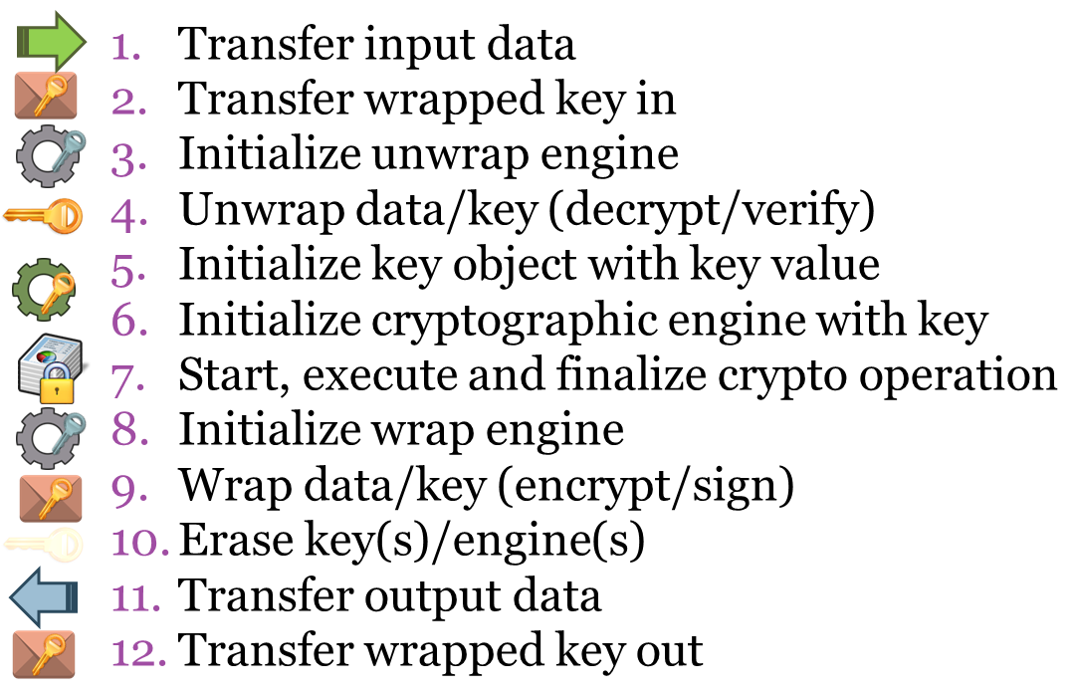
S1: One user, few keys
No sharing, all engines fully prepared

Slide 32
S2: One user, many keys
No sharing, frequent crypto context change

Slide 33
S3: Few users, few keys
Device is shared → isolation of users

Slide 34
S4:Few users, many keys
Limited sharing, frequent crypto context change

Slide 35
S5: Many users, many keys
High sharing, frequent crypto context change

Slide 36
HSM in cloud

Slide 37
Security topics in cloud environment
Move of legacy application into cloud
Previously used locally connected HSMs
Protection of messages exchanged between multiple cloud-based applications
Key exchange of used key without pre-distribution?
Volume encryption in cloud
Encrypted block mounted after application request (e.g., Amazon’s Elastic Block Storage)
Encrypted databases
Block encryption of database storage, encryption of rows/cells
Cryptography as a Service
Not only key management, also other cryptographic functionality

Slide 38
Use case: AWS Key Management Service
AWS Key Management Service Cryptographic Details, M. Campagna (2015)
https://d0.awsstatic.com/whitepapers/KMS-Cryptographic-Details.pdf
Centralized key management
Used by cloud-based applications
Used by any client application
Replication of wrapping keys into HSMs in different datacenters

Slide 39
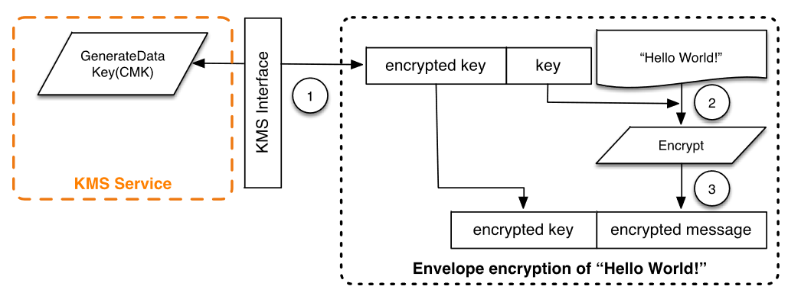
Usage scenario: envelope encryption
Protected message exchange between multiple (cloud-based) application
Random key generated in one application
Key protected (wrap) using trusted element (HSM)
Wrapped key appended to message
Key unwrapped in second application (via HSM)
https://d0.awsstatic.com/whitepapers/KMS-Cryptographic-Details.pdf

Slide 40
https://d0.awsstatic.com/whitepapers/KMS-Cryptographic-Details.pdf
What is difference to
PGP/S-MIME?

Slide 41
Who is trusted?
KMS Service to wrap envelope keys properly
KMS Service not to leak wrapping key
Cloud operator not to read unwrapped keys from memory

Slide 42
Use case: Amazon AWS CloudHSM
Amazon’s AWS CloudHSM
Based on SafeNet’s Luna HSM
Only few users can share one HSM
=> High initial cost (~$5000 + $1.88 per hour)
Note: significantly different service from AWS KMS
“Whole” HSM is available to single user/application, not only key (un)wrapping functionality
Suitable for legacy apps, compliancy requirements

Slide 43
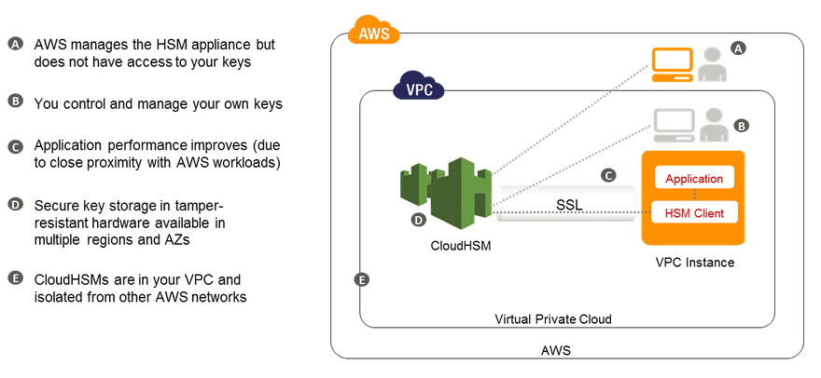
Use case: Amazon AWS CloudHSM

Slide 44
Cryptography as a service

Slide 45
Offloading security operations…
WS API: JSON

Slide 46
… into secured environment
How to import key(s) securely?
Which hardware platform to use?
High number of clients?

Slide 47
Cryptography as a Service (CaaS)
HSM
Notes:
Focus on device technology behind CaaS
(not business considerations)

Slide 48
Different levels of trust
CaaS with trusted server
Software operation only, HTTPS for in/out
Trust to server, CaaS platform is target, insider attack
CaaS with semi-trusted server
HTTPS for in/out, decrypted by server
Operation send into trusted hardware
CaaS platform still target
CaaS with untrusted server
HTTPS for in/out, but inner protection
Data decrypted/processed/encrypted inside device

Slide 49
Requirements – client view
Untrusted CaaS provider (handling secrets)
Secure import of app’s secrets - enrollment
Client<->CaaS communication security
Confidentiality/integrity of input and output data
Authentication of input/output requests
Key use control
Use constraints – e.g., number of allowed ops
Easy recovery from client-side compromise

Slide 50
Requirements – CaaS provider view
Massive scalability
W.r.t. users, keys, transactions…
Low latency of responses
Robust audit trail of key usage
Tolerance and recovery from failures
hardware/software failures
Easy to use API
also easy to use securely

Slide 51
CaaS - implementation issues
Software-only CaaS more vulnerable to attacks
Classic HSMs are not build for high-level of sharing
Performance degradation due to frequent context exchange
Logical separation only to few entities (16-32)
Physical separation on device-level
If interested, read more at
Architecture Considerations for Massively Parallel Hardware Security Platform, D. Cvrcek, P. Svenda (2015) http://crcs.cz/papers/space2015

Slide 52
HSM Security API
Hardware Security Module

Slide 53
Application Programming Interfaces (API)
Proprietary API (legacy or custom functions)
Standardized API - but proprietary library required (PKCS#11)
Cryptographic service providers – plugin into standardized API (CNG, CSP…)
Standardized API - no proprietary component (PIV, EMV CAP…)

Slide 54
PKCS#11, (PKCS#15), ISO/IEC 7816-15
Standards for API of cryptographic tokens
PKCS#11
http://www.rsa.com/rsalabs/node.asp?id=2133
software library on PC, rather low level functions
widely used, TrueCrypt, Mozilla FF/TB, OpenSSL, OpenVPN…
PKCS#15
http://www.rsa.com/rsalabs/node.asp?id=2141
both hardware and software-only tokens, identity cards…
superseded by ISO/IEC 7816-15 standard

Slide 55
PKCS#15 (https://github.com/OpenSC)
pkcs15-init
pkcs15-tool --dump
pkcs15-tool --list-keys
#!/bin/bash
sleep 5
pkcs15-init --create-pkcs15 --pin 12345678 --no-so-pin
sleep 5
pkcs15-init --store-pin --auth-id 01 --pin 12345678
--puk 12345678 --label “PV204 Tutorial"

Slide 56
PKCS#11
Standardized interface of security-related functions
vendor-specific library in OS, often paid
communication library->card proprietary interface
Functionality cover
slot and token management
session management
management of objects in smartcard memory
encryption/decryption functions
message digest
creation/verification of digital signature
random number generation
PIN management
Secure channel not possible!
developer can control only App→PKCS#11 lib
User Application
PKCS#11 interface
Vendor library
proprietary interface
Smartcard

Slide 57
PKCS#11 library
API defined in PKCS#11 specification
http://www.rsa.com/rsalabs/node.asp?id=2133
functions with prefix ‘C_’ (e.g., C_EncryptFinal())
header files pkcs11.h and pkcs11_ft.h
Usually in the form of dynamically linked library
cryptoki.dll, opensc-pkcs11.dll, dkck232.dll…
different filenames, same API functions (PKCS#11)
Virtual token with storage in file possible
suitable for easy testing (no need for hardware reader)
Mozilla NSS, SoftHSM…

Slide 58
Play with HSM (without HSM ☺)
SoftHSM
Software-only HSM
Open-source implementation of cryptographic store
Botan library for cryptographic operations
https://www.opendnssec.org/softhsm/
https://github.com/disig/SoftHSM2-for-Windows
Utimaco HSM simulator
https://hsm.utimaco.com/download/
Simulator of physical HSM (with PKCS#11 and other interfaces)

Slide 59
PKCS#11: Function prototypes
GetProcAddress() returns untyped function pointer
We need to cast this function pointer to known function type
Function types for PKCS#11 are in pkcs11_ft.h
typedef CK_RV CK_ENTRY (*FT_C_Encrypt)(
CK_SESSION_HANDLE hSession,
CK_BYTE_PTR pData,
CK_ULONG ulDataLen,
CK_BYTE_PTR pEncryptedData,
CK_ULONG_PTR pulEncryptedDataLen
);

Slide 60
PKCS#11: role model
Functions for token initialization
outside scope of the specification
usually implemented (proprietary function call), but erase all data on token
Public part of token
data accessible without login by PIN
Private part of token
data visible/accessible only when PIN is entered

Slide 61
PKCS#11: Load and init library
int LoadAndInitLibrary(const char* path, HINSTANCE* phLib) {
CK_RV status = CKR_OK;
FT_C_Initialize fInitialize = NULL;
if (phLib) {
if ((*phLib = LoadLibrary(path)) != NULL) {
// INITIALIZE LIBRARY
fInitialize = NULL;
if ((fInitialize = (FT_C_Initialize) GetProcAddress(*phLib, "C_Initialize")) != NULL) {
(fInitialize)(NULL);
}
else status = GetLastError();
}
else status = GetLastError();
}
else status = -1;
return status;
}

Slide 62
PKCS#11: Finalize and unload library
int FinalizeAndCloseLibrary(HINSTANCE hLib) {
CK_RV status = CKR_OK;
FT_C_Finalize fFinalize;
if (hLib != NULL) {
// UNINITIALIZE LIBRARY
fFinalize = NULL;
if ((fFinalize = (FT_C_Finalize) GetProcAddress(hLib, "C_Finalize")) != NULL) {
(fFinalize)(NULL);
}
FreeLibrary(hLib);
}
else status = -1;
return status;
}

Slide 63
PKCS#11: List tokens in system
Slots in system are equivalent to readers
C_GetSlotList
C_GetSlotInfo
Slot can be empty or with inserted token
C_GetTokenInfo

Slide 64
PKCS#11: Connect to token
When slot with token is found
C_OpenSession
public session is opened
Switch to private session by inserting PIN
C_Login
C_Logout
C_CloseAllSessions

Slide 65
PKCS#11: arguments lists
Most of the PKCS#11 functions accept parameters as CK_ATTRIBUTE[] array
Every value is encoded in single CK_ATTRIBUTE
CK_ATTRIBUTE_TYPE type
CK_VOID_PTR pValue
CK_ULONG ulValueLen
CK_CHAR label_public[] = {"Test1_public"}; //label of data object
CK_CHAR data_public[] = {“PV204 Public"};
CK_ATTRIBUTE dataTemplate_public[] = {
{CKA_CLASS, &dataClass, sizeof(dataClass)},
{CKA_TOKEN, &ptrue, sizeof(ptrue)},
{CKA_LABEL, label_public, sizeof(label_public)},
{CKA_VALUE, (CK_VOID_PTR) data_public, sizeof(data_public)},
{CKA_PRIVATE, &pfalse, sizeof(pfalse)} // is NOT private object
};
BYTE numAttributes_public = 5;
C_CreateObject(hSession, dataTemplate_public, numAttributes_public, &hObject);

Slide 66
PKCS#11: Store/search/get data
Data created in public/private part of the token
CKA_PRIVATE attribute
C_CreateObject()
User must be logged when creating/read private objects
You must find target object
attribute template, must be logged when searching private objects
C_FindObjectsInit()
C_FindObjects()
C_FindObjectsFinal()
Read data from object
C_GetAttributeValue()

Slide 67
PKCS#11: Cryptographic functionality
C_GetMechanismList to obtain supported cryptographic mechanisms (algorithms)
Many possible mechanisms defined (pkcs11t.h)
CK_MECHANISM_TYPE, not all supported
(compare to JavaCard API)
C_Encrypt, C_Decrypt, C_Digest, C_Sign, C_Verify, C_VerifyRecover, C_GenerateKey, C_GenerateKeyPair, C_WrapKey, C_UnwrapKey, C_DeriveKey, C_SeedRandom, C_GenerateRandom…

Slide 68
PKCS#11 - conclusions
Wide support in existing applications
Low-level API
Difficult to start with
Requires proprietary library by token manufacturer
Complex standard with vague specification => security problems
Hard to implement properly

Slide 69
Microsoft CNG
Cryptography API: Next Generation
Long-term replacement for CryptoAPI
http://msdn.microsoft.com/en-us/library/windows/desktop/aa376210%28v=vs.85%29.aspx
CNG API
Cryptographic Primitives
Key Storage and Retrieval
Key Import and Export
Data Protection API: Next Generation (CNG DPAPI)

Slide 70
Cryptographic Service Providers (CSP)
Generic framework with API for providers of cryptographic functionality
E.g., implementation of RSA
Different underlying storage (software vs. hardware-based)
Allows for runtime selection
Connect to target provider (usually identification string)
E.g., “Microsoft Base Cryptographic Provider v1.0”
Microsoft CSPs
http://msdn.microsoft.com/en-us/library/windows/desktop/aa386983%28v=vs.85%29.aspx
Java CSPs (JCE)

Slide 71
Chip Authentication Program (CAP)
Usage of chip-based banking card for additional operations
Designed for backward compatibility
existing cards can be used
Separate on-card applet is preferred, but not required
Designed by MasterCard as EMV-CAP
https://en.wikipedia.org/wiki/Chip_Authentication_Program
Adopted by Visa as Dynamic Passcode Authentication (DPA)
Hardware CAP readers available
Python software implementation
http://sites.uclouvain.be/EMV-CAP/Application/

Slide 72
CAP – supported commands
Supported operations
Code/identify
Response
Sign
Variants:
Mode 1: amount included in computed cryptogram
Mode 2: no amount, used for logging into system
Mode 2 + TDS
With transaction data signing
Multiple data fields of the transaction

Slide 73
Custom API pro/cons
Is design of own API better idea?
Pros:
derive api in line with use
focused api, no overhead
highly efficient implementation
Cons:
security holes by design
high effort
lost certification

Slide 74
Attacks against API

Slide 75
Attacks against PKCS#11
Lack of policy for function calls
functions are too “low-level”
sensitive objects can be manipulated directly
Key binding attack (C_WrapKey)
target key with double length is exported from SC
encrypted by unknown master key
attacker divide key into two parts and import them as wrapped key for ECB mode
perform brute-force search on each half separately
Missing authentication of wrapped key
attacker can create its own wrapping key
and ask for export of unknown key under his own wrapping key
Export of longer keys under shorter, …

Slide 76
RSA padding oracle attack
Allows to recover content of encrypted message even when key is unknown
Based on 1 bit leakage from correct/incorrect padding
Error status returned by device
(cycle) mess with encrypted message, send to card, inspect error
30 minutes with HSM, hours/days with smart card
See more at
http://secgroup.dais.unive.it/wp-content/uploads/2012/11/Practical-Padding-Oracle-Attacks-on-RSA.html

Slide 77
Tookan tool
Formal verification with real device model
probe PKCS#11 token with multiple function calls
automatically create formal model for token
run model checker and find attack
try to execute attack against real token
http://secgroup.dais.unive.it/projects/tookan/

Slide 78
Conclusions
Hardware Security Module is device build for security and performance of cryptographic operations
Security certifications (but be aware of limits)
Initially mostly for banking sector
Now more widespread (TLS, key management..)
Diverse APIs, potential logical attacks

