Slide 1
PV204 Security technologies
Rootkits, reverse engineering of binary applications, whitebox model
Petr Švenda svenda@fi.muni.cz
Faculty of Informatics, Masaryk University

Slide 2
What is planned for this lecture?
Rootkits (and defences)
Reverse engineering (of binary applications)
Whitebox attacker model

Slide 3
K. Thompson – Reflections on Trusting Trust
Subverted C compiler (Turing Award Lecture, 1983)
Adds additional functionality for selected compiled programs
E.g., login cmd: log password or allow user with specific name
Inspection of login’s source code will not reveal any issues
Adds malicious functionality of compiler into binary of compiler compiled with already subverted compiler
Inspection of source code of compiler will not reveal any problem
How can we detect modified login binary?
Expected hash, digital signatures
What if modified signature verification tool?

Slide 4
Rootkits

Slide 5
Rootkit definition
Root-kit
root user *nix systems
kit set of tools to operate/execute commands
Rootkit is piece or collection of software
Designed to enable access where it would be otherwise denied
Tries to hide(“cloak”) its presence in system
Installed after obtaining privileged access
Privileged escalation, credentials compromise, physical access…
Rootkit != exploit (rootkit usually installed after exploit)
Rootkit is usually accompanied with additional payload
Payload does the actual (potentially malicious) work

Slide 6
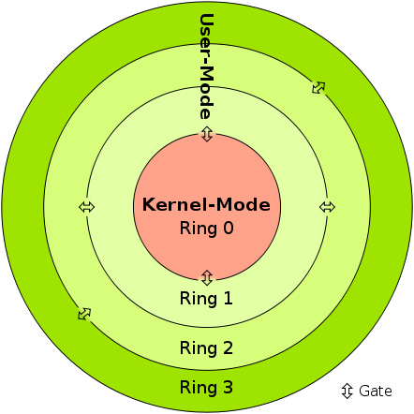
Protection rings
Idea: introduce separate runtime levels
crash in level X causes issue only in levels >=X
Direct support provided by CPU architectures
Ring 3: unprivileged user programs
Ring 2/1: device drivers
Ring 0: kernel programs
Performance penalty associated with ring switching
In practice, only 3 and 0 are commonly used
Captures only rings/levels starting with OS
Levels -1/-2/-3 introduced for layers below OS
Sven, Licensed under CC BY-SA 3.0 via Commons

Slide 7
Rootkit
Ring level
Ring “3+”
Managed code rootkits
Managed code (runtime, JVM)
Ring 3
User-mode rootkits
User-mode
Ring 1,2
Device drivers
Kernel rootkits
Ring 0
OS kernel, device drivers
Ring -1
Hypervisory-level rootkits
Hypervisory-level (VT-x, AMD-V)
Ring -2
System Management Mode, BIOS
SMM abuse, bootkits
Ring -3
Firmware, hardware
FW/HW rootkits

Slide 8
Principal ways of detection of rootkits
Detection running on system, same or higher level
Flaws in rootkit cloaking, side-channel
Detection running on system, lower level
Not controlled by rootkit, cannot cloak itself
Detection via (offline) image of system / memory
Rootkit is not running => cannot cloak itself

Slide 9
Types of offensive software (wrt OS)
Alternative taxonomy – how interfaced with system
Category | Interface to system | Location | Examples
Type 0 | Existing APIs | Rings 3, 0 | Filter driver, Browser helper objects, injected DLL/thread
Type I | Modified static components | Rings 3, 0 | Hooking, patching, bootkits
Type II | Modified dynamic components | Rings 3, 0 | Direct kernel object modification, Rogue callbacks
Type III | Outside of the system | Rings -1, -2,-3 | Rogue hypervisor, firmware mod
J. Rutkowska, Introducing Stealth Malware Taxonomy

Slide 10
Detection of rootkits
Signature-based
Files, mutexes… present on infected system
Behavioural-based (lecture 7)
Communication, hooks, latency…
Integrity checking
Detected modification of critical system files
Prevent execution of modified files
Memory dumps (lecture 8)
Detect rootkit when not running (!cloaked)
Rootkit detection tools (lectures 7,8)

Slide 11
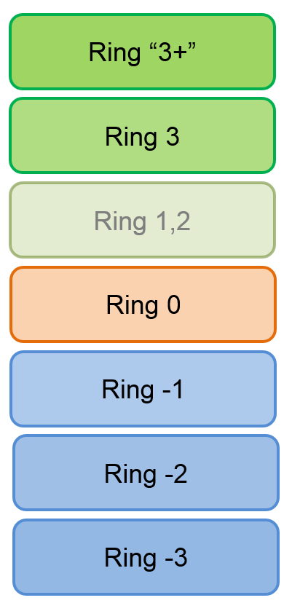
User-mode rootkits (Ring 3)
Injects payload into other user applications
Injection of modified dlls (user app will use different CreateFile)
Modification of applications (modification of CreateFile)
Interception of messages
RegisterWindowMessage()
Function hooking
More generic hooks (SetWindowsHookEx()) – window manager
User application-specific hooks (plugins, example browser hook)
File-system filters
Detect access to files by user application

Slide 12
Managed code rootkits (MCR) (Ring 3)
Ring 3 (level for runtime / VM)
Targets runtime environments for interpreted code
.NET VM, Java VM and Dalvik runtime…
Large attack surface for MCR
Attacking runtime class libraries
Attacking JIT compiler
Abusing runtime instrumentation features
Extending language with malware API
Object-oriented malware (inside OO runtime)
E. Metula: Managed Code Rootkits (Syngress)

Slide 13
Kernel-mode rootkits (Ring 0)
Runs with highest system privileges
Usually device drivers and loadable modules
Device drivers in MS Windows
Loadable kernel modules in Linux
Direct kernel object manipulation
Data structures like list of processes…
System Service Descriptor Table (SSDT) hook
System call table hook
Operating system may require mandatory drivers signing
More difficult to insert malicious driver
Still possible (compromised private keys: Stuxnet & Realtek’s keys)
Rootkits below OS level

Slide 14
Rootkits below OS level

Slide 15
Hypervisory-level rootkits (Ring -1)
Virtual-machine based rootkit (VMBR)
Type II hypervisors (VM under ordinary OS host)
Based on CPU hardware virtualization features
Intel VT or AMD-V
Rootkit hosts original target as virtual machine
And intercepts all relevant hardware calls
Examples: SubVirt, BluePill (AMD-V, Intel VT-x)

Slide 16
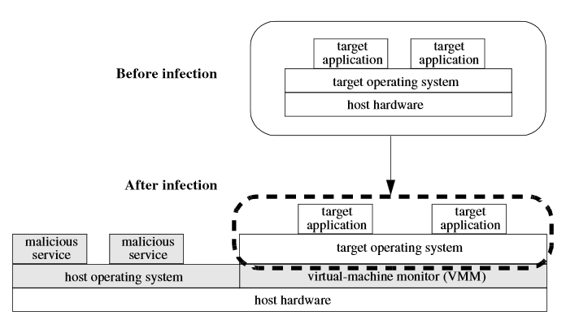
Hypervisory-level rootkits (Ring -1)
King et al: SubVirt: Implementing malware with virtual machines

Slide 17
Defense against hypervisory-level rootkits
Run detection/prevention on lower level
Detect by timing differences of operations
System is emulated => side-channel info (timings…)
Read and analyze HDD physical memory
After physical removal from (infected) computer
Boot from safe medium (CD, USB, network boot)
inspect before VMBR loads
But VMBR can emulate shutdown / reboot
Physical power unplug recommended
Trusted boot (based on TPM, lecture 13)

Slide 18
System Management Mode abuse (R.-2)
System Management Mode (SMM)
x86 feature since Intel 386, all normal execution is suspended
Used for power management, memory errors, hardware-assisted debugger…
High-privilege mode (Ring -2)
SMM entered via system management interrupt (SMI)
System cannot override or disable the SMI
Target for rootkits
Modify memory, loaders, MBR…

Slide 19
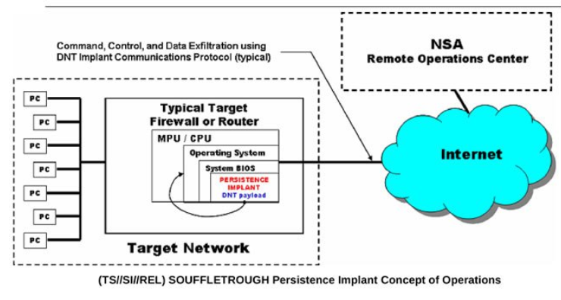
SMM Example: SOUFFLETROUGH implant
https://en.wikipedia.org/wiki/NSA_ANT_catalog
http://leaksource.info/2013/12/30/nsas-ant-division-catalog-of-exploits-for-nearly-every-major-software-hardware-firmware/

Slide 20
Bootkit rootkits (Ring -2)
Bootkit = Rootkit + Boot capability
Infect startup code
Master Boot Record (MBR)
Volume Boot Record (VBR)
Boot sector, BIOS routines…
“Evil maid” attack
Can be used to attack full disk encryption
Assumption: user will left device physically unattended
Legitimate bootloader replaced (+ key capture)

Slide 21
Full-disk encryption compromise
Full-disk encryption used to encrypt all data
Laptop powered down to prevent Coldboot or FireWire-based attacks (read key from memory)
Laptop left unattended (“Evil maid” enters)
USB used to read part of first sector of disk
If TrueCrypt/Bitlocker loader, then insert malicious bootloader
User is prompted with forged bootloader
Password is stored
How to transfer saved password / data to attacker?
Second visit of Evil maid
http://theinvisiblethings.blogspot.co.uk/2009/10/evil-maid-goes-after-truecrypt.html

Slide 22
Bootkit defenses
Prevention of physical access
Problematic for portable devices
Trusted boot (static vs. dynamic root of trust)
More in Lecture 13 (Trusted boot)
But bootloader must authenticate itself to user
E.g., present image encrypted by key stored in TPM
Before user enters its password
Defense by external verification of bootloader integrity
verify relevant unencrypted parts of disk (external USB)

Slide 23
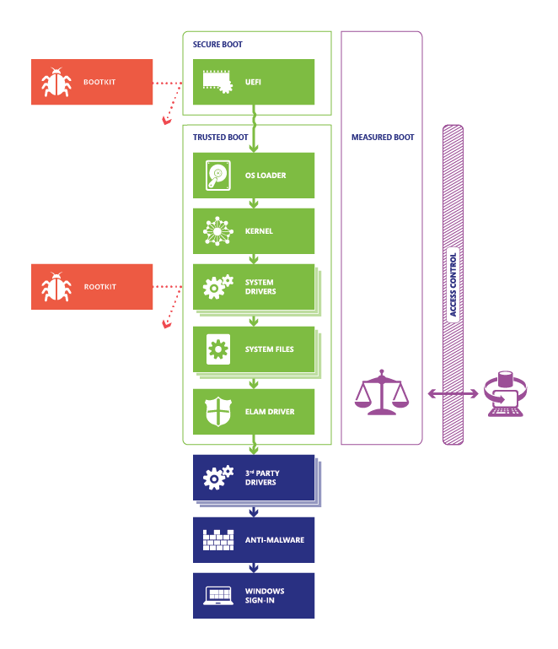
http://technet.microsoft.com/en-US/windows/dn168167.aspx

Slide 24
Firmware / hardware rootkits (Ring -3)
Persistent malware image in hardware
Network card, router, hard drive…
Can run even after removal of device from target computer
Once device is powered again

Slide 25
Anti-forensic techniques
How rootkits protects itself?
Common system API functions used for hooking
Hiding files
Hiding processes
RAM only rootkits
Data destruction
Data concealment
Data transformation and fabrication

Slide 26
Legitimate uses

Slide 27
Legitimate uses of rootkits
To whom is legitimacy measured?
Hide true nature of network “honeypots”
Protection of AV software against termination
Anti-theft protections
Digital rights management

Slide 28
Sony BMG Extended copy protection
Rootkit developed for (and approved) by Sony
Intended to limit possibility for disk copy
Users were not notified (silently installed after CD insert)
Digital rights management for Sony
To hide itself, any file starting with $sys$ was hidden
Detected by M. Russinovich’s RootkitRevealer
After public disclose, other malware started to hide itself by naming its files as $sys$ (user was already “infected”)
Sony released patch for removal (web-based uninstaller)
Even more serious flaw introduced (any visited page can install and run program)
Resulted in class-action lawsuit against Sony BMG

Slide 29
Reverse engineering

Slide 30
Reverse engineering
A process of knowledge or design extraction from final product (usually man-made)
Engineering:
Mental model → blueprints/source-code → product/binary
Reverse engineering (back engineering):
From product back to knowledge or design
Blueprints/source-code might be also recreated
Not necessary/possible to perfectly recreate design
Engineering might be loose transformation
Back engineering might not be perfect/complete

Slide 31
Reverse engineering is general process We will focus on software binaries only

Slide 32
Reverse engineering - legal issues
Reverse engineering is legal when
Own binary without documentation
Anti-virus research, Forensics…
Interoperability, Fair use, education
Problem with some copyright laws
not only selling circumvented content, but also attempt to circumvent is illegal
EFF Coders’ Rights Project Reverse Engineering FAQ
Legal doctrines, Risky aspects, Selected decisions
https://www.eff.org/issues/coders/reverse-engineering-faq

Slide 33
How to start reverse engineering
Learn basic concepts (compilers, memory, OS…)
See how source-code translates into binary
Try tools on simple examples (own code, tuts)
Utilize other knowledge (communication logs…)
Have fun! ☺

Slide 34
Basics
Debugger vs. debugger with binary modification capabilities
E.g., Visual Studio vs. OllyDbg
Disassembler vs. debugger
Static vs. dynamic code analysis
Disassembler vs. decompiler
Native code → assembler → source code
Native code vs. bytecode
Different instruction set, different execution model
Registry-based vs. stack-based execution

Slide 35
Compilation to native binary (C/C++)
Preprocessing "gcc -E hello.c > hello.i"
Macro expansion, include insertion…
Compilation "gcc -s hello.i"
Syntactic code control, most errors reported here
Assembly "as hello.s -o hello.o"
Compilation from assembler to native executable
Link "gcc hello.o"
Substitution of relative addresses by absolute
Ordinary build executes all steps together

Slide 36
Mixed source code/assembler in IDE
Most current IDE supports mixed source code/assembler instructions mode (Visual Studio, QT Creator...)
Mode is usually available only during a debugging
Write simple code (e.g., if then else condition), insert breakpoint and start debugging
Switch to mixed mode
Visual Studio→RClick→Go to disassembly
QTCreator→Debug→Operate by Instruction
Easy way to learn how particular source code is translated into assembler code

Slide 37
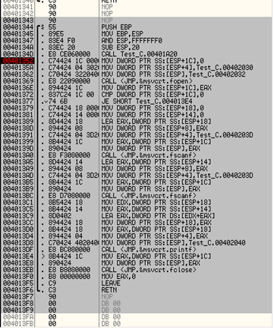
#include <stdio.h>
int main() {
FILE* file = NULL;
file = fopen("values.txt", "r");
if (file) {
int value1 = 0;
int value2 = 0;
fscanf(file, "%d", &value1);
fscanf(file, "%d", &value2);
value1 = value1 + value2;
printf("Result: %d", value1);
}
fclose(file);
}
Dump of assembler code for function main:
2 int main() {
0x00401344 <+0>: push %ebp
0x00401345 <+1>: mov %esp,%ebp
0x00401347 <+3>: and $0xfffffff0,%esp
0x0040134a <+6>: sub $0x20,%esp
0x0040134d <+9>: call 0x401a20 <__main>
3 FILE* file = NULL;
0x00401352 <+14>: movl $0x0,0x1c(%esp)
4 file = fopen("values.txt", "r");
0x0040135a <+22>: movl $0x402030,0x4(%esp)
0x00401362 <+30>: movl $0x402032,(%esp)
0x00401369 <+37>: call 0x401c90 <fopen>
0x0040136e <+42>: mov %eax,0x1c(%esp)
...
17 }
0x004013f5 <+177>: leave
0x004013f6 <+178>: ret
End of assembler dump.
Original C source code

Slide 38
Most common instructions/structures
Most common ASM instructions
Load/Store from to registers: MOV, LEA
Arithmetic: ADD, INC…
Relational: CMP, TEST
Jumps: JMP, J*
Functions: CALL, RET
Example of typical structures (C→ ASM)
Conditional jump, for loop, function call…
Familiarize via mixed source code/assembler in IDE
Be aware of debug/release differences

Slide 39
Jump operation
Jump operation
Unconditional JMP – jump every time
Conditional - based on the current value of flag(s)
JA* Jump if (unsigned) above - CF=0 and ZF=0
JB* Jump if (unsigned) below - CF=1
JE** Jump if equal - ZF=1
JG* Jump if (signed) greater - ZF=0 and SF=OF (SF=SignFlag)
JGE*Jump if (signed) gtr or equal - SF=OF
JL* Jump if (signed) less - SF != OF (!= is not)
JLE* Jump if (signed) less or equal - ZF=1 and OF != OF
JMP** Jump - Jumps always
JNE** Jump if not equal - ZF=0

Slide 40
Conditional branching
Conditional branching is usually realized by two consecutive operations:
Comparison operation setting Flags register
a) Conditional jumping operation to address based on Flags (Branch 1)
B) If not jumped then Branch 2 code is directly present starting with a next instruction, or unconditional jump JMP to Branch 2 is present

Slide 41
Comparison operations
CMP EAX, -1 - will set flag(s) in Registers
Zero and Sign flags are usually of interest
If two values are same (EAX == -1), Zero flag is set to 1
TEST A, B (usually TEST EAX, EAX)
logical AND operation
results not saved, Flags are set
TEST EAX, EAX will test if value in EAX is equal to 0
If EAX == 0 then Zero flag == 1, 0 otherwise

Slide 42
Compilation to bytecode (Java, C#)
Source code compiled into intermediate bytecode
Java bytecode,.NET CLI ...
Intermediate code interpreted by virtual machine
Just-in-time compilation
Intermediate code is compiled by VM into native code
Improve performance significantly
Relevant for dynamic analysis, not for static analysis
Usually easier to understand then assembler code

Slide 43
Structure of Executable

Slide 44
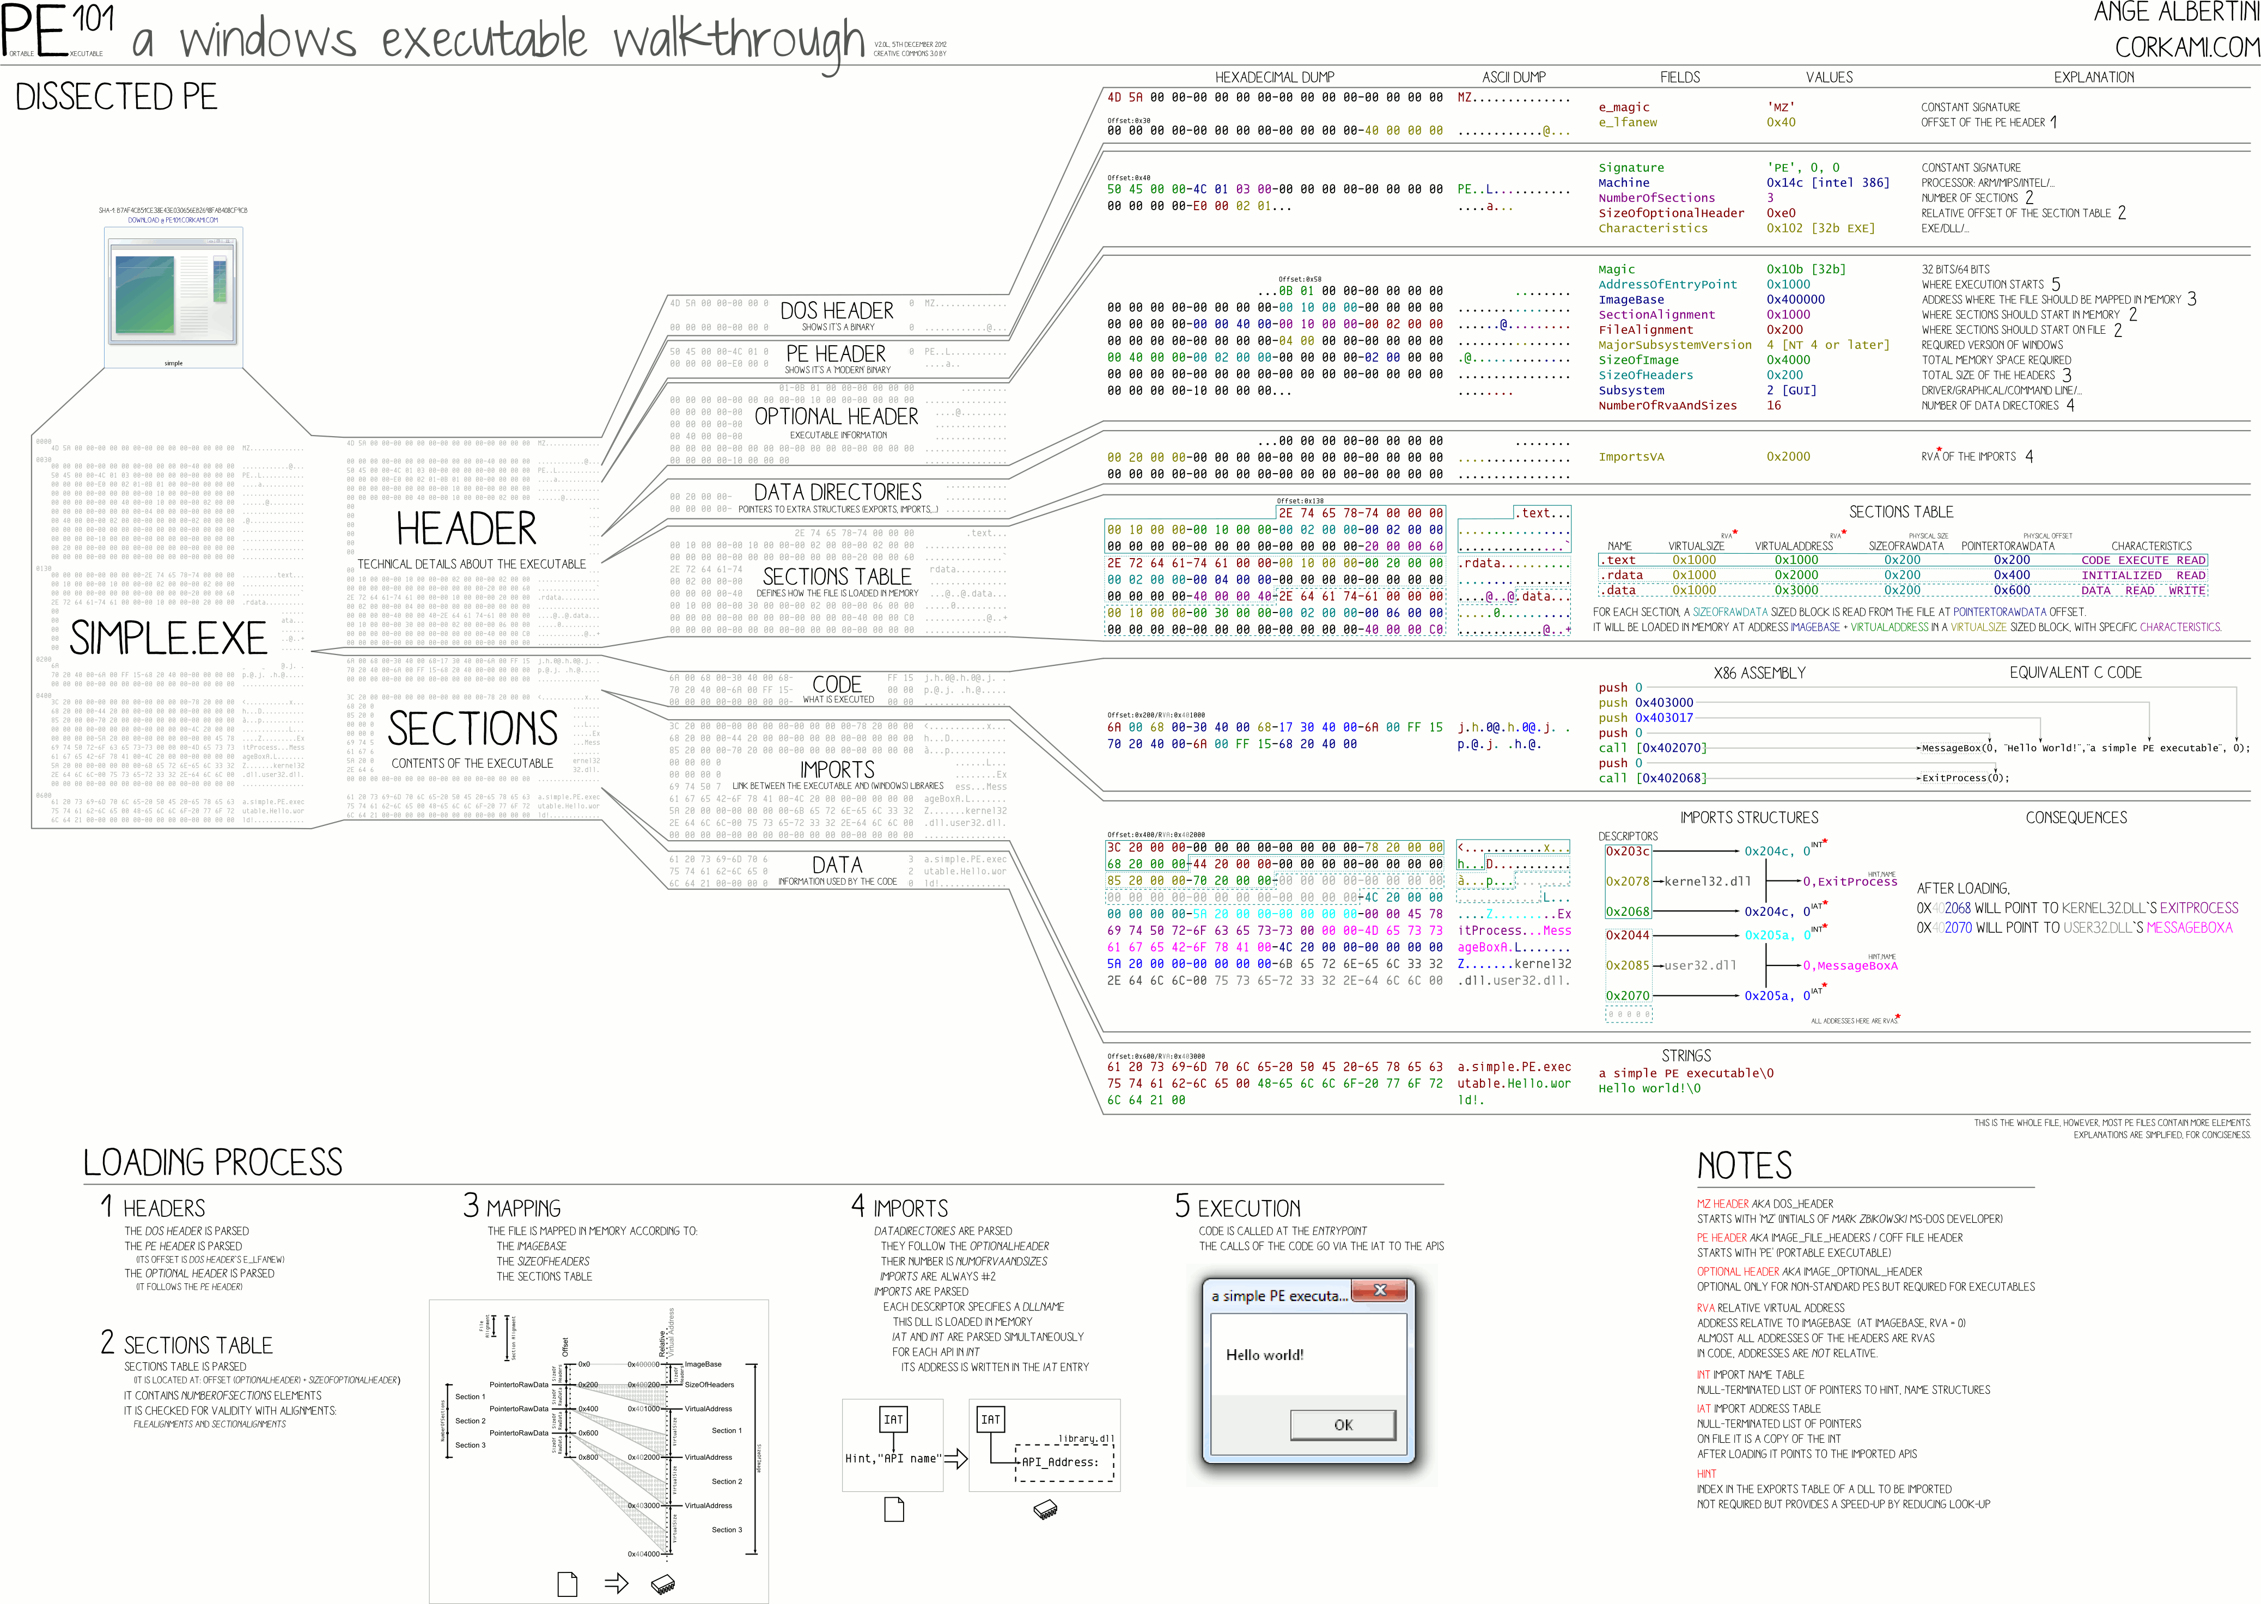
Structure of Win32 binary executable
PE File Format

Slide 45
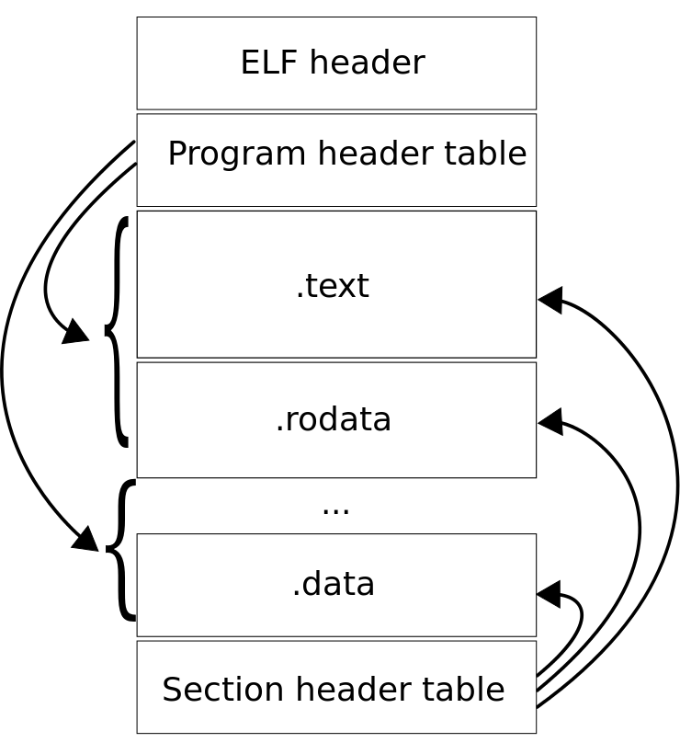
Structure of Linux binary executable
ELF format
"Elf-layout--en" by Surueña - Own work.
Licensed under CC BY-SA 3.0 via Commons

Slide 46
Structure of Java bytecode classfile
https://commons.apache.org/proper/commons-bcel/manual.html

Slide 47
Registry vs. stack-based execution

Slide 48
Registry-based execution
Values loaded (mov) from RAM to CPU registers
CPU operation (add, inc, test…) is executed
Resulting value is stored back (mov) to RAM
Name of the registers
EAX 32bit, AX 16bit, AH/AL 8bit
EIP ... next address to execute (instruction pointer)
EBX ... usually loop counter
Registers
Z – zero flag, C – carry flag, S – sign flag…

Slide 49
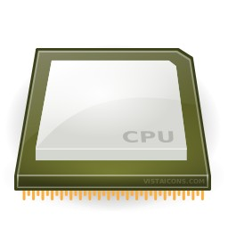
Add two numbers from file (HDD)
in.txt
"10 20"
Read values from HDD into RAM memory
fscanf(file, "%d", &value);
Move value from RAM memory to CPU registry
MOV 0x48(%esp),%eax
MOV 0x44(%esp),%edx
Execute CPU instruction (e.g., ADD)
ADD %edx,%eax
Transfer result from CPU register to RAM memory
MOV %eax, 0x48(%esp)
Save result from RAM memory to file
fprintf(file, "%d", value);
10
20
10
value = value + value2;
30
20
30
out.txt
"30"

Slide 50
Stack-based execution
Bytecode contains sequence of operations
Bytecode contains constants
All intermediate values stored on stack
Interpret:
Reads next operation from bytecode
Pop operand(s) for next operation from top of stack
Executes operation
Push result of operation on top of stack
No registers are used
all operands for current operation at the top of the stack

Slide 51
Example: JavaCard bytecode
.method Encrypt(Ljavacard/framework/APDU;)V 129 {
.stack 6;
.locals 3;
.descriptor Ljavacard/framework/APDU; 0.10;
L0: aload_1;
invokevirtual 30;
astore_2;
aload_1;
invokevirtual 42;
sstore_3;
sload_3;
bspush 8;
srem;
ifeq L2;
L1: sspush 26384;
invokestatic 41;
goto L2;
L2: getfield_a_this 1;
aload_2;
sconst_5;
sload_3;
getfield_a_this 10;
sconst_0;
invokevirtual 43;
pop;
getfield_a_this 10;
sconst_0;
aload_2;
sconst_5;
sload_3;
invokestatic 44;
pop;
aload_1;
sconst_5;
sload_3;
invokevirtual 45;
return;
}
// ENCRYPT INCOMING BUFFER
void Encrypt(APDU apdu) {
byte[] apdubuf = apdu.getBuffer();
short dataLen = apdu.setIncomingAndReceive();
short i;
// CHECK EXPECTED LENGTH (MULTIPLY OF 64 bites)
if ((dataLen % 8) != 0)
ISOException.throwIt(SW_CIPHER_DATA_LENGTH_BAD);
// ENCRYPT INCOMING BUFFER
m_encryptCipher.doFinal(apdubuf, ISO7816.OFFSET_CDATA, dataLen,
m_ramArray, (short) 0);
// COPY ENCRYPTED DATA INTO OUTGOING BUFFER
Util.arrayCopyNonAtomic(m_ramArray, (short) 0, apdubuf,
ISO7816.OFFSET_CDATA, dataLen);
// SEND OUTGOING BUFFER
apdu.setOutgoingAndSend(ISO7816.OFFSET_CDATA, dataLen);
}
Original JavaCard source code
Resulting JavaCard bytecode

Slide 52
Disassembling
Recovering information from binary executables

Slide 53
Disassembling of native binaries
Reversing process of compilation
Back from native code to ASM
Compilation/assembly is loose process:
Variable/function names
Unused structures
Performance optimization applied during compilation
Wide range of native platforms
Differences in support and performance of disassemblers
Bytecode is already on the level of “disassembled” binaries (usually easier to understand)

Slide 54
Structured code vs. sequence of executed ops
Structured code contains code for all branches
runnable binary/bytecode
Information loss in compiled binary
Stripped metadata and debugging symbols
Compiler optimizations
Sequence of executed instructions only from branches taken
E.g., power analysis of smart card

Slide 55
Structured code vs. sequence of executed ops
(bytecode)
getfield_a_this 0;
sconst_0;
baload;
sconst_1;
srem;
bastore;
(source code)
m_ram1[0] = (byte) (m_ram1[0] % 1);
compiler
oscilloscope
(power trace)
Bytecode reconstruction
(partial bytecode)
…; sconst_???; baload; sconst_???; srem; bastore;…

Slide 56
Tool: OllyDbg
Free disassembler and binary debugger
Works with Windows 32b binaries only
OllyDbg 64b version in development
Easy to start with, many tutorials
Designed to make changes in binary easy
Change of jumps/data (valid PE is recreated)
http://www.ollydbg.de/

Slide 57
Tool: IDA Pro
Interactive Disassembler is legendary full-fledged disassembler with ability to disassemble many different platforms
Free version available for non-commercial uses
http://www.hex-rays.com/idapro/idadownfreeware.htm
Free version disassemble only Windows binaries
Very nice visualization and debugger feature (similar as OllyDbg)

Slide 58
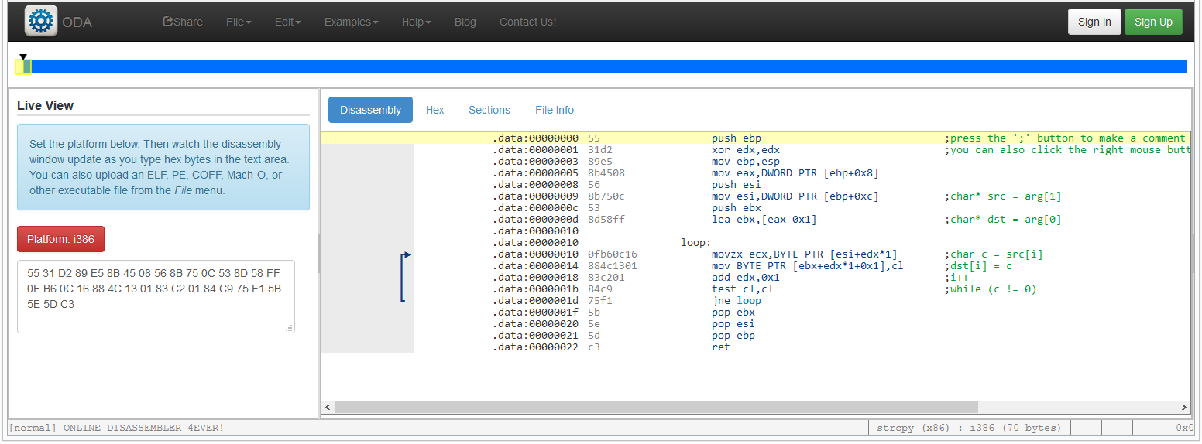
Tool: Online disassembler (ODA)
https://www.onlinedisassembler.com/odaweb/

Slide 59
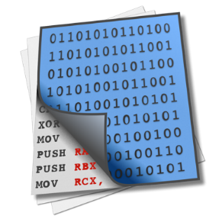
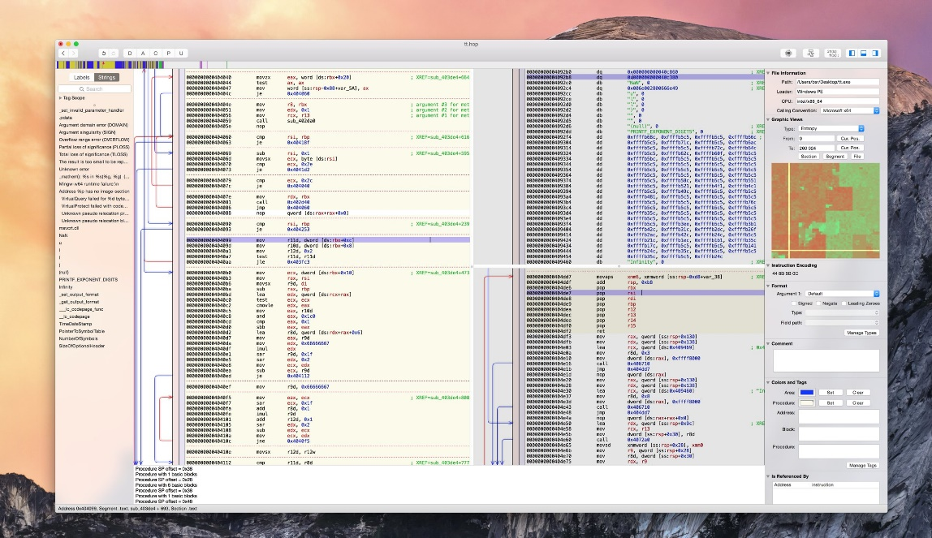
Tool: Hopper diassembler and debugger
Linux and OS X reverse engineering tool
Older version supported Windows, but not anymore
http://www.hopperapp.com
Additional support for on Objective-C

Slide 60
Control flow graph
Graph representation of control flow
Separated functions/blocks
connection by jump instructions

Slide 61
Decompilation
Native code decompilation
Decompiler produces source code from binary/ASM/bytecode code
Decompiler needs to do disassembling first and then try to create code that will in turn produce binary code you have at the beginning
Resulting code will NOT contain information removed during compilation (comments, function names, formatting...)
Bytecode decompilation
usually much easier (more information preserved)
Mapping between source code and bytecode is less ambiguous
Compilation of decompiled bytecode produces similar bytecode

Slide 62
Decompiler tools
C/C++
IDA
REC Studio 4.0, http://www.backerstreet.com/rec/rec.htm
Retargetable Decompiler, https://retdec.com/
Java bytecode
DJ Java Decompiler, http://neshkov.com/dj.html
Java Decompiler, http://jd.benow.ca/
.Net bytecode
dotPeek, https://www.jetbrains.com/decompiler/
ILSpy, http://ilspy.net/

Slide 63
Resources
Reverse Engineering for Beginners
http://beginners.re/Reverse_Engineering_for_Beginners-en.pdf
Great resource, many examples, tutorials
Tutorials for You: http://www.tuts4you.com
The Reverse Code Engineering Community: http://www.reverse-engineering.net/
Disassembling tutorial http://www.codeproject.com/KB/cpp/reversedisasm.aspx

Slide 64
How to protect
Protections Against Reverse Engineering

Slide 65
Standard vs. whitebox attacker model (symmetric crypto example)

Slide 66
Whitebox attacker model
The attacker is able to:
inspect and disassemble binary (static strings, code...)
observe/modify all executed instructions (OllyDbg...)
observe/modify used memory (OllyDbg, memory dump...)
How to still protect value of cryptographic key?
Who might be whitebox attacker?
Mathematician (for fun)
Security researcher / Malware analyst (for work)
DRM cracker (for fun&profit)
...

Slide 67
Classical obfuscation and its limits
Time-limited protection
Obfuscation is mostly based on obscurity
add bogus jumps
reorder related memory blocks
transform code into equivalent one, but less readable
pack binary into randomized virtual machine...
Barak’s (im)possibility result (2001)
family of functions that will always leak some information
but practical implementation may exists for others
Cannetti et. al. positive results for point functions
Goldwasser et. al. negative result auxiliary result

Slide 68
CEF&CED
Computation with Encrypted Data and Encrypted Function

Slide 69
Scenario
We’d like to compute function F over data D
secret algorithm F or sensitive data D (or both)
Solution with trusted environment
my trusted PC, trusted server, trusted cloud…
Problem: can be cloud or client really trusted?
server hack, DRM, malware...
Whitebox attacker model
controls execution environment (debugging)
sees all instructions and data executed

Slide 70
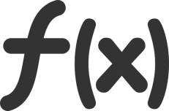
CEF
Computation with Encrypted Function (CEF)
A provides function F in form of P(F)
P can be executed on B’s machine with B’s data D as P(D)
B will not learn function F during computation
A
B

Slide 71
CED
Computation with Encrypted Data (CED)
B provides encrypted data D as E(D) to A
A is able to compute its F as F(E(D)) to produce E(F(D))
A will not learn D
A
B

Slide 72
CED via homomorphism
Convert your function into circuit with additions (xor) and multiplications (and) only
Compute addition and/or multiplication “securely”
an attacker can compute E(D1+D2) = E(D1)+E(D2)
but will learn neither D1 nor D2
Execute whole circuit over encrypted data
Partial homomorphic scheme
either addition or multiplication is possible, but not both
Fully homomorphic scheme
both addition and multiplication (unlimited)

Slide 73
Partial homomorphic schemes
Example with RSA (multiplication)
E(d₁).E(d₂) = d₁e . d₂e mod m = (d₁d₂)^{e} mod m = E(d₁d₂)
Example Goldwasser-Micali (addition)
E(d₁).E(d₂) = x^{d1}r₁^{2 .} X^{d2}r₂² = x^{d1+d2}(r₁r₂)² = E(d₁⊕d₂)
Limited to polynomial and rational functions
Limited to only one type of operation (mult or add)
or one type and very limited number of other type
Slow – based on modular mult or exponentiation
every operation equivalent to whole RSA operation

Slide 74
Fully homomorphic scheme - usages
Outsourced cloud computing and storage
FHE search, Private Database Queries
protection of the query content
Secure voting protocols
yes/no vote, resulting decision
Protection of proprietary info - MRI machines
expensive algorithm analyzing MR data, HW protected
central processing restricted due to private patient’s data
…

Slide 75
Fully homomorphic scheme (FHE)
Holy grail - idea proposed in 1978 (Rivest et al.)
both addition and multiplication securely
But no scheme until 2009 (Gentry)!
based on lattices over integers
noisy FHE usable only for few operations
combined with repair operation (enable to use it for more again)

Slide 76
Fully homomorphic scheme - practicality
Not very practical (yet ☺) (Gentry, 2009)
2.7GB key & 2h computation for every repair operation
repair needed every ~10 multiplication
FHE-AES implementation (Gentry, 2012)
standard PC ⇒ 37 minutes/block (but 256GB RAM)
Gentry-Halevi FHE accelerated in HW (2014)
GPU / ASICS, many blocks in parallel => 5 minutes/block
Replacing AES with other cipher (Simon) (2014)
2 seconds/block
Very active research area!

Slide 77
White-box attack resistant cryptography
Problem limited from every cipher to symmetric cryptography cipher only
protects used cryptographic key (and data)
Special implementation fully compatible with standard AES/DES… 2002 (Chow et al.)
series of lookups into pre-computed tables
Implementation of AES which takes only data
key is already embedded inside
hard for an attacker to extract embedded key
Distinction between key and implementation of algorithm (AES) is removed

Slide 78
Whitebox transform

Slide 79
Impractical solution
Input block
Output block = AES(input, key_{X})
Secure, but 2¹²⁸ x 16B memory storage
00…00…00
10…01…11
Precomputed table
00…00…01
10…11…01
…
…
2¹²⁸
used as index into table
01…11…11
00…01…11
2¹²⁸
…
…
01…11…11
01…10…00
11…11…11
10…00…10

Slide 80
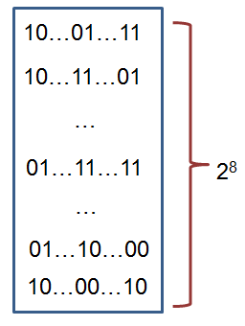
WBACR AES – some techniques
Pre-compute table for all possible inputs
practical for one 16bits or two 8bits arguments table with up to 2¹⁶ rows (~64KB)
AddRoundKey: data ⊕ key
8bit argument data, key fixed
Pack several operations together
AddRoundKey+SubBytes: T[i] = S[i ⊕ key];
Protect intermediate values by random bijections
removed automatically by next lookup
X = F⁻¹(F(X))
T[i] = S[F⁻¹(i) ⊕ key];

Slide 81
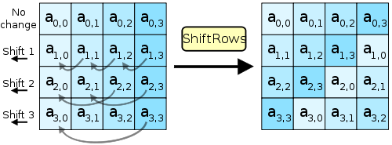
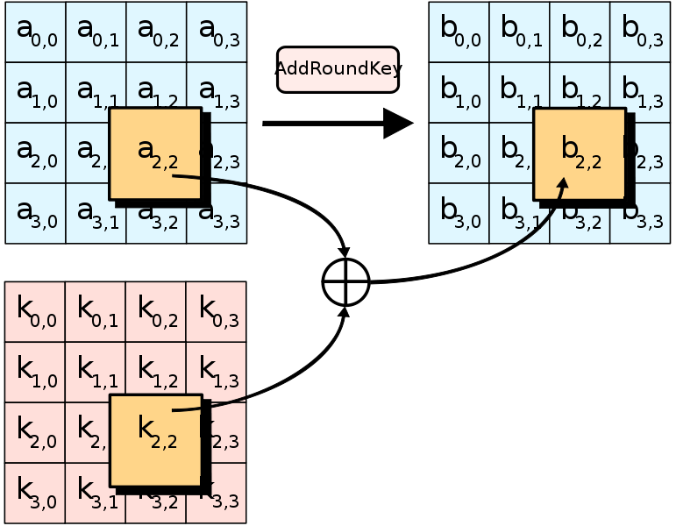
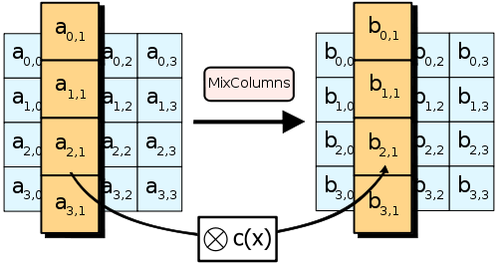
AES – short remainder (used ops)
Pictures taken from http://en.wikipedia.org/wiki/Advanced_Encryption_Standard

Slide 82
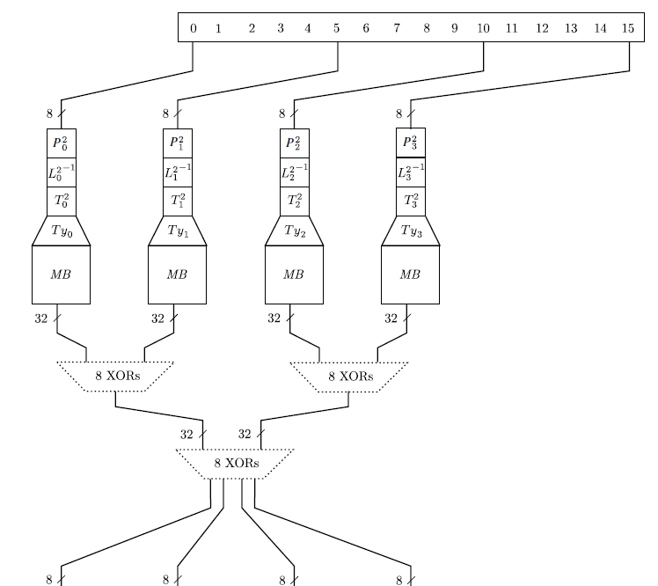
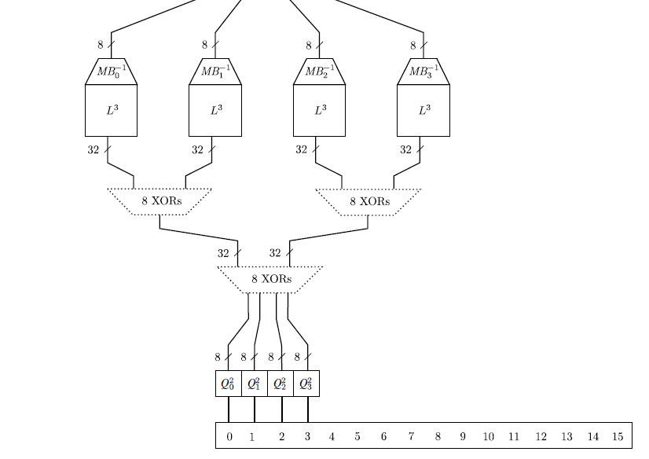

Slide 83
Whitebox cryptography lifecycle
[Secure environment]
Generate required key (random, database...)
Generate WAES tables (in secure environment)
[Potential insecure environment]
Compile WAES tables into target application
[Insecure environment (User PC)]
Run application and use WAES as usual (with fixed key)

Slide 84
AES
key
Environment outside control
of an attacker
makeTable()
precompTable
Environment under control
of an attacker
data
encrypted data
encrypt(data)

Slide 85
Resulting implementation
More difficult to detect that crypto was used
no fixed constants in the code
precomputed tables change with every generation
even two tables for same key are different
(but can still be found)
Resistant even when precomputed tables are found
when debugged, only table lookups are seen
key value is never manipulated in plaintext
transformation techniques should provide protection to key embedded inside tables

Slide 86
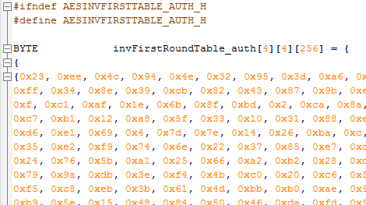
Demo – WAES
WAES tables generator
configuration options
*.h files with pre-computed tables
WAES cipher implementation
compile-in tables
tables as memory blob

Slide 87
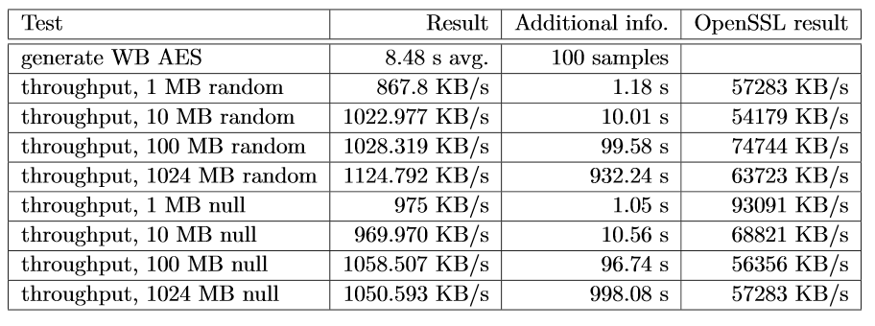
WAES performance
Intel Core i5 M560@2.67GHz
L. Bacinska, https://is.muni.cz//th/373854/fi_m/

Slide 88
WBACR AES - pros
Practically usable
implementation size ~800KB (tables)
speed ~MBs/sec (~6.5MB/s vs. 220MB/s)
Hard to extract embedded key
Complexity semi-formally guaranteed
(if the scheme is secure)
One can simulate asymmetric cryptography!
implementation contains only encryption part of AES
until attacker extracts key, decryption is not possible

Slide 89
WBACR AES - cons
Implementation can be used as oracle (black box)
attacker can supply inputs and obtain outputs
even if she cannot extract the key
(can be partially solved by I/O encodings)
Problem of secure input/output
protected is only AES, not code around
Key is fixed and cannot be easily changed
Successful cryptanalysis for several schemes
several former schemes broken
new techniques proposed

Slide 90
Can whitebox transform replace secure hardware (e.g., smart card)?
Only to limited extent
Limitation of arguments size
Operation atomicity
one cannot execute only half of card’s operations
No secure memory storage
no secure update of state (counter)
Both can be used as black-box
smart card can use PIN to limit usage
But still some reasonable usages remain

Slide 91
List of proposals and attacks
(2002) First WB AES implementation by Chow et. al. [Chow02]
IO bijections, linear mixing bijections, external coding
broken by BGE cryptanalysis [Bill04]
algebraic attack, recovering symmetric key by modelling round function by system of algebraic equations
(2006) White Box Cryptography: A New Attempt [Bri06]
attempt to randomize whitebox primitives, perturbation & random equations added, S-boxes are enc. keys. 4 AES ciphers, major voting for result
broken by Mulder et. al. [Mul10]
removes perturbations and random equations, attacking on final round removing perturbations, structural decomposition. 2¹⁷ steps
(2009) A Secure Implementation of White-box AES [Xia09]
broken by Mulder et. al. [Mul12]
linear equivalence algorithm used (backward AES-128 compatibility => linear protection has to be inverted in next round), 2³² steps
(2011) Protecting white-box AES with dual ciphers [Kar11]
broken by our work [Kli13]
protection shown to be ineffective

Slide 92
BGE attack in progress

Slide 93
More resources
Overviews, links
http://whiteboxcrypto.com/research.php
https://minotaur.fi.muni.cz:8443/~xsvenda/docuwiki/doku.php?id=public:mobilecrypto
Crackme challenges
http://www.phrack.org/issues.html?issue=68&id=8
Whitebox crypto in DRM
http://whiteboxcrypto.com/files/2012_MISC_DRM.pdf

Slide 94
Whitebox transform IS used in the wild
Proprietary DRM systems
details are usually not published
AES-based functions, keyed hash functions, RSA, ECC...
interconnection with surrounding code
Chow at al. (2002) proposal made at Cloakware
firmware protection solution
Apple’s FairPlay & Brahms attack
http://whiteboxcrypto.com/files/2012_MISC_DRM.pdf
...

