Slide 1
Unusual ways of marketing
© Leonard Walletzký

Slide 2
Why use unusual ways of marketing?
Classical ways do not work often.
There are too many competitors and you need to distinguish yourself
Your customers are very specific

Slide 3
Examples of unusual marketing
Niche marketing
Highly specialized product or service
Not suitable for big companies
Customizable products or services
Guerrilla marketing
Innovative ways of marketing
Using ideas, not money

Slide 4
Niche marketing
Meet the customer´s unique needs
Listen first
Manage production
Use messaging to differentiate
Know when to cut your losses

Slide 5
Ecologic niche marketing
Strategy of toll gates
After entering the market the company creates the barrier.
Strategy of specialized expertise
You need a specialized knowledge to conquer the segment
Strategy of specialized market
Systematic searching for the niche using specialized skills

Slide 6
Guerrilla marketing
You do not need to invest money, if you are willing to invest
Time
Energy
Imagination
Information
It exposes marketing what it really is
A process that you control

Slide 7
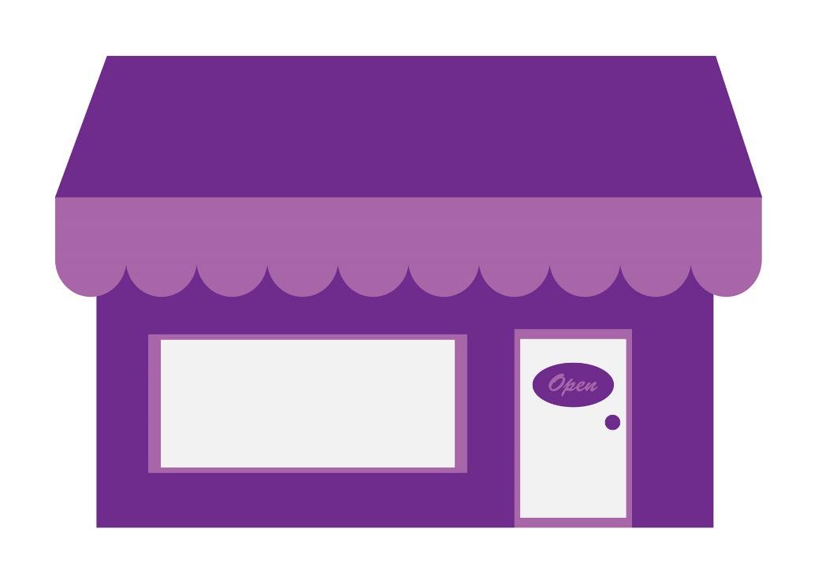
Example of guerilla marketing
SALE 60%
SALE 50%
Main entrance

Slide 8
Comparsion
Performance indicators
Sales, responses, hints
Profit
Ideas to be based on
Experiment and judgement
Psychology
Grow philosophy
Grow first, than diverse
Grow if you want to, but stay focused
Grow speed
Lineary
Geometrically
Customer focus
While trade is done
Follow ups

Slide 9
Comparsion
Competitors
Seek for the victims
Finding cooperators
Positioning
Logo is the top tool
Meme
Focus
Me (Our)
You (Yours)
Customer
What can we take
What we can give
Types of advertisement
Independent
Combination

Slide 10
Comparsion
Counting
Money
Relationships
Technology
Not necessary
Experienced users
Units to communicate
Segments
Individuals
Intentions
Ignored
Based on
Relationship
Monolog
Dialog

Slide 11
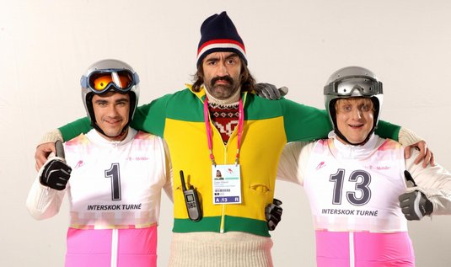
Meme
is an idea, behavior, or style that spreads from person to person within a culture
It represents the idea and the company
Short and useful

Slide 12
How to prepare guerilla marketing
Commitment
Be serious in your behavior
Investment
You need to invest money
Consistent
Confident
Plan carefully your actions
You do not need to spend money
Do not change!
Consistency breeds familiarity
Be confident in your business
Do your ads regularly

Slide 13
How to prepare guerilla marketing
Patient
Wait for your success
Use your weapons
Assortment
Take many different marketing tools
Do not concentrate to pre-sale marketing
Subsequent
Communicate with existing customers
It is more costly to sell to new customers!
Convenient
Be interested in your customer´s convenience
They will come back

Slide 14
How to prepare guerilla marketing
Amazement
Marketing must amaze people
This element will attract the attention!
Measurement
You need to measure the effectiveness of your marketing
Tool to eliminate insufficient ways
Involvement
Involve customers into the process
They will feel as the part of the final product
Dependent
You are dependent on many factors
Focus to the team work than to individuality

Slide 15
How to prepare guerilla marketing
Armament
Our weapon is technology
Use what the others are afraid of
Consent
To be opt in = open for new information, challenges and opportunities
Broaden the consent first and then to make the sale
Content
The customers know the difference between style and substance
You need to focus to the core of your business
Augment
Your job is never over
Always improve your marketing

Slide 16
10 trues about marketing
The market is continually changing
People forget quickly
Your competition will not quit
Marketing strengthens your identity
Marketing is essential to survival and growth

Slide 17
10 trues about marketing
Marketing enables you to keep your customers
Marketing maintains morale
Your marketing program gives you an advantage over competitors who have ceased to the market
Marketing allows your business to continue operating
You stand to lose out on the money, time and effort you have invested

Slide 18
Conclusion
Niche marketing
Guerrilla marketing
Basic features of both
Why to use unusual ways of marketing

