Slide 1
Test driven development
Radim Göth

Slide 2
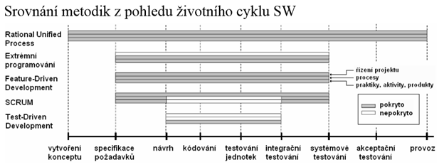

Slide 3
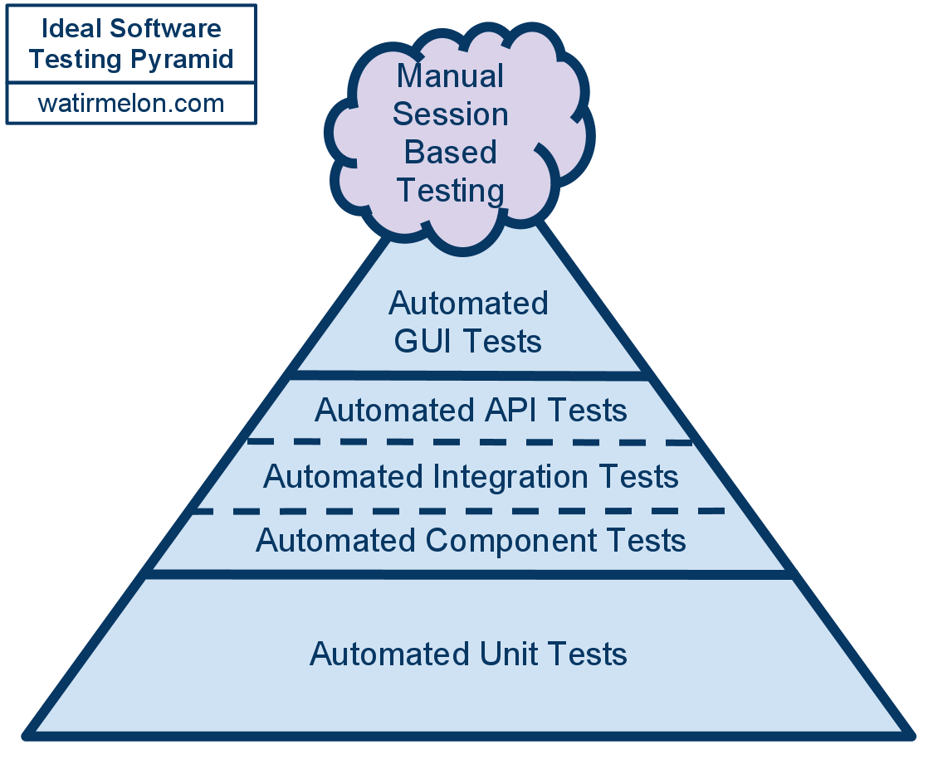
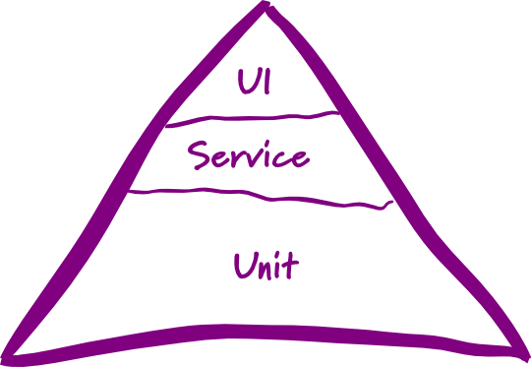
Test pyramid

Slide 4
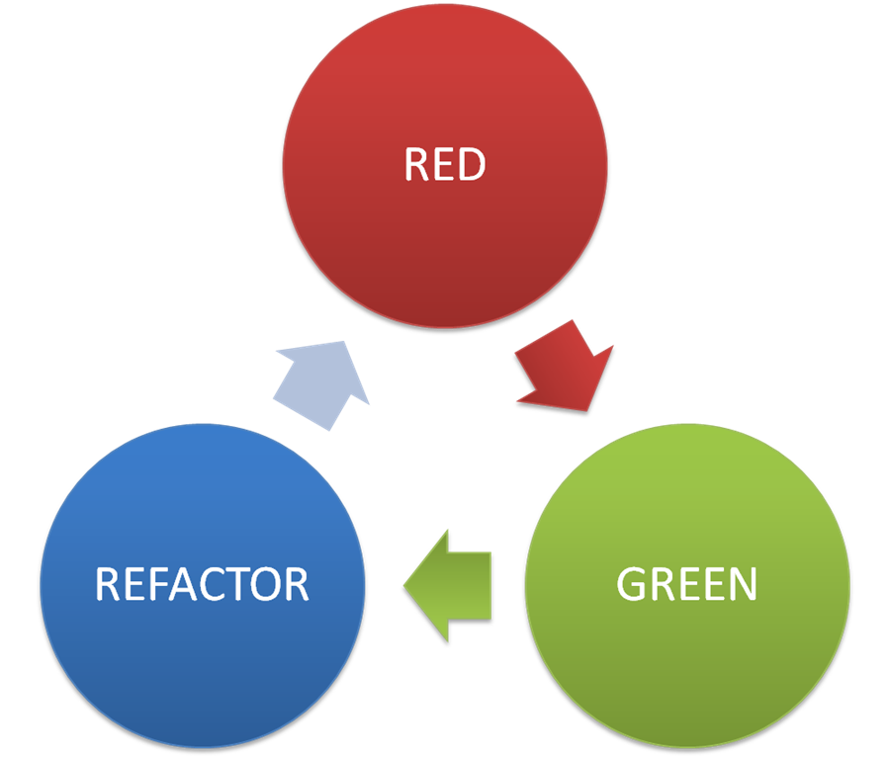
TDD
Kent Beck – reinvented TDD, invented XP
Software development process
Pair programming
Rules:
  Write failing test
  Write implementation to pass the test
  Refactor your code
  Repeat

Slide 5
Naming conventions
Project naming
  <ProjectUnderTest>.Tests
Class naming
  <ClassUnderTest>Tests
Test method naming
  Given_When_Then
  <methodUnderTest>_Given_Then

Slide 6
Unit test structure
Arrange
Act
Assert
One Assert per test
More assert per test
  Refactor the test (e.g. custom assert method)
  At least add the description to assert

Slide 7
Leap year excercise
Write a function that returns true or false depending on whether its input integer is a leap year or not.
A leap year is divisible by 4, but is not otherwise divisible by 100 unless it is also divisible by 400.
2001 is a typical common year
1996 is a typical leap year
1900 is an atypical common year
2000 is an atypical leap year

Slide 8
Fizz buzz
Fizz Buzz is a mathematical game which is played with a group of people. Each person says a number in sequence, but when the number is a multiple of 3, they have to say "Fizz", when it is a multiple of 5 they have to say "Buzz", and if it is a multiple of both 3 and 5, "FizzBuzz". If someone makes a mistake and it is noticed, they are out.
A typical game might start like: 1, 2, Fizz, 4, Buzz, Fizz, 7, 8, Fizz, Buzz, 11, Fizz, 13, 14, Fizz Buzz, etc.

