Slide 1
VB036: Presentations and visuals
Mgr. Antonín Zita, M.A.

Slide 2
Avoid Using As a Script
Although your visual aids are a useful memory aid for you, you need to consider your audience’s needs when you are designing them. Don’t use PowerPoint as a script! This often results in slides being overloaded by text, which is too dense and too small for the audience to easily read. Ideally font size should be 24 points and above. The audience can read faster than you can speak so, if you are reading directly from your slides, they’ll be ahead of you and wondering why you didn’t just e-mail them a copy of your slides! As you are preparing your PowerPoint presentation think about how it relates to what you are saying and what you intend the audience to learn from each slide. As you are presenting draw their attention to the relevant information on the slide.

Slide 3
Bad vs. Good Visuals
Impact of Malpractice Reforms
Impact of Malpractice Reforms
Direct reforms had a larger effect on the supply of nongroup vs group physicians, on the supply of most (but not all) specialties with high malpractice insurance premiums, on states with high levels of managed care, and on supply through retirements and entries than through the propensity of physicians to move between the states.
Larger effect on:
  Nongroup vs group physicians
  Most specialties
  Managed care
  Retirement & entries

Slide 4
Bad vs. Good Visuals
Too much text in slides is detrimental
Animations are very useful
Control the amount of information that the audience sees at a given moment.
Audience will pay attention to the content of your speech
Too much text in slides is detrimental
Animations are very useful
Control the amount of information that the audience sees at a given moment.
Audience will pay attention to the content of your speech

Slide 5
Text Formatting
Don’t use ugly/complicated fonts
Don’t use annoying or difficult to see colors
  Don’t change colors between the points

Slide 6
Text Formatting (cont.)
Don’t use distracting/difficult to read from backgrounds
Be consistent in the use of backgrounds

Slide 7
Text Formatting (cont.)
Don’t make your visuals too bland

Slide 8
Visuals
Avoid bad or irrelevant visuals
Should be related to the topic

Slide 9

PowerPoint is not a text medium;
VISUAL
it's a
medium
and
Presentations are not an information medium;
they're a
medium

Slide 10
Proofread to Check Spelling & Grammar
Proof-read careful to avoid smelling mistakes and incorect grammar?

Slide 11
Sources
Include a list of sources!
Avoid “Wikipedia.com” or “Google.com”

Slide 12
Sources
Ippolito, Kate. “Effective PowerPoint Presentations.” Learn Higher. http://archive.learnhigher.ac.uk/groupwork/episode6/amp/altversion.html
Kennedy, Niall. “Microsoft Technology Platform Presentation.” https://www.flickr.com/photos/niallkennedy/sets/1269791/
Noer, Muhammad. “Steve Job’s Presentation Techniques Revealed.” Best Presentation. 2013. http://www.bestpresentation.net/presentation-secrets-steve-jobs/)
Purewal, Sarah Jacobsson. “The World’s Worst PowerPoint Presentations.” PCWorld, 17 Aug. 2010. http://www.pcworld.com/article/203396/worlds_worst_powerpoint_presentations.html
Smith, Jeff. “Suing PowerPoint Well.” Department of English and American Studies, Faculty of Arts, Masaryk University. Presentation.
“Successfully Using Visual Aids in Your Presentation.” University of Alabama School of Medicine. 2005. http://www.uab.edu/uasomume/fd2/visuals/index.htm
Williams, Erica J. Presentations in English. Honkong: MacMillan, 2008.

Slide 13
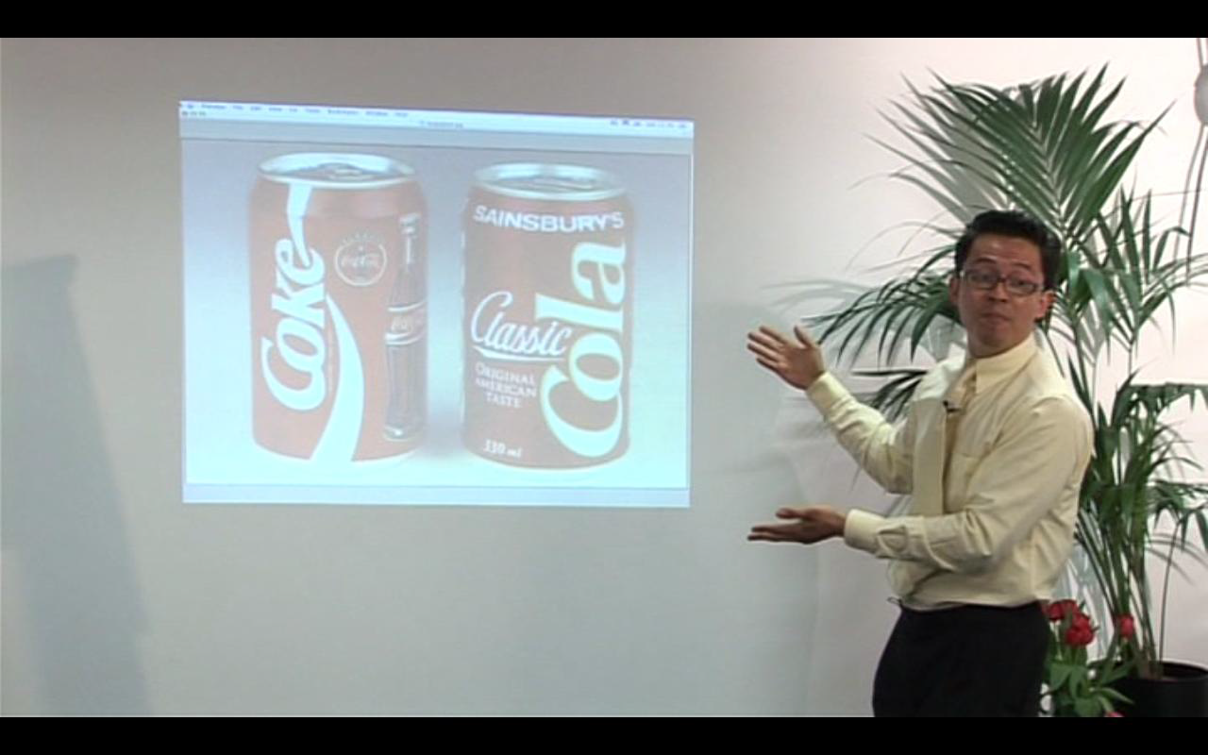
A Proper Use of Visuals

Slide 14
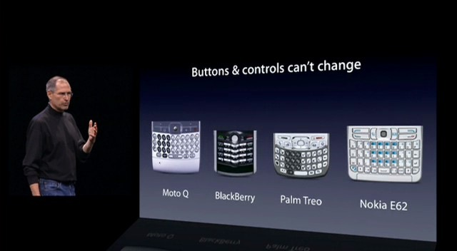

Slide 15
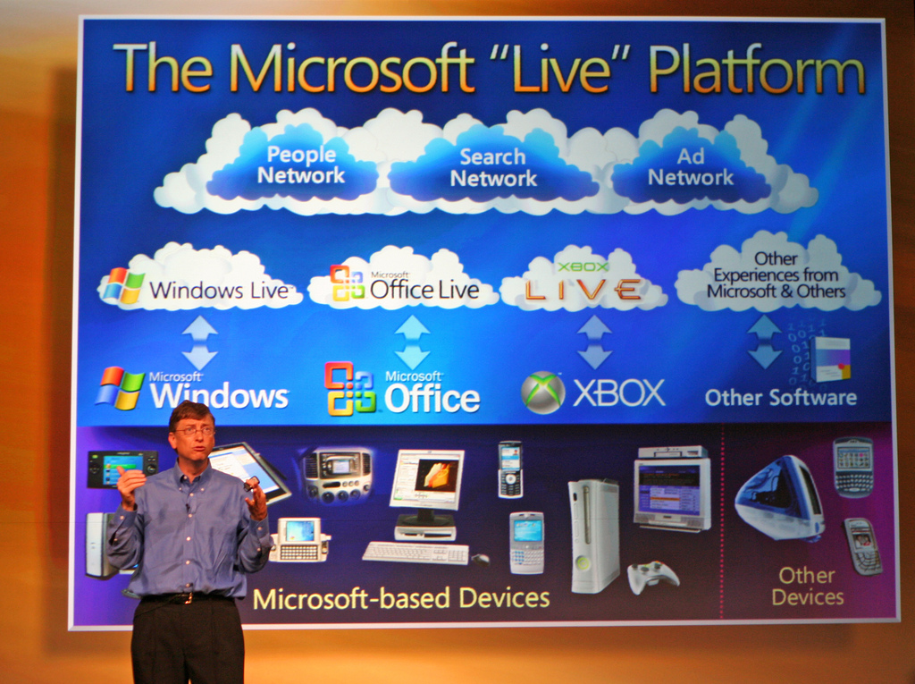

Slide 16
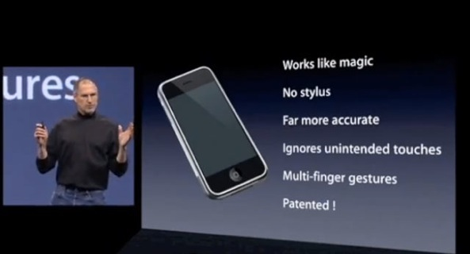

Slide 17


Slide 18
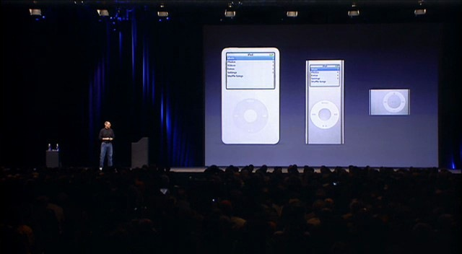

Slide 19
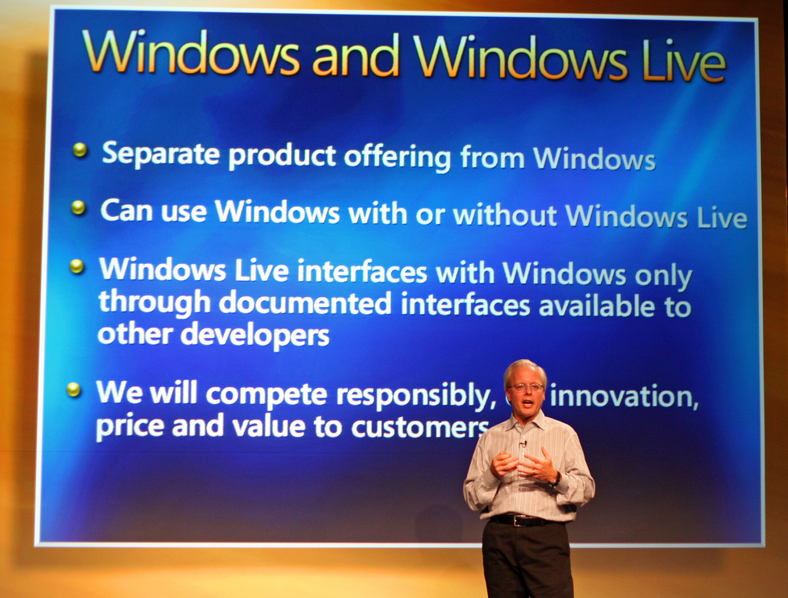

Slide 20
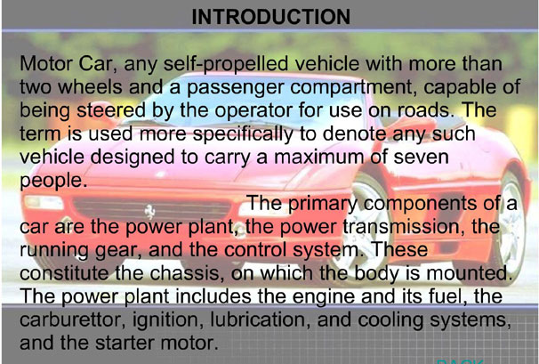

Slide 21
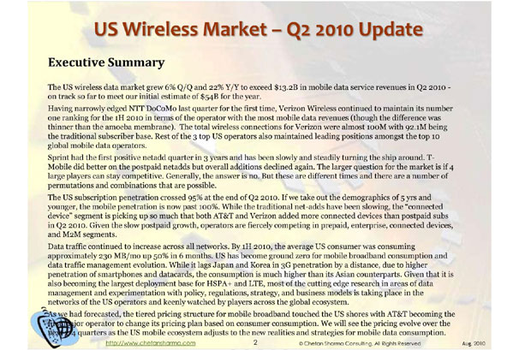

Slide 22
Slides: An Exercise
What is genetic data?
Our DNA consists of 4 bases A, C, T and G; so our genetic data is a string of these 4 letters, e.g. …AGGGGATTTAAA…
But at each genetic location a person can have 1 or 2 types, so can encode the genetic data in terms of 0 and 1s, e.g. …0101001010101…

Slide 23
Slides: An Exercise
Why do we simulate genetic data?
Lots of methods in literature about how to locate disease genes
To assess a method, apply it to data set and compare predicted location with actual location
But need data sets with known location of disease gene … not many of these
Use simulated data sets

Slide 24
Slides: An Exercise
Why is simulating genetic data challenging?
Real genetic data is not a random set of 0 and 1s
There are complex correlation structures due to thousands of years of evolution
Realistic simulated data should contain these structures

