Slide 1
PA197 Secure Network Design
Wireless Sensor Networks – attacker models, secure routing, IDS
Petr Švenda svenda@fi.muni.cz
Faculty of Informatics, Masaryk University

Slide 2
Overview
Intro to wireless sensor networks
Security considerations
  Why are WSNs special?
Attacker models
Routing → attacks → secure routing
Intrusion detection, reaction

Slide 3


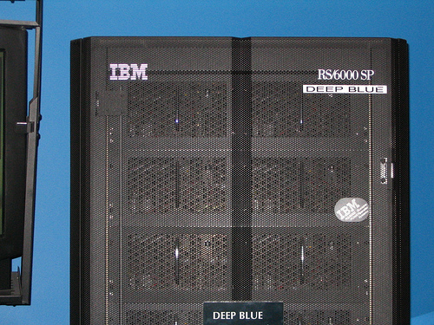


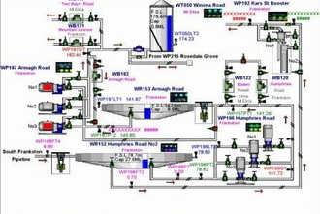
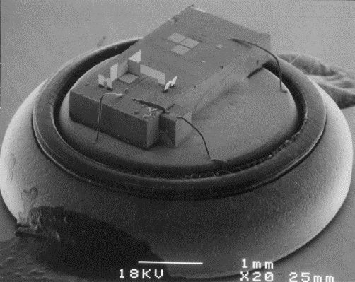
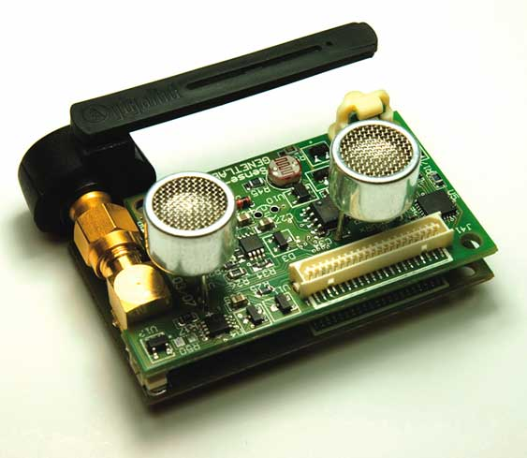
Route to nodes technology

Slide 4
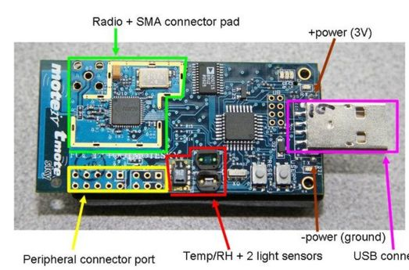
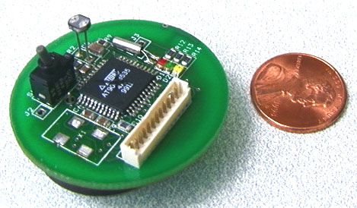
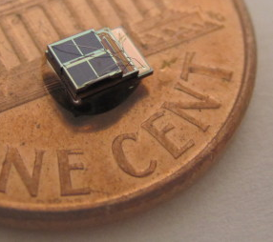

Wireless Sensor Node
Basic technology
  8 bit CPU, ~1 kB RAM, ~10² kB flash
  short range radio, battery powered
  condition sensor (temperature, pressure, …)
  xBow MicaZ, TelosB, BT LE, Weightless…
  https://en.wikipedia.org/wiki/List_of_wireless_sensor_nodes
Putting pieces together…
  battery-powered small MCU
  + efficient radio module
  + environmental sensor
  => Wireless Sensor Network (WSN)

Slide 5

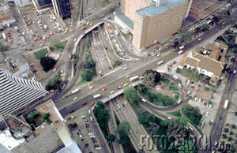
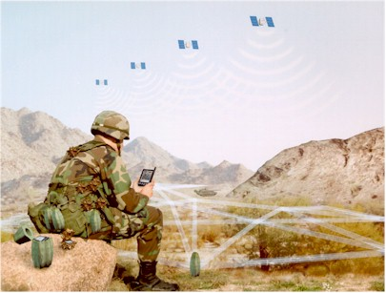
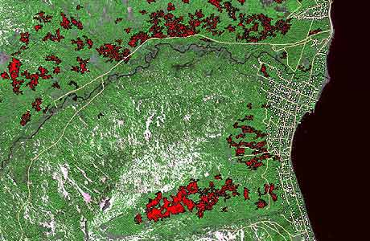
Do we have useful application for WSN?
Medical information
Traffic control
Remote fire detection
Combat field control

Slide 6
Ideal in 2000:
WSN is highly distributed network with high number of low-cost sensor nodes powered by battery connected via multi-hop communication with base station
Notes:
pridat obrazek smart dust

Slide 7
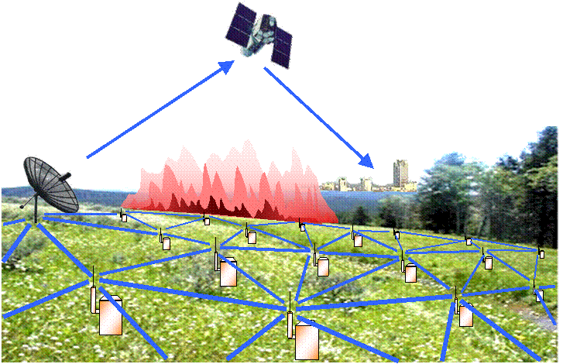
Large scale Wireless Sensor Networks
Network of nodes and few powerful base stations
  10² – 10⁶ sensor nodes
  particular nodes deployed randomly, e.g., from plane
Network characteristics
  covering large areas - distributed
  ad-hoc position/neighbours – not known in advance
  multi-hop communication
The price (still) is a current problem
  currently ~100$ or more (complete node)
  (but 3.35 $ for CC1110F32)

Slide 8


Slide 9
Reality in 2017 ☺:
WSN is highly distributed centralized network with high small number of low-cost high-cost sensor nodes powered by battery power grid connected via multi-hop communication with communicating directly to base station
But situation is getting better ☺
Notes:
pridat obrazek sensoru s velkou baterii

Slide 10
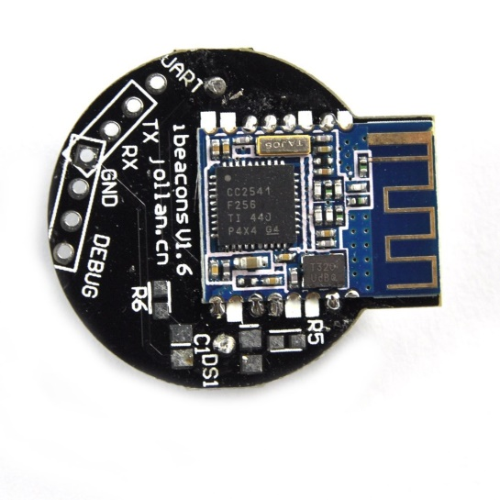

Current low(er)-cost technology
IEEE 802.15.4 standard for low-rate PANs
  Basis for ZigBee tec.
Bluetooth LE/Smart enabled devices
  ~$10 for BT module
Weightless-N/P/W (IoT), http://www.weightless.org/
  5 km range, 10 years lifetime, $2 price (planned ☺)
  Thanks to large range, fewer hops to reach sink node
Libelium Waspmote (multi-RF node)
Simple processing can be run directly on network controller chip (if accessible)
  Espressif ESP8266 ($1.6) WiFi module
Diymall Ibeacon Module

Slide 11
Operating systems for WSNs
Should work on very limited device (10²-10³B RAM)
Should provide concurrency (perceived, real)
Should be flexible enough to support different usage scenarios
Should conserve as much energy as possible
Examples: TinyOS, Contiky, RIOT…

Slide 12

TinyOS architecture (Berkley)
Used to be the most popular operating system for sensor nodes
  first version released in 2002 (TinyOS 1.2), current 2.1.2 (released in 2012)
  Open-source work https://github.com/tinyos/tinyos-main (active)
  network protocols, sensor drivers and data acquisition tools
Basic design principles
  Event-driven (routines serving particular event)
  Telescoping abstractions
    abstractions with spectrum of levels, portability and optimization
  Partial virtualization
    top layers of telescopic abstractions are shared or virtualized
  Static binding and allocation
    no dynamic allocation, all required resources allocated statically
Applications written in Network Embedded System C (nesC)
  optimized for low memory, real-time applications

Slide 13

Contiki architecture
Initial release 2003, current version 3.0 (2015)
  http://contiki-os.org/
Basic design principles
  Dynamic loading and unloading of code at runtime
  Event-driven kernel
  Proto-threads (small routines executed after event)
OS requires about 10 kilobytes of RAM (minimum)
  More complex than TinyOS (400B RAM only)
  TCP/IP stack… Optional addition of GUI etc.

Slide 14
We (will) have exciting technology.
Why/What security measures should be used?

Slide 15
Where do we need security in WSNs?
Sensitive data are often sensed/processed
  military application
  medical information, location data (privacy)
Commercially viable information
  information for sale – cost for owner of the network
  know-how - agriculture monitoring
Protection against vandalism
  distant non-existing fires blocks fireman
Early stage of WSN allows to build security in rather than as late patch

Slide 16

Why not “Just use TLS”?
What are differences from standard networks and why classical solutions mail fail?
  Why we cannot use standard “TLS” for protection of data?
  Party authentication, confidentiality, integrity, freshness…
Sometimes we can! (don’t be dogmatic)
But: certificates, asymmetric crypto, revocation control, high data/computational overhead, session management, authentication of data, local aggregation…

Slide 17
Some differences from standard networks
Running on battery (limited resource)
  days for personal network
  years for large scale monitoring network
  especially communication is energy-expensive
Relatively limited computation power
  powerful CPU possible, but energy demanding
Links can be temporal, network often disconnected
  by design, by necessity

Slide 18



Some differences from standard networks
Nodes can be captured by an attacker
  all secrets can be extracted from unprotected nodes
  and returned back as malicious node
How to detect malicious node?
How to react on detected malicious node?
When detection/reaction is hard,
focus on prevention

Slide 19
Main topics in WSNs (network security)
Establishing network
  Deployment, redeployment
  Neighbor discovery, clustering
Using and maintaining network
  Sensing, data collection, data aggregation
  Routing and reliable communication
  Energy efficiency of all tasks (running on battery)
Supporting security functions
  Key management (pre-distribution, establishment, use)
  Secure communication, authentication
  Partially compromised network

Slide 20
Network lifetime
Initial deployment
Network operation
key update
message routing …
time
link key setup
message routing …
nodes authentication
link key setup
neighbors discovery
new to old nodes
authentication
physical deployment
key pre-distribution
nodes re-deployment

Slide 21
Attacker models
Wireless Networks – Attacker Models

Slide 22
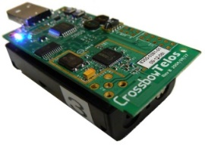

Attacker models - capabilities
Passive attacker
  Does not inject/modify messages and does not jam
Active attacker
  May inject/modify messages or perform jamming
External attacker
  Not a legitimate member of a network
  Not compromised any node or used key (yet)
Internal attacker
  Legitimate member of a network
  compromised a single/few static/mobile sensor node(s) and/or possesses a single/few key(s)

Slide 23
Attacker models – capabilities (cont.)
Local attacker
  Can overhear only a local area: single or few hop(s)
  Depending on antenna, transmission signal strength…
Global attacker
  Can overhear most/all node-to-node and node-to-base station communication simultaneously for all the time

Slide 24
Attacker models - levels
Level 1 attacker
  A low cost attacker with minimum equipment requirements
  Typical capabilities: Passive, External, Local
Level 2 attacker
  A medium cost attacker with distributed eavesdropping and transmitting device(s), but no compromised node
  Typically a group of people with radio devices
  Typical capabilities: Active, External, Global

Slide 25
Attacker models – levels (cont.)
Level 3 attacker
  A medium cost attacker with common or special equipment and knowledge
  The most common one as far as intentional serious attacks on a network are concerned
  Typical capabilities: Active, Internal, Local
Level 4 attacker
  A high cost attacker with special equipment and knowledge (well-funded organization with high motivation)
  Typical capabilities: Active, Internal, Global

Slide 26
routing
Wireless Networks – Routing

Slide 27
Target network topology
BS
Sensor node
BS
Base station
Notes:
Term SA coined by Ross Anderson and Adrian Perrig 2004. Keys exchanged in plaintext, assumption of incomplete eavesdropping, then simple protocol to turn some intercepted keys back
Their SA protocol was very simple – one intermediate, transmit key, combine
Second one step transmission – because existing key is used to encrypt transmission, order of protocol runs matters
Multistep – not only single intermediate

Slide 28
Routing influenced by data reporting model
How models compares?
Routing requirements
Attacker perspective
Time-driven
  Periodic, continuous
  E.g., “send current temperature every 10 seconds”
Event-driven
  when event happens
  E.g., “report if temperature is more than 80°C”
Query-driven
  When someone (base station) asks
  E.g., “send me the current temperature on node 42”
Hybrid (combination)

Slide 29
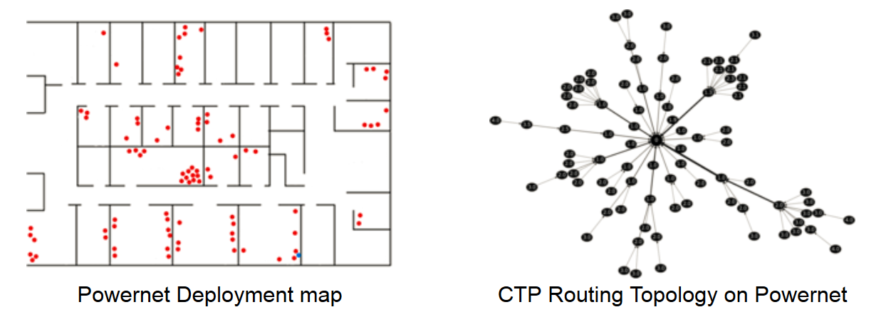
Example: static fixed routing tree
Every node is preloaded with ID of parent node closer to BS
  Received message is forwarded to parent node
Advantages
  Simple, low-memory consumption
  Reduced attack surface (no route discovery)
Disadvantages
  Disconnect on node’s failure
  Non-uniform battery consumption
  Not adapting to network changes

Slide 30
Example: Collection Tree Protocol (CTP)
Collection Tree Protocol (CTP), default in TinyOS
  Many-to-one collection data collection protocol (nodes to BS)
  Address-free routing (only route towards BS)
Routing metric is number of steps to BS (sink node)
  Number of expected transmissions (ETX) to reach sink node
  Each node keeps only smallest ETX to nearest sink node
  Routes with lower metric are preferred
  Message is send only from higher ETX to lower ETX
Routing loops prevention
  In case of message with lower ETX then own => update path
Possibility to periodically refresh routing metric
  Continuous adaptation to network changes
Notes:
http://www.btnode.ethz.ch/static_docs/tinyos-2.x/pdf/tep123.pdf

Slide 31
CTP – resulting routing tree
Source: http://sing.stanford.edu/gnawali/ctp/

Slide 32
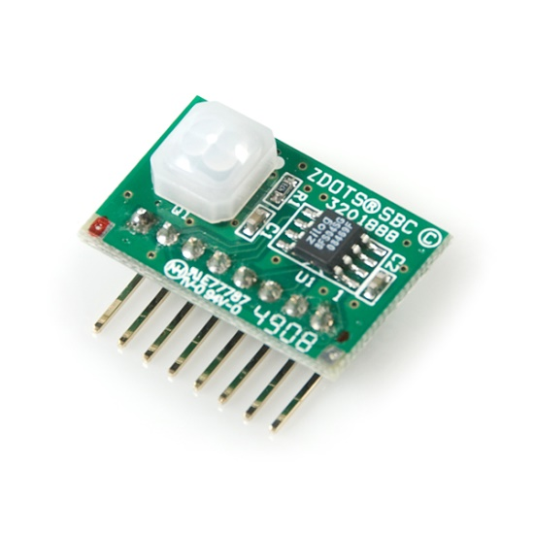
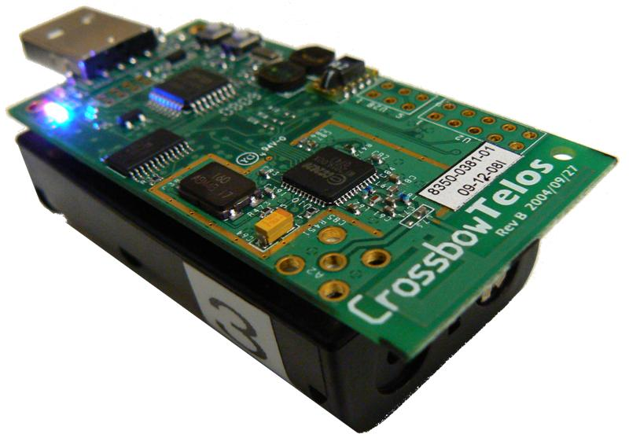
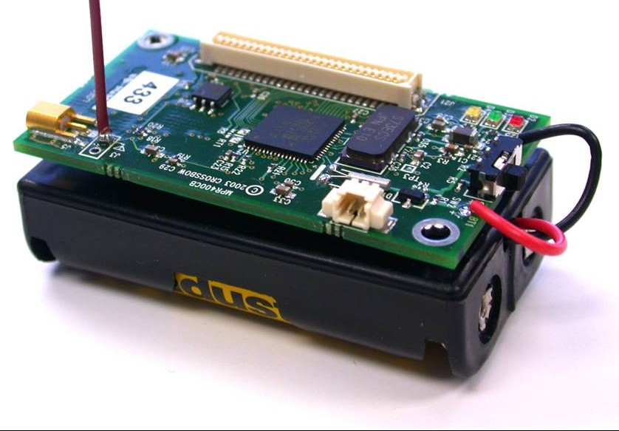
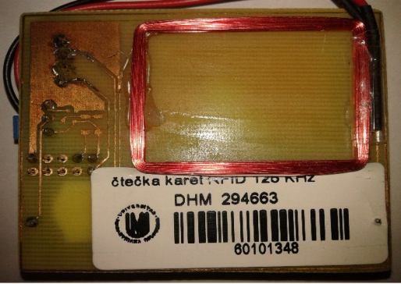
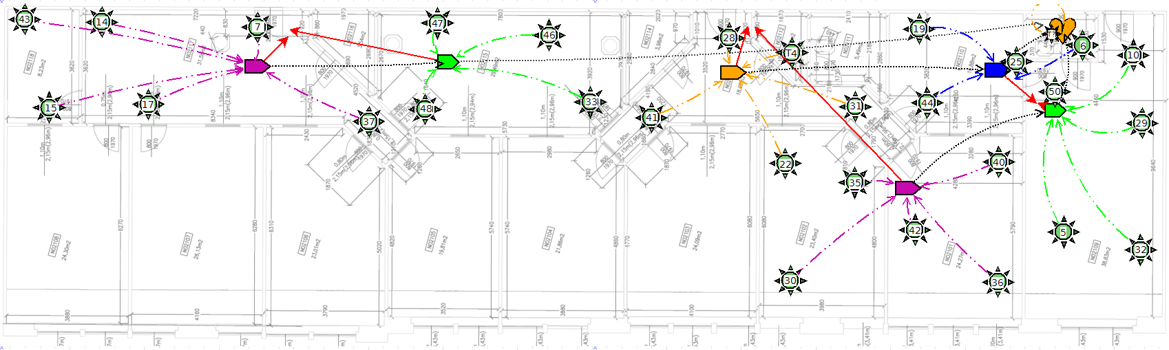
Hardware used, testbed
Zilog ePIR
RFID reader 125kHz
Crossbow TelosB
Crossbow MICAz
CRoCS Laboratory testbed

Slide 33
General attacks against routing
Spoofed, altered, or replayed routing information
Selective forwarding
Sinkhole attacks
Sybil attacks
Wormholes
HELLO flood attacks
Acknowledgement spoofing
Adapted from http://webs.cs.berkeley.edu/papers/sensor-route-security.pdf

Slide 34
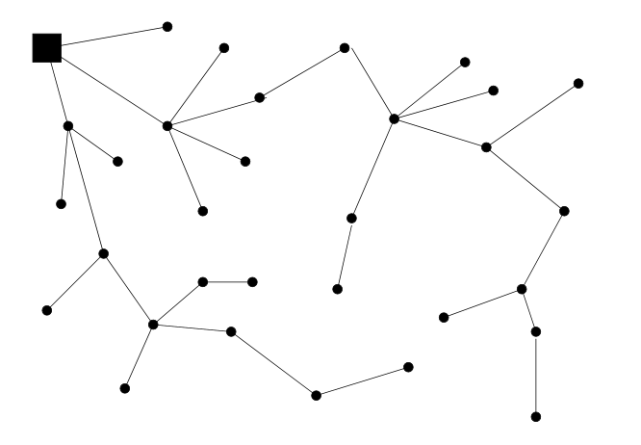
Basic topology with single sink node
Source: http://webs.cs.berkeley.edu/papers/sensor-route-security.pdf

Slide 35
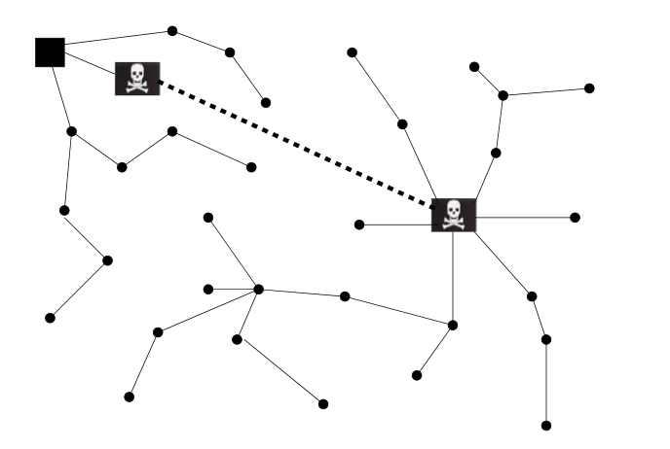
Wormhole attack
Artificially short path(s)
Perception of locality
Influences routing metrics
Source: http://webs.cs.berkeley.edu/papers/sensor-route-security.pdf

Slide 36
Sinkhole attack
Forge routing information, becomes malicious sink
Messages not delivered to legitimate sink
Messages selectively forwarded to legitimate sink
Source: http://webs.cs.berkeley.edu/papers/sensor-route-security.pdf

Slide 37
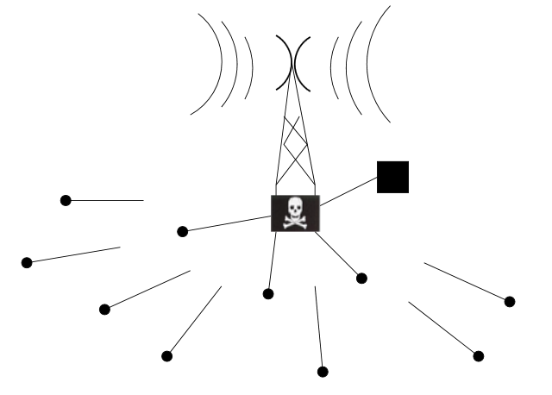
HELLO flood attack
Strong transmission of neigh. discovery or route establishment packet
Nodes will try to contact malicious sender
Source: http://webs.cs.berkeley.edu/papers/sensor-route-security.pdf

Slide 38
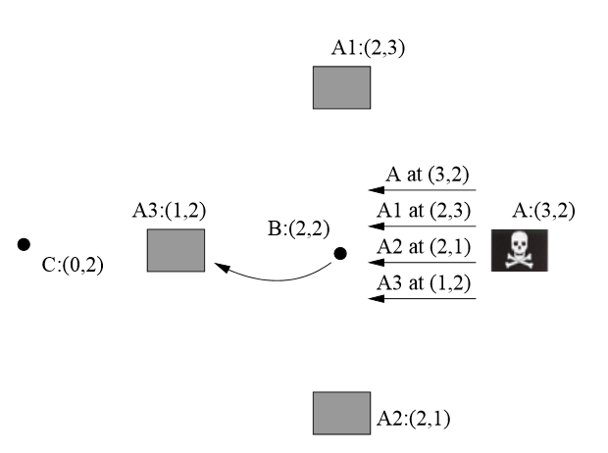
Acknowledgements spoofing
Attacker fakes response from legitimate nodes (faster)
Perception of closeness of non-reachable nodes
Source: http://webs.cs.berkeley.edu/papers/sensor-route-security.pdf

Slide 39

Sybil attack
Attacker pretends to have additional nodes connected behind him
Creates perception of multiple nodes sensing same forged event, influences majority voting…
Source: http://webs.cs.berkeley.edu/papers/sensor-route-security.pdf

Slide 40
Collection Tree Protocol - security?
How would you attack CTP-enabled network?
Bogus routing information
  Manipulate propagated ETX values
Selective forwarding
  No control of delivery
Sinkhole
  Advertise itself as base station (sink hole)
Wormhole attack
  Shortcut path between two nodes via different medium (=> preferred path)
HELLO flood attack
  Flood network with CTP beacons, corrupt paths and drain energy
…
Notes:
http://webs.cs.berkeley.edu/papers/sensor-route-security.pdf

Slide 41
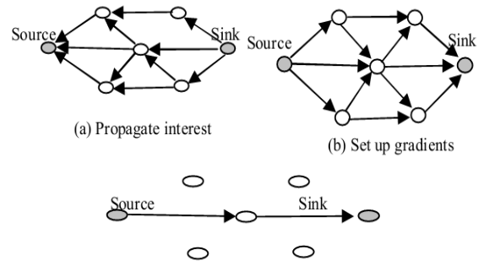
Example: Directed diffusion
Base station floods network for named data (interest)
  “Which node has temperate higher than 80°C?”
Gradients with distance from base station
  If data found, returned back via reverse path
Properties:
  Data-centric routing
  Robust due to flooding
No cryptographic protection
  Basic version, many extensions
Attacks:
  Suppress flow, cloning flow (eavesdropping)
  Selective forwarding…
Notes:
C.
Intanagonwiw
at,
R.
Go
vindan,
and
D.
Estrin,
“Directed
dif
fusion:
A
scalable
and
rob
ust
communication
paradigm
for
sensor
netw
orks,
”
in
Pr
oceedings
of
the
Sixth
Annual
International
Confer
ence
on
Mobile
Computing
and
Networks
(MobiCOM
’00)
,
August
2000

Slide 42
secure routing
Wireless Networks – Secure Routing

Slide 43
Why we need special routing for WSN?
MANY existing routing schemes for ad-hoc networks
Should have low packet overhead and node state
  Energy efficiency
  But: CPU/radio efficiency improves
Should not be based on public key cryptography
  Increases cost of hardware / transmission
  But: ECC or pairing-based crypto?
Should omit unnecessary complexity “any two nodes”
  Data-centric routing
  Energy-aware routing
  But: depends on usage scenario

Slide 44
Security and efficiency tradeoff
There is tradeoff between security and efficiency
Q: Should I require packet/message confirmations?
  Or just hope to be delivered to save energy?
Q: Should I require cryptographically signed ACKs?
  Or just detect discrepancies on base station?
Q: Should I use multiple paths to deliver?
  Or just one to save energy? Aggregate data?
Always confront to your expected attacker model and usage scenario

Slide 45
Multipath routing algorithms
Targets improved reliability, security and load balance
  Reliability – probabilistically bypassing unrealiable path
  Security – limits localized sinkhole (by bypassing it)
  Load balance – spread of communication load (energy)
Nature of algorithms
  Infrastructure-based (more stable paths, infrastructure help)
  Non-infrastructure-based (paths discovered adhoc)
  Coding based (message split into parts via different routes)

Slide 46
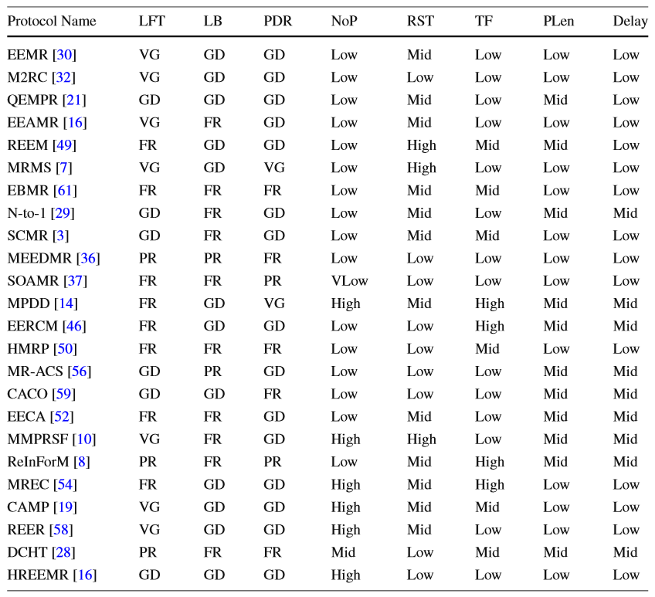
Multipath Routing Techniques in Wireless Sensor
Networks: A Survey; Kewei Sha, Jegnesh Gehlot, Robert Greve

Slide 47
Intrusion detection
Wireless Networks – Intrusion Detection System

Slide 48
Distributed intrusion detection
Attacks considered: Jammer, Dropper, Selective dropper, Sybil, Sinkhole…
Promiscuity eavesdropping on IDS node
Gather runtime characteristics about neighbours
Compute monitored node “reputation”
If significant deviation is detected => reaction
  Report to BS or neighbours, change routing path, block offender (time-limited suicide)…

Slide 49
IDS monitored network characteristics
Signal Strength (of received packet from node)
Carrier Sensing time (time to be clear to send)
Packet Delivery Ratio (packets successfully forwarded by monitored node)
Packet Send Ratio (how many packets send by monitored node were forwarded further?)
…

Slide 50
Generic problems with IDS
How long to store characteristics?
  limited memory
How to reliable measure all wanted characteristics?
  usually impossible, missed/unheard transmissions
How to detect deviances in noisy environment?
  Natural packet loss rate, attacker just below threshold
How monitoring node should survive on batteries?
How NOT to be tricked by an attacker to blame legitimate node?

Slide 51
Summary
WSNs specifics: Limited communication, local knowledge, partial compromise
Many factors influence resulting network settings
  Usage scenario
  Available hardware parameters => network topology
  Sensitivity and nature of data processed => attacker model
Area is currently flooded with different protocols
  Have good understanding of basic principles
  Be critical in judging various proposal
  Have clear definition of usage scenario & attacker model

Slide 52
Mandatory reading
Ch. Karlof, D. Wagner, Secure routing in wireless sensor networks: attacks and countermeasures (2003)
http://webs.cs.berkeley.edu/papers/sensor-route-security.pdf

