Slide 1
PA197 Secure Network Design
Cryptography aspects in Wireless Sensor Networks
Petr Švenda svenda@fi.muni.cz
Faculty of Informatics, Masaryk University

Slide 2
Lecture overview
Cryptography and key management in WSNs
  Approaches and typical issues
Partial compromise and what can be done
  Dealing with partially compromised network
Case study: WSNProtectLayer

Slide 3
Network lifetime
Initial deployment
Network operation
key update
message routing …
time
link key setup
message routing …
nodes authentication
link key setup
neighbors discovery
new to old nodes
authentication
physical deployment
key pre-distribution
nodes re-deployment

Slide 4
Cryptographic aspects
Wireless Sensor Networks – Crypto

Slide 5
Do we have need for on-node crypto?
Data for base-station (end-to-end)
Data for neighbors (hop-by-hop encryption)
Nodes authentication
Authenticated broadcast
Group/cluster-keys (aggregation)
Traffic analysis resistance (phantom routing…)
No-keys, symmetric crypto, asymmetric crypto
Random number generation (IV, padding, keys…)

Slide 6
Recall: WSN specifics
Limited computation power and memory
Limited energy
  Consumed by communication, computation, storage…
Limited connectivity
No direct central synchronization
  Low-range radio
  No or loosely synchronized clocks
Limited or no tamper resistance

Slide 7
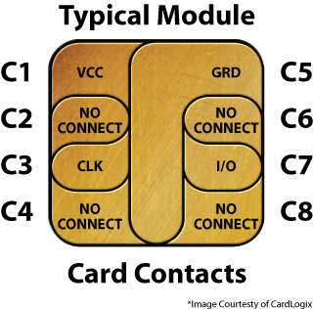
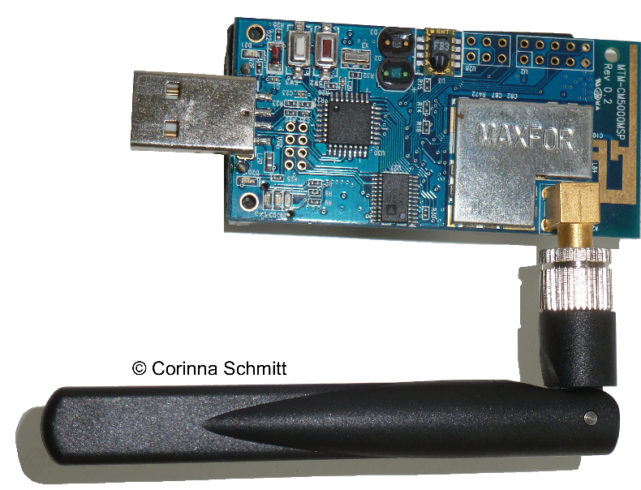
Native vs. software-only cryptography
Native support inside radio module
Software execution on main processor
Additional cryptographic co-processor
III. Additional cryptographic co-processor
II. Software execution on main processor
I. Native support by radio module

Slide 8
I. Crypto in radio module

Slide 9
Native cryptographic support by radio
Cryptographic functionality provided by radio module
  Supported algorithms depend on used standard, only very few
  Usually easy to use and transparent to developer/user
  Energy efficient (ASIC)
Usually focus only on link-level security
  Encryption, integrity (MAC), node authentication, key establishment
Performance matched to radio’s transmission rate
Allows for better parallelization => lower latency
  Main processor not occupied with cryptographic operation
Customized crypto protocols usually not possible

Slide 10
Native cryptographic support - examples
IEEE 802.15.4 (ZigBee, AES-128b)
  AES-CBC-MAC-32/64 (no encryption, 4/8B MAC)
  AES-CTR (CTR mode for encryption, no MAC)
  AES-CCM-32/64 (encryption + MAC)
Bluetooth LE/Smart (AES-128b, ECDH P-256)
  AES-CCM (encryption + MAC)
  ECDH (key establishment)
…

Slide 11
Crypto on main processor

Slide 12
Crypto on main processor
Cryptographic functionality executed on main processor
  Performance highly depends on main processor
  Usually less energy efficient and possibly slower than other options
High flexibility: customized algorithms and protocols
  Anything that can be compiled, fit and executed on MCU
  Important parameters: code size (EEPROM), state (RAM), speed
Introduces additional latency
  Main processor occupied with crypto operation, serialization
Possibility to update implementation in the field
  Over-the-air (OTA) updates
Keys can be extracted after node capture
  no tamper resistance

Slide 13
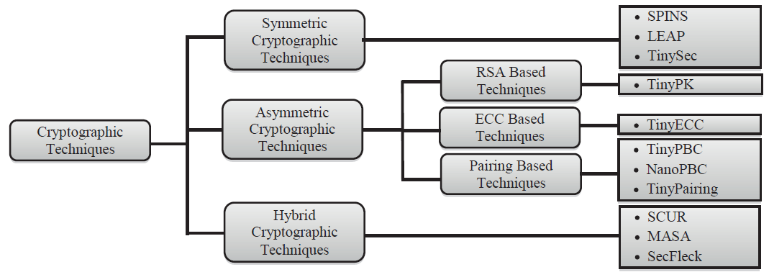
Available implementations
Standalone algorithms (e.g., AES)
General-purpose libraries (mostly C)
Platform specific libraries (TinySec…)
Kernel modules (part of embedded OS)
Security Frameworks for Wireless Sensor Networks-Review
Gaurav Sharma, Suman Bala, Anil K. Verma DOI: 10.1016/j.protcy.2012.10.119

Slide 14
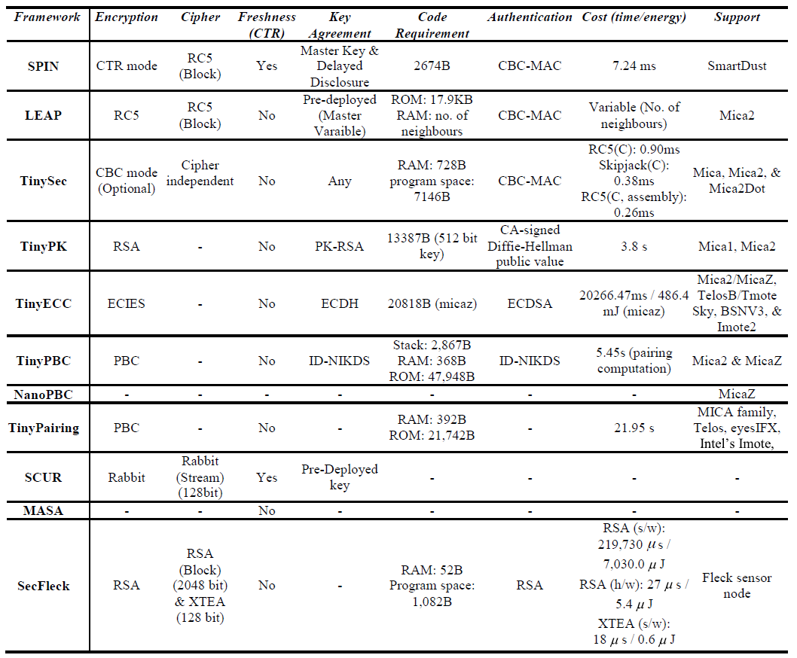
Security Frameworks for Wireless Sensor Networks-Review: G. Sharma, S. Bala, A. Verma DOI: 10.1016/j.protcy.2012.10.119

Slide 15
Modes for encryption / integrity
CBC used often in software libraries (simple)
  Need for initialization vector update and synchronization
CTR mode
  possibility for precomputation => lower latency when packet arrives
  No message length extension
  (used also in Bluetooth LE / IEEE 802.15.4 ZigBee)
CBC-MAC - same underlying code reused

Slide 16
Initialization vector management
IV is send with every packet
  Shorter than normally (e.g., 2 bytes only), ~10% overhead
    Relatively low number of messages (65k) before key update
  Advantage in high packet loss environments
  Example: TinySec, ZigBee
IV is kept synchronized (counter), no IV send
  Resynchronization on packet loss required
  Example: SPINS
Only part of IV send (last few bits)
  Balance between overhead and expected number of lost packets
  Example: MiniSec-U

Slide 17
SPINS/SNEP (Perrig et al., 2002)
Suite of lightweight protocols
  Based on symmetric cryptography only, RC5 (stream c.)
SNEP: Sensor Network Encryption Protocol
  Semantic security, Data authentication
  Replay protection – synchronized counters
  Freshness – weak (counter), strong (challenge)
  Low communication overhead
De-facto benchmark for protocols proposed later
Notes:
http://users.ece.cmu.edu/~adrian/projects/mc2001/mc2001.pdf

Slide 18
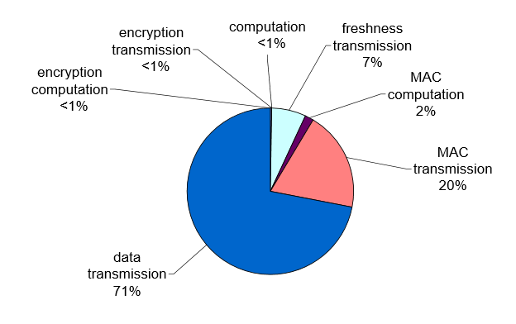
SPINS – energy consumption
http://users.ece.cmu.edu/~adrian/projects/mc2001/mc2001.pdf

Slide 19
Asymmetric crypto – energy consumption
Significantly different ratio w.r.t. symmetric crypto
  Most energy consumed by computation of operation (MCU)
  Transmission accounts only to about 1% of energy use
  Even when significantly longer signature is transmitted
    128B RSA signature vs. 4-8B MAC
Overall impact on network lifetime is still very small
  Relevant only to networks with high number of signed messages
More important factors are code size, state and increased probability of collision during transmission
https://www.ics.uci.edu/~steffenp/files/SASN_piotrowski.pdf

Slide 20
Authenticated Broadcast
Authenticated message to be delivered to “all” nodes
Solution1: Asymmetric crypto
  Potentially high computation and transmission overhead
Solution2: Single network-wide key for MAC verification
  Single compromised node => attacker can forge BS’s messages
Solution3: Unique key between every node and BS
  Compromised node => only messages to this node can be forged
  But separate message (or at least MAC) for every node needs to be computed and delivered (significant overhead)
Can we use symmetric crypto and have only single key?

Slide 21
μTesla: Authenticated Broadcast
Message broadcasted from base station with MAC
  Node stores received message, but cannot verify yet
Base station later broadcasts key used for MAC (“epoch”)
  Once broadcasted, nodes can verify messages from given epoch
  New messages from previous epoch are not accepted any more
    As MAC key for that epoch is now public
Message authentication keys form hash key chain
  No need to store keys for older epochs
  Validity of MAC keys can be verified against pre-distributed root

Slide 22
Hash chains (as used in µTesla)
root = H¹(H²(…H^{X}(seed)…))
Knowledge of root will not allow to compute any H^{i}
  Inversion of hash function H is hard
H^{i} can be quickly verified against H^{i-1}
  Unlimited length of chain (if root is not required)
  Length X chosen in advance (if root is pre-distributed)
Knowledge of seed allows to compute any chain value
  Used by base station for MAC key computation
root used for verification of μTesla MAC keys
  By deployed nodes

Slide 23
μTesla properties
Very low overhead (MAC/message + key/epoch)
Requires loosely synchronized clock (”epochs”)
Robust against packet loss
Overhead independent from number of nodes

Slide 24
crypto co-processor
Tamper Resistant Hardware and Asymmetric crypto on WSN node

Slide 25
Cryptographic co-processor
Additional dedicated co-processor for crypto ops
  Only cryptographic speedup (no tamper protection)
  Also tamper protection of cryptographic secrets
Possibility to parallelize (MCU/Crypto/Radio)
Small to medium flexibility (fixed set of algorithms)
Energy efficient
E.g., cryptographic smart card provides:
  Strong tamper resistance, RSA-1024/2048, ECC…
  Strong protection also for keys for symmetric crypto
  Relatively cheap ($2, Feitian A40 Infineon SLE78)

Slide 26
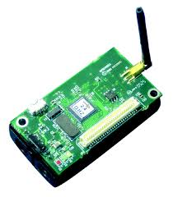
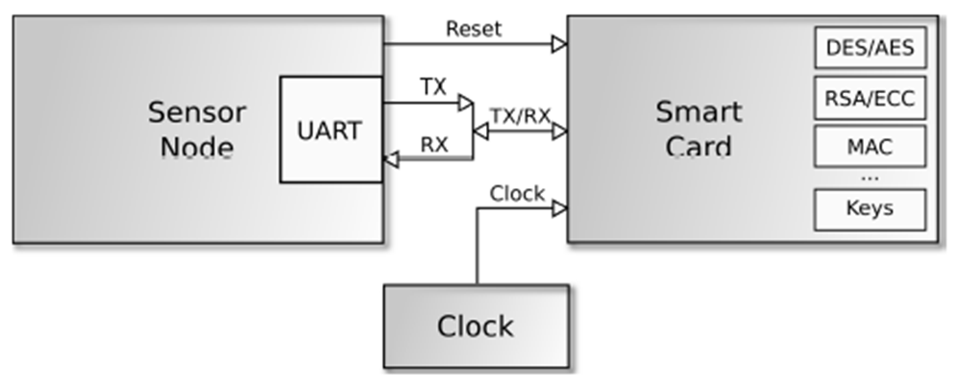
Smart card to sensor node connection
Direct connection via serial interface (UART)
  Communication speed 9600 baud, APDU commands
Keys and crypto operation executed only on-card
Hanáček, Nagy, Pecho: Power Consumption of Hardware Cryptography Platform for Wireless Sensor, IEEE CS, 2009, s. 6, ISBN 978-0-7695-3914-0

Slide 27
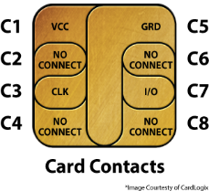
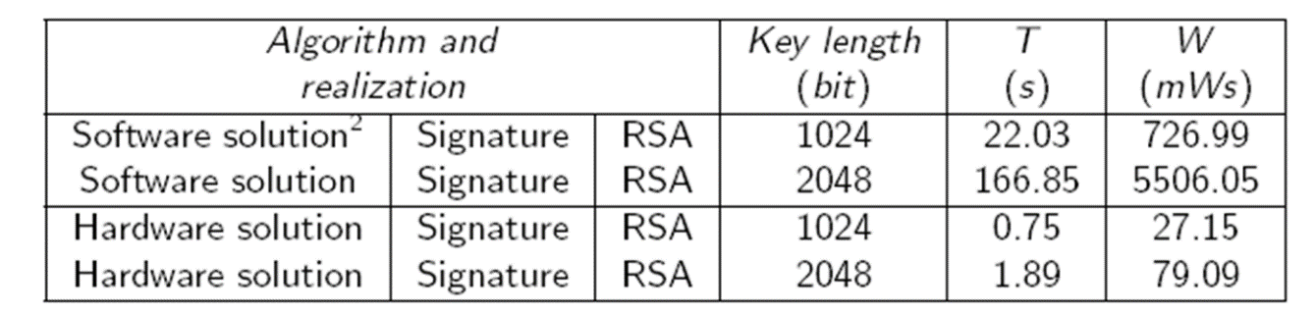
Performance with cryptographic smartcard
Total time = T(dataIn) + T(operation) + T(dataOut)
Experiment: MICAz (ATmega128L), GemXpresso R4
Performance for RSA-1024b
  30x faster (750ms), 27x more energy efficient (27mW)
Performance for RSA-2048b
  88x faster (1900ms), 70x more energy efficient (79mW)
Hanáček, Nagy, Pecho: Power Consumption of Hardware Cryptography Platform for Wireless Sensor, IEEE CS, 2009, s. 6, ISBN 978-0-7695-3914-0

Slide 28
Performance with newer cards
Even faster with current cards and faster UART
  9600 baud → 128000 baud => 12x faster data I/O
$2 Feitian A40 smart card (Infineon SLE78)
  25ms per single RSA-1024b operation
  150ms per single RSA-2048b operation
Expected performance
  below 50ms (440x faster) for RSA-1024
  below 200ms (900x faster) for RSA-2048
Even cheaper and efficient ASICs available…

Slide 29

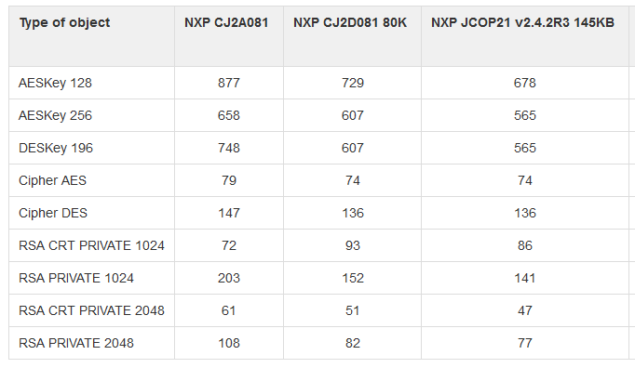
Multiple keys / engines can be stored
https://www.fi.muni.cz/~xsvenda/jcalgtest

Slide 30
Key Distribution
Wireless Sensor Networks – Key Distribution

Slide 31
Problem: wide range of assumptions
Different works assume different types of WSNs
  network architecture and topology
  network nodes hardware and required lifetime
  degree of (de)centralism, level of nodes mobility
  communication medium used, quality of links
  computational power, memory limitations, energy source
  routing and data collection algorithms
  assumptions about attacker capabilities
  …
One security approach doesn’t fit all scenarios

Slide 32
Level of keys pre-distribution (I.)
No pre-distribution
  all keys established after nodes are deployed
  e.g., Key Infection (exchange keys in plaintext)
  problem: usually assumes period of limited attacker
Fixed network wide “master” key(s)
  pre-distributed keys allowing key establishment with all others
  problem: very low node capture resilience

Slide 33
Fixed network wide “master” key(s)
Single master key shared by whole network
All transmission encrypted/MAC by master key
  What are possible attacks?
  Reuse of key for long time, no origin authentication…
  Compromise of master key (node capture)
Link keys derived from master key
  linkKey = KDF(nodeID1 | nodeID2 | random)
What attacks are possible?

Slide 34



Why “Master key” pre-distribution fails
Perfect in terms of memory storage
Completely fails with single node

Slide 35
Level of keys pre-distribution (II.)
No pre-distribution
  all keys established after nodes are deployed
  e.g., Key Infection (exchange keys in plaintext)
  problem: usually assumes period of limited attacker
Fixed network wide “master” key(s)
  pre-distributed keys allowing key establishment with all others
  problem: very low node capture resilience
Partial pre-distribution
  not all nodes can establish key directly
  e.g., probabilistic pre-distribution [EG02]
  problem: node capture resiliency

Slide 36
Probabilistic key pre-distribution
Key pool
K7
K3
K27
K23
K16
K21
K11
K53
K23
Eschenauer & Gligor 2002
Elegant idea with low memory requirements
  based on birthday paradox
  large pool of cryptographic keys with unique IDs used
For every node prior deployment:
  randomly select keys from large key pool
  return selected keys back to pool
  proceed with next node
K75
K11
K8
K1
K7
K3
K23
K11
K75
K23

Slide 37
Probabilistic key pre-distribution (2)
K7
K3
K23
K11
K75
K23
During neighbour discovery:
  neighbours establish radio communication
  nodes iterate over their keyrings for shared key(s)
  if shared (by chance) key(s) are found, secure link is established
  e.g., 100 keys from 10000 => 60% probability at least one key shared
Not all nodes can establish secure link
  but sufficient connectivity probability can be set
Node capture resilience (NCR) is a problem

Slide 38
How probabilistic pre-distribution fails
Keys from uncaptured nodes compromised as well

Slide 39
Level of keys pre-distribution (III.)
Pairwise keys (node2BS, node2node)
  all nodes can establish keys if necessary
  Every node to BS, every node to every node

Slide 40
Pairwise keys – every node to BS
Predistributed unique key(s) between BS and every node
  BS holds database of all keys, node holds just single key to BS
End-to-end encryption/MAC
  Intermediate nodes just forward towards BS
  Low latency, memory and computation overhead (no processing on intermediate nodes)
Possibility for periodic key update
  newKey = KDF(oldKey, “Period_{i}”), erase previous oldKey
  Better than newKey=KDF(masterKey,“Period_{i}”) – why?
Disadvantages of scheme?
  No data aggregation, insertion of corrupted packets…

Slide 41
Pairwise keys – every node to every node
Predistributed unique key(s) between every two nodes
  Every node holds keys to all other potential neighbours
  (1MB flash storage => 65k of 16B keys)
  Proper key is found and used when needed
Unused keys may be erased after neighbour discovery
  When unused keys will not be necessary
  No need for a priory knowledge of network layout
Keys to not yet deployed nodes can be also included
  Later redeployment of fresh nodes
  Authentication between old and new nodes possible
Node capture resiliency
  no keys except for compromised node are revealed

Slide 42
How “Pairwise keys” pre-distribution fails?
Only links to captured node are compromised
Key from captured node can be used everywhere
Node2
K₁₂
K₂₃
K₂₄
Node1
K₁₂
K₁₃
K₁₄
Node1
K₁₂
K₁₃
K₁₄
Node4
K₁₄
K₂₄
K₃₄
Node3
K₁₃
K₂₃
K₃₄

Slide 43
Level of keys pre-distribution (2)
Pairwise keys (node2BS, node2node)
  all nodes can establish keys if necessary
Asymmetric cryptography
  all nodes can establish keys if necessary
  e.g., ECC, pairing-based crypto
  shown to be feasible (2.5 sec verification, 20KB ROM)
  problem: revocation of compromised keys/nodes

Slide 44
Why asymmetric cryptography may fail?
Only links to captured node are compromised
High computational/transmission overhead (> 128B)
Private key from captured node can be used everywhere
Revocation is hard

Slide 45
Level of keys pre-distribution (2)
Pairwise keys
  all nodes can establish keys if necessary
Asymmetric cryptography
  all nodes can establish keys if necessary
  e.g., ECC, pairing-based crypto
  shown to be feasible (2.5 sec verification, 20KB ROM)
  problem: revocation of compromised keys/nodes
Central key distribution (via Base Station)
  BS acts as trusted third party, centralized solution (SPINS)
  problem: multi-hop communication to BS

Slide 46

How TTP distribution fails?
Every key is established via base station (good control)
Communication is multi-hop and energy expensive
Network may be temporarily disconnected
Base station

Slide 47
Partial compromise
All approaches vulnerable to some extend.
What should we do with partial compromise?

Slide 48
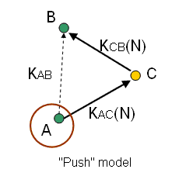
Secrecy amplification protocols

Slide 49
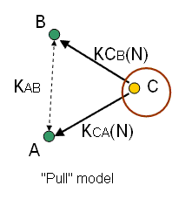
Secrecy amplification protocols
Additional protocol executed atop of distributed keys
  network partially compromised after some attack
  some link keys known to attacker (eavesdropped, captured)
Secrecy amplification is able to secure previously compromised link(s)
  transport of fresh link key over secure path
  success depends on compromise pattern
Protocol can be executed even when information about compromise is not available
  old and new key is combined
PUSH
PULL

Slide 50
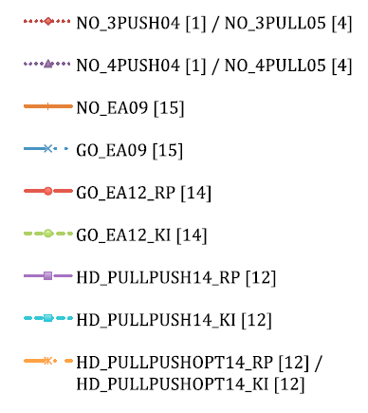
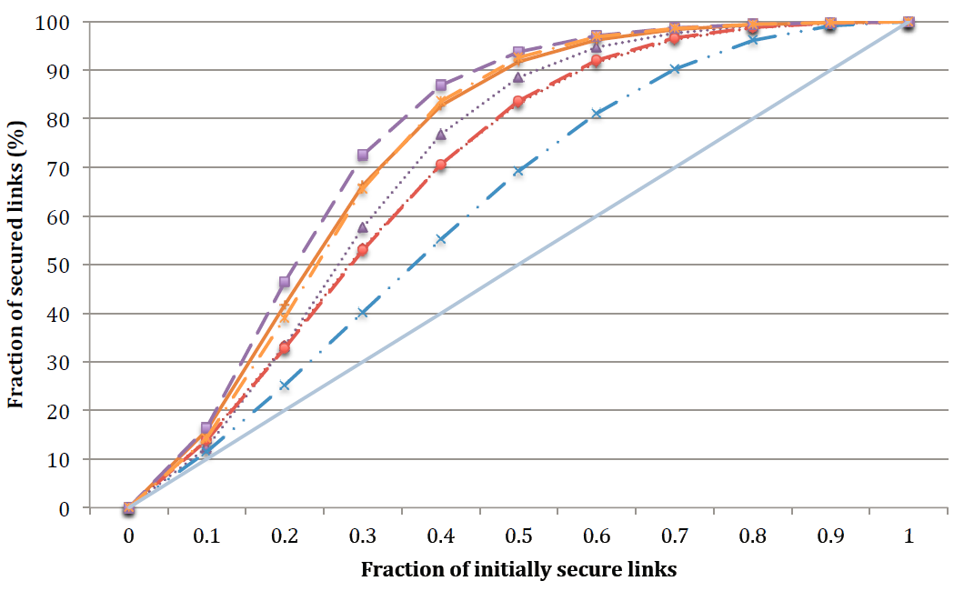
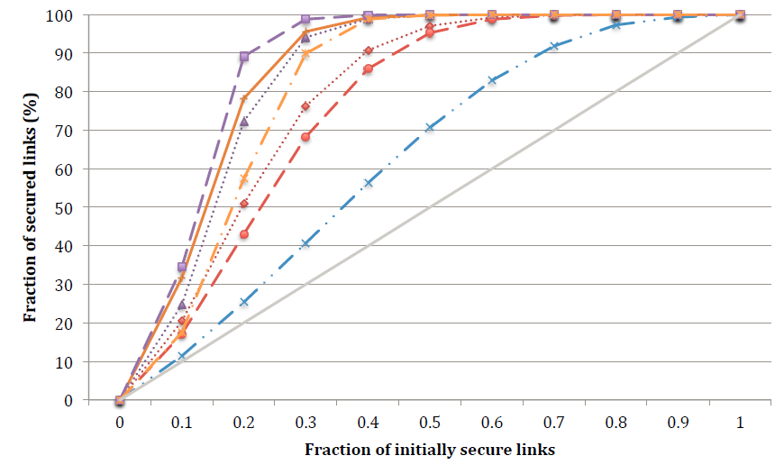
Comparison: total success rate
Avg 7.5 neighbours
Avg 20.3 neighbours
before SA: 60 % secure
after SA: 97 % secure
Depending on network density, up to 30 % → 95 %
Notes:
Great improvement, but for what price? And what is important currency in battery-powered networks? Number of messages -> Energy

Slide 51
Main advantages of secrecy amplification
Is preventive measure (no detection/reaction)
Can work in (partially) compromised environment
Work with different underlying (pre)distributions
Are introducing secrets (keys) usable only locally
Can be (automatically) parameterized/optimized
Can run continuously – attacker must maintain its presence
Survey: http://www.crcs.cz/papers/wistp2015

Slide 52
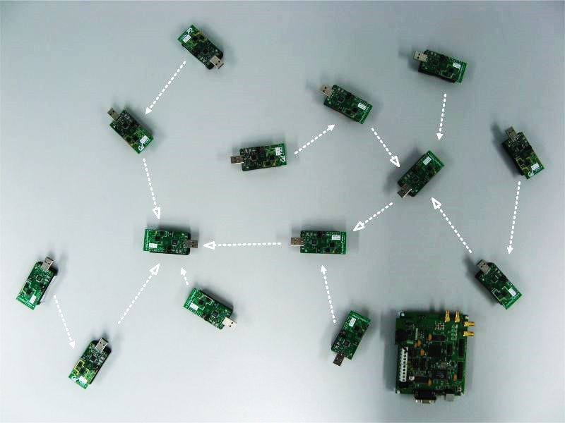
Hybrid SA - prototype implementation
TelosB hardware platform with the TinyOS 2.1.2 operating system
Three different roles:
  master: being node N_{C}
  slave: being node N_{P}
  forwarder: being intermediate node
Six phases executed in parallel
  discovery of radio distance to neighbors
  measured distances broadcast
  computation of mapping to real nodes
  execution of hybrid protocol
  verification of shared sub-keys transmitted
  combination of all sub-keys with existing link key

Slide 53
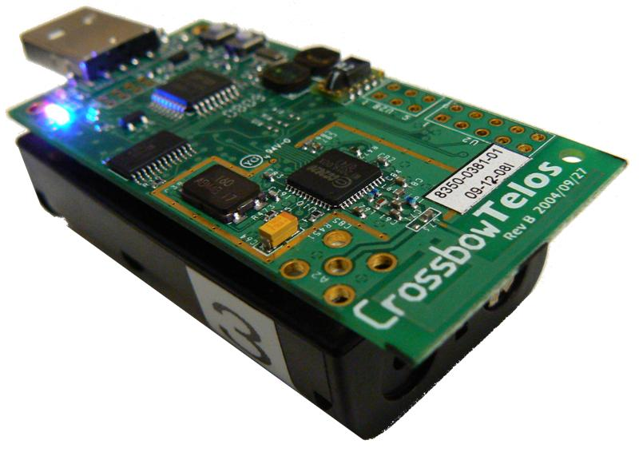
Practical implementation – results
Scenario: 10 neighbours on average
Hybrid secrecy amplification protocol
TinyOS 2.1.2 implementation
  < 500B RAM (peak usage, reusable later), ~3KB code
  Seconds to minutes to reliably map radio propagation
    highly depends on surrounding noise, etc.
  ~1 KB of payload is transmitted during whole secrecy amplification phase (by every node)
  1 second worth local computation
  1-10 seconds to transmit all amplification messages

Slide 54
Case study: wsnProtectLayer
https://github.com/crocs-muni/WSNProtectLayer

Slide 55
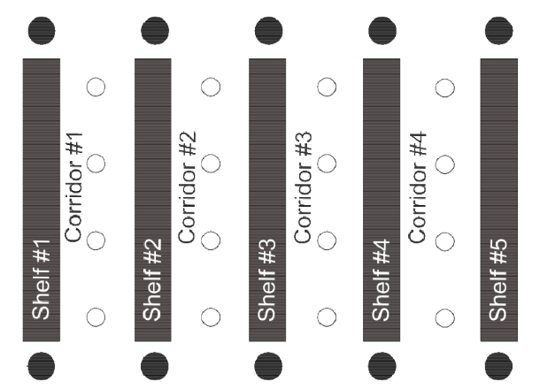
Scenario 1 - Warehouse
Monitored devices with RFID-based radio tags
Tracking of person movement
Static routes
Long-living network

Slide 56
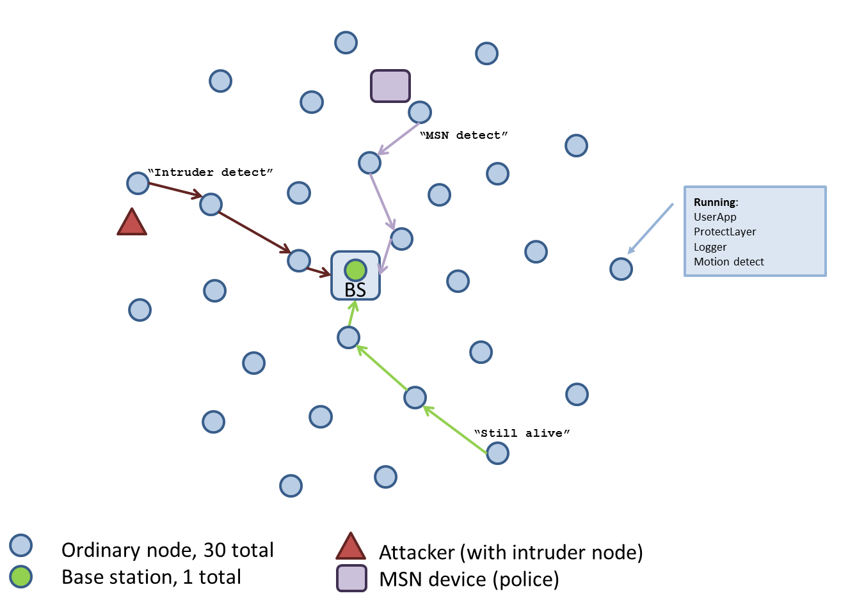
Scenario 2 – Police unit
Defense of central point (base station)
Detection of moving attacker
Reporting of moving policeman
Jamming detection
Dynamic routes
Short-living network

Slide 57
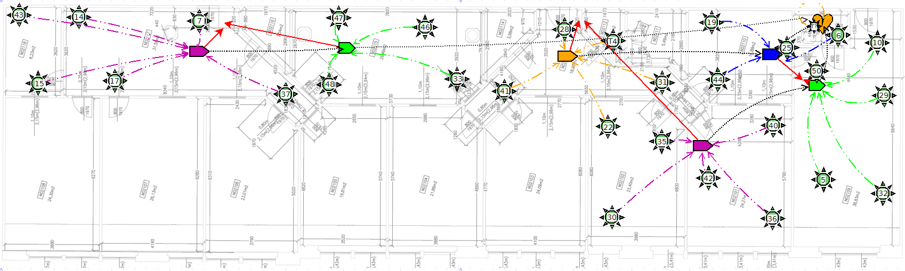
Scenario 3 – Building monitoring
Tracking of selected person movement
Multiple levels of privacy protection
Static routes
Long-living network

Slide 58


Attacker models assumed
Local / global passive eavesdropping
  Packet capture, traffic analysis
Active attacker manipulating traffic
  Packet dropping, injection, jamming
Active attacker capturing nodes
  And extracting cryptographic keys

Slide 59



Core architecture components
Intrusion detection component
  Distributed packet dropper and jamming detection
  Local neighbour reputation metric
  Base station notified when misbehaving node is detected
Privacy protection component
  4 levels of protection, controlled by authenticated broadcast
  Open communication
  Message integrity and authentication
  Packet encryption
  Traffic analysis-resistant phantom routing
Key management component
  Cryptographic key distribution and establishment (node, base stations)
  Cryptographic services for other components

Slide 60
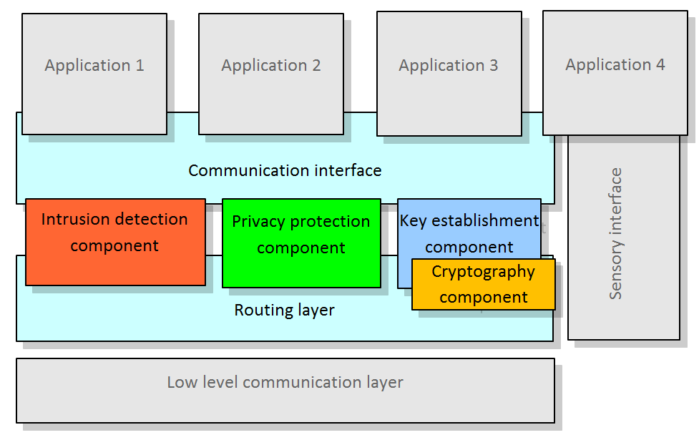

Slide 61
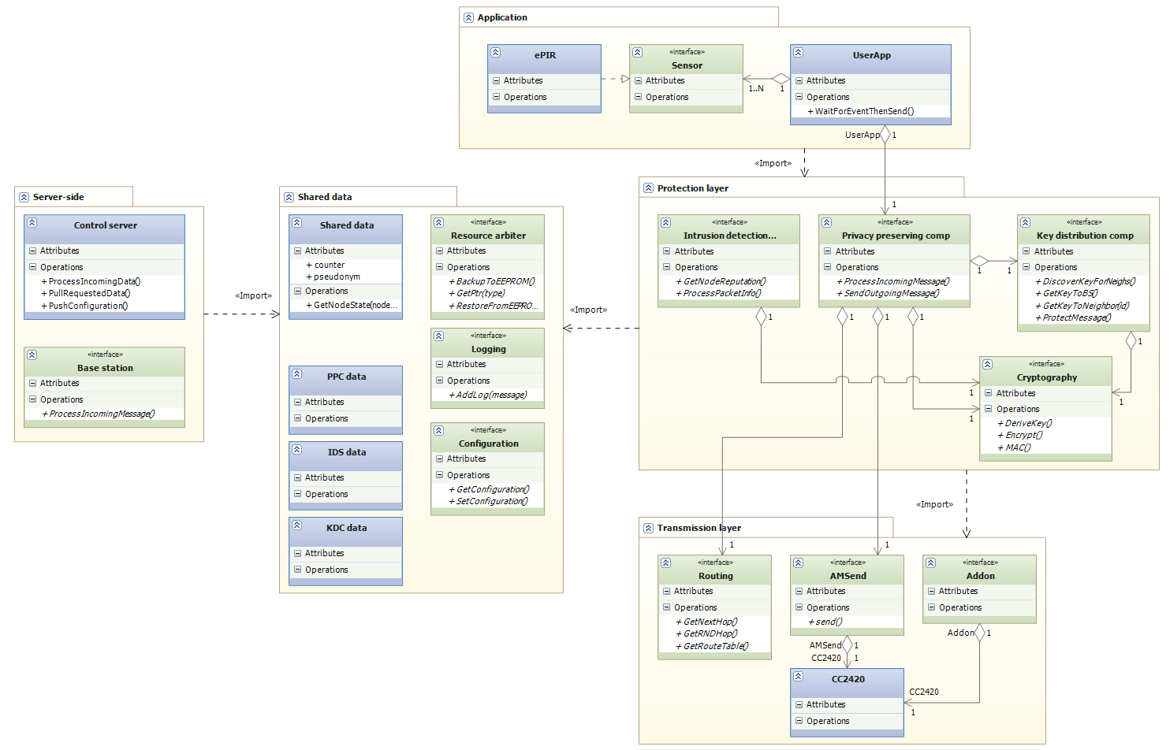
Architecture
Original user application
ProtectLayer middleware
Server control
AM Radio module
Node persistent state

Slide 62
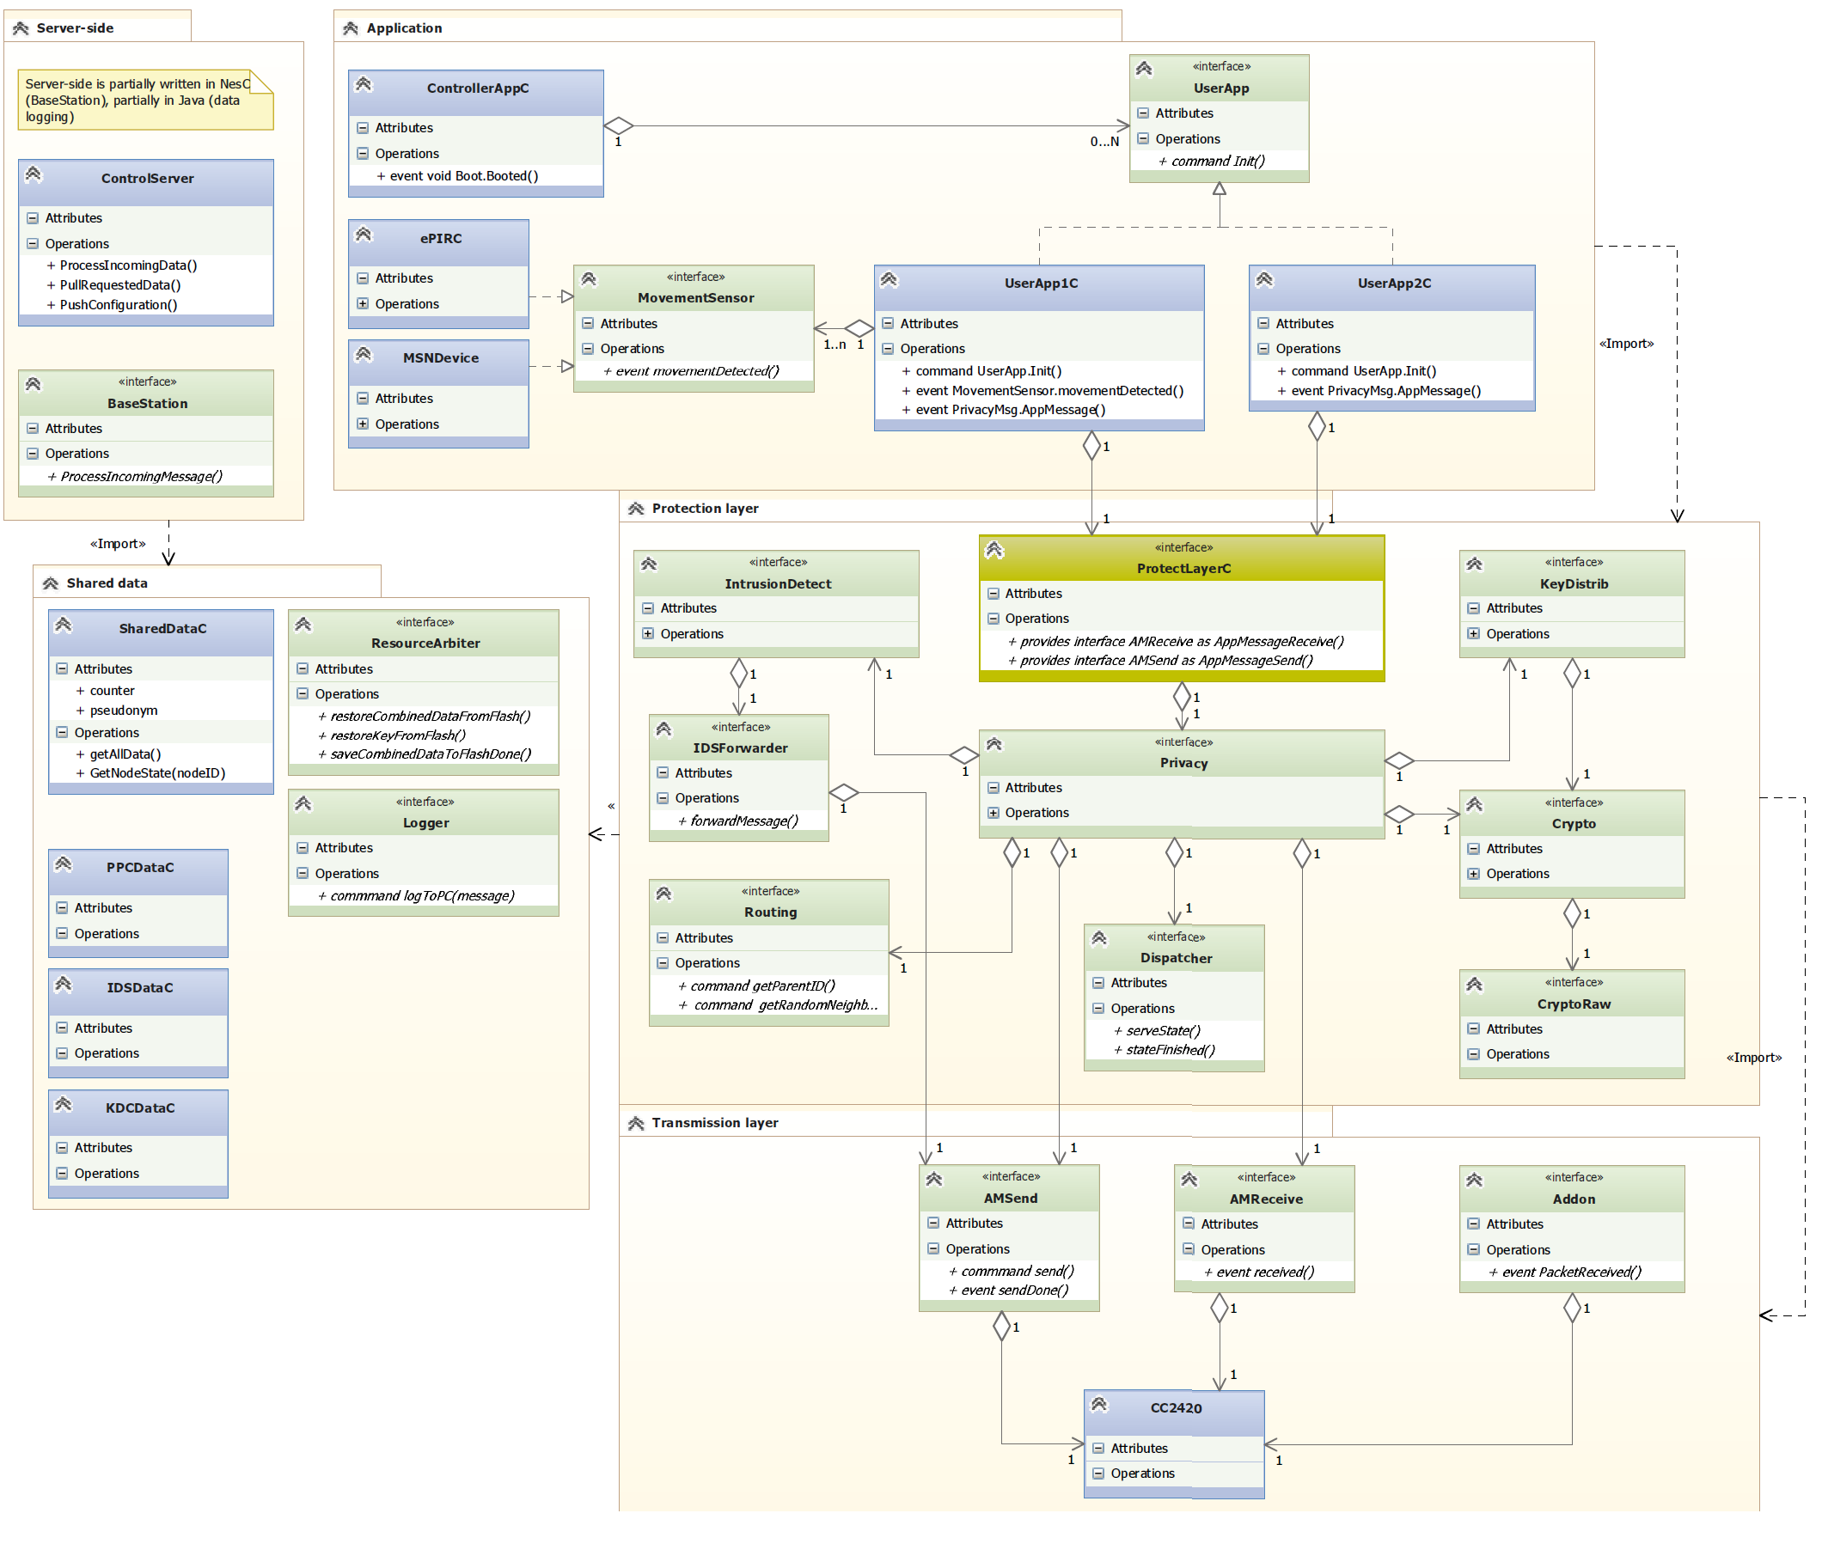

Slide 63
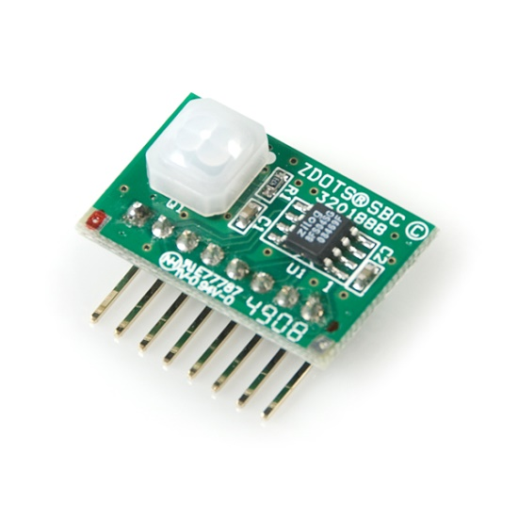
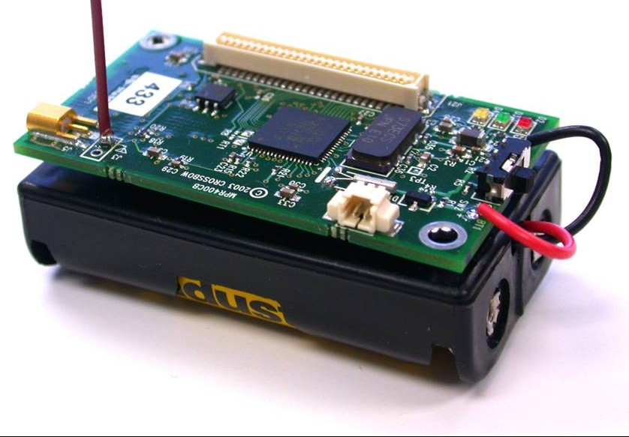
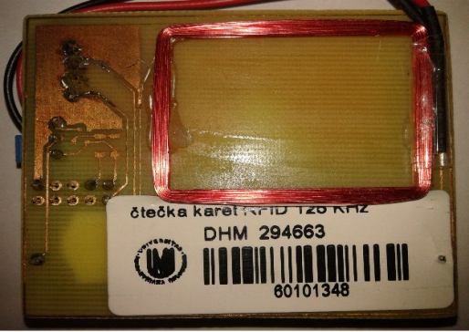
Hardware used, testbed
Zilog ePIR
RFID reader 125kHz
Crossbow TelosB
Crossbow MICAz
Laboratory testbed

Slide 64
Wiring Blink2Radio @ ProtectLayer…
configuration BlinkToRadioAppC {
}
implementation {
components MainC;
components LedsC;
components BlinkToRadioC as App;
components new TimerMilliC() as Timer0;
components new TimerMilliC() as InitTimer;
---> Original Components
components ActiveMessageC;
components new AMSenderC(AM_BLINKTORADIO);
components new AMReceiverC(AM_BLINKTORADIO);
---> Replaced by new ProtectLayerC
// Basic components wiring
App.Boot -> MainC;
App.Leds -> LedsC;
App.Timer0 -> Timer0;
App.InitTimer -> InitTimer;
---> Original wirings
App.Packet -> AMSenderC;
App.AMPacket -> AMSenderC;
App.AMControl -> ActiveMessageC;
App.AMSend -> AMSenderC;
App.Receive -> AMReceiverC;
---> Replaced by new one to ProtectLayerC
}
configuration BlinkToRadioAppC {
}
implementation {
components MainC;
components LedsC;
components BlinkToRadioC as App;
components new TimerMilliC() as Timer0;
components new TimerMilliC() as InitTimer;
components ProtectLayerC;
// Basic components wiring
App.Boot -> MainC;
App.Leds -> LedsC;
App.Timer0 -> Timer0;
App.InitTimer -> InitTimer;
App.Packet -> ProtectLayerC.Packet;
App.AMControl -> ProtectLayerC.AMControl;
App.AMSend -> ProtectLayerC.AMSend;
App.Receive -> ProtectLayerC.Receive;
}

Slide 65
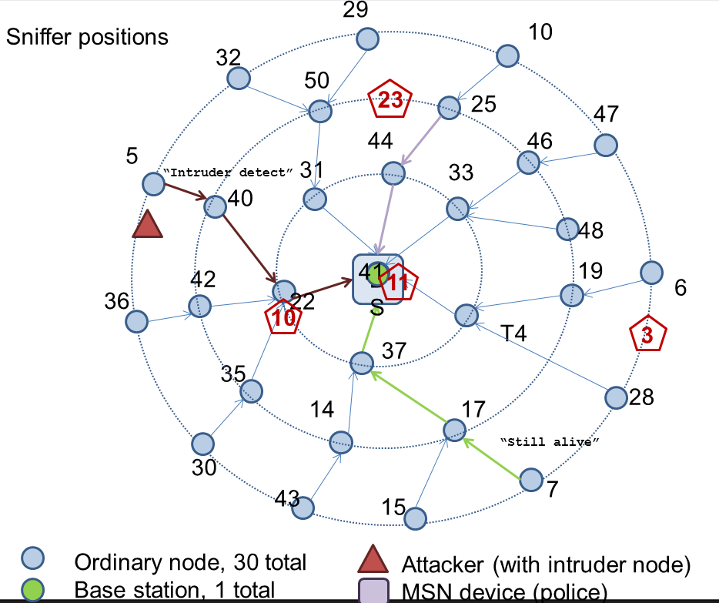
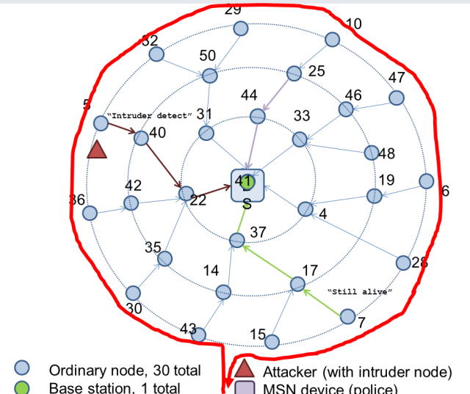
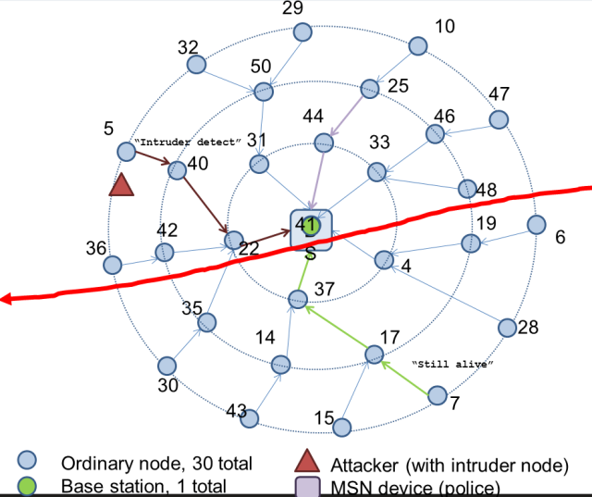
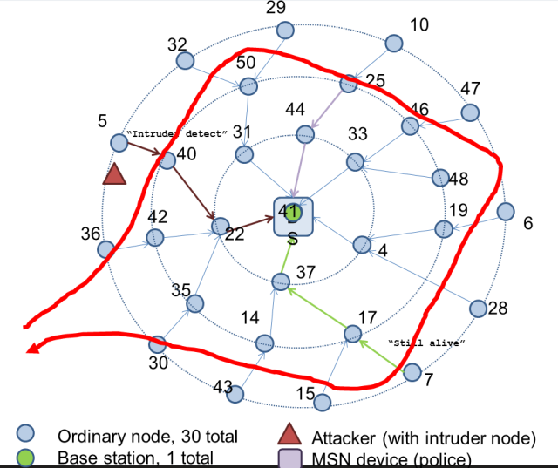
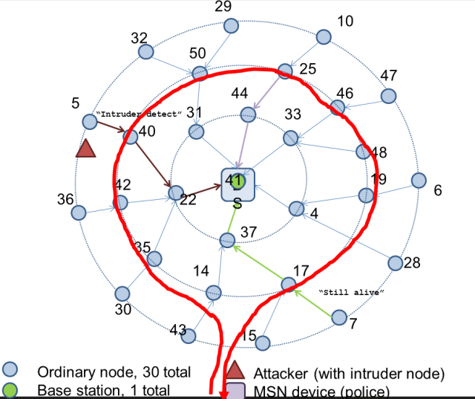
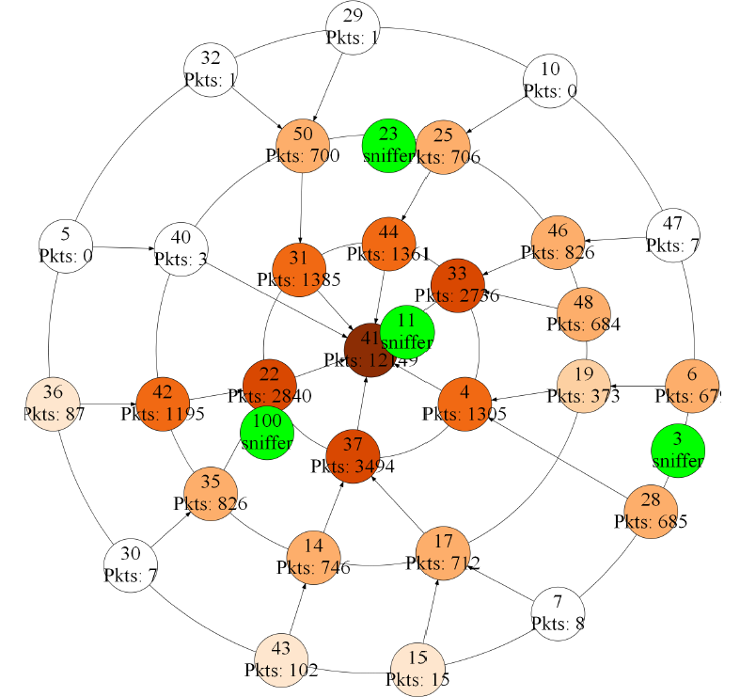
Police scenario

Slide 66
Try it!
TinyOS 2.x-based (TelosB nodes used)
Václav MATYÁŠ, Petr ŠVENDA, Andriy STETSKO, Dušan KLINEC, Filip JURNEČKA a Martin STEHLÍK. WSNProtectLayer – security middleware for wireless sensor networks. Securing Cyber-Physical Systems. USA: CRC Press, 2015. s. 119-162, 44 s. CRC Press. ISBN 978-1-4987-0098-6.
https://github.com/crocs-muni/WSNProtectLayer

Slide 67
Summary
Common security protocols often cannot be used
  Preference for symmetric crypto-only solutions
  Low transmission overhead important due to energy
Key distribution is (as usual) critical factor
Partial compromise should be anticipated
  And protocols designed to be able to cope with it
Mandatory reading
  A. Perrig et al: SPINS: Security Protocols for Sensor Networks
  https://users.ece.cmu.edu/~adrian/projects/mc2001/mc2001.pdf

