Slide 1

Capture the Flag from WWE Bank
KYPO game for practising penetration testing
CSIRT-MU, Masaryk University, Brno

Slide 2
Game Essentials
Objective: Steal confidential information from an internal database.
Background: fictitious WWE Bank organizes a hacking challenge.
Structure: several levels (more than 4 and less than 8) with particular tasks.
Game characteristics: learning by doing, fun, stress, frustration, uncertainty, time pressure, eureka, satisfaction.

Slide 3
Attack Phases
Getting familiar with the environment
Select target
Find vulnerability
Find a way to exploit vulnerability
Make the target useful for attacker

Slide 4
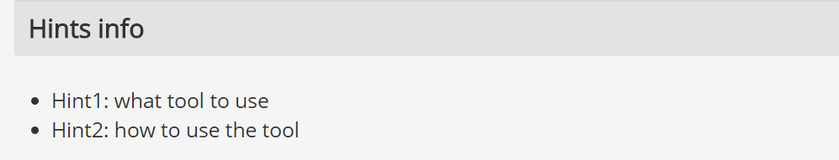
Game Hints and Solutions
Hints: each level offer several hints for penalty points, hints can be taken in arbitrary order
Recommended solution: if you are struggling, you can access step-by-step solution of the level
Game characteristics: learning by doing, fun, stress, frustration, uncertainty, time pressure, eureka, satisfaction.
Invalid flag!

Slide 5
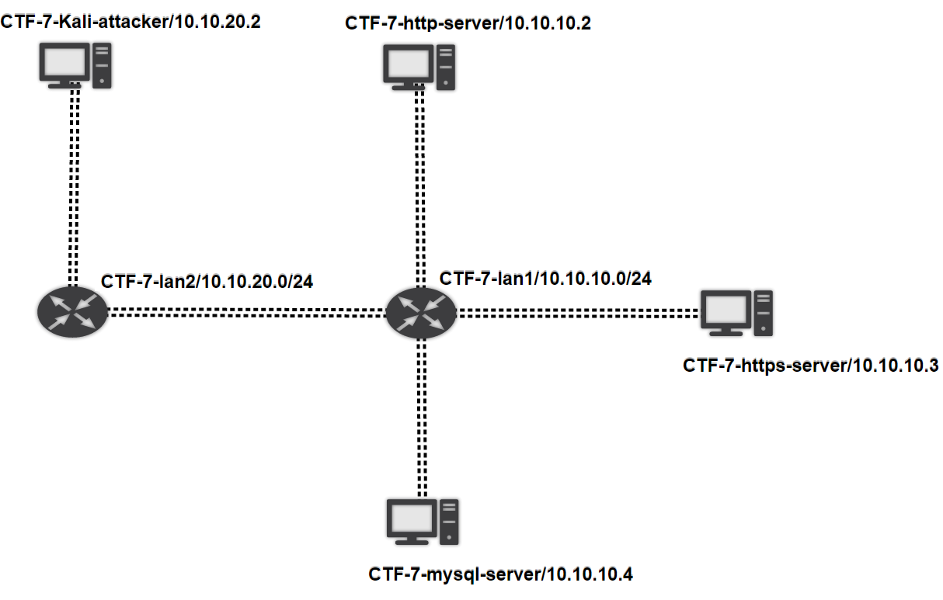
Network Topology
You are here

Slide 6
Recommendations
2-hour session allows your own pace.
Ask us for help, we may tell you something useful.
Each team/player has own sandbox, do not hesitate to try everything.
Take hints and be prepared to spend some points for that.
Use Google, use Google, use Google!

Slide 7
Let’s Go!
Open Chrome browser and go to kypo2.ics.muni.cz.
Log in with your university account using Shibboleth.
Choose your sandbox in a table.
Now you can see network topology.
Open CTF game in a new tab.
Read introduction.
Fill questionnaire.
Start the game!
Notes:
Make a photo of your final score and compare it with your friends.

Slide 8
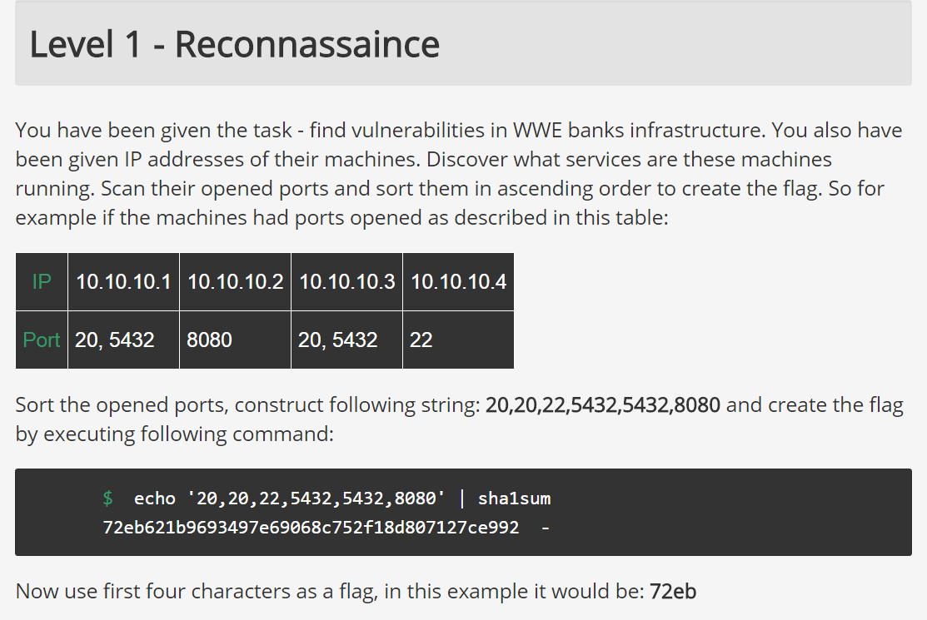
Let’s Go!

Slide 10
Homework
You have access to a sandbox IP 147.251.255.133 with two networks
The attacker is in the network 10.10.20.0/24
Victims are in the network 10.10.10.0/24
Use nmap and Metasploit
Credentials for your machine login:root pass:toor

Slide 11
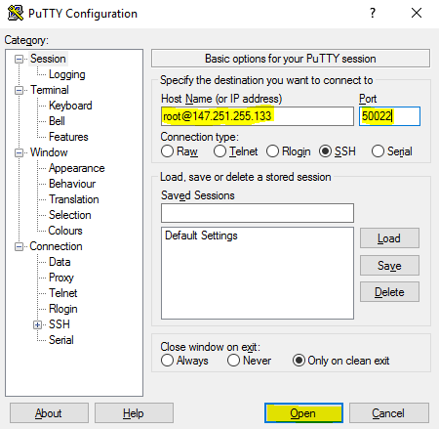
Homework – How to Connect on Windows
Using Windows Putty

Slide 12
Homework – How to Connect on Linux
Using Linux ssh:
  ssh –p 50022 root@147.251.255.133

Slide 13
Homework – How to Submit
Submit the homework in a format:
Number of active Ips in the 10.10.10.0/24 subnet
Version of Samba servers from 10.10.10.0/24 subnet
Ordered list of existing vulnerabilities of the Samba servers according to the CVE database (use cvedetails.com) having score >= 9.0
Describe briefly used commands

