Slide 1

PA197 Secure network design
Basic wireless networking
Petr Švenda svenda@fi.muni.cz
Faculty of Informatics, Masaryk University

Slide 2
Laboratory
Jammer attack
Simple static routing via one intermediate node
  Sender→Transmitter (receive, send)→Receiver (blink)
  Single parent for routing towards “BS” (e.g., CTP)
Node-to-node routing
  Simple flooding routing with multiple neighbours
  Packet with target ID, retransmitted to all neighbours

Slide 3
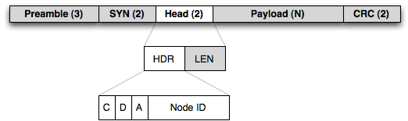
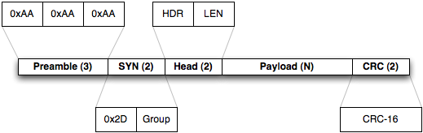
RF12 packet structure
C = CTL, D = DST, A = ACK, 5-bit node ID
  A bit (ACK) – indicates if sender wants to get ACK back
  D bit (DST) – indicates if node ID bits specify destination or source node
  C bit (CTL) – 1 if packet is ACK (and A must be 0)
http://jeelabs.org/2011/06/09/rf12-packet-format-and-design/index.html
Values set/visible via (rf12_send, rf12_recv)

Slide 4
Non-discriminative jammer
Occupies/distorts whole channel
  Sending packets all the time without waiting for clear channel
  No need to send correctly formatted packets or use same type of radio
How to detect non-discriminative jammer?
  Abnormally high number of lost packets
  Abnormally high send waiting time (clear channel)
  Abnormally low RSSI
  Detection by whole channel monitoring (e.g., SDR)

Slide 5
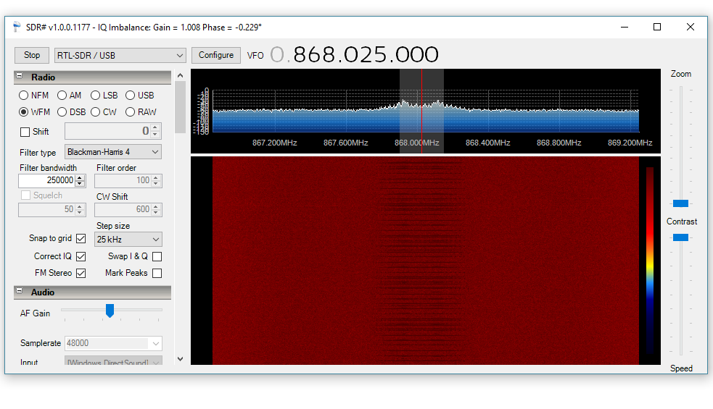
Non-discriminative jammer : SDR

Slide 6
Selective jammer
Not jamming continuously, bursts to corrupt particular message
Disturb next message that is expected to be send
  Attacker in promiscuous mode, receives message_{i}
  Prevents transmission of message_{i+1} (occupies channel…)
Disturb rest of a currently transmitted message based on initial part
  Requires high speed processing of radio channel and low latency decision
    Not possible with our RF12 module (whole packet only)
  Disturb only part of a message (e.g., CRC checksum)
    Message is dropped upon reception
How to detect selective jammer?
  Detection of abnormally high number of corrupted or lost packets
  Sensing of channel with different radio and detection of burst transmissions

Slide 7
Simple static routing via one intermediate
Pair together with two other colleagues
  Same as previous one-hop exercise
  Output message with counter to serial port (monitor packet loss)
Use one intermediate node (fixed routing topology)
  Sender→Transmitter (receive, send)→Receiver (blink)
Test on distance (hall space, other floors…)
  How far you can extend coverage? Multiple transmitters?
Straightforward extension to fixed routing to BS
  Every one has single parent for routing towards BS
  e.g., The Collection Tree Protocol (CTP)
Think about advantages and disadvantages
  Flexibility, robustness, malicious passive/active attacker

Slide 8
Any node to any node routing - flooding
What are options for any-to-any routing?
  Think about limitations in context of ad-hoc/WSNs
Implement node-to-node routing
  Simple flooding routing with multiple neighbours
    Establish list of neighbouring nodes
  Packet contains target node ID (data section)
  Locally retransmitted to all neighbours
How to eventually stop flooding?
  Time To Live? (TTL decrement after every hop, 0 => drop)
  Packet Unique ID (seen twice => do not resend, state)

Slide 9
Homework 12 – Attack against routing
Influence routing discovery phase of laboratory testbed to create sink-hole attack
  messages routed towards your malicious node
  Route discovery phase runs for 5 minutes (LEDs are blinking fast)
Capture packets during message exchange phase
  5 minutes, no blinking
  Capture all packets routed to you, format: #num1#num2
    E.g., #3289#893756
  Replace second number after # with your UCO
    E.g., #3289#4085
Send modified captured packet to BS
  BS will reply, store all responses into file to be submitted as solution

Slide 10
Homework 12 – Attack against routing
Produce short (1xA4) text description of solution
  How routing discovery phase is done
  How were packets analyzed
  How resend was done to maximize number of captured packets
Try to maximize number of captured/resend packets
  Part of the points will be assigned based on the amount of packets
Submit before: 29.5. 23:59am (full number of points)
  Every additional started day (24h) means 1.5 points penalization

