Slide 1
Mining Data Streams
Advanced Search Techniques for Large Scale Data Analytics
Pavel Zezula and Jan Sedmidubsky
Masaryk University
http://disa.fi.muni.cz

Slide 2
Data Streams
In many data mining situations, we do not know the entire data set in advance
Stream Management is important when the input rate is controlled externally:
  Google queries
  Twitter or Facebook status updates
We can think of the data as infinite and
non-stationary (the distribution changes
over time)

Slide 3
The Stream Model
Input elements enter at a rapid rate,
at one or more input ports (i.e., streams)
  We call elements of the stream tuples
The system cannot store the entire stream accessibly
Q: How do you make critical calculations about the stream using a limited amount of (secondary) memory?

Slide 4
General Stream Processing Model
Ad-Hoc
Queries
Processor
. . . 1, 5, 2, 7, 0, 9, 3
. . . a, r, v, t, y, h, b
. . . 0, 0, 1, 0, 1, 1, 0
time
Streams Entering.
Each is stream is
composed of
elements/tuples
Standing
Queries
Output
Limited
Working
Storage
Archival
Storage

Slide 5
Problems on Data Streams
Types of queries one wants on answer on
a data stream:
  Sampling data from a stream
    Construct a random sample
  Queries over sliding windows
    Number of items of type x in the last k elements
    of the stream
  Filtering a data stream
    Select elements with property x from the stream
  Counting distinct elements
    Number of distinct elements in the last k elements
    of the stream

Slide 6
Applications (1)
Mining query streams
  Google wants to know what queries are
  more frequent today than yesterday
Mining click streams
  Yahoo wants to know which of its pages are getting an unusual number of hits in the past hour
Mining social network news feeds
  E.g., look for trending topics on Twitter, Facebook

Slide 7
Applications (2)
Sensor Networks
  Many sensors feeding into a central controller
Telephone call records
  Data feeds into customer bills as well as settlements between telephone companies
IP packets monitored at a switch
  Gather information for optimal routing
  Detect denial-of-service attacks

Slide 8
Sampling from a Data Stream:
Sampling a fixed proportion
As the stream grows the sample
also gets bigger

Slide 9
Sampling from a Data Stream
Since we can not store the entire stream,
one obvious approach is to store a sample
Two different problems:
  (1) Sample a fixed proportion of elements
  in the stream (say 1 in 10)
  (2) Maintain a random sample of fixed size
  over a potentially infinite stream
    At any “time” k we would like a random sample
    of s elements
      What is the property of the sample we want to maintain?
      For all time steps k, each of k elements seen so far has
      equal prob. of being sampled

Slide 10
Sampling a Fixed Proportion
Problem 1: Sampling fixed proportion
Scenario: Search engine query stream
  Stream of tuples: (user, query, time)
  Answer questions such as: How often did a user run the same query in a single days
  Have space to store 1/10th of query stream
Naïve solution:
  Generate a random integer in [0..9] for each query
  Store the query if the integer is 0, otherwise discard

Slide 11
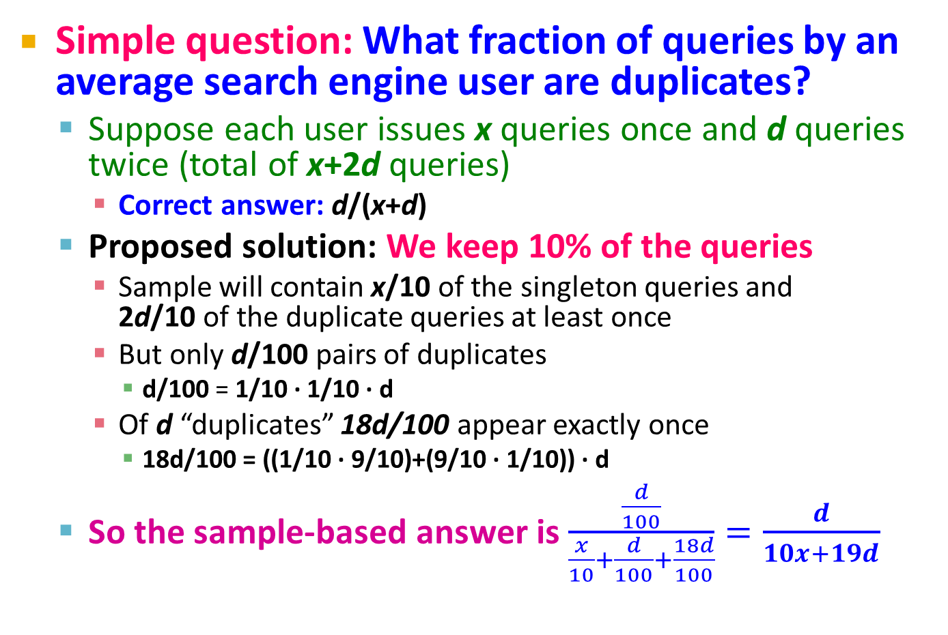
Problem with Naïve Approach
Simple question: What fraction of queries by an average search engine user are duplicates?
  Suppose each user issues x queries once and d queries twice (total of x+2d queries)
    Correct answer: d/(x+d)
  Proposed solution: We keep 10% of the queries
    Sample will contain x/10 of the singleton queries and
    2d/10 of the duplicate queries at least once
    But only d/100 pairs of duplicates
      d/100 = 1/10 ∙ 1/10 ∙ d
    Of d “duplicates” 18d/100 appear exactly once
      18d/100 = ((1/10 ∙ 9/10)+(9/10 ∙ 1/10)) ∙ d
  So the sample-based answer is $\frac{\frac{d}{100}}{\frac{x}{10}+\frac{d}{100}+\frac{18d}{100}}=\frac{d}{10x+19d}$
Notes:
d/100 appear twitece: 1st query gets sampled with prob. 1/10, 2nd also with 1/10, there are d such queries: d/100
18d/100 appear once. 1/10 for first to get selection and 9/10 for the second to not get selected. And the other way around so 18d/100

Slide 12
Solution: Sample Users
Solution:
Pick 1/10th of users and take all their
searches in the sample
Use a hash function that hashes the
user name or user id uniformly into 10 buckets

Slide 13
Generalized Solution
Stream of tuples with keys:
  Key is some subset of each tuple’s components
    e.g., tuple is (user, search, time); key is user
  Choice of key depends on application
To get a sample of a/b fraction of the stream:
  Hash each tuple’s key uniformly into b buckets
  Pick the tuple if its hash value is at most a
Hash table with b buckets, pick the tuple if its hash value is at most a.
How to generate a 30% sample?
Hash into b=10 buckets, take the tuple if it hashes to one of the first 3 buckets

Slide 14
Sampling from a Data Stream:
Sampling a fixed-size sample
As the stream grows, the sample is of fixed size

Slide 15
Maintaining a fixed-size sample
Problem 2: Fixed-size sample
Suppose we need to maintain a random
sample S of size exactly s tuples
  E.g., main memory size constraint
Why? Don’t know length of stream in advance
Suppose at time n we have seen n items
  Each item is in the sample S with equal prob. s/n
How to think about the problem: say s = 2
Stream: a x c y z k c d e g…
At n= 5, each of the first 5 tuples is included in the sample S with equal prob.
At n= 7, each of the first 7 tuples is included in the sample S with equal prob.
Impractical solution would be to store all the n tuples seen
so far and out of them pick s at random

Slide 16
Solution: Fixed Size Sample
Algorithm (a.k.a. Reservoir Sampling)
  Store all the first s elements of the stream to S
  Suppose we have seen n-1 elements, and now
  the n^{th} element arrives (n > s)
    With probability s/n, keep the n^{th} element, else discard it
    If we picked the n^{th} element, then it replaces one of the
    s elements in the sample S, picked uniformly at random
Claim: This algorithm maintains a sample S
with the desired property:
  After n elements, the sample contains each element seen so far with probability s/n

Slide 17
Proof: By Induction
We prove this by induction:
  Assume that after n elements, the sample contains each element seen so far with probability s/n
  We need to show that after seeing element n+1 the sample maintains the property
    Sample contains each element seen so far with probability s/(n+1)
Base case:
  After we see n=s elements the sample S has the desired property
    Each out of n=s elements is in the sample with probability s/s = 1

Slide 18
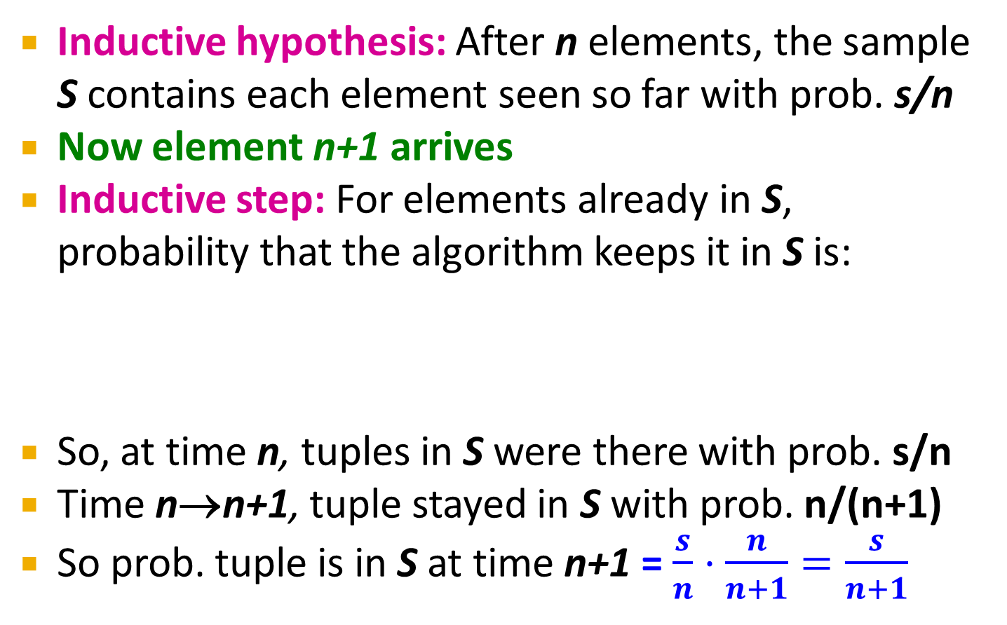
Proof: By Induction
Inductive hypothesis: After n elements, the sample S contains each element seen so far with prob. s/n
Now element n+1 arrives
Inductive step: For elements already in S, probability that the algorithm keeps it in S is:
So, at time n, tuples in S were there with prob. s/n
Time n→n+1, tuple stayed in S with prob. n/(n+1)
So prob. tuple is in S at time n+1 = $\frac{s}{n}⋅\frac{n}{n+1}=\frac{s}{n+1}$
Element n+1 discarded
Element n+1
not discarded
Element in the
sample not picked

Slide 19
Queries over a
(long) Sliding Window

Slide 20
Sliding Windows
A useful model of stream processing is that queries are about a window of length N –
the N most recent elements received
Interesting case: N is so large that the data cannot be stored in memory, or even on disk
  Or, there are so many streams that windows
  for all cannot be stored
Amazon example:
  For every product X we keep 0/1 stream of whether that product was sold in the n-th transaction
  We want answer queries, how many times have we sold X in the last k sales

Slide 21
Sliding Window: 1 Stream
Sliding window on a single stream:
N = 6
q w e r t y u i o p a s d f g h j k l z x c v b n m
q w e r t y u i o p a s d f g h j k l z x c v b n m
q w e r t y u i o p a s d f g h j k l z x c v b n m
q w e r t y u i o p a s d f g h j k l z x c v b n m
Past Future

Slide 22
Counting Bits (1)
Problem:
  Given a stream of 0s and 1s
  Be prepared to answer queries of the form
  How many 1s are in the last k bits? where k ≤ N
Obvious solution:
Store the most recent N bits
  When new bit comes in, discard the N+1st bit
0 1 0 0 1 1 0 1 1 1 0 1 0 1 0 1 1 0 1 1 0 1 1 0
Suppose N=6
Past Future

Slide 23
Counting Bits (2)
You can not get an exact answer without storing the entire window
Real Problem:
What if we cannot afford to store N bits?
  E.g., we’re processing 1 billion streams and
  N = 1 billion
But we are happy with an approximate answer
0 1 0 0 1 1 0 1 1 1 0 1 0 1 0 1 1 0 1 1 0 1 1 0
Past Future

Slide 24
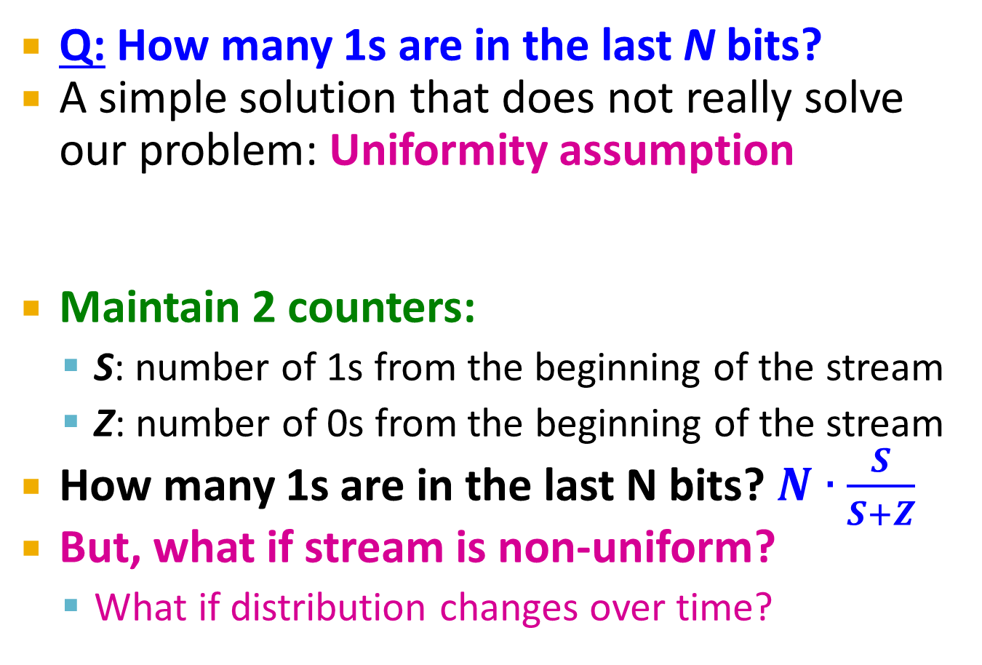
An attempt: Simple solution
Q: How many 1s are in the last N bits?
A simple solution that does not really solve our problem: Uniformity assumption
Maintain 2 counters:
  S: number of 1s from the beginning of the stream
  Z: number of 0s from the beginning of the stream
How many 1s are in the last N bits? $N∙\frac{S}{S+Z}$
But, what if stream is non-uniform?
  What if distribution changes over time?
N
0 1 0 0 1 1 1 0 0 0 1 0 1 0 0 1 0 0 0 1 0 1 1 0 1 1 0 1 1 1 0 0 1 0 1 0 1 1 0 0 1 1 0 1 0
Past Future

Slide 25
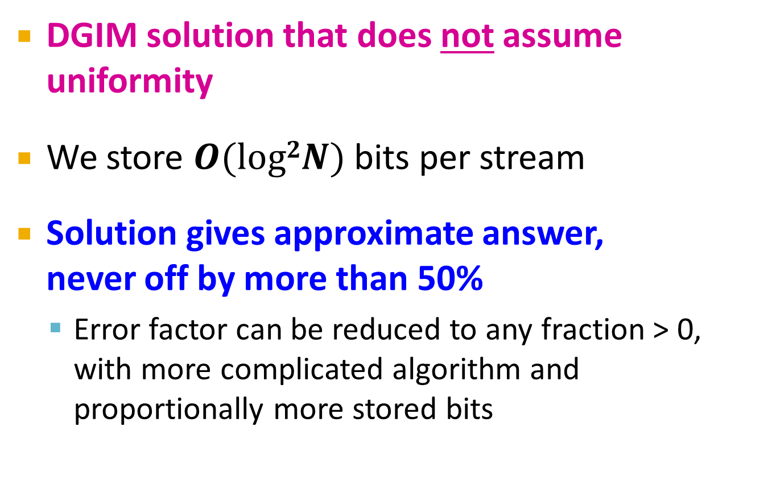
DGIM Method
[Datar, Gionis, Indyk, Motwani]
DGIM solution that does not assume uniformity
We store $O(log2N)$ bits per stream
Solution gives approximate answer,
never off by more than 50%
  Error factor can be reduced to any fraction > 0, with more complicated algorithm and proportionally more stored bits

Slide 26
Idea: Exponential Windows
Solution that doesn’t (quite) work:
  Summarize exponentially increasing regions
  of the stream, looking backward
  Drop small regions if they begin at the same point as a larger region
Window of width 16 has 6 1s
6
10
?
4
3
2
2
1
1
0
0 1 0 0 1 1 1 0 0 0 1 0 1 0 0 1 0 0 0 1 0 1 1 0 1 1 0 1 1 1 0 0 1 0 1 0 1 1 0 0 1 1 0 1 0
N
We can reconstruct the count of the last N bits, except we are not sure how many of the last 6 1s are included in the N
Notes:
remember -- this is a strawman algorithm that doesn't really work, so I never spent much time worrying about it, and you shouldn't either.
However, you don't have to worry about where the buckets begin or end in this algorithm, since that is determined completely from the count
of bits received so far. The rule for updating is as follows.
1. when a bit comes in, create a bucket of length 1 with the proper count (0 or 1).
2. If any level has 3 buckets:
a) add the rightmost two and create a bucket at the next higher
level (twice the length) with that sum.
b) delete the leftmost two buckets, keeping only the rightmost of the three..
3. Repeat (2) recursively for progressively higher levels.
I hope this helps. I would really invite students to figure it out if they care (they won't).

Slide 27
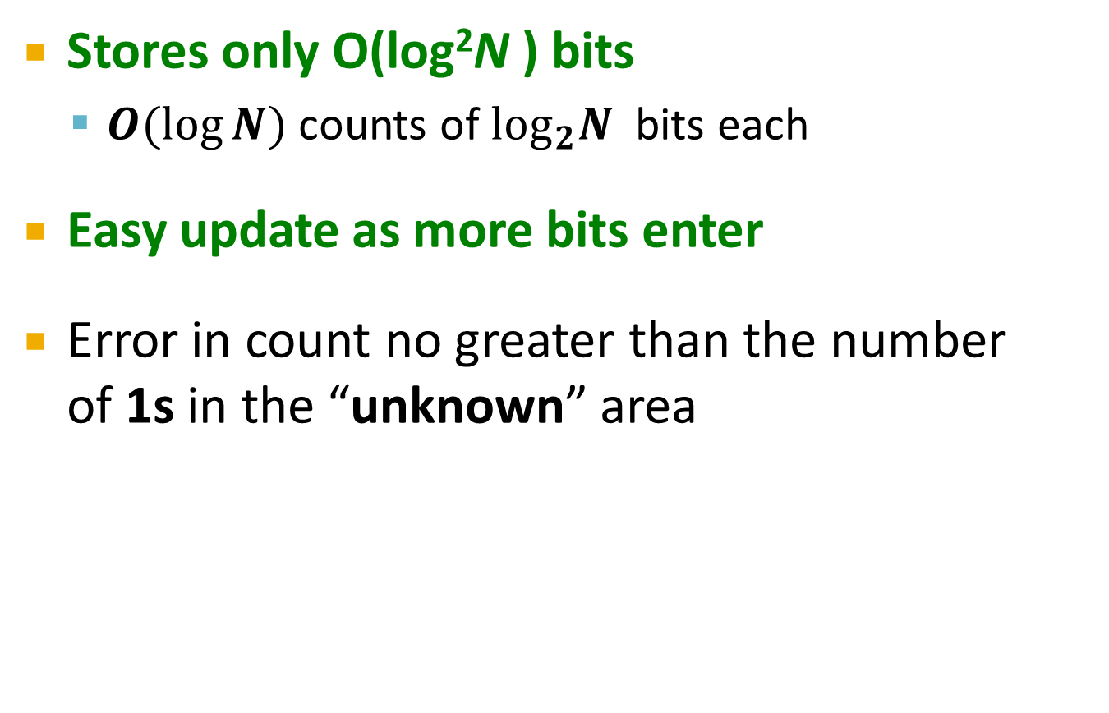
What’s Good?
Stores only O(log²N ) bits
  $O(log⁡N)$ counts of $\log_{2}N$ bits each
Easy update as more bits enter
Error in count no greater than the number
of 1s in the “unknown” area
Notes:
$O(logN)$ counts – the number of intervals
$\log_{2}N$ – number of bits needed to represent a single number (count) for each interval

Slide 28
What’s Not So Good?
As long as the 1s are fairly evenly distributed, the error due to the unknown region is small – no more than 50%
But it could be that all the 1s are in the unknown area at the end
In that case, the error is unbounded!
6
10
?
4
3
2
2
1
1
0
0 1 0 0 1 1 1 0 0 0 1 0 1 0 0 1 0 0 0 1 0 1 1 0 1 1 0 1 1 1 0 0 1 0 1 0 1 1 0 0 1 1 0 1 0
N

Slide 29
Fixup: DGIM method
[Datar, Gionis, Indyk, Motwani]
Idea: Instead of summarizing fixed-length blocks, summarize blocks with specific number of 1s:
  Let the block sizes (number of 1s) increase exponentially
When there are few 1s in the window, block sizes stay small, so errors are small
1001010110001011010101010101011010101010101110101010111010100010110010
N

Slide 30
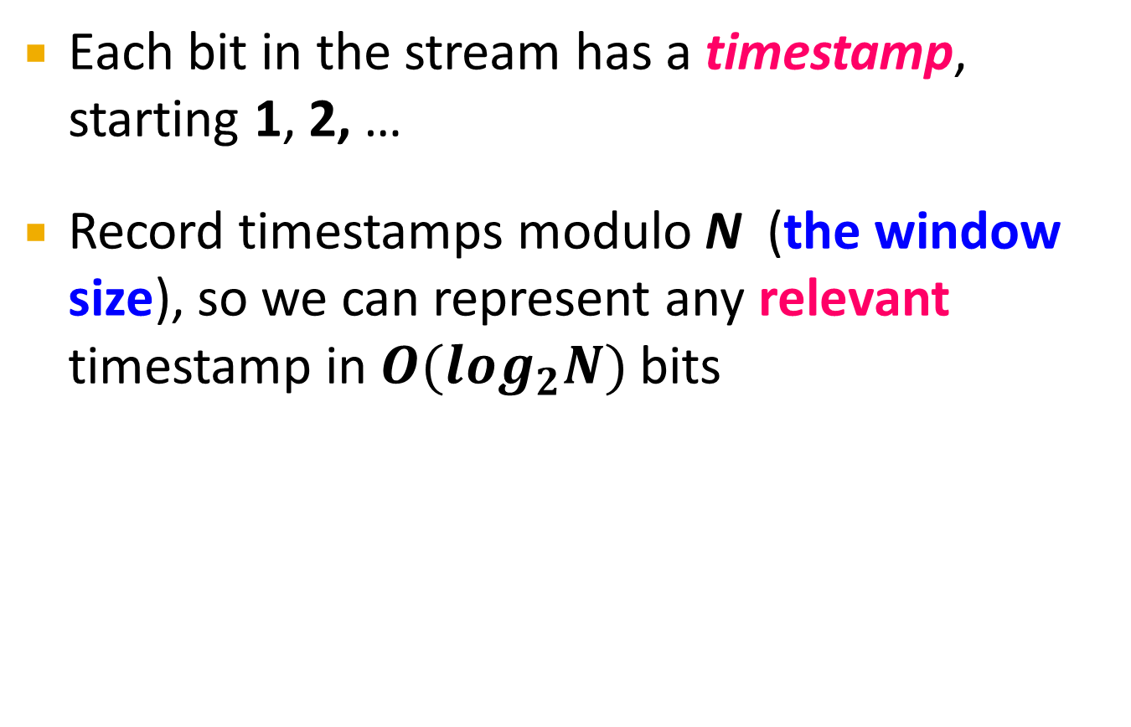
DGIM: Timestamps
Each bit in the stream has a timestamp, starting 1, 2, …
Record timestamps modulo N (the window size), so we can represent any relevant timestamp in $O(log_{2}N)$ bits

Slide 31
DGIM: Buckets
A bucket in the DGIM method is a record consisting of:
  (A) The timestamp of its end [O(log N) bits]
  (B) The number of 1s between its beginning and end [O(log log N) bits]
Constraint on buckets:
Number of 1s must be a power of 2
  That explains the O(log log N) in (B) above
1001010110001011010101010101011010101010101110101010111010100010110010
N

Slide 32
Representing a Stream by Buckets
Either one or two buckets with the same power-of-2 number of 1s
Buckets do not overlap in timestamps
Buckets are sorted by size
  Earlier buckets are not smaller than later buckets
Buckets disappear when their
end-time is > N time units in the past

Slide 33
Example: Bucketized Stream
At least 1 of
size 16. Partially
beyond window.
2 of
size 8
2 of
size 4
1 of
size 2
2 of
size 1
1001010110001011010101010101011010101010101110101010111010100010110010
N
Three properties of buckets that are maintained:
- Either one or two buckets with the same power-of-2 number of 1s
- Buckets do not overlap in timestamps
- Buckets are sorted by size

Slide 34
Updating Buckets (1)
When a new bit comes in, drop the last (oldest) bucket if its end-time is prior to N time units before the current time
2 cases: Current bit is 0 or 1
If the current bit is 0:
no other changes are needed

Slide 35
Updating Buckets (2)
If the current bit is 1:
  (1) Create a new bucket of size 1, for just this bit
    End timestamp = current time
  (2) If there are now three buckets of size 1, combine the oldest two into a bucket of size 2
  (3) If there are now three buckets of size 2,
  combine the oldest two into a bucket of size 4
  (4) And so on …

Slide 36
Example: Updating Buckets
Current state of the stream:
1001010110001011010101010101011010101010101110101010111010100010110010
Bit of value 1 arrives
0010101100010110101010101010110101010101011101010101110101000101100101
Two orange buckets get merged into a yellow bucket
0010101100010110101010101010110101010101011101010101110101000101100101
Next bit 1 arrives, new orange bucket is created, then 0 comes, then 1:
0101100010110101010101010110101010101011101010101110101000101100101101
Buckets get merged…
0101100010110101010101010110101010101011101010101110101000101100101101
State of the buckets after merging
0101100010110101010101010110101010101011101010101110101000101100101101

Slide 37
How to Query?
To estimate the number of 1s in the most recent N bits:
  Sum the sizes of all buckets but the last
          (note “size” means the number of 1s in the bucket)
  Add half the size of the last bucket
Remember: We do not know how many 1s
of the last bucket are still within the wanted window

Slide 38
Example: Bucketized Stream
At least 1 of
size 16. Partially
beyond window.
2 of
size 8
2 of
size 4
1 of
size 2
2 of
size 1
1001010110001011010101010101011010101010101110101010111010100010110010
N

Slide 39
(1) Filtering Data Streams

Slide 40
Filtering Data Streams
Each element of data stream is a tuple
Given a list of keys S
Determine which tuples of stream are in S
Obvious solution: Hash table
  But suppose we do not have enough memory to store all of S in a hash table
    E.g., we might be processing millions of filters
    on the same stream

Slide 41
Applications
Example: Email spam filtering
  We know 1 billion “good” email addresses
  If an email comes from one of these, it is NOT spam
Publish-subscribe systems
  You are collecting lots of messages (news articles)
  People express interest in certain sets of keywords
  Determine whether each message matches user’s interest

Slide 42
First Cut Solution (1)
Given a set of keys S that we want to filter
Create a bit array B of n bits, initially all 0s
Choose a hash function h with range [0,n)
Hash each member of s∈ S to one of
n buckets, and set that bit to 1, i.e., B[h(s)]=1
Hash each element a of the stream and output only those that hash to bit that was set to 1
  Output a if B[h(a)] == 1

Slide 43
First Cut Solution (2)
Output the item since it may be in S.
Item hashes to a bucket that at least
one of the items in S hashed to.
Filter
Item
Hash
func h
0010001011000
Bit array B
Drop the item.
It hashes to a bucket set
to 0 so it is surely not in S.
Creates false positives but no false negatives
  If the item is in S we surely output it, if not we may still output it
Notes:
True positive = correctly identified
False positive = incorrectly identified
True negative = correctly rejected
False negative = incorrectly rejected

Slide 44
First Cut Solution (3)
|S| = 1 billion email addresses
|B|= 1GB = 8 billion bits
If the email address is in S, then it surely hashes to a bucket that has the big set to 1,
so it always gets through (no false negatives)
Approximately 1/8 of the bits are set to 1, so about 1/8th of the addresses not in S get through to the output (false positives)
  Actually, less than 1/8th, because more than one address might hash to the same bit
Notes:
Fraction of 1s in B = 1 – e^{-1/8} = 0.1175
Compare with our earlier estimate: 1/8 = 0.125

Slide 45
Bloom Filter
Consider: |S| = m, |B| = n
Use k independent hash functions h₁ ,…, h_{k}
Initialization:
  Set B to all 0s
  Hash each element s∈ S using each hash function h_{i}, set B[h_{i}(s)] = 1 (for each i = 1,.., k)
Run-time:
  When a stream element with key x arrives
    If B[h_{i}(x)] = 1 for all i = 1,..., k then declare that x is in S
      That is, x hashes to a bucket set to 1 for every hash function h_{i}(x)
    Otherwise discard the element x
(note: we have a
single array B!)

Slide 46
Bloom Filter – Analysis
m = 1 billion, n = 8 billion
  k = 1: (1 – e^{-1/8}) = 0.1175
  k = 2: (1 – e^{-1/4})² = 0.0493
What happens as we
keep increasing k?
“Optimal” value of k: n/m ln(2)
  In our case: Optimal k = 8 ln(2) = 5.54 ≈ 6
    Error at k = 6: (1 – e^{-1/6})² = 0.0235
False positive prob.
Number of hash functions, k

Slide 47
Bloom Filter: Wrap-up
Bloom filters guarantee no false negatives, and use limited memory
  Great for pre-processing before more
  expensive checks
Suitable for hardware implementation
  Hash function computations can be parallelized
Is it better to have 1 big B or k small Bs?
  It is the same: (1 – e^{-km/n})^{k} vs. (1 – e^{-m/(n/k)})^{k}
  But keeping 1 big B is simpler

Slide 48
(2) Counting Distinct Elements

Slide 49
Counting Distinct Elements
Problem:
  Data stream consists of a universe of elements chosen from a set of size N
  Maintain a count of the number of distinct elements seen so far
Obvious approach:
Maintain the set of elements seen so far
  That is, keep a hash table of all the distinct elements seen so far

Slide 50
Applications
How many different words are found among the Web pages being crawled at a site?
  Unusually low or high numbers could indicate artificial pages (spam?)
How many different Web pages does each customer request in a week?
How many distinct products have we sold in the last week?

Slide 51
Using Small Storage
Real problem: What if we do not have space
to maintain the set of elements seen so far?
Estimate the count in an unbiased way
Accept that the count may have a little error, but limit the probability that the error is large

Slide 52
Flajolet-Martin Approach
Pick a hash function h that maps each of the N elements to at least log₂ N bits
For each stream element a, let r(a) be the number of trailing 0s in h(a)
  r(a) = position of first 1 counting from the right
    E.g., say h(a) = 12, then 12 is 1100 in binary, so r(a) = 2
Record R = the maximum r(a) seen
  R = max_{a} r(a), over all the items a seen so far
Estimated number of distinct elements = 2^{R}

Slide 53
Why It Works: Intuition
Very very rough and heuristic intuition why
Flajolet-Martin works:
  h(a) hashes a with equal prob. to any of N values
  Then h(a) is a sequence of log₂ N bits,
  where 2^{-r} fraction of all as have a tail of r zeros
    About 50% of as hash to ***0
    About 25% of as hash to **00
    So, if we saw the longest tail of r=2 (i.e., item hash
    ending *100) then we have probably seen
    about 4 distinct items so far
  So, it takes to hash about 2^{r} items before we
  see one with zero-suffix of length r

