Slide 1
Analysis of Large Graphs: Link Analysis, PageRank
Advanced Search Techniques for Large Scale Data Analytics
Pavel Zezula and Jan Sedmidubsky
Masaryk University
http://disa.fi.muni.cz

Slide 2
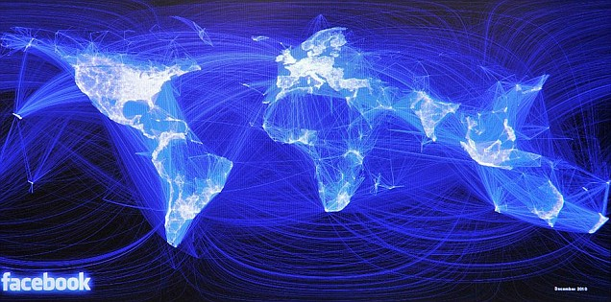
Graph Data: Social Networks
Facebook social graph
4-degrees of separation [Backstrom-Boldi-Rosa-Ugander-Vigna, 2011]

Slide 3
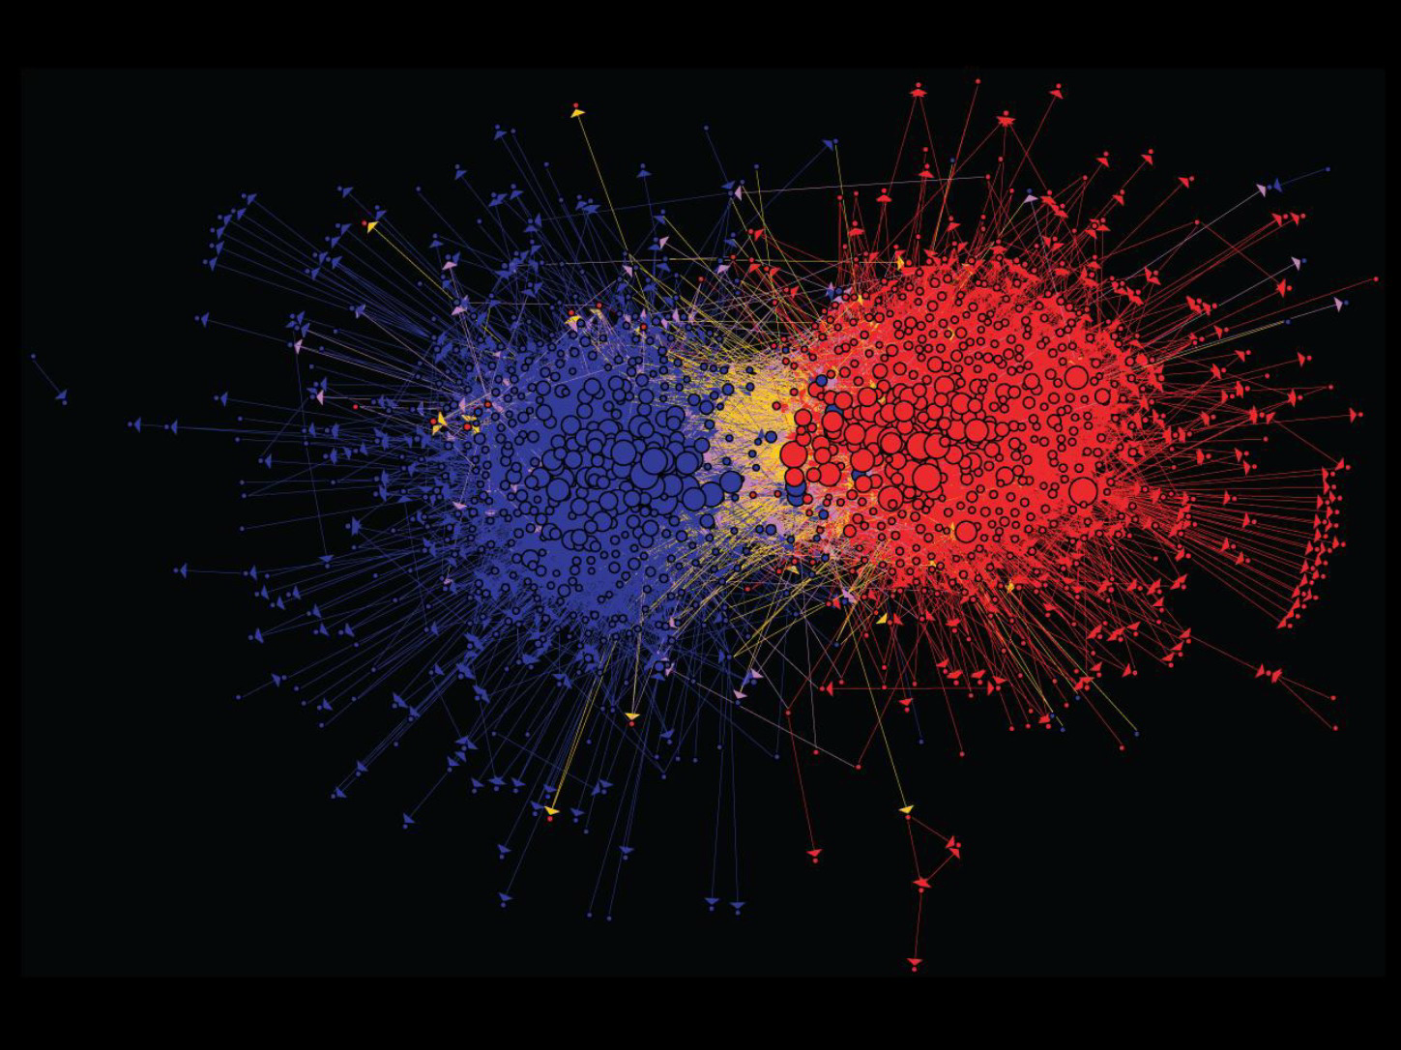
Graph Data: Media Networks
Connections between political blogs
Polarization of the network [Adamic-Glance, 2005]

Slide 4
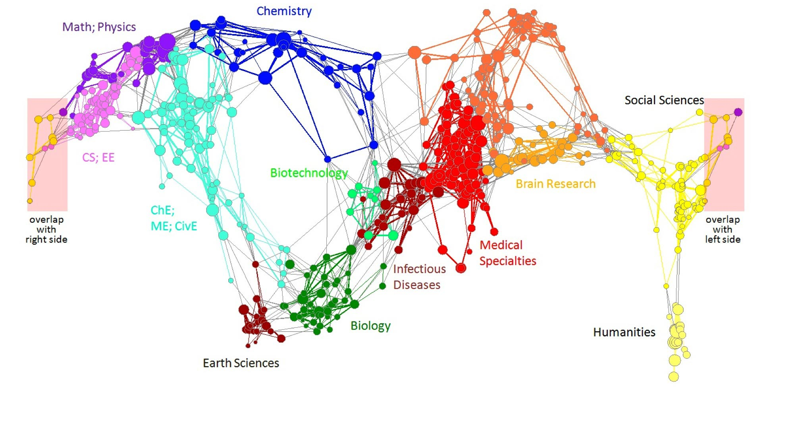
Graph Data: Information Nets
Citation networks and Maps of science
[Börner et al., 2012]

Slide 5
Graph Data: Communication Nets
domain2
domain1
router
domain3
Internet

Slide 6
Web as a Graph
Web as a directed graph:
Nodes: Webpages
Edges: Hyperlinks
I teach a class on Networks.
CS224W: Classes are in the Gates building
Computer Science Department at Stanford
Stanford University

Slide 7
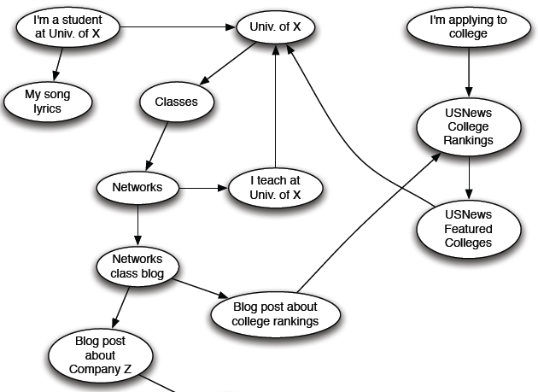
Web as a Directed Graph

Slide 8
Broad Question
How to organize the Web?
First try: Human curated Web directories
Yahoo, DMOZ, LookSmart
Second try: Web Search
Information Retrieval investigates: Find relevant docs in a small and trusted set
Newspaper articles, Patents, etc.
But: Web is huge, full of untrusted documents, random things, web spam, etc.

Slide 9
Web Search: 2 Challenges
2 challenges of web search:
(1) Web contains many sources of information Who to “trust”?
Trick: Trustworthy pages may point to each other!
(2) What is the “best” answer to query “newspaper”?
No single right answer
Trick: Pages that actually know about newspapers might all be pointing to many newspapers

Slide 10
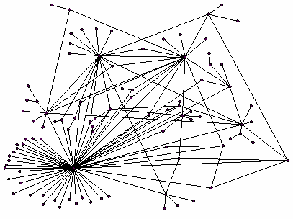
Ranking Nodes on the Graph
All web pages are not equally “important”
www.joe-schmoe.com vs. www.stanford.edu
There is large diversity in the web-graph node connectivity. Let’s rank the pages by the link structure!

Slide 11
Link Analysis Algorithms
We will cover the following Link Analysis approaches for computing importances of nodes in a graph:
Page Rank
Topic-Specific (Personalized) Page Rank
Web Spam Detection Algorithms

Slide 12
PageRank: The “Flow” Formulation

Slide 13
Links as Votes
Idea: Links as votes
Page is more important if it has more links
In-coming links? Out-going links?
Think of in-links as votes:
www.stanford.edu has 23,400 in-links
www.joe-schmoe.com has 1 in-link
Are all in-links are equal?
Links from important pages count more
Recursive question!

Slide 14
Example: PageRank Scores
B
38.4
C
34.3
A
3.3
D
3.9
E
8.1
F
3.9
1.6
1.6
1.6
1.6
1.6

Slide 15
Simple Recursive Formulation
Each link’s vote is proportional to the importance of its source page
If page j with importance r_{j} has n out-links, each link gets r_{j} / n votes
Page j’s own importance is the sum of the votes on its in-links
i
k
r_{i}/3
r_{k}/4
j
r_{j}/3
r_{j} = r_{i}/3+r_{k}/4
r_{j}/3
r_{j}/3

Slide 16
PageRank: The “Flow” Model
A “vote” from an important page is worth more
A page is important if it is pointed to by other important pages
Define a “rank” r_{j} for page j
The web in 1839
y/2
y
a/2
y/2
m
a
m
a/2
“Flow” equations:
r_{y} = r_{y} /2 + r_{a} /2
r_{a} = r_{y} /2 + r_{m}
r_{m} = r_{a} /2
$d_{i}$ … out-degree of node $i$

Slide 17
Solving the Flow Equations
Flow equations:
3 equations, 3 unknowns, no constants
No unique solution
All solutions equivalent modulo the scale factor
Additional constraint forces uniqueness:
$r_{y} +r_{a}+ r_{m} = 1$
Solution: $r_{y} =\frac{2}{5}, r_{a} =\frac{2}{5}, r_{m} =\frac{1}{5}$
Gaussian elimination method works for small examples, but we need a better method for large web-size graphs
We need a new formulation!
r_{y} = r_{y} /2 + r_{a} /2
r_{a} = r_{y} /2 + r_{m}
r_{m} = r_{a} /2

Slide 18
PageRank: Matrix Formulation
Stochastic adjacency matrix $M$
Let page $i$ has $di$ out-links
If $i →j$, then $Mji =\frac{1}{di}$ else $Mji = 0$
$M$ is a column stochastic matrix
Columns sum to 1
Rank vector $r$: vector with an entry per page
$ri$ is the importance score of page $i$
$\sum_{i}{r_{i}^{}=1}$
The flow equations can be written $r = M⋅ r$

Slide 19
Example
Remember the flow equation:
Flow equation in the matrix form
$$M⋅ r=r$$
Suppose page i links to 3 pages, including j
i
j
r_{j}
.
=
r_{i}
1/3
M
.
r
=
r

Slide 20
Eigenvector Formulation
The flow equations can be written $r = M ∙ r$
So the rank vector r is an eigenvector of the stochastic web matrix M
In fact, its first or principal eigenvector, with corresponding eigenvalue 1
Largest eigenvalue of M is 1 since M is column stochastic (with non-negative entries)
We know r is unit length and each column of M sums to one, so $Mr≤1$
We can now efficiently solve for r! The method is called Power iteration
NOTE: x is an eigenvector with the corresponding eigenvalue λ if: $$Ax=λx$$

Slide 21
Example: Flow Equations & M
 | y | a | m
y | ½ | ½ | 0
a | ½ | 0 | 1
m | 0 | ½ | 0
y
a
m
r = M∙r
r_{y} = r_{y} /2 + r_{a} /2
r_{a} = r_{y} /2 + r_{m}
r_{m} = r_{a} /2
y ½ ½ 0 y
a = ½ 0 1 a
m 0 ½ 0 m

Slide 22
Power Iteration Method
Given a web graph with n nodes, where the nodes are pages and edges are hyperlinks
Power iteration: a simple iterative scheme
Suppose there are N web pages
Initialize: r⁽⁰⁾ = [1/N,….,1/N]^{T}
Iterate: r^{(t+1)} = M ∙ r^{(t)}
Stop when |r^{(t+1)} – r^{(t)}|₁ < ε
d_{i} …. out-degree of node i
|x|₁ = ∑_{1≤i≤N}|x_{i}| is the L1 norm
Can use any other vector norm, e.g., Euclidean

Slide 23
PageRank: How to solve?
Power Iteration:
Set $r_{j}=1$/N
1: ${r′}_{j}=\sum_{i→j}{\frac{r_{i}}{d_{i}}}$
2:$r=r′$
Goto 1
Example:
r_{y} 1/3 1/3 5/12 9/24 6/15
r_{a} = 1/3 3/6 1/3 11/24 … 6/15
r_{m} 1/3 1/6 3/12 1/6 3/15
y
 | y | a | m
y | ½ | ½ | 0
a | ½ | 0 | 1
m | 0 | ½ | 0
a
m
r_{y} = r_{y} /2 + r_{a} /2
r_{a} = r_{y} /2 + r_{m}
r_{m} = r_{a} /2
Iteration 0, 1, 2, …

Slide 24
PageRank: How to solve?
Power Iteration:
Set $r_{j}=1$/N
1: ${r′}_{j}=\sum_{i→j}{\frac{r_{i}}{d_{i}}}$
2:$r=r′$
Goto 1
Example:
r_{y} 1/3 1/3 5/12 9/24 6/15
r_{a} = 1/3 3/6 1/3 11/24 … 6/15
r_{m} 1/3 1/6 3/12 1/6 3/15
y
 | y | a | m
y | ½ | ½ | 0
a | ½ | 0 | 1
m | 0 | ½ | 0
a
m
r_{y} = r_{y} /2 + r_{a} /2
r_{a} = r_{y} /2 + r_{m}
r_{m} = r_{a} /2
Iteration 0, 1, 2, …

Slide 25
Random Walk Interpretation
Imagine a random web surfer:
At any time $t$, surfer is on some page $i$
At time $t+1$, the surfer follows an out-link from $i$ uniformly at random
Ends up on some page $j$ linked from $i$
Process repeats indefinitely
Let:
$p(t)$ … vector whose $i$^{th} coordinate is the prob. that the surfer is at page $i$ at time $t$
So, $p(t)$ is a probability distribution over pages
i₁
i₂
i₃
j

Slide 26
The Stationary Distribution
i₁
i₂
i₃
Where is the surfer at time t+1?
Follows a link uniformly at random
$p\left(t+1\right)= M⋅p(t)$
Suppose the random walk reaches a state $p\left(t+1\right)= M⋅p(t) = p(t)$
then $p(t)$ is stationary distribution of a random walk
Our original rank vector $r$ satisfies $r = M⋅r$
So, $r$ is a stationary distribution for the random walk
j

Slide 27
Existence and Uniqueness
A central result from the theory of random walks (a.k.a. Markov processes):
For graphs that satisfy certain conditions, the stationary distribution is unique and eventually will be reached no matter what the initial probability distribution at time t = 0

Slide 28
PageRank: The Google Formulation

Slide 29
PageRank: Three Questions
Does this converge?
Does it converge to what we want?
Are results reasonable?
or
equivalently

Slide 30
Does this converge?
Example:
r_{a} 1 0 1 0
r_{b} 0 1 0 1
a
b
=
Iteration 0, 1, 2, …

Slide 31
Does it converge to what we want?
Example:
r_{a} 1 0 0 0
r_{b} 0 1 0 0
a
b
=
Iteration 0, 1, 2, …

Slide 32
PageRank: Problems
Dead end
2 problems:
(1) Some pages are dead ends (have no out-links)
Random walk has “nowhere” to go to
Such pages cause importance to “leak out”
(2) Spider traps: (all out-links are within the group)
Random walked gets “stuck” in a trap
And eventually spider traps absorb all importance
Spider trap

Slide 33
Problem: Spider Traps
Power Iteration:
Set $r_{j}=1$
$r_{j}=\sum_{i→j}{\frac{r_{i}}{d_{i}}}$
And iterate
Example:
r_{y} 1/3 2/6 3/12 5/24 0
r_{a} = 1/3 1/6 2/12 3/24 … 0
r_{m} 1/3 3/6 7/12 16/24 1
y
 | y | a | m
y | ½ | ½ | 0
a | ½ | 0 | 0
m | 0 | ½ | 1
a
m
m is a spider trap
r_{y} = r_{y} /2 + r_{a} /2
r_{a} = r_{y} /2
r_{m} = r_{a} /2 + r_{m}
Iteration 0, 1, 2, …
All the PageRank score gets “trapped” in node m.

Slide 34
Solution: Teleports!
The Google solution for spider traps: At each time step, the random surfer has two options
With prob. β, follow a link at random
With prob. 1-β, jump to some random page
Common values for β are in the range 0.8 to 0.9
Surfer will teleport out of spider trap within a few time steps
y
y
a
m
a
m

Slide 35
Problem: Dead Ends
Power Iteration:
Set $r_{j}=1$
$r_{j}=\sum_{i→j}{\frac{r_{i}}{d_{i}}}$
And iterate
Example:
r_{y} 1/3 2/6 3/12 5/24 0
r_{a} = 1/3 1/6 2/12 3/24 … 0
r_{m} 1/3 1/6 1/12 2/24 0
y
 | y | a | m
y | ½ | ½ | 0
a | ½ | 0 | 0
m | 0 | ½ | 0
a
m
r_{y} = r_{y} /2 + r_{a} /2
r_{a} = r_{y} /2
r_{m} = r_{a} /2
Iteration 0, 1, 2, …
Here the PageRank “leaks” out since the matrix is not stochastic.

Slide 36
Solution: Always Teleport!
Teleports: Follow random teleport links with probability 1.0 from dead-ends
Adjust matrix accordingly
y
y
a
m
a
m
 | y | a | m
y | ½ | ½ | 0
a | ½ | 0 | 0
m | 0 | ½ | 0
 | y | a | m
y | ½ | ½ | ⅓
a | ½ | 0 | ⅓
m | 0 | ½ | ⅓

Slide 37
Why Teleports Solve the Problem?
Why are dead-ends and spider traps a problem and why do teleports solve the problem?
Spider-traps are not a problem, but with traps PageRank scores are not what we want
Solution: Never get stuck in a spider trap by teleporting out of it in a finite number of steps
Dead-ends are a problem
The matrix is not column stochastic so our initial assumptions are not met
Solution: Make matrix column stochastic by always teleporting when there is nowhere else to go

Slide 38
Solution: Random Teleports
Google’s solution that does it all: At each step, random surfer has two options:
With probability β, follow a link at random
With probability 1-β, jump to some random page
PageRank equation [Brin-Page, 98] $r_{j}=\sum_{i→j}{β \frac{r_{i}}{d_{i}}}+(1−β)\frac{1}{N}$
d_{i} … out-degree of node i
This formulation assumes that $M$ has no dead ends. We can either preprocess matrix $M$ to remove all dead ends or explicitly follow random teleport links with probability 1.0 from dead-ends.

Slide 39
The Google Matrix
PageRank equation [Brin-Page, ‘98] $r_{j}=\sum_{i→j}{β\frac{r_{i}}{d_{i}}}+(1−β)\frac{1}{N}$
The Google Matrix A:
$$A=β M+\left(1−β\right){\left[\frac{1}{N}\right]}_{N×N}$$
We have a recursive problem: $r=A⋅r$ And the Power method still works!
What is β ?
In practice β =0.8,0.9 (make 5 steps on avg., jump)
[1/N]_{NxN}…N by N matrix where all entries are 1/N

Slide 40
Random Teleports (β = 0.8)
M
[1/N]_{NxN}
7/15
y
1/2 1/2 0
1/2 0 0
0 1/2 1
1/3 1/3 1/3
1/3 1/3 1/3
1/3 1/3 1/3
0.8
+ 0.2
7/15
1/15
7/15
1/15
y 7/15 7/15 1/15
a 7/15 1/15 1/15
m 1/15 7/15 13/15
13/15
a
7/15
m
1/15
1/15
A
y
a =
m
1/3
1/3
1/3
0.33
0.20
0.46
0.24
0.20
0.52
0.26
0.18
0.56
7/33
5/33
21/33
. . .

Slide 41
How do we actually compute the PageRank?

Slide 42
Computing Page Rank
Key step is matrix-vector multiplication
r^{new} = A ∙ r^{old}
Easy if we have enough main memory to hold A, r^{old}, r^{new}
Say N = 1 billion pages
We need 4 bytes for each entry (say)
2 billion entries for vectors, approx 8GB
Matrix A has N² entries
10¹⁸ is a large number!
A = β∙M + (1-β) [1/N]_{NxN}
½ ½ 0
½ 0 0
0 ½ 1
1/3 1/3 1/3
1/3 1/3 1/3
1/3 1/3 1/3
A =
0.8
+0.2
7/15 7/15 1/15
7/15 1/15 1/15
1/15 7/15 13/15
=

Slide 43
Matrix Formulation
Suppose there are N pages
Consider page i, with d_{i} out-links
We have M_{ji} = 1/|d_{i}| when i → j and M_{ji} = 0 otherwise
The random teleport is equivalent to:
Adding a teleport link from i to every other page and setting transition probability to (1-β)/N
Reducing the probability of following each out-link from 1/|d_{i}| to β/|d_{i}|
Equivalent: Tax each page a fraction (1-β) of its score and redistribute evenly

Slide 44
Rearranging the Equation
$r =A⋅r$, where $A_{ji}=β{ M}_{ji}+\frac{1−β}{N}$
$r_{j} =\sum_{i=1}^{N}{A_{ji}⋅r_{i}}$
$r_{j} =\sum_{i=1}^{N}{\left[β{ M}_{ji}+\frac{1−β}{N}\right]⋅r_{i}}$
$=\sum_{i=1}^{N}{β{ M}_{ji}⋅r_{i}+\frac{1−β}{N}}\sum_{i=1}^{N}{r_{i}}$
$=\sum_{i=1}^{N}{β{ M}_{ji}⋅r_{i}+\frac{1−β}{N}}$ since $∑r_{i}=1$
So we get: $r=β M⋅r+{\left[\frac{1−β}{N}\right]}_{N}$
Note: Here we assumed M has no dead-ends
[x]_{N} … a vector of length N with all entries x

Slide 45
Sparse Matrix Formulation
We just rearranged the PageRank equation
$$r=βM⋅r+{\left[\frac{1−β}{N}\right]}_{N}$$
where [(1-β)/N]_{N} is a vector with all N entries (1-β)/N
M is a sparse matrix! (with no dead-ends)
10 links per node, approx 10N entries
So in each iteration, we need to:
Compute r^{new} = β M ∙ r^{old}
Add a constant value (1-β)/N to each entry in r^{new}
Note if M contains dead-ends then $\sum_{j}{r_{j}^{new}}<1$ and we also have to renormalize r^{new} so that it sums to 1

Slide 46
PageRank: The Complete Algorithm
Input: Graph $G$ and parameter $β$
Directed graph $G$ (can have spider traps and dead ends)
Parameter $β$
Output: PageRank vector $r^{new}$
Set: $r_{j}^{old} =\frac{1}{N}$
repeat until convergence: $\sum_{j}{\left|r_{j}^{new}−r_{j}^{old}\right|>ε}$
$∀j: {r′}_{j}^{new}=\sum_{i→j}{β \frac{r_{i}^{old}}{d_{i}}}$
${r′}_{j}^{new}=0$ if in-degree of $j$ is 0
Now re-insert the leaked PageRank:
$∀j: r_{j}^{new}={r^{′}}_{j}^{new}+\frac{1−S}{N}$
$r^{old}=r^{new}$
where: $S=\sum_{j}{{r′}_{j}^{new}}$
If the graph has no dead-ends then the amount of leaked PageRank is 1-β. But since we have dead-ends the amount of leaked PageRank may be larger. We have to explicitly account for it by computing S.

Slide 47
Sparse Matrix Encoding
Encode sparse matrix using only nonzero entries
Space proportional roughly to number of links
Say 10N, or 4*10*1 billion = 40GB
Still won’t fit in memory, but will fit on disk
source
node
degree
destination nodes
0 | 3 | 1, 5, 7
1 | 5 | 17, 64, 113, 117, 245
2 | 2 | 13, 23

Slide 48
Some Problems with PageRank
Measures generic popularity of a page
Will ignore/miss topic-specific authorities
Solution: Topic-Specific PageRank (next)
Uses a single measure of importance
Other models of importance
Solution: Hubs-and-Authorities
Susceptible to Link spam
Artificial link topographies created in order to boost page rank
Solution: TrustRank

Slide 49
Topic-Specific PageRank

Slide 50
Topic-Specific PageRank
Instead of generic popularity, can we measure popularity within a topic?
Goal: Evaluate Web pages not just according to their popularity, but by how close they are to a particular topic, e.g. “sports” or “history”
Allows search queries to be answered based on interests of the user
Example: Query “Trojan” wants different pages depending on whether you are interested in sports, history and computer security

Slide 51
Topic-Specific PageRank
Random walker has a small probability of teleporting at any step
Teleport can go to:
Standard PageRank: Any page with equal probability
To avoid dead-end and spider-trap problems
Topic Specific PageRank: A topic-specific set of “relevant” pages (teleport set)
Idea: Bias the random walk
When walker teleports, she pick a page from a set S
S contains only pages that are relevant to the topic
E.g., Open Directory (DMOZ) pages for a given topic/query
For each teleport set S, we get a different vector r_{S}

Slide 52
Matrix Formulation
To make this work all we need is to update the teleportation part of the PageRank formulation:
$Aij = β M_{ij}+(1−β)/|S|$ if $i∈ S$
$β M_{ij}+0$ otherwise
A is stochastic!
We weighted all pages in the teleport set S equally
Could also assign different weights to pages!
Compute as for regular PageRank:
Multiply by M, then add a vector
Maintains sparseness

Slide 53
Example: Topic-Specific PageRank
Suppose S = {1}, β = 0.8
0.2
0.5
1
Node Iteration
0 1 2 … stable
1 0.25 0.4 0.28 0.294
2 0.25 0.1 0.16 0.118
3 0.25 0.3 0.32 0.327
4 0.25 0.2 0.24 0.261
0.4
0.5
0.4
1
2
3
0.8
1
1
0.8
0.8
4
S={1,2,3,4}, β=0.8:
r=[0.13, 0.10, 0.39, 0.36]
S={1,2,3} , β=0.8:
r=[0.17, 0.13, 0.38, 0.30]
S={1,2} , β=0.8:
r=[0.26, 0.20, 0.29, 0.23]
S={1} , β=0.8:
r=[0.29, 0.11, 0.32, 0.26]
S={1}, β=0.90:
r=[0.17, 0.07, 0.40, 0.36]
S={1} , β=0.8:
r=[0.29, 0.11, 0.32, 0.26]
S={1}, β=0.70:
r=[0.39, 0.14, 0.27, 0.19]

Slide 54
TrustRank: Combating the Web Spam

Slide 55
What is Web Spam?
Spamming:
Any deliberate action to boost a web page’s position in search engine results, incommensurate with page’s real value
Spam:
Web pages that are the result of spamming
This is a very broad definition
SEO industry might disagree!
SEO = search engine optimization
Approximately 10-15% of web pages are spam

Slide 56
Web Search
Early search engines:
Crawl the Web
Index pages by the words they contained
Respond to search queries (lists of words) with the pages containing those words
Early page ranking:
Attempt to order pages matching a search query by “importance”
First search engines considered:
(1) Number of times query words appeared
(2) Prominence of word position, e.g. title, header

Slide 57
First Spammers
As people began to use search engines to find things on the Web, those with commercial interests tried to exploit search engines to bring people to their own site – whether they wanted to be there or not
Example:
Shirt-seller might pretend to be about “movies”
Techniques for achieving high relevance/importance for a web page

Slide 58
First Spammers: Term Spam
How do you make your page appear to be about movies?
(1) Add the word movie 1,000 times to your page
Set text color to the background color, so only search engines would see it
(2) Or, run the query “movie” on your target search engine
See what page came first in the listings
Copy it into your page, make it “invisible”
These and similar techniques are term spam
Notes:
Do not forget to tell the joke "I used to do this when I was young" when talking about point (1) :D

Slide 59
Google’s Solution to Term Spam
Believe what people say about you, rather than what you say about yourself
Use words in the anchor text (words that appear underlined to represent the link) and its surrounding text
PageRank as a tool to measure the “importance” of Web pages

Slide 60
Why It Works?
Our hypothetical shirt-seller looses
Saying he is about movies doesn’t help, because others don’t say he is about movies
His page isn’t very important, so it won’t be ranked high for shirts or movies
Example:
Shirt-seller creates 1,000 pages, each links to his with “movie” in the anchor text
These pages have no links in, so they get little PageRank
So the shirt-seller can’t beat truly important movie pages, like IMDB

Slide 61
Google vs. Spammers: Round 2!
Once Google became the dominant search engine, spammers began to work out ways to fool Google
Spam farms were developed to concentrate PageRank on a single page
Link spam:
Creating link structures that boost PageRank of a particular page

Slide 62
Link Spamming
Three kinds of web pages from a spammer’s point of view
Inaccessible pages
Accessible pages
e.g., blog comments pages
spammer can post links to his pages
Owned pages
Completely controlled by spammer
May span multiple domain names

Slide 63
Link Farms
Spammer’s goal:
Maximize the PageRank of target page t
Technique:
Get as many links from accessible pages as possible to target page t
Construct “link farm” to get PageRank multiplier effect

Slide 64
Link Farms
Accessible
Owned
Inaccessible
1
t
2
M
Millions of farm pages
One of the most common and effective organizations for a link farm

Slide 65
TrustRank: Combating the Web Spam

Slide 66
Combating Spam
Combating term spam
Analyze text using statistical methods
Similar to email spam filtering
Also useful: Detecting approximate duplicate pages
Combating link spam
Detection and blacklisting of structures that look like spam farms
Leads to another war – hiding and detecting spam farms
TrustRank = topic-specific PageRank with a teleport set of trusted pages
Example: .edu domains, similar domains for non-US schools

Slide 67
TrustRank: Idea
Basic principle: Approximate isolation
It is rare for a “good” page to point to a “bad” (spam) page
Sample a set of seed pages from the web
Have an oracle (human) to identify the good pages and the spam pages in the seed set
Expensive task, so we must make seed set as small as possible

Slide 68
Why is it a good idea?
Trust attenuation:
The degree of trust conferred by a trusted page decreases with the distance in the graph
Trust splitting:
The larger the number of out-links from a page, the less scrutiny the page author gives each out-link
Trust is split across out-links

Slide 69
Hubs and Authorities
HITS (Hypertext-Induced Topic Selection)
Is a measure of importance of pages or documents, similar to PageRank
Proposed at around same time as PageRank (‘98)
Goal: Say we want to find good newspapers
Don’t just find newspapers. Find “experts” – people who link in a coordinated way to good newspapers
Idea: Links as votes
Page is more important if it has more links
In-coming links? Out-going links?

Slide 70
PageRank and HITS
PageRank and HITS are two solutions to the same problem:
What is the value of an in-link from u to v?
In the PageRank model, the value of the link depends on the links into u
In the HITS model, it depends on the value of the other links out of u
The destinies of PageRank and HITS post-1998 were very different

