Slide 1
PB173 - Tématický vývoj aplikací v C/C++ Domain specific development in C/C++
Skupina: Aplikovaná kryptografie a bezpečné programování
Petr Švenda svenda@fi.muni.cz

Slide 2
Block cipher modes for Authenticated Encryption

Slide 3
Modes for authenticated encryption
Encryption preserves confidentiality but not integrity
Common integrity functions (like CRC) protect against random faults
Cryptographic message integrity protects intensional errors

Slide 4
Confidentiality, integrity, privacy
Message confidentiality [encryption]
attacker is not able to obtain info about plaintext
Message integrity [MAC]
attacker is not able to modify message without being detected (PTX, CTX)
Message privacy [encryption]
attacker is not able to distinguish between encrypted message and random string
same message is encrypted each time differently

Slide 5
Encryption and MAC composition
Modes for block ciphers (CBC, CTR, CBC-MAC)
Compositions (encryption + MAC)
encrypt-and-mac [E_{Ke,Km}(M) = E_{Ke}(M) | T_{Km}(M)]
can fail with privacy and authenticity
mac-then-encrypt [E_{Ke,Km}(M) = E_{Ke}(M | T_{Km}(M))]
can fail with authenticity
encrypt-then-mac [E_{Ke,Km}(M) = E_{Ke}(M) || T_{Km}(E_{Ke}(M)]
always provides privacy and authenticity
Paralelizability issue
Authenticated-encryption modes (AE)
special block cipher modes for composed process

Slide 6
Usage scenarios
Powerful, parallelizable environments
hardware accelerators
Powerful, but almost serial environments
personal computer, PDA
Restricted environments
smart cards, microcontrollers, IoT
Different scenarios have different needs

Slide 7
Important features for AE modes
Provable security
Performance, paralelizability, memory req.
important for high-speed encryption, SC
Patent
early AE modes are patented
Associated data authentication
authentication of non-encrypted part
Online, incremental MAC, number of keys, endian dependency …
http://blog.cryptographyengineering.com/2012/05/how-to-choose-authenticated-encryption.html
www.fi.muni.cz/~xsvenda/docs/AE_comparison_ipics04.pdf

Slide 8
EAX mode
Encrypt-than-mac composition
Provable secure, unpatented

Slide 9
Offset CodeBook mode (OCB)
Memory efficient, fast mode
Provable secure, but patented

Slide 10
Cipher-State mode (CS)
Memory efficient, fast mode, unpatented
Not provable secure (inner state of cipher)

Slide 11
Galois/Counter Mode (GCM)
Need pre-computed table (4kB-64kB)
fast mode, provable secure, unpatented, NIST standard
http://csrc.nist.gov/publications/nistpubs/800-38D/SP-800-38D.pdf

Slide 12
Implementation: AES-GCM from mbedTLS
gcm.h, gcm.c
int gcm_init( gcm_context *ctx,
const unsigned char *key,
unsigned int keysize );
int gcm_crypt_and_tag( gcm_context *ctx,
int mode, // GCM_ENCRYPT (alternatively GCM_DECRYPT)
size_t length,
const unsigned char *iv,
size_t iv_len,
const unsigned char *add, // authenticated, but not encrypted
size_t add_len,
const unsigned char *input, // authenticated and encrypted
unsigned char *output, // encrypted data
size_t tag_len,
unsigned char *tag );
int gcm_auth_decrypt( gcm_context *ctx,
size_t length, // length of input data
const unsigned char *iv,
size_t iv_len,
const unsigned char *add, // authenticated, but not encrypted
size_t add_len,
const unsigned char *tag, // authenticator (MAC value)
size_t tag_len,
const unsigned char *input, // encrypted data
unsigned char *output ); // decrypted data

Slide 13
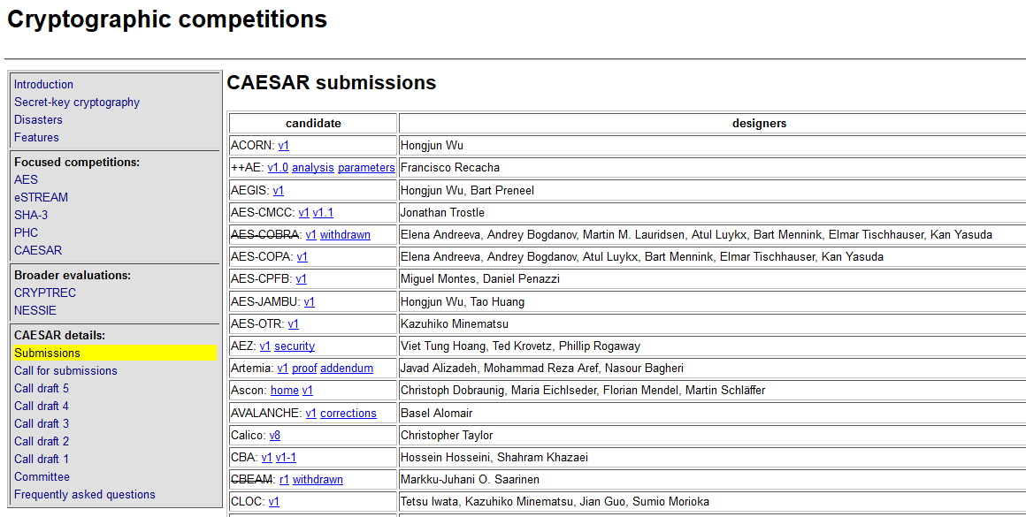
CAESAR competition
http://competitions.cr.yp.to/caesar-submissions.html

Slide 14
Conclusions
Composition of ENC and MAC can fail
encrypt-then-mac provable secure
specially designed composed modes
One of the most promising mode is patented (OCB)
fast alternative GCM, CS
Searching for new modes (CAESAR competition)
Suitable mode depends on usage
parallelizability, memory
specific needs (online, incremental MAC)

Slide 15
Practical assignment

Slide 16
Practical assignment
Presentation of results from 2 weeks ago
Functions to be implemented (and tested!)
new user registration (in: user name / password, out: status)
user authentication to server (in:user/pass, out: status)
obtain list of other online users (out: formated list – JSON?)

Slide 17
Practical assignment - client
Update your implementation of server functions based on feedback
And add into GitHub repo
Create implementation of basic client process
No network communication yet, just methods + tests!
Functions to be implemented (and tested!)
Login user (client side) (in: user name / password, out: status)
=> prepared structure to be send to server
Prepare protected message for another user (in: user identification, session context (keys, counters…), out: protected message, status)
Encryption, MAC, Use suitable Authenticated Encryption mode
Update session context
Unprotect message from another user (in: protected message, session context (keys, counters…), out: unprotected message, status)
Think how to handle errors
Don’t forget to document functions in JavaDoc-style

Slide 18
Submissions, deadlines
Upload application source codes as single zip file into IS Homework vault (Crypto - 5. homework (AE))
Zip file from current version of repo
DEADLINE 3.4. 12:00
Up to 10 points assigned

