Slide 1
PB173 - Tématický vývoj aplikací v C/C++ (jaro 2017)
Skupina: Aplikovaná kryptografie a bezpečné programování
Petr Švenda svenda@fi.muni.cz

Slide 2
Security code review
Architecture overview
Design choices and possible design flaws
Code review
How well is architecture actually implemented
Whitebox, greybox & blackbox testing
different level of access to code and documentation
Available tools
mainly for code review

Slide 3
Security code review (2)
You will always have a limited time
try to rapidly build overall picture
use tools to find low hanging fruit
Focus on most sensitive and problematic areas
use tools to focus your analysis scope
More eyes can spot more problems
experts on different areas

Slide 4
Architecture overview

Slide 5
Architecture overview
Get all information you can quickly
Assets
What has the value in the system?
What damage is caused when successfully attacked?
What mechanisms are used to protect assets?
Roles
Who has access to what?
What credentials needs to be presented?
Thread model
What is expected to do harm?
What are you defending against?

Slide 6
Architecture overview (2)
Usage of well established techniques and standards
Comparison with existing schemes
What is the advantage of new scheme?
Why changes were made?
Security tradeoffs documented
Possible threat, but unmitigated?
Is documented or overlooked?

Slide 7
Sensitive data flow mapping
Identify sensitive data
password, key, protected data...
Find all processing functions
and focus on them
Create data flow between functions
e.g. Doxygen call graph
Inspect when functions can be called
Is key schedule validity checked?
Can be function called without previous function calls?
Where are sensitive data stored between calls?

Slide 8
Protocol design (and implementation)
Packet confidentiality, integrity and authenticity
Packet removal/insertion detection
Replay attack
Reflection attack
Man in the middle

Slide 9
Code overview

Slide 10
Cryptography usage
CIA (Confidentiality, Integrity, Availability)
Plaintext data over insecure channel? Encrypted only?
Can be packet send twice (replay)?
What is the application response on data modification?
What algorithms are used
Broken/insecure algorithms? MD5? simple DES?
What key lengths are used?
< 90 bits symmetric crypto?
< 1024 bits asymmetric crypto?
Random number generation
Where the key comes from?
Is source entropic enough?
srand() & rand()?

Slide 11
Cryptography usage (2)
Key creation
Where the keys originate? Enough entropy?
Who has access?
Key storage
Hard-coded keys
Keys in files in plaintext
Keys over insecure channels
Keys protected by less secure keys
Key destruction
How are keys erased from memory?
Can exception prevent key erase?

Slide 12
Cryptography implementation
Implementation from well known libraries?
Own algorithms?
security by obscurity?
usually not secure enough
Own modifications?
Why?
sometimes used to prevent compatible programs
decreased number of rounds?
Performance optimization with security impact?

Slide 13
Code inspection
Overall code logic
Memory management - allocation, input validation
String operations – copy, concatenate, string termination
Data flow – conditional jumps, test of return values
Race conditions (TOCTOU)

Slide 14
Input validation
Hard (and expensive) to do right
Always use white-listing (what is allowed), not black listing (what is banned)
Check for buffer overruns
functions called with attacker’s input
dangerous functions (strcpy…)
arrays with fixed lengths
Large inputs in general
try to insert 1KB of text instead of user name
Fuzzing
large amount of automated inputs with different length

Slide 15
Recommended reading
Process of security code review
http://ieeexplore.ieee.org/stamp/stamp.jsp?arnumber=01668009
Why cryptosystems fail, R. Anderson
http://www.cl.cam.ac.uk/~rja14/Papers/wcf.pdf
Software Security Code Review
http://www.softwaremag.com/l.cfm?doc=2005-07/2005-07code
Static code analysis tools
http://en.wikipedia.org/wiki/List_of_tools_for_static_code_analysis
Security in web applications (OWASP)
http://www.owasp.org/index.php/Code_Review_Introduction

Slide 16
Static analysis tools
List of static checkers
http://spinroot.com/static/
http://en.wikipedia.org/wiki/List_of_tools_for_static_code_analysis
https://security.web.cern.ch/security/recommendations/en/code_tools.shtml
We will be interested in C/C++ checkers
but tools exists for almost any language

Slide 17
Both free and commercial tools
Commercial tools
PC-Lint (Gimpel Software)
Klocwork Insight (Klocwork)
Coverity Prevent (now under HP, free for open-source)
Microsoft PREfast (included in Visual Studio)
Free tools
Rough Auditing Tool for Security (RATS) http://code.google.com/p/rough-auditing-tool-for-security/
CppCheck http://cppcheck.sourceforge.net/
Flawfinder http://www.dwheeler.com/flawfinder/
Splint http://www.splint.org/
FindBugs http://findbugs.sourceforge.net (for Java programs)
Doxygen’s call graphs from source http://www.stack.nl/~dimitri/doxygen/
...

Slide 18
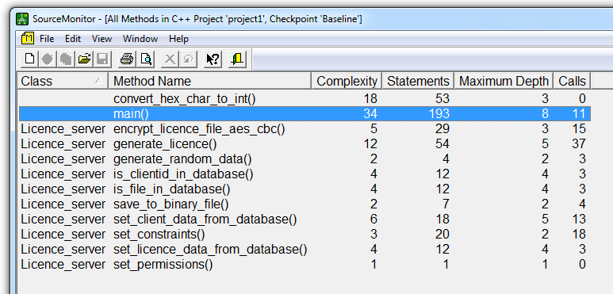
Source monitor – example outputs
Complexity: 1-10 (OK), 11-20 (sometimes), > 20 (BAD)

Slide 20
Schedule
17.4. No seminar
24.4. Implementation with TCP socket
1.5. No seminar
5.5. Final implementation with TLS socket (QSslSocket) => start of code review
8.5. No seminar
15.5. Presentation of other project review

Slide 21
Practical assignment – code review
Make your documentation & code available
Create Doc folder in your GitHub repo
Upload also to IS repository (available to others)
Crypto - Project for review
deadline 5.5. 23:59 (Friday)
Security analysis of design and code of other team
Start work after 5.5. 24:00 based on IS and GitHub materials
Presentation of findings 15.5. 12:00
Points (max. 30) will be awarded according to:
number&severity of problems found in reviewed projects
quality of architecture and code

Slide 22
Practical assignment
Some tips what to analyze:
which functions are manipulating with sensitive information
where is random numbers coming from
code bugs?
Use some analysis tools
gcc -Wall -Wextra
MSVS:Project→C/C++ →General →Warning level (/W4 /Wall)
call graphs (e.g., Doxygen, http://cecko.eu/public/doxygen)
Cppcheck (C/C++, Windows) http://cppcheck.sourceforge.net/
Code complexity
...

Slide 23
Practical assignment (2)
Summarize your findings
problem identification + severity + applicability + short description
2 pages enough (per project)
Identifikace problému: A_x (celková bezpečnostní architektura) / C_x (kód implementace)
Závažnost: nízká / střední / vysoká / není možné rozhodnout
Proveditelnost útoku: snadná (lze přímo externím útočníkem) / v závislosti na dalších součástech systému / není možné rozhodnout (obvykle značí potenciální zranitelnost, kde ale detailní postup pro možné zneužití přímo neznáme)
Popis problému: místo výskytu v kódu ve tvary soubor.c:číslo_řádku:funkce – popis
Navrhované řešení: jednoduchý popis (v případě, že jsme návrh schopni poskytnout)

Slide 24
Total points
We missed three weeks due to public holiday
So far 7 assignments assigned
Two more: TLS implementation, project review
30 points for project quality and functionality
Original requirements:
10x10 (hw) + 30 (project) => max 130, 85 to pass
Updated requirements:
9x10 (hw) + 30 (project) => max 120, 75 points to pass

