Slide 1
PV204 Security technologies
Secure authentication and authorization
Petr Švenda svenda@fi.muni.cz
Faculty of Informatics, Masaryk University

Slide 2
Overview
Authentication and key exchange protocols
Problems and design principles
Authentication protocols in electronic passports

Slide 3
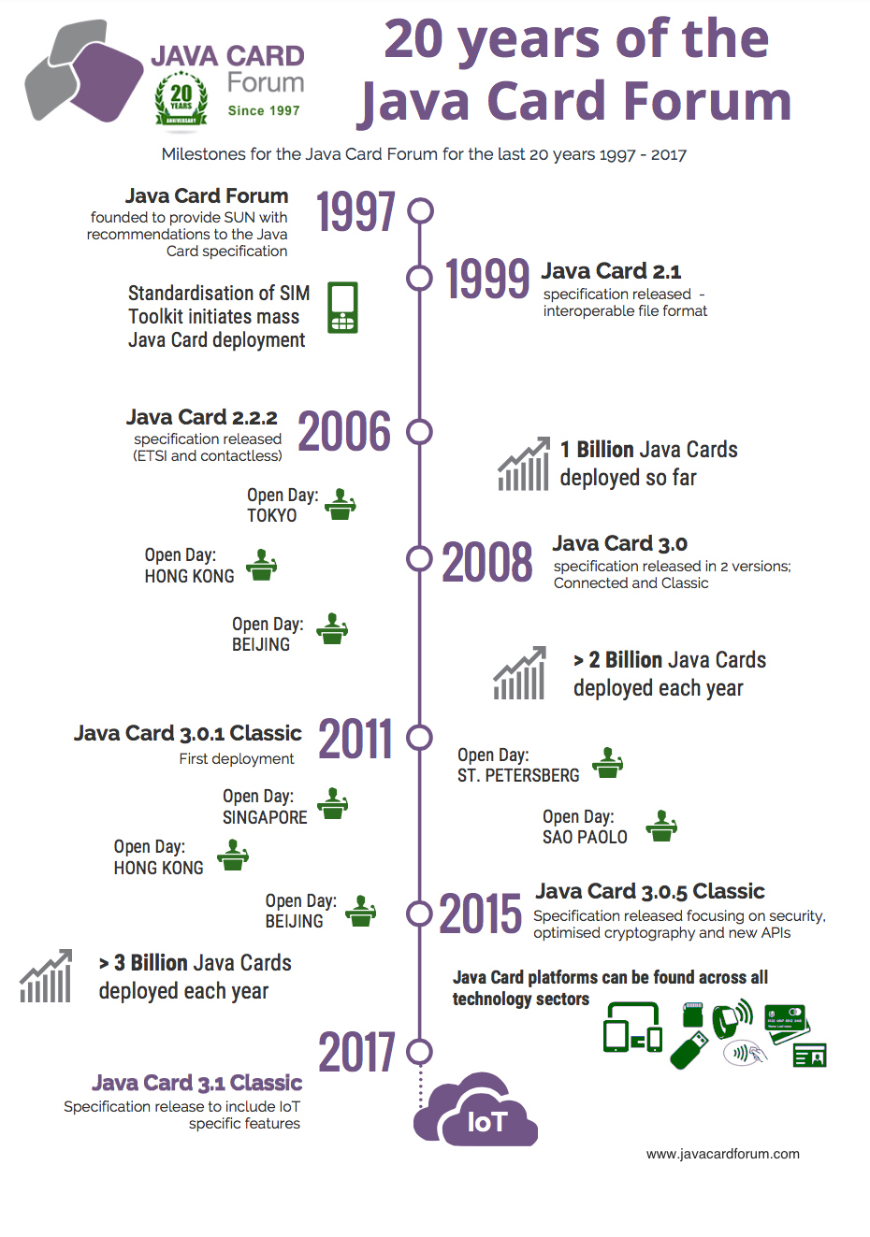

Slide 4
Security protocols

Slide 5
Security protocols
Security protocol = composition of cryptoprimitives
“Security protocols are three line programs that people still manage to get wrong.” (R. Needham)

Slide 6
Security protocol aspects
Entity authentication
Key agreement, establishment or distribution
Data encryption and integrity protection
Non-repudiation
Secure multi-party computation (SMPC)
…

Slide 7
Basic terms
Identification
  Establish what the (previously unknown) entity is
Authentication
  Verify if entity is really what it claims to be
Authorization (access control)
  Define an access policy to use specified resource
  Check if entity is allowed (authorized) to use resource
Authentication may be required before entity is authorized to use resource

Slide 8
Authentication (AUTH) vs. Key establishment (KE)
Early literature called protocols used to establish session keys as “authentication protocols”
Authentication is also possible without session keys
  Example: Challenge-response, active authentication
Session keys can be established without authentication
  Example: non-authenticated Diffie-Hellman

Slide 9
User vs. key-oriented goals
User-oriented authentication goals
  Entity authentication
  Strong entity authentication – fresh entity authentication
  Mutual authentication
Key-oriented goals
  Key establishment
  Key derivation
  Implicit key establishment
  Key confirmation
  Mutual belief in the key

Slide 10
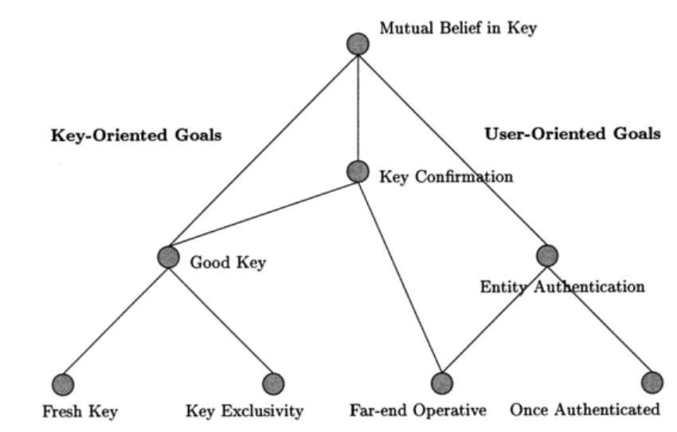
Hierarchy of AUTH&KE goals
Protocols for Authentication and Key Establishment By Colin Boyd, Anish Mathuria

Slide 11
Entity authentication
Entity = user, machine/device
Something entity knows (password, key…)
Something entity is (biometrics…)
Something entity have (smartcard…)
Multi-factor authentication
  More than one factor (password + smartcard)
  Aim to increase attacker’s cost to compromise multiple security layers (factors)

Slide 12
Protocol message components
Keys
  Long-term keys
  Session keys
Identifiers
  Protocol principals (Alice, Bob…)
Nonce(s)
  Random values, timestamps, counters
Components are combined by crypto mechanism(s)

Slide 13
Protocols and attacks

Slide 14
Typical models of adversary
Adversary controls the communication
  Between all principals
  Observe, alter, insert, delay or delete messages
Adversary can obtain session/long term keys
  used in previous runs
Malicious insider
  adversary is legitimate protocol principal
Attacker can obtain partial knowledge
  Compromise or side-channels
…

Slide 15

Needham–Schroeder protocol: symmetric
Basis for Kerberos protocol (AUTH, KE), 1978
  Two-party protocol (A,B) + trusted server (S)
  Session key K_{AB} generated by S and distributed to A together with part intended for B
  Parties A and B are authenticated via S
A → S: A, B, N_{A}
S → A: {N_{A}, K_{AB}, B, {K_{AB}, A}K_{BS}}K_{AS}
A → B: {K_{AB}, A}K_{BS}
B → A: {N_{B}, A}K_{AB}
A → B: {N_{B} - 1}K_{AB}
Which part ensures:
Authentication
Key confirmation
Freshness
Can you spot problem?

Slide 16
N-S symmetric: Problem?
Vulnerable to replay attack (Denning, Sacco, 1981)
If an attacker compromised older K_{AB} then
  {K_{AB}, A}K_{BS} can be replayed to B (step 3.)
  B will not be able to tell if K_{AB} is fresh
  Attacker will then impersonate A using old (replayed, compromised) key K_{AB}
Fixed by inclusion of nonce/timestamp N’_{B} generated by B (two additional steps before step 1.)
  Bob can now check freshness of {K_{AB}, A, N’_{B}}K_{BS}
What is required attacker model?

Slide 17
What is required attacker model?
Able to capture valid communication ({K_{AB}, A}K_{BS})
Able to compromise older K_{AB}
Actively communicate with B (reply ({K_{AB}, A}K_{BS})
But is assumption of compromise
of old key realistic?

Slide 18
How (not) to reason about potential compromise
NO: all my (many) keys are in secure hardware and therefore I’m secure (no compromise possible)
  Nothing like perfect security exists
YES: assume compromise and evaluate impact
  Where are sensitive keys
  How hard is to compromise them
  What will be the impact of the compromise
  Can I limit number/exposure of keys? For what price?

Slide 19
What if key is compromised?
Prevention, detection (hard), reaction
Prevention of compromise
  Limit usage of a key
    master key → session keys
    Use PKI instead of many symmetric keys in trusted terminals
  Limit key availability
    Erase after use, no/limited copy in memory, trusted element
  Limited-time usefulness of keys (key update)
    (Perfect) forward secrecy: Information before is secure
Reaction on compromise
  stop using key, update and let know (revocation)

Slide 20
Needham–Schroeder protocol: asymmetric
Simple asymmetric AUTH & KE protocol
Designed by R. Needham and M. Schroeder (1978)
  (below is simplified version without PKI server S)
A → B: {A, N_{A}}PK_{B}
B → A: {N_{A}, N_{B}}PK_{A}
A → B: {N_{B}}PK_{B}
Which part ensures:
Authentication
Freshness
Key establishment
Can you spot the problem?

Slide 21
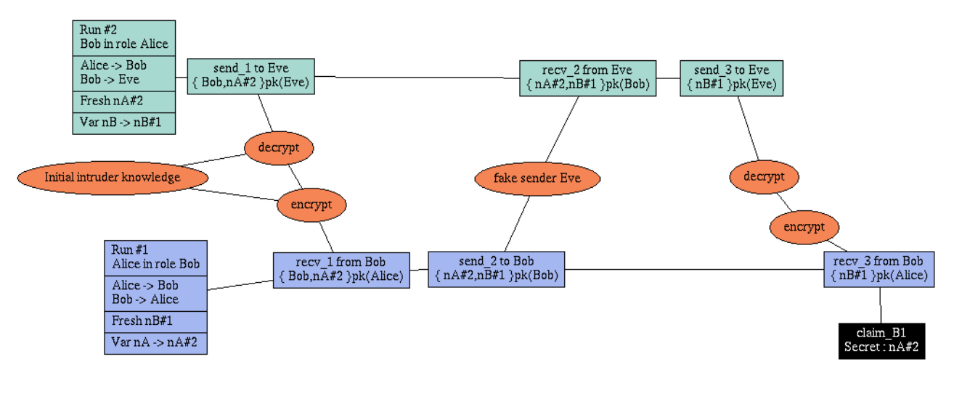
N-S asymmetric: Problem?
Discovered by G. Lowe 17 years after using formal verification method/tool

Slide 22
Formal verification of protocols
Negatives
Specific attacker model
  Different attacker (e.g., side-channels) => attack possible
Assumes perfect crypto-primitives
Sensitive to precise specification
Hard to express real-world complex protocols
  Search space too large
Positives
Automated process
Prevents basic and some advanced design flaws
Favours simple solutions
  Complexity is enemy of security
Is formal verification
panacea?

Slide 23
References
Security Protocols Open Repository
  http://www.lsv.ens-cachan.fr/Software/spore/
C. Cremer, Scyther tool
  https://github.com/cascremers/scyther/
Cas Cremer’s exercise sheet
  https://www.cs.ox.ac.uk/people/cas.cremers/scyther/scyther-exercises.html

Slide 24
N-S asymmetric: Fix
Fixed by addition of B’s identity into second step
A → B: {A, N_{A}}PK_{(B)}
B → A: {B, N_{A}, N_{B}}PK_{(A)}
A → B: {N_{B}}PK_{(B)}

Slide 25
Authenticated Key Exchange

Slide 26
Methods for key establishment
Derive from pre-shared secret (KDF)
Establish with help of trusted party (Kerberos, PKI)
Establish over insecure channel (Diffie-Hellman)
Establish over other (secure) channel
Establish over non-eavesdropable channel (BB84)
…

Slide 27
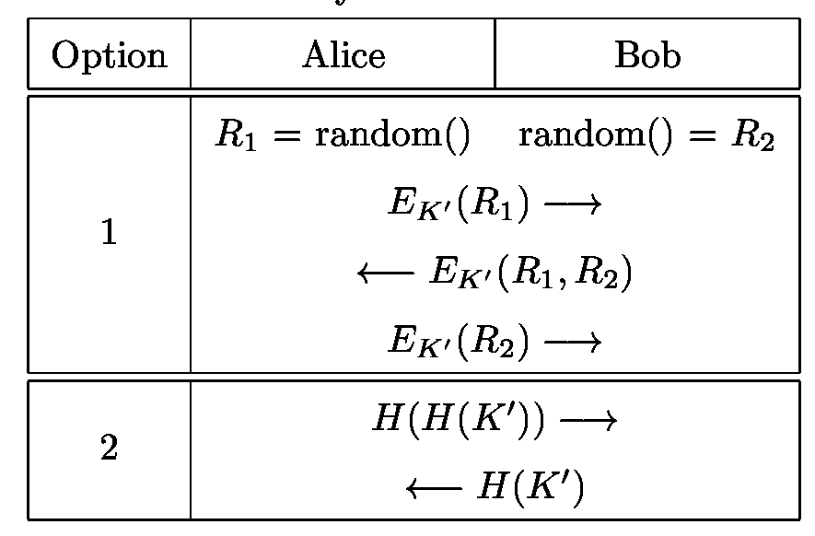
Methods for key confirmation
Goal: ensure that parties use same key value(s)
Implicit confirmation by use of valid key
  E.g., MAC by session key on future message is valid
Explicit confirmation by challenge-response
  Dedicated steps in protocol
http://www.themccallums.org/nathaniel/2014/10/27/authenticated-key-exchange-with-speke-or-dh-eke/

Slide 28
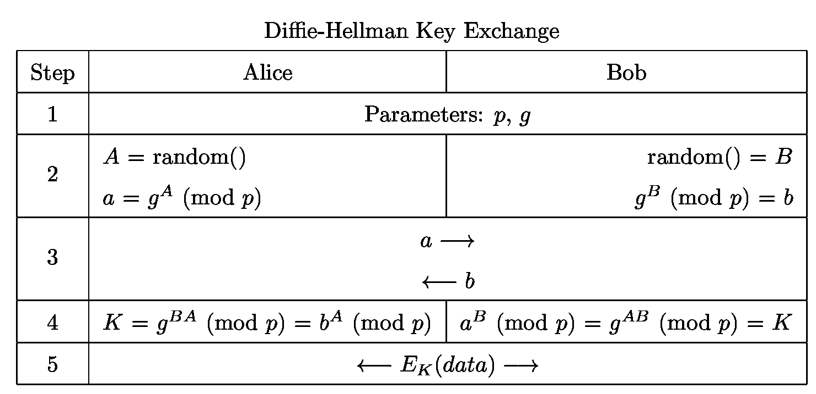
Diffie-Hellman key exchange
Which part ensures:
Key establishment
Key confirmation
Authentication
http://www.themccallums.org/nathaniel/2014/10/27/authenticated-key-exchange-with-speke-or-dh-eke/

Slide 29
Diffie-Hellman in practice
K is not used directly, but K’ = KDF(K) is used
  Original K may have weak bits
  Multiple keys may be required (K_{ENC}, K_{MAC})
Is vulnerable to man-in-the-middle attack (MitM)
  Attacker runs separate DH with A and B simultaneously
  (Unless a and b are authenticated)
Be aware of particular p and g
  If group g is widely used up to 1024b then precomputation is possible (Logjam, CCS15)
    Huge precomputation effort, but feasible for national agency
    Certain combination of g and p => fast discrete log to obtain A
  If p is really prime and g has larger order (Indiscrete logs, NDSS17)

Slide 30
Diffie-Hellman in practice
DH can be used as basis for Forward secrecy
DH can be used as basis for Password-Authenticated Key Exchange
Variant of DH based on elliptic curves used (ECDH)
  ECDH is preferred algorithm for TLS, ePassport…
  ECDH is algorithm of choice for secure IM (Signal)

Slide 31
Forward secrecy - motivation
Assume that session keys are exchanged using long-term secrets
  Pre-distributed symmetric cryptography keys (SCP’02)
  Public key cryptography (TLS_RSA_...)
What if long-term secret is compromised?
  All future transmissions can be read
  Attacker can impersonate user in future sessions
  All previous transmissions can be compromised if traffic was captured
Can III. be prevented? (Forward secrecy)
Can I. be prevented? (Backward secrecy)

Slide 32
Forward secrecy – how to achieve
(Perfect) Forward Secrecy
  Compromise of long-term keys does not compromise past session keys
Solution: ephemeral key pair (DH/RSA/…)
  Fresh keypair generated for every new session
  Ephemeral public key used to exchange session key
  Ephemeral private key is destroyed after key exchange
    Captured encrypted transmission cannot be decrypted
Long-term key is used only to authenticate ephemeral public key to prevent MitM

Slide 33
Use of forward secrecy: examples
HTTPS / TLS
  DHE-RSA, DHE-DSA, ECDHE-RSA, ECDHE-ECDSA…
SSH (RFC 4251)
Off-the-Record Messaging (OTR) protocol (2004)
TextSecure v2 → Axolotl protocol (TextSecure app)
TextSecure v3 now known as Signal protocol (2015)

Slide 34
Password-Authenticated Key Exchange (PAKE)

Slide 35
PAKE protocols - motivation
Diffie-Hellman can be used for key establishment
  Authentication ca be added via pre-shared key
But why not directly derive session keys from pre-shared instead of running DH?
  Compromise of pre-shared key => compromise of all data transmissions (including past) => no forward secrecy
  Pre-shared key can have low entropy (password) => attacker can brute-force
Password-Authenticated Key Exchange (PAKE)
  Sometimes called Escalation protocols

Slide 36
PAKE protocols - principle
Goal: prevent MitM and offline brute-force attack
Generate asymmetric keypair for every session
  Both RSA and DH possible, but DH provides better performance in keypair generation
Authenticate public key by (potentially weak) shared secret (e.g., password)
  And limit number of failed authentication requests!
Exchange/establish session keys for symmetric key cryptography using authenticated public key

Slide 37
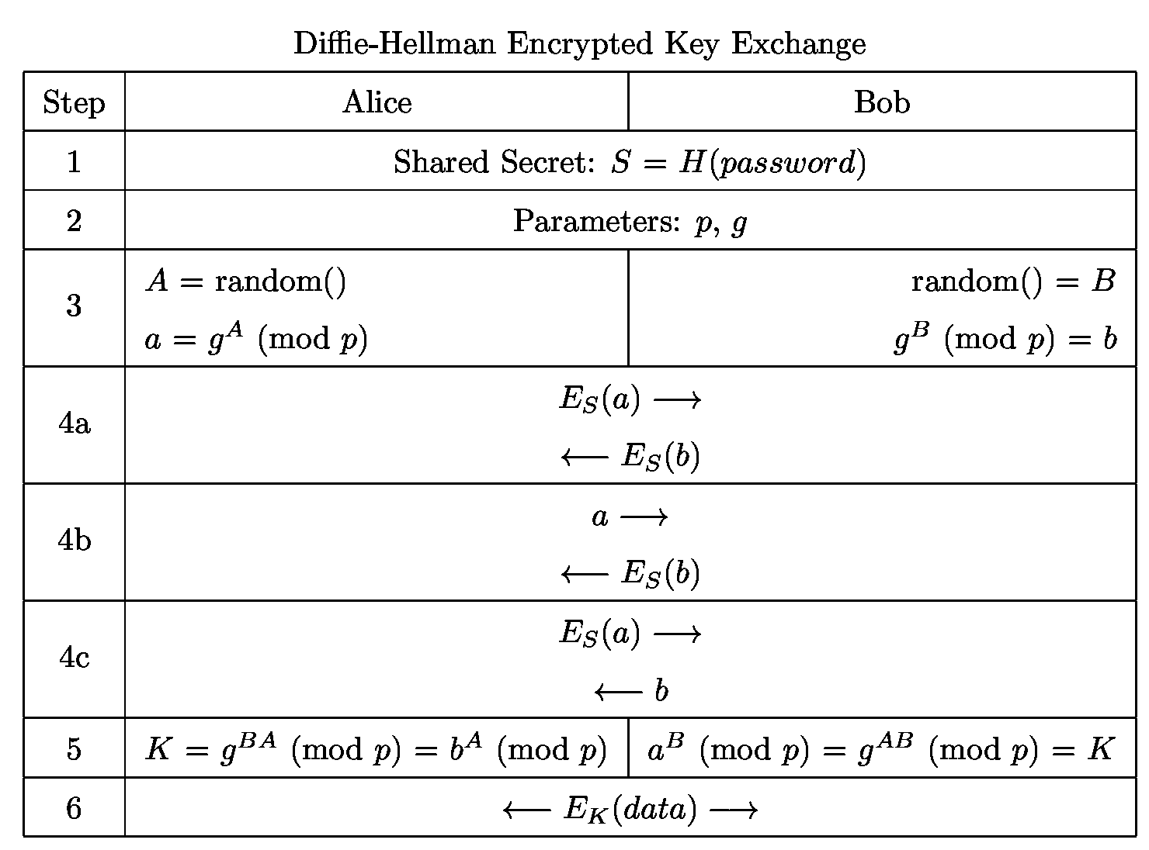
Diffie-Hellman Encrypted Key Exchange
http://www.themccallums.org/nathaniel/2014/10/27/authenticated-key-exchange-with-speke-or-dh-eke/

Slide 38
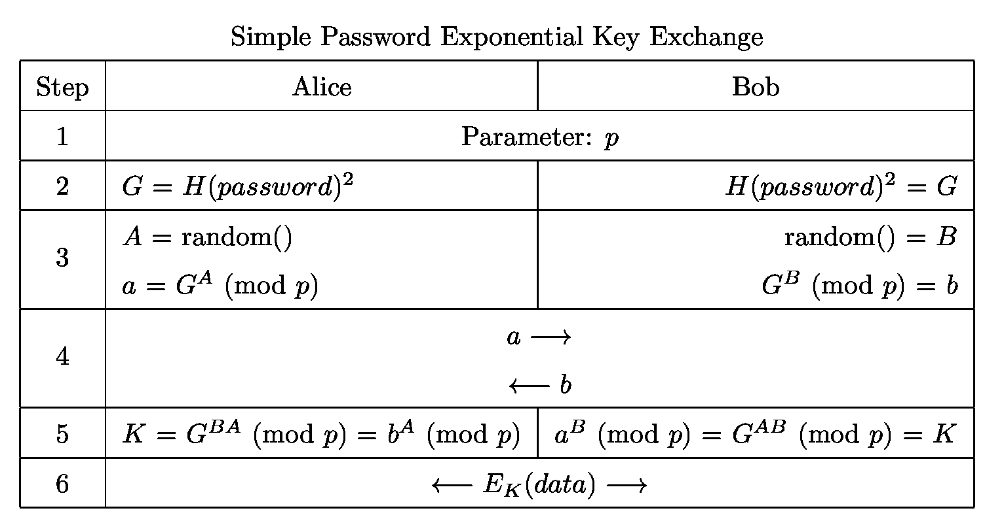
Simple Password Exponential Key Exchange (SPEKE)
http://www.themccallums.org/nathaniel/2014/10/27/authenticated-key-exchange-with-speke-or-dh-eke/

Slide 39
Secure Instant messaging

Slide 40
Off-The-Record Messaging (OTR), 2004
Protocol for protection of instant messaging
Perfect forward and backward secrecy
  Via use of ephemeral DH keys
  Added OTR ratcheting (new DH key for every message)
Plausible deniability of messages
  Message MAC is computed, message send and received
  MAC key used to compute MAC is then publicly broadcast
  As MAC key is now public, everyone can forge past messages (will not affect legitimate users but can dispute claims of cryptographic message log in court)

Slide 41
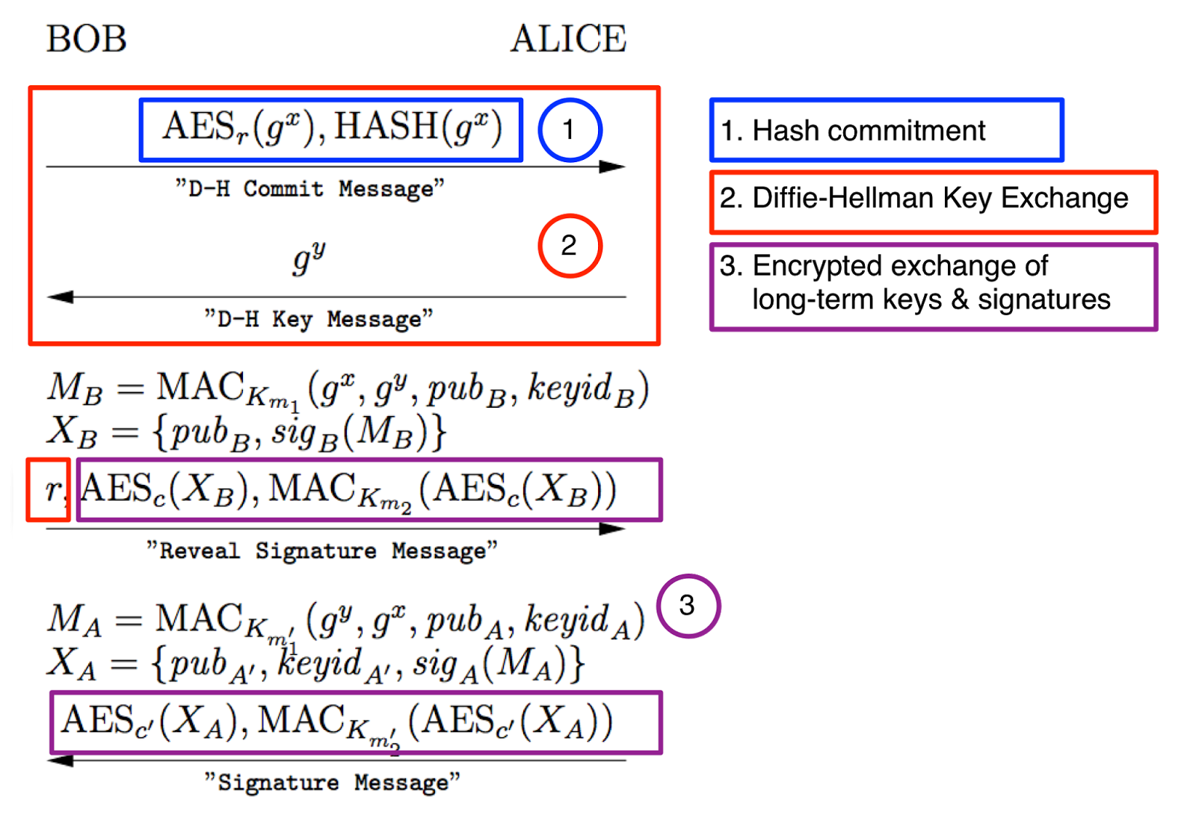
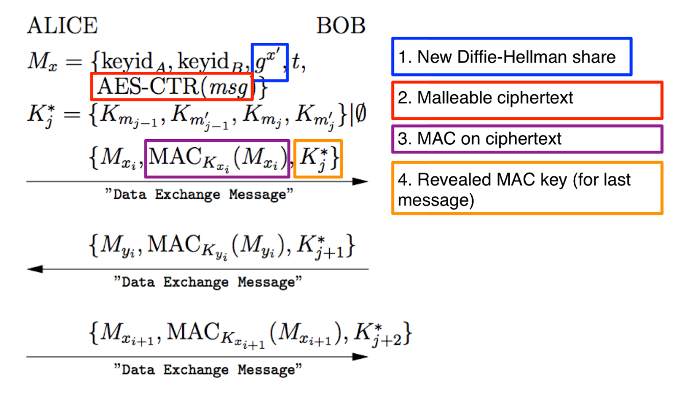

Slide 42

The Signal protocol
State-of-the-art of instant messaging protocols
  Used in Signal, WhatsApp, Facebook Messenger, Google Allo…
The protocol provides:
  confidentiality, integrity, message authentication,
  participant consistency, destination validation,
  forward secrecy, backward secrecy (aka future secrecy)
  causality preservation, message unlinkability, message repudiation, participation repudiation and asynchronicity
  end-to-end encrypted group chats
Requires (untrusted) servers
  relaying of messages and storage of public key material
https://en.wikipedia.org/wiki/Signal_Protocol

Slide 43
The Signal protocol implementation
3-DH with Curve25519, AES-256, HMAC-SHA256
Authentication of users
  1) Trust on first use 2) Trusted party (PKI) 3) Fingerprint check using other channel (hex, QR code…)
Protection of messages
  3-DH with perfect forward secrecy and backward secrecy
  AE with deniability (MAC key later broadcast)
  Support for offline messages with future ECDH keys (ratcheting)
Protection of metadata (no strong anonymity as e.g., Tor)
  Message delivery time and communicating parties available
  Service provider (e.g., OpenWhisperSystem or WhatsApp) may choose to keep or delete this information

Slide 44
The Signal protocol – group messaging
Speaker consistency
Out-of-order resilience
Dropped message resilience
Computational equality
Trust equality
Subgroup messaging
Contractible and expandable group membership
Read more details at https://www.whatsapp.com/security/WhatsApp-Security-Whitepaper.pdf
https://en.wikipedia.org/wiki/Signal_(software)#Encryption_protocols

Slide 45
Design of protocols

Slide 46
Design of cryptographic protocols
Don’t design own cryptographic protocols
  Use existing well-studied protocols (TLS, EAC-PACE…)
  Don’t remove “unnecessary” parts of existing protocols
Follow all required checks on incoming messages
  Verification of cryptograms, check for revocation…
Don’t design and implement your own (if possible)
  Potential for error, implementation attacks…
But more likely you will need to design own protocol than to design own crypto algorithm
  => can actually happen ☺

Slide 47
Design principles (Abadi & Needham) I.
The conditions for a message to be acted should be clearly set out so reviewer can judge if they are acceptable.
  Documentation, diagrams, formal specification
Every message should say what it means, message interpretation should depend only on its content.
  “This is 2nd message of SCP’02 from A to B”
  No assumptions like next random chunk number should be encrypted 2nd message because I just received 1st message
Mention name of principal (“Alice01”)
  Prevents (if checked) unintended parallel runs of protocol
  Prevents reflection attack

Slide 48
Design principles (Abadi & Needham) II.
Be clear about why encryption is being done
  For confidentiality, not to “somewhat” ensure integrity
When signing encrypted data, it should not be inferred that signing entity knows data content
  No knowledge of encryption key
Be clear about properties of nonce
  random, never repeated, unpredictable, secret
  Random → almost never repeated unintentionally

Slide 49
Design principles (Abadi & Needham) III.
If predictable quantity is to be effective, it should be protected so that an intruder cannot simulate a challenge and later replay the message
  Counter as challenge → counter freshness verification necessary → state
If timestamps are used as freshness guarantees, then difference between local clocks at various machines must be much less then allowable age of message
  Otherwise an attacker can replay within time window
Key may have been used recently and yet be old and possibly compromised
  Clear session state after session end, check freshness

Slide 50
Design principles (Abadi & Needham) IV.
It should be possible to deduce which protocol and which run of that protocol a message belongs to including order number in the protocol
  Danger of parallel runs of same protocol
  MAC and chaining with fresh session keys prevents message mixing
Trust relation should be made explicit and there should be good reason for its necessity.
  Less trust needed → better security achieved

Slide 51
Electronic passports and citizen ID cards
Credit: Slides partially based on presentation by Zdenek Říha

Slide 52
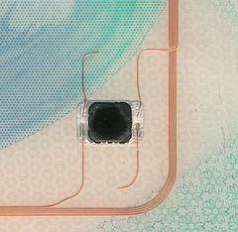
Passports of the first generation
Electronic passport
  Classical passport booklet + passive contactless smartcard
  (ISO14443, communication distance 0-10 cm)
  Chip & antenna integrated in a page or cover
Technical specification standardized by ICAO
  Standard 9303, 6th edition
  References many ISO standards
Data is organised in 16 data groups (DG) and 2 meta files
  DG1-DG16, EF.COM, EF.SOD
  Mandatory is DG1 (MRZ), DG2 (photo), EF.COM and EF.SOD (passive authentication)

Slide 53
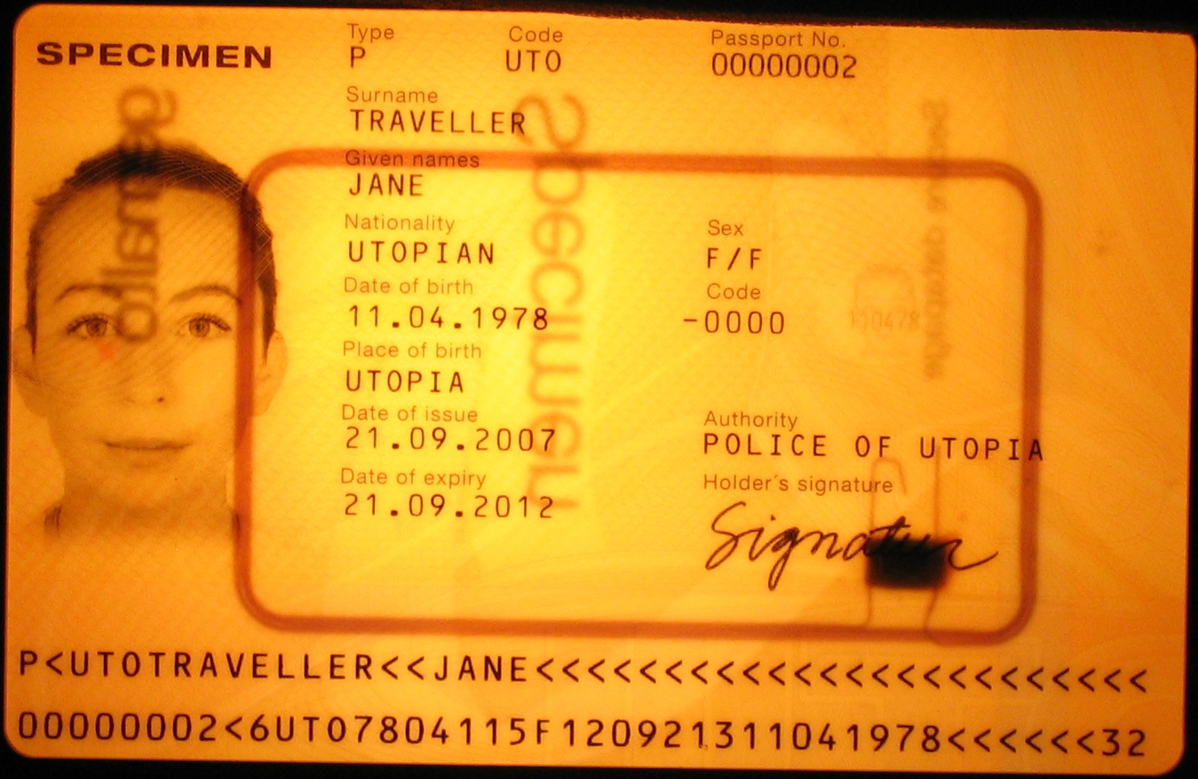
Chip and antenna

Slide 54
Data groups
Data group | Stored data
DG1 | Machine readable zone (MRZ)
DG2 | Biometric data: face
DG3 | Biometric data: fingerprints
DG4 | Biometric data: iris
DG5 | Picture of the holder as printed in the passport
DG6 | Reserved for future use
DG7 | Signature of the holder as printed in the passport
DG8 | Encoded security features – data features
DG9 | Encoded security features – structure features
DG10 | Encoded security features – substance features
DG11 | Additional personal details (address, phone)
DG12 | Additional document details (issue date, issued by)
DG13 | Optional data (anything)
DG14 | Data for securing secondary biometrics (EAC)
DG15 | Active Authentication public key info
DG16 | Next of kin

Slide 55
Protocols used in ePassports I.
SG: security goal, S: solution used
Authentication of inspection system to chip [BAC]
  Read basic digital data from chip (MRZ, photo)
  SG: Passport provides basic data only to local terminal with physical access to passport
  S: Auth. SCP, sym. crypto keys derived from MRZ [BAC]
Authorized access to more sensitive chip data
  SG: Put more sensitive data on chip (fingerprint, iris), but limit availability only to inspection systems of trustworthy countries
  S: Challenge-response auth. protocol [EAC,EAC-PACE], PKI + cross-signing between trustworthy states [EAC]

Slide 56
Protocols used in ePassports II.
SG: security goal, S: solution used
Genuine data on passport
  SG: Are data on passport unmodified?
  S: digital signatures, PKI [passive authentication]
Authentication of chip to inspection system
  SG: Is physical chip inside passport genuine?
  S: Challenge-response authentication protocol [AA, EAC-PACE]
Transfer data between chip and IS securely
  SG: attacker can’t eavesdrop/modify/replay
  S: secure channel [EAC, EAC-PACE]

Slide 57
Authorization and passports
Inspection terminal to read basic info from chip
Inspection terminal to read biometric data from chip
You to enter country based on chip data

Slide 58
Electronic passports
- more details

Slide 59
Basic Access Control (BAC) protocol
Authentication&secure channel between inspection terminal and chip
  Based on symmetric crypto (3DES), similar to SCP’0x protocols
  Low computational requirements
Problem: anyone with access to MRZ can authenticate
Problem: MRZ has insufficient entropy
  Document number, birth date, expiration date used
  Theoretically 58/74 bits, but in practice about 32 bits
Offline attack (eavesdrop then crack)
  Eavesdrop valid communication between chip and reader
  Brute-force attack in less then hour (2³² ops, offline attack)
Online attacks against chip (att. model: found passport)
  Significantly slower, ~20 ms for every attempt

Slide 60
EAC – motivation
EU passports stores fingerprints (from 2009)
  More sensitive than facial photo => better protocol needed
Goal: not everyone with access to passport (and MRZ for BAC) should be able to read out fingerprint
  Issuing country decides who else can access
Stronger authentication than BAC required

Slide 61
Mind exercise: symmetric crypto
What if only symmetric crypto is used?
  Every chip has own unique symmetric key
  Large number of keys in inspection terminals
  Compromise of single terminal breach security
  => impractical and insecure => not used

Slide 62
Extended Access Control (EAC) protocol
Based on asymmetric cryptography (RSA/DH/ECDSA)
Chip Authentication (CA) based on PACE protocol
  Password Authenticated Connection Establishment (PACE)
  Uses chip’s static DH/ECDSA key and terminal’s ephemeral DH key pair (perfect forward secrecy)
  Both parties combines chip’s public static and ephemeral public key into same key K
  Keys for encryption and MAC (K_{ENC}, K_{MAC}) are derived from exchanged K
How can be Terminal sure of authenticity of chip’s static key?
  Signed by Issuing country
Terminal Authentication (TA)
  Based on challenge-response protocol (RSA/ECDSA, SHA-1/2)
  Hash of the ephemeral DH key from previous step hashed with challenges

Slide 63
Terminal authentication I.
Only authorized border authorities can read the secondary biometric data (fingerprints and iris)
  The inspection system must prove to the chip it is authorized
  The chip stores a trust point – root certificate
  Inspection system presents a valid certificate chain (starting from the passport’s trust point) specifying the IS’s authorizations (e.g. to read DG3)
  Challenge-response where IS proves knowledge/access of a secret key (whose public part is certified)
  Certificates in Card-verifiable (CV) format

Slide 64
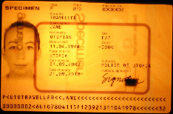
Terminal Authentication II
Country A
Country B
Country C
CV CA
CV CA
CV CA
DV
DV
DV
DV
IS
...
IS
IS
...
IS
IS
...
IS
IS
...
IS
Root public key of issuing country: CV CA

Slide 65
Terminal Authentication III
Supported algorithms
  RSA PKCS#1 v1.5 with SHA-1 or SHA-256
  RSA PSS with SHA-1 or SHA-256
  ECDSA with SHA-1, SHA-224 or SHA-256
  Key lengths
    For ECDSA allowed 160, 192, 224, 256 bits
    For RSA allowed 1024, 1280, 1536, 2048 and 3072 bits
    In practice ECDSA is more common, key lengths 192 and 224 bit most popular, existing implementations also support 256 and 384 bits.
    For RSA the PKCS#1 v1.5 padding is much more popular than PSS, key lengths are between 512 (test only) and 2048 bits.

Slide 66
Active Authentication (AA) protocol
Motivation: Prevent cloning of passport
  Is chip inside passport authentic?
Passport-specific asymmetric key stored on chip
Public key freely readable (DG15 file, hash signed)
Authentication against terminal
  Terminal generates 8 random bytes
  Chip adds additional 8 random bytes, hash and sign
  Terminal verifies signature
Privacy attack: terminal’s challenge is date → signed
PACE protocol replaces Active Authentication

Slide 67
EAC Chip authentication
Verifies the authenticity of the chip
  Replaces Active Authentication
  Improves the security of Secure Messaging
    Keys with higher entropy than for Basic Access Control (BAC)
Diffie-Hellman key pair (passport’s chip)
  Public key and domain parameters stored in DG14
  Private key never leaves the chip
Diffie-Hellman key pair (inspection system – IS)
  Key pair generated according to passport’s domain parameters
  Private key kept secret, public key sent to chip
Both the parties (passport, IS) now share a secret
  The secret is used to derive the SM keys, the ability to communicate proves the authenticity of the chip

Slide 68
Chip authentication II
Algorithms supported by the EAC specification
  Diffie-Hellman (PKCS#3)
  Elliptic Curve Diffie-Hellman (ISO 15946, BSI TR-03111 )
  Both DH and ECDH popular with chip manufacturers
    DH with 1024 or 1536 bit prime
    ECDH with mostly 224 bit curves, some implementations use 256 or 384 bits
No challenge semantics
Coexistence of CA and AA

Slide 69
Passive Authentication
CSCA
Goal: are data in chip unchanged?
The list of the hashes (SHA-1/2)
of all present data groups is digitally
signed by the issuing organisation
(Document Signer)
  State printing house, Embassy, Etc.
The X.509 certificate of the Document Signer issued by the CA of the issuing country (Country Signing CA – e.g. the ministry of interior) is included.
The CSCA certificates must be exchanged bilaterally
ICAO PKD for DS certificates, CSCA CRL and cross certificates
Passive authentication is a mandatory security feature of all ePassports
DS1
DS2
ePassport 1
ePassport 2
ePassport 3

Slide 70
Passive Authentication – the details
The file EF.SOD contains a CMS (PKCS#7) SignedData structure (file is read and validated by inspection system)
  The signed data is the list of hashes of the present data groups
  The DS certificate is included (ICAO optional, EU mandatory)
  Data is signed by the DS
Signature schemes
  RSA with PKCS#1 v1.5 padding (min. 3072 bits for CSCA, 2048 bits for DS)
    E.g. Hungary, France, Spain, Portugal, Italy: RSA 4096 bit key with SHA-1
    E.g. Austria, Netherlands: RSA 3072 bit key with SHA-256
  RSA with PSS padding (min 3072 bits for CSCA, 2048 for DS)
    E.g. Czech Republic, Norway, Denmark, Japan and Australia – all with SHA-256
  DSA (not standardized for key lengths > 1024)
  ECDSA (domain parameters must be specified, min. 256 bits for CSCA, 224 bits for DS)
    E.g. Switzerland, Germany, Russia – all with SHA-1
Message Digest algorithms (for signature schemes and hashes of Data Groups)
  SHA-1 and all SHA-2 algorithms

Slide 71
How Signal and ePass compares?
Completely different usage scenario
  Instant messaging vs. person/terminal authentication
  Frequent updates possible vs. 15 years passport validity
Different trust relations and participants structure
  N friends vs. many partially or fully distrusting participants
  Mostly online vs. mixed offline/online (even without clock!)
Underlying cryptographic primitives are shared
  Forward secrecy, ECDH, AES, SHA-2…
  Ratcheting and deniability not necessary for ePass

Slide 72
Conclusions
Design of (secure) protocols is very hard
  Understand what are your requirements
  Use existing protocols, e.g., TLS, Signal or EAC-PACE
Strong session keys established with weak passwords
  Password-Authenticated Key Exchange
Electronic passport uses variety of protocols
  Interesting and complex usage scenarios
Mandatory reading
  M. Green, Noodling about IM protocols, http://blog.cryptographyengineering.com/2014/07/noodling-about-im-protocols.html
  M. Marlinspike, Advanced cryptographic ratcheting https://whispersystems.org/blog/advanced-ratcheting/

