Slide 1
PV204 Security technologies
In-Memory Malware Analysis
Václav Lorenc
Senior Security Analyst, Oracle + NetSuite

Slide 2
Agenda
Basic intro
No assembly required
No malware (de)obfuscation magic
How does the OS look “inside”?
Processes and other data structures
How the memory is organized
Common tools used for analysis
Searching for system “oddities”
What are the important system indicators?
Real samples discussed and analyzed! (Labs)

Slide 3
Why memory analysis?
It’s fun!
Acquiring evidence for legal investigations
It used to be different in the past
Incident response activities
Easy way how to learn more about the attackers
Malicious binary may only be present in memory
Technical simplification of reverse engineering
No binary obfuscation present – the code has to run

Slide 4
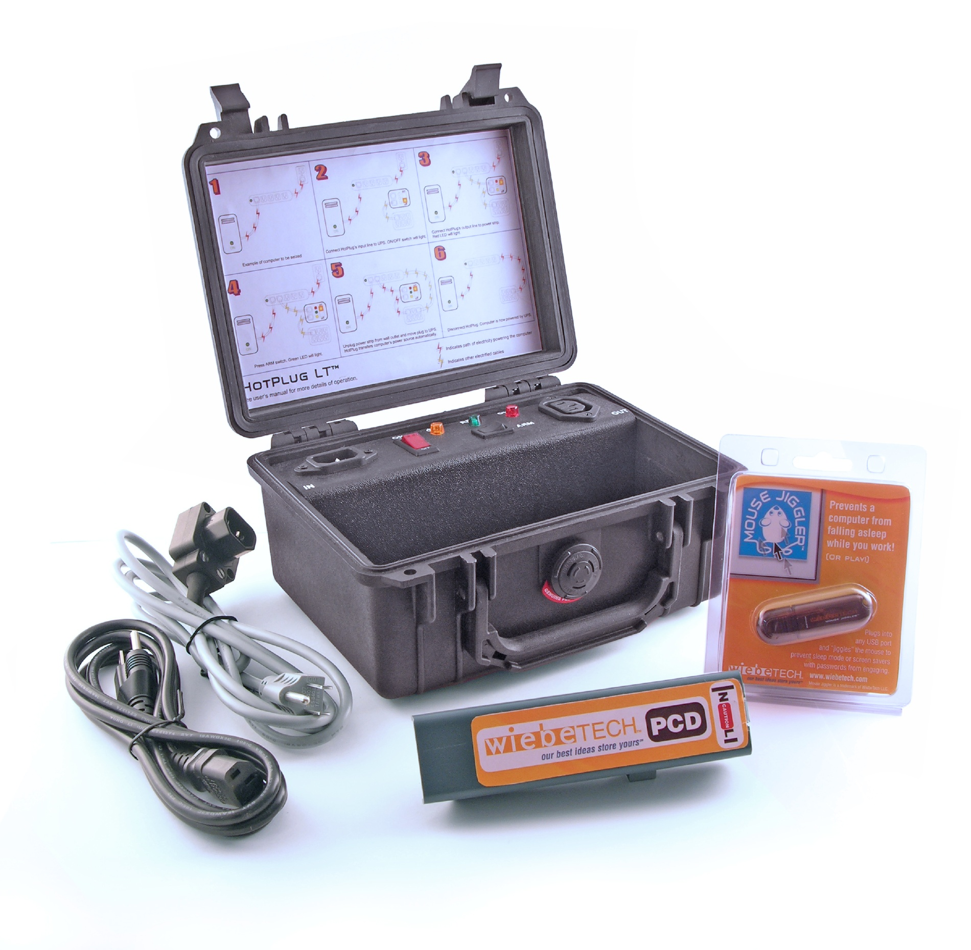

Slide 5
Challenges in Reverse Engineering (RE)
Assembly language (for multiple platforms)
Plus undocumented instructions (or behavior)
Anti-debugging tricks
Exceptions, interrupts, PE manipulations, time checking, ...
Anti-VM tricks
Uncommon behavior of known instructions
Registry detections, HW detections
Code obfuscation/packing
The most challenging to overcome, mostly

Slide 6
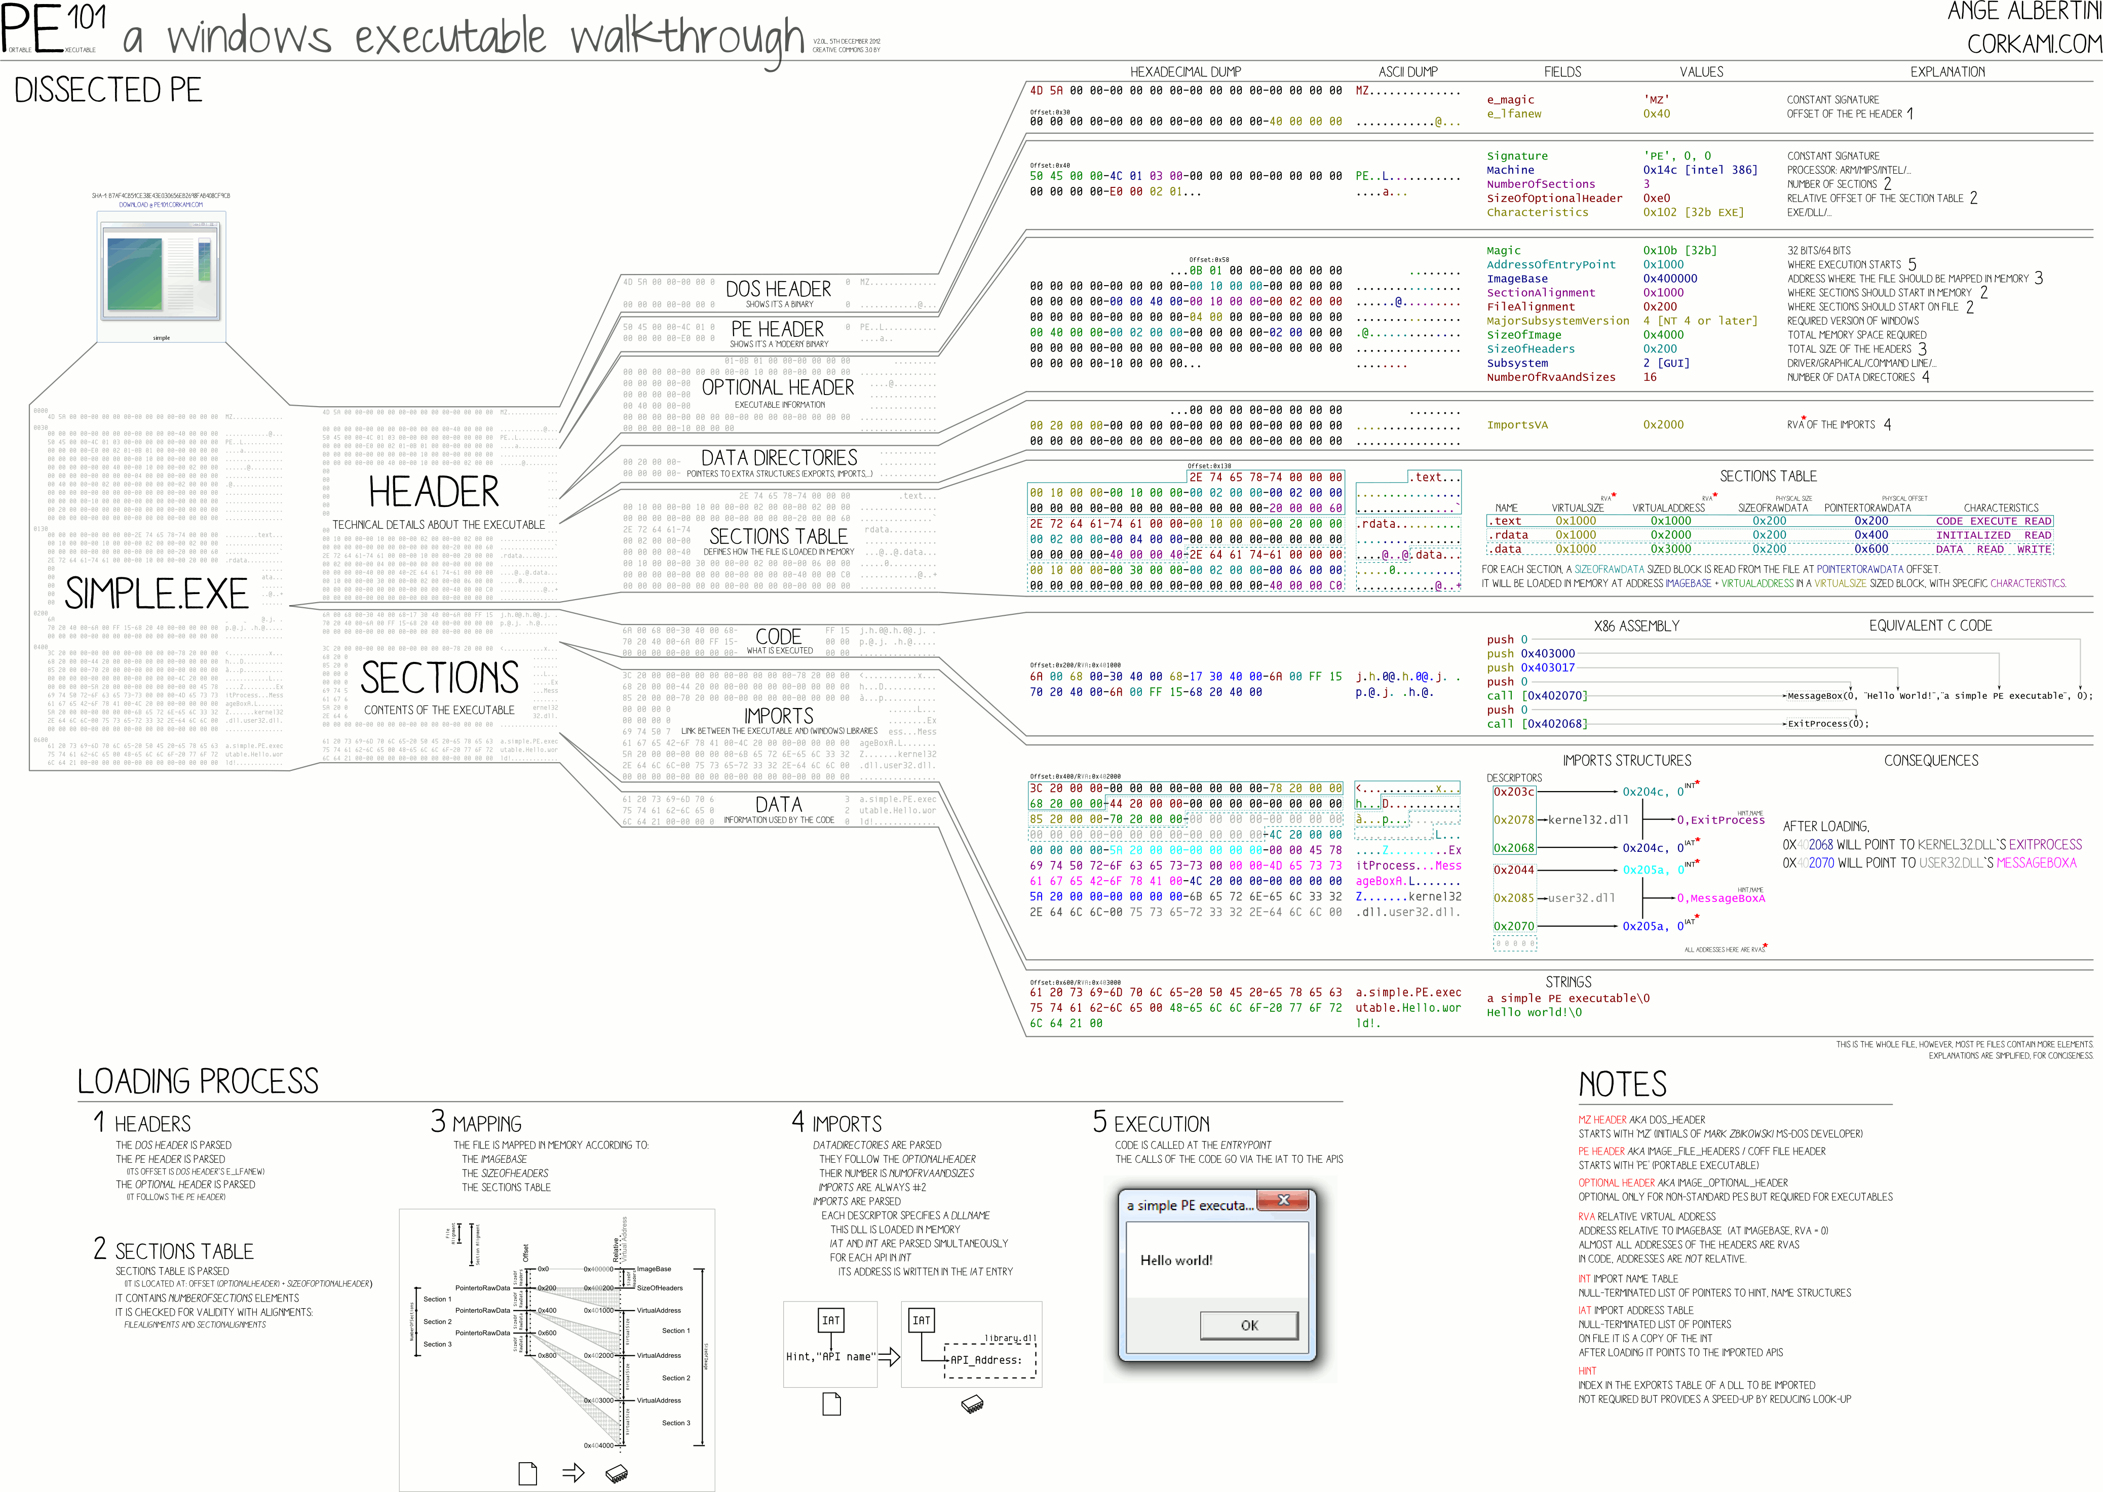
PE File Format

Slide 7
PDF File Format

Slide 8
‘cause reverse engineering ninjas are busy
MEMORY ANALYSIS…

Slide 9
x86/x64 Memory organization
Physical memory
RAM; what we really have installed
Virtual memory
Separation of logical process memory from the physical
Logical address space > physical (e.g. swap)
Address space shared by several processes, yet separated
Paging vs. Segmentation
Possible memory organization approaches

Slide 10
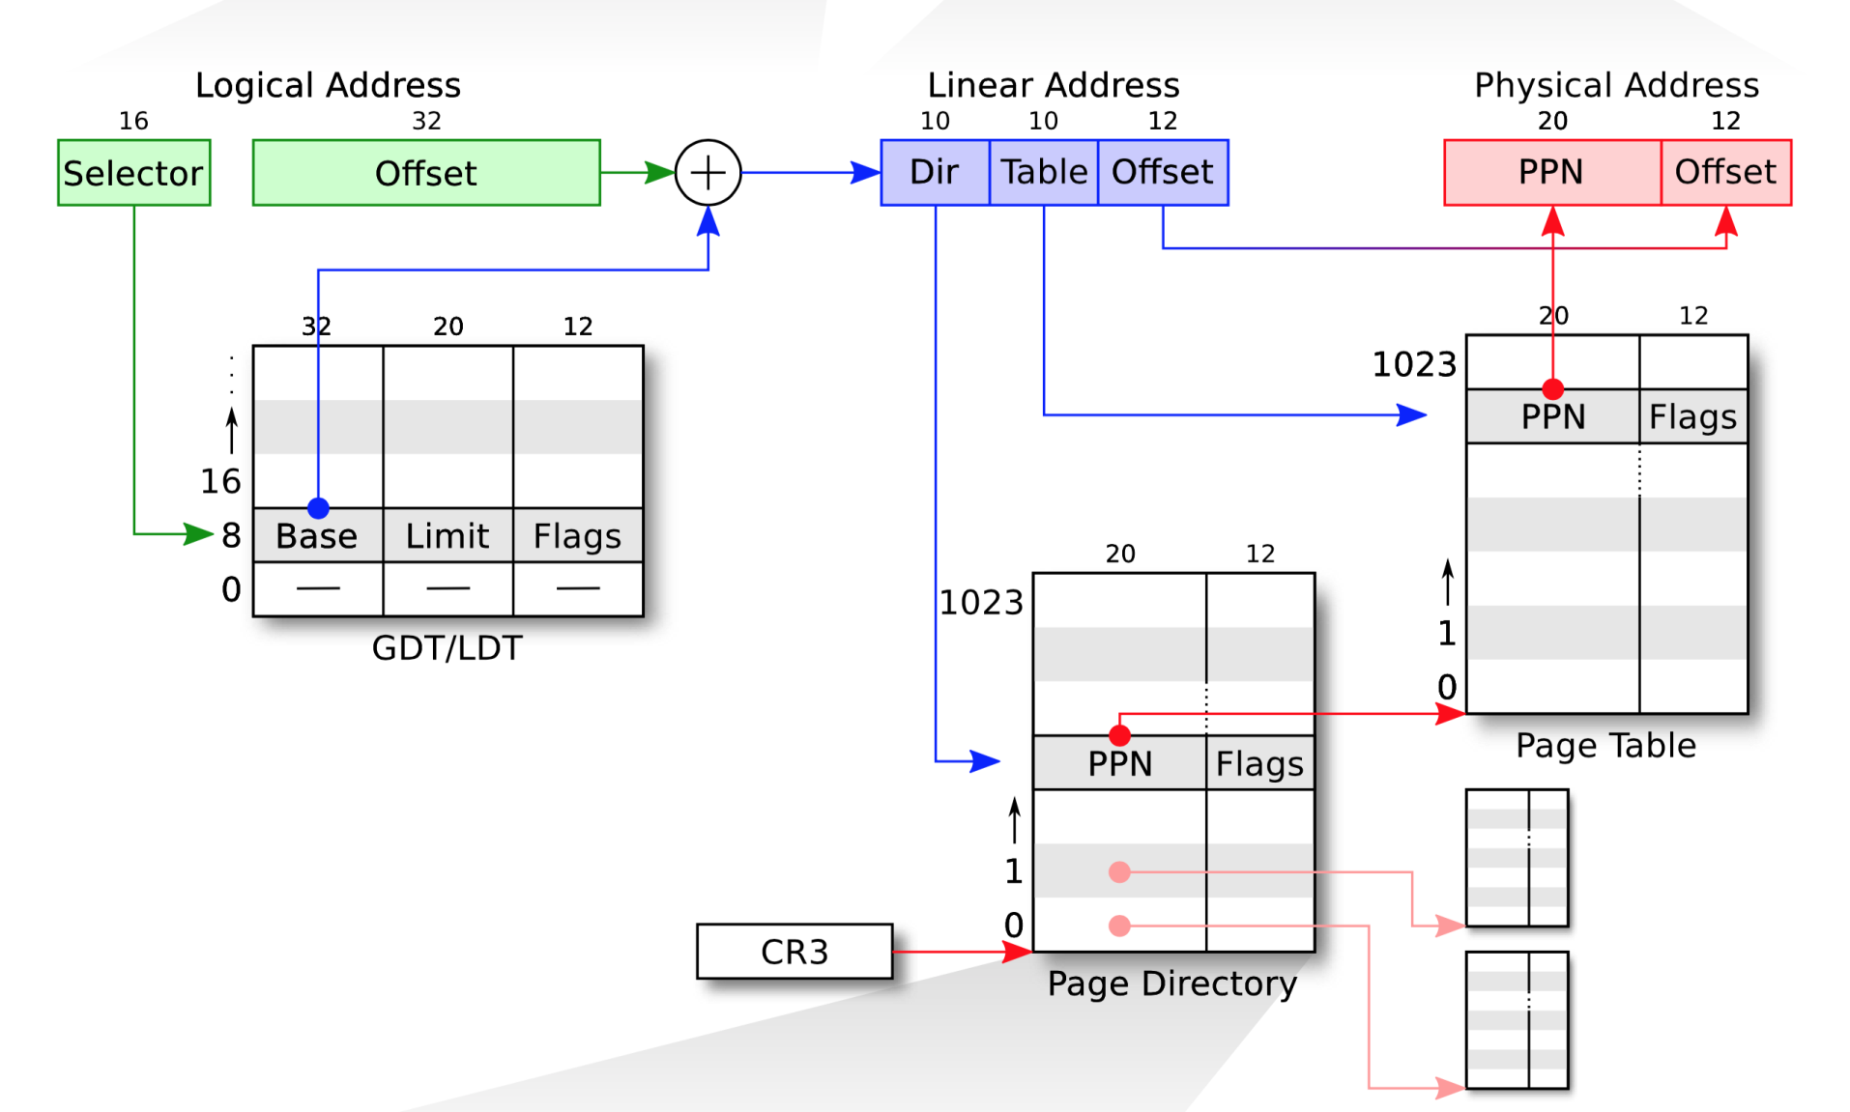
Segmentation
Paging
Physical Address

Slide 11
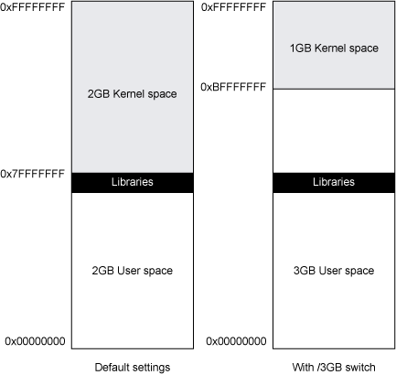
Win32 Address Space

Slide 12
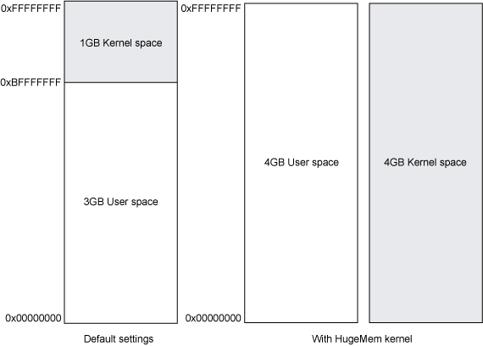
Linux Address Space

Slide 13
Operating System Data Structures
How the OS knows about processes, files, …?
A lot of ‘metadata’ for important data
Based on C/C++ data structures (see MSDN documentation)
(Double-)linked list
Another common data structure (not only in OS)
Method for implementing lists in computer memory
Direct Kernel Object Manipulation (DKOM)
Used for manipulating the structures to hide malicious stuff

Slide 14
Double Linked Lists

Slide 15
DKOM – Direct Kernel Object Manipulation
Dozens of various (double-)linked lists in Win32
Maintained by kernel
Processes, threads, opened files, memory allocations, …
DKOM is used by rootkits
Hiding from the sight of the user
Rootkit paradox
Rootkits need to run on the system
… and need to remain hidden at the same time
Memory analysis can help to discover DKOM
Anti-analysis techniques are known as well
Notes:
http://www.blackhat.com/presentations/bh-usa-04/bh-us-04-butler/bh-us-04-butler.pdf

Slide 16
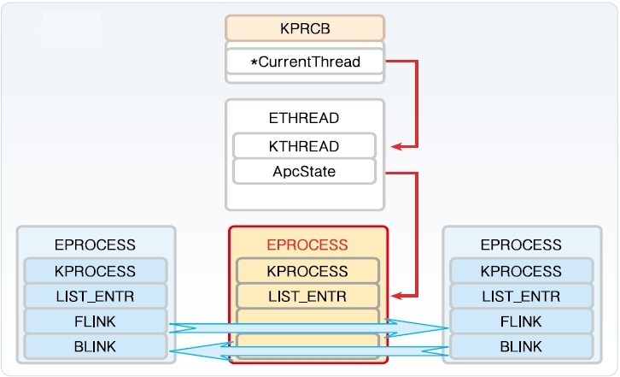
Windows Process Structures

Slide 17
Interesting OS Structures
Suspicious Memory Pages
Processes
Threads
Sockets (Connections)
Handles (Files)
Modules/Libraries
Mutexes
LSA (Local Security Authority)
Registry
…

Slide 18
Memory Pages
Various ‘flags’
Read/write/executable pages
Helping OS to organize memory efficiently
Executable + Writable pages
Why is it bad?
Process Injection technique
Allocating a memory that can be modified (unpacked, decoded, decrypted) and executed.
Used by legitimate processes too (Windows OLE)

Slide 19
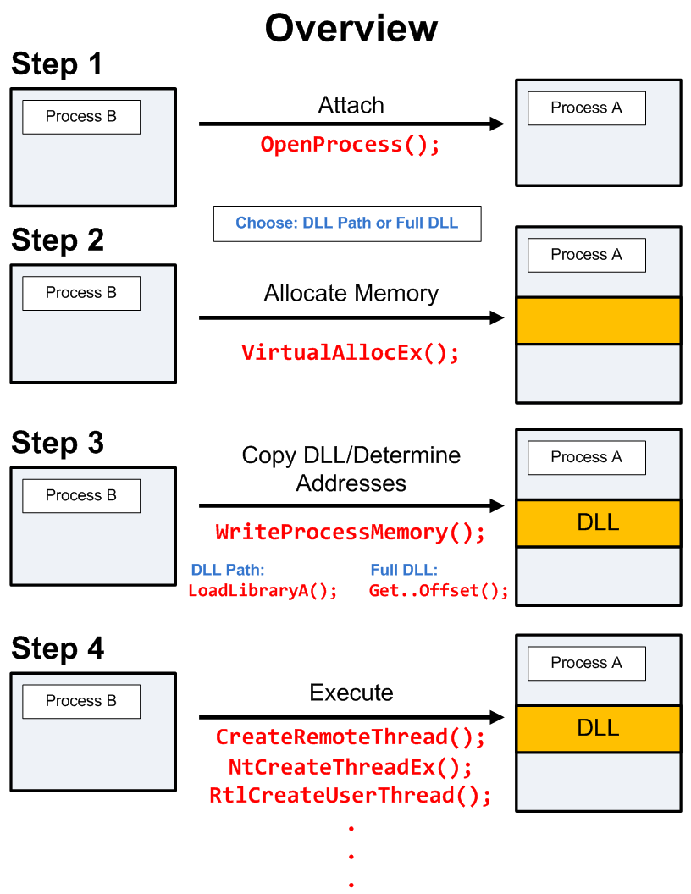
DLL/Process Injection
So that Internet Explorer behaves like a malicious process…

Slide 20
And now something completely…
PRACTICAL

Slide 21
Memory (re)sources
Live RAM
The most common source for analysis
Easier to obtain from virtualized hosts
Paging file/Swap
Used by operating systems to allocate more memory then available RAM
Hibernation file
Memory crash dumps
Very limited analysis options

Slide 22
Memory Acquisition
VM?
Yes
Memory Dump
Snapshot
Clone
No
Running?
No
Hibernation File
Page File (Swap)
Crash Dumps
Yes
Got root?
Dumping locally
Remote access?
Cost / Benefits
Tool Footprint
Yes
No
FireWire
PCI Probes

Slide 23
Memory Acquisition
Virtual Machines
VMWare, VirtualBox, …
VirtualBox –dbg –startvm “MalwareVM” (and .pgmphystofile command)
Directly from the system! (if we have system rights to do that)
windd, fastdump, memoryze
Or we can hibernate the system (hiberfil.sys)
Remotely
Encase Enterprise, Mandiant Intelligent Response, Access Data FTK
Common issues
Unsupported OS (Linux, MacOS; 32bit/64bit)
Swap (portions of memory on drive)
Malware not running inside a virtual machine

Slide 24
Memory Acquisition (2)
Local memory acquisition notes
Unless you have plenty of money, try to get root/admin access to the host
Better to acquire to external storage (USB, network)
The lower tool’s memory footprint, the better
If you run malware in VM, better have less RAM
Faster analysis
.. And configure no swap for the system too

Slide 25
Memory Acquisition (3)
Remote memory acquisition
Very useful for fast Incident Response
Requires enterprise licenses for the commercial tools
Acquisition is done over network
Agents already in memory, no extra memory demands
Open source alternative?
GRR (Google Rapid Response)
Still in development, primarily Incident Response tool
Allows remote memory acquisition

Slide 26
Memory Analysis Tools
Mandiant Redline
Free, available for Windows
HBGary Responder (CE/Pro)
Community Edition available against registration
Volatility Framework
Open source, no GUI
Rekall
Open source, ‘Volatility done right’, GUI
Google supported (part of GRR agent)

Slide 27
Mandiant/FireEye Redline
Free tool for Incident Response
Not open-source, though
.NET executable (runs only under Windows)
Nice and simple user interface
Very nice analysis workflow
Perfect for searching for string information
Rates the level of suspiciousness over processes
Sad things
Memory analysis not reliable, process rating as well

Slide 28
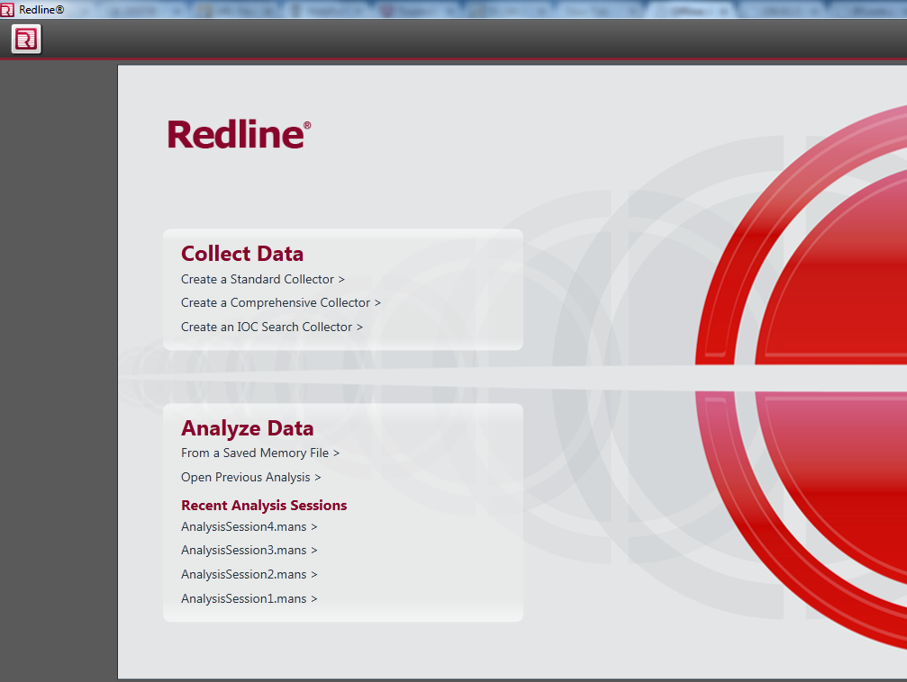
Redline: Start

Slide 29
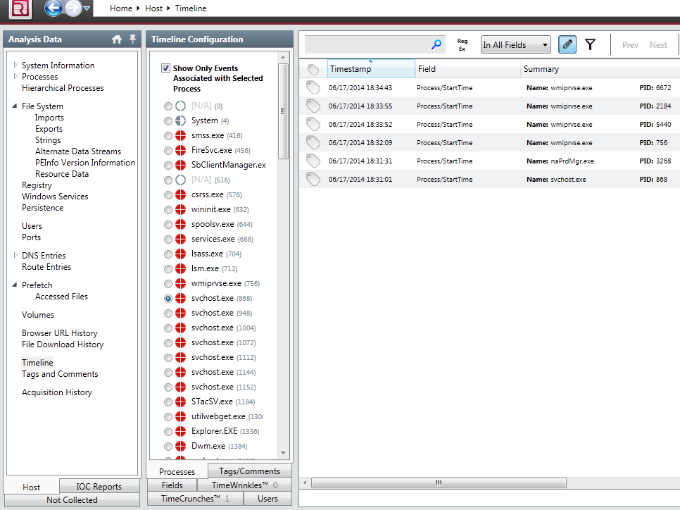
Redline: Timeline

Slide 30
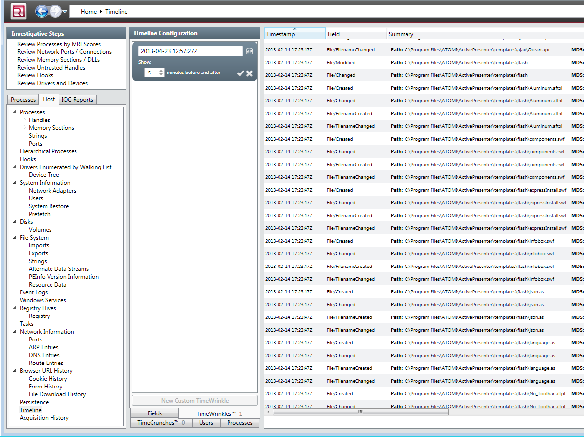
Redline: Time Wrinkles

Slide 31
HBGary Responder (Pro/CE)
Professional Tool
Very expensive
Yet not very well maintained in the last few years
Windows only
.NET written, supports only Windows images
‘Killer’ features
Digital DNA
automatic rating of suspicious processes
Visual ‘Canvas’ debugger
Supports the analysis of (unpacked) binaries

Slide 32
HBGary Responder Pro -- DDNA
Examples of the ‘reasoning’ behind DDNA
Does the process communicate over TCP/IP?
Does it manipulate with registry?
Did the analysis reveal any known bad stuff (strings, IPs, mutexes?)
Does the process access any other process in the system?
Does it access some system-critical process?
Did the analysis find any evidence of obfuscation?
…

Slide 33
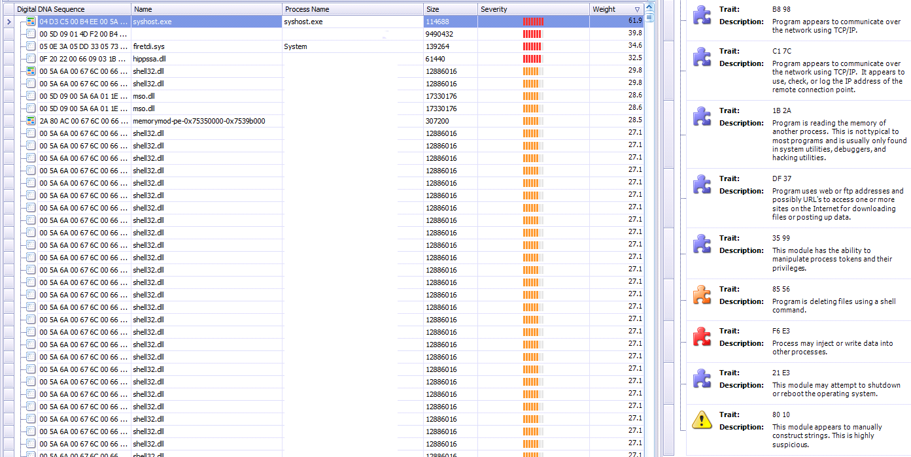
Responder Pro: DDNA

Slide 34
Responder Pro: DDNA

Slide 35
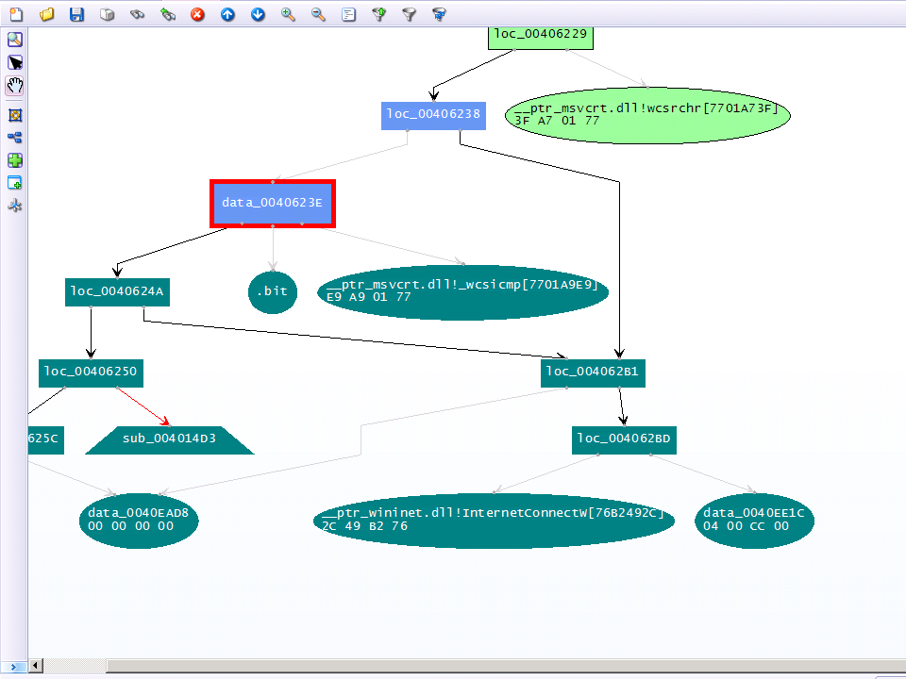
Responder Pro: Canvas

Slide 36
Volatility Framework
Open source tool
GPL licensed
Written in Python
Available for variety of platforms (Linux, Windows, Mac OS)
Can be automated; many contributed plugins
Supports analysis of memory dumps from various OSs
Windows, Linux, MacOS, Android
Both 32-bit and 64-bit versions
Command-line driven
Two (experimental) web GUIs

Slide 37
Google Rekall
Another open source tool
Supported by Google
Included as a part of GRR (Google Rapid Response) agent
Originally based on the code of Volatility
Shared commands
Different architectural concepts
Proof-of-concept GUI
Better workflows

Slide 38
Additional Important Tools
Strings
Both *nix and Windows
Extracts strings information from the file
Can be used in cooperation with Volatility/Rekall
Beware of text encoding! (ascii, utf-8, …)
Foremost
Forensic tool
Can extract various data files from an image (or process)
Images, executables, documents, …

Slide 39
Forensic analysis of RAM?
Are there any benefits?
Collecting forensic evidence
Executable images
PDF/Doc documents
Possible origin of the infection?
Images
URLs
Getting approximate timeline
Works better on servers (always online, higher uptime, way more RAM)

Slide 40
What to search for in Operating System?
Command&Control (C2) communication
Hidden processes
Process/DLL injection evidence
Non-standard/infamous binaries/mutexes
Open sockets and files
Registry records
Command-line history
Encryption keys!

Slide 41
Known Bad Mutexes
Conficker: .*-7 and .*-99
Sality.AA: Op1mutx9
Flystud.??: Hacker.com.cn_MUTEX
NetSky: 'D'r'o'p'p'e'd'S'k'y'N'e't'
Sality.W: u_joker_v3.06
Poison Ivy: )!VoqA.I4 (and 10 thousand others)
Koobface: 35fsdfsdfgfd5339

Slide 42
Known Good Processes/Locations
Process Name | Expected Path
lsass.exe | \windows\system32
services.exe | \windows\system32
csrss.exe | \windows\system32
explorer.exe | \windows
spoolsv.exe | \windows\system32
smss.exe | \windows\system32
svchost.exe | \windows\system32
iexplore.exe | \program files \program files (x86)
winlogon.exe | \windows\system32

Slide 43
Operational Security (OpSec)
Basics of OpSec
“Think before you act” mentality
Limited information sharing
Specifics of memory analysis
You can often upload dumped executables to VirusTotal
md5 of the process is different from the executable
This doesn’t apply for documents/HTML pages!
However, incomplete binaries still can infect your system!
Running in VM or other OS is recommended

Slide 44
Recommended Analysis Process
Use Internet! (Google, VirusTotal, …)
Make notes!
What OS is being analyzed? (imageinfo)
Network connections? (+ whois records, …)
Processes (hidden, odd, non-standard; timestamps, …)
Mutexes (+ files open)
Dump processes when needed (OpSec!)
Strings (URIs, C-like strings %s %d, domains, …)
Summarize your findings in final report

Slide 45
More information
Web pages of this course
https://dior.ics.muni.cz/~valor/pv204/
Additional resources
Public memory images for analysis
Reverse Engineering for Beginners (amazing PDF doc)
REMnux: All you need to start with RE
ContagioDump blog (for additional malware samples)

Slide 46
Answers & Questions
Thank you for your attention.

Slide 47
Lab

Slide 48
Lab Requirements
Oracle VirtualBox
And enough space on your hard drive (12 GB at least)
Volatility Framework
Mandiant Redline
Unix tools
strings, foremost
Your favorite text editor for notes
Javascript/PDF analysis tools

Slide 49
Recommended Analysis Process
Use Internet! (Google, VirusTotal, …)
Make notes!
What OS is being analyzed?
Network connections? (+ whois records, …)
Processes (hidden, odd, non-standard; timestamps, …)
Mutexes (+ files open)
Strings (URIs, C-like strings %s %d, domains, …)
…
Summarize your findings in final report

Slide 50
Volatility Framework – cheat sheet
psxview (search for hidden processes)
apihooks
driverscan
ssdt / driverirp / idt
connections / connscan (WinXP, active network connections)
netscan (Win7, opened network sockets and connections)
pslist / psscan (process listing from WinAPI vs. EPROCESS blocks)
malfind / ldrmodules (code injection + dump / DLL detection)
hivelist (registry lookup and parsing) / hashdump
handles / dlllist / filescan (filelist / DLL files / FILE_OBJECT handles)
cmdscan / consoles (cmd.exe history / console buffer)
shimcache (application compatibility info)
memdump / procmemdump / procexedump

Slide 51
Analysis: xp-infected.vmem
Recommended tools
Volatility, Rekall (or Redline)
Objectives:
Get familiar with memory of your first infected system

Slide 52
Analysis: win7_x64.vmem
Recommended tools
Volatility, Rekall (or Redline)
Objectives:
Get familiar with memory of Win7 x64 system
Can you see any differences from the previous sample?

Slide 53
Analysis: zeus.vmem
Recommended tools
Volatility, Rekall
Objectives:
Find suspicious network connections
Find process responsible for the network activity
Can you figure out what infections this

Slide 54
Analysis: zeus2x4.vmem
Recommended tools
Volatility, Rekall
Objectives:
Find suspicious network connections
Find process responsible for the network activity
Can you figure out what infections this
Can you dump the virus configuration?

Slide 55
Analysis: bob.vmem
Recommended tools
Volatility, Rekall, Foremost, Strings
Objectives:
Find suspicious network connections
Find process responsible for the network activity
Can you figure out what caused the infection?
Can you dump the initial source vector?
What known vulnerability (CVE) has been exploited?

Slide 56
More information
Web pages of this course
https://dior.ics.muni.cz/~valor/pv204/
Additional resources
Public memory images for analysis
Reverse Engineering for Beginners (amazing PDF doc)
REMnux: All you need to start with RE
ContagioDump blog (for additional malware samples)

Slide 57
Answers & Questions
Thank you for your attention.

