Slide 1
Quality assurance
Testing, Validation and stuff

Slide 2
Motivation
Why and to what purpose?
Lives or money can depend on it
Algorithms analysis is not enough
SW company needs to guarantee some quality to sell product

Slide 3
What is testing?
Testing goals?
Process used to identify quality of SW
SW Development Life Cycle(SDLC)
Black box vs white box testing

Slide 4
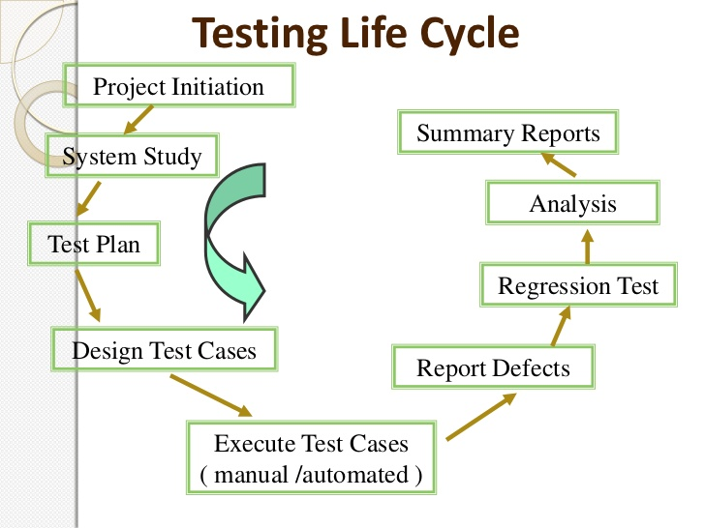
What is testing?
Testing life cycle

Slide 5
What is testing?
Testing of simple application
Small HW device
Basic operations like calculator (+,%,-,x)
Connection to wifi (provides advanced options)
Keyboard for input
Save result with date and time

Slide 6
What is testing?
Testing of simple application
Small HW device
Basic operations like calculator (+,%,-,x)
Connection to wifi (provides advanced options)
Keyboard for input
Save result with date and time
Chceck inputs, characters, translation, operator priority
Memory overflow, display overflow, memory damage
Connection: sw/hw failure, server offline, „incompatible“ result
Keyboard input, comunication between keyboard and system
Date/time, time zones, summer/winter time, leap year
Check for succesful save, load, export, handling operations with floats

Slide 7
What is testing?
Or how much is enough?
Finding defects
Gaining conidence about level of quality
Providing information for decision-making
Prevent defects

Slide 8
What is testing?
Seven testing principles
Testing shows presence of defects
Exhaustive testing is impossible
Early testing
Defect clustering
Pesticide paradox
Testing is context dependent
Absence-of-error fallacy

Slide 9
Psychology of testing
Seven testing principles
Mindset of tester is different from developers
Independent view of QA

Slide 10
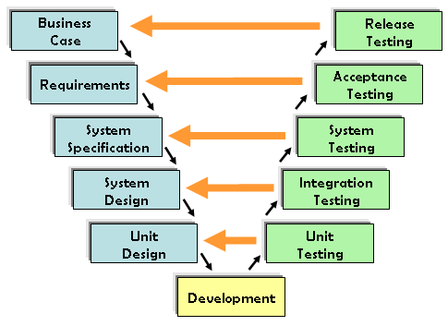
Testing in general
Unit or component testing
Integration testing
System testing
Acceptance testing
Regression testing
Smoak tests, sanity test

Slide 11
Testing in agile development
What to do, when testing methods do not fit in my agile development policy?
Why not agile testing?

Slide 12
Developer testing – why?
Or testing against all rules
Low testing capacity
Low quality of development
Long task life cycle
Better understanding of task solutions

Slide 13
Developer testing – how?
Or testing against all rules
Test preparations early of sprint
Testing distributed to developers
Test review
Retest

Slide 14
Developer testing – now
Or testing against all rules
All tasks are proprly tested
QAs are not digged into work
Tasks are closed much faster
Basic end-to-end testing
Quality is developer dependent
Not prepared tests delay development

Slide 15
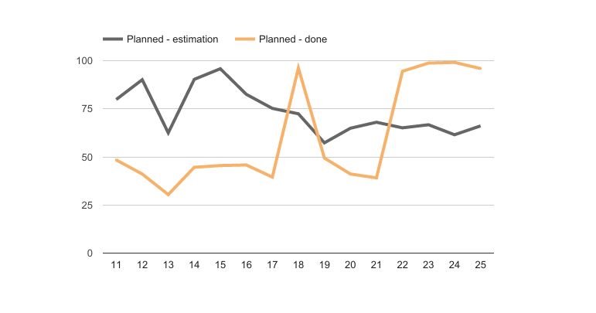
Developer testing – how?
Or testing against all rules

Slide 16
Thanks for your attention
Peter strieška – QA engineer in Y Soft

