Slide 1
SSME, Masaryk Uni ., Brno
Intercultural Management
Derek Mainwaring
ESIEE Paris May 2017
Notes:
1

Slide 2
Course Objectives:
To give participants a « toolbox of ideas and concepts » for living and working in a multicultural context
To make participants aware of their own cultural paradigm(s)
To make participants aware of their own preferred work style(s)
To make participants aware of the « soft skills » needed in multicultural team mgt.
To give some insights into particular cultures/environments - snapshots

Slide 3
CULTURAL AWARENESS
Doing something familiar (signing your name) in an unfamiliar way
Seeing a familar thing (your signature) from an unfamiliar angle
Feeling delighted / amused / uncomfortable / strange / irritated / unhappy ……………
with the unfamiliar object/activity
Notes:
3

Slide 4
Introductory comments
7 images to make you think about
culture……………..and its influence on our lives

Slide 5
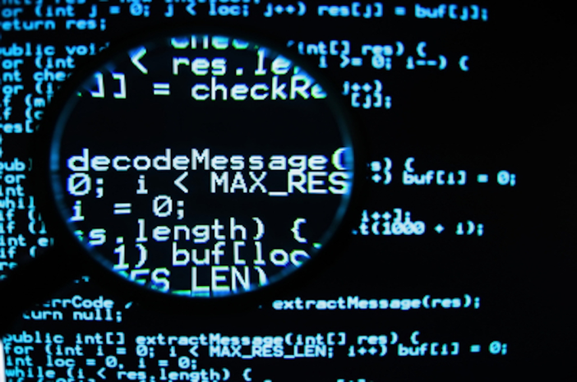
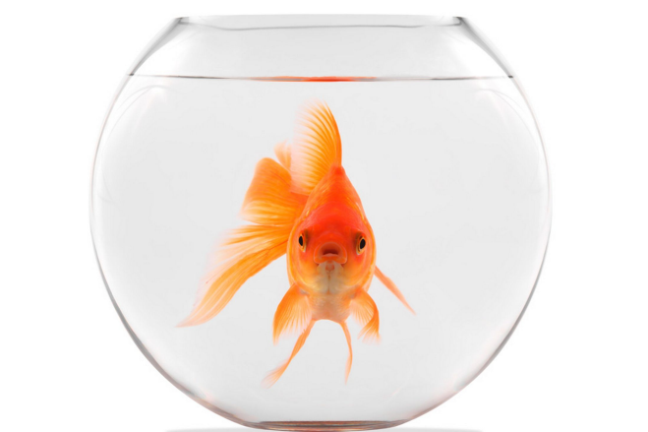

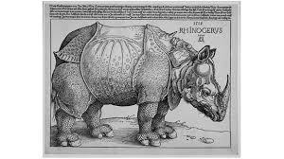

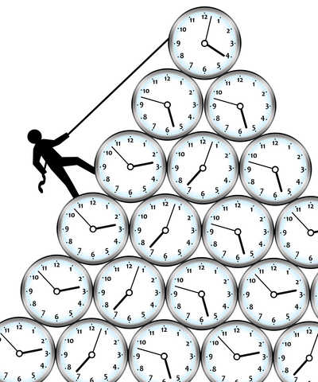
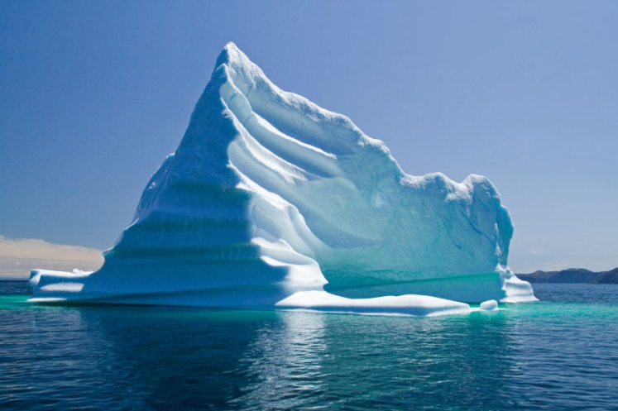

7 images of culture…

Slide 6
Image 1
Culture is…
…the software of the mind
Hofstede, 1981
Notes:
6

Slide 7
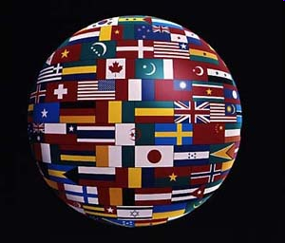
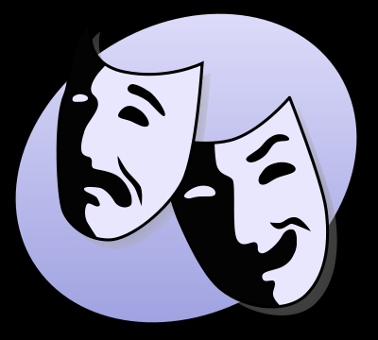
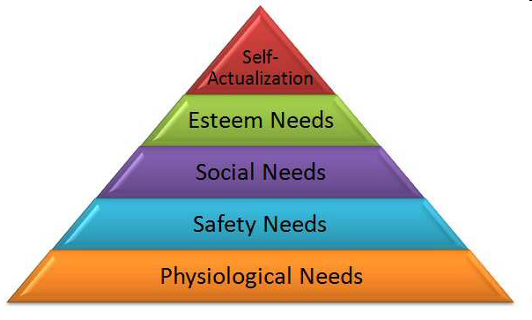
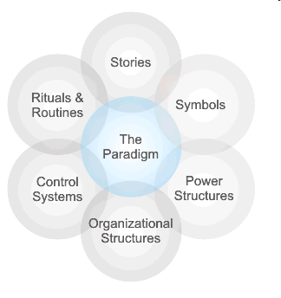
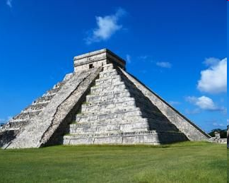
Some images – reflect…….

Slide 8
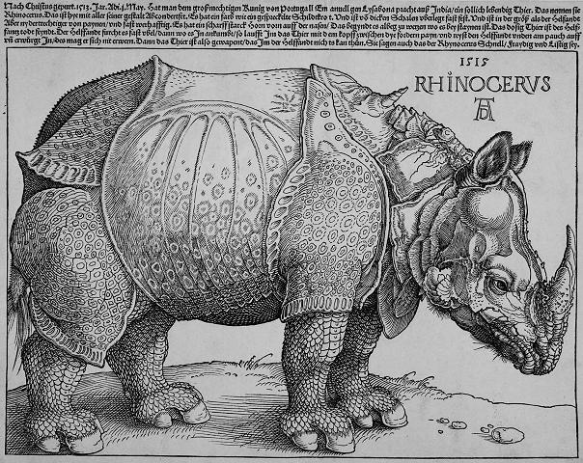
Image 2 : Durer’s rhinoceros, 1515
PERCEPTION
Notes:
8

Slide 9
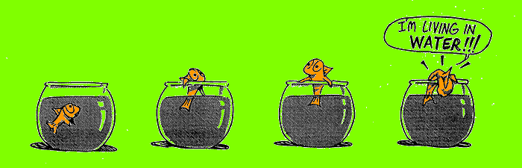
Culture is what water is to a fish
Image 3: the goldfish
…it takes it for granted until it is out of its environment
Notes:
9

Slide 10
Image 4 - Our identity: a flower
We have many identities, not just national
But our identity is how we integrate the fact that we belong to many groups and that our belonging to groups evolves over time
So identity is a process, NOT a fixed object
Notes:
10

Slide 11



Derek’s identity
Liverpudlian
English
Parent
Partner
Postcard collector
Music lover
Etc
Irish/Welsh
.
Parisian
Teacher
Notes:
11

Slide 12
Clusters of identity
Nation region
locality
Academic
background
Metropolitan
suburban
provincial
Organisation
enterprise
Home- family
independent
Religion
moral code
Sport hobby
interests
Etc.,etc.!
Notes:
12

Slide 13
Image 5 – the stick man
How do we perceive culture?
How does contact with a new culture affect us?
3 zones
Notes:
13

Slide 14
3 zones
cerebral
affective
visceral
…and these are ALL
normal!
Notes:
14

Slide 15
Image 6: the time curve...
-
Our reaction to a new (cultural) experience varies over time
honeymoon period
Valley of despair
Time of contact in new culture
Notes:
15

Slide 16
Image 7 – the Iceberg
Many aspects of « culture » are not visible, evident or conscious
Metaphor: the iceberg

Slide 17
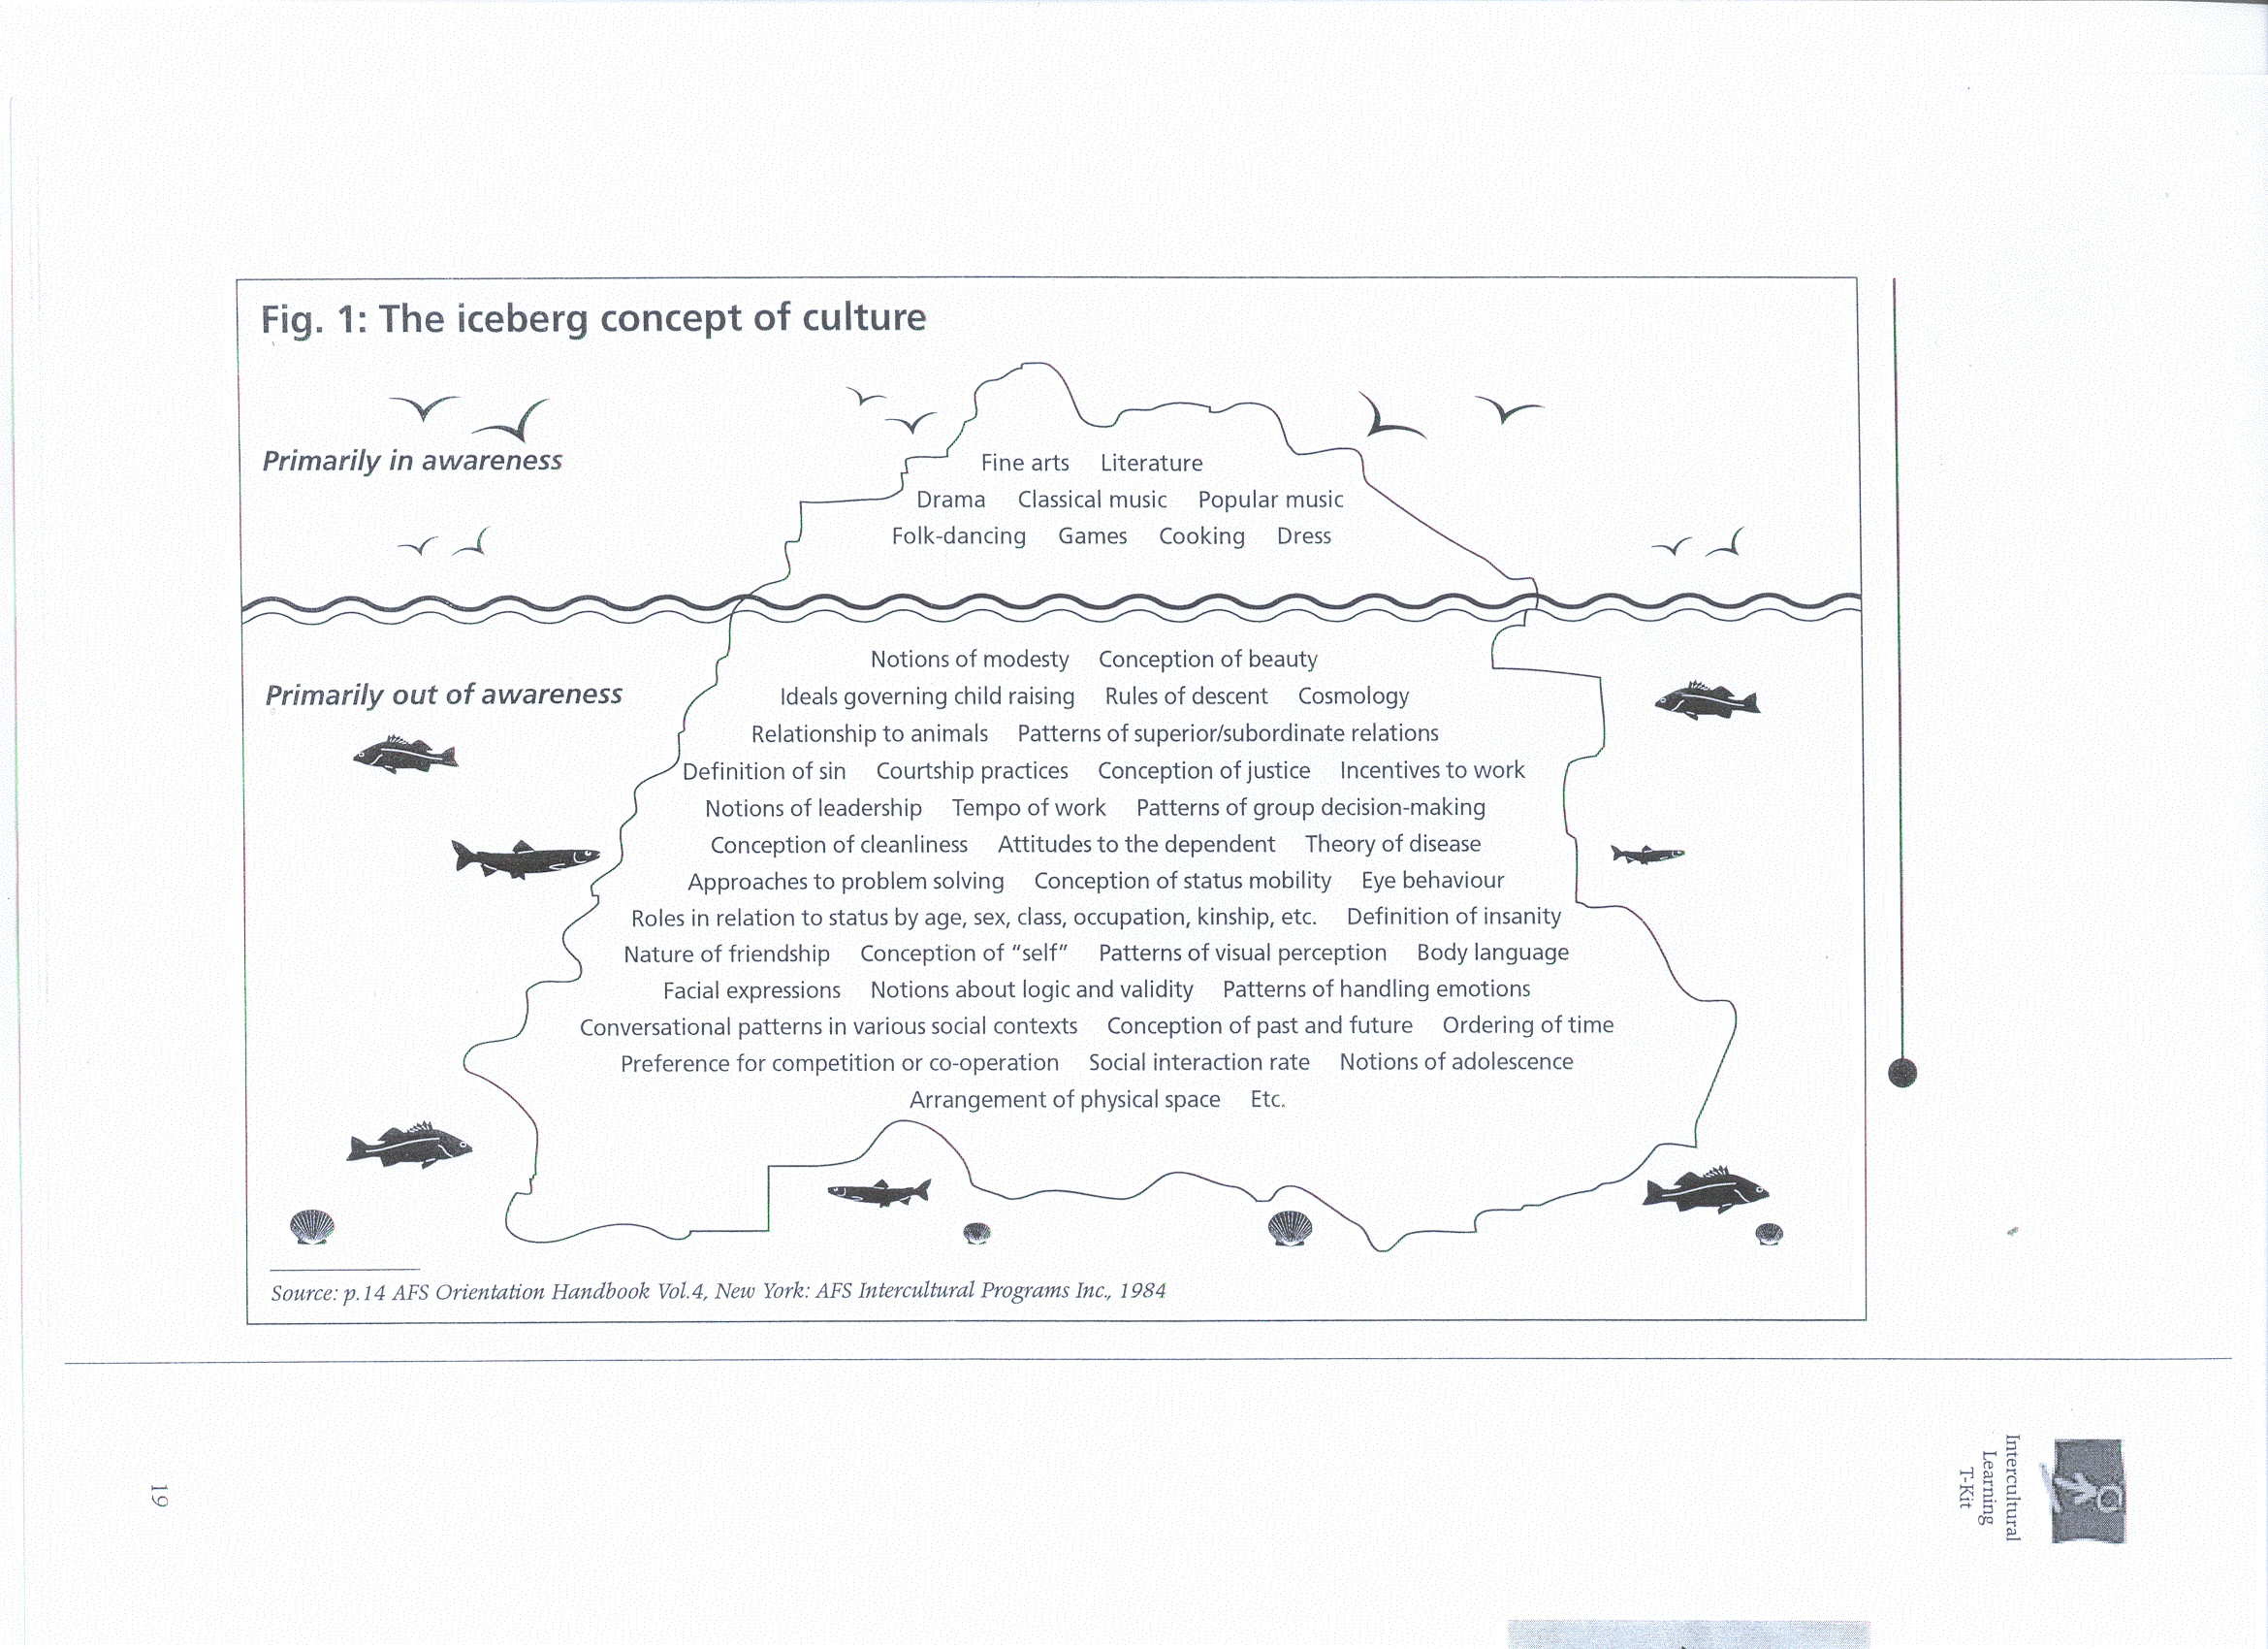
Notes:
17

Slide 18
Review of 7 images
1. Software
2. Rhino
3. Goldfish
4. Flower
5. Stick man - Head, heart & guts!
6. Time curve
7. Iceberg

Slide 19



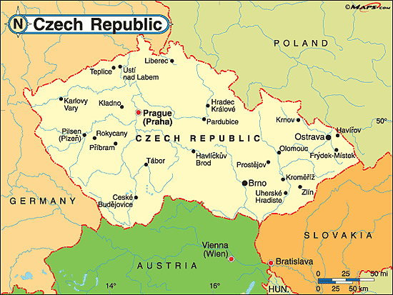



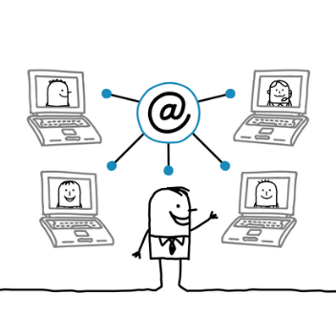
Intercultural Management: contexts

Slide 20
Contexts
Single-Track
Multi-Track
Short-term: « Business trip » Long-term: Expatriation | Multi-national team, multi-national project, Cross-functional team
Transfer of procedure (HR, IS etc.) to « offshore » location | Global organisation multi-national multi-cultural multi-functional - matrix
Individual
i.e. YOU!
Organisational

Slide 21
Keywords
Culture
Teamwork
Management

Slide 22
“The Globally Competent Engineer”
Working effectively with people who define problems differently
Title of article, Journal of Engineering Education,
April 2006 – Downey, Lucena et al.
Example: deductive/inductive pb.solving

Slide 23

Example: Main reasons why American managers fail on foreign assignments
The manager’s spouse cannot adjust to new physical or cultural surroundings
The manager cannot adapt to new physical or cultural surroundings
Family problems
The manager is emotionally immature
The manager cannot cope with foreign duties
The manager is not technically competent
The manager lacks the proper motivation for foreign assignments
McGraw-Hill
© 2004 The McGraw-Hill Companies, Inc. All rights reserved.

Slide 24
The Cultural Environment
A few general ideas to start with…….
All about working and living with people….
Culture as software
Perceptions
Feelings
Adapting
Awareness / Competence

Slide 25
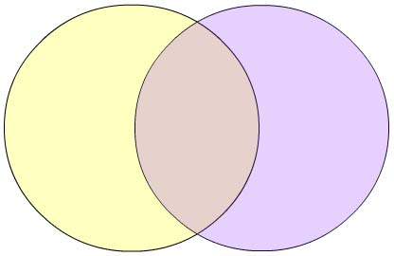

Cultural differences & similarities
A
B
x
Y
Y
x
Y
x
Y
x

Slide 26
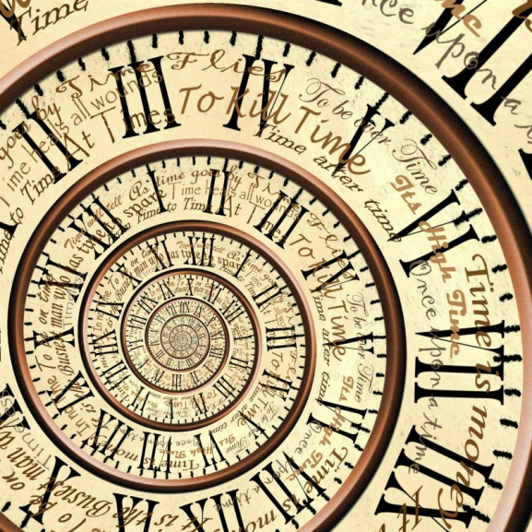
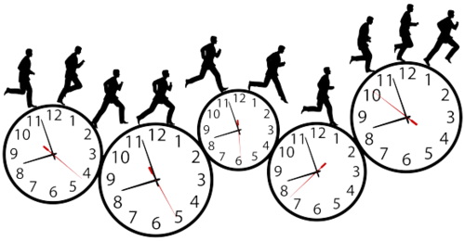


Concepts & competencies…..Time

Slide 27
Space, Time and Context Across Cultures
The work of E.T.Hall
What is the appropriate personal distance?
Monochronic time
(clock time, sequential, linear)
Polychronic time
(relational time, simultaneous activities, circular)
Low & High Context Communication
Notes:
27

Slide 28
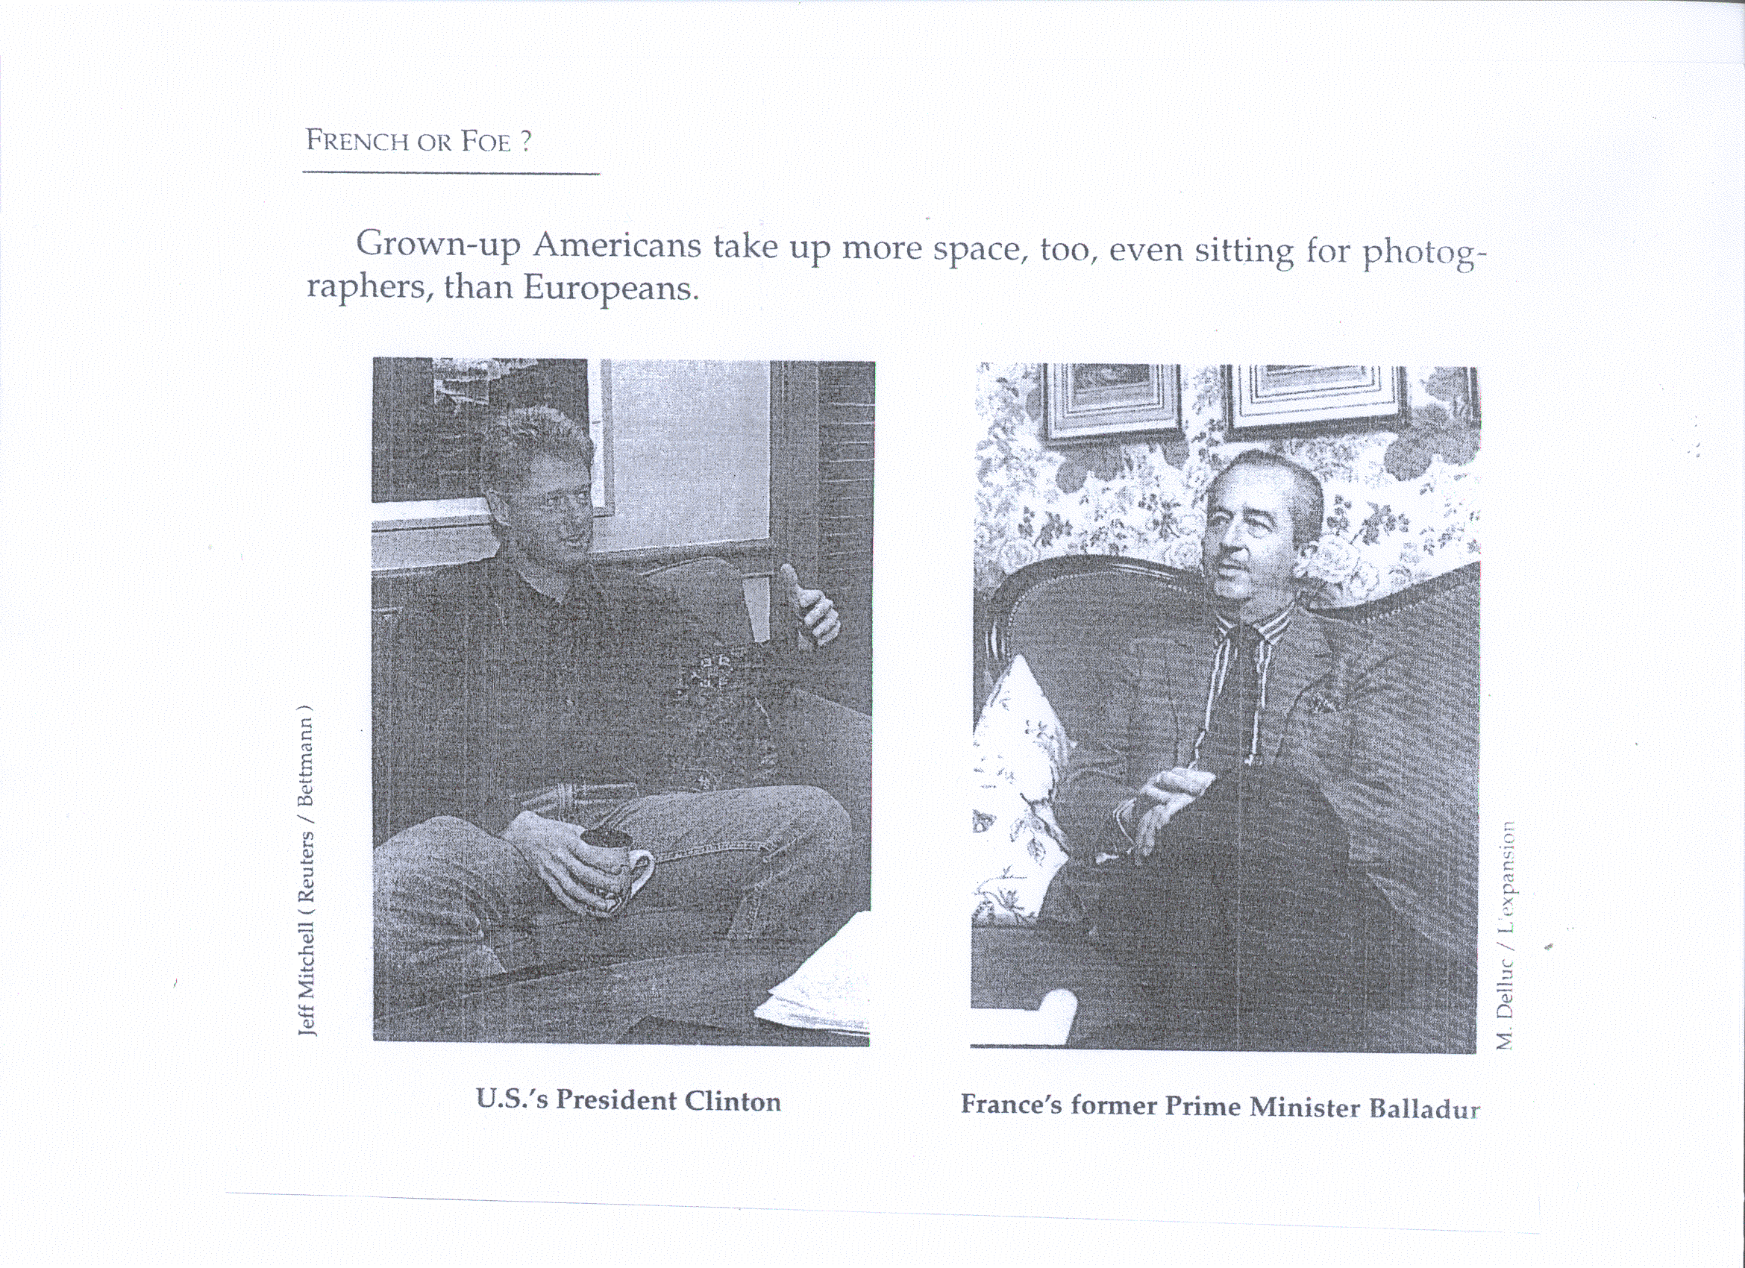
Personal space……………
Notes:
28

Slide 29
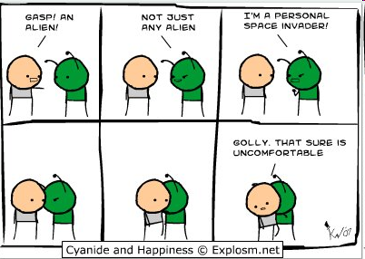
Personal space

Slide 30
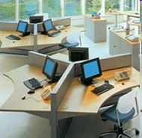
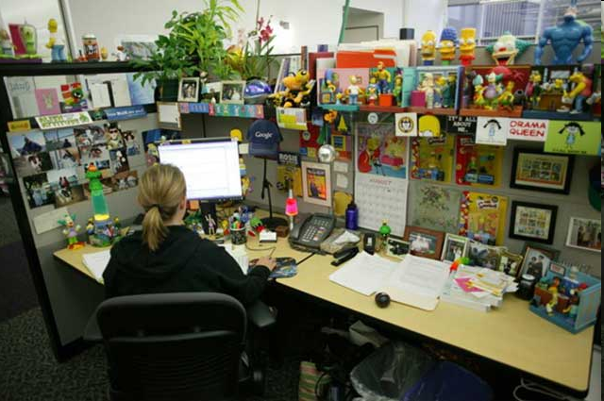
Work space

Slide 31
Territoriality – Hall: Proxemics
High territoriality = property & boundaries are important
  Ownership of material things
  Security of property
  Developed concept of « mine »
  Feel comfortable in « own » space
  High territoriality often = low context

Slide 32
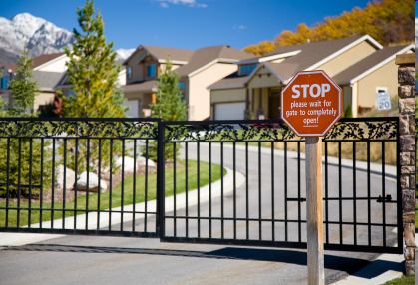
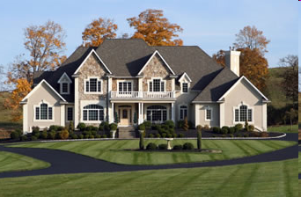
High territoriality

Slide 33
Low territoriality
Ownership of space and boundaries less important
Share territory and objects
Sense of « stealing » less developed

Slide 34
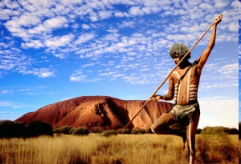
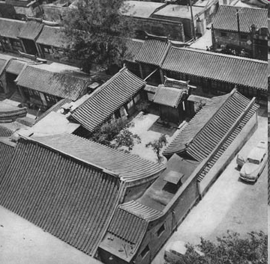
Low territoriality

Slide 35
MONOCHRONIC
Does one thing at a time
Makes time-based commitments
Sticks to deadlines
Adheres to plans
Emphasises promptness
Is committed to job in hand
Is used to short-term relationships
Is low context, needs information

Slide 36
POLYCHRONIC
Does many things at once
Considers time commitments as flexible
Is committed to relationships
Is easily distracted
Tends to form long-term relationships
Changes plans frequently
Is high context, interprets situation

Slide 37
Communication & context
Low & high context
Direct & indirect communication styles
Self-enhancement or effacement
Person-oriented or status-oriented

Slide 38
Direct Communication = Low Context
        C O N T E X T
Verbal
Non-Verbal
Meaning is in the verbal message
Seek clarity of expression
“Speaking one’s mind”
Face-to-face communication
-> BUT can be perceived as pushy, unsophisticated or aggressive by those with less direct communication style
Notes:
38

Slide 39
Indirect Communication = High Context
        C O N T E X T
Verbal
Non-Verbal
Meaning is in the context
Vague and ambiguous language
Many things are left “unsaid”
→ BUT can be perceived as deceiving by individuals
who prefer a more direct communication style
Notes:
39

Slide 40
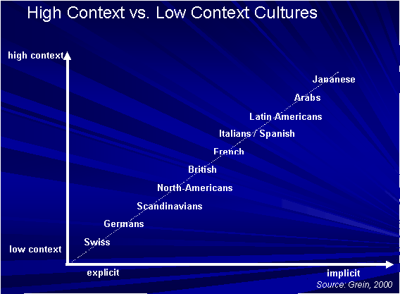
Notes:
40

