Slide 1
Masaryk Uni, Brno
INTERCULTURAL MANAGEMENT 3
Further conceptual input:
More key concepts
Derek Mainwaring
Notes:
1

Slide 2
Debate
Some people say that cross-cultural studies are just stereotyping people and cultures……………………….
……well let’s look at the notion of stereotypes……and the idea that « everybody’s the same the world over »…

Slide 3
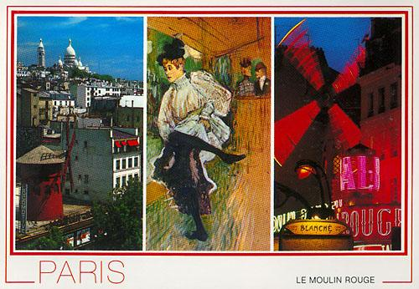
Part One: Stereotypes
Notes:
3

Slide 4

Heaven is a place where….
The chefs are….French
The mechanics are….German
The police are….British
The lovers are….Italian
And everything is organisd by….the Swiss

Slide 5

Hell is a place where….
The chefs are….
The mechanics are….
The lovers are….
The police are….
And everything is organised by….

Slide 6
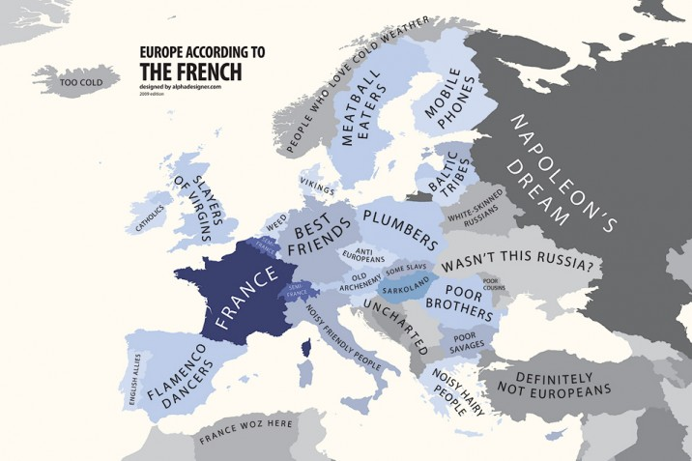
Stereotypes
http://alphadesigner.com/art-store/europe-according-to-france-print/

Slide 7
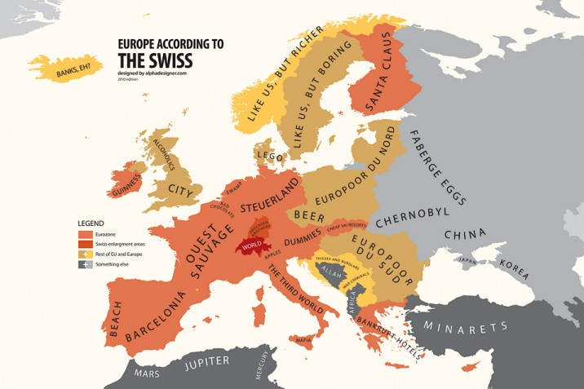
Stereotypes
http://alphadesigner.com/art-store/europe-according-to-switzerland-print/

Slide 8
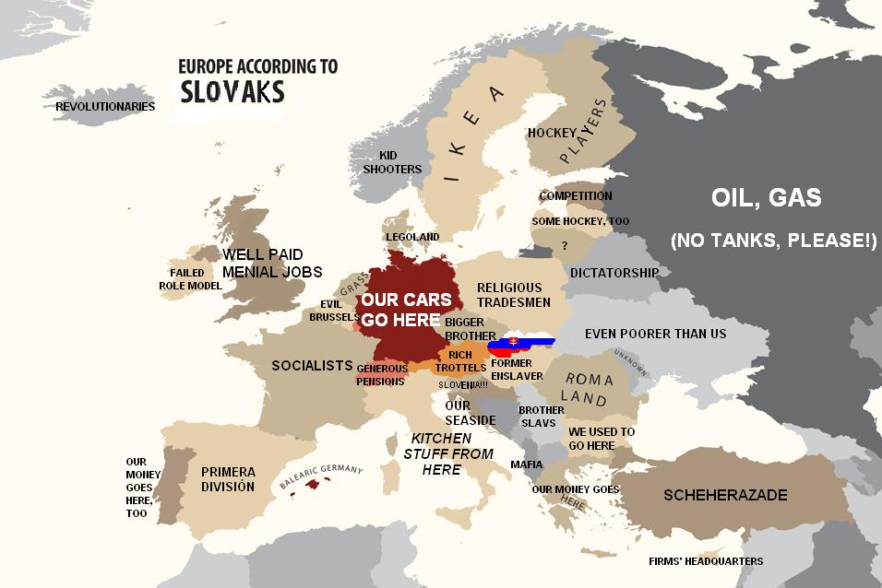
Stereotypes

Slide 9
So, what can we say about Stereotypes?
Stereotypes are inevitable ……
…to help classify or organise information
fruits are sweet, Scandinavians have blonde hair
…to help explain the unusual/different and reassure myself
what a strange way to conduct a meeting!
…to deal with uncertainty
it must be English humour!
Notes:
9

Slide 10
Stereotypes are inevitable ……
to anticipate the behaviour of others
kids always like chocolate
We must be on time for the German visitors
…to define oneself, in opposition to others
These youngsters can’t live without cellphones
I don’t need to be on time , she’s Costa Rican
Notes:
10

Slide 11
BUT they are dangerous because…
…they simplify and over-generalise
tomatoes and avocados are fruit too
Scandinavians – blonde hair – Bjork?
…they confirm prejudices
See, I told you so, they’re all the same
…they are ethnocentric and deny the value of otherness
Meetings are always like this here – pointless!
Notes:
11

Slide 12
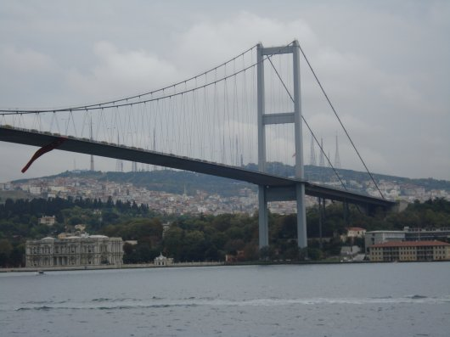
Example: Where is this?

Slide 13
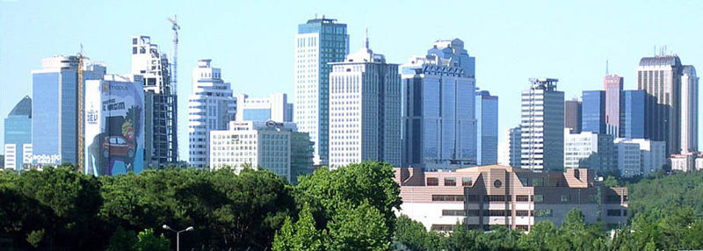
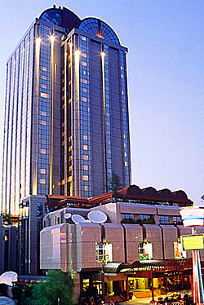
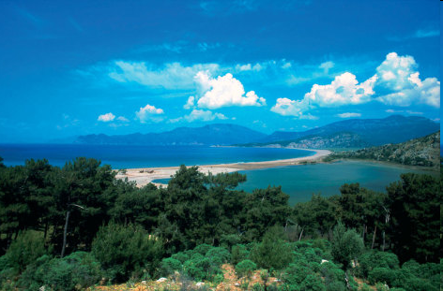
Where is this?

Slide 14
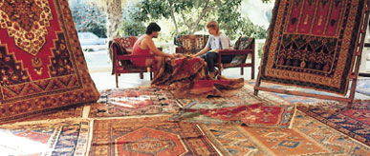
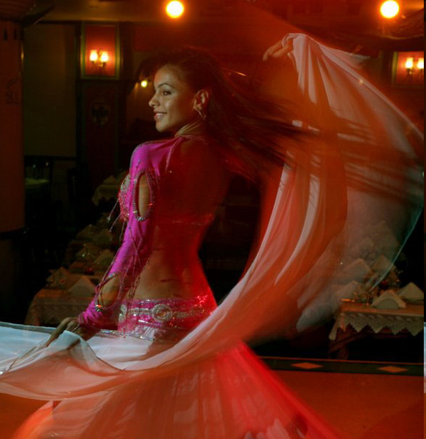
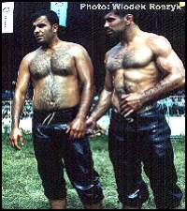
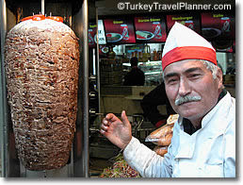
Where is this?

Slide 15
So, how to deal with stereotypes
Recognise them!
Analyse them - there may be some « truth » in them, however incomplete
Challenge them – esp. the « All x are y » type
But…. accept that they exist!
Move on……………………..
Notes:
15

Slide 16
Strategy: the ORID learning loop
OBSERVE
DEVELOP
REFLECT
INVESTIGATE
Based on Mattock,1999
DM, 2005
Notes:
16

Slide 17
Example
OBSERVE – Japanese gift wrapping, wrapping can be more beautiful than gift
REFLECT – Importance of appearances… Ceremony/ritual… Imp. of paper
INVESTIGATE – Japan is a very crowded island – no room for trees
DEVELOP – If paper is precious this adds to the ritual imp. of business cards
Notes:
17

Slide 18
Further examples 1
Learning about others: observations
Iceland – road-building gangs composed almost entirely of schoolchildren
reflect…..investigate….develop….
Guatemala – Mayan infants always have head covered…………..
Notes:
18

Slide 19
Further examples 2
Learning about self when in contact with others: example: a Brit in France
Lunch-time…… compromise
Meetings…..adapt
Food culture…..integrate

Slide 20
CULTURAL AWARENESS vs. COMPETENCE
Awareness
Competence
Intercultural Management 1

Slide 21
Intercultural Awareness
See/understand/explain differences
Know about cultural difference and…
Anticipate potential problems
Self-awareness
Essentially this is knowledge
Intercultural Management 1
Notes:
21

Slide 22
Intercultural Competence
Intercultural mindset: awareness of cultural diversity (expressed through different communication styles)
Plus…..
Intercultural skill set: knowledge of cultural frameworks and ways to work with them – language skills, flexibility, openness, resilience, autonomy, transparency, etc.
Plus….
Intercultural sensitivity: ability to experience cultural difference – empathy
Essentially these are skills
Intercultural Management 1
Notes:
22

Slide 23
CULTURAL AWARENESS vs. COMPETENCE
See but don’t
empathise
Awareness
Just do it!
Competence
Intercultural Management 1
Notes:
23
Notice that all the descriptions mentioned friendliness.

Slide 24
But BEWARE
Cultural relativism!!!!
You can « excuse » everything by saying:
« oh well, it’s cultural »
Examples?
Intercultural Management 1

Slide 25
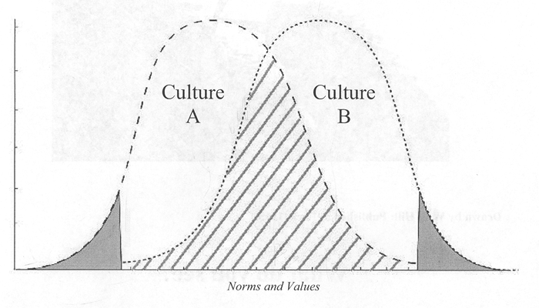
Reminder: Social sciences work with generalisations/tendencies
Notes:
25

Slide 26
Remember the Debate
We’ve looked at the « inevitability » of some forms of stereotyping…
But
…what about the idea that:
« everybody’s the same the world over »…???

Slide 27
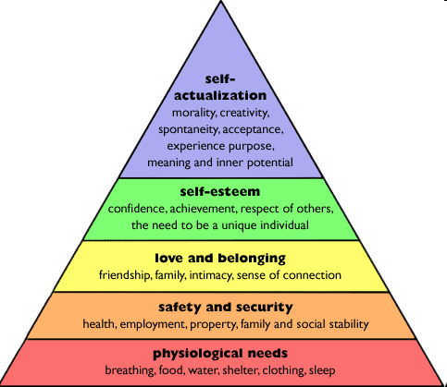
Maslow’s pyramid
All humans have the same needs….
So, yes we are all the same
BUT….

Slide 28

Cultural similarities and differences
The way we express and recognise those needs is sometimes different….
Sunday on the street
Germany
China

Slide 29

Socialising
Germany
China

Slide 30

Giving your opinion
Germany
China

Slide 31
Concepts outlined by Trompenaars
Universal vs. Particular
Individual vs. Collective
Neutral vs. Emotional
Specific vs. Diffuse
Achievement vs. Ascription
Internal vs. External control
Notes:
31

Slide 32
Universal vs. Particular
Rules
Trust = one who honours word or contract
Only one truth or reality
A deal is a deal
« We can’t make exceptions »
Relationships
Trust = one who honours changing sutuations
Several perspectives on reality
Relationships evolve
« He/she is a special case »
Notes:
32

Slide 33

Examples
Germany: the red traffic light
The notion & tolerance of « cheating »
Notes:
33

Slide 34

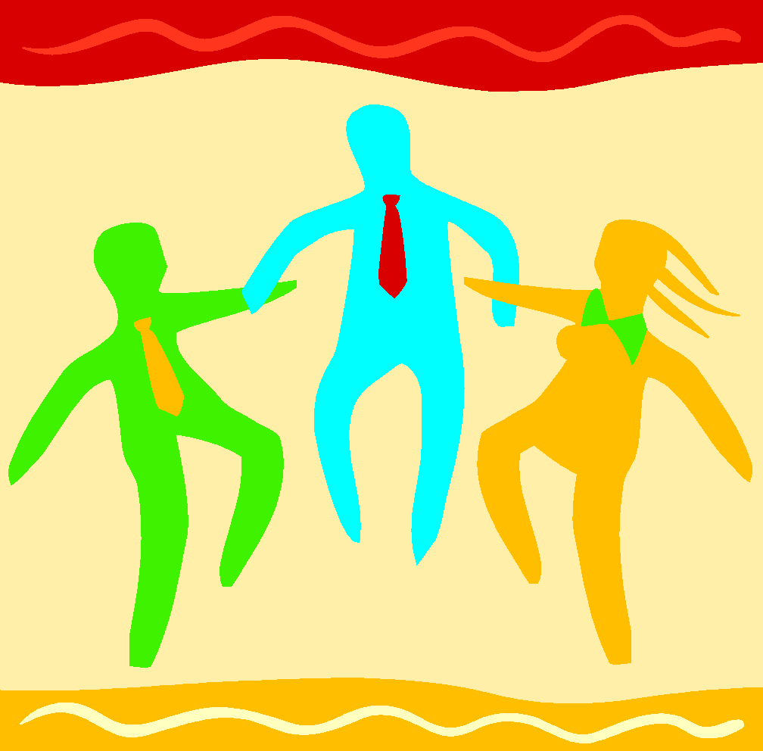
“I” vs “We” Cultures
Individual vs. Collective
Versus
“I identity; Individual goals
Ties between individuals are loose
“The American dream” “Amer-I-can”
“We” identity; group goals
Integrated into strong, cohesive
groups
“The pig that squeals goes to market”
Notes:
34

Slide 35

“I” versus “We” Cultures
Examples
United States
Australia
United Kingdom
Canada
Netherlands
New Zealand
Sweden
France
Germany
Examples
Guatemala
Ecuador
Panama
Indonesia
Pakistan
Taiwan
China
Japan
West/East African countries
Notes:
35

Slide 36
Neutral vs Emotional
Do not reveal what they are thinking/feeling
Cool and self-possessed conduct admired
Physical contact, gestures, expressions are limited
Reveal thoughts & feelings verbally & non-verbally
Heated, vital, animated conduct admired
Touching, gesturing & dramatic expressions

Slide 37

Emotionally Restrained
Communication Style
Emotions are discredited as unprofessional
Trust is developed and credibility developed through
emotional suppression
Sensitive to hurting feelings of others

Slide 38
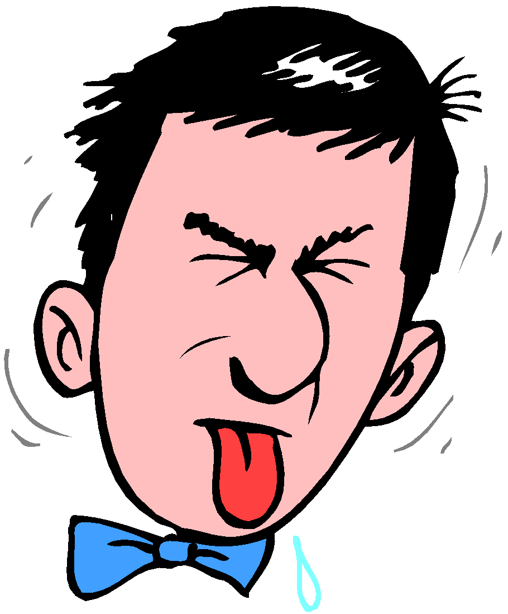
Emotionally Expressive
Communication Style
Emotions are an indicator of the importance of the matter
Trust and emotional commitment is developed and
credibility established through emotions

Slide 39
Verbal Styles 1
a.
b.
a.
b.
a.
b.

Slide 40
Verbal Styles 2
Self-effacement
Emphasizes the importance of humbling oneself
Displays the use of self-deprecation concerning one’s efforts or performance
Ex: UK
Self-enhancement
Emphasizes the importance of one’s accomplishments and achievements
Ex: USA
Notes:
40

Slide 41
Specific vs. Diffuse
Direct communication
Role-dependent behaviour
Public & private kept separate
Management by objectives (MbO)
Indirect comm’n.
Person or context dependent behaviour
Public & private interact
Management by process (e.g. TQM)
Notes:
41

Slide 42
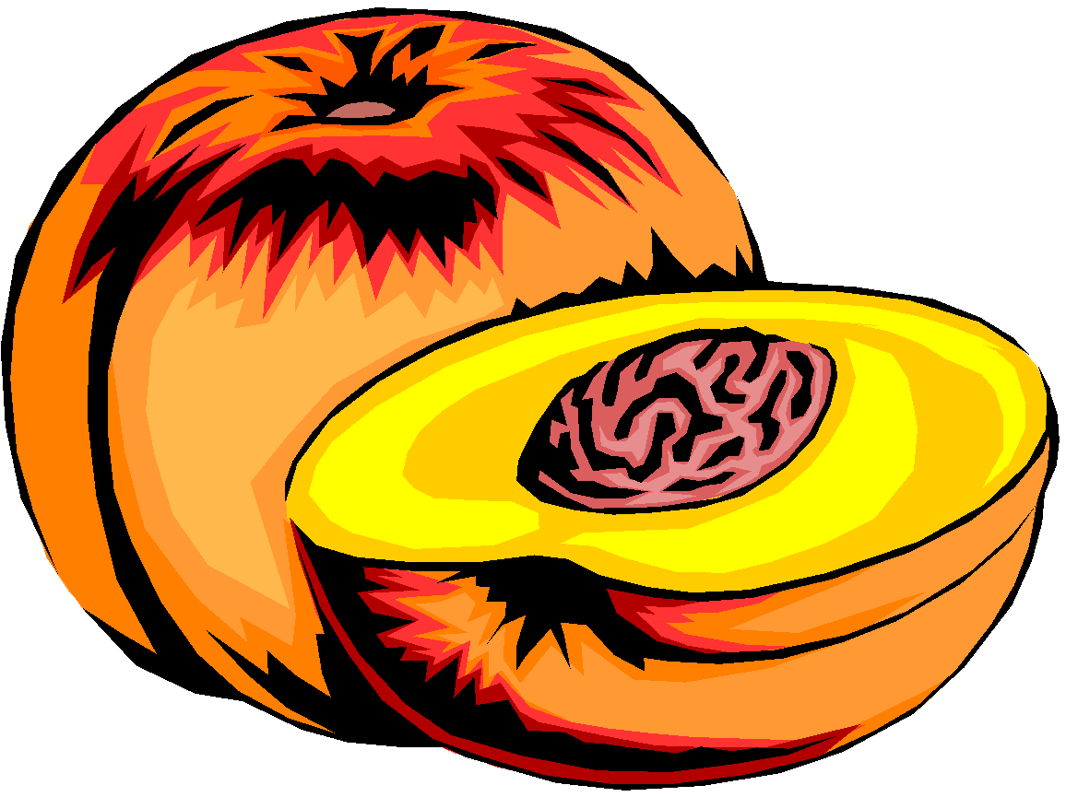

Public Versus Private Space, Communication, and Interaction
United States
Many other countries
Notes:
42

Slide 43
Lewin’s circles
Private
kitchen
Private
car
Golf club
Many activities in « public » sphere
Many activities in « private » sphere
Notes:
43

Slide 44
Public and Private Types
public
private
private
Discomfort Zone
Notes:
44

Slide 45
Verbal Styles 3
Person-oriented
Role not important
Informality – no apparent link between appearance and status
Individual-centered
Verbal style less indicative of competence
Status-oriented
Role-centered – WHO you are
Formality – in dress, speech codes (tu/vous, Du/Sie etc.), titles (Herr Doktor, Doktor)
Emphasizes hierarchy and deference to authority
Use of proper verbal style (context-dependent)
Notes:
45

Slide 46
Achievement vs Ascription
Respect based on knowledge & skills
Skills or experience-based CV
Judged by what done
- accomplishments
Performance related pay effective
Respect based on seniority
Background or title-based CV
Judged by status (gender, age, connections)
Top-down rewards effective
Notes:
46

Slide 47
The interesting case of France
Achievement-oriented to a certain level
Entrance to selective education on merit
The best educational institutions are state-owned
Ascription-oriented thereafter
« X-Mines » still opens doors
CV –it’s not so much what you have done but which school you went to.
Notes:
47

Slide 48
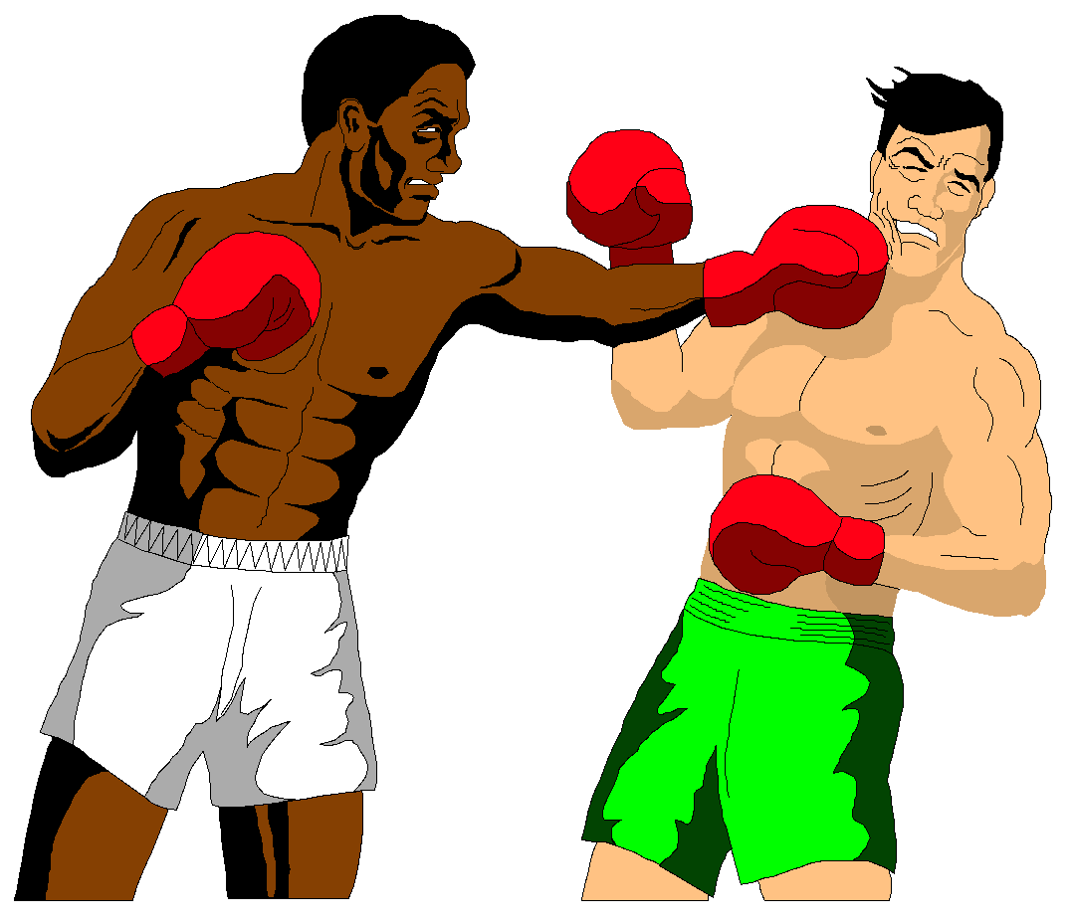
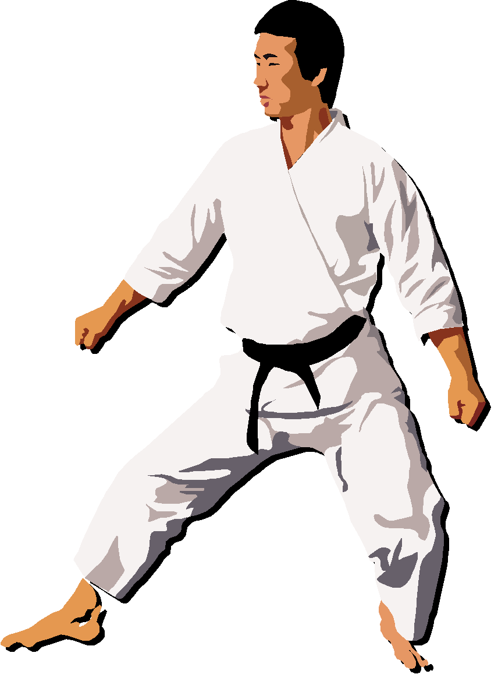
Relationship to Nature:
Internal versus External Control
External Control
Nature as an organism
Subjugation to nature
Internal Control
Nature as a mechanism
Dominance over nature
Notes:
48

Slide 49
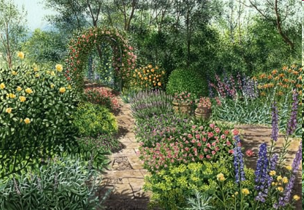
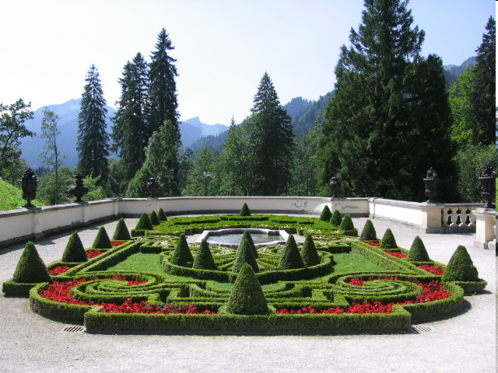
Nature: the garden
French garden
English garden

Slide 50
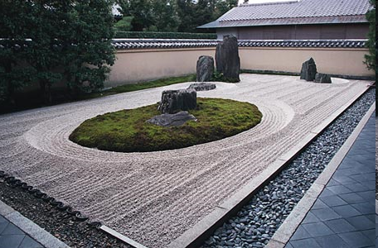
Japanese Zen garden

Slide 51
Internal versus External Control
What happens to me is my own doing. Success = being in control
OR
Things can be controlled from the outside. Success = being in harmony

Slide 52


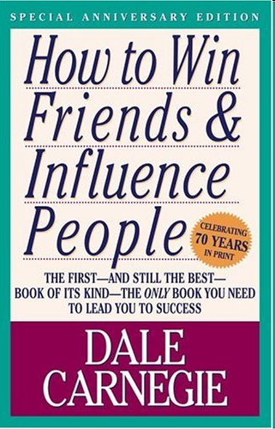
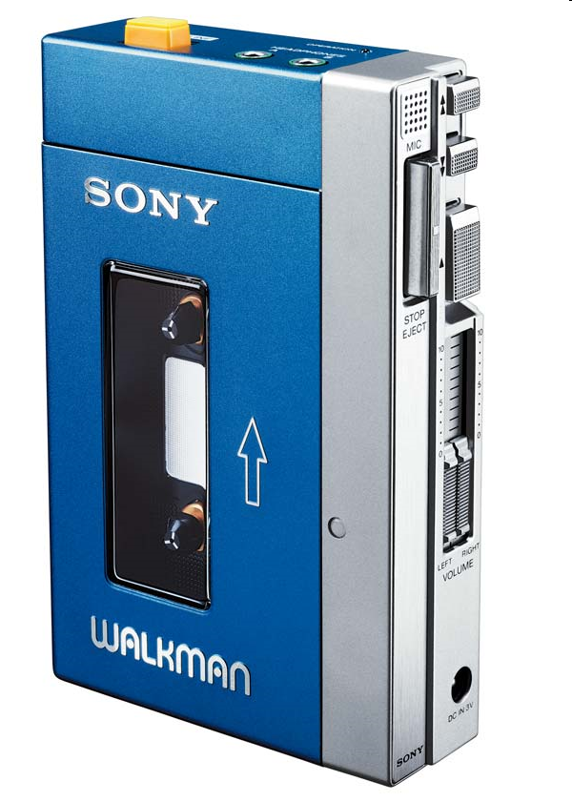
Internal versus External Control

Slide 53
Some Values U.S. Americans Live By
I am important and
have control over my
environment
Task/action orientation
Friendly and informal
relationships
Initiative
Independence
Achievement
Linear time orientation
Present Future
Problem-solving attitude
Change is positive
Rules

Slide 54
Bennett’s model of Intercultural sensitivity (1993)
INTEGRATION
6 stages:
ADAPTATION
ACCEPTANCE
IMITATION
DEFENCE
DENIAL

