Slide 1
Software-defined networks (SDN)
PA160: Net-Centric Computing II.
Tomáš Rebok
Institute of Computer Science Masaryk University
rebok@ics.muni.cz

Slide 2
Motivation

Slide 3
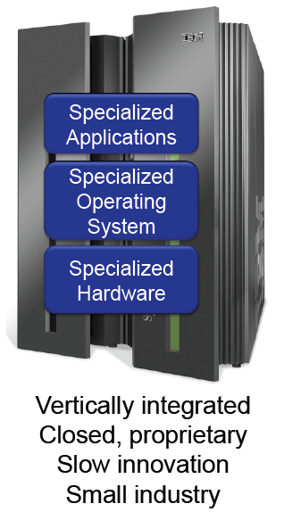
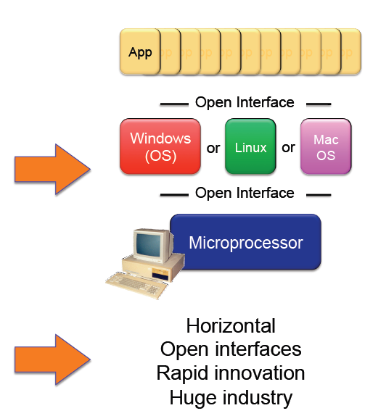
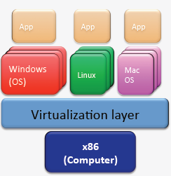

Traditional Computing vs Modern Computing

Slide 4
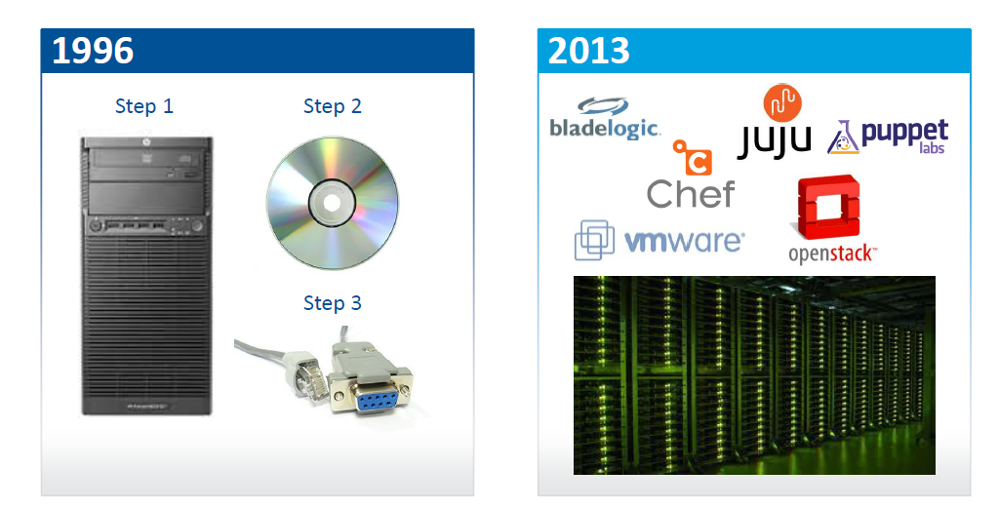
Traditional vs Modern Computing Provisioning Methods
Source: Adopted from Transforming the Network With Open SDN by Big Switch Network

Slide 5
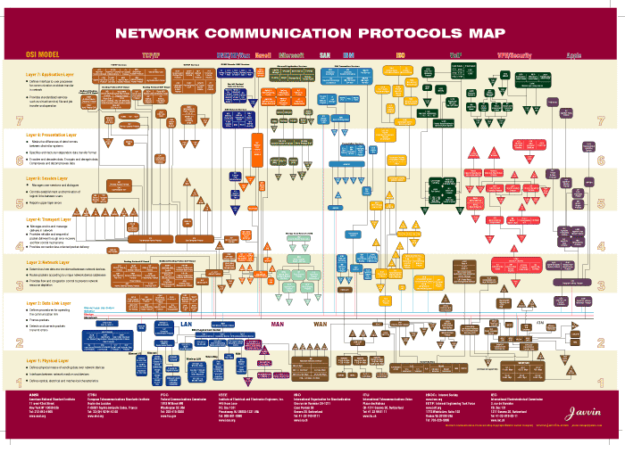
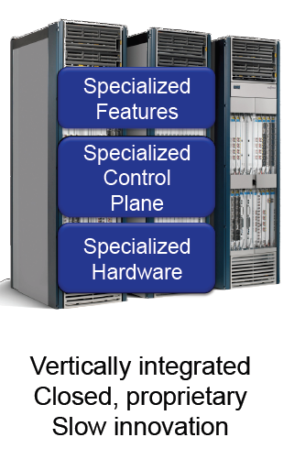
Modern Networking Complexity
Ref: Javvin

Slide 6
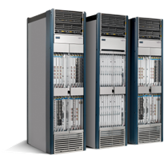

The Ossified Network
Routing, management, mobility management,
access control, VPNs, …
Feature
Feature
Million of lines
of source code
6000+ RFCs
Barrier to entry
Operating
System
Specialized Packet Forwarding Hardware
Billions of gates
Bloated
Power Hungry
Many complex functions baked into the infrastructure
    OSPF, BGP, multicast, differentiated services,
    Traffic Engineering, NAT, firewalls, MPLS, redundant layers, …
An industry with a “mainframe-mentality”, reluctant to change
6
Notes:
6

Slide 7
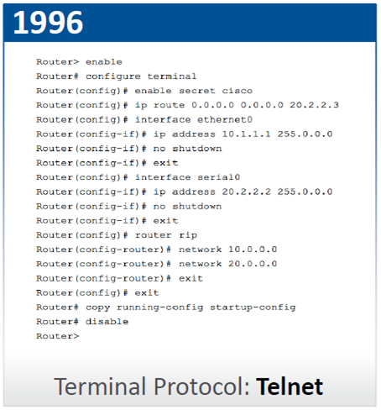
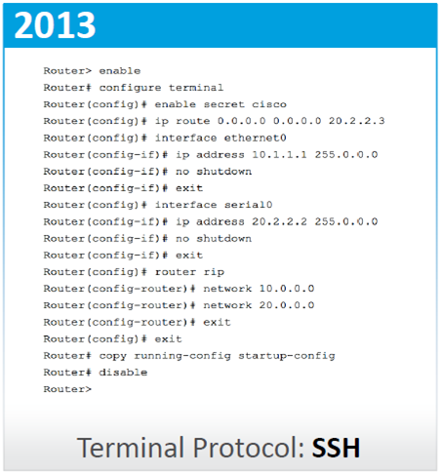
Traditional vs Modern Networking Provisioning Methods
Source: Adopted from Transforming the Network With Open SDN by Big Switch Network

Slide 8
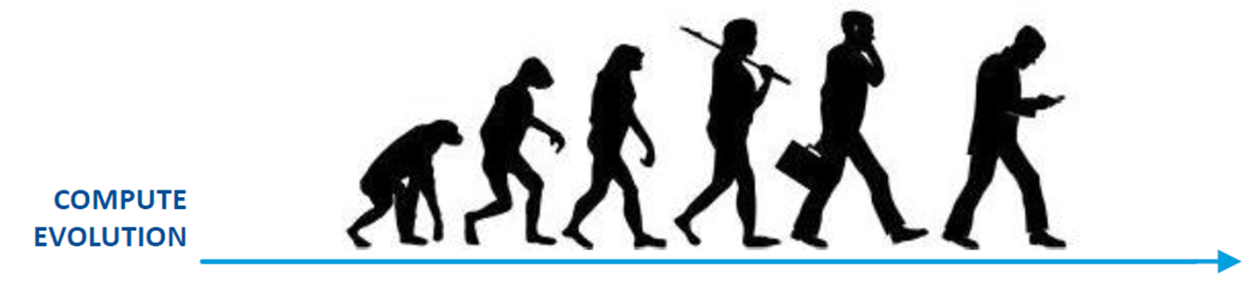
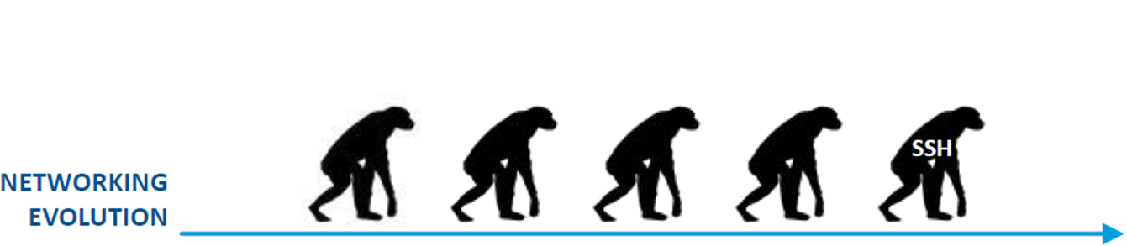
Computing vs Networking
Source: Adopted from Transforming the Network With Open SDN by Big Switch Network

Slide 14
Software-Defined Networking (SDN)
The answer to necessary networking evolution
      making them able to better (i.e. more flexibly, faster, …) react to current requirements
The basic idea: Management of network services through abstraction of lower-level functionality
      decoupling the system that makes decisions about where traffic is sent (the control plane) from the underlying systems that forward traffic to the selected destination (the data plane)
      centralized management

Slide 15















Current Internet
Closed to Innovations in the Infrastructure
Closed
App
App
App
Operating
System
Specialized Packet Forwarding Hardware
App
App
App
Operating
System
App
App
App
Specialized Packet Forwarding Hardware
Operating
System
App
App
App
Specialized Packet Forwarding Hardware
Operating
System
Specialized Packet Forwarding Hardware
App
App
App
Operating
System
Specialized Packet Forwarding Hardware
15
Notes:
The next 3 slides are a set of animation to show how we enable innovation:
- Infrastructure is closed to innovation and only driven by vendors. Consumers have little say
- Business model makes it hard for new features to be added

Slide 16















“Software Defined Networking” approach to open it
App
App
App
Network Operating System
App
App
App
Operating
System
Specialized Packet Forwarding Hardware
App
App
App
Operating
System
App
App
App
Specialized Packet Forwarding Hardware
Operating
System
App
App
App
Specialized Packet Forwarding Hardware
Operating
System
Specialized Packet Forwarding Hardware
App
App
App
Operating
System
Specialized Packet Forwarding Hardware
Notes:
How do we redefine the architecture to open up networking infrastructure and the industry!
By bring to the networking industry what we did to the computing world

Slide 17
The “Software-defined Network”
2. At least one good operating system
Extensible, possibly open-source
3. Well-defined open API
App
App
App
Network Operating System
1. Open interface to hardware
Simple Packet Forwarding Hardware
Simple Packet Forwarding Hardware
Simple Packet Forwarding Hardware
Simple Packet Forwarding Hardware
Simple Packet Forwarding Hardware
Notes:
Switches, routers and other middleboxes are dumbed down
The key is to have a standardized control interface that speaks directly to hardware

Slide 18
Software-defined network (SDN)

Slide 19
SDN – Basic Concepts
Software-Defined Networking = a modern buzzword ☹
      like Software-Defined Anything…
Several SDN concepts have been proposed
      all of them follow the basic ideas
        centralized control, programmability, flexibility, …
      could be based on:
        uniform configuration of (more or less) traditional devices
          RESTconf, NETconf, specialized protocols, …
        novel networking paradigm (requiring novel devices)
          OpenFlow

Slide 20
Notes:
Switches, routers and other middleboxes are dumbed down
The key is to have a standardized control interface that speaks directly to hardware

Slide 21
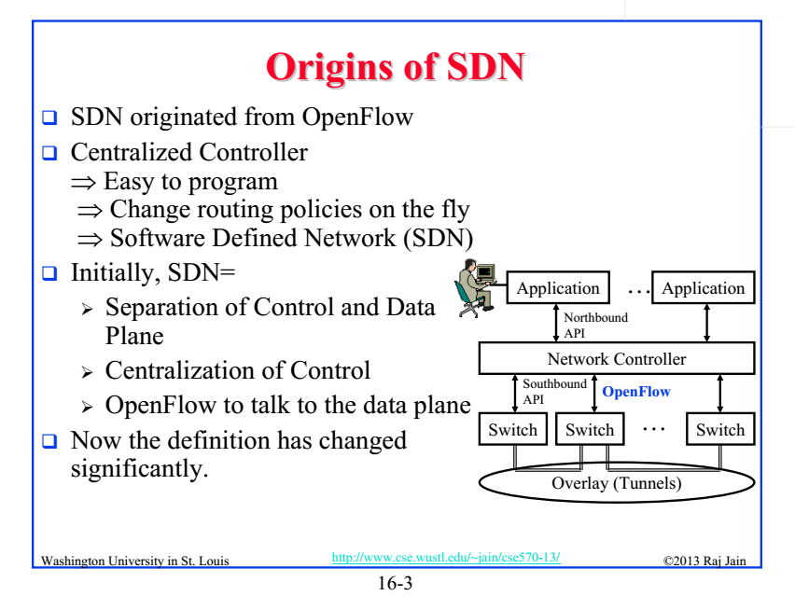

Slide 22
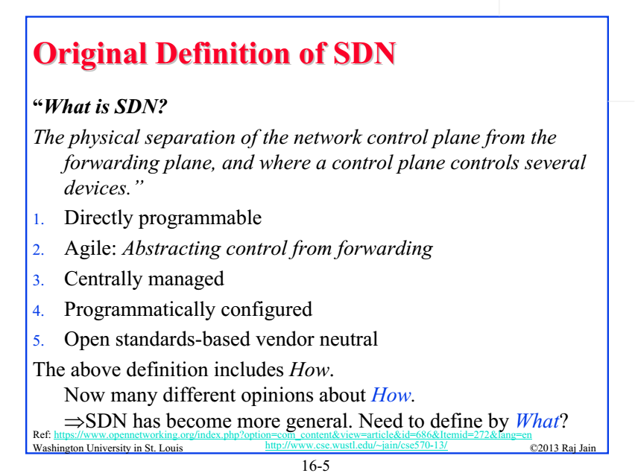

Slide 23
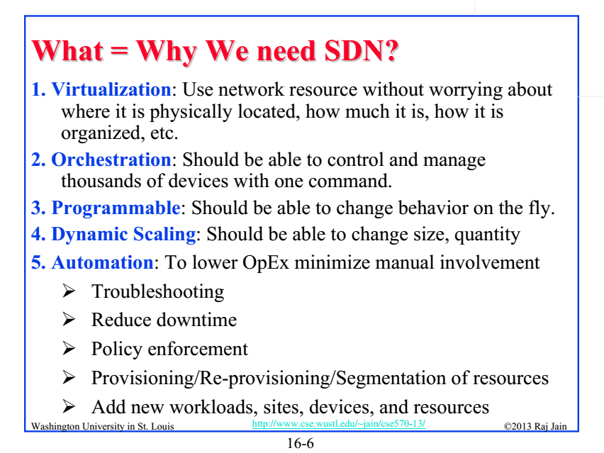

Slide 24
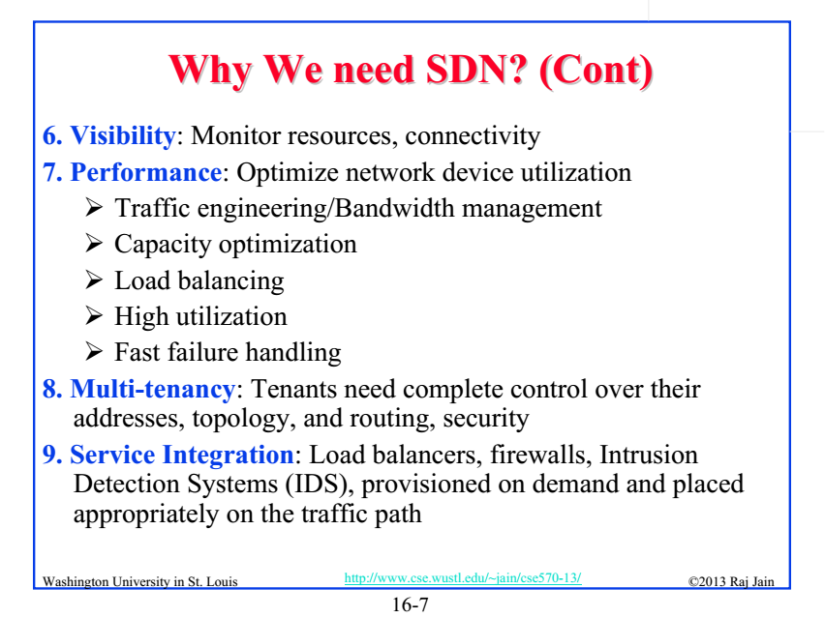

Slide 25
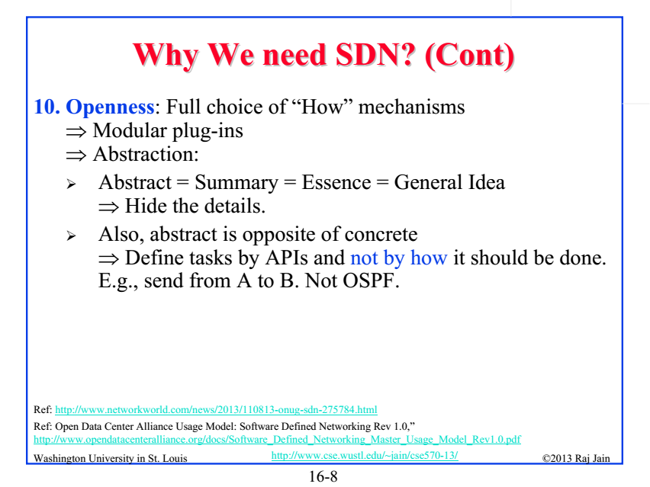

Slide 26
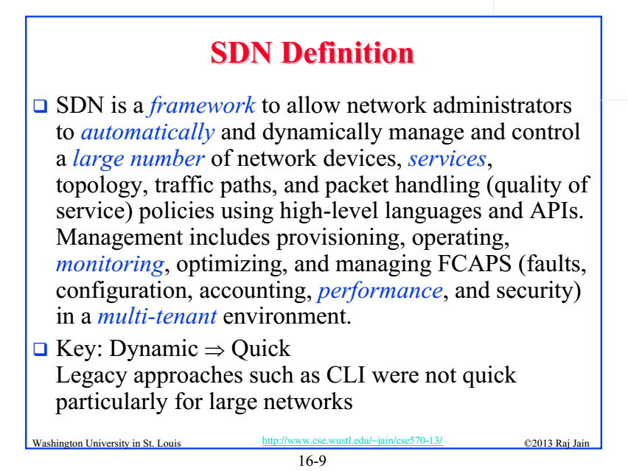

Slide 27
SDN – benefits summary
Reducing overhead costs (easier management)
      centralized management
Easier and faster deployment of new services
      from weeks/months to days/hours/minutes
Higher flexibility
      allowing to support applications with specific needs
Higher usage efficiency
      lowering over-provisioning
Support of new features and applications
      including e.g. virtualization/slicing of the network
etc. etc.
Notes:
Ondro, jen pro Tebe: overprovisioning je volna kapacita site, kterou musis ponechat, aby sit fungovala (v SDN si muzes diky vysoke flexibilite ty toky planovat efektivneji)

Slide 28
OpenFlow protocol

Slide 29
SDN/OpenFlow - introduction
A novel networking paradigm
      first standard communication interface between the control and forwarding layers
        vendor-independent
          forwarding HW has to comply with the OpenFlow specification
      allows direct access to and manipulation of the forwarding plane of network devices
          besides basic OpenFlow SW client, the devices contain packet forwarding tables (flow tables)
            define packet matching rules and packet actions

Slide 30
Notes:
Switches, routers and other middleboxes are dumbed down
The key is to have a standardized control interface that speaks directly to hardware

Slide 31
Notes:
Switches, routers and other middleboxes are dumbed down
The key is to have a standardized control interface that speaks directly to hardware

Slide 32
Notes:
Switches, routers and other middleboxes are dumbed down
The key is to have a standardized control interface that speaks directly to hardware

Slide 33


Components of OpenFlow Network
Controller
OpenFlow Switch
OpenFlow Switch specification
OpenFlow
Protocol
PC
Secure
Channel
TCP / TLS
sw
Flow
Table
hw
* Figure From OpenFlow Switch Specification

Slide 34

How does OpenFlow work?
34

Slide 35
OpenFlow Example
Controller
OpenFlow Client
PC
Software
Layer
Flow Table
MAC
src
MAC
dst
IP
Src
IP
Dst
TCP
sport
TCP
dport
Action
Hardware
Layer
*
*
*
5.6.7.8
*
*
port 1
port 1
port 2
port 3
port 4
5.6.7.8
1.2.3.4

Slide 36



OpenFlow usage
Controller
Alice’s Rule
Alice’s code
OpenFlow Switch
PC
Decision?
OpenFlow
Protocol
Alice’s Rule
Alice’s Rule
OpenFlow Switch
OpenFlow Switch
OpenFlow offloads control intelligence to a remote software
Notes:
36
36
How the actual protocol works

Slide 37
OpenFlow Basics
Flow Table Entries
Rule
Action
Stats
Packet + byte counters
Forward packet to zero or more ports
Encapsulate and forward to controller
Send to normal processing pipeline
Modify Fields
Any extensions you add!
Switch
Port
VLAN
ID
VLAN
pcp
MAC
src
MAC
dst
Eth
type
IP
Src
IP
Dst
IP
ToS
IP
Prot
L4
sport
L4
dport
+ mask what fields to match
Notes:
Now I’ll describe the API that tries to meet these goals.

Slide 38
Examples
Switching
Switch
Port
MAC
src
MAC
dst
Eth
type
VLAN
ID
IP
Src
IP
Dst
IP
Prot
TCP
sport
TCP
dport
Action
*
*
00:1f:..
*
*
*
*
*
*
*
port6
Flow Switching
Switch
Port
MAC
src
MAC
dst
Eth
type
VLAN
ID
IP
Src
IP
Dst
IP
Prot
TCP
sport
TCP
dport
Action
port3
00:20..
00:1f..
0800
vlan1
1.2.3.4
5.6.7.8
4
17264
80
port6
Firewall
Switch
Port
MAC
src
MAC
dst
Eth
type
VLAN
ID
IP
Src
IP
Dst
IP
Prot
TCP
sport
TCP
dport
Action
*
*
*
*
*
*
*
*
*
22
drop

Slide 39
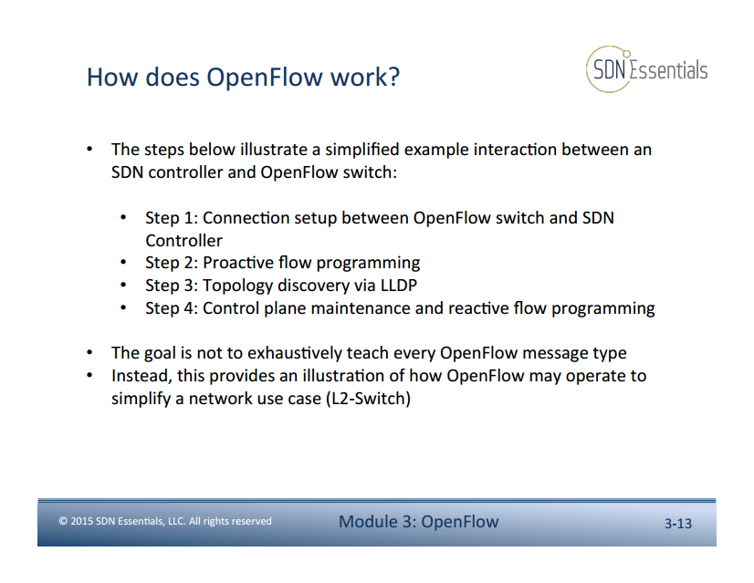

Slide 40
Scalability & Robustness
40

Slide 41

Centralized vs Distributed Control
Both models are possible with OpenFlow
Centralized Control
Distributed Control
Controller
Controller
OpenFlow
Switch
OpenFlow
Switch
Controller
OpenFlow
Switch
OpenFlow
Switch
Controller
OpenFlow
Switch
OpenFlow
Switch

Slide 42
Flow Routing vs. Aggregation
Both models are possible with OpenFlow
Flow-Based
Every flow is individually set up by controller
Exact-match flow entries
Flow table contains one entry per flow
Good for fine grain control, e.g. campus networks
Aggregated
One flow entry covers large groups of flows
Wildcard flow entries
Flow table contains one entry per category of flows
Good for large number of flows, e.g. backbone

Slide 43
Reactive vs. Proactive (pre-populated)
Both models are possible with OpenFlow
Reactive
First packet of flow triggers controller to insert flow entries
Efficient use of flow table
Every flow incurs small additional flow setup time
If control connection lost, switch has limited utility
Proactive
Controller pre-populates flow table in switch
Zero additional flow setup time
Loss of control connection does not disrupt traffic
Essentially requires aggregated (wildcard) rules

Slide 44
Basic SDN/OpenFlow principles

Slide 45
Basic SDN/OpenFlow principles
Basic networking concepts remain unchanged
      including all the packet headers & communication protocols
        however, some configuration protocols and functions (like VRF) are not needed any more
      the only change is performed in packet handling and its configuration
Major benefits in network management
      centralized control & easier management
      network segmentation on multiple levels
        physical and virtual network separation
      dynamic response

Slide 46
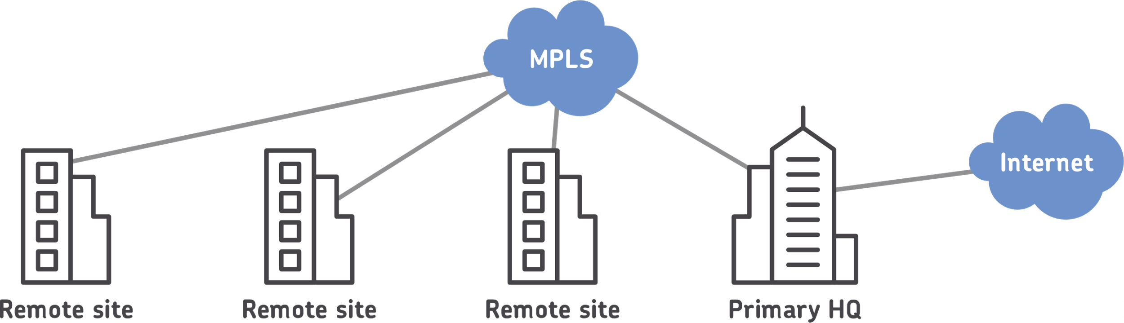
Real-life deployment
Traditional approach
Let’s illustrate a few basic real-life concepts on MUNI network
(simplified description)
      interconnects several sites (faculties) using MPLS core
        employes further complex technologies (like VRF, BGP, …)
      on each site, several separate networks exist
        separated using VLANs (isolation of different-purpose network – Windows/Linux hosts, printers, specific segments etc.)
      very complex ecosystem with limited
      flexibility
        and very hard to maintain
          many technologies
          used

Slide 47
Real-life deployment
SDN/OpenFlow approach
The SDN/OF network consists of several “dumb” network devices (forwarding elements)
      the logical network view dynamically configured by the controller
Several layers of network separation
      Virtual Tenant Networks (VTNs)
        for networks separation based on e.g. the purpose
      Virtual network representations
        simplified configuration of L2/L3 networks
      Physical separation
        allows multiple network instances, controlled by different controllers
          each of them further separated into VTNs, L2/L3 network, etc.

Slide 48
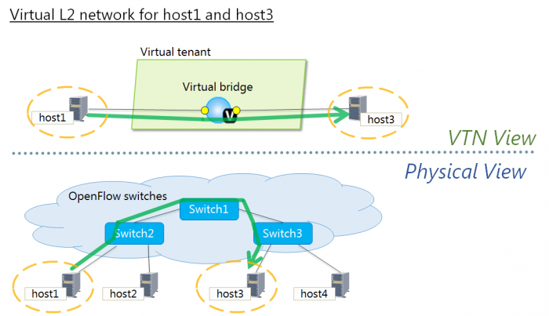
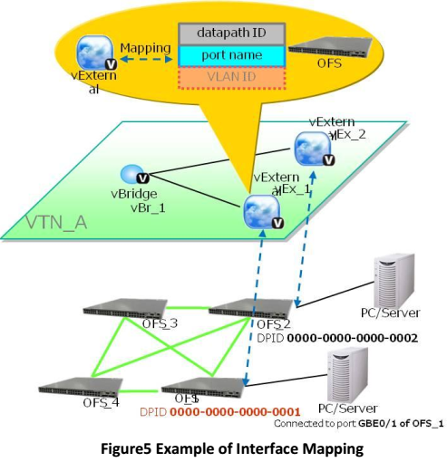
Real-life deployment
SDN/OpenFlow approach
Virtual networks in SDNs – Virtual Tenant Networks
Link redundancy
is welcomed!
Separate VTNs for (MUNI examples):
production network
technology network
sensitive-data network
infected nodes or nodes under attack
experimental network
commercial network
… all of them fully isolated (may run same IPs)
Notes:
Nad tim obrazkem se prosim dukladneji zamysli; tady se da ohledne VTNs okomentovat hodne veci…

Slide 49
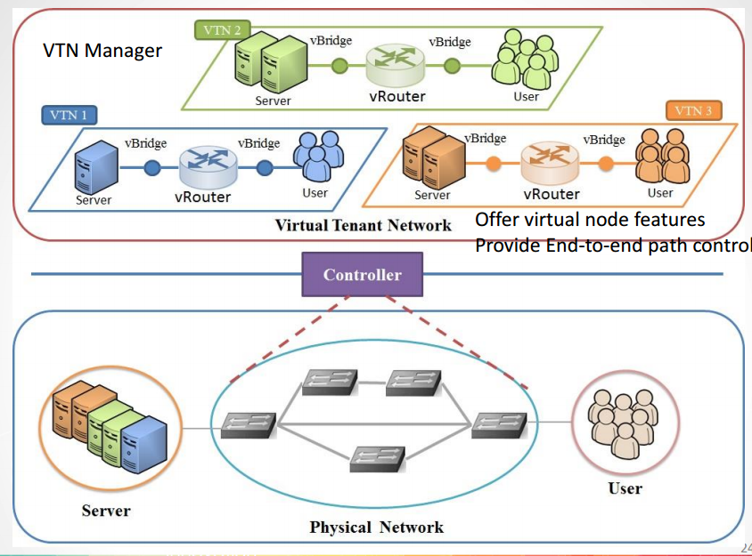
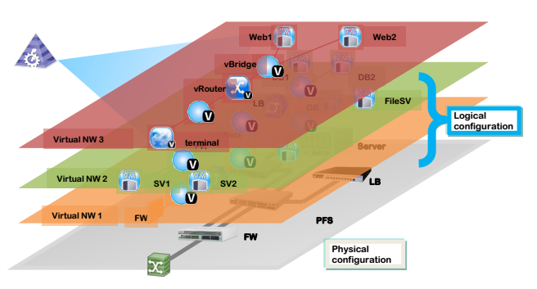
Real-life deployment
SDN/OpenFlow approach
Virtual networks in SDN – Virtual Tenant Networks
Notes:
Zduraznit, ze VTNs jsou logickou konfiguraci site, kazda muze slouzit pro jiny ucel…

Slide 50
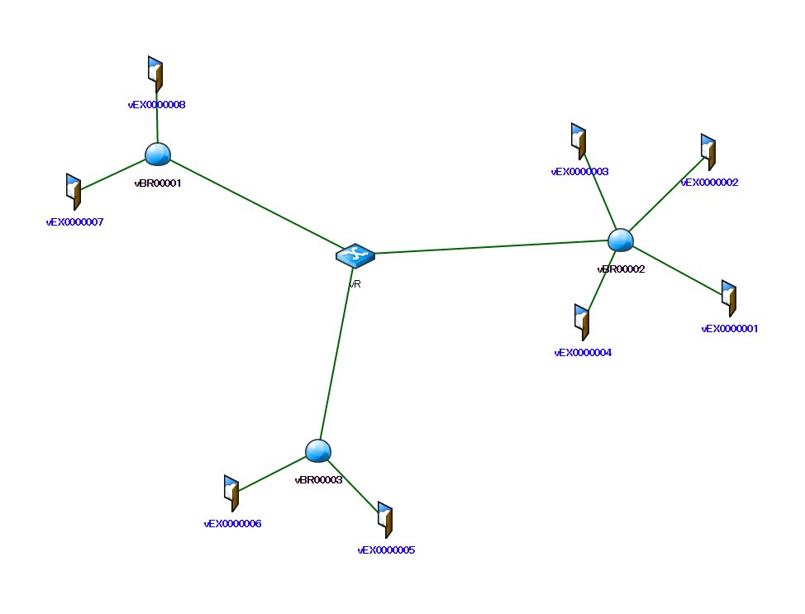
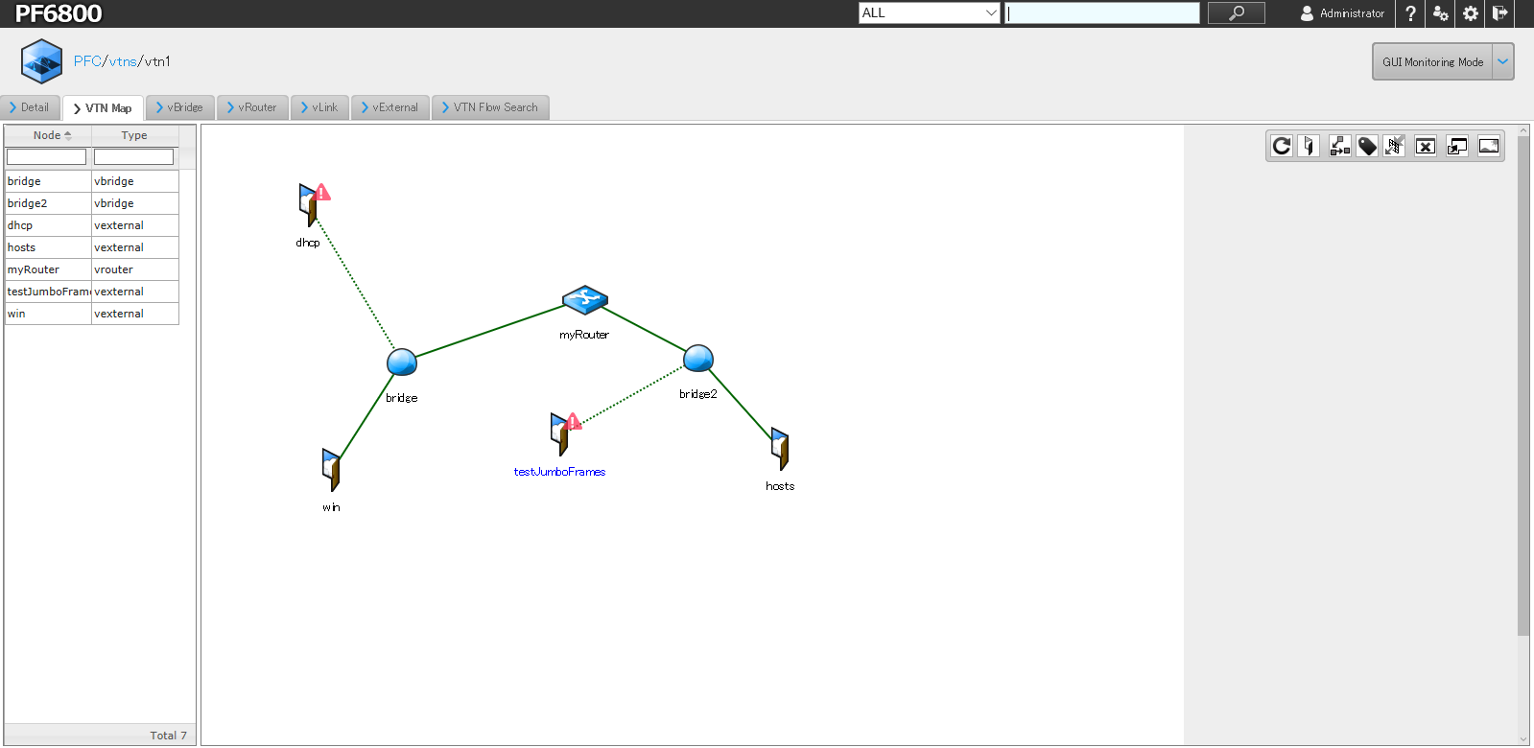
Real-life deployment
SDN/OpenFlow approach
Virtual network representation / topology (in each VTN may differ)
just end ports (statically/dynamically) configured
internal configuration of all OFSs computed by the controller
Notes:
OFS = OpenFlow Switch

Slide 51
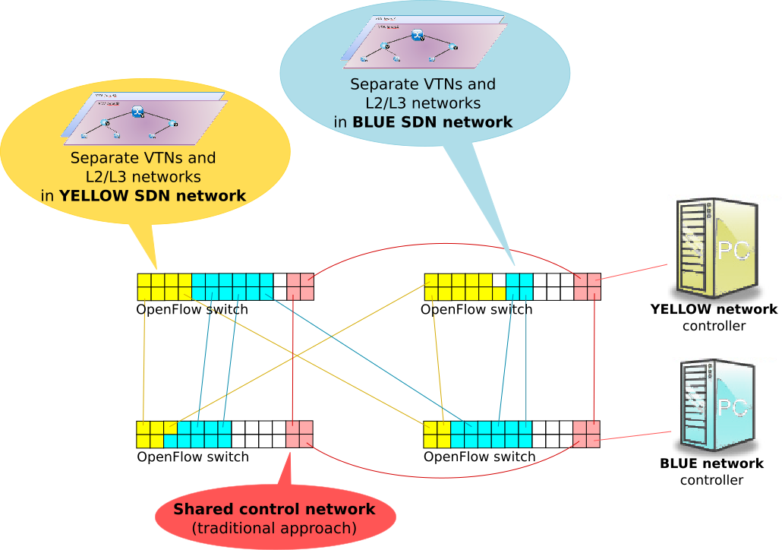
Real-life deployment
SDN/OpenFlow approach
Physical network separation
      allows to divide
      OpenFlow HW switches into
      separate (SDN) worlds
          controller by own
          SDN controllers
          e.g. production,
          experimental controller
          and control network
In case of hybrid switches, part of the HW may serve as control network (traditional approach)
Notes:
Zde jeste dodam obrazek fyzickeho rozdeleni (vcetne moznosti vyuziti pro ridici sit)…

Slide 52
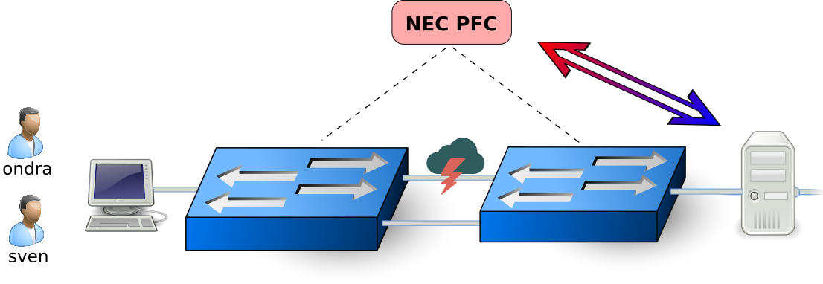
SDN/OpenFlow Demo
  FTP client and FTP server
  Two physical paths through the network exist
        one path is congested (allows for a lower speed)
          emulated using increased packet drop & delay
        the other one is free (thus faster)
  Two users: ondra & sven
        user “sven” is privileged
          his transmission speed is monitored and – if too low – the FTP server contacts SDN controller, which forces his flows to use the free/faster link
            (monitoring in 2sec. interval)
          all the other users remain on the congested link

Slide 53
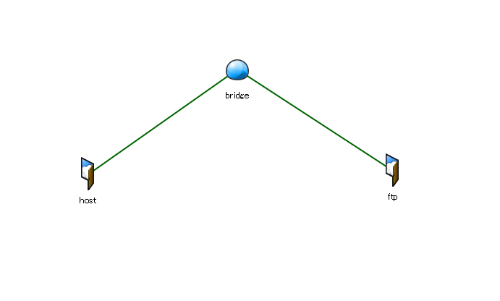
SDN/OpenFlow Demo – VTN representation
  VTN representation:

Slide 54
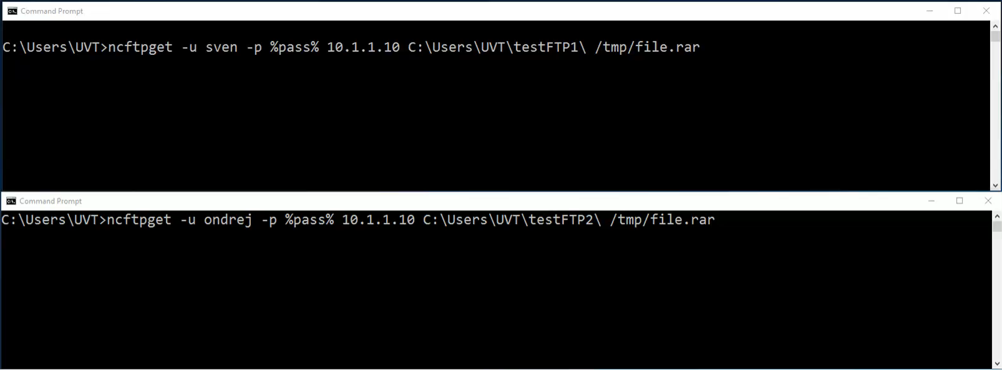
SDN/OpenFlow Demo
Video running…

Slide 55
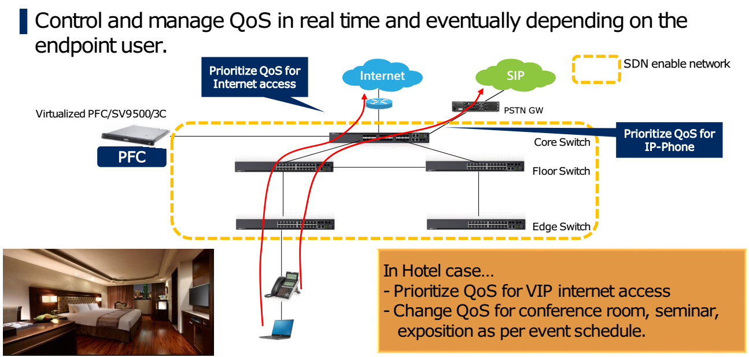
Further examples of real-life use-cases

Slide 56
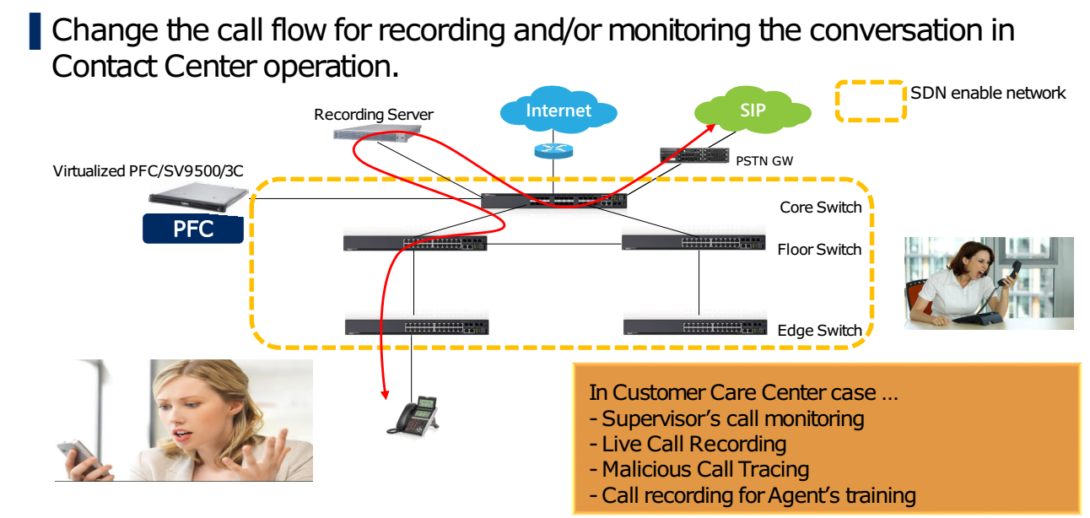
Further examples of real-life use-cases
Notes:
Zde se da zminit, ze neco podobneho lze pouzit pro bezpecnost – definovane toky smerovat na Intrusion Detection System, a tam je analyzovat…

Slide 57
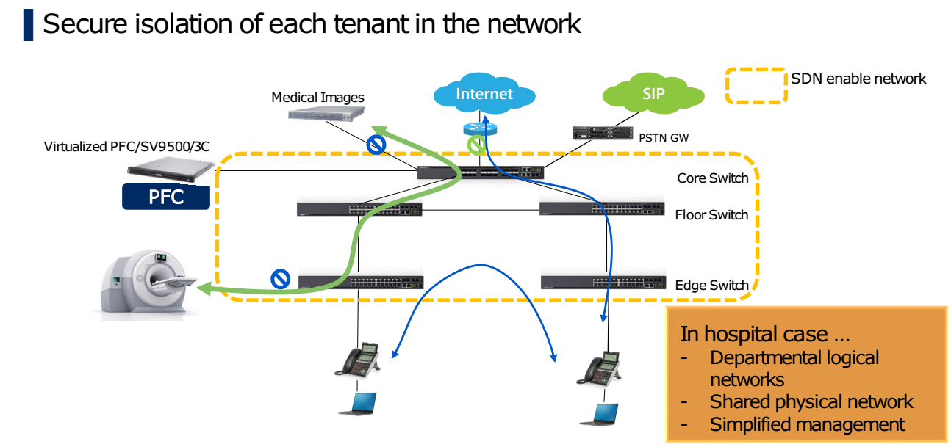
Further examples of real-life use-cases
Notes:
Napriklad ochrana prenosu citlivych dat…

Slide 58
Further examples of real-life use-cases
Further use-case examples related to university usage
      prioritize traffic / enforce lower priority (backups)
      security applications
        centralized monitoring probes (monitoring just specific traffic)
          e.g. HTTP traffic through DPI, FTP through common probes
        isolation of infected nodes and monitoring the attacker
        distribution of filtering rules
          in cooperation with stateful firewall
      connection redundancy, high-capacity links deployment, …
      etc. etc.

Slide 59
Network Function Virtualization (NFV)

Slide 60
Today’s network infrastructure
Diverse network functions (NF).
Providing desired overall functionality or service.
Adding new services
  New service instances take weeks to activate
  New service types may take months up to years
  New service types require either new equipment or upgrading of existing equipment
We have to simplify network design, increase agility, speed up deployment of new services.

Slide 61
What is NFV ?
NFV – Network Functions Virtualization
Likewise VM
Virtualization – NF and part of the infrastructure is implemented as a software.
Result – from dedicated proprietary appliance to COTS hardware

Slide 62
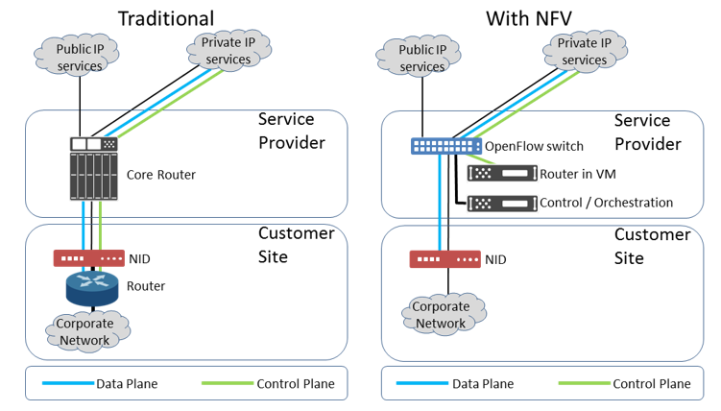
NFV in nutshell

Slide 63
SDN controllers

Slide 64
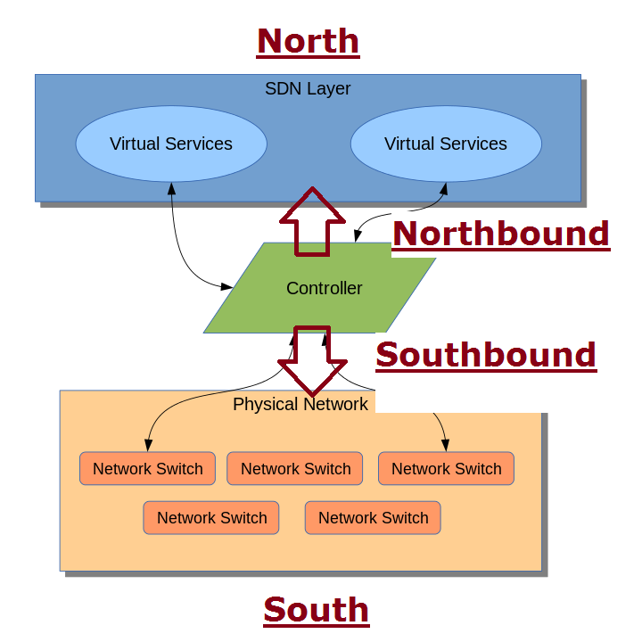
SDN controllers
Common objectives:
      multiple Southbound interface protocol support
      well-defined Northbound API support
      programmability
      high availability &
      performance
      security
Open-source vs. commercial

Slide 65
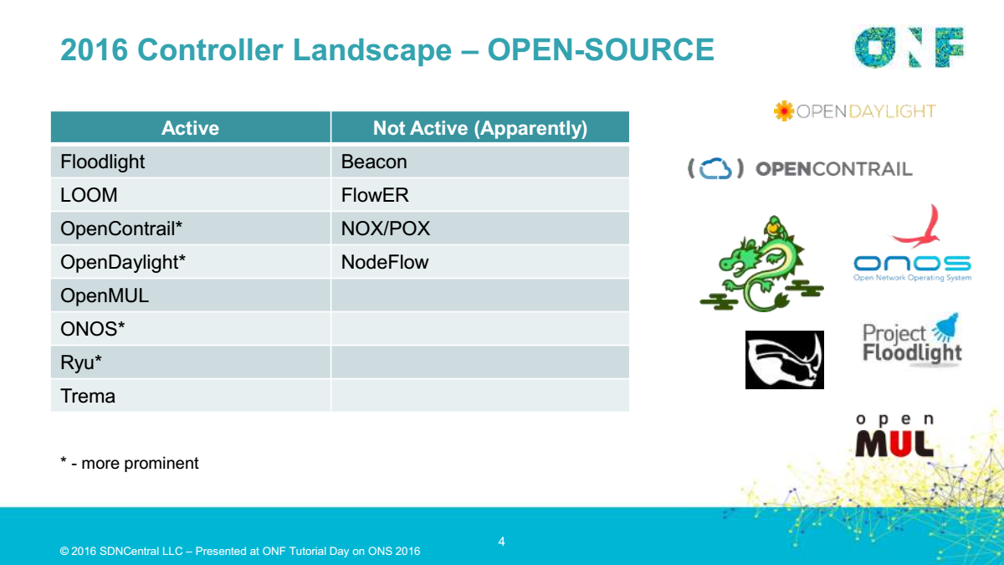

Slide 66
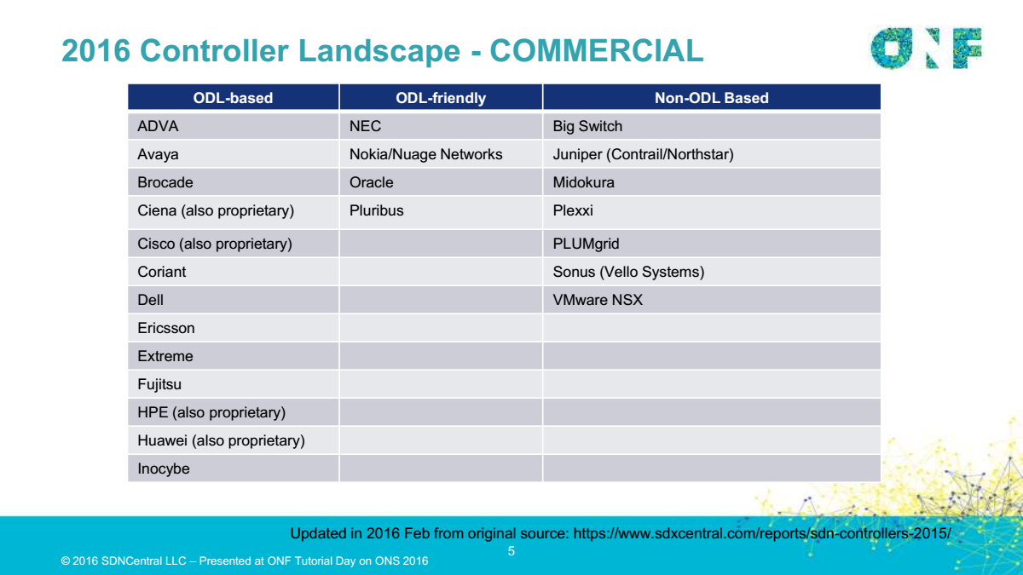

Slide 67



OpenDaylight architecture illustration
- Lithium
DLUX
VTN Coordinator
OpenStack Neutron
SDNI Wrapper
Network Applications
Orchestrations & Services
AAA AuthN Filter
OpenDaylight APIs REST/RESTCONF/NETCONF
Base Network Functions
Network Services
Network Abstractions (Policy/Intent)
Platform Services
OpenFlow Stats Manager
Service Function Chaining
OVSDB Neutron
Authentication, Authorization & Accounting
Controller Platform Services/Applications
OpenFlow Switch Manager
Reservation
Device Discovery, Identification & Driver Management
ALTO Protocol Manager
OpenFlow Forwarding Rules Mgr
Virtual Private Network
Network Intent Composition
Neutron Northbound
L2 Switch
Virtual Tenant Network Mgr.
LISP Service
Group Based Policy Service
Persistence
Host Tracker
Unified Secure Channel Mgr
DOCSIS Abstraction
SDN Integration Aggregator
Topology Processing
Link Aggregation Ctl Protocol
SNMP4SDN
Time Series Data Repository
Messaging (Notifications / RPCs)
Service Abstraction Layer/Core
Data Store (Config & Operational)
OpenFlow
OVSDB
NETCONF
LISP
BGP
PCEP
CAPWAP
OPFLEX
SXP
SNMP
USC
SNBI
HTTP
CoAP
LACP
PCMM/COPS
Southbound Interfaces &
Protocol Plugins
OpenFlow Enabled Devices
Open vSwitches
Additional Virtual & Physical Devices
Data Plane Elements
(Virtual Switches, Physical Device Interfaces)
Module 3: OpenDaylight
3-03

Slide 68
NETCONF & YANG
different SDN view…

Slide 69


NETCONF and YANG in Context
Yang
Models
YANG Models
Management
Applications
NETCONF
Manager
NETCONF
YANG Models
YANG Models
YANG Models

Slide 70
What is a Data-Model? What is a Network Management Protocol?
Data-Model
  A data-model explicitly and precisely determines the structure, syntax and semantics of the data…
  …that is externally visible
  Consistent and complete
Protocol
  Remote primitives to view and manipulate the data
  Encoding of the data as defined by the data-model
Protocol
Data-Model

Slide 71
Standards background, motivation and history
RFC 3535: Operators’ problems and requirements on network management
(results of IETF’s meeting with network operators)

Slide 72

Informational RFC 3535
SNMP had failed
  For configuration, that is
  Extensive use in fault handling and monitoring
CLI scripting
  “Market share” 70%+
Abstract
This document provides an overview of a workshop held by the Internet Architecture Board (IAB) on Network Management. The workshop was hosted by CNRI in Reston, VA, USA on June 4 thru June 6, 2002. The goal of the workshop was to continue the important dialog started between network operators and protocol developers, and to guide the IETFs focus on future work regarding network management.
configuration

Slide 73
Operator Requirement #1/14
1. Ease of use is a key requirement for any network management technology from the operators point of view.
Maybe not assume integrators and
software developers for any addition
or change
Manage

Slide 74
Operator Requirement #2-3/14
2. It is necessary to make a clear distinction between configuration data, data that describes operational state and statistics.
3. It is required to be able to fetch separately configuration data, operational state data, and statistics from devices, and to be able to compare these between devices.
Clearly separating configuration
Ability to compare across devices
$show running-config

Slide 75
Operator Requirement #4-5/14
4. It is necessary to enable operators to concentrate on the configuration of the network as a whole rather than individual devices.
5. Support for configuration transactions across a number of devices would significantly simplify network configuration management.
Service and Network management, not only device management
Network wide transactions
VPN Configuration
All or nothing

Slide 76
Operator Requirement #6-7/14
6. Given configuration A and configuration B, it should be possible to generate the operations necessary to get from A to B with minimal state changes and effects on network and systems. It is important to minimize the impact caused by configuration changes.
7. A mechanism to dump and restore configurations is a primitive operation needed by operators. Standards for pulling and pushing configurations from/to devices are desirable.
Devices figure out ordering
No unnecessary changes
Finally: backup/restore of configuration
The litmus-test of a management interface
configuration

Slide 77
Operator Requirement #8, 10/14
8. It must be easy to do consistency checks of configurations over time and between the ends of a link in order to determine the changes between two configurations and whether those configurations are consistent.
10. It is highly desirable that text processing tools such as diff, and version management tools such as RCS or CVS, can be used to process configurations, which implies that devices should not arbitrarily reorder data such as
access control lists.
Validation of configuration
Validation at network level
Text based configuration
Text
VPN Configuration
Valid?

Slide 78
Operator Requirement #9/14
Standardized data models
9. Network wide configurations are typically stored in central master databases and transformed into formats that can be pushed to devices, either by generating sequences of CLI commands or complete configuration files that are pushed to devices. There is no common database schema …, although the models used by various operators are probably very similar.
It is desirable to extract, document, and standardize the common parts of these network wide configuration
database schemas.
Interfaces Data-Model

Slide 79
Operator Requirement #13/14
13. It is important to distinguish between the distribution of configurations and the activation of a certain configuration.
Devices should be able to hold multiple configurations.
Support for multiple configuration sets
Delayed, orchestrated activation
Config, Config, Commit

Slide 80
Operator Requirement #11,12,14/14
Role-Based Access Control (RBAC)
  Data oriented
  Task oriented
11. … Typical requirements are a role-based access control model and the principle of least privilege, where a user can be given only the minimum access necessary to perform a required task.
12. It must be possible to do consistency checks of access control lists across devices.
14. SNMP access control is data-oriented, while CLI access control is usually command (task) oriented. … As such, it is a requirement to support both data-oriented and task-oriented
access control

Slide 81

NETCONF was designed to conform to RFC 3535.
Today many operators require NETCONF and YANG in devices.
NETCONF makes a difference on the bottom line.

Slide 82
What makes NETCONF/YANG different?
 | SNMP | NETCONF | SOAP | REST
Standard | IETF | IETF | W3C | -
Resources | OIDs | Paths |  | URLs
Data models | Defined in MIBs | YANG Core Models
Data Modeling Language | SMI | YANG | (WSDL, not data) | Undefined, (WSDL), WADL, text…
Management Operations | SNMP | NETCONF | In the XML Schema, not standardized | HTTP operations
Encoding | BER | XML | XML | XML, JSON,…
Transport Stack | UDP | SSH TCP | SSL HTTP TCP | SSL HTTP TCP
“RESTConf”

Slide 83
What makes NETCONF/YANG different?
SNMP
NETCONF
GET
GET-NEXT
SET
TRAP
…
… so what?
<get-config>
<edit-config>
<copy-config>
<delete-config>
<get>
<lock>
…
… same same?
Protocol
The SNMP Protocol
NETCONF
Data-Model
MIB Modules
YANG Modules

Slide 84
What makes NETCONF/YANG different?
This is where the difference is:
In the supported use cases!
Use Case | SNMP | NETCONF
Get collection of status fields | Yes | Yes. Bulk xfer up to 10x faster. Really.
Set collection of configuration fields | Yes, up to 64kB | Yes
Set configuration fields in transaction | No | Yes
Transactions across multiple network elements | No | Yes
Invoke administrative actions | Well… | Yes
Send event notifications | Yes | Yes, connected
Backup and restore configuration | Usually not | Yes
Secure protocol | v3 is fair | Yes
Test configuration before final commit | No | Yes

Slide 85
YANG ?
Data modeling language
  Configuration data
  State data
Tree structure
Data and Types
acme-box module
properties container
name: string, config
interfaces container
interface: list, index = name
name: string, config
oper-state: enum, config

Slide 86
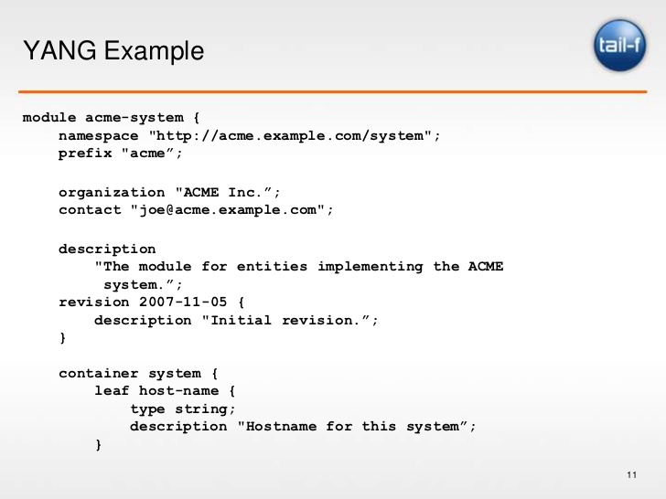
YANG Header

Slide 87
Thank you for your attention!

