Slide 1
PA197 Secure Network Design
Security aspects of wireless personal area networks (PANs)
Petr Švenda svenda@fi.muni.cz
Faculty of Informatics, Masaryk University

Slide 2
Overview
“Project” – spanning over three lectures and labs
  Implementing network based on Arduino with RF module
  Passive “sniffer” eavesdropping attacker
  Active attacker against routing
Security considerations of wireless transmission
Technology for Personal Area Networks (PANs)
  Bluetooth, NFC, ZigBee
  Design goals
  Security vulnerabilities
  Combination of technologies

Slide 3

Multi-lab project

Slide 4
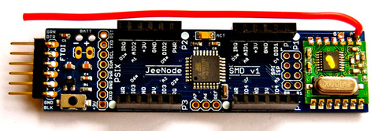
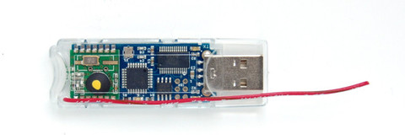
Wireless network devices
Arduino with RF module
  Easy C programming
  Much easier then e.g., TinyOS
Every student will get node
  Programming at home, homework
  Cooperation with others to form basic network
Permanently running network of 20+ nodes in lab
  Used for testing the attacks etc. at larger network tests
  10-15 minutes scenarios, then reset of the network

Slide 5
Wireless network project
Implementation of ad-hoc network based on Arduino with RF module
Larger “project” spanning over next three weeks
  Labs & Homework
Laboratory 9: initial implementation of reliable packet transmissions and neighbor discovery, eavesdropping
Laboratory 10: parsing routing info, actively manipulating routing information
Laboratory 11: Pairwise and probabilistic key distribution and secure channel

Slide 6
What to prepare for labs
Download and install Arduino software in advance!
  https://www.arduino.cc/en/Main/Software
Read Arduino development guide (L. Nemec)
  Uploaded in IS, labs folder
Collect JeeNodes today or during Wednesday labs
  Please don’t forget to sign the sheet!

Slide 7
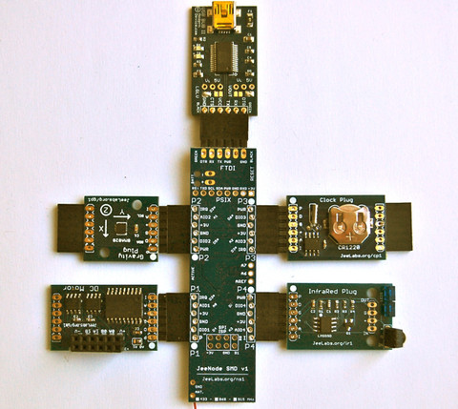

Slide 8
Personal area networks

Slide 9
Main design goals
(Not necessary all at the same time)
Energy efficiency
  Running long time only on batteries
Physical locality of communication (NFC)
  Imposing restrictions on attacker
Quick establishment of temporary connections
  Usable security
Ad-hoc networking
  Temporary networks without pre-fixed structure

Slide 10
Basic steps of communication
Discover other device(s)
  Public broadcast vs. private sharing
Authenticate and establish initial key(s) (pairing)
  Usually once for new devices
Authenticate and refresh keys for paired devices
  If long-term persistence is maintained (known devices)
Exchange packets between devices
Terminate connection

Slide 11
Wireless medium - attacks
Wireless networks

Slide 12
Attack surface is large
Wireless signal propagates more easily
  Eavesdropping, message injection
  Also more difficult to localize attacker
Processing transmissions more complicated
  Potential for bugs in implementation, network stack
Potential for physical device compromise
  Device not connected => easier to be lost/stolen…

Slide 13
Wireless medium – basic properties
Eavesdropping on active transmission is easy
  Omnidirectional vs. directional antenna
  Active vs. passive communication mode
Eavesdropping on passive device (RFID,ISO14443) more difficult (passive mode)
  Tag/card does not emit signal on its own
  Tag/card specifically distorts EM field measured by reader
Multiple channels may require multi-channel eavesdropping
  Frequency hopping based on secret sequence (PRNG)

Slide 14
Generic attacks: Eavesdropping
Active → active transmission
  Directional antenna, e.g., Bluetooth 10² → 10⁴ meters
Active → passive transmission
  Tens of meters for active signals (reader → tag), easy
  Up to 1m for passive signals (tag → reader), difficult
Signals must be reliable enough for normal communication => stronger than necessary
Eavesdropping cannot be generally prevented
  Possibly only significantly limited in distance (NFC)
Solution: use secure channels (encryption, auth)
Notes:
http://www.radio-electronics.com/info/wireless/nfc/nfc-near-field-communications-security.php

Slide 15
Attack: record and compromise later
Eavesdropped communication is encrypted
Used key is later recovered by other means
  End-node compromise, side-channel attack, bruteforce…
  => Past communication can be decrypted (later)
How to prevent?
  (Perfect) forward secrecy protocols (e.g., ECDH)
Notes:
http://www.radio-electronics.com/info/wireless/nfc/nfc-near-field-communications-security.php

Slide 16
(Perfect) forward secrecy protocols
Long-term key compromise doesn’t compromise past session keys
Fresh keypair generated for every new session
Ephemeral public key used to exchange session key
Ephemeral private key is destroyed after key exchange
  Captured encrypted transmission cannot be decrypted
Long-term key is used only to authenticate ephemeral public key to prevent MitM
Where used? TLS, OTR/Signal, ePassports…
Where NOT used? If only symmetric crypto based

Slide 17
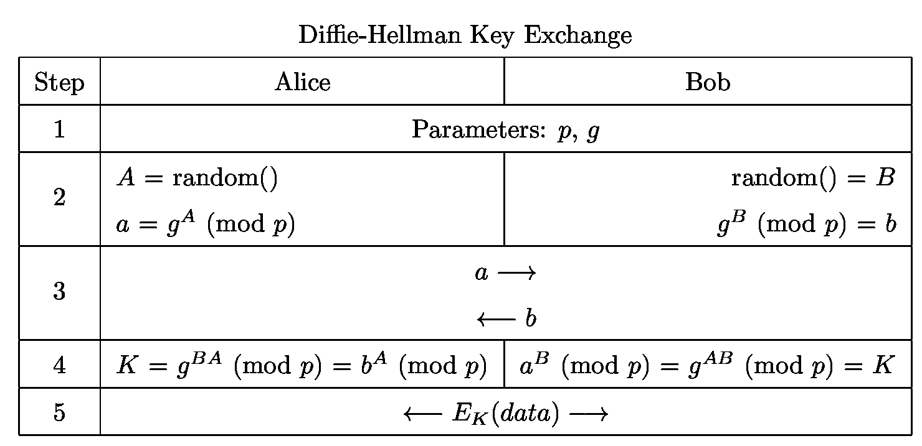
DH based on elliptic curves used (ECDH)
EC curve, G (base point)
A x G (scalar multiplication)
B x G
A x B x G
A x b
B x a
A x B x G
http://www.themccallums.org/nathaniel/2014/10/27/authenticated-key-exchange-with-speke-or-dh-eke/

Slide 18
Generic attacks: data corruption
Attacker tries to corrupt data during transmission
  Channel level: additional transmission → jamming
  Link/tunnel level: sinkhole, dropper…
    Form of denial-of-service
Broad vs. selective jamming
  Broad jamming requires higher power of transmission
  Selective jamming corrupts only few bits in header / packets
Solution: device detects and verifies signal strength, counts transmitted/dropped packets…
  But signal naturally fluctuates => harder to detect attack

Slide 19
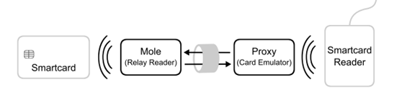
Generic attacks: Man-in-the-middle
Third device acts as relay between two legitimate devices
  Log/block/modify communication
  Emulates perception of close presence (door lock, card payment)
If mounted against active-active communication mode
  Attacker can be farther away
  Possibly needs to block legitimate traffic (to legitimate party)
If mounted in active-passive mode
  Attacker needs to be closer to victim (passive → active)
May require low-latency on attackers side
Potential defense: distance bounding protocols

Slide 20
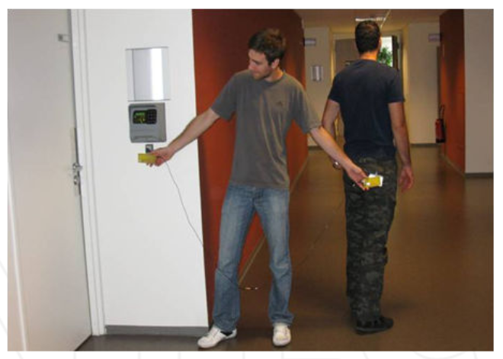
Example: Passive wired relay
No amplifier or other active components required
Coaxial cable between two antennas, 20 metres or more
Very low delay (practically not detectable)
Low cost
http://cdn.intechopen.com/pdfs-wm/44973.pdf

Slide 21
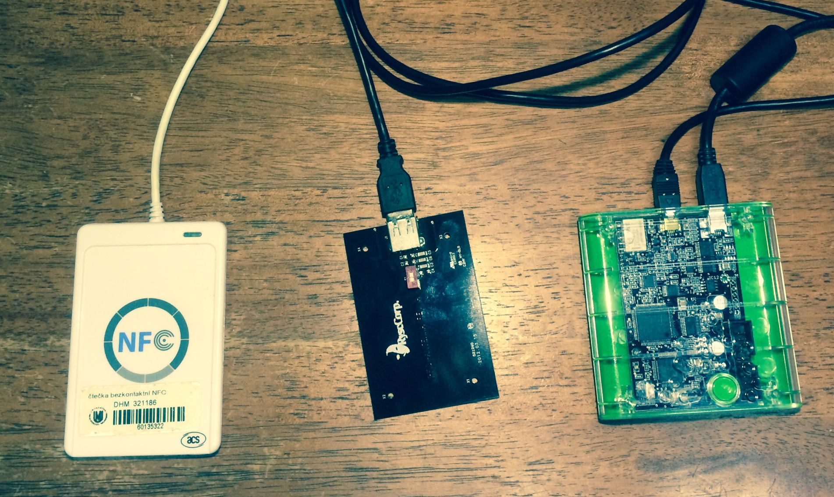
Example: ePassport simulator Proxmark III
(M. Korec) https://is.muni.cz/auth/th/396490/fi_b/

Slide 22
Distance bounding protocols
Enable verifying device to establish upper bound on physical distance from connecting device
  Time to receive response to challenge is measured
  Multiplied by speed of light (~RF waves speed)
Problem: transmission time may be significantly smaller than necessary processing time
  Especially for high-frequency channels
  Important to measure precisely 1 ns => 15cm error
More likely to detect active MitM than passive relay
http://cdn.intechopen.com/pdfs-wm/44973.pdf

Slide 23

Bluetooth
Wireless networks - Bluetooth

Slide 24
Bluetooth – basic information
Wireless standard for exchanging data over short distances
  IEEE 802.15.1 standard (no longer maintained)
  Specification maintained by Bluetooth Special Interest Group (SIG)
UHF radio waves in the ISM band from 2.4 to 2.485 GHz (globally unlicensed band, scientific and medical)
  Frequency-hopping spread spectrum (1600 hops/sec), Adaptive Frequency-Hopping (AFH, avoids crowded frequencies)
  79 designated Bluetooth 1MHz channels (40 for BT 4.x)
Class 1/2/3 devices (max. power, distance ~100/10/1m)
Speed 1Mbit – 24Mbit / sec
Bluetooth usage profiles (https://en.wikipedia.org/wiki/List_of_Bluetooth_profiles)

Slide 25
Bluetooth - networking
Each BT device has unique 48-bit device address
Discoverable vs. hidden mode
  On demand response (device name, class, services, info)
  If discoverable then always respond
  If hidden then respond only if device address is already known
Packet-based protocol with master-slave order
  One master → up to 7 slaves (forms piconet)
  Even and odd medium slots for master/slave transmission
Multiple piconets form scatternet
  Some devices both master in piconet X and slave in piconet Y
  Extends device range via multi-hop communication
  Not really used in practice so far

Slide 26
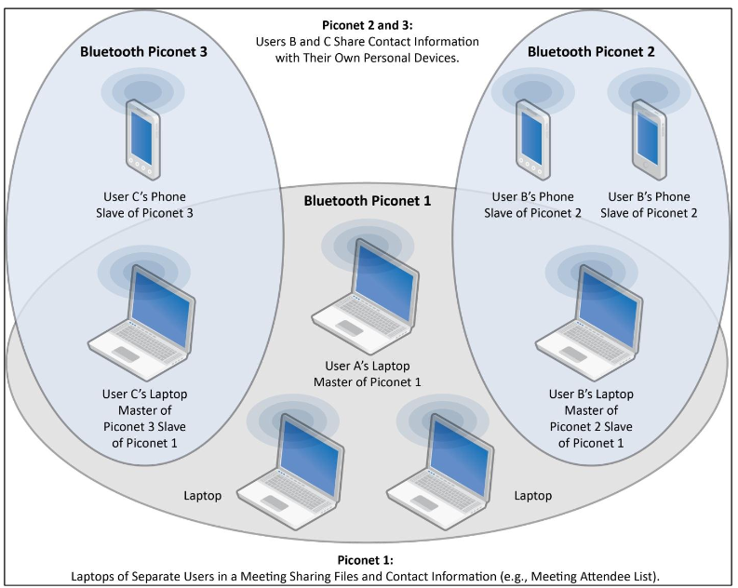
Bluetooth – piconets, scatternet
http://csrc.nist.gov/publications/nistpubs/800-121-rev1/sp800-121_rev1.pdf

Slide 27

Bluetooth vs. WiFi
AP-based WiFi is asymmetric (infrastructure)
  BT is master – slave, but usually ad-hoc
BT generally requires less configuration
BT is more power efficient, especially BT 4.x LE
AP-based WiFi is generally more suitable for infrastructural placement, BT for ad-hoc networking
Cooperation of technologies
  Initial pairing setup via BT, fast transmission via WiFi

Slide 28

Bluetooth security
Wireless networks - Bluetooth
Notes:
Slides will be heavily based on very good NIST’s Guide to Bluetooth Security
http://csrc.nist.gov/publications/nistpubs/800-121-rev1/sp800-121_rev1.pdf

Slide 29

Security requirements
What you would like to have? ☺
NIST guidelines to Bluetooth security
  https://nvlpubs.nist.gov/nistpubs/SpecialPublications/NIST.SP.800-121r2.pdf

Slide 30
Bluetooth – versions, security features
BT 1.0 [1994?] Initial version, mandatory encryption
BT 1.1 [2002] Possibility for non-encrypted channels
BT 2.1 [2007] Secure simple pairing (SSP)
BT 3.0 [2009] Negotiation of high speed over 802.11 link
BT 4.0 [2010] BT low energy (Wibree), coin cell power, Bluetooth Smart Ready, SSP not available
BT 4.2 [2014] Introduces important features for IoT, LE Secure Connections, Link Layer Privacy, ECDH-based SPP
BT 5 [2016] Larger range and transmission speed

Slide 31
Bluetooth security modes
Mode 1 provides no security
  Any device can connect, no encryption
  Up to Bluetooth 2.0 + Enhanced Data Rate (EDR) and NOT beyond
Mode 2 provides security at the service level
  After a communication channel is established
  Centralized security manager controls
Mode 3 provides security at the link level
  Before a logical channel is established
  Authentication and encryption of all connections
  Decreases attack surface, but requires key predistribution
Mode 4 provides Secure Simple Pairing
  Connects two previously unpaired devices (DH, ECDH)

Slide 32
Bluetooth – crypto algorithms used
SAFER+ block cipher
  used as building block for key derivation, authentication
E0 stream cipher for encryption
  Encryption key, master device BT address, real-time clock
E22 key derivation algorithm
  Derive initial key from address, rand and PIN
E21 session key derivation algorithm
  Link key generation from initial key
E1 authentication algorithm
  Authenticate devices after pairing
AES cipher in Counter mode (AES-CCM)
  Introduced for Bluetooth LE (BT 4.0)
General trend: used to be custom crypto (earlier, < 4.0), move towards standard primitives (now, >= 4.0)
BT < 4.0
BT >= 4.0

Slide 33
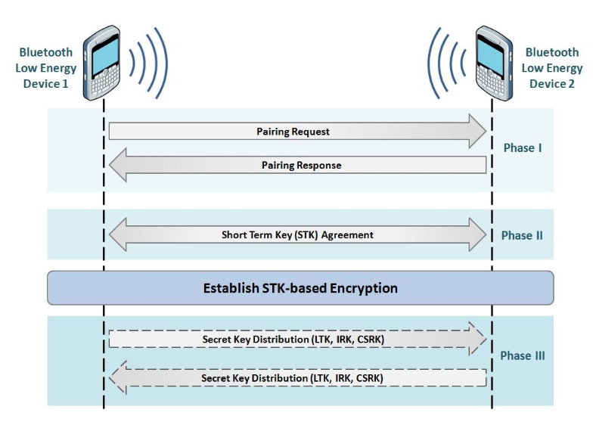
Bluetooth pairing
https://www.bluetooth.com/specifications/adopted-specifications

Slide 34
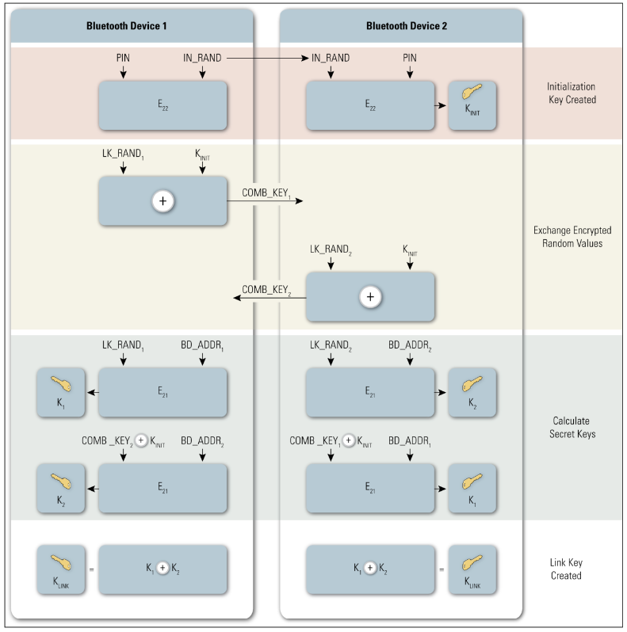
BT Initial key → link key (E22 and E21)
http://csrc.nist.gov/publications/nistpubs/800-121-rev1/sp800-121_rev1.pdf

Slide 35
BT Pairing – Legacy pairing
BT 2.0 and before
Initial key exchange (K_{INIT}) over unencrypted link
  What attacks are possible?
Passkey/PIN → initialization key → link key
  Short passkey problem (passive attack ~ms)
  http://www.eng.tau.ac.il/~yash/shaked-wool-mobisys05/index.html

Slide 36
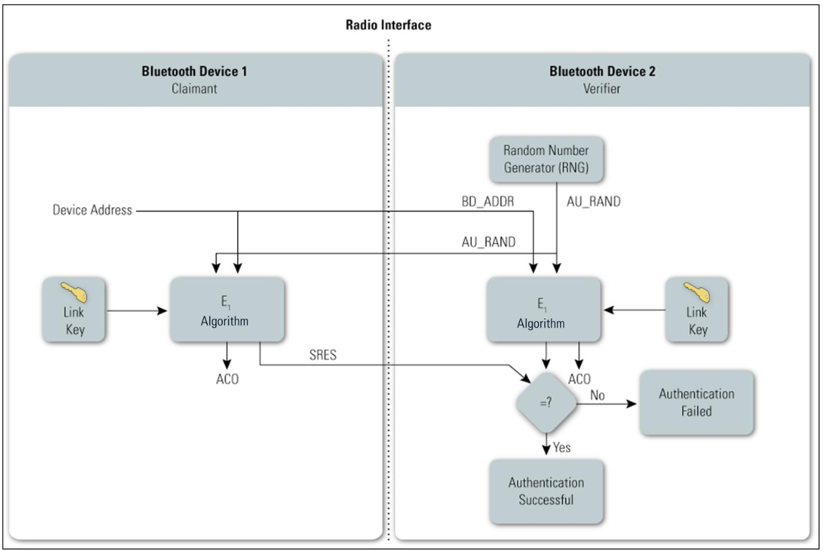
BT – authentication (E1)
http://csrc.nist.gov/publications/nistpubs/800-121-rev1/sp800-121_rev1.pdf

Slide 37
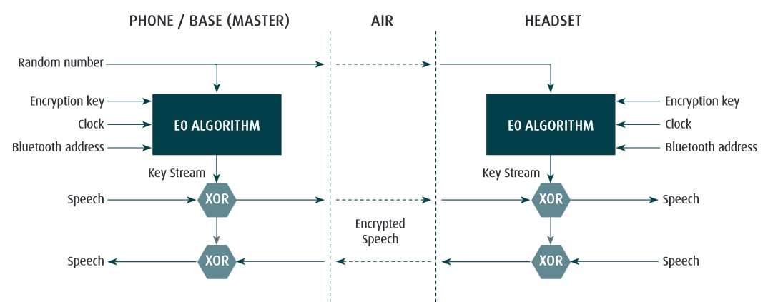
Bluetooth – E0 encryption
http://www.jabra.com/~/media/Documentation/Whitepapers/WP_Bluetooth_50004_V01_1204.pdf

Slide 38
Bluetooth attacks
Bluesnarfing, Bluebugging
  Unauthorized extraction of data from device (discoverable mode)
Guessing device address via brute-force attack
  48bit MAC address, but first 24 as manufacture’s id
Limited key-usage period (< BT 2.1)
  Around 23.5 hours before simple XOR attack (E0 stream cipher)
Encryption can be forced to be turned off (< BT 2.1)
L2CAP level attacks
  Parts of data packet not protected by integrity
  Fuzzing used to find flaws in device’s firmware

Slide 39
BT Pairing – Legacy pairing
BT 2.0 and before
Initial key exchange (K_{INIT}) over unencrypted link
  What attacks are possible?
Passkey/PIN → initialization key → link key
  Short passkey problem (passive attack ~ms)
  http://www.eng.tau.ac.il/~yash/shaked-wool-mobisys05/index.html
Is attack prevented by perfect forward secrecy?
  No, but force attacker to be active (MitM)
How to use Passkey/PIN to prevent MitM?
  Escalation protocols (fresh DH + PIN for authentication)

Slide 40
DH based on elliptic curves used (ECDH)
EC curve, G (base point)
A x G (scalar multiplication)
B x G
A x B x G
A x b
B x a
A x B x G
http://www.themccallums.org/nathaniel/2014/10/27/authenticated-key-exchange-with-speke-or-dh-eke/

Slide 41
BT Pairing – Secure Simple Pairing (SSP)
Secure Simple Pairing (SSP, from BT 2.1)
  Public-key crypto based (ECDH from BT 4.2) for key agreement
How to authenticate ECDH public part?
  Just works mode: no authentication
  Numeric comparison mode: display challenge and confirm
  Passkey Entry mode: insert passphrase
  Out Of Band mode: use other channel to establish auth. key
128 bit random link key for encryption (at maximum)
  Length negotiated by devices

Slide 42
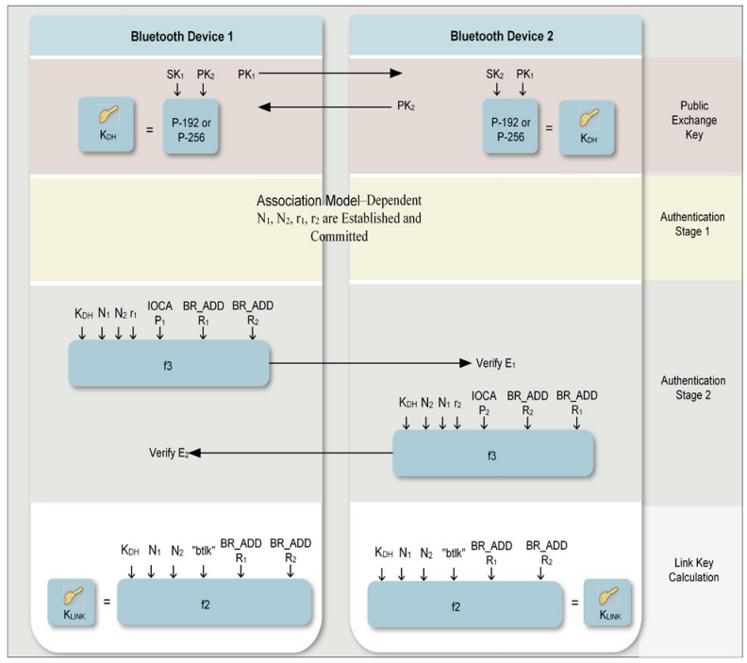
SSP
Just works / Numeric comparison / Pass Key Entry / Out of Band…
https://nvlpubs.nist.gov/nistpubs/SpecialPublications/NIST.SP.800-121r2.pdf

Slide 43
Bluetooth LE/Smart (BT 4.x) (2010)
For low-energy, storage/computation restricted devices
Simplified protocol for link key establishment
  LE pairing protocol establish long-term key (LTK)
  Key transport instead of key agreement is used
  One device generates LTK and transports during pairing
    What are security implications?
Support for out-of-band for pairing
  E.g., NFC-based exchange of Temporary Key (TK)
AES-CCM introduced (relevant for FIPS 140-2)
Introduction of private device address
  Public device address from encrypted (changing) private address
  Eavesdropper will not learn public address => no address tracking
Notes:
800-121-rev1, chapter 3.2

Slide 44
Bluetooth LE/Smart (BT 4.0)
BT Secure Simple Pairing uses Diffie-Hellman
  To prevent passive eavesdropping and forward secrecy
  But asymmetric crypto is slow(er) + energy consuming
Design decision for 4.0 – no SSP at the time
  BT 4.0 LE/Smart pairing is symmetric-cryptography based
  Passive eavesdropping + delayed key compromise possible
BT LE pairing with ECDH keys added in BT 4.2
  Authenticated ECDH exchange of link key

Slide 45
Bluetooth – Tracking privacy
Each BT device has unique 48-bit device address
  BT 1.0 required mandatory transmission, later dropped
Discoverable / non-discoverable mode
  Once discoverable, device’s address is trackable
  Address space (48b, manufacturer) can be brute-forced
BT 4.0 (BT LE) allows for private device address
  Public device address (used in key establishment) broadcasted only in encrypted form
  Eavesdropper cannot track target device based on MAC

Slide 46
Bluetooth security tools
BlueSpam - sends file via OBEX to active devices
BlueHell http://sourceforge.net/projects/bluehell/
Bluelog http://tools.kali.org/wireless-attacks/bluelog
  Discover and log discoverable devices
BlueMaho https://wiki.thc.org/BlueMaho
  Monitor devices, test known attacks
Bluepot https://github.com/andrewmichaelsmith/bluepot/
  Bluetooth Honeypot

Slide 47
Bluetooth – (moral) summary
One of early protocols intended for battery-powered “limited” devices (BT 1.x)
  Cell phones that time, wireless headsets…
  Vulnerabilities due to insecure defaults, proprietary crypto etc.
  Typical for the period of its introduction (recall also WiFi’s WEP…)
More security features introduced (BT 2.x)
  But also usability, adoption and intellectual property dispute issues
Cooperation with other technologies, speed (BT 3.x)
  Initial exchange and configuration, then faster WiFi transmissions
Added focus on extra low energy devices (BT 4.x)
  Secure by default, standardized crypto algorithms
  Renewed interest and support, wider adoption

Slide 48

NFC
Wireless networks – Near Field Communication

Slide 49
Near Field Communication (NFC)
Low-power, low-bandwidth communication
  Initially for reader to tag communication
  Possibility for tag emulation by device (=>device to device)
Be aware of potential confusion of “NFC” term
  As general term (short distance communication)
  As NFC as specific implementation (NFC A, ISO18092)

Slide 50
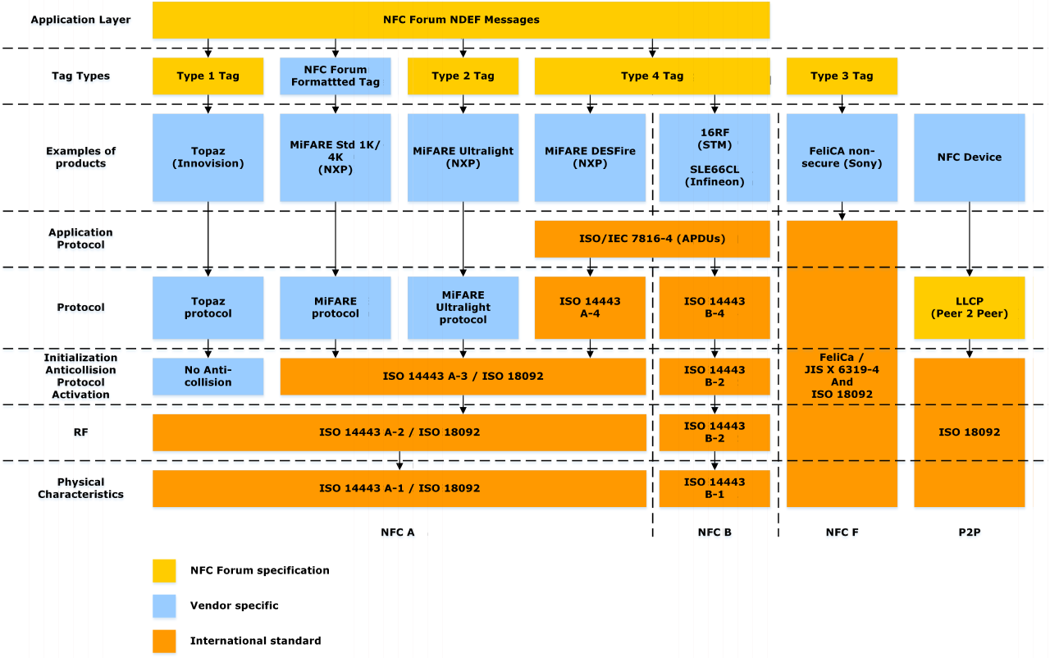
NFC standards
"NFC Protocol Stack" by Erik Hubers –
Licensed under CC BY-SA 4.0 via Commons

Slide 51
Security goals of NFC
Physical presence proof
  Only short distance communication possible
  Locality of eavesdropping
Simplify key management for other protocols (OOB)
  Uses physical presence proof
  NFC → initial key → BT SSP → BT/WiFi transmission
  NFC → IP, MAC, key → WiFi-Direct
Utilize secure hardware via reader
  Physical tag, token, cryptographic smart card…
Turn mobile phone into security token
  Card emulation

Slide 52
NFC communication modes
Reader/writer mode
  Read (and/or write) NFC tags and stickers
  No security except physical presence bounding
  Usually only tag’s/sticker’s ID transmitted
P2P mode
  exchange data with other NFC peer
  used by Android Beam between two NFC-enabled phones
Card emulation
  NFC device emulates tag/cryptographic smart card

Slide 53
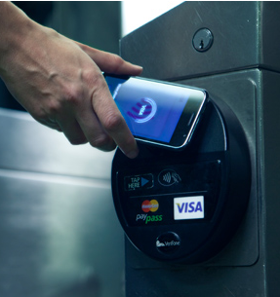
NFC mode: Card emulation
NFC device emulates tag/cryptographic smart card
Card emulation mode
  NFC device acts as NFC card
  Emulated by separate chip in device – secure element
    Commands are relayed to real card
Host-based card emulation
  Emulation without physical secure element
  Phone provides functionality of smart card
    Software “smart card”

Slide 54
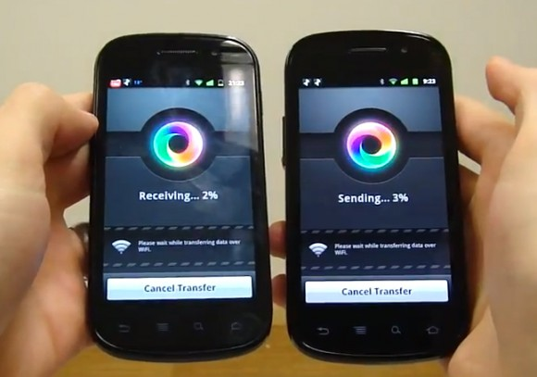
NFC as bootstrapping technology
Out Of Band (OOB) exchange of initial secrets
  Utilizes “physical” presence property of NFC
  Simplifies initial key exchange
    dependency on difficulty of eavesdropping/MitM
Android Beam
  Uses NFC to exchange 6-digits passcode for Bluetooth
Samsung S-Beam
  IP,MAC via NFC for WiFi-Direct
…

Slide 55
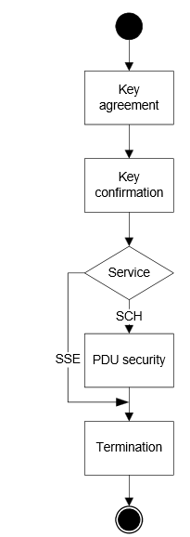
NFC security (NFC-SEC, NFC-SEC-01)
“Shared Secret Service” (SSE)
  Results in confirmed shared key between devices
  Based on Elliptic Curve Diffie-Hellman key exchange scheme (ECDH-192b)
  Not authenticated (MiTM possible, but physical location)
"Secure Channel Service" (SCH)
  Results in link key for secure channel derived from SSE
  Uses AES and AES-CRT for key derivation, encryption, integrity
Application-level security possible
  Use NFC to exchange keys for Bluetooth/WiFi
  Implement custom protocol between devices (if needed)
http://www.ecma-international.org/publications/files/ECMA-ST/ECMA-386.pdf
http://www.ecma-international.org/publications/files/ECMA-ST/ECMA-385.pdf
Notes:
http://ecma-international.org/activities/Communications/tc47-2008-089.pdf

Slide 56
Fuzzing NFC stack
Direct emulation of one side
  Card emulation mode
MITM between reader and card (proxy)
  Data modified in transport
  No need to implement NFC stack fully
Compromise of NFC stack allows for BT open
  Android, BLUETOOTH_ADMIN
R. Miller, Exploring the NFC Attack Surface (2012)
  http://media.blackhat.com/bh-us-12/Briefings/C_Miller/BH_US_12_Miller_NFC_attack_surface_WP.pdf

Slide 57
NFC vs. Bluetooth
NFC consumes significantly less energy
NFC has significantly shorter maximum distance
  Active→passive mode, advantage of physical bounding
NFC is compatible with existing standards/devices
  Passive RFID
Bluetooth LE moved more towards energy-efficiency
  But still only active-active mode
Notes:
http://www.rsaconference.com/writable/presentations/file_upload/mbs-w09-security-implications-of-nfc-in-authentication-and-identity-management.pdf

Slide 58

ZigBee (IEEE 802.15.4)
Wireless networks – Moving towards more networking

Slide 59
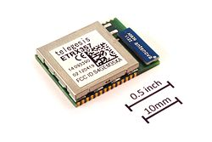
ZigBee – characteristics
Standardized as IEEE 802.15.4
  ZigBee Alliance maintains current version
  Niche between Bluetooth and WiFi
Low cost, low power, mesh networking
  Low power transmissions, smaller bitrate (250 kbit/s)
  10-100 meters (active-active communication mode)
  Focus on sensors and control automation
Various radio bands (2.4GHz), routing specifications
Supports star, tree and mesh network topology
  E.g., wireless sensor networks, up to 65000 nodes

Slide 60
ZigBee network
ZigBee Coordinator (ZC) / PAN coordinator
  One coordinator per network
  Responsible for establishment of network
  Serve as repository for security keys
ZigBee Router (ZR) / Coordinator
  Pass data from one node to another (routing scheme)
  Intermediate node in network
ZigBee End Device (ZED) / Network device
  Cheaper to produce, end (sensor) node
  Cannot relay communication => can sleep => battery life

Slide 61
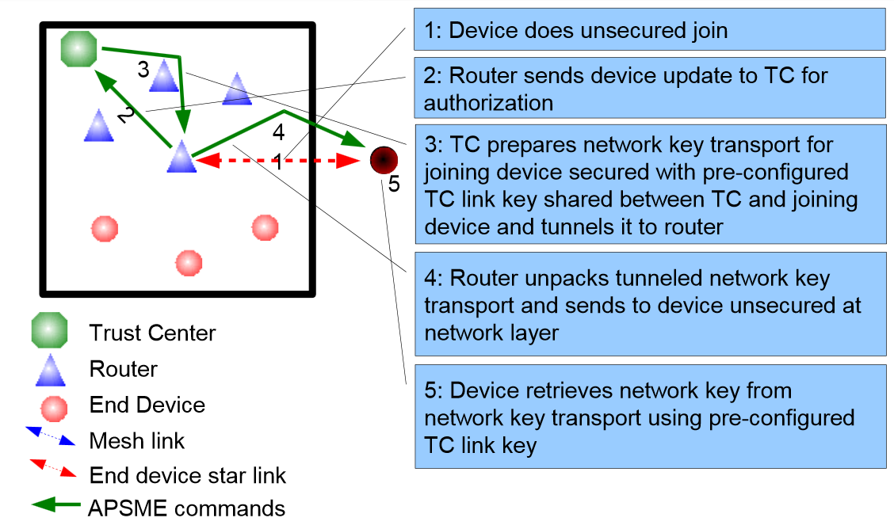
Joining ZigBee network
  Source: https://docs.zigbee.org/zigbee-docs/dcn/09-5378.pdf

Slide 62
ZigBee keys
Pre-installation of master keys
  Network key (shared by all), Link key (between 2 devices)
Transport of link keys
  Trust center (ZC) sends link key to both nodes
Certificate-based key establishment
  Trust center (ZC) facilitate establishment, no keys send between device and ZC
  Elliptic Curve MQV key agreement scheme

Slide 63
ZigBee cryptography
Mostly based on symmetric cryptography
  AES with 128b keys, master key, link key, network key(s)
  Uses AES-CCM* mode for link layer encryption
    encryption/integrity-only mode possible, MAC 4 bytes
Certificate-based key establishment
  Elliptic Curve MQV key agreement scheme
  Requires certification authority

Slide 64
Summary

Slide 65
Comparison: BT/NFC/ZigBee
BT initially not for low-energy, but adapted (BT 4.x)
NFC uses active-passive mode (locality)
Pre-distributed keys vs. user interaction vs. locality
ZigBee towards mesh networks
Bluetooth LE also in direction of mesh networks
(Next lecture will focus more on WSNs)

Slide 66
Similarity between protocols (security)
Easy eavesdropping
Usage of proprietary (weak) ciphers (at begin)
Incorrect implementations of (complicated) standard
Reuse of key stream (“never” need 2²⁰ packets?)
Problem of initial pairing (how to authenticate?)
Brute-forcing usable/memorable/short PINs
Problem of device tracking (unique device ID)
Security generally getting better over time

