Slide 1
Cloud Deployment Scenarios

Slide 2
Preface
List the four major cloud deployment types
Describe the features of private, public, hybrid, and community clouds
List some additional cloud deployment types
Select the most appropriate deployment model based on a set of business and technical requirements
Agenda
Cloud deployment models - public, private, hybrid, community clouds
Selection criteria for cloud deployment types

Slide 3
Cloud deployment models
There are 4 cloud deployment model that will be covered during this chapter
Public Cloud
Private Cloud
Community Cloud
Hybrid Cloud

Slide 4
Gartner Definition of Public Cloud computing
Gartner defines public cloud computing as a style of computing where scalable and elastic IT-enabled capabilities are provided as a service to external customers using Internet technologies—i.e., public cloud computing uses cloud computing technologies to support customers that are external to the provider’s organization.
Using public cloud services generates the types of economies of scale and sharing of resources that can reduce costs and increase choices of technologies.

Slide 5
Public Cloud
A public cloud is a publicly accessible cloud environment owned by a third-party cloud provider. The IT resources on public clouds are usually provisioned via the previously described cloud delivery models and are generally offered to cloud consumers at a cost or are commercialized via other avenues (such as advertisement).
The cloud provider is responsible for the creation and on-going maintenance of the public cloud and its IT resources. Many of the scenarios and architectures explored in upcoming chapters involve public clouds and the relationship between the providers and consumers of IT resources via public clouds.

Slide 6
Gartner definition of Private Cloud computing
Private cloud computing is a form of cloud computing that is used by only one organization, or that ensures that an organization is completely isolated from others.

Slide 7
Private Cloud Computing
A private cloud is owned by a single organization. Private clouds enable an organization to use cloud computing technology as a means of centralizing access to IT resources by different parts, locations, or departments of the organization.
The use of a private cloud can change how organizational and trust boundaries are defined and applied. The actual administration of a private cloud environment may be carried out by internal or outsourced staff.

Slide 8
Hybrid Cloud Computing
A hybrid cloud is a cloud environment comprised of two or more different cloud deployment models. For example, a cloud consumer may choose to deploy cloud services processing sensitive data to a private cloud and other, less sensitive cloud services to a public cloud.
Typical challenges:
Management
Workload Balancing,
Brokerage / Integration
Portability

Slide 9
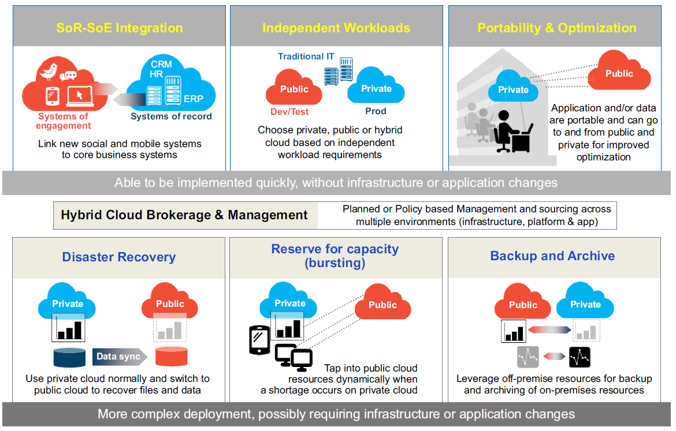
Hybrid Cloud Use Cases (examples)

Slide 10
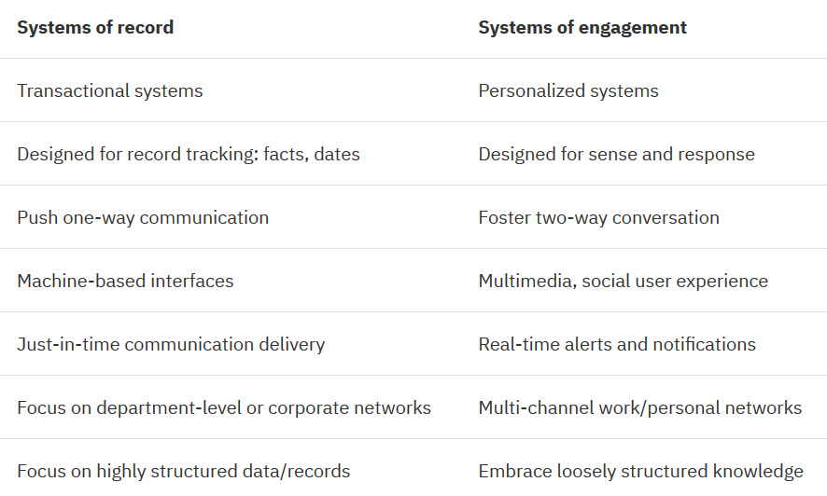
System of records vs system of engagement
SoE: EXAMPLES:
Hong Kong department Stores
A chain of Hong Kong department stores used its Web-based system of engagement to capture the near-real-time activity of each Web visitor and achieved a 250 percent higher conversion rate with customer-generated product reviews.
North American airline
A Canadian airline carrier increased customer satisfaction and streamlined booking operations by offering a mobile self-service solution that increased mobile check-ins by 13.5 percent. These systems of engagement increased mobile flight pass bookings and reduced the cost of check-in cost by 80% compared to traditional counter check-in process

Slide 11
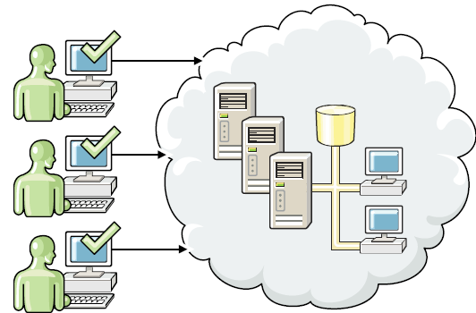
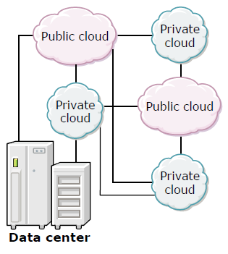
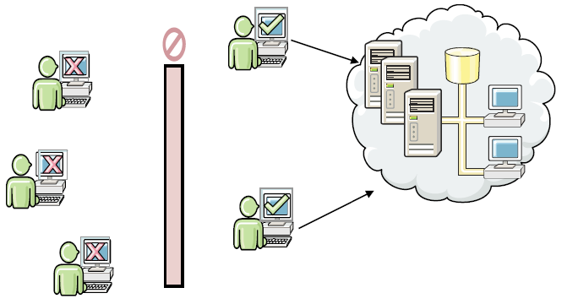
Public Cloud
Hybrid Cloud
Private Cloud
Notes:
11

Slide 12
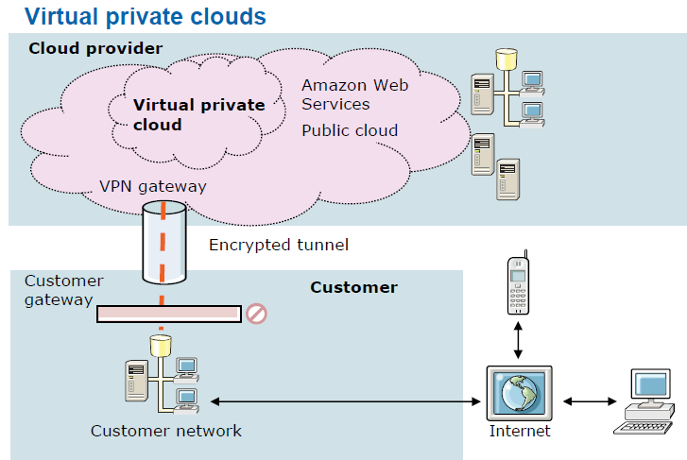
A virtual private cloud (VPC) is dedicated to a single user within a public cloud.
The virtual private cloud extends the customer network into the cloud provider’s “space”, making the additional resources available on demand.
Notes:
The isolation between one VPC user and all other users of the same cloud (other VPC users as well as other public cloud users) is achieved normally through allocation of a private IP subnet and a virtual communication construct (such as a VLAN or a set of encrypted communication channels) per user. In a VPC, the previously described mechanism, providing isolation within the cloud, is accompanied with a VPN function (again, allocated per VPC user) that secures, by means of authentication and encryption, the remote access of the organization to its VPC cloud resources.
12

Slide 13
Workload types – cloud suitability (public vs. private)
Private cloud | Public Cloud
Employee information or other sensitive data typically restricted to the enterprise | Test systems and environments
Workloads composed of multiple, co-dependent services | Pre-production systems and environments
Workloads requiring customization | Mature packaged offerings, like e-mail and collaboration
Workloads based on third-party software that does not have a virtualization or cloud-aware licensing strategy | Storage solutions (including storage as a service)
High throughput online transaction processing | Backup solutions (including backup and restore as a service)
 | Batch processing jobs with limited security requirements
 | Data-intensive workloads if the provider has a cloud storage offering linked to the cloud compute

Slide 14
Community Cloud
A community cloud is similar to a public cloud except that its access is limited to a specific community of cloud consumers. The community cloud may be jointly owned by the community members or by a third-party cloud provider that provisions a public cloud with limited access. The member cloud consumers of the community typically share the responsibility for defining and evolving the community cloud

