Slide 1
PV204 Security technologies
Introduction to smart cards as secure elements
Petr Švenda
svenda@fi.muni.cz @rngsec
https://crocs.fi.muni.cz/people/svenda
Faculty of Informatics, Masaryk University, Czech Republic

Slide 2
Smart cards
Lecture:
PC/SC communication framework, APDU
Basic platforms – JavaCard & .net card & MULTOS, comparison
Secure channel protocol (authentication, session keys, APDU protection), SCP
Attacks against two-factor authentication
Lab
Creating secure channel protocol
Communicating with smart cards

Slide 3
Mind path for lecture
Smart cards are typical example of secure element → what smart card can be → what smart card is capable of
Current variance on cards side → current variance on host side → how smart cards fits into bigger system
How to communicate with cards
Contact (ISO7816-2) / contactless (ISO/IEC 14443)
Low level transmission (T=0/T=1, ISO 7816-4)
Logical packets (APDU)
Standardized API on card (OpenPlatform, PIV, OpenPGP, ePassport)
Standardized API on host (PC/SC, PKCS#11/15)
Secure channel with card (OpenPlatform SCP’03, BAC, EAC)
What are cards capable of – supported algorithms, speed
What sc can be used for
Digital signatures – generate and use private key (+ attacks), key encryption on card
Two-factor authentication, access control (challenge-response protocol) (+attacks)
Secure environment (code protection, trusted element - tokenization) (+attacks)

Slide 4
Overview
What smart cards are?
What smart cards are capable of?
How to manage smart cards?
Secure channel protocols
Two-factor authentication and some attacks

Slide 5
What A Smart card is?
Smart card basics

Slide 6
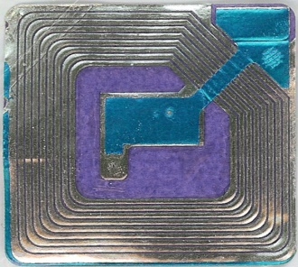
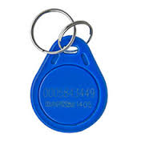
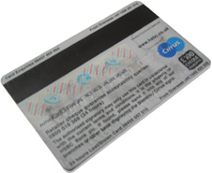
Basic types of (smart) cards
Contactless “barcode”
Fixed identification string (RFID, < 5 cents)
Simple memory cards (magnetic stripe, RFID)
Small write memory (< 1KB) for data, (~10 cents)
Memory cards with PIN protection
Memory (< 5KB), simple protection logic (<$1)

Slide 7
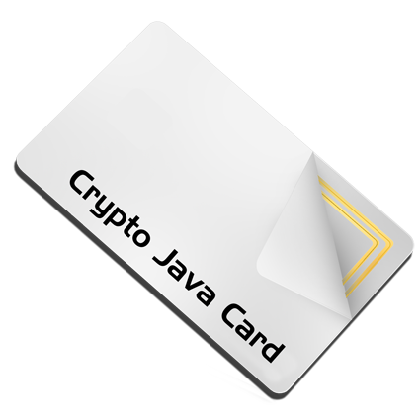
Basic types of (smart) cards (2)
Cryptographic smart cards
Support for (real) cryptographic algorithms
Mifare Classic ($1), Mifare DESFire ($3)
User-programmable cryptographic smart cards
JavaCard, .NET card, MULTOS cards ($2-$30)
Chip manufacturers: NXP, Infineon, Gemalto, G&D, Oberthur, STM, Atmel, Samsung...
We will mainly focus on these two categories

Slide 8
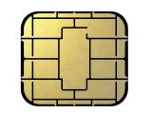
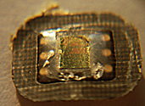
Cryptographic smart cards
CRYPTO
RNG
CPU
ROM
SRAM
EEPROM
SC is quite powerful device
8-32 bit processor @ 5-20MHz
persistent memory 32-150kB (EEPROM)
volatile fast RAM, usually <<10kB
truly random generator
cryptographic coprocessor (3DES,AES,RSA-2048,...)
8.05 billion units shipped in 2013 (ABI Research)
mostly smart cards
telco, payment and loyalty...
1 billion contactless estimated for 2016 (ABI Research)
chip
contacts
contacts

Slide 9
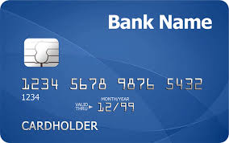
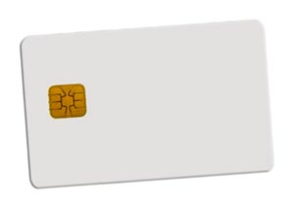
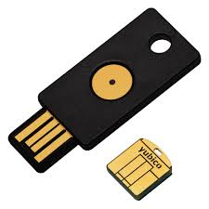
Smart cards forms
Many possible forms
ISO 7816 standard
SIM size, USB dongles, Java rings…
Contact(-less), hybrid/dual interface
contact physical interface
contact-less interface
hybrid card – separate logics on single card
dual interface – same chip accessible contact & c-less

Slide 10
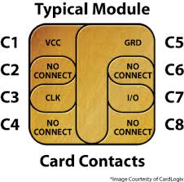
Contact vs. contactless
Contact cards (ISO7816-2)
I/O data line, voltage and GND line
clock line, reset lines
Contactless cards
ISO/IEC 14443 type A/B, radio at 13.56 MHz
Chip powered by current induced on antenna by reader
Reader → chip communication - relatively easy
Chip → reader – dedicated circuits are charged, more power consumed, fluctuation detected by reader
Multiple cards per single reader possible

Slide 11
Smart cards are used for…
GSM SIM modules
Digital signatures
Bank payment card (EMV standard)
System authentication
Operations authorizations
ePassports
Multimedia distribution (DRM)
Secure storage and encryption device
…

Slide 12
Smart card is highly protected device
Intended for physically unprotected environment
NIST FIPS140-2 standard, security Level 4
Common Criteria EAL4+/5+
Tamper protection
Tamper-evidence (visible if physically manipulated)
Tamper-resistance (can withstand physical attack)
Tamper-response (erase keys…)
Protection against side-channel attacks (power,EM,fault)
Periodic tests of TRNG functionality
Approved crypto algorithms and key management
Limited interface, smaller trusted computing base (than usual)
http://csrc.nist.gov/groups/STM/cmvp/documents/140-1/140val-all.htm

Slide 13
Main advantages of crypto smart cards
High-level of security (CC EAL5+, FIPS 140-2)
Fast cryptographic coprocessor
Programmable secure execution environment
Secure memory and storage
On-card asymmetric key generation
High-quality and very fast RNG
Secure remote card control

Slide 14
Smartcards in wider system

Slide 15
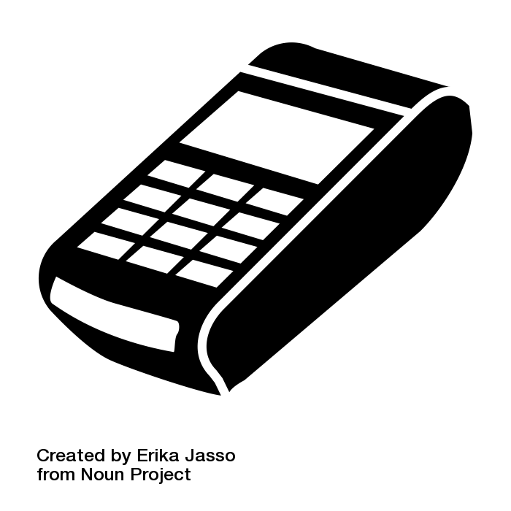
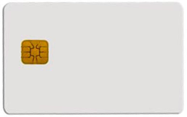
Big picture – terminal/reader and card
Merchant payment
Digital signature
What principles and standards are used?

Slide 16
Big picture - components
User application
OS smart card API
User application
Merchant terminal GUI
Banking transfer GUI
Browser TLS
…
Card application
EMV applet for payments
SIM applet for GSM
OpenPGP applet for PGP
…
smart card reader
contact(less)
transmission
Card I/O manager
Card application
Card OS

Slide 17
PC application
with direct control:
GnuPG, GPShell
PC application via library:
browser TLS, PDF sign…
Custom app with
direct control
Libraries
PKCS#11, OpenSC, JMRTD
Smartcard control language API
C/C# WinSCard.h, Java java.smartcardio.*, Python pyscard
System smartcard interface: Windows’s PC/SC, Linux’s PC/SC-lite
Manage readers and cards, Transmit ISO7816-4’s APDU
Readers
Contact: ISO7816-2,3 (T=0/1)
Contactless: ISO 14443 (T=CL)
APDU packet
API: EMV, GSM, PIV, OpenPGP, ICAO 9303 (BAC/EAC/SAC)
OpenPlatform, ISO7816-4 cmds, custom APDU
Card application 1
Card application 2
Card application 3
SC app programming:
JavaCard, MultOS, .NET

Slide 18
Main standards
User application
OS smart card API
ISO7816 1-4
Card physical properties ISO7816-1
Physical layer communication protocol ISO7816-2-3
Data packet format (APDU)
PC/SC, PC/SCLite (host side)
Readers/cards management
Transmission of logical APDU packets
C/C# WinSCard.h, Java java.smartcardio.*, Python pyscard
PKCS#11
standardized interface on host side
card can be proprietary
GlobalPlatform
remote card management interface
secure installation of applications
smart card reader
contact(less)
transmission
Card I/O manager
Card application
Card OS

Slide 19
Card’s programming platforms
User application
OS smart card API
MultOS
Multiple supported languages, native compilation
Often bank cards
JavaCard (details in 3rd lecture)
open programming platform from Sun
applets portable between cards
Microsoft .NET for smartcards
Similar to JavaCard, but C#
Applications portable between cards
Limited market penetration
smart card reader
contact(less)
transmission
Card I/O manager
Card application
Card OS

Slide 20
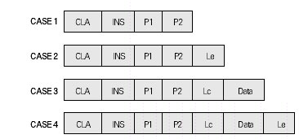
APDU (Application Protocol Data Unit)
APDU is basic logical communication datagram
header (5 bytes) and up to ~256 bytes of user data
Format specified in ISO7816-4
Header/Data format
CLA – instruction class
INS – instruction number
P1, P2 – optional data
Lc – length of incoming data
Data – user data
Le – length of the expected output data
Some values of CLA/INS/P1/P2 standardized
Custom values used by application developer

Slide 21
What values of APDU header are used?
Standardized values for selected application
Interoperability
http://techmeonline.com/most-used-smart-card-commands-apdu/
Custom commands for proprietary application

Slide 22
Selected software components
PC/SC (MS API: SCardxx, Java: java.smartcardio.*)
PC/SCLite (implementation of PC/SC for Linux/MAC)
OpenSC – proxy component between proprietary tokens and PKCS#11 interface
SoftHSM – virtual PKCS#11-compliant card

Slide 23
Smartcard algorithms and performance

Slide 24
Common algorithms
Basic - cryptographic co-processor
Truly random data generator
3DES, AES128/256
MD5, SHA1, SHA-2 256/512
RSA (up to 2048b common, 4096 possible)
ECC (up to 192b common, 384b possible)
Diffie-Hellman key exchange (DH/ECDSA)
Custom code running in secure environment
E.g. HMAC, OTP code, re-encryption
Might be significantly slower (e.g., SW AES 50x slower)

Slide 25
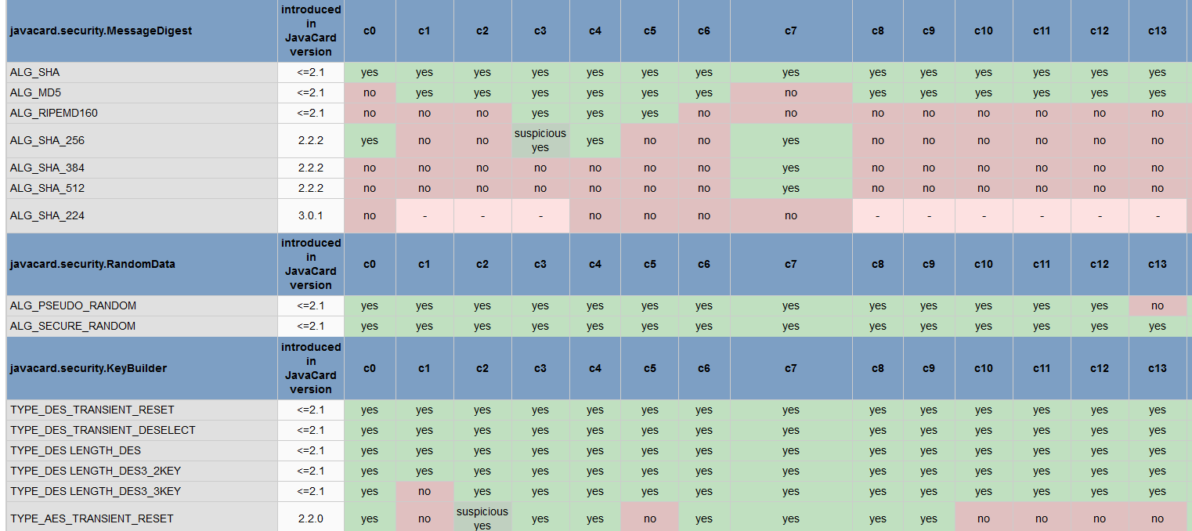
Cryptographic operations
Supported algorithms (JCAlgTester, 62+ cards)
https://github.com/crocs-muni/JCAlgTest
https://www.fi.muni.cz/~xsvenda/jcsupport.html

Slide 26
What is the typical performance?
Hardware differ significantly
Clock multiplier, memory speed, crypto coprocessor…
Typical speed of operation is:
Milliseconds (RNG, symmetric crypto, hash)
Tens of milliseconds (transfer data in/out)
Hundreds of millisecond (asymmetric crypto)
Seconds (RSA keypair generation)
Operation may consists from multiple steps
Transmit data, prepare key, prepare engine, encrypt
→ additional performance penalty

Slide 27
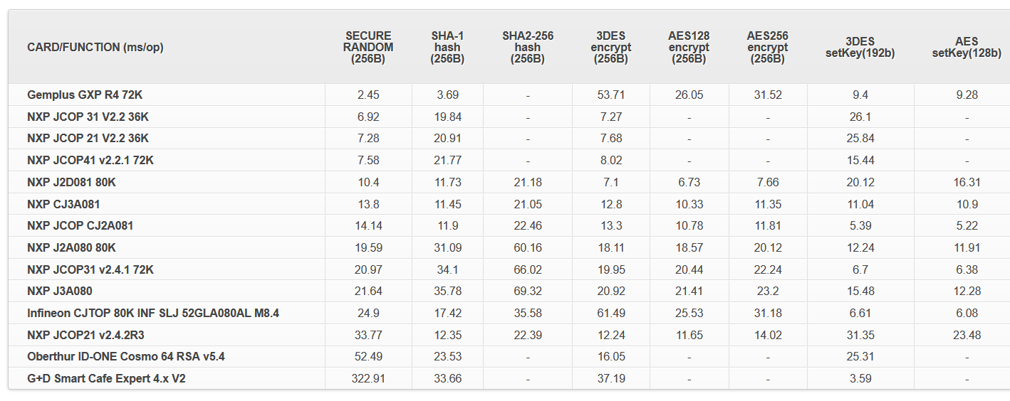
Performance tables for common cards
https://jcalgtest.org
Visit https://jcalgtest.org

Slide 28
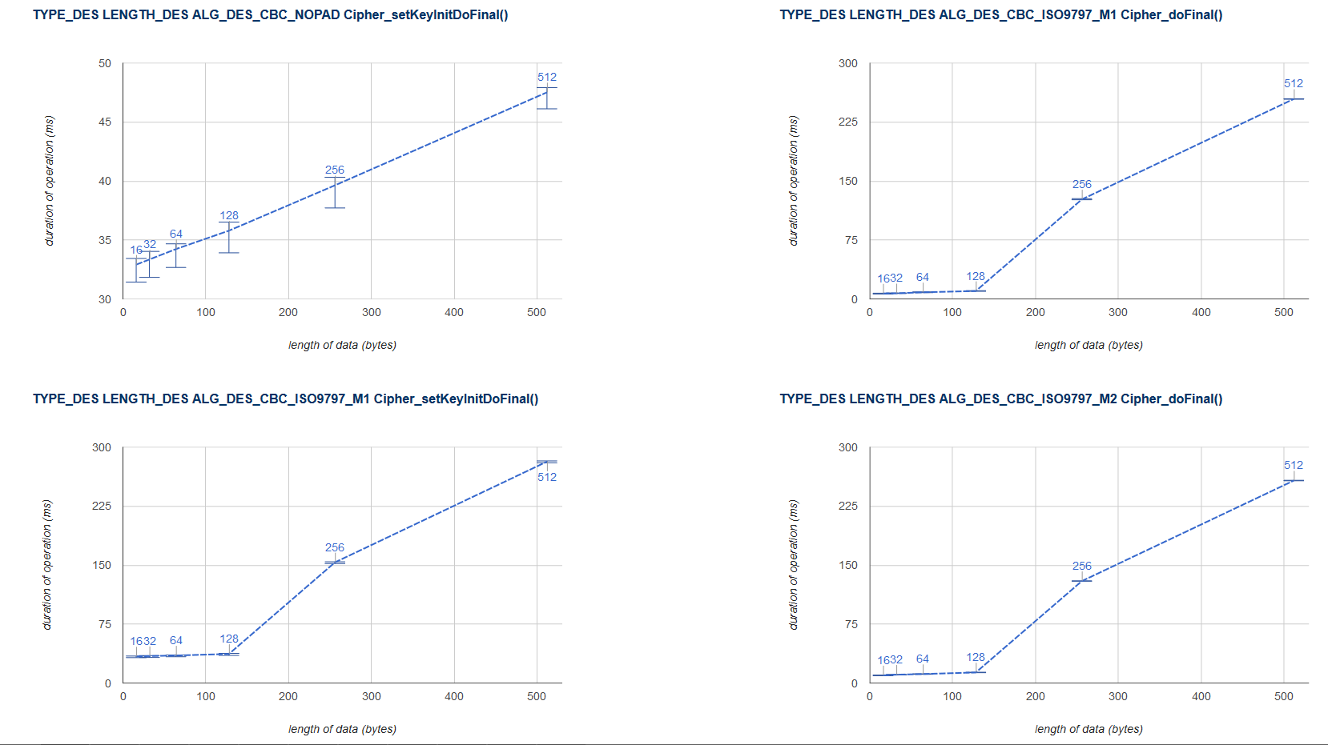
Performance with variable data lengths
https://jcalgtest.org
Limited memory and resources
may cause non-linear dependency on a processed data length

Slide 29
Smart card management

Slide 30
Motivation
How to upload, install and remove applications?
Who should be allowed to upload/remove apps?
What if multiple mutually distrusting apps on card?
How to update application in already issued card?
Need for cross-platform interoperable standard
Many manufactures and platform providers

Slide 31
Globalplatform

Slide 32
GlobalPlatform
Specification of API for card administration
Upload/install/delete applications
Card lifecycle management
Card security management
Security mechanisms and protocols
Newest is GlobalPlatform Card Specification v2.3
December 2015
Previous versions also frequently used
http://www.globalplatform.org/specificationscard.asp

Slide 33
GlobalPlatform – main terms
Card Manager
Security
Domain 1
Security
Domain 2
Smart card life cycle
OP_READY, INITIALIZED (prepared for personalization)
SECURED (issued to user, use phase)
CARD_LOCKED (temporarily locked (attack), unlock to SECURED)
TERMINATED (logically destroyed)
Card Manager (CM)
Special card component responsible for administration and card system service functions (cannot be removed)
Security Domain (SD)
Logically separated area on card with own access control
Enforced by different authentication keys

Slide 34
GlobalPlatform – main terms
Card Manager
Security
Domain 1
Security
Domain 2
Applet 2
Applet 3
Applet 1
Card Content (apps,data) Management
Content verification, loading, installation, removal
Security Management
Security Domain locking, Application locking
Card locking, Card termination
Application privilege usage, Security Domain privileges
Tracing and event logging
Command Dispatch
Application selection
(Optional) Logical channel management

Slide 35
Smart card life cycles
The smart card passes various logical life cycle states between manufacture and final destruction
Life cycle states define which operations can be performed with the card
The card Life Cycle States OP_READY and INITIALIZED are intended for use during the Pre-Issuance phases of the card’s life.
The states SECURED, CARD_LOCKED and TERMINATED are intended for use during the Post-Issuance phase of the card although it is possible to terminate the card at any point during its life.

Slide 36
Smart card life cycles
OP_READY – card is ready for uploading of key diversification data, any application and issuer specific structures.
INITIALIZED – card is fully prepared but not yet issued to card holder.
SECURED – card is issued to card holder. Card management is possible only throw Security domain in secure sense (installation of signed applets etc.).
CARD_LOCKED – card is locked due to some security policy and no data management can be performed. Card can be locked by Security domain and later unlocked as well (switch back to SECURED state).
TERMINATED – card is logically “destroyed“ due to card expiration or detection of the severe security thread.

Slide 37
Global Platform APDU commands
DELETE – delete uniquely identifiable object (e.g. JavaCard applet)
STORE_DATA – upload content of single data object
GET_DATA - used to retrieve a single data object
SET_STATUS – set Life Cycle status
GET_STATUS – return Life Cycle status
INSTALL – initiate installation, typically (JavaCard) applet
LOAD – upload file from PC to smart card, e.g. JavaCard cap file
PUT_KEY – update value of specified key

Slide 38
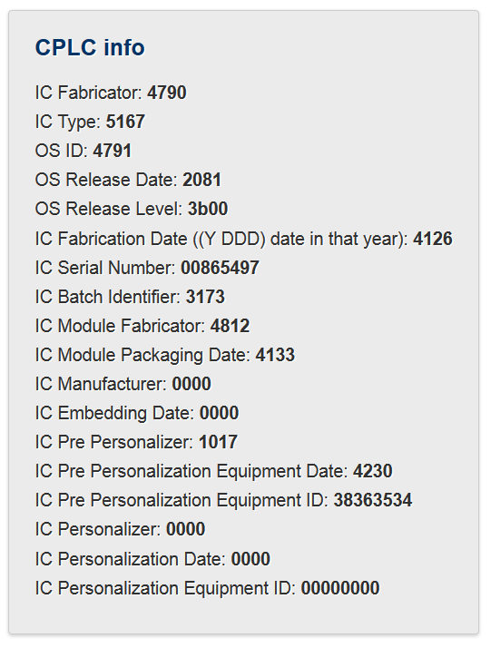
Card Production Life Cycle (CPLC)
Manufacturing metadata
Dates (OS, chip)
Circuit serial number
Not mandatory
GlobalPlatform APDU
80 CA 9F 7F 00
gppro --info
ISO7816 APDU
00 CA 9F 7F 00

Slide 39
Secure channel Protocol
How to authenticate and communicate securely?

Slide 40
Transport Layer Security (TLS) Protocol
Full TLS handshake (RFC 5246)

Slide 41
TLS handshake
Credit: Cloudflare

Slide 42
Why not to use TLS all the time?
Requires asymmetric cryptography
Unsuitable for slower devices
Requires long keys
Unsuitable for devices with small memory
Requires significant data overhead (~6.5KB)
http://netsekure.org/2010/03/tls-overhead/
More lightweight protocols exist
RFID / smartcards / IoT…
Note: TLS can be fully implemented on smartcards
https://github.com/gilb/smart_card_TLS

Slide 43
Secure channels – questions to ask
What attacker model is assumed?
Integrity protection? Encryption? Authentication?
One-side or mutual authentication?
What kind of cryptography is used?
What keys are required/pre-distributed?
Additional trust hierarchy required?
Is necessary to generate random numbers/keys?
What if keys are compromised? Forward secrecy?

Slide 44
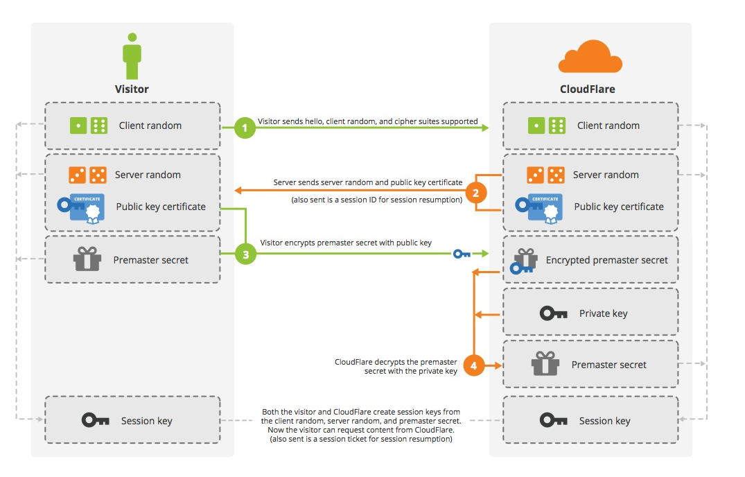
What attacker model is assumed?
Integrity protection? Encryption? Authentication?
One-side or mutual authentication?
What kind of cryptography is used?
What keys are required/pre-distributed?
Additional trust hierarchy required?
Is necessary to generate random numbers/keys?
What if keys are compromised? Forward secrecy?

Slide 45
Common lightweight SCPs
OpenPlatform SCP’01,’02 (3DES-based)
OpenPlatform SCP‘10 (RSA-based)
OpenPlatform SCP’03 (AES-based)
ISO/IEC 7816-4 Secure Messaging
ePassports Basic Access Control (3DES-based)
ePassports Extended Access Control (3DES,RSA,DH,SHA1/2-based)

Slide 46
Secure channel – typical composition
Exchange basic (public) parameters
Generate random challenges (freshness)
Use pre-distributed secrets and challenges to generate session keys (protect long term secrets)
Compute and verify authentication cryptograms (entity authentication)
Encrypted&MAC message(s) (Secure Messaging)
End secure channel (erase session keys)

Slide 47
SCP – what to take into account
Usage scenario and expected attackers
Confidentiality and integrity of command data
Network level attacks (replay…)
Atomicity of critical operations
Robustness against side channel attacks (time and power analysis, fault attacks…)
Robustness against incorrect attempts (limit, delay retries…)
Resilience against traffic analysis
API and implementation attacks

Slide 48
SCP – usage scenario and attacker model
What are the sensitive objects (keys, data, functions)?
What are these sensitive objects used for and what is the data flow of these objects?
What are the capabilities of the attackers (funding, tools, knowledge)?
What are the points where an attacker can observe the system (dump of exchanged messages, debugging, ...)?
Which parts of the system must be trusted to achieve required functionality (less the better)?

Slide 49
SCP – network attacks
Use HMAC or OMAC instead of simple hash only
Include command header/metadata into MAC
Pre-share two keys (encryption, mac) or derive from master instead of using only one
Use pre-shared keys only to derive session keys. Session keys are used than to generate cryptograms etc.
Session keys must be dependent on contributions from both parties. One party cannot force resulting key into specific value

Slide 50
SC – network attacks
Replay attack – hash chain better than counter only
Encrypt then MAC: MAC(ENC(data))
Close channel on error
Use GCM rather than CBC rather than ECB
Be aware of block swap in ECB mode, cut attack in CBC
Do not use XOR for combination of values – use hash/HMAC instead
Reflection attack: Do not use symmetric protocol messages (A→B cannot be reflected as B→A)

Slide 51
Example: GlobalPlatform SCP’03
Mutual authentication (based on symmetric crypto)
Session key derivation (based on long-term keys)
NIST SP 800-108
Message (APDU) confidentiality and integrity MAC
INITIALIZE UPDATE
Random challenge, card’s computations
EXTERNAL AUTHENTICATE
Terminal response
Secure messaging

Slide 52
Secure Channel Protocol '03‘, Card Specification v2.2 – Amendment D, GPC_SPE_014

Slide 53
Secure Channel Protocol '03‘, Card Specification v2.2 – Amendment D, GPC_SPE_014

Slide 54
ePassport protocols (ICAO 9303)
Significantly more complex trust model
Passport, Inspection terminal, Trusting countries, Distrusting countries
Multiple sensitivity levels (basic info / fingerprint / iris)
Combination of symmetric and asymmetric cryptography
Basic Access Control (BAC) protocol
SCP-like protocol, static key is content from MRZ
Extended Access Control (EAC) protocol
Terminal authentication (RSA/ECDSA, SHA-1/2)
Chip authentication (DH/ECDSA key)
PACE protocol to establish session keys
Active Authentication (AA) protocol
More in 4th lecture

Slide 55
Two factor authentication

Slide 56
Two-factor authentication
Two factors with tokens/smart cards
Token (smart card, phone) + Knowledge (PIN, Password)
Authorize transaction with card and PIN
Authenticate with password and SMS
Authenticate user with One-Time Password (OTP) generated on mobile phone (stored secret key) after screen unlock (pattern)
…
How to attack two-factor?

Slide 57
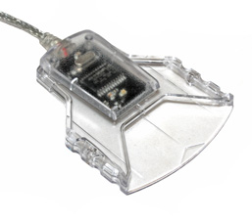
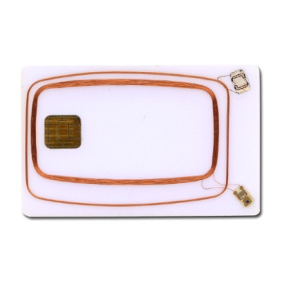
Application uses PC/SC interface (SCardxx)
User application
winscard.dll
reader driver
USB driver
APDU

Slide 58
Where to log communication?
In-application logging
User application
winscard.dll
“Stub” winscard.dll logging
reader driver
Virtual reader
In-card logger
USB driver
HW USB sniffer
APDU
SW USB sniffer
HW ISO7816 T=0/1

Slide 59
APDUPlay project (https://www.fi.muni.cz/~xsvenda/apduinspect.html)
based on ApduView utility (by Fernandes)
User application
[begin]
SCardTransmit (handle 0xEA010001)# apduCounter:0#
totalBytesINCounter:1#
transmitted:00 a4 04 00 0a a0 00 00 00 28 80 10 30 01 ff
responseTime:31#
SCardTransmit result:0x0#
received:6a 81
SCardTransmit (handle 0xEA010001)# apduCounter:1#
totalBytesINCounter:16#
…
winscard.dll (stub)
original.dll

Slide 60
What can you do then…
Log all APDU send via SCardTransmit()
Log all SCardXXX function calls

Slide 61
Visualize logged APDU’s

Slide 62
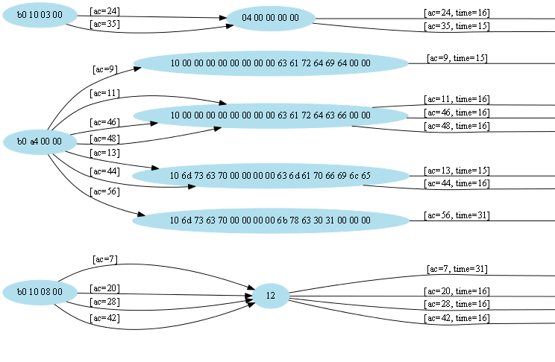

Slide 63
For two-factor, logging is usually not enough
Manipulate incoming/outgoing APDUs
modify packet content (change receiver account number)
replay of previous packets (pay twice)
simulate presence of smart card
…
00 a4 04 00 08 01 02 03 04 05 06 07 08
winscard.dll (stub)
90 00
[RULE1]
MATCH1=in=1;t=0;cla=00;ins=a4;p1=04;
ACTION=in=0;data0=90 00;le=02;

Slide 64
German banking malware (2009)
Two-factor authorization of transactions (chipTAN/cardTAN)
Application code injection
modifies info about transaction and balance shown to user in browser
intercepts/modifies transaction data for signature by smart card
http://www.cio.com/article/2429854/infrastructure/german-police--two-factor-authentication-failing.html
The Fairy Tale of “What You See Is What You Sign” - Trojan Horse Attacks on Software for Digital Signatures (2001)
http://www.hanno-langweg.de/hanno/research/scits01p.pdf
Importance of physical PIN-pad and display of transaction amount independently

Slide 65
German banking malware
User application
Code inject application
winscard.dll
reader driver
USB driver
APDU

Slide 66
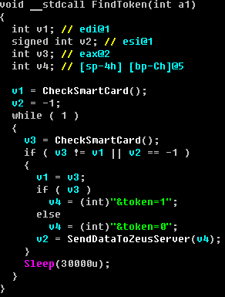
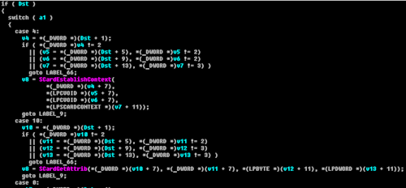
ZeuS smartcard support module
ZeuS Banking Trojan (2010, 2012)
Analysed by A. Matrosov, Group-IB and others
http://www.welivesecurity.com/2010/11/05/dr-zeus-the-bot-in-the-hat/
http://www.secureworks.com/cyber-threat-intelligence/threats/zeus/
Smart card controlled via PC/SC interface

Slide 67
ZeuS smartcard support module
User application
Malicious app
Malicious application
winscard.dll
reader driver
USB driver
APDU

Slide 68
Win32/Spy.Ranbyus
Analysed by A. Matrosov
http://www.welivesecurity.com/2012/06/05/smartcard-vulnerabilities-in-modern-banking-malware/
Scans for available smart cards, info send to C&C
uses PC/SC SmartCard API for scan
later redirects communication on USB level (FabulaTech USB for RD installed)

Slide 69
Win32/Spy.Ranbyus
User application
Malicious app
Malicious application
winscard.dll
reader driver
USB driver
APDU
Remote USB redirection

Slide 70
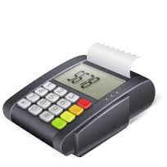
Skimmers, PoS hacks
Manipulated PoS firmware:
Magnetic skimmer (+ send data over GSM)
MitM: chip→verified by signature
APDU

Slide 71
Mandatory reading
When Organized Crime Applies Academic Results
A Forensic Analysis of an In-Card Listening Device
https://eprint.iacr.org/2015/963.pdf
Which academic attacks is of concern?
What system is targeted?
How is attack carried out? Is it protocol flaw?
What can prevent this attack vector?

Slide 72
Conclusions
Smartcards are highly secure and capable modules
Programmable
Accessible (cost, API…)
Many aspects of Secure Channel Protocols
Requirements
Attacker model
Overheads
Two-factor authentication is not silver bullet
Questions

