Slide 1
PV204 Security technologies
Authentication and passwords
Petr Švenda svenda@fi.muni.cz
Faculty of Informatics, Masaryk University

Slide 2
How to approach homework I.
What you should specify your configuration (replication)
  live vs. dedicated machine → impact on measurement
  list platform configuration, compilation flags used (for replication)
Analysis
  Good to print only shape of histogram instead of bars (visibility)
  Good to print multiple histograms in single graph - better visibility
  Don't compare only original to the protected version. More sense makes to compare different data/exponent for given version (e.g., protected)
Good to test also with medium hamming weight
  More spread in histogram with same data → harder to use Template attacks
  Be aware what is included in timing - e.g., generation of masking r? Network jitter (can attacker model and subtract)?

Slide 3
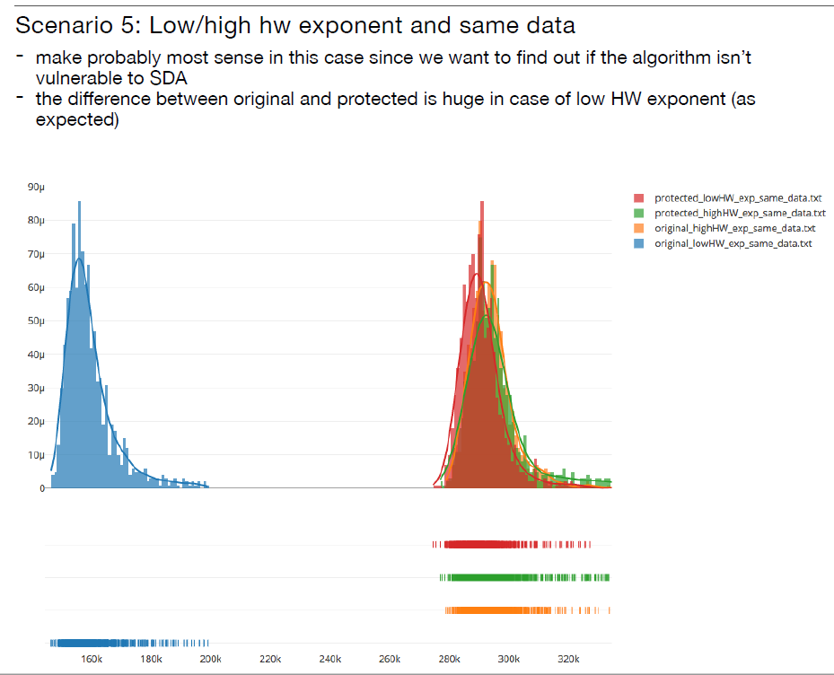
Example solution (J. Masarik)

Slide 4
Conclusions for Homework I.
Variability for the same data and key => noise in measurement (=> potentially harder to attack)
Difference between any two measured values => possibility to use template attack
Difference between data with low/mid/high hamming weight => some information is leaking
Dependency of time on HW of private exponent may be possible to detect even for improved or blinded RSA
Compiler can remove inserted protection (releases)

Slide 5
Authentication & Authorization

Slide 6
Basic terms
Identification
  Establish what the (previously unknown) entity is
Authentication
  Verify if entity is really what it claims to be
Authorization (access control)
  Define an access policy to use specified resource
  Check if entity is allowed (authorized) to use resource
Authentication may be required before entity allowed to use resource to which is authorized

Slide 7
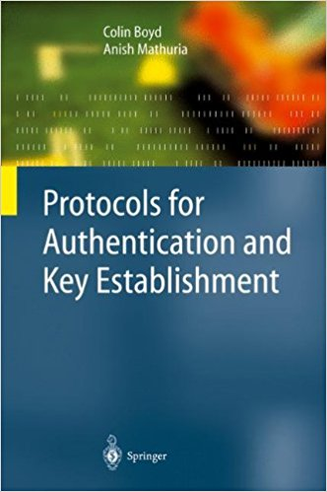
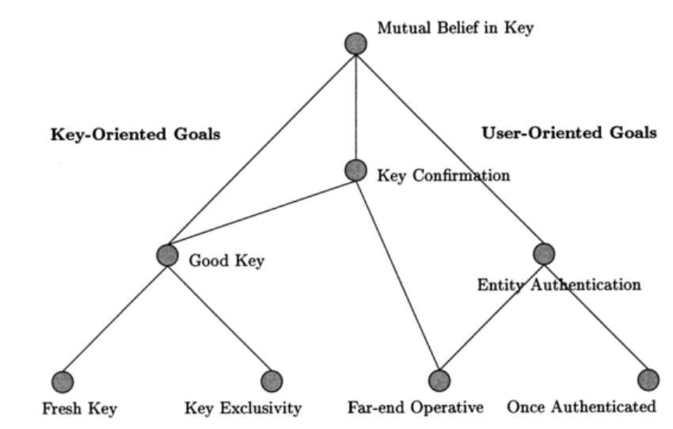
Hierarchy of authentication and key establishment goals
Protocols for Authentication and Key Establishment By Colin Boyd, Anish Mathuria

Slide 8
Passwords

Slide 9
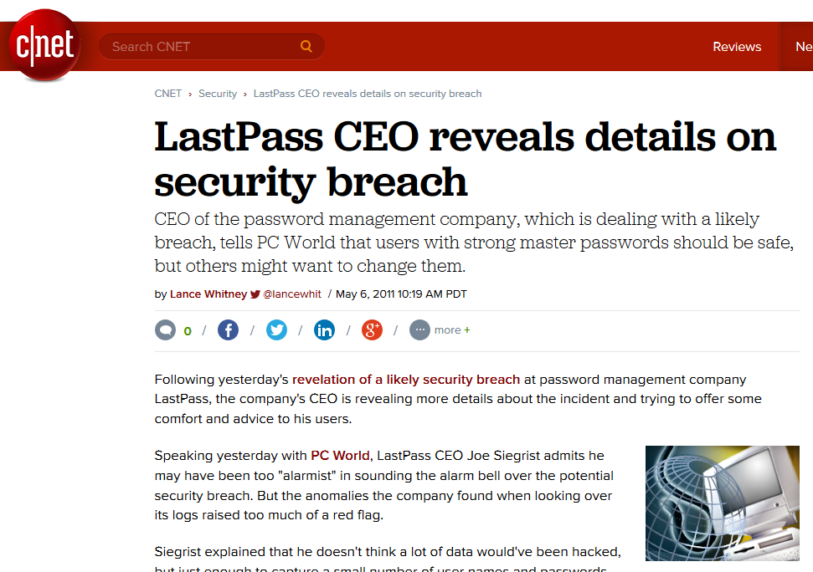
But passwords are encrypted, right?

Slide 10
Problems associated with passwords
How to create strong password?
How to use password securely?
How to store password securely?
Same value is used for the long time (exposure)
Value of password is independent from target operation (e.g., authorization of request)
…

Slide 11
Mode of usage for passwords
Verify by direct match
  provided_password == expected_password?
  Example: HTTP basic access authentication
  Be aware of potential side-channels
Verify by derived value (hash(password | salt))
  Be aware of rainbow tables and brute-force crackers
Derive key: Password → cryptographic key
  Example: key = PBKDF2(password)
Use to establish authenticated key
  Example: Password + Diffie-Hellman → authenticated key…

Slide 12
Where passwords can be compromised?
Database storage
  Cleartext storage
  Backup data (tapes)
  Server compromise
Host machine (memory, history, cache)
Network transmission (network sniffer, proxy logs)
Hardcoded secrets (inside app binary)
Difficult to detect compromise and change after the exposure

Slide 13
Password (hash) cracking
Scenario: dump of passwords hash database
Password cracking attacks
  Brute-force attack (up to 7-8 characters)
  Dictionary attack (inputs with higher probability)
  Dictionary + brute-force (Password[0-9]*)
  Rainbow tables (time-memory trade-off)
  Parallelization (many parallel cores)
  GPU/FPGA/ASIC speedup of cracking
Tools
  Generic: John the Ripper, Brutus, RainbowCrack…
  Targeted to application: TrueCrack, Aircrack-NG…

Slide 14
Password cracking defenses
Don’t transmit or store in plaintext
Process password on client, transmit only digest
Don’t encrypt, hash instead
Use salt to prevent rainbow tables attack
Use memory-hard KDF algorithms
  To slow down custom build hardware
  Use strong KDF to derive keys (PBKDF2→Argon2)

Slide 15
Handling passwords in source code
Limiting memory exposure
  Load only when needed
  Erase right after use
  Pass by reference / pointer to prevent copy in memory
  Derive session keys
Don’t hardcode password into application binary
Nice presentation (K. Kohli, examples how NOT to): http://www.slideshare.net/amiable_indian/insecure-implementation-of-security-best-practices-of-hashing-captchas-and-caching-presentation

Slide 16
Alternative to hardcoded passwords/keys
Don’t use passwords ☺
Ask the user for a password
Keep secrets in a separate file
Encrypt stored secrets
Store secrets in protected database
Use already existing authentication credentials
CERN guidelines
  https://security.web.cern.ch/security/recommendations/en/password_alternatives.shtml

Slide 17
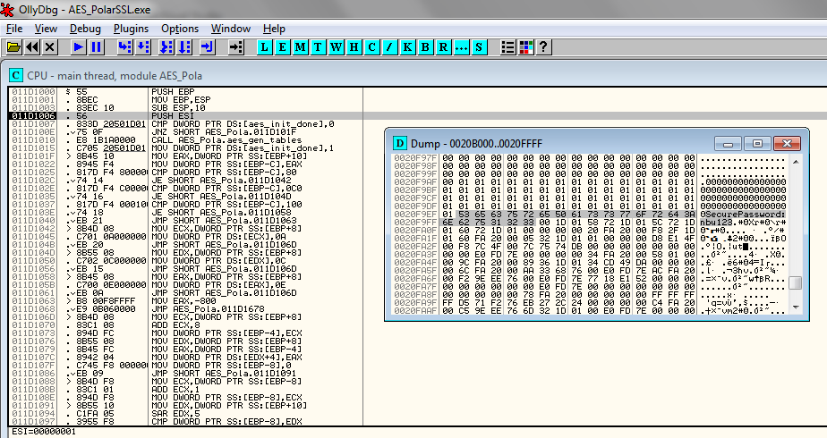
Hard-coded password might be visible both in application binary and memory

Slide 18
Possible password replacements
Cambridge’s TR – wide range of possibilities listed
  The quest to replace passwords: a framework for comparative evaluation of Web authentication schemes
  https://www.cl.cam.ac.uk/techreports/UCAM-CL-TR-817.pdf
Many different possibilities, but passwords are cheap to start with, lot of legacy code exists and no mechanism offers all benefits
Mandatory reading: UCAM-CL-817
  At least chapters: II. Benefits, V. Discussion
  Whole report is highly recommended

Slide 19
One-time Passwords

Slide 20

Recall: Problems associated with passwords
How to create secure password?
How to use password securely?
How to store password securely?
Same value is used for the long time (exposure)
Value of password is independent from target operation (e.g., authorization of request)
…
One-time passwords tries to address these issues

Slide 21
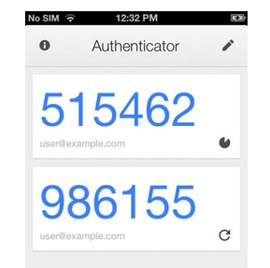
HMAC-based One-time Password Algorithm
HMAC-based One-time Password Algorithm (HOTP)
  Secret key K
  Counter (challenge) C
  HMAC(K,C) = SHA1(K ⊕ 0x5c5c… ∥ SHA1(K ⊕ 0x3636… ∥ C))
  HOTP(K,C) = Truncate(HMAC(K,C)) & 0x7FFFFFFF
  0x7FFFFFFF mask to drop most significant bit (portability)
  HOTP-Value = HOTP(K,C) mod 10^{d} (d … # of digits)
Many practical implementations
  E.g., Google Authenticator
https://en.wikipedia.org/wiki/HOTP

Slide 22
HOTP – items, operations
Logical operations
  Generate initial state for new user and distribute key
  Generate HOTP code and update state (user)
  Verify HOTP code and update state (auth. server)
Security considerations of HOTP
  Client compromise
  Server compromise
  Repeat of counter/challenge
  Counter mismatch tolerance window

Slide 23
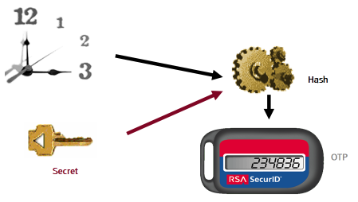
Time-based One-time Password Algorithm
Very similar to HOTP
  Time used instead of counter
Requires synchronized clocks
  In practice realized as time window
Tolerance to gradual desynchronization possible
  Server keeps device’s desynchronization offset
  Updates with every successful login
Sylvain Maret

Slide 24
OCRA: OATH Challenge-Response Algorithm
Initiative for Open Authentication (OATH)
OCRA is authentication algorithm based on HOTP
OCRA code = CryptoFunction(K, DataInput)
  K: a shared secret key known to both parties
  DataInput: concatenation of the various input data values
    Counter, challenges, H(PIN/Passwd), session info, H(time)
  Default CryptoFunction is HOTP-SHA1-6
  https://tools.ietf.org/html/rfc6287
Don’t confuse with Oauth (delegation of authentication)
  The OAuth 2.0 Authorization Framework (RFC6749)
  TLS-based security protocol for accessing HTTP service

Slide 25
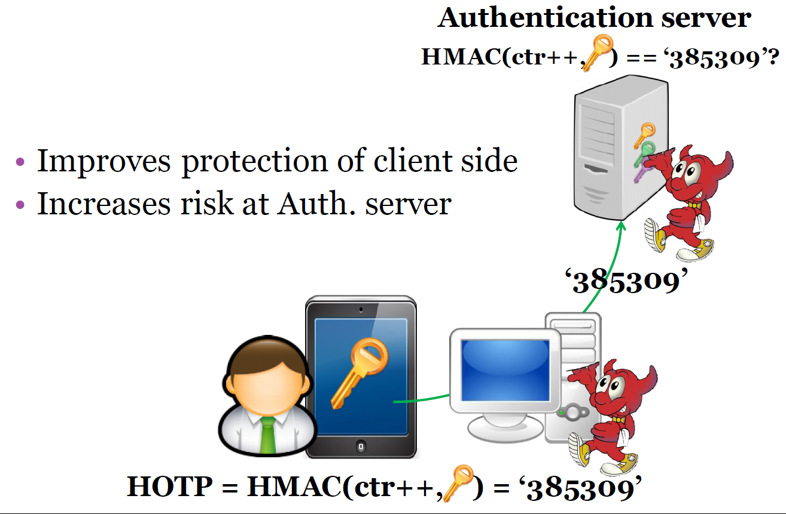

Slide 26
Increased risk at *OTP verification server
More secure against client compromise
  Using OTP instead of passwords, KDF(time|key),
But what if server is compromised?
  database hacks, temporal attacker presence
  E.g., Heartbleed – dump of OTP keys
Possible solution
  Trusted hardware on the server
  OTP code verified inside trusted environment
  OTP key never leaves the hardware

Slide 27
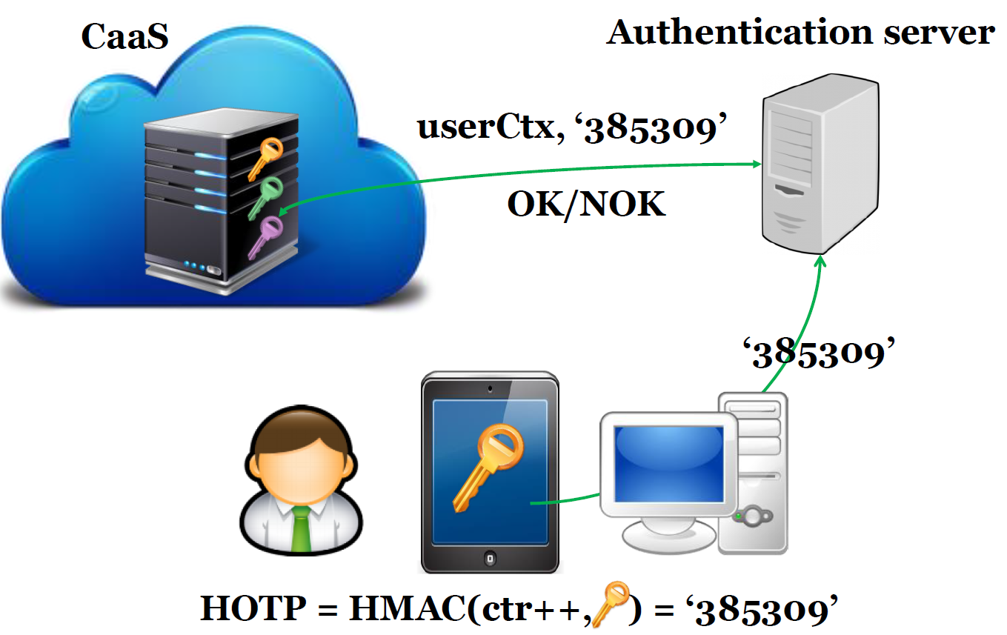

Slide 28
Problem: is OTP code fresh?

Slide 29
FIDO U2F protocol

Slide 30
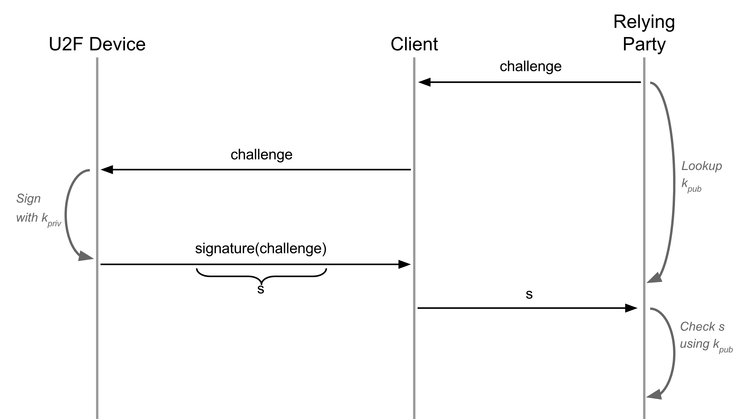
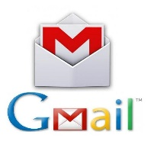

Revision 1: ECC-based challenge-response
Problems: phishing, MiTM…
https://developers.yubico.com/U2F/Protocol_details/Overview.html

Slide 31
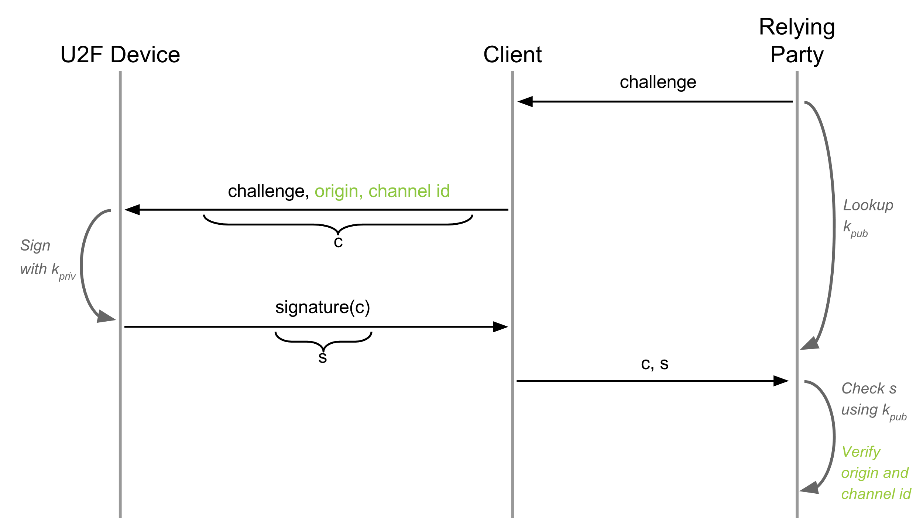
Revision 2: URI + TLS channel id added
https://accounts.google.com/ServiceLogin
Problem: two users using same device => detectable by service (same k_{priv})
https://developers.yubico.com/U2F/Protocol_details/Overview.html

Slide 32
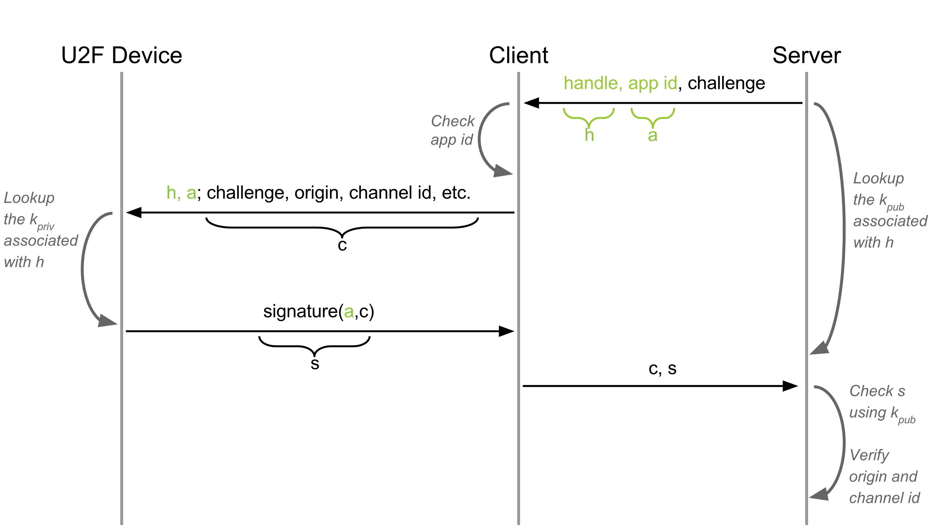
Revision 3: Application-specific key added
new key pair and key handle for each registration
Problem: Undetectable device cloning
https://developers.yubico.com/U2F/Protocol_details/Overview.html

Slide 33
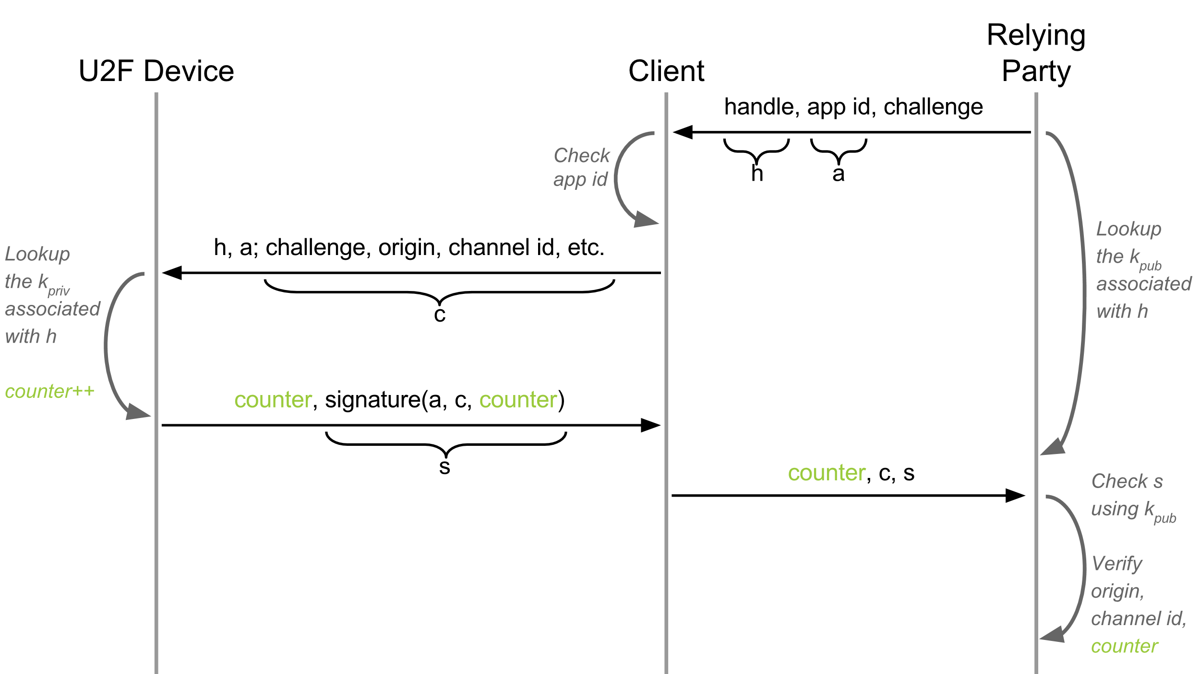
Revision 4: Authentication counter added
Incremental counter
Option: What if server wants to verify device properties before register?
https://developers.yubico.com/U2F/Protocol_details/Overview.html

Slide 34
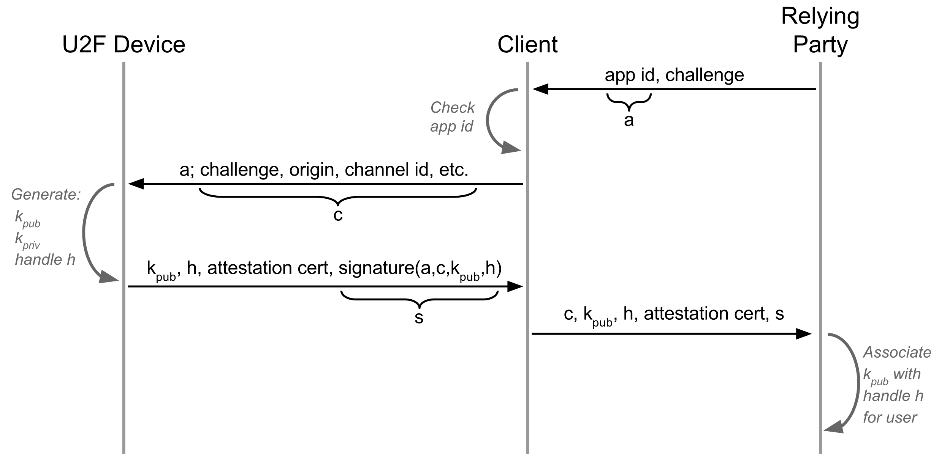
Revision 5: Device attestation added
Attestation certificate signed with TTP
ECDSA NIST secp256r1 used
https://developers.yubico.com/U2F/Protocol_details/Overview.html

Slide 35
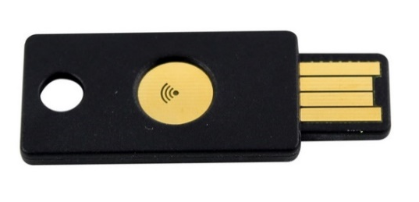
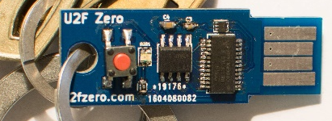
FIDO U2F devices
Why have button? Is missing display problem?
Recent problem: direct WebUSB API in Chrome
  Malware bypass U2F API checking the URL
  Legitimate URL is send from malicious page
  https://www.wired.com/story/chrome-yubikey-phishing-webusb/
  APDU-level communication: https://npmccallum.gitlab.io/post/u2f-protocol-overview/
Well known is Yubikey, but open-source hardware and software-only implementations also possible
  https://github.com/conorpp/u2f-zero

Slide 36
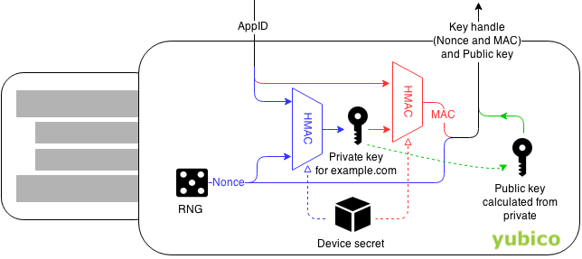

Always dig for implementation details
How are ECC keys generated and stored?
Yubikey saves ECC storage place by deriving ECC private keys instead of randomly generating
  Possible as the ECC private key is random value
Device secret generated during manufacturing
What is the possible attack
https://developers.yubico.com/U2F/Protocol_details/Key_generation.html

Slide 37

Methods of derivation of secrets from password
H(‘Password’) →

Slide 38
Problems when password used as a key
Passwords are usually shorter / longer than key
If password as a key => low number of distinct keys
Password does not contain same amount of entropy as binary key (only printable characters…)
K = SHA-2(“password”)
  Same passwords from multiple users => same key
  Large pre-computed “rainbow” tables allow for quick check
  Solved by addition of random (potentially public) salt
    K = SHA-2(pass | salt)
Dictionary-based brute-force still possible

Slide 39
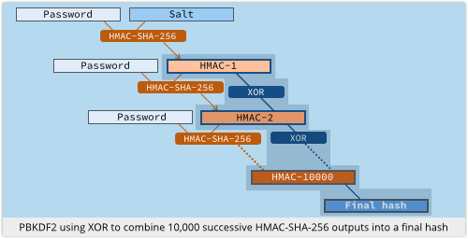
Derivation of secrets from password
PBKDF2 function, widely used
  Password is HMAC “key”
  Iterations to slow derivation
  Salt added
Problem with custom-build hardware (GPU, ASIC)
  Repeated iterations not enough to prevent bruteforce
  (or would be too slow on standard CPU – user experience)
Source: https://nakedsecurity.sophos.com

Slide 40
scrypt – memory hard function
Design as a protection against cracking hardware (usable against PBKDF2)
  GPU, FPGA, ASICs…
  https://github.com/wg/scrypt/blob/master/src/main/java/com/lambdaworks/crypto/SCrypt.java
Memory-hard function
  Force computation to hold r (parameter) blocks in memory
  Uses PBKDF2 as outer interface
Improved version: NeoScrypt (uses full Salsa20)

Slide 41
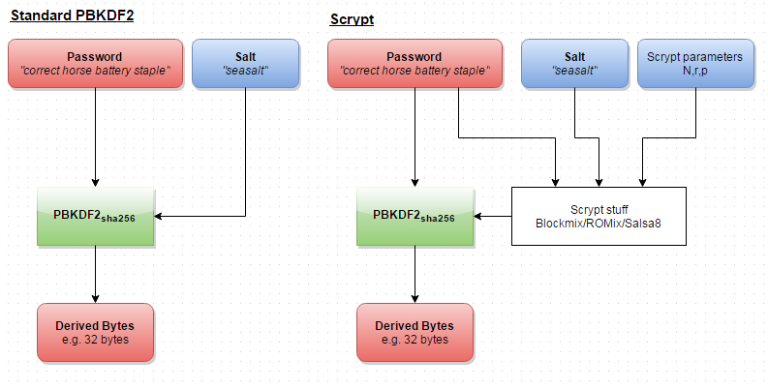
Reuse of external PBKDF2 structure
https://www.reddit.com/r/crypto/comments/3dz285/password_hashing_competition_phc_has_selected/

Slide 42
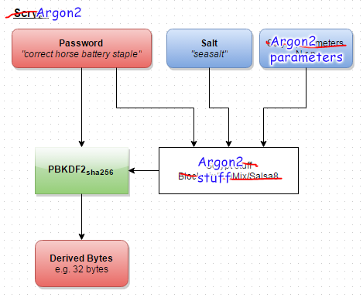
Argon2
Password hashing competition (PHC) winner, 2013
https://www.reddit.com/r/crypto/comments/3dz285/password_hashing_competition_phc_has_selected/

Slide 43
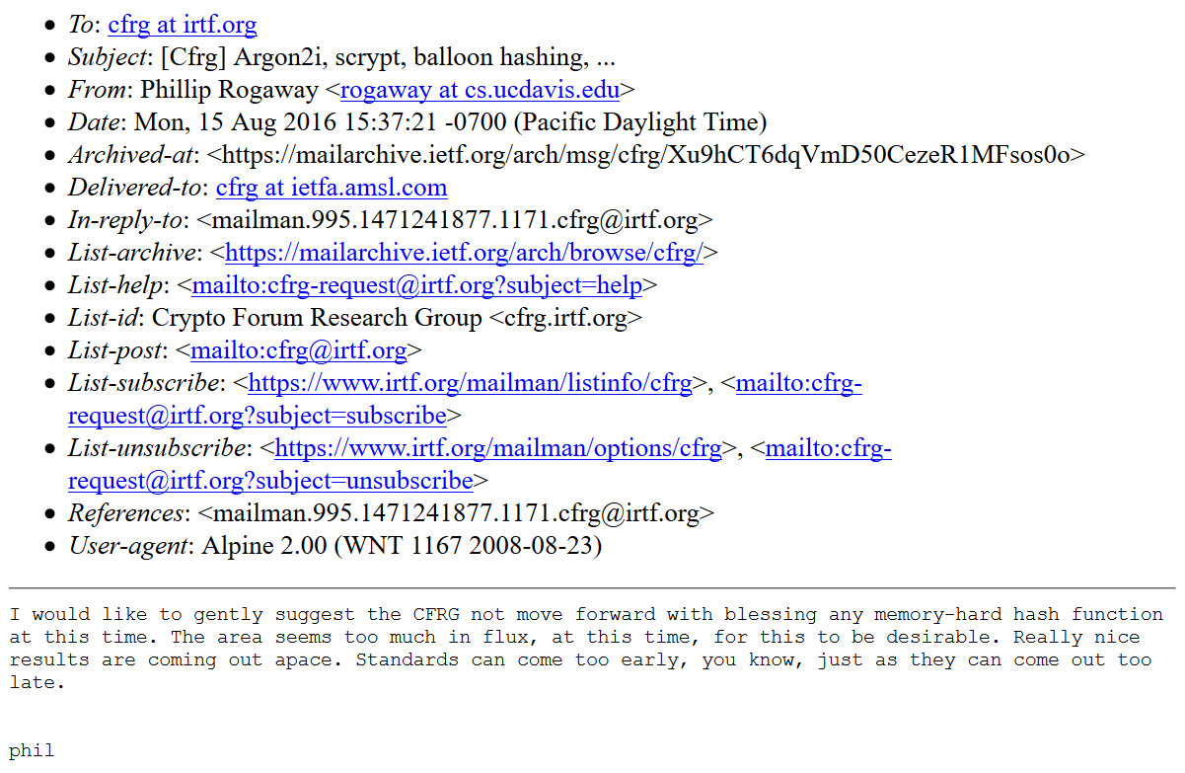
Problem solved?
Problem: situation with PHC winner still unclear in 2018 ☹
https://www.ietf.org/mail-archive/web/cfrg/current/msg08439.html

Slide 44
Password managers

Slide 45








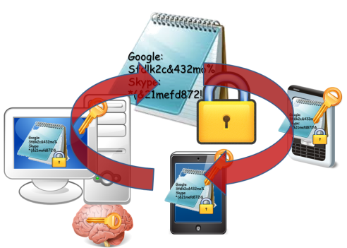

Evolution of password (managers)
Pαs$w0rd
Human memory only
Write it down on paper
Write it into file
Use local password manager
Pαs$w0rd01
Google:
Sfdlk2c&
Skype:
*(&21mefd
Google:
Sfdlk2c&432mo%
Skype:
*(&21mefd872!&
Google:
Sfdlk2c&432mo%
Skype:
*(&21mefd872!&

Slide 46




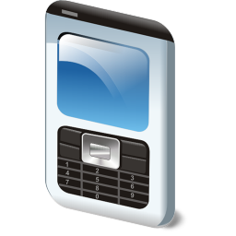
Remote password managers
KeePass+Dropbox
LastPass
1Password
MozillaSync
…
Google:
Sfdlk2c&432mo%
Skype:
*(&21mefd872!&

Slide 47

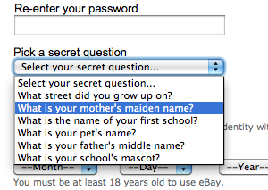
Common (mis-)Assumptions
User has strong password
  >60% can be usually brute-forced
Server/service is hard to compromise
  Server-side compromises are now very frequent
User have unique passwords
  Gawker/root.com leak: 76% had the exact same password
Different authentication channels are independent
  Web-browsing + SMS on smart phones?
Account recovery often weak(er)

Slide 48
But passwords are encrypted, right?

Slide 49


Human is still the weakest link
Google:
Sfdlk2c&432mo%
Skype:
*(&21mefd872!&
Google:
Sfdlk2c&432mo%
Skype:
*(&21mefd872!&
More than 60% of users have weak passwords
password123

Slide 50
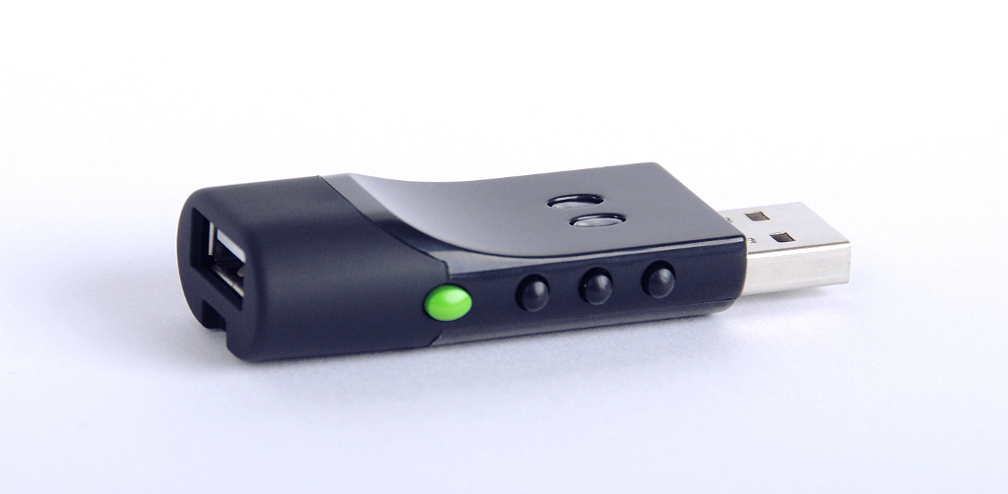
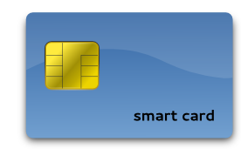
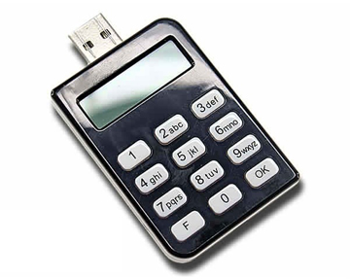
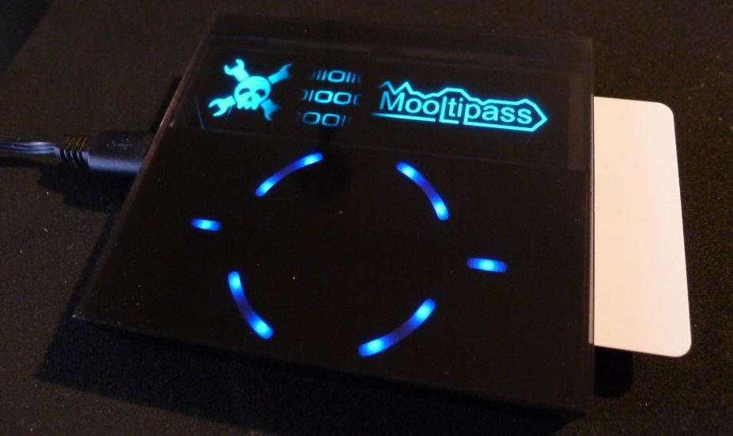
Hardware tokens
SmartArchitects’s Password sCrib
Evergreen password lock
Price, usability, compatibility…
Hack-a-Day’s Mooltipass

Slide 51
Common (mis-)Assumptions
User has strong password
Server/service is hard to compromise
User have unique passwords
Different authentication channels are independent
Recovery

Slide 52
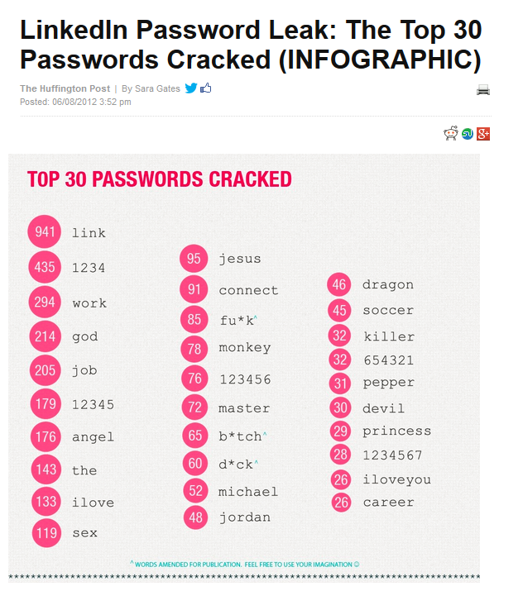
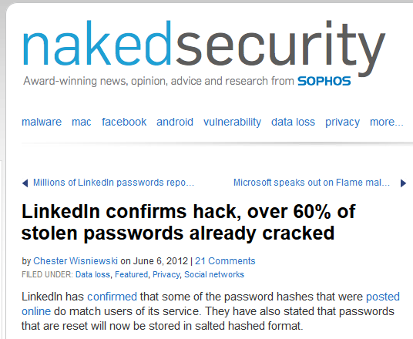
User has strong password

Slide 53
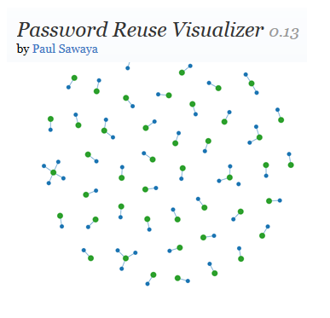
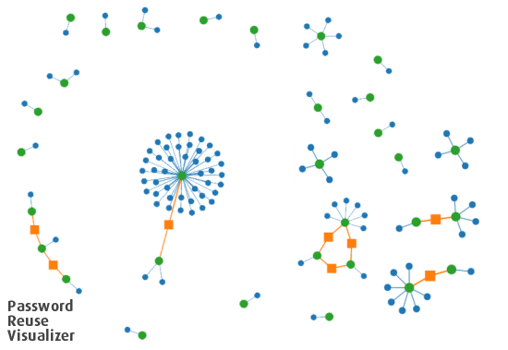
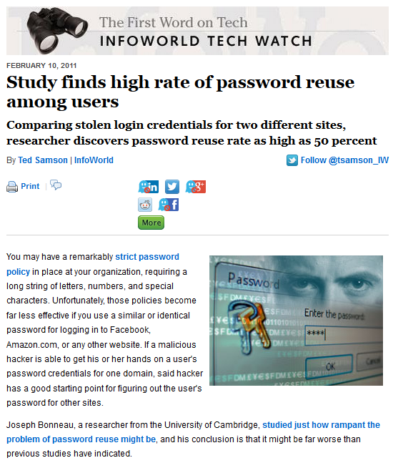
User have unique passwords…
Study: Gawker vs. root.com passwords leak
“…[from successfully cracked passwords] 76% used the exact same password. A further 6% used passwords differing by only capitalisation or a small suffix (e.g. ‘password’ and ‘password1′).”, J. Bonneau
http://www.lightbluetouchpaper.org/2011/02/09/measuring-password-re-use-empirically/

Slide 54
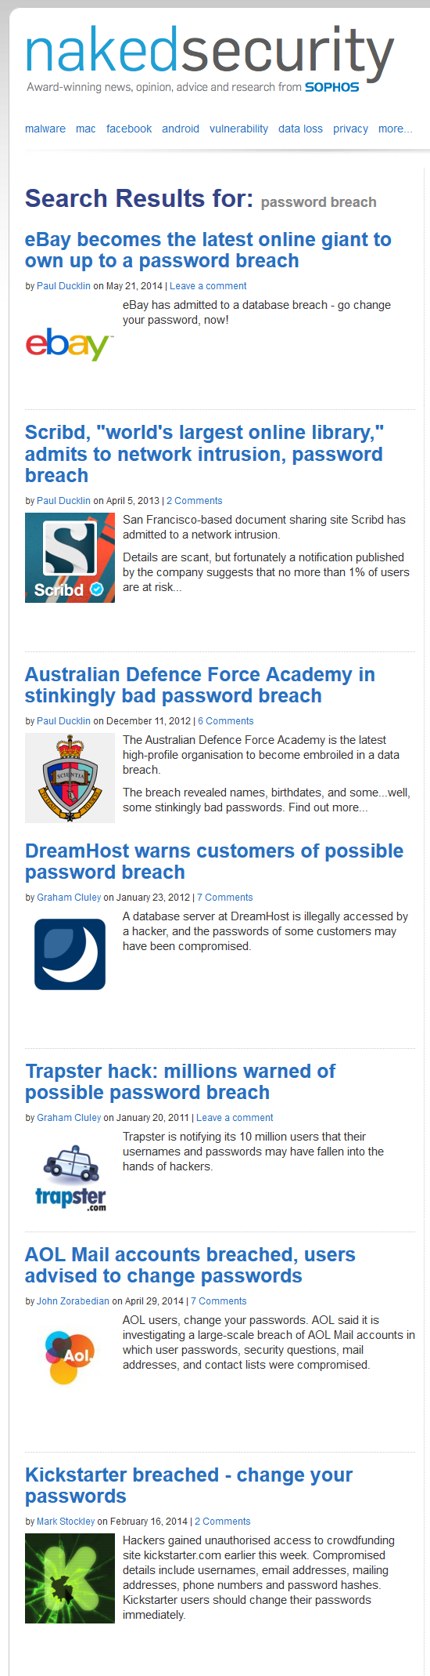
Service is hard to compromise?

Slide 55
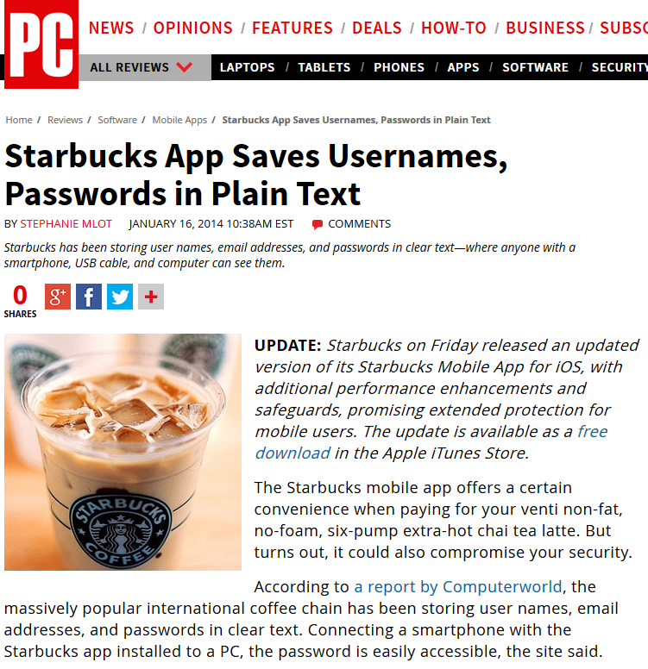
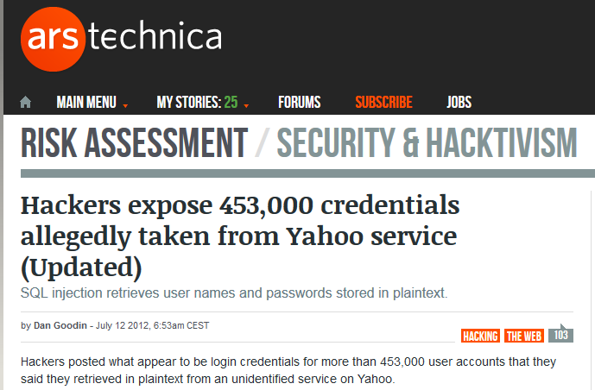

Services follow the best security principles
Service implementation is correct and bug-free

Slide 56



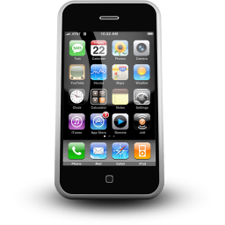


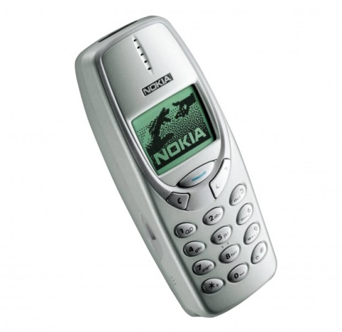
Different authentication channels are independent

Slide 57





Security can be maintained “forever”
Allow for some form of risk management

Slide 58
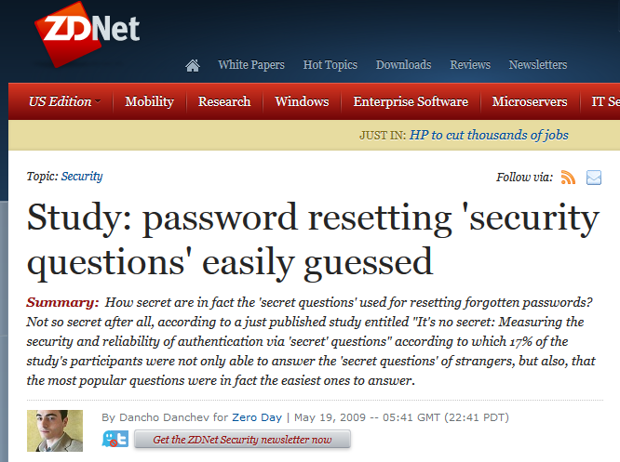
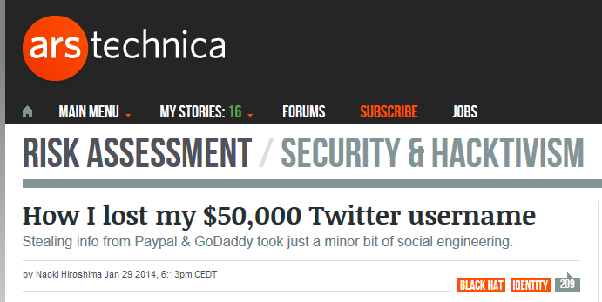
Access recovery is as secure as primary one
Recovery info shared over multiple services…

Slide 59
Password manager for multiple devices
Case study

Slide 60
Assumptions
Functional
  User stores fixed secrets (passwords…)
  User has multiple connected devices
  Easy to use ☺
Security
  Service can’t be trusted
  User chooses weak password
  Devices can be lost (and later revoked)
  User has independent channel (phone)

Slide 61
Main security design principles
Treat storage service as untrusted and perform security sensitive operations on client
Make necessary trusted component as small as possible
Prevent offline brute-force, but don’t expect strong password from user
  add entropy from other source
Make transmitted sensitive values short-lived
Trusted hardware can provide additional support

Slide 62
Public-key cryptography indirection
Google:
Sfdlk2c&432mo%
Google:
Sfdlk2c&432mo%
Skype:
*(&21mefd872!&
K
K
K
Priv_U
Pub_U
KEK
K = H(‘Password’)
KEK = H(‘Password’)
Password
Password

Slide 63


Public-key crypto indirection
Google:
Sfdlk2c&432mo%
K’,K’’,K’’’…
K
[K’]Pub_U
K
Priv_U
Pub_U
KEK
Public-key crypto indirection allows for asynchronous change of K
KEK = H(‘Password’)
Long private key can be also stored on Service
Password

Slide 64
Weak password?
Google:
Sfdlk2c&432mo%
Google:
Sfdlk2c&432mo%
K
Users tend to have weak passwords…
K
Priv_U
K
Priv_U
K
Pub_U
KEK
KEK
Attacker has motivation for attacking the Service!
KEK = H(‘Password’)
KEK = H(‘Password’)
Password
Password

Slide 65

Trusted element
Google:
Sfdlk2c&432mo%
K
User1:SecretData
User2:SecretData’
…
K
Priv_U
Pub_U
KEK
SecretData1,
SecretData2,
SecretData3…
Threshold crypto
SecretData
KEK = H(‘Password’
| SecretData)
Separate trusted entities provide additional data
Password

Slide 66


Google:
Sfdlk2c&432mo%
K
SecretData
User1:SecretData
User2:SecretData’
…
K
Priv_U
Pub_U
KEK
SecretData
SMS:
KEK = H(‘Password’ | SecretData)
Password

Slide 67
Multiple devices
Google:
Sfdlk2c&432mo%
K
K
Priv_U
Pub_U
KEK
KEK
KEK
KEK
Dev1
Dev2
Dev3
Dev3
Dev1
Dev2

Slide 68

Other operations
Device management (new, remove, revoke)
Device authentication
Group management (users, boards, secrets)
Password change, private key change
Access recovery
…
Devil is in the details…

Slide 69
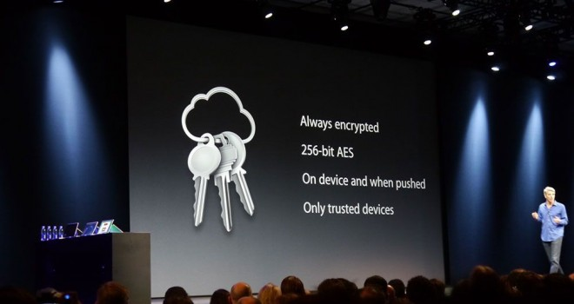
Do we have some implementations?
Apple’s service showcased in 2013
Lack of details until iOS Security report 02/2014
  https://www.apple.com/business/docs/iOS_Security_Guide.pdf
https://blog.cryptographyengineering.com/2016/08/13/is-apples-cloud-key-vault-crypto/ (M.Green)
Apple iCloud Keychain

Slide 70
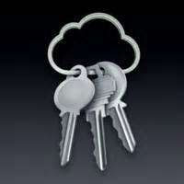
Apple’s iCloud Keychain
Multiple similarities to described example
  Layer of indirection via asymmetric cryptography
  Support for multiple devices
  Asynchronous operations via application tickets
  Authorization and signature of additional devices
  User phone registered and required
Still reliance on user’s (potentially weak) password
  But limited number of tries allowed
Trusted component of iCloud realized via internal HSM
  Recovery mode with 4 digit code (default, can be set longer)
  HSM will decrypt recovery key only after code validation
  4 digits length is not an issue here – HSM enforce limited # retries

Slide 71
Summary
Passwords have multiple issues, but are hard to be replaced
Important to use passwords securely (guidelines)
One-time passwords and tokens getting more used
Password manager with synchronization over multiple devices is not straightforward
Mandatory reading: UCAM-CL-817
  At least chapters: II. Benefits, V. Discussion
  Whole report is highly recommended

