Slide 1
PV204 Security technologies
Hardware Security Modules (HSM), PKCS#11
Petr Švenda svenda@fi.muni.cz
Faculty of Informatics, Masaryk University

Slide 2
Overview
Usage scenarios for HSMs
Available hardware, security certifications
Available security APIs (PKCS#11…)
Known API-level attacks

Slide 3
Hardware Security Modules (HSMs)
Difference to smartcards
Use-cases
HSM security
Usage of HSM in cloud
Certifications (FIPS140-2, CC EAL)
Cryptography as a service
Steps of HSM operations
API
Attacks against API

Slide 4
Hardware Security Module
Hardware Security Module

Slide 5

Hardware Security Module - definition
HSM is trusted hardware element
  Contains own physical and logical protection
  May provide increased performance (compared to CPU)
Attached to or put inside PC/server/network box
Provides in-device:
  Secure key generation (and entry)
  Secure storage (and backup)
  Secure use (cryptographic algorithms)
Should never export sensitive data in plaintext
  Especially keys = Critical Security Parameters (CSP)
You already know one example of HSM

Slide 6
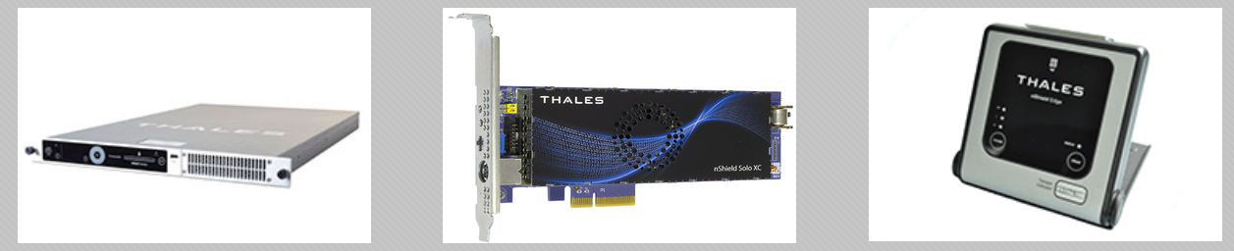
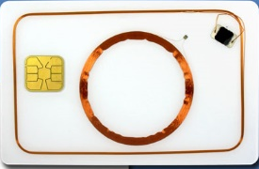
Smart cards HSMs
Price: $3-30
2-3 RSA signs/sec
USB/serial connection
Mostly disconnected
No battery
3KB RAM, 100KB flash
Limited algs support
$100-$10000
100-10000 RSA signs/sec
UTP/PCI connected
Always connected
Own battery (time…)
MBs-GBs, SSD
Wide range of algorithms
Rich API + management
  Common applications
Trusted input interface (smartcard reader)

Slide 7
Typical use-cases for HSMs
Payment industry (PIN and transaction verification)
TLS accelerator (server’s private key)
Certification authority (protection of CA private key)
Key management (distribution, derivation)
Software signing
Custom uses (DRM…)
Vendors - market is now consolidating
  IBM, nCipher , Thales, Safenet, Gemalto, Utimaco…

Slide 8
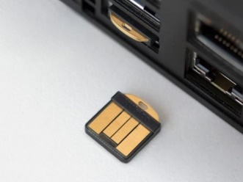
Many HSM forms possible
Stand-alone Ethernet boxes (1U/2U)
PCI cards
Serial/USB tokens
SmartCards, TPMs…
Note: we will focus on more powerful devices (smart cards already covered)
YubiHSM
https://www.thales-esecurity.com/products-and-services/products-and-services/hardware-security-modules

Slide 9
Hardware Security Module - specification
Common functions
  Generate functions (generate new key)
  Load functions (import key, plain/wrapped by other key)
  Use key functions (various cryptographic algorithms)
  Export key functions (wrapping)
  Access control functions (public, login user, login admin)
  Destroy secrets functions
Possibility to write custom “plugins”
  Custom code running inside HSM
  (usually invalidates certification)

Slide 10
Hardware Security Module - protection
Protections against physical attacks (tamper)
  Invasive, semi-invasive and non-invasive attacks
Protection against logical attacks
  API-level attacks, Fuzzing…
Preventive measures
  Statistical testing of random number generator
  Self-testing of cryptographic engines (encrypt twice, KAT)
  Firmware integrity checks
  Periodic reset of device (e.g., every 24 hour)
  …

Slide 11
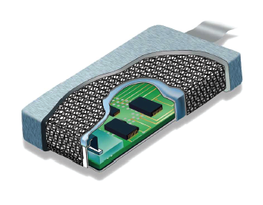
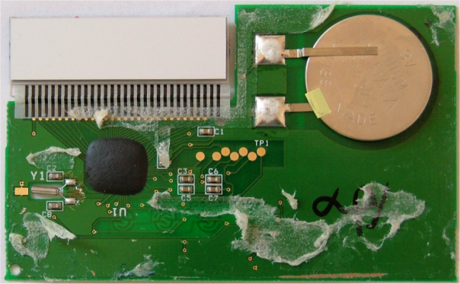

HSM – tamper security
www.techbriefs.com
Protection epoxy
Wiring mesh
Temperature sensors
Light sensors
Variations (glitches) in power supply
Erasure of memory (write 0/random)
  After tamper detection to mitigate data remanence
…
Which one is tamper resistance,
evidence, detection and/or reaction?

Slide 12
HSM – logical security
Access control with limited/delayed tries
  < 1:1000 000 probability of random guess of password
  < 1:100 000 probability of unauthorized access in one minute
Integrity and authentication of firmware update
  Signed firmware updates
Logical separation of multiple users (memory)
  Additional protection logic for separate memory regions
Audit trails
…

Slide 13



Certifications

Slide 14
Certifications: FIPS140-2,CC EAL,PCI HSM
NIST FIPS 140-2
  Verified under Cryptographic Module Validation Program (CMVP)
  NIST FIPS 140-2 Level 1+2 – basic levels, tamper evidence (broken shell, epoxy), role-based authentication (user/admin))
  NIST FIPS 140-2 Level 3 – addition of physical tamper-resistance, identity-based auth, separation of interfaces with different sensitivity
  NIST FIPS 140-2 Level 4 + additional physical security requirements, environmental attacks (very few devices certified)
  NIST FIPS 140-3 (2013, but still draft)
    Additional focus on software security and non-invasive attacks
List of validated devices http://csrc.nist.gov/groups/STM/cmvp/validation.html

Slide 15
Certifications: NIST FIPS 140-2
Requirements on hardware and software components of security modules to be used by US government
  Verified under Cryptographic Module Validation Program (CMVP)
  Testing against a defined cryptographic module, provides a suite of conformance tests to required security level
  List of validated devices http://csrc.nist.gov/groups/STM/cmvp/validation.html
Common levels for HSMs
  NIST FIPS 140-2 Level 1+2 – basic levels, tamper evidence (broken shell, epoxy), role-based authentication (user/admin))
  NIST FIPS 140-2 Level 3 – addition of physical tamper-resistance, identity-based authentication, separation of interfaces with different sensitivity

Slide 16
Certifications: NIST FIPS 140-2 (cont.)
Common levels for HSMs (cont.)
  NIST FIPS 140-2 Level 4 + additional physical security requirements, environmental attacks
  http://csrc.nist.gov/publications/fips/fips140-2/fips1402.pdf
  Only very few devices certified to FIPS 140-2 Level 4
NIST FIPS 140-3 (2013, but still draft)
  Additional focus on software security and non-invasive attacks

Slide 17
NIST FIPS 140-2 and RNG
Truly random number generators (TRNG)
  No approved FIPS 140-2 TRNG
Pseudorandom number generators
  ANSI X9.31 Appendix A.2.4, 3DES/AES-based
FIPS 140-2 requires testing of RNG
  Known-answer-tests (KAT), Diehard battery

Slide 18
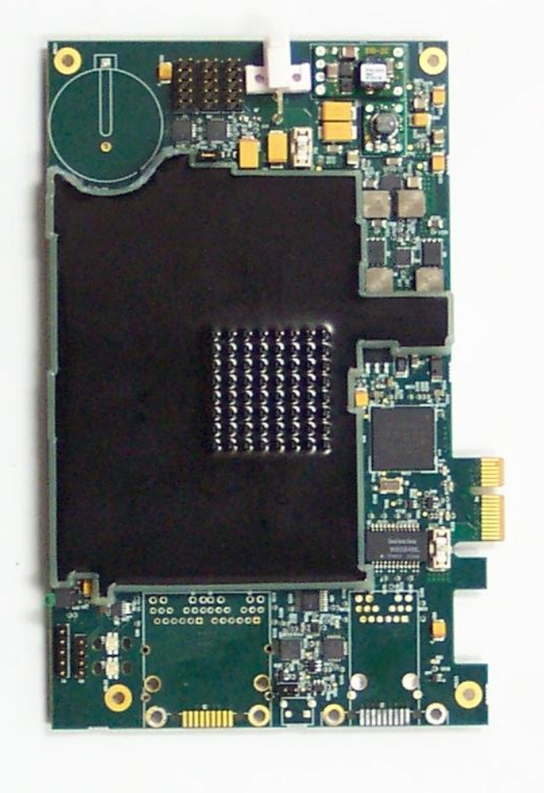
“Random” FIPS 140-2 example
EXP9000 Hardware Security Module (07/2011)
  http://csrc.nist.gov/groups/STM/cmvp/documents/140-1/140sp/140sp1577.pdf
  FIPS140-2, security level 3
  Approved algorithms
  Non approved algorithms
  Roles and authentication
  Critical Security Parameters (CSP)
  Physical security mechanisms
  …

Slide 19
Certifications: Common Criteria EAL 4-5+
CC does not directly measure the security of the system/device itself
  only states level on which the system/device was tested
  and against what Security Target
To achieve particular level, system must meet assurance requirements
  Documentation, design analysis, functional/penetration testing
CC certifies that system followed certain rules when implementing target goals
  Broader than FIPS 140-2

Slide 20
Certifications: Common Criteria EAL 4-5+
Common levels for HSMs
  EAL4: Methodically Designed, Tested and Reviewed
  EAL5: Semi-formally Designed and Tested
Protection profiles
  Specifies generic security evaluation criteria to substantiate vendors' claims (more technical)
  Crypto Module Protection Profile (BSI)
  https://www.bsi.bund.de/cae/servlet/contentblob/480256/publicationFile/29291/pp0045b_pdf.pdf
+ means “augmented” version (current version + additional requirements, e.g., EAL4+)

Slide 21
Certifications: PCI HSM version 1,2
PCI HSM v1 (2009), v2 (2012)
  https://www.pcisecuritystandards.org/security_standards/documents.php
Focused on area of payment transactions
  Payment terminals, backend HSMs…
  Payment transaction processing
  Cardholder authentication
  Card issues procedure
Set of logical and physical requirements relevant to payment industry
  Closer to NIST FIPS 140-2 then to CC (more concrete requirements)

Slide 22
Cost of certification
Certification is usually done by commercial “independent” laboratories
  Laboratories are certified by governing body
  Quality and price differ
  Usually payed for by device manufacturer
Certification pre-study
  Verify if product is ready for certification
Full certification
  Checklist if all required procedures were followed

Slide 23
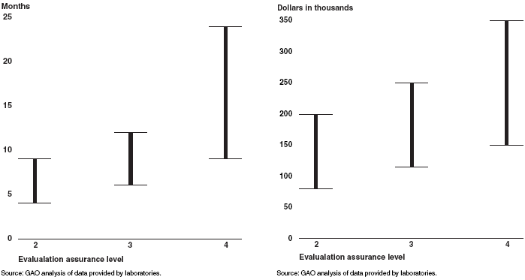
Cost of CC EAL (US GAO, 2006)
Motivation to keep already certified version longer in production

Slide 24
Be aware what is actually certified
Certified != secure
  Satisfies defined criteria, producer claims were verified to be valid
  Infineon’s RSA prime generation algorithm (BSI, CVE-2017-15361)
Usually certified bundle of hardware and software
  Concrete underlying hardware
  Concrete version of firmware, OS and pre-loaded application
Certification usually invalidated when:
  New hardware revision used (less common)
  New version of firmware, OS, application (common)
  Any customization, e.g., user firmware module (very common)
Pragmatic result
  “I’m using product that was certified at some point in time”

Slide 25
How is certified product used?
Trade-off between security functionality and required data centre operations
Certification FIPS 140-2
  users usually turn FIPS mode off (want use additional functionality)
“Almost” FIPS 140-2 mode
  Everything FIPS except what user added (custom module)

Slide 26
HSM performance

Slide 27
HSM – performance I.
Limited independent public information available
  Claim: “up to 9000 RSA-1024b operations / second”
But…
  Real operations are not just raw crypto (formatting of messages…)
  Longer key length may be needed (RSA-2048b)
  Internal vs. external speed (data in/out excluded)
  Measurements in “optimal” situations (single pre-prepared key, large data blocks…)
  …

Slide 28
HSM – performance II.
Relatively difficult to obtain fair comparison
F. Demaertelaere (2010)
  https://handouts.secappdev.org/handouts/2010/Filip%20Demaertelaere/HSM.pdf
RSA 1024 bit private key operation: 100 – 7000 ops/sec
ECC 160 bit ECDSA signatures: 250 – 2500 ops/sec
3DES: 2 - 8 Mbytes/sec
AES: 6 - 40 Mbytes/sec (256 bit key)
No significant breakthrough in technology since 2010
Higher throughput achieved by multiple HSMs

Slide 29
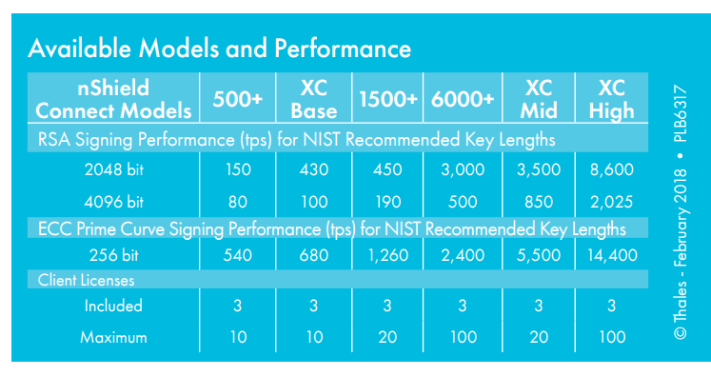
Recent update (Feb 2018)
http://go.thalesesecurity.com/rs/480-LWA-970/images/ThalesEsecurity_nShield_Connect_ds.pdf

Slide 30
HSM - load balancing, failover
HSMs often used in business critical scenarios
  Authorization of payment transaction
  TLS accelerator for internet banking
  …
Redundancy and load-balancing required
Single HSM is not enough
  At least two in production for failover
  At least one or two for development and test

Slide 31
Steps of crypto operation
Hardware Security Module

Slide 32









Steps of cryptographic operation
Transfer input data
Transfer wrapped key in
Initialize unwrap engine
Unwrap data/key (decrypt/verify)
Initialize key object with key value
Initialize cryptographic engine with key
Start, execute and finalize crypto operation
Initialize wrap engine
Wrap data/key (encrypt/sign)
Erase key(s)/engine(s)
Transfer output data
Transfer wrapped key out

Slide 33
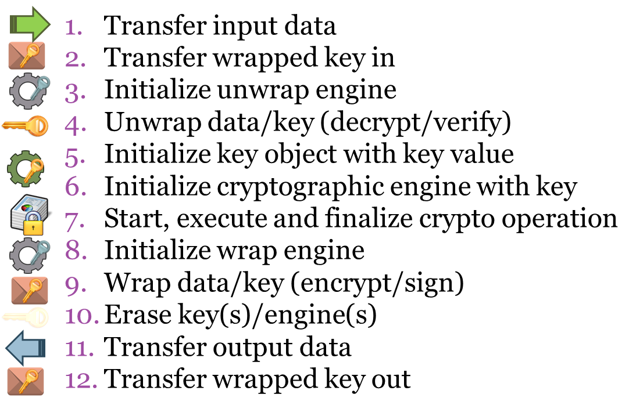
S1: One user, few keys
No sharing, all engines fully prepared

Slide 34
S2: One user, many keys
No sharing, frequent crypto context change

Slide 35
S3: Few users, few keys
Device is shared → isolation of users

Slide 36
S4: Few users, many keys
Limited sharing, frequent crypto context change

Slide 37
S5: Many users, many keys
High sharing, frequent crypto context change

Slide 38
HSM in cloud

Slide 39
Security topics in cloud environment
Move of legacy application into cloud
  Previously used locally connected HSMs
Protection of messages exchanged between multiple cloud-based applications
  Key exchange of used key without pre-distribution?
Volume encryption in cloud
  Encrypted block mounted after application request (e.g., Amazon’s Elastic Block Storage)
Encrypted databases
  Block encryption of database storage, encryption of rows/cells
Cryptography as a Service
  Not only key management, also other cryptographic functionality

Slide 40
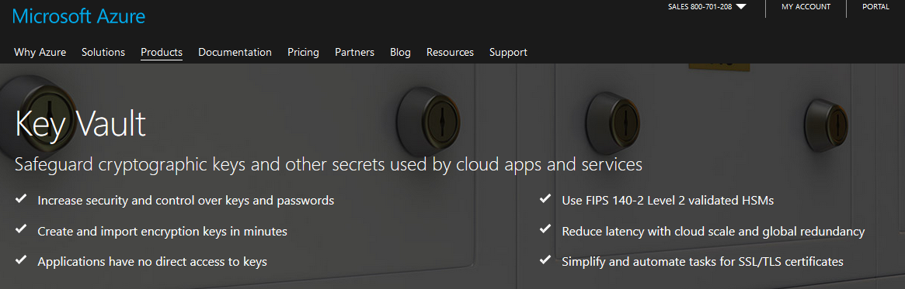
Use case: Microsoft Azure KeyVault
REST API to generate keys, export pub, use keys…
  https://docs.microsoft.com/en-us/rest/api/keyvault/
Language bindings (language specific wrappers)
  JS, PowerShell, C#…

Slide 41
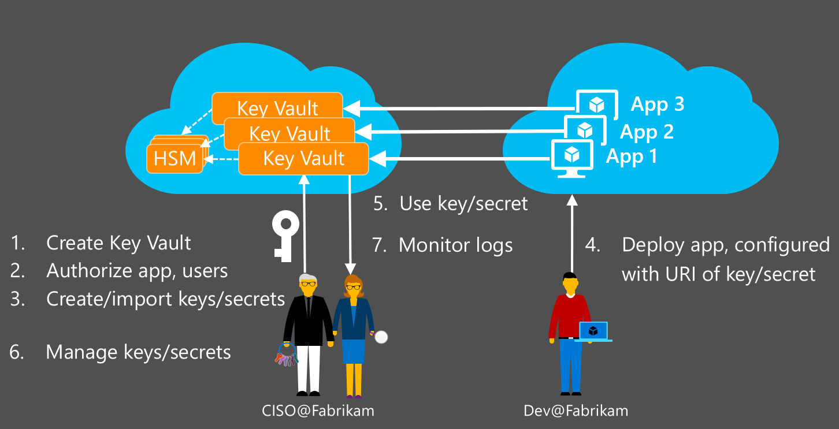
Microsoft Azure KeyVault
https://channel9.msdn.com/Events/Ignite/2015/BRK2706

Slide 42
Use case: AWS Key Management Service
AWS Key Management Service Cryptographic Details, M. Campagna (2015)
  https://d0.awsstatic.com/whitepapers/KMS-Cryptographic-Details.pdf
Centralized key management
  Used by cloud-based applications
  Used by any client application
  Replication of wrapping keys into HSMs in different datacenters

Slide 43
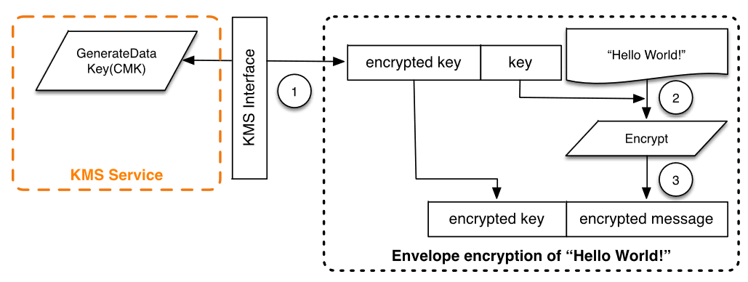
Usage scenario: envelope encryption
Protected message exchange between multiple (cloud-based) application
  Random key generated in one application
  Key protected (wrap) using trusted element (HSM)
  Wrapped key appended to message
  Key unwrapped in second application (via HSM)
https://d0.awsstatic.com/whitepapers/KMS-Cryptographic-Details.pdf

Slide 44
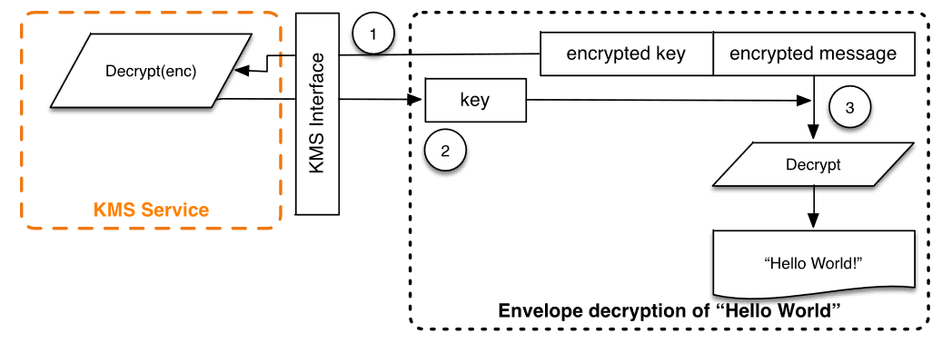
https://d0.awsstatic.com/whitepapers/KMS-Cryptographic-Details.pdf
What is difference to
PGP/S-MIME?

Slide 45
Who is trusted?
KMS Service to wrap envelope keys properly
KMS Service not to leak wrapping key
Cloud operator not to read unwrapped keys from memory

Slide 46
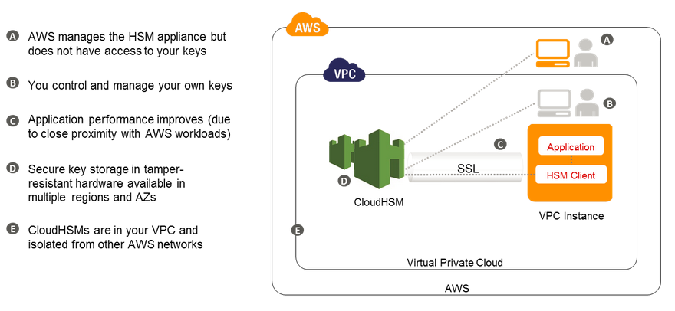
Use case: Amazon AWS CloudHSM
Amazon’s AWS CloudHSM
  Based on SafeNet’s Luna HSM
  Only few users can share one HSM (probably no sharing)
  => High initial cost (~$5000 + $1.88 per hour)
Note: significantly different service from AWS KMS
  “Whole” HSM is available to single user/application, not only key (un)wrapping functionality
  Suitable for legacy apps, compliancy requirements

Slide 47
Use case: Amazon AWS CloudHSM

Slide 48
Cryptography as a service

Slide 49






Offloading security operations…
WS API: JSON

Slide 50


… into secured environment
Cryptography as a Service (CaaS)
How to import key(s) securely?
Which hardware platform to use?
High number of clients?

Slide 51








Different levels of trust
CaaS with trusted server
  Software operation only, HTTPS for in/out
  Trust to server, CaaS platform is target, insider attack
CaaS with semi-trusted server
  HTTPS for in/out, decrypted by server
  Operation send into trusted hardware
  CaaS platform still target
CaaS with untrusted server
  HTTPS for in/out, but inner protection
  Data decrypted/processed/encrypted inside device

Slide 52
Requirements – client view
Untrusted CaaS provider (handling secrets)
Secure import of app’s secrets - enrollment
Client<->CaaS communication security
  Confidentiality/integrity of input and output data
  Authentication of input/output requests
Key use control
  Use constraints – e.g., number of allowed ops
Easy recovery from client-side compromise

Slide 53
Requirements – CaaS provider view
Massive scalability
  W.r.t. users, keys, transactions…
Low latency of responses
Robust audit trail of key usage
Tolerance and recovery from failures
  hardware/software failures
Easy to use API
  also easy to use securely

Slide 54
Hardware options for CaaS
Use of general-purpose hardware (CPU, GPU)
Use of generic programmable hardware (FPGA)
Use of dedicated cryptographic circuits (ASICs)
Use of secure processors (HSMs, smartcards)
(use of additional tamper protection of device)
(use of fully homomorphic encryption)

Slide 55
CaaS - implementation issues
Security
  Software-only CaaS more vulnerable to attacks
  Access control and operation authorization critical
Performance
  Classic HSMs are not build for high-level of sharing
  Performance degradation due to frequent context exchange (key scheduling, engine preparation)
  Logical separation only to few entities (16-32)
  Physical separation on device-level (=> very limited)

Slide 56
Secure parallel multi-processor
High number of secure processors
  Secure memory, secure execution, crypto engines
  FIPS140-2 Level 3/4, CC EAL 4+
Secure channels between secure processors
Untrusted controller
  Small trusted computing base
  Initialization/operational phase
Restricted use and audit trail (=> state)
High-speed I/O data interface
High robustness due to high redundancy
  If one card lock or die, other will serve a request
Physical separation of secure processors

Slide 57






HSM from smartcards
User key
(encrypted)
Controller
Input data: user key #2
Secure processors
Input data: user key #1

Slide 58
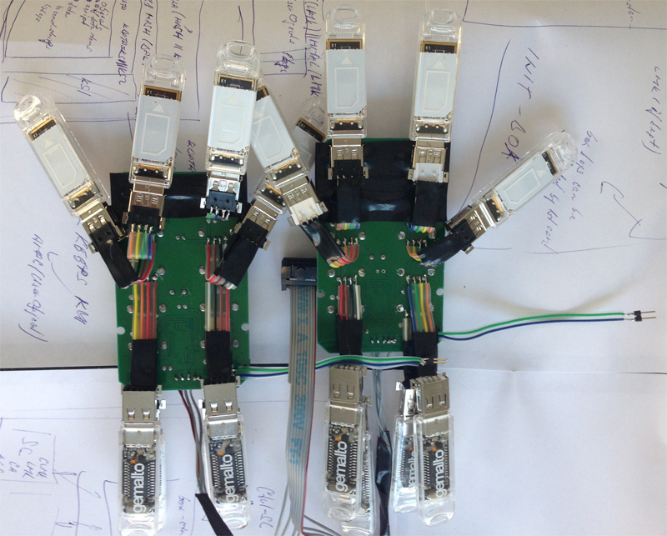
First prototype:
12+2 configuration
  Performance (NXP J2D081):
  ~80 RSA-1024 signs/sec
  ~150 HMAC/sec

Slide 59

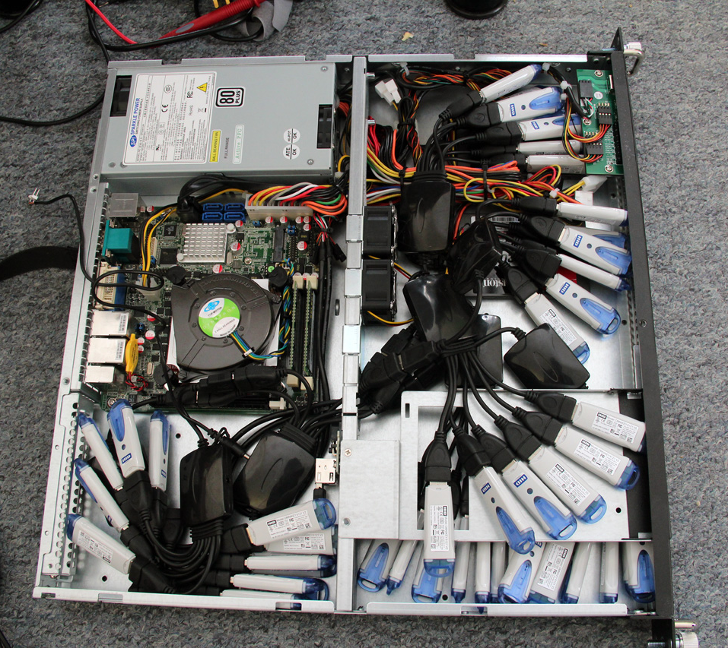
Prototype (1U):
43+2 cards configuration
  Performance (NXP J2D081):
  ~250 RSA-1024 signs/sec
  ~480 HMAC/sec

Slide 60
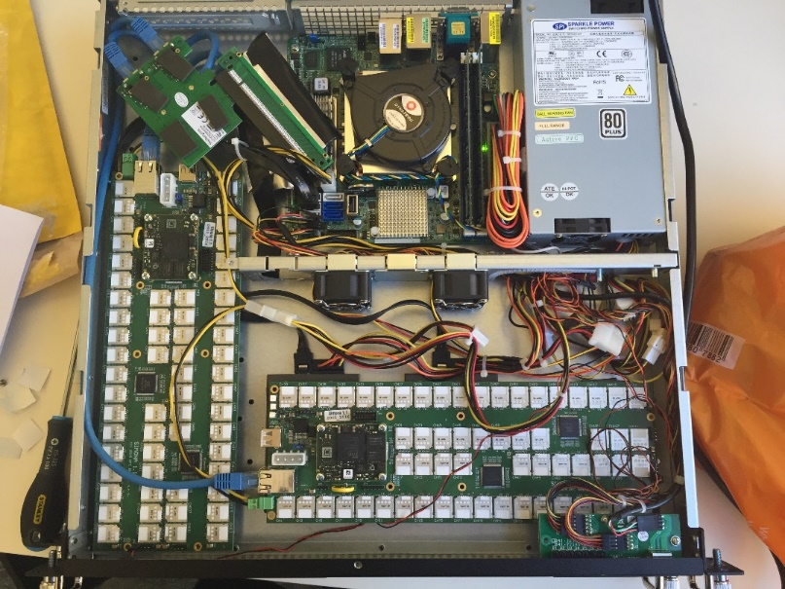
Simona boards (1U):
120 cards configuration / board,
3 boards fits into 1U, 20 boards into 3U
Performance depends on used smartcards - results measured for NXP J2D081, current cards 4x faster
  Performance (1U, NXP J2D081):
  ~2000 RSA-1024 signs/sec
  ~4000 HMAC/sec

Slide 61
Some development issues
Many common software components fails when used in uncommon “extreme” settings
  Many readers/cards used, high peak load, long-term usage…
Task should be processed in given time frame
  Assigned card may fail to deliver result
  Several timeouts must be implemented

Slide 62
Some development issues
1000 / 1 < 1000 / 11
  Adding more cards may not speed up anything
  just one smart card - 93s to process 1000 packets
  11 smart cards - 123s required instead
“Thread hell” inevitable
  Serialized assignment of tasks is inefficient
  Task assignment must be highly parallelized
Lock-free programming
  prevent by hard lock or detect and respond?

Slide 63
Not just “send and encrypt fast”
Protection of incoming/outgoing data
Device is shared – secure load/unload user ctxs
Hierarchical control of loaded keys
User specifies limited use for its key (credits)
Signed audit trail collected from processors
  independently verifiable, control over uses
If interested, read more at
  Architecture Considerations for Massively Parallel Hardware Security Platform, Space’15 http://crcs.cz/papers/space2015
  High-Assurance Cryptographic Hardware from Untrusted Components, ACM CCS’17, https://crocs.fi.muni.cz/public/papers/mpc_ccs17

Slide 64
Single point of failure

Slide 65

Motivation: Single point of failure
Single device can be malfunctioning or just break
  Availability problem, redundancy required
Software/hardware design flaws or coding errors
  Leakage of sensitive data or key material
Supply chain can be compromised
  Introduction of backdoor
…

Slide 66


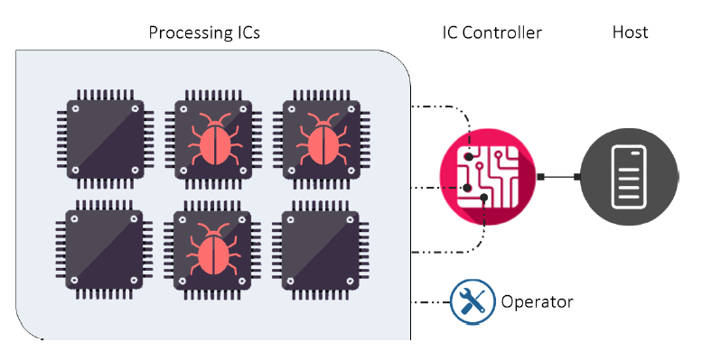
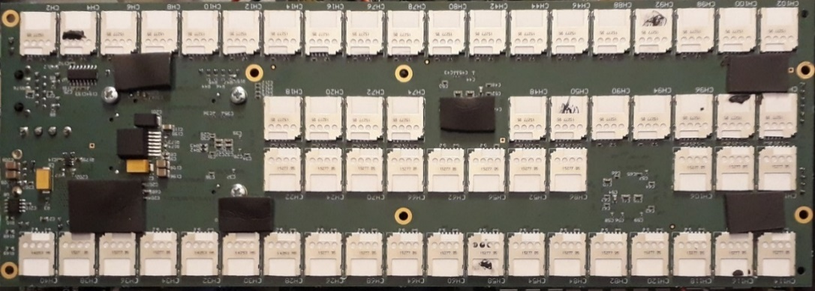


Secure multiparty signature
ACM CCS’17, BlackHat/Devcon’17
If 4 cards per quorum
120 cards => 30 quorums
=> 230+ decrypts / second
=> 60+ signatures / second
Secure multi-party computation
Suite of ECC-based multi-party protocols proposed
  Distributed key generation, ElGamal decryption, Schnorr signing
Efficient implementation on JavaCards
  Tested on grid of 120 cards

Slide 67

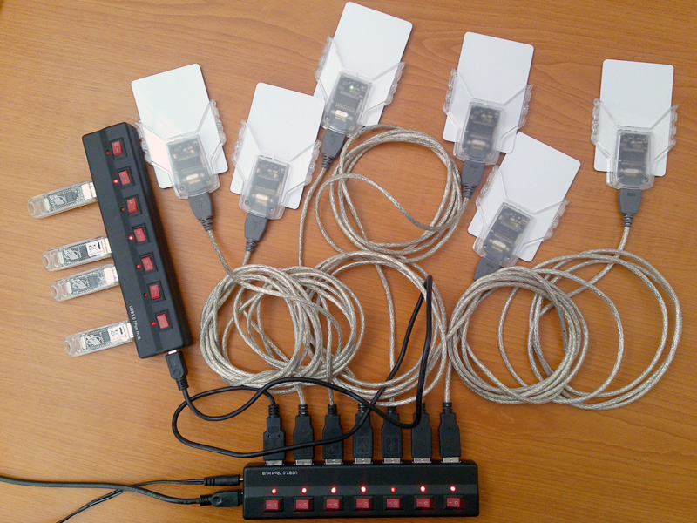
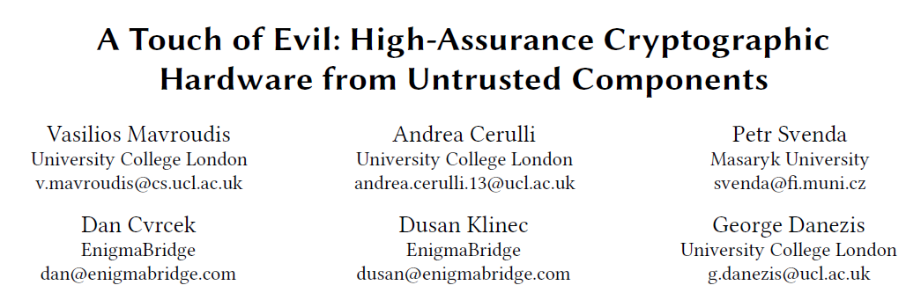
Try it!
JavaCard Applet + controlling Java application
  https://github.com/OpenCryptoProject/Myst
More information:
  https://trojantolerance.org

Slide 68
HSM Security API
Hardware Security Module

Slide 69
Application Programming Interfaces (API)
Proprietary API (legacy or custom functions)
Standardized API - but proprietary library required (PKCS#11)
Cryptographic service providers – plugin into standardized API (CNG, CSP…)
Standardized API - no proprietary component (PIV, EMV CAP…)
Proprietary (service-specific), but public API (MS KeyVault, AWS..)

Slide 70
PKCS#11, (PKCS#15), ISO/IEC 7816-15
Standards for API of cryptographic tokens
PKCS#11
  http://www.rsa.com/rsalabs/node.asp?id=2133
  software library on PC, rather low level functions
  widely used, TrueCrypt, Mozilla FF/TB, OpenSSL, OpenVPN…
PKCS#15
  http://www.rsa.com/rsalabs/node.asp?id=2141
  both hardware and software-only tokens, identity cards…
  superseded by ISO/IEC 7816-15 standard

Slide 71
PKCS#15 (https://github.com/OpenSC)
pkcs15-init
pkcs15-tool --dump
pkcs15-tool --list-keys
#!/bin/bash
sleep 5
pkcs15-init --create-pkcs15 --pin 12345678 --no-so-pin
sleep 5
pkcs15-init --store-pin --auth-id 01 --pin 12345678
--puk 12345678 --label “PV204 Tutorial"

Slide 72
PKCS#11
Standardized interface of security-related functions
  vendor-specific library in OS, often paid
  communication library->card proprietary interface
Functionality cover
  slot and token management
  session management
  management of objects in smartcard memory
  encryption/decryption functions
  message digest
  creation/verification of digital signature
  random number generation
  PIN management
Secure channel not possible!
  developer can control only App→PKCS#11 lib
User Application
PKCS#11 interface
Vendor library
proprietary interface
Smartcard

Slide 73
PKCS#11 library
API defined in PKCS#11 specification
  http://www.rsa.com/rsalabs/node.asp?id=2133
  functions with prefix ‘C_’ (e.g., C_EncryptFinal())
  header files pkcs11.h and pkcs11_ft.h
Usually in the form of dynamically linked library
  cryptoki.dll, opensc-pkcs11.dll, dkck232.dll…
  different filenames, same API functions (PKCS#11)
Virtual token with storage in file possible
  suitable for easy testing (no need for hardware reader)
  Mozilla NSS, SoftHSM…

Slide 74
PKCS#11: role model
Functions for token initialization
  outside scope of the specification
  usually implemented (proprietary function call), but erase all data on token
Public part of token
  data accessible without login by PIN
Private part of token
  data visible/accessible only when PIN is entered

Slide 75
PKCS#11: Cryptographic functionality
C_GetMechanismList to obtain supported cryptographic mechanisms (algorithms)
Many possible mechanisms defined (pkcs11t.h)
  CK_MECHANISM_TYPE, not all supported
  (compare to JavaCard API)
C_Encrypt, C_Decrypt, C_Digest, C_Sign, C_Verify, C_VerifyRecover, C_GenerateKey, C_GenerateKeyPair, C_WrapKey, C_UnwrapKey, C_DeriveKey, C_SeedRandom, C_GenerateRandom…

Slide 76
PKCS#11 - conclusions
Wide support in existing applications
Low-level API
Difficult to start with
Requires proprietary library by token manufacturer
Complex standard with vague specification => security problems
  Hard to implement properly

Slide 77

Play with HSM (without HSM ☺)
SoftHSM
  Software-only HSM
  Open-source implementation of cryptographic store
  Botan library for cryptographic operations
  https://www.opendnssec.org/softhsm/
  https://github.com/disig/SoftHSM2-for-Windows
Utimaco HSM simulator
  https://hsm.utimaco.com/download/
  Simulator of physical HSM (with PKCS#11 and other interfaces)

Slide 78
Microsoft CNG
Cryptography API: Next Generation (CNG API)
Long-term replacement for CryptoAPI
CNG API
  Cryptographic Primitives
  Key Storage and Retrieval
  Key Import and Export
  Data Protection API: Next Generation (CNG DPAPI)
http://msdn.microsoft.com/en-us/library/windows/desktop/aa376210%28v=vs.85%29.aspx

Slide 79
Cryptographic Service Providers (CSP)
Generic framework with API for providers of cryptographic functionality
  E.g., implementation of RSA
  Different underlying storage (software vs. hardware-based)
Allows for runtime selection
  Connect to target provider (usually identification string)
  E.g., “Microsoft Base Cryptographic Provider v1.0”
Microsoft CSPs
  http://msdn.microsoft.com/en-us/library/windows/desktop/aa386983%28v=vs.85%29.aspx
Java CSPs (JCE)…

Slide 80
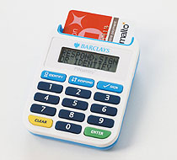
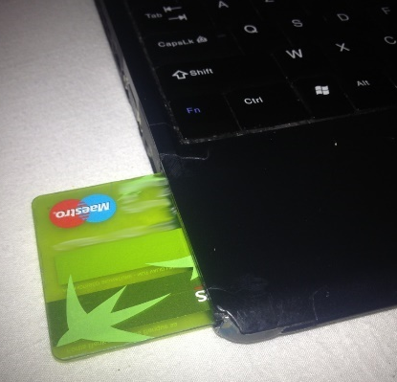
Chip Authentication Program (CAP)
Usage of chip-based banking card for additional operations
Designed for backward compatibility
  existing cards can be used
  Separate on-card applet is preferred, but not required
Designed by MasterCard as EMV-CAP
  https://en.wikipedia.org/wiki/Chip_Authentication_Program
  Adopted by Visa as Dynamic Passcode Authentication (DPA)
Hardware CAP readers available
Python software implementation
  http://sites.uclouvain.be/EMV-CAP/Application/

Slide 81
CAP – supported commands
Supported operations
  Code/identify
  Response
  Sign
Variants:
  Mode 1: amount included in computed cryptogram
  Mode 2: no amount, used for logging into system
  Mode 2 + TDS
    With transaction data signing
    Multiple data fields of the transaction

Slide 82
Custom API pro/cons
Is design of own API better idea?
Pros:
  derive api in line with use
  focused api, no overhead
  highly efficient implementation
Cons:
  security holes by design
  high effort
  lost certification

Slide 83
Attacks against API

Slide 84
Attacks against PKCS#11
Lack of policy for function calls
  functions are too “low-level”
  sensitive objects can be manipulated directly
Key binding attack (C_WrapKey)
  target key with double length is exported from SC
  encrypted by unknown master key
  attacker divide key into two parts and import them as wrapped key for ECB mode
  perform brute-force search on each half separately
Missing authentication of wrapped key
  attacker can create its own wrapping key
  and ask for export of unknown key under his own wrapping key
Export of longer keys under shorter, …

Slide 85
RSA padding oracle attack
Allows to recover content of encrypted message even when key is unknown
Based on 1 bit leakage from correct/incorrect padding
  Error status returned by device
(cycle) mess with encrypted message, send to card, inspect error
30 minutes with HSM, hours/days with smart card
See more at
  http://secgroup.dais.unive.it/wp-content/uploads/2012/11/Practical-Padding-Oracle-Attacks-on-RSA.html

Slide 86
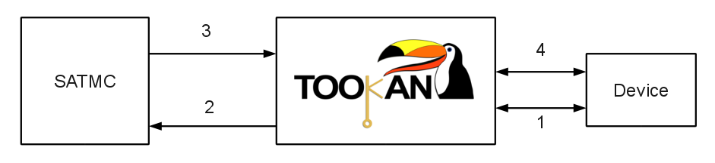
Tookan tool
Formal verification with real device model
  probe PKCS#11 token with multiple function calls
  automatically create formal model for token
  run model checker and find attack
  try to execute attack against real token
http://secgroup.dais.unive.it/projects/tookan/

Slide 87
Conclusions
Hardware Security Module is device build for security and performance of cryptographic operations
Security certifications (but be aware of limits)
Initially mostly for banking sector
  Now more widespread (TLS, key management..)
Diverse APIs, potential logical attacks

Slide 89
PKCS#11 details

Slide 90
PKCS#11: Function prototypes
GetProcAddress() returns untyped function pointer
We need to cast this function pointer to known function type
Function types for PKCS#11 are in pkcs11_ft.h
typedef CK_RV CK_ENTRY (*FT_C_Encrypt)(
CK_SESSION_HANDLE hSession,
CK_BYTE_PTR pData,
CK_ULONG ulDataLen,
CK_BYTE_PTR pEncryptedData,
CK_ULONG_PTR pulEncryptedDataLen
);

Slide 91
PKCS#11: Load and init library
int LoadAndInitLibrary(const char* path, HINSTANCE* phLib) {
CK_RV status = CKR_OK;
FT_C_Initialize fInitialize = NULL;
if (phLib) {
if ((*phLib = LoadLibrary(path)) != NULL) {
// INITIALIZE LIBRARY
fInitialize = NULL;
if ((fInitialize = (FT_C_Initialize) GetProcAddress(*phLib, "C_Initialize")) != NULL) {
(fInitialize)(NULL);
}
else status = GetLastError();
}
else status = GetLastError();
}
else status = -1;
return status;
}

Slide 92
PKCS#11: Finalize and unload library
int FinalizeAndCloseLibrary(HINSTANCE hLib) {
CK_RV status = CKR_OK;
FT_C_Finalize fFinalize;
if (hLib != NULL) {
// UNINITIALIZE LIBRARY
fFinalize = NULL;
if ((fFinalize = (FT_C_Finalize) GetProcAddress(hLib, "C_Finalize")) != NULL) {
(fFinalize)(NULL);
}
FreeLibrary(hLib);
}
else status = -1;
return status;
}

Slide 93
PKCS#11: List tokens in system
Slots in system are equivalent to readers
  C_GetSlotList
  C_GetSlotInfo
Slot can be empty or with inserted token
  C_GetTokenInfo

Slide 94
PKCS#11: Connect to token
When slot with token is found
  C_OpenSession
  public session is opened
Switch to private session by inserting PIN
  C_Login
  C_Logout
C_CloseAllSessions

Slide 95
PKCS#11: arguments lists
Most of the PKCS#11 functions accept parameters as CK_ATTRIBUTE[] array
Every value is encoded in single CK_ATTRIBUTE
  CK_ATTRIBUTE_TYPE type
  CK_VOID_PTR pValue
  CK_ULONG ulValueLen
CK_CHAR label_public[] = {"Test1_public"}; //label of data object
CK_CHAR data_public[] = {“PV204 Public"};
CK_ATTRIBUTE dataTemplate_public[] = {
{CKA_CLASS, &dataClass, sizeof(dataClass)},
{CKA_TOKEN, &ptrue, sizeof(ptrue)},
{CKA_LABEL, label_public, sizeof(label_public)},
{CKA_VALUE, (CK_VOID_PTR) data_public, sizeof(data_public)},
{CKA_PRIVATE, &pfalse, sizeof(pfalse)} // is NOT private object
};
BYTE numAttributes_public = 5;
C_CreateObject(hSession, dataTemplate_public, numAttributes_public, &hObject);

Slide 96
PKCS#11: Store/search/get data
Data created in public/private part of the token
  CKA_PRIVATE attribute
  C_CreateObject()
User must be logged when creating/read private objects
You must find target object
  attribute template, must be logged when searching private objects
  C_FindObjectsInit()
  C_FindObjects()
  C_FindObjectsFinal()
Read data from object
  C_GetAttributeValue()

