Slide 1
Black-box analysis of malware
Vít Bukač
CROCS, Faculty of Informatics, Masaryk University
Supervisor IT Security, CIRT, Honeywell Global Security
PV204 Security Technologies

Slide 2
Black-box analysis of malware – Outline
Lecture
  Malware
  Black-box principle
  Tools
  Automatic sandbox analysis
Hands-on lab
  Analysis of provided malware samples

Slide 3
Malware

Slide 4
Malware definition
“Malware, short for malicious software, is an umbrella term used to refer to a variety of forms of hostile or intrusive software, including computer viruses, worms, Trojan horses, ransomware, spyware, adware, scareware, and other intentionally harmful programs. It can take the form of executable code, scripts, active content, and other software. Malware is defined by its malicious intent, acting against the requirements of the computer user — and so does not include software that causes unintentional harm due to some deficiency.”

Slide 5
Malware types
  Trojan
  Fake AV
  Backdoor
  Remote Access Tool (RAT)
  Dropper
  Downloader
  Information stealer
  Keylogger
  Ransomware
  Coinminer
  Sniffer
  Virus
  Worm
  Spyware
  Adware
  Botnet

Slide 6
Malware infection vectors
Email
  Link
  Attachment
  Link + document download
Malicious website
  Drive-by download
USB
Cracked software
Worms

Slide 7
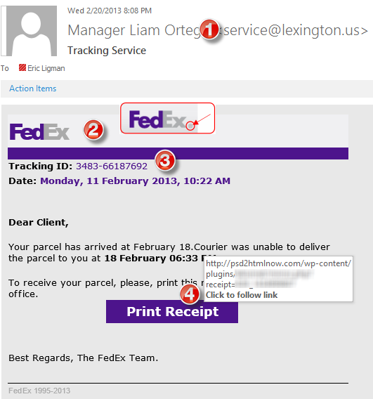
Infection vector – Phishing
Subject
  “Account blocked”
  “Package to be delivered”
  “Expiring subscription”
  “Invoice” / “Receipt” / “Parchment”
Signs
  Unexpected sender address (1)
  Graphic errors (2)
  Erroneous info (3)
  Links to unexpected URL (4)
  Links to same URL
  Generic salutation
  Use of threats, sense of urgency

Slide 8
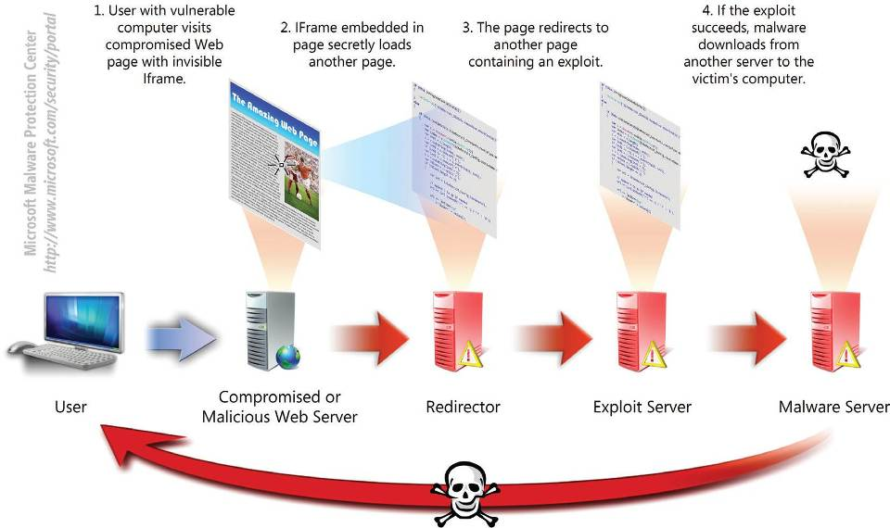
Infection vector – Drive-by download

Slide 9
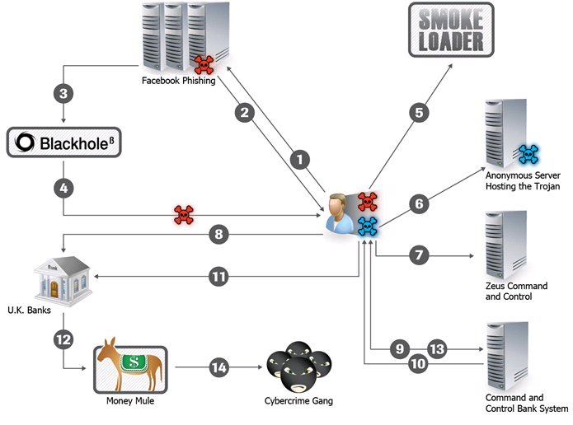
Example – Zeus infection
Notes:
User access fake Facebook page from phishing link
Webpage asks to update Flash Player
If the user refuses to install malicious flash player, Blackhole exploit kit is attempted instead
Computer exploited
Initial callback to Smoke Loader
Downloads Zeus banker trojan
Downloads config file
User accesses one of UK banks
Zeus monitors and reports about these activities
C&C server instructs the bot to steal money
Zeus makes the transaction
Money is sent to a money mule in UK
Zeus logs successful transaction, new recipient and money volume
Money mule takes the money and sends them to cybercrime gang

Slide 10
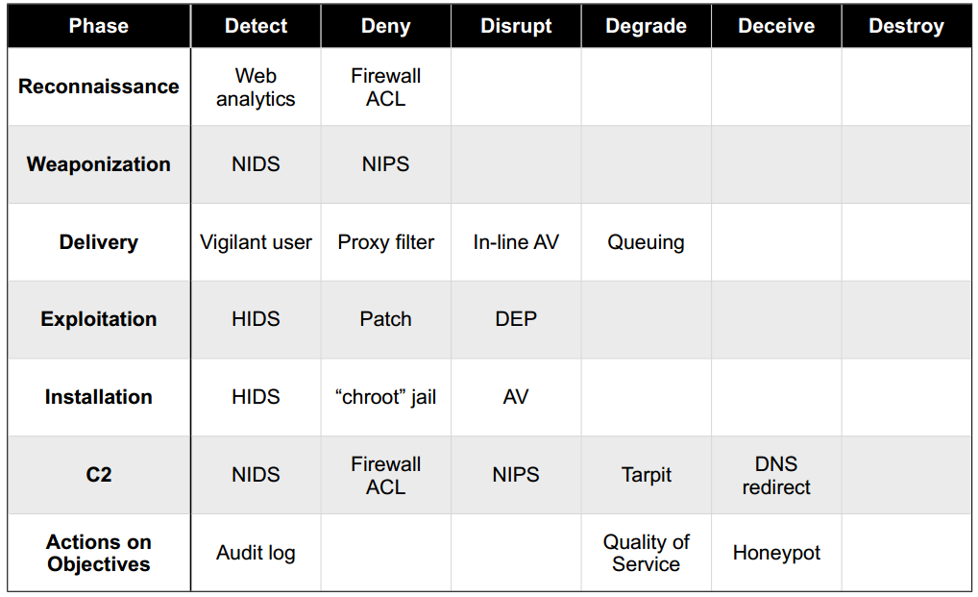
Malware Kill Chain + Defense in Depth
Notes:
Each phase requires successful previous phases
Various detection methods at each phase

Slide 11
Black box malware analysis

Slide 12
Motivation – Ask the right questions
What is the scope of compromise? What are 2nd stage callbacks?
Communication between local file server and an unknown IP address in China has been observed. What process is responsible for the communication?
Malware is creating temporary files. Where are these files located?
Malware executable is created again after system reboot. How is it possible and what is causing it?
A new type of malware has been spreading through internal network. How to quickly assess the malware capabilities? What is its purpose? Is it based on any well-known tool?

Slide 13

Black box malware analysis
Dynamic analysis – file is executed
Analysis without internal knowledge
  Observable inputs
  Observable outputs
Quick, simple
Common monitoring tools
Collected indicators about
  Filenames, process names, process parent/child relationships, temporal relationships, domain names, IP addresses, registry keys, persistence methods, cleanup operations etc.
Can be highly automated

Slide 14
Black box malware analysis – Principle
Prepare analysis environment
Create snapshot
Run monitoring tools
Run malware
Collect and observe interactions between malware and VM
Restore snapshot
Repeat 3-6 as needed

Slide 15
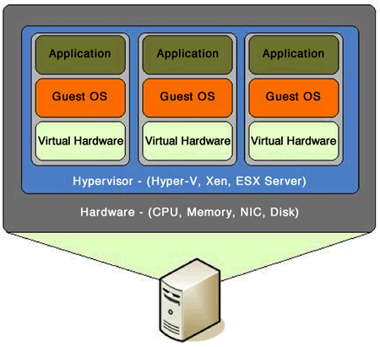
Analysis environment
Virtual Machine
  Limited/no connectivity
  Virtualized services (DNS, HTTP,…)
  Several VMs for various host types
Software
  Monitoring tools
  Often exploited applications
Risks
  VM isolation breach
  Malware inactivity in VM

Slide 16
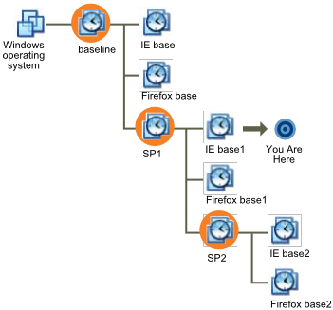
Virtual machine snapshot
Snapshots
  Saved state of VM
  Disk state, memory state
Quick restoration of previous state

Slide 17
Tools

Slide 18
Network analysis
Capturing sent/received packets
Protocol dissection
Promiscuous mode
Tools
  Tcpdump, Wireshark, NetworkMiner
Indicators
  Domain names, IP addresses, protocols, ports, HTTP parameters
Q&A
  Who is this program communicating with? What reputation does the partner have? What data is exchanged? Is it encrypted or obfuscated?

Slide 19
Network analysis – What to look for
New established connections – HTTP 80/8080
  Direct calls for domains without DNS lookup
  Random domain names (e.g., rpxiodffd.biz)
  Suspicious domain names (e.g., gooogle.org)
  Similarly looking domain names (e.g., osinstall.biz, swinstall.biz, swinstall.com)
Outgoing portscans
Ping/DNS request for well known services
  Connection availability test
Be aware of background OS/processes activities!

Slide 20
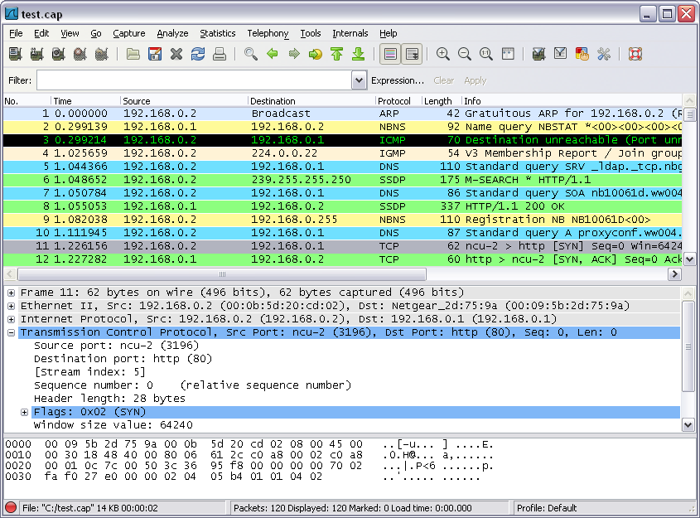
Example – Wireshark

Slide 21
File system
Observing file accesses and modifications
Background file manipulation
Tools
  Procmon, Handle
Indicators
  File names, folder names, order of actions, compromise spread through local system
Q&A
  Where is malware copied after the initial infection? What filenames are used? Where is the collected data stored?

Slide 22
File system – What to look for
New file names & folders
  New created files and folders
  Batch files (.cmd, .bat, .vbs, .ps1)
  Known favorite malware file names (e.g., 1.exe, test.exe, new.exe)
  Known file names in uncommon folders (e.g., C:\Temp\svchost.exe)
  Recycler
Modifications of system files
Temporary storage files, encrypted archives

Slide 23
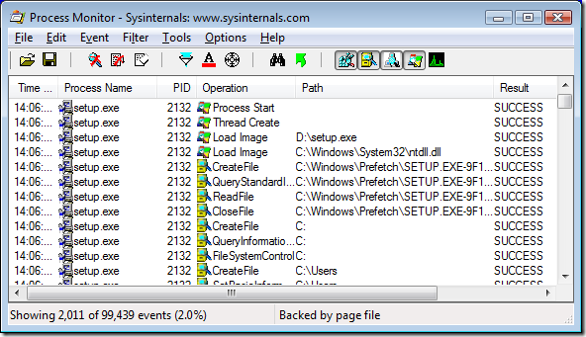
Example – Procmon

Slide 24
Registry
Regedit
RegRipper
Autoruns

Slide 25
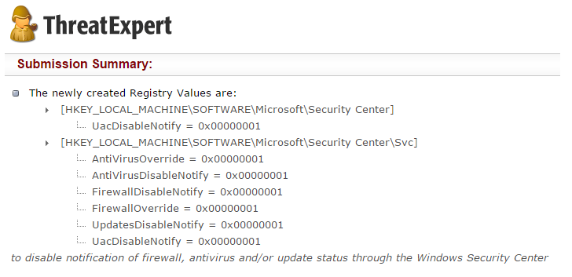
Registry – What to look for
Well-known locations
  Autorun locations
  Task scheduler
Changes tracking
Keywords fulltext search
  Filenames
  Processes
  Domain names

Slide 26
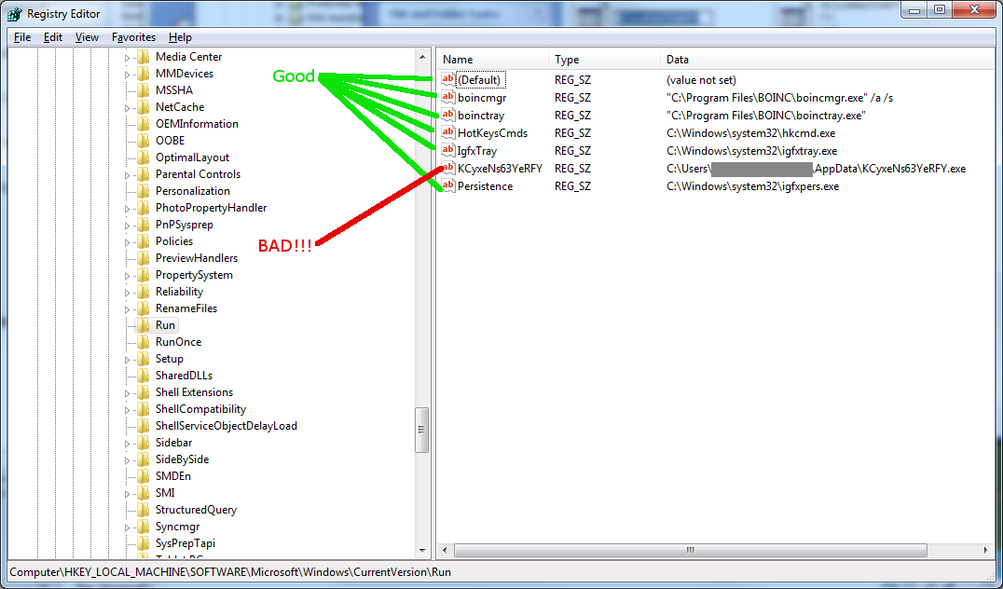
Registry – Regedit

Slide 27
Processes
Observing initial system compromise
Processes parent/child relationships
Tools
  Process Explorer, Procmon
Indicators
  Process names, order of execution, dropper activity
Q&A
  What processes are run after malware binary is executed? Are batch files involved? Are there watcher processes?

Slide 28
Processes – What to look for
Order of executables
  Initial malware
  Dropper/downloader
  Persistence executable
  Final malware
Command line interpreters
  cmd.exe
  Powershell
  Cscript, wscript

Slide 29
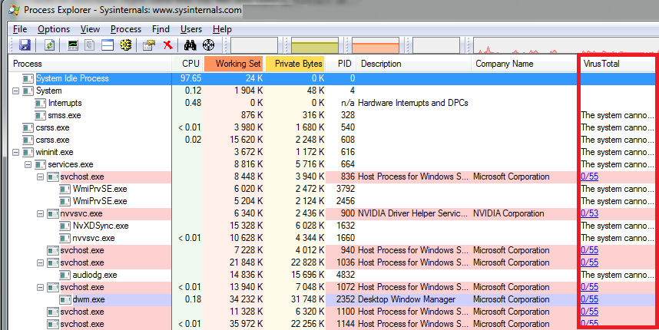
Example – Process Explorer

Slide 30
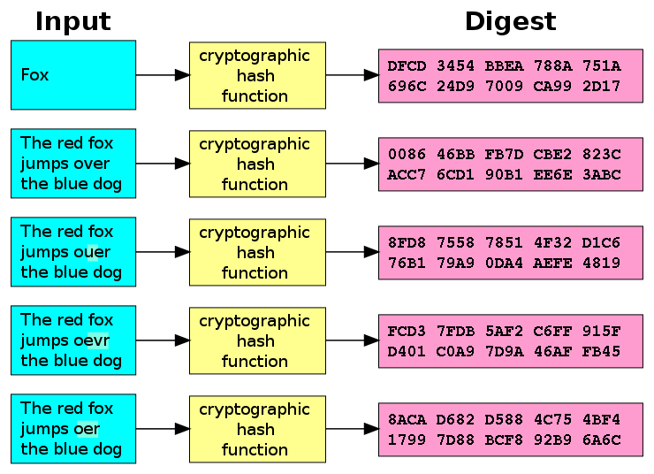
Executable file analysis
Cryptographic hash
  Hash function which is considered
  practically impossible to invert
  Unique identification of file
  Counter: Polymorphism
  MD5, SHA1
Fuzzy hash
  Context triggered piecewise hash
  Families of files
  ssdeep
Strings

Slide 31
Example – Strings
server.exe
AppData
4bcce4de98bcdb4d29f66c0fe1ffe002
hackerhani.no-ip.biz
Software\Microsoft\Windows\CurrentVersion\Run
Software\
yy-MM-dd
??-??-??
Microsoft
Windows
SystemDrive
netsh firewall delete allowedprogram "
Software
cmd.exe /c ping 0 -n 2 & del "
SEE_MASK_NOZONECHECKS
netsh firewall add allowedprogram "
Domain name
Persistence registry key
Commands to be executed
MD5: 5d347384ea978a96bc842ad9f29e95f2

Slide 32
Analysis

Slide 33
Black box analysis – indicator interpretation
Network analysis – domain & IP verification, processes communicating
Hash comparison
  Collisions, same-hash files
Behavior analysis
  System processes, created processes, persistence
File manipulation

Slide 34
Document analysis – Quick insight
EXIF information
File metadata
Document sandboxing
Document interpretation ambiguity
Practical examples
  Double extensions, different content in different viewers, code block obfuscation & hiding

Slide 35
Automated sandbox analysis

Slide 36
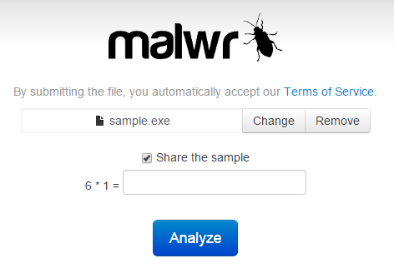
Automated sandboxing
Automated
  Execute malware in sandbox
  Wait a few seconds
  Receive summary report
  Investigate report
Non-interactive
Known tools
  Cuckoo, Norman, Anubis etc.

Slide 37

Cuckoo sandbox
Open source malware analysis system
Can analyze
  Windows executables, DLLs, PDF documents, URLs, HTML files, PHP scripts, Visual Basic scripts, ZIP archives, Python files, etc.
Modular, scriptable
Full memory dump (for Volatility Framework)
Django web interface
Mongo (NoSQL) database

Slide 38
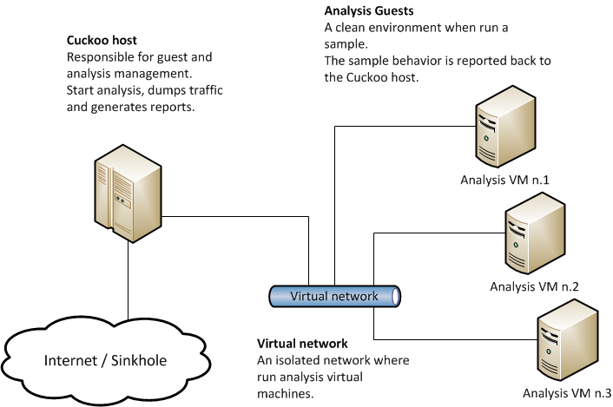
Cuckoo – Architecture

Slide 39
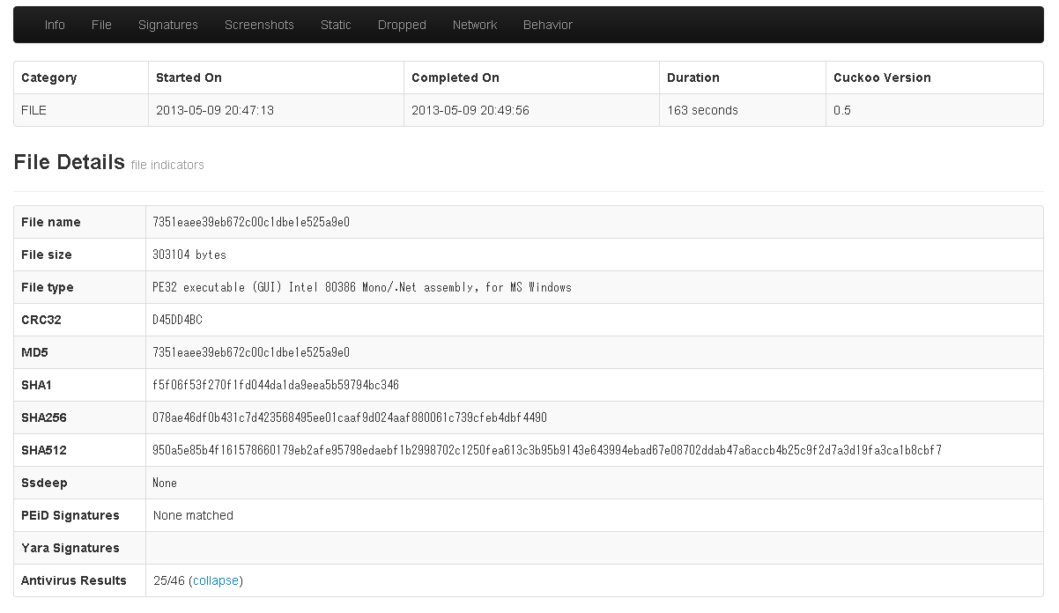
Cuckoo – GUI

Slide 40




Internet sandbox services
Public service
  OpSEC issues
Huge comparison database
Exact match by hash
Similarity search by keywords
Malwr.com (public Cuckoo sandbox)
VirusTotal.com
ThreatExpert.com
Hybrid-Analysis.com

Slide 41

Operational security (OpSec)
Advanced attackers monitor victim’s actions
  Unique indicators visible on Google?
  Attacker host monitoring for incoming traffic
  Keywords search in mails, PDFs…
Basics of OpSec
  “Think before you act” mentality
  Limited information sharing
  Trace removal
PassiveTotal.org

Slide 42
OpSec – Basic rules
No ping
No DNS lookup
No accessing to suspicious domains
No premature remediation steps (reboot, antivirus scan, OS reinstall)
No upload of samples
No indicator validation on external sources
NOT EVEN through 3rd parties

Slide 43
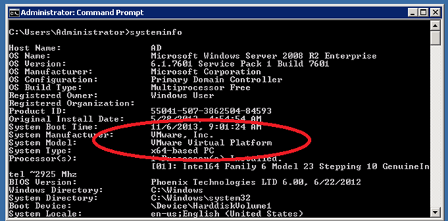
Anti-sandbox techniques
Continuous development – sandbox vs. anti-sandbox
Malware inactive in analysis environment
Tools presence detection (Wireshark, etc.)
Virtualization detection
  Registry (key existence, key value)
  File system (file existence, drivers)
  Processes (syscall response)
Human presence detection
  Mouse movement
  Keyboard activity
  File artefacts

Slide 44
Lab

Slide 45
Lab – Overview
Hands-on experience of manual black-box analysis
Guided analysis of selected malware samples
Tools
  Wireshark – Network activity
  Process Monitor – File system activity, process creation
  Autoruns – Persistence
  Regshot – Registry changes
  Process explorer – Process map

Slide 46
Lab – Samples
2-3 samples from different malware families
  Commodity malware – Zeus, ZeroAccess, Generic Trojans,…
Students will execute samples in virtual environment
  Provided simple analysis virtual machine (Windows)
  Indicators collected – network, files, persistence
  Discussion about interpretation of facts
Homework
  2 samples for analysis independently
  Write a cohesive report and present key information to the reader

