Slide 1
Management by Competencies
Integration and Subsummary

Slide 2
Human and factual elements of conflict
Emotional envelope
Factual core
quarrel
problem
Synergetization
(C) J. Plamínek
Notes:
principle of depersonalization
principle of mediation

Slide 3

Obvious and hidden elements of conflict
attitudes
Why?
interests
more recognizable
Why?
more soluble
interests
Why?
interests
Synergetization
(C) J. Plamínek
Notes:
principle of rationalization
princinple of many dimensions

Slide 4
Principles of conflicts handling
Principle of evolution
Principle of prevention
Principle of depersonalization
Principle of mediation
Principle of rationalization
Principle of many dimensions
Are there conflicts?
Are conflicts handled well?
Evolution
Revolution
Stagnation
Emotional envelope
Factual core
Synergetization

Slide 5
The origin of the team
Cooperation cannot be ordered or learnt
  set up appropriate conditions so that cooperation pays off
Conflicts are natural and essential to avoid stagnation, however they have to be treated well
  conflicts between interests of group members and group itself
  conflicts coming from diversity of group members
When conditions for cooperation are set up AND conflicts are managed the ordinary group can change itself to the team
Synergetization

Slide 6
Maturation of the group
Who?
Process
Thing
Power
Relations
How?
What?
Who?
Synergetization
(C) J. Plamínek

Slide 7
 | 1. Gaining confidence and order | 2. Waking of Activity | 3. Synergy development
Managing force | Person (manager) | Members (including manager) | Ideas
Focus | Operational task, manager | Processes and rules | Relations and goals
Managerial style | Directive management | Open management | Synergistic management
Typical kind of communication | Monolog | Dialog | Facilitation
Decision making | Authoritative | Consultative | Delegative or participative
Effective incentives | Stimulation | Motivation | Self-motivation
Relationships development | Passivity retreat, onset of competition | Development of competition, onset of cooperation | Development of team work
Synergetization
(C) J. Plamínek

Slide 8

Team development
(C) J. Plamínek
Synergetization

Slide 9
Managing conflict people
I
S
H
M
O
D
What bothers me specifically?
Is the problem on my side?
Is the problem in the system?
Does he or she cause the problems intentionally?
Why does he or she cause the problems?
Integration
Notes:
1) describe problem in the terms of consequences
2) it is easier change myself than another person
3 work for two people simultaneously, he works for me, but I can not evaluate him

Slide 10
Typical causes of intentional conflicts (possible answers to question 5)
I
S
H
M
O
D
Wants to attract attention
then assign the role
Wants to solve a problem
then reveal and understand the problem
Wants to mask his or her inability
then habilitate him or her
Does not like me, want to hurt me
are there specific causes?
if so, remove them
if not, limit contacts
Does not care, is passive
then orientate and motivate him or her
It is his or her nature or unknown
if it is important, ask specialist
Integration

Slide 11
Individual development
I
S
H
M
O
D
Freedom
Latitude
Dependence
Synergy
Integration
(C) J. Plamínek
Notes:
dependence – napodobování ostatních, neschopnost tvořit nové reakce,
latitude – nezávislé chování, přehlížení odpovědnosti, nevnímají sebe sama v širších souvislostech –
freedom - rozvíjení citlivosti k potřebám okolí, schopnost vidět se očima ostatních, uvšědomovat si důsledky svých činů

Slide 12
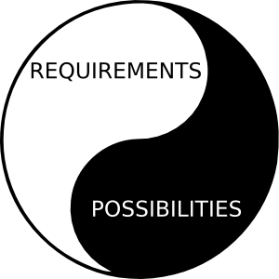

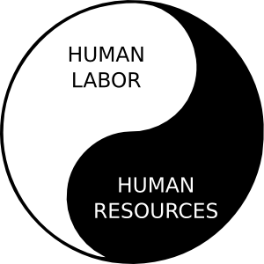
Previously on MbC
Qualities
(the way we are)
Person
(human resources bearer)
value
claiming
Competition
Me>0, You<0
egoism
Cooperation
Me>0, You>0
value
co-creation
STABILITY
EFFECTIVITY
USEFULNESS
DYNAMICS
Me=-You
Me=You
Abilities
(what we know and can do)
Attitudes
(what we want, what we believe in)
Passivity
Me=0, You=0
Me=0
oppression
Integration
Synergetization
Habilitation
Motivation
Orientation
Definition
altruism
Synergy
Activity
Order
Trust
Processes
Services
Products
Clients
Customers
Money
Resources
Destruction
Me<0, You<0
Yielding
Me<0, You>0
value
destruction
value
offering
self-destruction
You=0

Slide 13
Agenda
Theory of vitality
  pyramids interaction
Theory of constraints
Competency rule
Roles and tasks
Troubleshooting
Management by Competencies

Slide 14
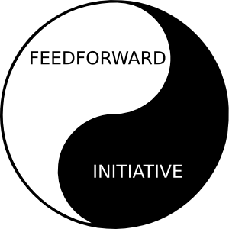


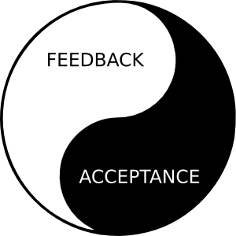
Strategy: Theory of vitality
crisis
Stability
Effectivity
Usefulness
Dynamics
Integration
Synergetization
Habilitation
Motivation
Orientation
Definition
eqi.
activity
stability
acceptation
structures
resources
processes
tasks
products
needs
subjects
(C) J. Plamínek

Slide 15
Tactics: Theory of Constraints
Dynamics?
yes
no
no
Dynamics!
Stability!
Consultation!
yes
Stability?
Usefulness?
yes
Effectiveness!
no
Usefulness!
no
yes
Effectiveness?
(C) J. Plamínek

Slide 16
Competency rule
Every success or failure of any company corresponds to the competencies of people responsible for company performance (R. Fišer)
competence= resources + labor
(C) J. Plamínek

Slide 17
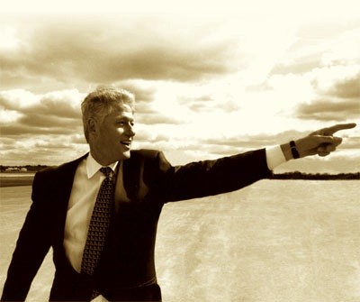


Roles and tasks
strategic frame
Role of Leader
Role of Manager
monitoring
goals
ways
tasks
evaluation
internal
resources
internal
products
Role of Performer
(C) J. Plamínek

Slide 18
Leadership tasks
2 tasks
strategic frame definition
strategic frame “selling”

Slide 19
Managerial tasks
12
tasks
define products
define processes
define resources
define structures
define feedbacks
define feedfwds
define tasks and competencies
motivate people
habilitate people
orientate people
synergetize people
integrate people

Slide 20
Performer tasks
3 tasks
performance
provision of special resources
care of own resources

Slide 21
Troubleshooting cycle
competency rule
I
S
H
M
O
D
pyramid of culture
functional model
!
theory of constraint
!
What | When | Who
theory of constraint
S
E
U
D
realization project
(C) J. Plamínek
pyramid of vitality

Slide 22
Management by Competencies
Methodology
Tactics
Strategy
competency rule
!
theory of constraint
S
E
U
D
I
S
H
M
O
D
theory of vitality
(C) J. Plamínek

