Slide 1
Xamarin
Martin Bojnanský
Microsoft Student Partner & SW Engineer @ Riganti
@martinbojnansky
martin.bojnansky@outlook.com
http://bojnansky.com

Slide 2
Navigation

Slide 3
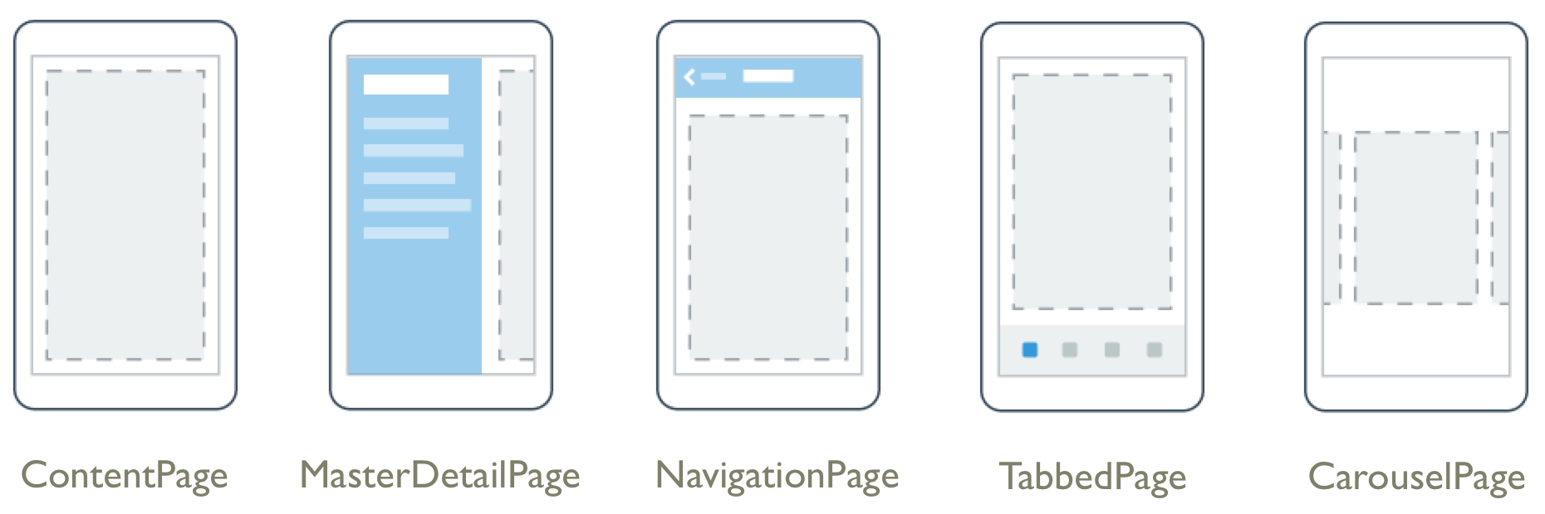
Navigation Controls
Typy stránok pre navigáciu

Slide 4
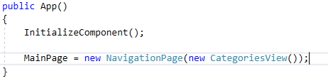



Hierarchy Navigation

Slide 5



Modal Navigation

Slide 6

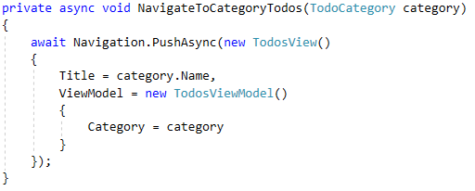
ViewModel Navigation

Slide 7
Lifecycle

Slide 8
App Lifecycle
OnStart()
Štart aplikácie
OnSleep()
Uspanie (minimalizovanie, prechod do inej aplikácie)
OnResume()
Obnovenie zo spánku

Slide 9
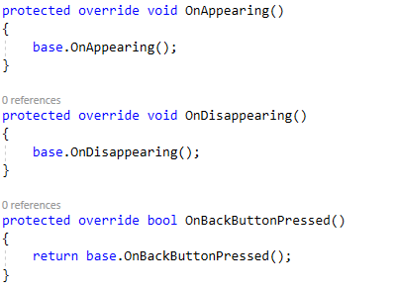
Page Lifecycle

Slide 10
Prism
Open-Source MVVM Framework
http://prismlibrary.github.io/docs/xamarin-forms/Getting-Started.html

Slide 11
Dependency Service

Slide 12

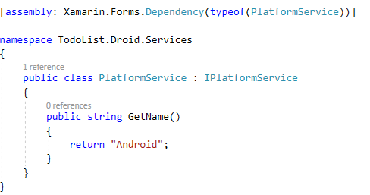
Dependency Service
Platform-Specific Implementation
Definícia Interface pre každú platformu zvlášť

