Slide 1
Test driven development
Radim Göth

Slide 2
Outline
Extreme programming
What is TDD and how it is practiced
Unit testing
Installing NUnit
Coding katas

Slide 3
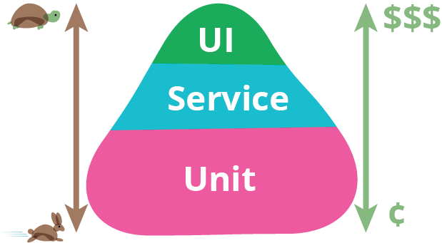
Test pyramid
https://martinfowler.com/bliki/TestPyramid.html

Slide 4
Unit vs integration testing
12
8
UnitA
UnitB

Slide 5
J. Ráček, Analýza a návrh systémů

Slide 6
Extreme Programming
Stand ups
Planning game
Pair programming
TDD
Collective code ownership
Continuous integration
Code is everythink
No useless analysis
No useless documentation

Slide 7
Naming conventions
Project naming
<ProjectUnderTest>.Tests
Class naming
<ClassUnderTest>Tests
Test method naming
Given_When_Then
<methodUnderTest>_Given_Then

Slide 8
Unit test structure
Arrange
Act
Assert
One Assert per test (ideal situation)
More assert per test
Could be refactored (e.g. custom assert method)
Only if it doesn’t make sense to divide test into several others

Slide 9
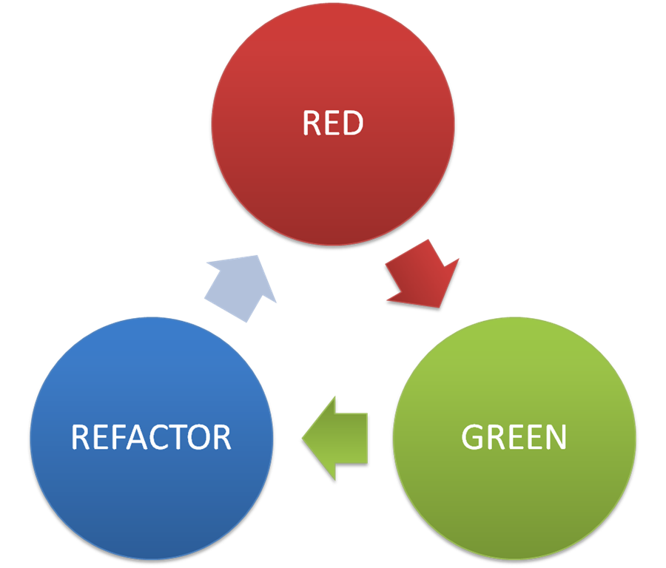
TDD
Kent Beck – reinvented TDD, invented XP
Software development process
Pair programming
Rules:
Write failing test
Write simplest implementation to pass the test
Refactor your code
Repeat

Slide 10
Coding katas
Is a way to
exercise your brain
exercise TDD
learn new language

Slide 11
Leap year excercise
Write a function that returns true or false depending on whether its input integer is a leap year or not.
A leap year is divisible by 4, but is not otherwise divisible by 100 unless it is also divisible by 400.
2001 is a typical common year
1996 is a typical leap year
1900 is an atypical common year
2000 is an atypical leap year

Slide 12
Fizz buzz
Fizz Buzz is a mathematical game which is played with a group of people. Each person says a number in sequence, but when the number is a multiple of 3, they have to say "Fizz", when it is a multiple of 5 they have to say "Buzz", and if it is a multiple of both 3 and 5, "FizzBuzz". If someone makes a mistake and it is noticed, they are out.
A typical game might start like: 1, 2, Fizz, 4, Buzz, Fizz, 7, 8, Fizz, Buzz, 11, Fizz, 13, 14, Fizz Buzz, etc.
string FizzBuzz(int start, int count)

Slide 13
Events
http://codingdojo.cz/
http://globalday.coderetreat.org/

