Slide 1
PA197 Secure Network Design
Security aspects of wireless personal area networks (PANs)
Please insert any comments, hints or spotted inaccuracies here: https://drive.google.com/file/d/1MCgHENIHcd4g9y8TdIsttTSWMonHVR0V/view?usp=sharing
Petr Švenda svenda@fi.muni.cz
Faculty of Informatics, Masaryk University

Slide 2
Overview
“Project” – spanning over three lectures and labs
Implementing network based on Arduino with RF module
Passive “sniffer” eavesdropping attacker
Active attacker against routing
Security considerations of wireless transmission
Technology for Personal Area Networks (PANs)
Bluetooth, NFC, ZigBee
Design goals
Security vulnerabilities
Combination of technologies

Slide 3
Multi-lab project

Slide 4
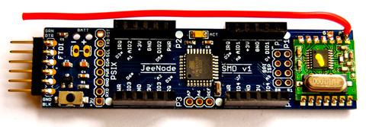
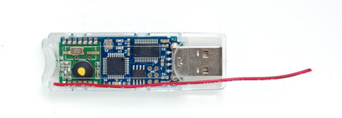
Wireless network devices
Arduino with RF module
Easy C programming
Much easier then e.g., TinyOS
Every student will get node
Programming at home, homework
Cooperation with others to form basic network
Permanently running network of 20+ nodes in lab
Used for testing the attacks etc. at larger network tests
10-15 minutes scenarios, then reset of the network

Slide 5
Wireless network project
Implementation of ad-hoc network based on Arduino with RF module
Larger “project” spanning over next three weeks
Labs & Homework
Laboratory 9: initial implementation of reliable packet transmissions and neighbor discovery, eavesdropping
Laboratory 10: parsing routing info, actively manipulating routing information
Laboratory XX: Pairwise and probabilistic key distribution and secure channel
Not this year, partially covered in previous two labs

Slide 6
What to prepare for labs
Download and install Arduino software in advance!
https://www.arduino.cc/en/Main/Software
Read Arduino development guide (L. Nemec)
Uploaded in IS, labs folder
Collect JeeNodes today or during Wednesday labs
Please don’t forget to sign the sheet!

Slide 7
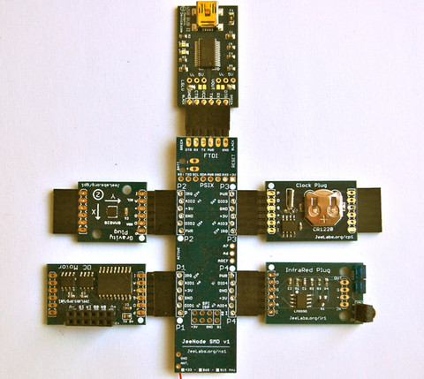

Slide 8
Personal area networks

Slide 9
Main design goals
(Not necessary all at the same time)
Energy efficiency
Running long time only on batteries
Physical locality of communication (NFC)
Imposing restrictions on attacker
Quick establishment of temporary connections
Usable security
Ad-hoc networking
Temporary networks without pre-fixed structure

Slide 10
Basic steps of communication
Discover other device(s)
Public broadcast vs. private sharing
Authenticate and establish initial key(s) (pairing)
Usually once for new devices
Authenticate and refresh keys for paired devices
If long-term persistence is maintained (known devices)
Exchange packets between devices
Terminate connection

Slide 11
Wireless medium - attacks
Wireless networks

Slide 12
Attack surface is large
Wireless signal propagates more easily
Eavesdropping, message injection
Also more difficult to localize attacker
Processing transmissions more complicated
Potential for bugs in implementation, network stack
Potential for physical device compromise
Device not connected => easier to be lost/stolen…

Slide 13
Wireless medium – basic properties
Eavesdropping on active transmission is easy
Omnidirectional vs. directional antenna
Active vs. passive communication mode
Eavesdropping on passive device (RFID,ISO14443) more difficult (passive mode)
Tag/card does not emit signal on its own
Tag/card specifically distorts EM field measured by reader
Multiple channels may require multi-channel eavesdropping
Frequency hopping based on secret sequence (PRNG)

Slide 14
Generic attacks: Eavesdropping
Active → active transmission
Directional antenna, e.g., Bluetooth 10² → 10⁴ meters
Active → passive transmission
Tens of meters for active signals (reader → tag), easy
Up to 1m for passive signals (tag → reader), difficult
Signals must be reliable enough for normal communication => stronger than necessary minimum
Eavesdropping cannot be generally prevented
Possibly only significantly limited in distance (NFC)
Solution: use secure channels (encryption, auth)
Notes:
http://www.radio-electronics.com/info/wireless/nfc/nfc-near-field-communications-security.php

Slide 15
Attack: record and compromise later
Eavesdropped communication is encrypted
Used key is later recovered by other means
End-node compromise, side-channel attack, bruteforce…
=> Past communication can be decrypted (later)
How to prevent?
(Perfect) forward secrecy protocols (e.g., ECDH)
Notes:
http://www.radio-electronics.com/info/wireless/nfc/nfc-near-field-communications-security.php

Slide 16
(Perfect) forward secrecy protocols
Long-term key compromise doesn’t compromise past session keys
Fresh keypair generated for every new session
Ephemeral public key used to exchange session key
Ephemeral private key is destroyed after key exchange
Captured encrypted transmission cannot be decrypted
Long-term key is used only to authenticate ephemeral public key to prevent MitM
Where used? TLS, OTR/Signal, ePassports…
Where NOT used? If only symmetric crypto based

Slide 17
DH based on elliptic curves used (ECDH)
EC curve, G (base point)
A x G (scalar multiplication)
B x G
A x B x G
A x b
B x a
A x B x G
http://www.themccallums.org/nathaniel/2014/10/27/authenticated-key-exchange-with-speke-or-dh-eke/

Slide 18
Generic attacks: data corruption
Attacker tries to corrupt data during transmission
Channel level: additional transmission → jamming
Link/tunnel level: sinkhole, dropper…
Form of denial-of-service
Broad vs. selective jamming
Broad jamming requires higher power of transmission
Selective jamming corrupts only few bits in header / packets
Solution: device detects and verifies signal strength, counts transmitted/dropped packets…
But signal naturally fluctuates => harder to detect attack

Slide 19
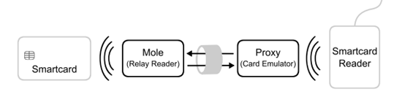
Generic attacks: Man-in-the-middle
Third device acts as relay between two legitimate devices
Log/block/modify communication
Emulates perception of close presence (door lock, card payment)
If mounted against active-active communication mode
Attacker can be farther away
Possibly needs to block legitimate traffic (to legitimate party)
If mounted in active-passive mode
Attacker needs to be closer to victim (passive → active)
May require low-latency relaying on attackers side
Potential defense: distance bounding protocols

Slide 20
Example: Passive wired relay
No amplifier or other active components required
Coaxial cable between two antennas, 20 metres or more
Very low delay (practically not detectable)
Low cost
http://cdn.intechopen.com/pdfs-wm/44973.pdf

Slide 21
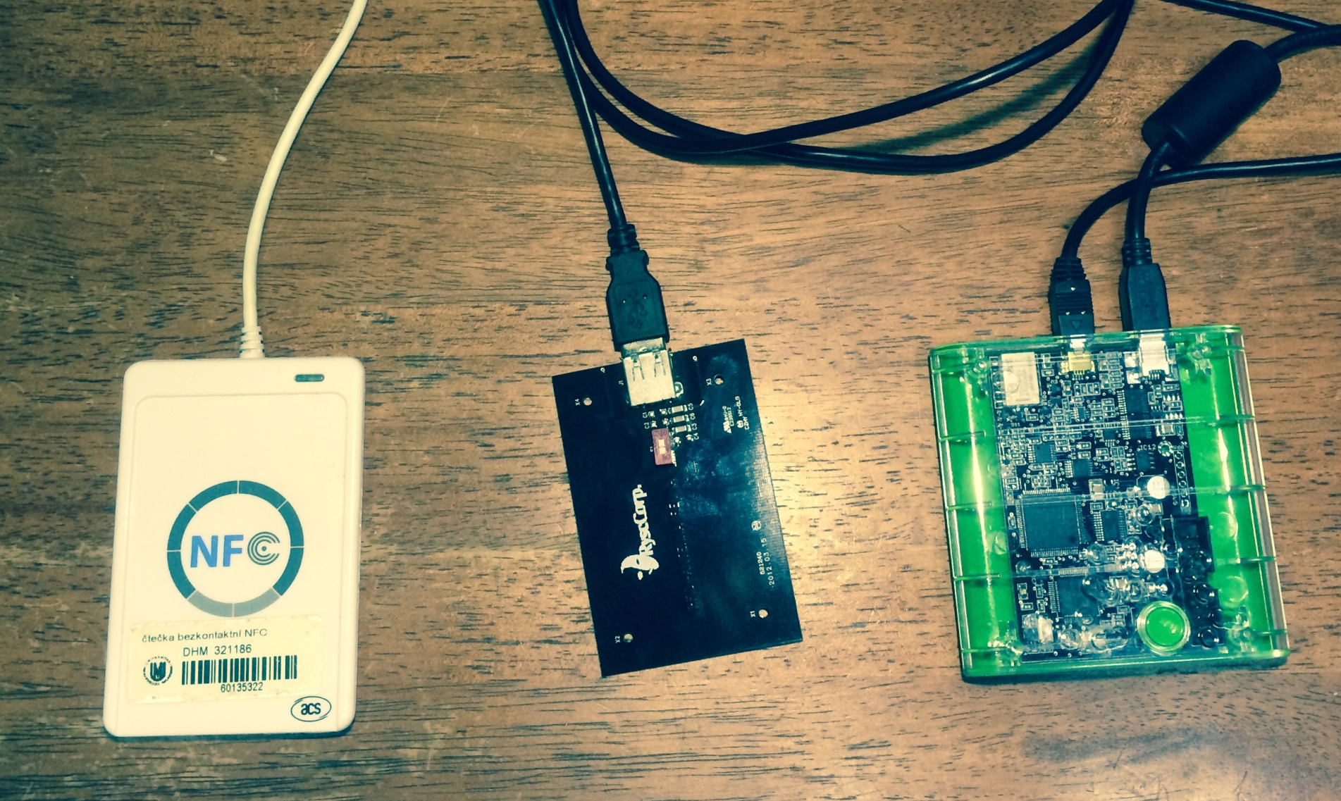
Example: ePassport simulator Proxmark III (M. Korec) https://is.muni.cz/auth/th/396490/fi_b/

Slide 22
Distance bounding protocols
Enable verifying device to establish upper bound on physical distance from connecting device
Time to receive response to challenge is measured
Multiplied by speed of light (~RF waves speed)
Problem: transmission time may be significantly smaller than necessary processing time
Especially for high-frequency channels
Important to measure precisely 1 ns => 15cm error
More likely to detect active MitM than passive relay
http://cdn.intechopen.com/pdfs-wm/44973.pdf

Slide 23
Bluetooth
Wireless networks - Bluetooth

Slide 24
Bluetooth – basic information
Wireless standard for exchanging data over short distances
IEEE 802.15.1 standard (no longer maintained)
Specification maintained by Bluetooth Special Interest Group (SIG)
UHF radio waves in the ISM band from 2.4 to 2.485 GHz (globally unlicensed band, scientific and medical)
Frequency-hopping spread spectrum (1600 hops/sec), Adaptive Frequency-Hopping (AFH, avoids crowded frequencies)
79 designated Bluetooth 1MHz channels (40 for BT 4.x)
Class 1/2/3 devices (max. power, distance ~100/10/1m)
Speed 1Mbit – 24Mbit / sec
Bluetooth usage profiles (https://en.wikipedia.org/wiki/List_of_Bluetooth_profiles)

Slide 25
Bluetooth - networking
Each BT device has unique 48-bit device address
Discoverable vs. hidden mode
On demand response (device name, class, services, info)
If discoverable then always respond
If hidden then respond only if other device address is already known
Packet-based protocol with master-slave order
One master → up to 7 slaves (forms piconet)
Even and odd medium slots for master/slave transmission
Multiple piconets form scatternet
Some devices both master in piconet X and slave in piconet Y
Extends device range via multi-hop communication
(Not really used in practice so far)

Slide 26
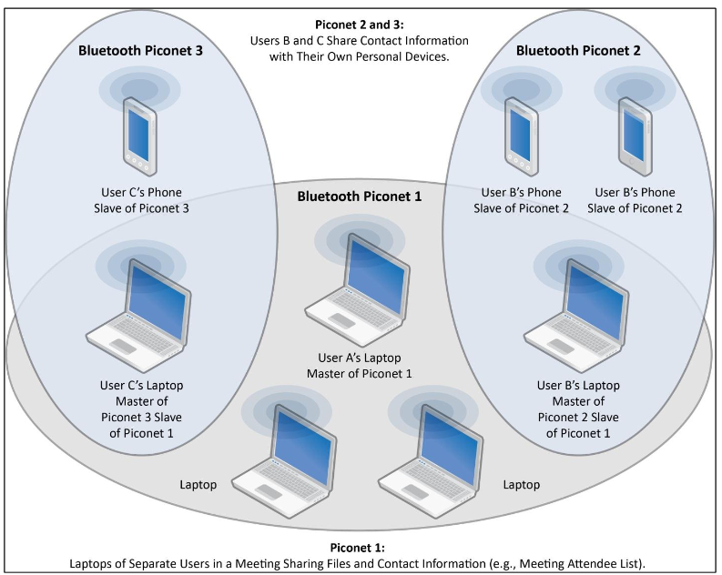
Bluetooth – piconets, scatternet
http://csrc.nist.gov/publications/nistpubs/800-121-rev1/sp800-121_rev1.pdf

Slide 27
Bluetooth vs. WiFi
AP-based WiFi is asymmetric (infrastructure)
BT is master – slave, but usually ad-hoc
BT generally requires less configuration
BT is more power efficient, especially BT 4.x LE
AP-based WiFi is generally more suitable for infrastructural placement, BT for ad-hoc networking
Cooperation of technologies
Initial pairing setup via BT, fast transmission via WiFi

Slide 28
PA197 - PANs, Bluetooth struktury

Slide 29
Bluetooth security
Wireless networks - Bluetooth
Notes:
Slides will be heavily based on very good NIST’s Guide to Bluetooth Security
http://csrc.nist.gov/publications/nistpubs/800-121-rev1/sp800-121_rev1.pdf

Slide 30
Security requirements
What would you like to have? ☺
NIST guidelines to Bluetooth security
https://nvlpubs.nist.gov/nistpubs/SpecialPublications/NIST.SP.800-121r2.pdf

Slide 31
Bluetooth – versions, security features
BT 1.0 [1994?] Initial version, mandatory encryption
BT 1.1 [2002] Possibility for non-encrypted channels
BT 2.1 [2007] Secure simple pairing (SSP)
BT 3.0 [2009] Negotiation of high speed over 802.11 link
BT 4.0 [2010] BT low energy (Wibree), coin cell power, Bluetooth Smart Ready, SSP not available
BT 4.2 [2014] Introduces important features for IoT, LE Secure Connections, Link Layer Privacy, ECDH-based SPP
BT 5 [2016] Larger range and transmission speed
BT 5.1 [2019] Angle of Arrival/Departure (tracking devices), broadcast data without full connection (e.g., thermometer)

Slide 32
Bluetooth security modes
Mode 1 provides no security
Any device can connect, no encryption
Up to Bluetooth 2.0 + Enhanced Data Rate (EDR) and NOT beyond
Mode 2 provides security at the service level
After a communication channel is established
Centralized security manager controls
Mode 3 provides security at the link level
Before a logical channel is established
Authentication and encryption of all connections
Decreases attack surface, but requires key predistribution
Mode 4 provides Secure Simple Pairing
Connects two previously unpaired devices (DH, ECDH)

Slide 33
Bluetooth – crypto algorithms used
SAFER+ block cipher
used as building block for key derivation, authentication
E0 stream cipher for encryption
Encryption key, master device BT address, real-time clock
E22 key derivation algorithm
Derive initial key from address, rand and PIN
E21 session key derivation algorithm
Link key generation from initial key
E1 authentication algorithm
Authenticate devices after pairing
AES cipher in Counter mode (AES-CCM)
Introduced for Bluetooth LE (BT 4.0)
General trend: used to be custom crypto (earlier, < 4.0), move towards standard primitives (now, >= 4.0)
BT < 4.0
BT >= 4.0

Slide 34
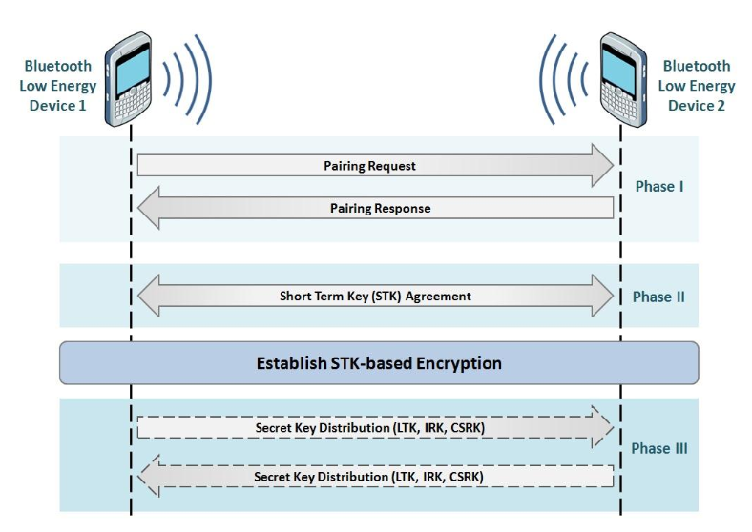
Bluetooth pairing
https://www.bluetooth.com/specifications/adopted-specifications

Slide 35
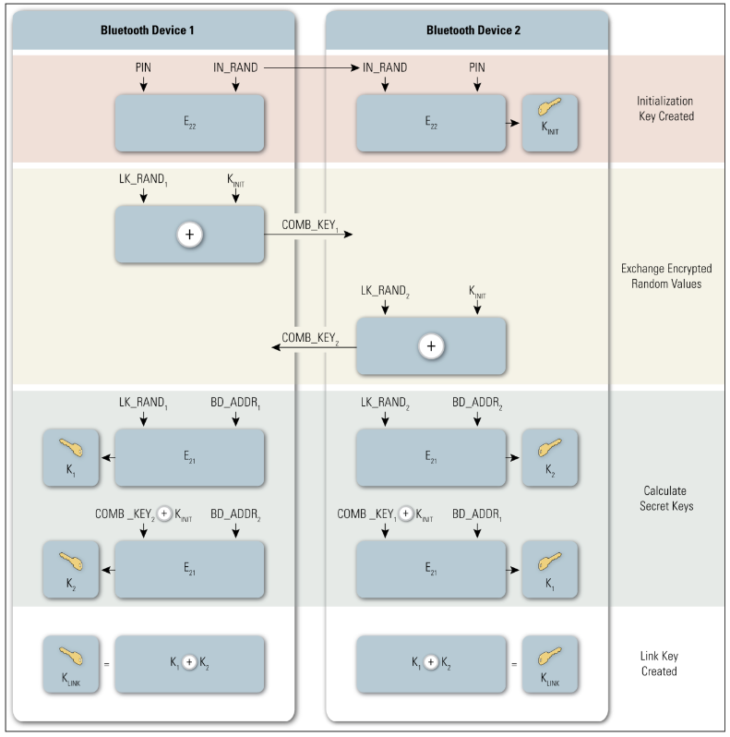
BT Initial key → link key (E22 and E21)
http://csrc.nist.gov/publications/nistpubs/800-121-rev1/sp800-121_rev1.pdf

Slide 36
BT Pairing – Legacy pairing
BT 2.0 and before
Initial key exchange (K_{INIT}) over unencrypted link
What attacks are possible?
Passkey/PIN → initialization key → link key
Short passkey problem (passive attack ~ms)
http://www.eng.tau.ac.il/~yash/shaked-wool-mobisys05/index.html

Slide 37
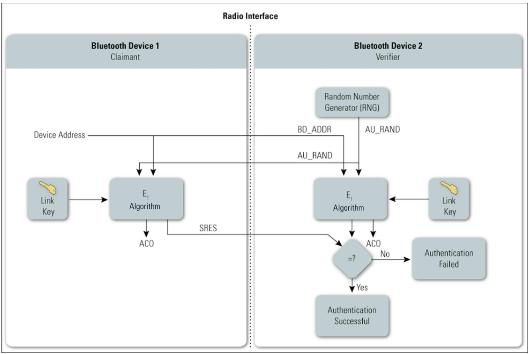
BT – authentication (E1)
http://csrc.nist.gov/publications/nistpubs/800-121-rev1/sp800-121_rev1.pdf

Slide 38
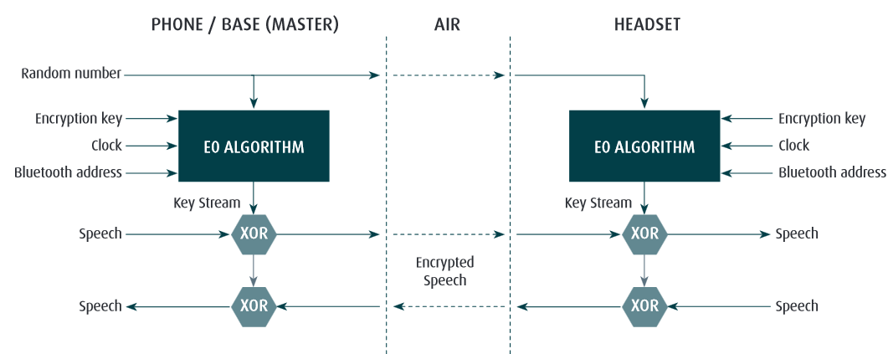
Bluetooth – E0 encryption
http://www.jabra.com/~/media/Documentation/Whitepapers/WP_Bluetooth_50004_V01_1204.pdf

Slide 39
Bluetooth attacks
Bluesnarfing, Bluebugging
Unauthorized extraction of data from device (discoverable mode)
Guessing device address via brute-force attack
48bit MAC address, but first 24 as manufacture’s id
Limited key-usage period (< BT 2.1)
Around 23.5 hours before simple XOR attack (E0 stream cipher)
Encryption can be forced to be turned off (< BT 2.1)
L2CAP level attacks
Parts of data packet not protected by integrity
Fuzzing used to find flaws in device’s firmware

Slide 40
BT Pairing – Legacy pairing
BT 2.0 and before
Initial key exchange (K_{INIT}) over unencrypted link
What attacks are possible?
Passkey/PIN → initialization key → link key
Short passkey problem (passive attack ~ms)
http://www.eng.tau.ac.il/~yash/shaked-wool-mobisys05/index.html
Is attack prevented by perfect forward secrecy?
No, but force attacker to be active (MitM)
How to use Passkey/PIN to prevent MitM?
Escalation protocols (fresh DH + PIN for authentication)

Slide 41
DH based on elliptic curves used (ECDH)
EC curve, G (base point)
A x G (scalar multiplication)
B x G
A x B x G
A x b
B x a
A x B x G
http://www.themccallums.org/nathaniel/2014/10/27/authenticated-key-exchange-with-speke-or-dh-eke/

Slide 42
BT Pairing – Secure Simple Pairing (SSP)
Secure Simple Pairing (SSP, from BT 2.1)
Public-key crypto based (ECDH from BT 4.2) for key agreement
How to authenticate ECDH public part?
Just works mode: no authentication
Numeric comparison mode: display challenge and confirm
Passkey Entry mode: insert passphrase
Out Of Band mode: use other channel to establish auth. key
128 bit random link key for encryption (at maximum)
Length negotiated by devices

Slide 43
SSP
Just works / Numeric comparison / Pass Key Entry / Out of Band…
https://nvlpubs.nist.gov/nistpubs/SpecialPublications/NIST.SP.800-121r2.pdf

Slide 44
Bluetooth LE/Smart (BT 4.x) (2010)
For low-energy, storage/computation restricted devices
Simplified protocol for link key establishment
LE pairing protocol establish long-term key (LTK)
Key transport instead of key agreement is used
One device generates LTK and transports during pairing
What are the security implications?
Support for out-of-band for pairing
E.g., NFC-based exchange of Temporary Key (TK)
AES-CCM introduced (relevant for FIPS 140-2)
Introduction of private device address
Public device address from encrypted (changing) private address
Eavesdropper will not learn public address => no address tracking
Notes:
800-121-rev1, chapter 3.2

Slide 45
Bluetooth LE/Smart (BT 4.0)
BT Secure Simple Pairing uses Diffie-Hellman
To prevent passive eavesdropping and forward secrecy
But asymmetric crypto is slow(er) + energy consuming
Design decision for 4.0 – no SSP at the time
BT 4.0 LE/Smart pairing is symmetric-cryptography based
Passive eavesdropping + delayed key compromise possible
BT LE pairing with ECDH keys added in BT 4.2
Authenticated ECDH exchange of link key

Slide 46
Bluetooth – Tracking privacy
Each BT device has unique 48-bit device address
BT 1.0 required mandatory transmission, later dropped
Discoverable / non-discoverable mode
Once discoverable, device’s address is trackable
Address space (48b, manufacturer) can be brute-forced
BT 4.0 (BT LE) allows for private device address
Public device address (used in key establishment) broadcasted only in encrypted form
Eavesdropper cannot track target device based on MAC

Slide 47
Bluetooth security tools
BlueSpam - sends file via OBEX to active devices
BlueHell http://sourceforge.net/projects/bluehell/
Bluelog http://tools.kali.org/wireless-attacks/bluelog
Discover and log discoverable devices
BlueMaho https://wiki.thc.org/BlueMaho
Monitor devices, test known attacks
Bluepot https://github.com/andrewmichaelsmith/bluepot/
Bluetooth Honeypot

Slide 48
Bluetooth – (moral) summary
One of early protocols intended for battery-powered “limited” devices (BT 1.x)
Cell phones that time, wireless headsets…
Vulnerabilities due to insecure defaults, proprietary crypto etc.
Typical for the period of its introduction (recall also WiFi’s WEP…)
More security features introduced (BT 2.x)
But also usability, adoption and intellectual property dispute issues
Cooperation with other technologies, speed (BT 3.x)
Initial exchange and configuration, then faster WiFi transmissions
Added focus on extra low energy devices (BT 4.x)
Secure by default, standardized crypto algorithms
Renewed interest and support, wider adoption

Slide 49
NFC
Wireless networks – Near Field Communication

Slide 50
Near Field Communication (NFC)
Low-power, low-bandwidth communication
Initially for reader to tag communication
Possibility for tag emulation by device (=>device to device)
Be aware of potential confusion of “NFC” term
As general term (short distance communication)
As NFC as specific implementation (NFC A, ISO18092)

Slide 51
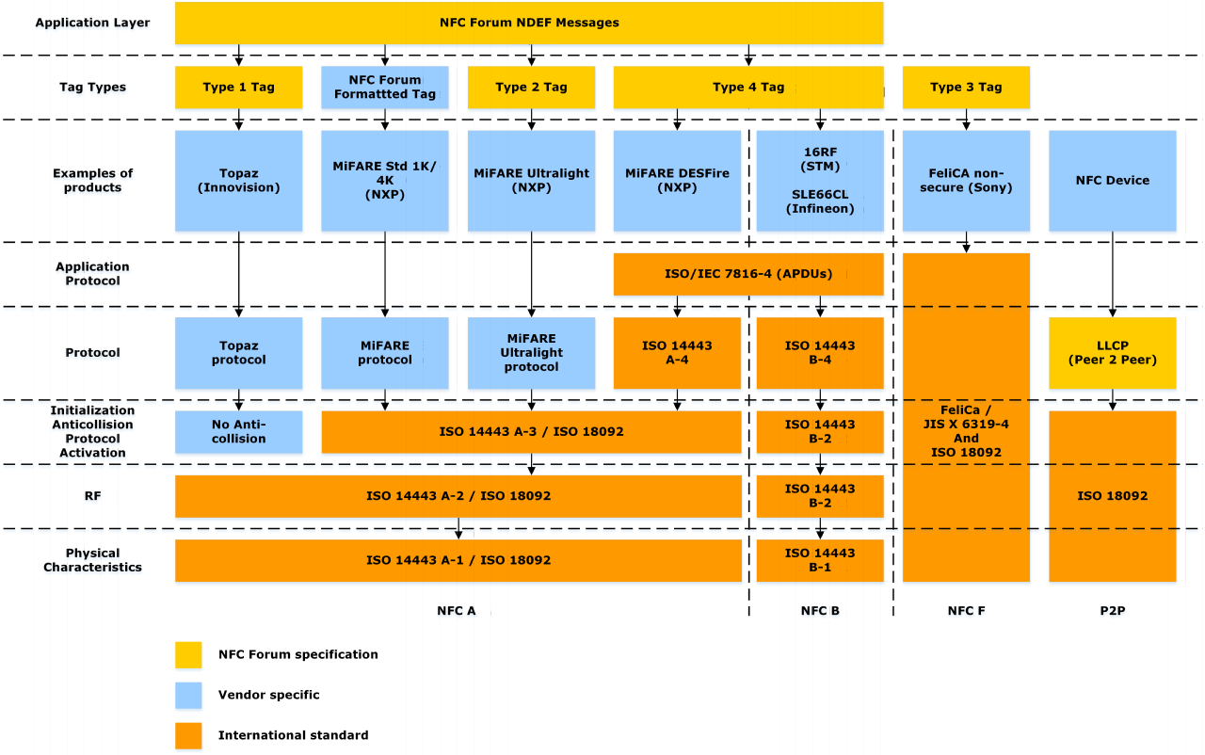
NFC standards
"NFC Protocol Stack" by Erik Hubers –
Licensed under CC BY-SA 4.0 via Commons

Slide 52
Security goals of NFC
Physical presence proof
Only short distance communication possible
Locality of eavesdropping
Simplify key management for other protocols (OOB)
Uses physical presence proof
NFC → initial key → BT SSP → BT/WiFi transmission
NFC → IP, MAC, key → WiFi-Direct
Utilize secure hardware via NFC reader
Physical tag, token, cryptographic smart card…
Turn mobile phone into security token
Card emulation

Slide 53
NFC communication modes
Reader/writer mode
Read (and/or write) NFC tags and stickers
No security except physical presence bounding
Usually only tag’s/sticker’s ID transmitted
P2P mode
exchange data with other NFC peer
used by Android Beam between two NFC-enabled phones
Card emulation
NFC device emulates tag/cryptographic smart card

Slide 54
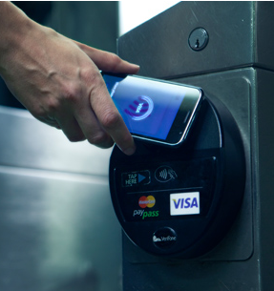
NFC mode: Card emulation
NFC device emulates tag/cryptographic smart card
Card emulation mode
NFC device acts as NFC card
Emulated by separate chip in device – secure element
Commands are relayed to real card
Host-based card emulation
Emulation without physical secure element
Phone provides functionality of smart card
Software “smart card”
Apple Pay, Android Pay…

Slide 55
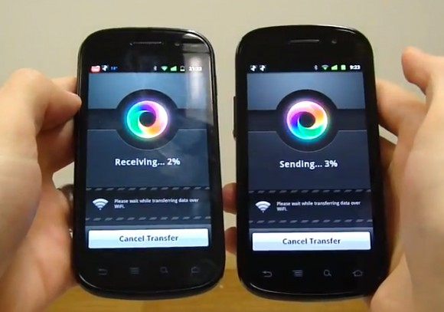
NFC as bootstrapping technology
Out Of Band (OOB) exchange of initial secrets
Utilizes “physical” presence property of NFC
Simplifies initial key exchange
dependency on difficulty of eavesdropping/MitM
Android Beam
Uses NFC to exchange 6-digits passcode for Bluetooth
Samsung S-Beam
IP,MAC via NFC for WiFi-Direct
…

Slide 56
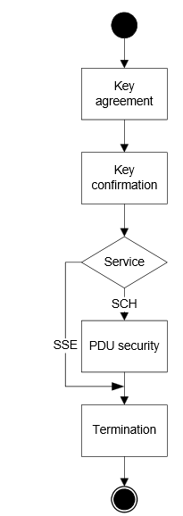
NFC security (NFC-SEC, NFC-SEC-01)
“Shared Secret Service” (SSE)
Results in confirmed shared key between devices
Based on Elliptic Curve Diffie-Hellman key exchange scheme (ECDH-192b)
Not authenticated (MiTM possible, but physical location)
"Secure Channel Service" (SCH)
Results in link key for secure channel derived from SSE
Uses AES and AES-CRT for key derivation, encryption, integrity
Application-level security possible
Use NFC to exchange keys for Bluetooth/WiFi
Implement custom protocol between devices (if needed)
http://www.ecma-international.org/publications/files/ECMA-ST/ECMA-386.pdf
http://www.ecma-international.org/publications/files/ECMA-ST/ECMA-385.pdf
Notes:
http://ecma-international.org/activities/Communications/tc47-2008-089.pdf

Slide 57
Fuzzing NFC stack
Direct emulation of one side
Card emulation mode
MITM between reader and card (proxy)
Data modified in transport
No need to implement NFC stack fully
Compromise of NFC stack allows for BT open
Android, BLUETOOTH_ADMIN
R. Miller, Exploring the NFC Attack Surface (2012)
http://media.blackhat.com/bh-us-12/Briefings/C_Miller/BH_US_12_Miller_NFC_attack_surface_WP.pdf

Slide 58
NFC vs. Bluetooth
NFC consumes significantly less energy
NFC has significantly shorter maximum distance
Active→passive mode, advantage of physical bounding
NFC is compatible with existing standards/devices
Passive RFID
Bluetooth LE moved more towards energy-efficiency
But still only active-active mode
Notes:
http://www.rsaconference.com/writable/presentations/file_upload/mbs-w09-security-implications-of-nfc-in-authentication-and-identity-management.pdf

Slide 59
ZigBee (IEEE 802.15.4)
Wireless networks – Moving towards more networking

Slide 60
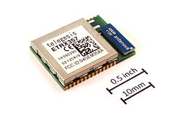
ZigBee – characteristics
Standardized as IEEE 802.15.4
ZigBee Alliance maintains current version
Niche between Bluetooth and WiFi
Low cost, low power, mesh networking
Low power transmissions, smaller bitrate (250 kbit/s)
10-100 meters (active-active communication mode)
Focus on sensors and control automation
Various radio bands (2.4GHz), routing specifications
Supports star, tree and mesh network topology
E.g., wireless sensor networks, up to 65000 nodes

Slide 61
ZigBee network
ZigBee Coordinator (ZC) / PAN coordinator
One coordinator per network
Responsible for establishment of network
Serve as repository for security keys
ZigBee Router (ZR) / Coordinator
Pass data from one node to another (routing scheme)
Intermediate node in network
ZigBee End Device (ZED) / Network device
Cheaper to produce, end (sensor) node
Cannot relay communication => can sleep => battery life

Slide 62
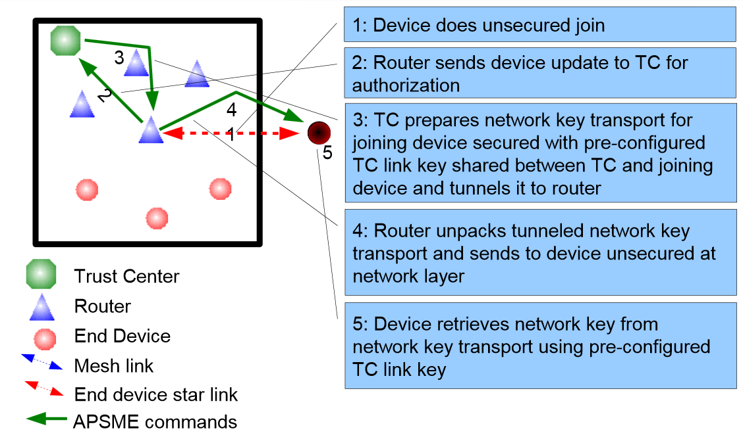
Joining ZigBee network
Source: https://docs.zigbee.org/zigbee-docs/dcn/09-5378.pdf

Slide 63
ZigBee keys
Pre-installation of master keys
Network key (shared by all), Link key (between 2 devices)
Transport of link keys
Trust center (ZC) sends link key to both nodes
Certificate-based key establishment
Trust center (ZC) facilitate establishment, no keys send between device and ZC
Elliptic Curve MQV key agreement scheme

Slide 64
ZigBee cryptography
Mostly based on symmetric cryptography
AES with 128b keys, master key, link key, network key(s)
Uses AES-CCM* mode for link layer encryption
encryption/integrity-only mode possible, MAC 4 bytes
Certificate-based key establishment
Elliptic Curve MQV key agreement scheme
Requires certification authority

Slide 65
Summary

Slide 66
Comparison: BT/NFC/ZigBee
BT initially not for low-energy, but adapted (BT 4.x)
NFC uses active-passive mode (locality)
Pre-distributed keys vs. user interaction vs. locality
ZigBee towards mesh networks
Bluetooth LE also in direction of mesh networks
(Next lecture will focus more on WSNs)

Slide 67
Similarity between protocols (security)
Easy eavesdropping
Usage of proprietary (weak) ciphers (at beginning)
Incorrect implementations of (complicated) standard
Reuse of key stream (“never” need 2²⁰ packets?)
Problem of initial pairing (how to authenticate?)
Brute-forcing usable/memorable/short PINs
Problem of device tracking (unique device ID)
Security generally getting better over time

