Slide 1
Clustering
Advanced Search Techniques for Large Scale Data Analytics
Pavel Zezula and Jan Sedmidubsky
Masaryk University
http://disa.fi.muni.cz

Slide 2
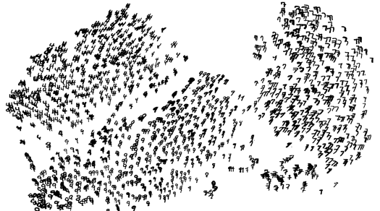
High Dimensional Data
Given a cloud of data points we want to understand its structure

Slide 3
The Problem of Clustering
Given a set of points, with a notion of distance between points, group the points into some number of clusters, so that
  Members of a cluster are close/similar to each other
  Members of different clusters are dissimilar
Usually:
  Points are in a high-dimensional space
  Similarity is defined using a distance measure
    Euclidean, Cosine, Jaccard, edit distance, …

Slide 4
Example: Clusters & Outliers
x
xx x
x x
x x x
x
x x x
x
x
xx x
x x
x x x
x
x x x
x
x
x x
x x x x
x x x x
x x x
x x
x x
x x x x
x x x x
x x x
x x
x x
x x x x
x x x
x
x x
x x x x
x x x
x
x
Outlier
Cluster

Slide 5
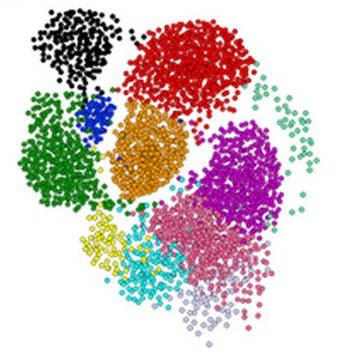
Clustering is a hard problem!

Slide 6
Why is it hard?
Clustering in two dimensions looks easy
Clustering small amounts of data looks easy
And in most cases, looks are not deceiving
Many applications involve not 2, but 10 or 10,000 dimensions
High-dimensional spaces look different: Almost all pairs of points are at about the same distance

Slide 7
Clustering Problem: Music CDs
Intuitively: Music divides into categories, and customers prefer a few categories
  But what are categories really?
Represent a CD by a set of customers who bought it:
Similar CDs have similar sets of customers, and vice-versa

Slide 8
Clustering Problem: Music CDs
Space of all CDs:
Think of a space with one dim. for each customer
  Values in a dimension may be 0 or 1 only
  A CD is a point in this space (x₁, x₂,…, x_{k}),
  where x_{i} = 1 iff the i ^{th} customer bought the CD
For Amazon, the dimension is tens of millions
Task: Find clusters of similar CDs

Slide 9
Clustering Problem: Documents
Finding topics:
Represent a document by a vector
(x₁, x₂,…, x_{k}), where x_{i} = 1 iff the i ^{th} word
(in some order) appears in the document
  It actually doesn’t matter if k is infinite; i.e., we don’t limit the set of words
Documents with similar sets of words
may be about the same topic

Slide 10
Cosine, Jaccard, and Euclidean
As with CDs we have a choice when we think of documents as sets of words or shingles:
  Sets as vectors: Measure similarity by the cosine distance
  Sets as sets: Measure similarity by the Jaccard distance
  Sets as points: Measure similarity by Euclidean distance

Slide 11
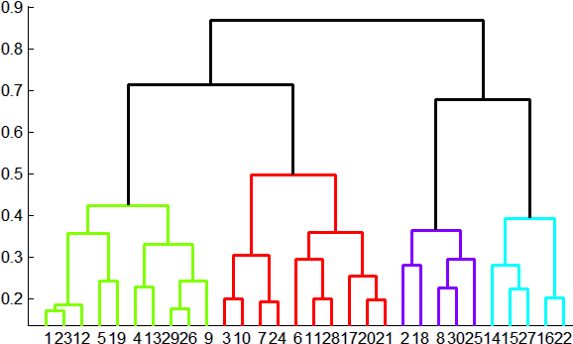
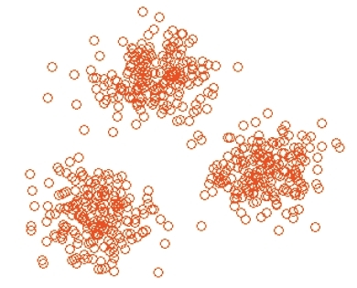
Overview: Methods of Clustering
Hierarchical:
  Agglomerative (bottom up):
    Initially, each point is a cluster
    Repeatedly combine the two
    “nearest” clusters into one
  Divisive (top down):
    Start with one cluster and recursively split it
Point assignment:
  Maintain a set of clusters
  Points belong to “nearest” cluster

Slide 12
Hierarchical Clustering
Key operation:
Repeatedly combine
two nearest clusters
Three important questions:
  1) How do you represent a cluster of more
  than one point?
  2) How do you determine the “nearness” of clusters?
  3) When to stop combining clusters?

Slide 13
Hierarchical Clustering
Key operation: Repeatedly combine two nearest clusters
(1) How to represent a cluster of many points?
  Key problem: As you merge clusters, how do you represent the “location” of each cluster, to tell which pair of clusters is closest?
Euclidean case: each cluster has a
centroid = average of its (data)points
(2) How to determine “nearness” of clusters?
  Measure cluster distances by distances of centroids

Slide 14
Example: Hierarchical clustering
(5,3)
o
(1,2)
o
o (2,1) o (4,1)
o (0,0) o (5,0)
x (1.5,1.5)
x (4.7,1.3)
x (1,1)
x (4.5,0.5)
Data:
o … data point
x … centroid
Dendrogram

Slide 15
And in the Non-Euclidean Case?
What about the Non-Euclidean case?
The only “locations” we can talk about are the points themselves
  i.e., there is no “average” of two points
Approach 1:
  (1) How to represent a cluster of many points?
  clustroid = (data)point “closest” to other points
  (2) How do you determine the “nearness” of clusters? Treat clustroid as if it were centroid, when computing inter-cluster distances

Slide 16
“Closest” Point?
(1) How to represent a cluster of many points?
clustroid = point “closest” to other points
Possible meanings of “closest”:
  Smallest maximum distance to other points
  Smallest average distance to other points
  Smallest sum of squares of distances to other points
    For distance metric d clustroid c of cluster C is:
Datapoint
Centroid
X
Centroid is the avg. of all (data)points in the cluster. This means centroid is an “artificial” point.
Clustroid is an existing (data)point that is “closest” to all other points in the cluster.
Clustroid
Cluster on
3 datapoints

Slide 17
Defining “Nearness” of Clusters
(2) How do you determine the “nearness” of clusters?
  Approach 2:
  Intercluster distance = minimum of the distances between any two points, one from each cluster
  Approach 3:
  Pick a notion of “cohesion” of clusters, e.g., maximum distance from the clustroid
    Merge clusters whose union is most cohesive

Slide 18
Cohesion
Approach 3.1: Use the diameter of the merged cluster = maximum distance between points in the cluster
Approach 3.2: Use the average distance between points in the cluster
Approach 3.3: Use a density-based approach
  Take the diameter or avg. distance, e.g., and divide by the number of points in the cluster

Slide 19
Implementation
Naïve implementation of hierarchical clustering:
  At each step, compute pairwise distances
  between all pairs of clusters, then merge
  O(N³)
Careful implementation using priority queue can reduce time to O(N² log N)
  Still too expensive for really big datasets
  that do not fit in memory

Slide 20
k-means clustering

Slide 21
k–means Algorithm(s)
Assumes Euclidean space/distance
Start by picking k, the number of clusters
Initialize clusters by picking one point per cluster
  Example: Pick one point at random, then k-1 other points, each as far away as possible from
  the previous points

Slide 22
Populating Clusters
1) For each point, place it in the cluster whose current centroid it is nearest
2) After all points are assigned, update the locations of centroids of the k clusters
3) Reassign all points to their closest centroid
  Sometimes moves points between clusters
Repeat 2 and 3 until convergence
  Convergence: Points don’t move between clusters and centroids stabilize

Slide 23
Example: Assigning Clusters
x
x
x
x
x
x
x
x
x
x
x
x … data point
… centroid
Clusters after round 1

Slide 24
Example: Assigning Clusters
x
x
x
x
x
x
x
x
x
x
x
x … data point
… centroid
Clusters after round 2

Slide 25
Example: Assigning Clusters
x
x
x
x
x
x
x
x
x
x
x
x … data point
… centroid
Clusters at the end

Slide 26
Getting the k right
How to select k?
Try different k, looking at the change in the average distance to centroid as k increases
Average falls rapidly until right k, then changes little
Best value
of k
Average
distance to
centroid
k

Slide 27
Example: Picking k
x
xx x
x x
x x x
x
x x x
x
Too few;
many long
distances
to centroid.
x
x x
x x x x
x x x x
x x x
x x
x x
x x x x
x x x
x
x

Slide 28
Example: Picking k
x
xx x
x x
x x x
x
x x x
x
x
Just right;
distances
rather short.
x x
x x x x
x x x x
x x x
x x
x x
x x x x
x x x
x
x

Slide 29
Example: Picking k
Too many;
little improvement
in average
distance.
x
xx x
x x
x x x
x
x x x
x
x
x x
x x x x
x x x x
x x x
x x
x x
x x x x
x x x
x
x

Slide 30
The BFR Algorithm
Extension of k-means to large data

Slide 31
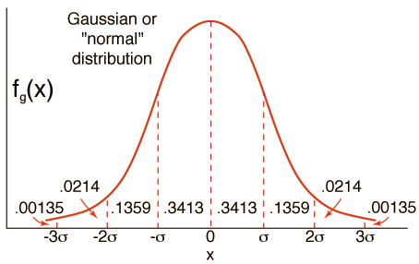
BFR Algorithm
BFR [Bradley-Fayyad-Reina] is a
variant of k-means designed to
handle very large (disk-resident) data sets
Assumes that clusters are normally distributed around a centroid in a Euclidean space
  Standard deviations in different
  dimensions may vary
    Clusters are axis-aligned ellipses
Efficient way to summarize clusters
(want memory required O(clusters) and not O(data))

Slide 32
BFR Algorithm
Points are read from disk one main-memory-full at a time
Most points from previous memory loads are summarized by simple statistics
To begin, from the initial load we select the initial k centroids by some sensible approach:
  Take k random points
  Take a small random sample and cluster optimally
  Take a sample; pick a random point, and then
  k–1 more points, each as far from the previously selected points as possible

Slide 33
Three Classes of Points
3 sets of points which we keep track of:
Discard set (DS):
  Points close enough to a centroid to be summarized
Compression set (CS):
  Groups of points that are close together but not close to any existing centroid
  These points are summarized, but not assigned to a cluster
Retained set (RS):
  Isolated points waiting to be assigned to a compression set

Slide 34
BFR: “Galaxies” Picture
Points in
the RS
Compressed sets.
Their points are in
the CS.
A cluster. Its points
are in the DS.
The centroid
Discard set (DS): Close enough to a centroid to be summarized
Compression set (CS): Summarized, but not assigned to a cluster
Retained set (RS): Isolated points

Slide 35
Summarizing Sets of Points
For each cluster, the discard set (DS) is summarized by:
The number of points, N
The vector SUM, whose i^{th} component is the sum of the coordinates of the points in the i^{th} dimension
The vector SUMSQ: i^{th} component = sum of squares of coordinates in i^{th} dimension
A cluster.
All its points are in the DS.
The centroid

Slide 36
Summarizing Points: Comments
2d + 1 values represent any size cluster
  d = number of dimensions
Average in each dimension (the centroid)
can be calculated as SUM_{i} / N
  SUM_{i} = i^{th} component of SUM
Variance of a cluster’s discard set in dimension i is: (SUMSQ_{i} / N) – (SUM_{i} / N)²
  And standard deviation is the square root of that
Next step: Actual clustering
Note: Dropping the “axis-aligned” clusters assumption would require storing full covariance matrix to summarize the cluster. So, instead of SUMSQ being a d-dim vector, it would be a d x d matrix, which is too big!

Slide 37
The “Memory-Load” of Points
Processing the “Memory-Load” of points (1):
1) Find those points that are “sufficiently close” to a cluster centroid and add those points to that cluster and the DS
  These points are so close to the centroid that
  they can be summarized and then discarded
2) Use any main-memory clustering algorithm to cluster the remaining points and the old RS
  Clusters go to the CS; outlying points to the RS
Discard set (DS): Close enough to a centroid to be summarized.
Compression set (CS): Summarized, but not assigned to a cluster
Retained set (RS): Isolated points

Slide 38
The “Memory-Load” of Points
Processing the “Memory-Load” of points (2):
3) DS set: Adjust statistics of the clusters to account for the new points
  Add Ns, SUMs, SUMSQs
4) Consider merging compressed sets in the CS
5) If this is the last round, add all compressed sets in the CS and all RS points into their nearest cluster
Discard set (DS): Close enough to a centroid to be summarized.
Compression set (CS): Summarized, but not assigned to a cluster
Retained set (RS): Isolated points

Slide 39
A Few Details…
Q1) How do we decide if a point is “close enough” to a cluster that we will add the point to that cluster?
Q2) How do we decide whether two compressed sets (CS) deserve to be combined into one?

Slide 40
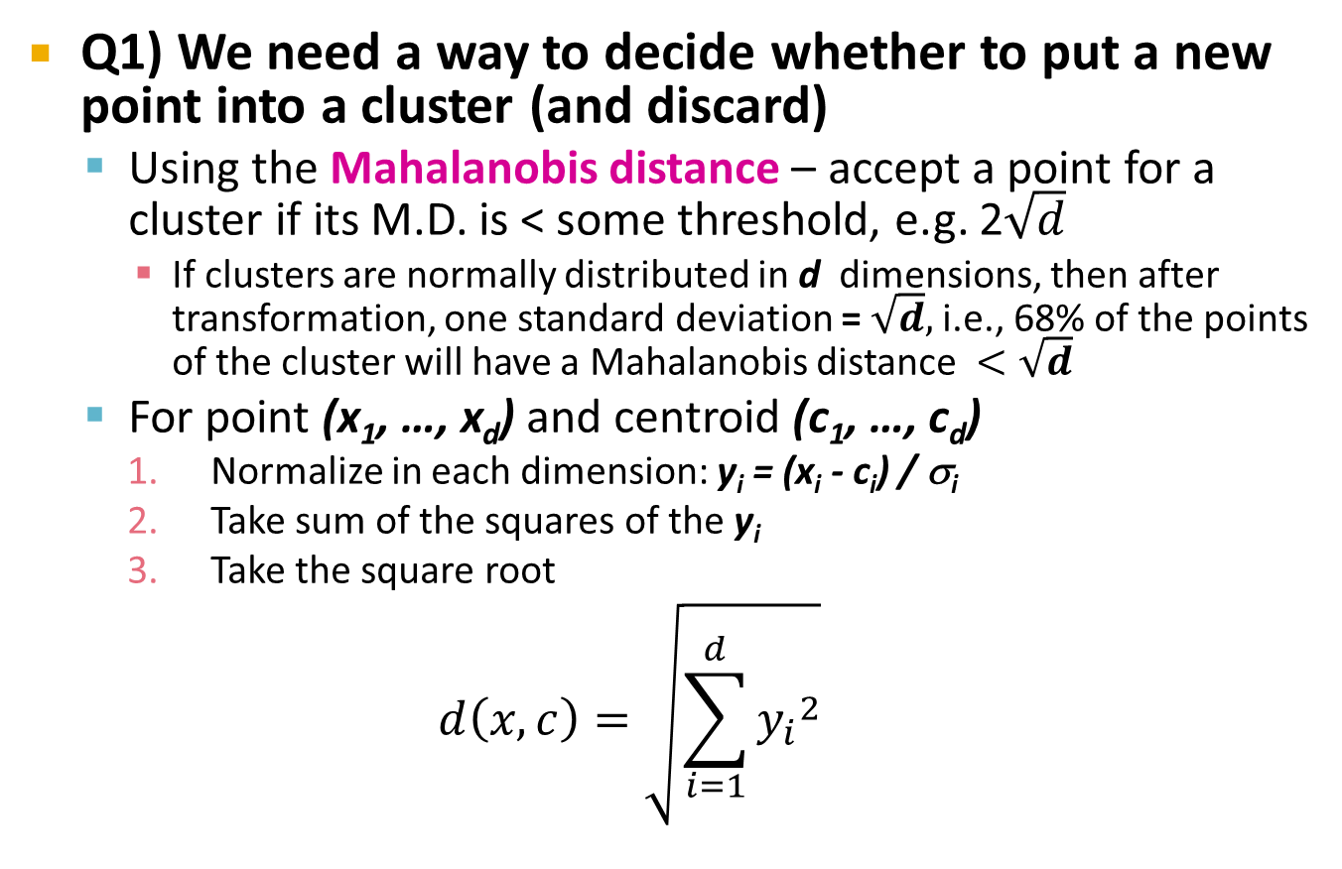
How Close is Close Enough?
Q1) We need a way to decide whether to put a new point into a cluster (and discard)
  Using the Mahalanobis distance – accept a point for a cluster if its M.D. is < some threshold, e.g. 2$\sqrt{d}$
    If clusters are normally distributed in d dimensions, then after transformation, one standard deviation = $\sqrt{d},$i.e., 68% of the points of the cluster will have a Mahalanobis distance $<\sqrt{d}$
  For point (x₁, …, x_{d}) and centroid (c₁, …, c_{d})
    Normalize in each dimension: y_{i} = (x_{i} - c_{i}) / σ_{i}
    Take sum of the squares of the y_{i}
    Take the square root
  $$d\left(x,c\right)=\sqrt{\sum_{i=1}^{d}{{y_{i}}^{2}}}$$
σ_{i} … standard deviation of points in the cluster in the i^{th} dimension

Slide 41
Should 2 CS clusters be combined?
Q2) Should 2 CS subclusters be combined?
Compute the variance of the combined subcluster
  N, SUM, and SUMSQ allow us to make that calculation quickly
Combine if the combined variance is
below some threshold

Slide 42
The CURE Algorithm
Extension of k-means to clusters
of arbitrary shapes

Slide 43
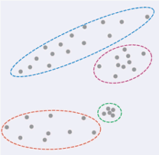
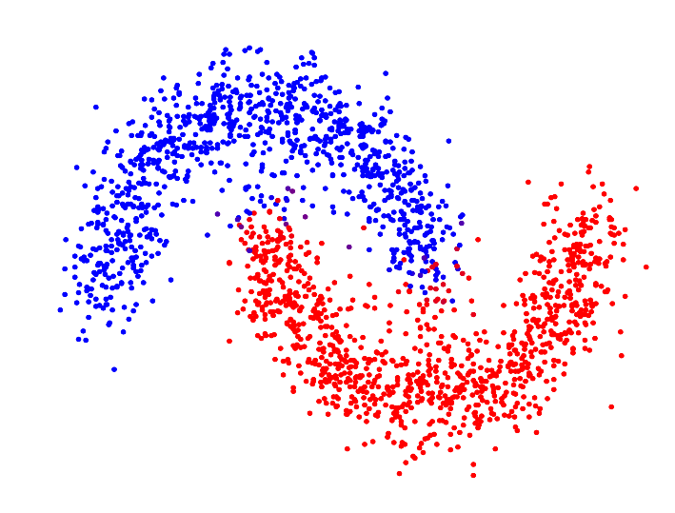
The CURE Algorithm
Vs.
Problem with BFR/k-means:
  Assumes clusters are normally
  distributed in each dimension
  And axes are fixed – ellipses at
  an angle are not OK
CURE (Clustering Using REpresentatives):
  Assumes a Euclidean distance
  Allows clusters to assume any shape
  Uses a collection of representative
  points to represent clusters

Slide 44
Example: Stanford Salaries
h
h
h
e
e
e
h
e
e
e
h
e
e
e
e
salary
h
e
h
h
h
h
h
h
h
age

Slide 45
Starting CURE
2 Pass algorithm. Pass 1:
0) Pick a random sample of points that fit in main memory
1) Initial clusters:
  Cluster these points hierarchically – group
  nearest points/clusters
2) Pick representative points:
  For each cluster, pick a sample of points, as dispersed as possible
  From the sample, pick representatives by moving them (say) 20% toward the centroid of the cluster

Slide 46
Example: Initial Clusters
h
h
h
e
e
e
h
e
e
e
h
e
e
e
e
h
salary
e
h
h
h
h
h
h
h
age

Slide 47
Example: Pick Dispersed Points
h
h
h
e
e
e
h
e
e
e
h
e
e
e
e
h
salary
e
Pick (say) 4
remote points
for each
cluster.
h
h
h
h
h
h
h
age

Slide 48
Example: Pick Dispersed Points
h
h
h
e
e
e
h
e
e
e
h
e
e
e
e
h
salary
e
Move points
(say) 20%
toward the
centroid.
h
h
h
h
h
h
h
age

Slide 49
Finishing CURE
Pass 2:
Now, rescan the whole dataset and
visit each point p in the data set
Place it in the “closest cluster”
  Normal definition of “closest”:
  Find the closest representative to p and
  assign it to representative’s cluster
p

Slide 50
Summary
Clustering: Given a set of points, with a notion of distance between points, group the points into some number of clusters
Algorithms:
  Agglomerative hierarchical clustering:
    Centroid and clustroid
  k-means:
    Initialization, picking k
  BFR
  CURE

