Slide 1
Experimenting Motion Words: Processing Motion Capture Data
Petra Budíková, Vlastislav Dohnal, Jan Sedmidubský, Pavel Zezula

Slide 2
Outline
motion words – revision
data – whole actions, segmented
distance density for DTW + L2
creating motion words
motion words quality
  cluster analysis metrics – Silhouette, Rand Index, U-ARI, 1NN consistency
  retrieval quality
motion sequence metrics
  DTW with equality
  Edit distance, N-W, S-W

Slide 3
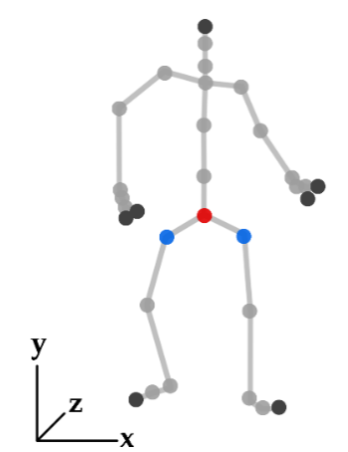








Motion capture (MoCap) data
Continuous spatio-temporal characteristics of a human motion simplified into a discrete sequence of 3D skeletons
Many application domains: computer animation, medicine, sports, …
Standard motion analysis operations: classification, subsequence search, semantic annotation
  Common task: determining similarity of two motion sequences

Slide 4
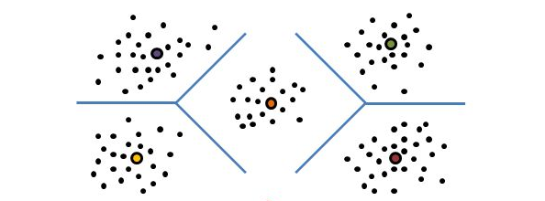
Evaluating motion similarity (cont.)
Alternative: motion word approach
  Expected advantages:
    Applicable to a wide range of MoCap processing tasks
    Applicable for comparing motion sequences of any size
    Compact motion representation, lower memory requirements
    Efficient text-processing methods can be applied for indexing and retrieval
<4.3,…>, <0.5,…>; …
ABC MOP …
raw MoCap data
Short segments
High-dimensional
segment features
Low-dimensional
motion words
  similarity of two motion sequences = similarity of the sequences of motion words

Slide 5




Processing with MWs: overview
Similar?
…
…
…
…
segmentation
segmentation
raw MoCap data
raw MoCap data
feature extraction
feature extraction
<4.3,…>; <0.5,…>; <7.2,…>; <1.1,…>
<4.5,…>; <5.8,…>; <7.2,…>; <3.6,…>
Similar?
transformation to MWs
transformation to MWs
Match?
ABC
MOP
BBD
XVA
ABD
RRT
BBD
FGD
STEP 1: MW creation and matching
Similar?
STEP 2: similarity of MW sequences
STEP 3: complete motion processing

Slide 6
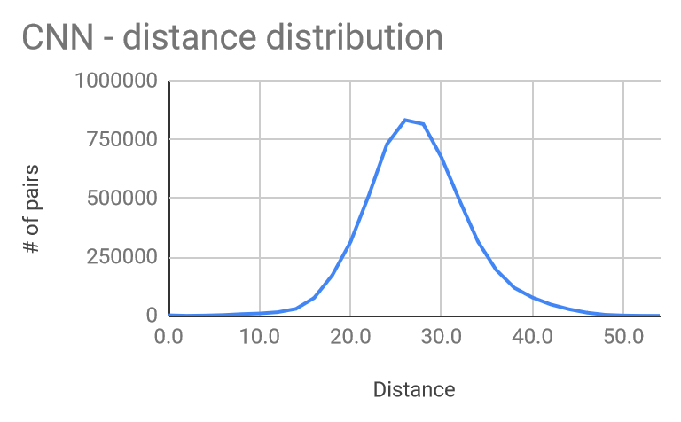
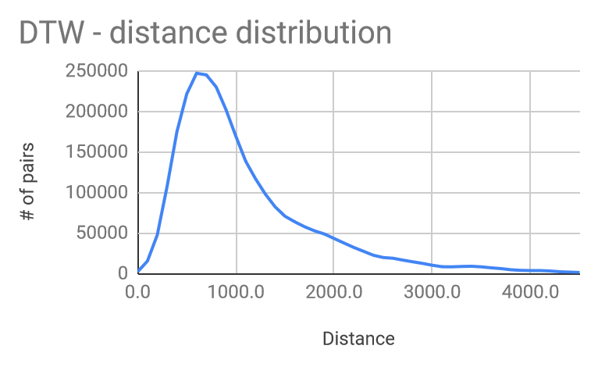
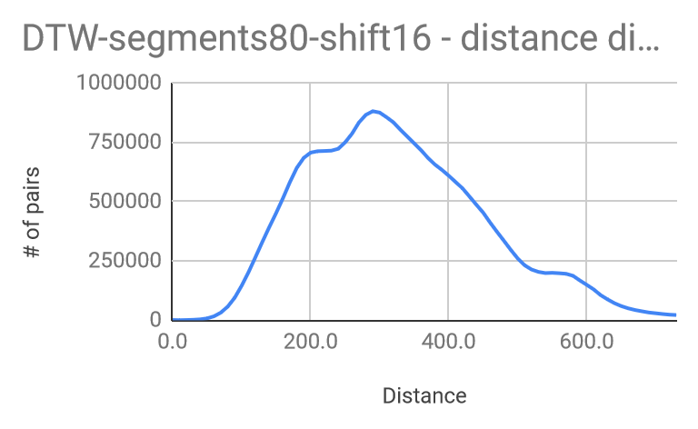
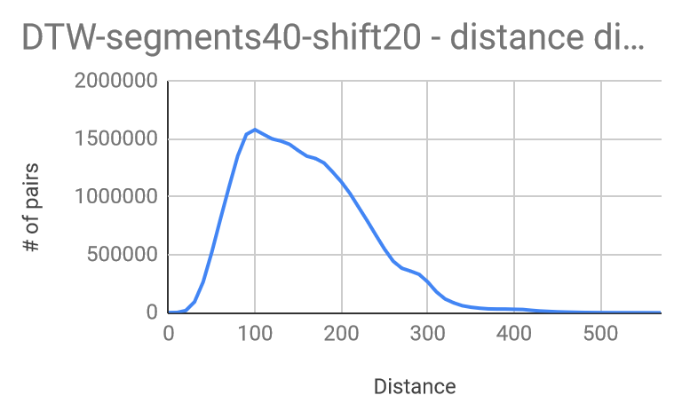
Data Sets (dist func. DTW on L2)
hdm05-annotations_specific-1fold_130classes.data
  CNN extracted descriptors (4,096 float vectors), 2345 objects
  Euclidean distance
hdm05-annotations_specific-coords_normPOS-fps12.data
  raw data – 3d positions of joints, FPS reduced, 2345 objects
  Euclidean distance on joints, DTW on sequences
hdm05-annotations_specific-coords_normPOS-fps12.data
  segments80-shift16 (28104 objects)
  segments40-shift20 (27404 objects)

Slide 7
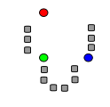
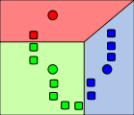
Creating Motion Words
Motion word (basic version)
  One-dimensional representation of MoCap data segment
  Obtained by disjoint quantization of segments of MoCap data
    One motion segment <-> one MW
Quantization techniques
  k-medoids
  Voronoi partitioning with preselected cell centers
    Incremental (space outliers), random

Slide 8
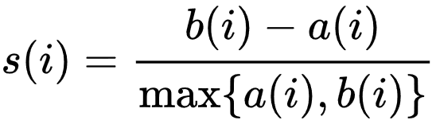
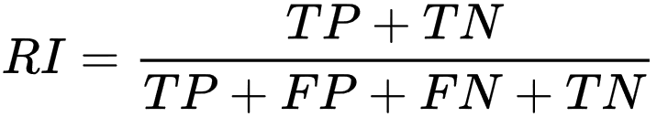
Motion Words Quality
Cluster Analysis Measures
  Silhouette coefficient – ratio of average distance between segments having the same word (a) to the average distance to other words (b)
    +1 – well clustered
    -1 – poorly clustered
  Rand Index – similarity between two clusterings
    Unsupervised variant based on
    two distance thresholds (similar, dissimilar)
      TP – close pairs having the same word
      TN – distant pair having different words
      FP – same word but not close
      FN – different word but close
  Adjusted Rand Index
    corrected-for-chance version (subtract agreement of random clustering)
    Unsupervised variant (U-ARI)
  1NN consistency – nearest neighbor of a segment should have the same word

Slide 9
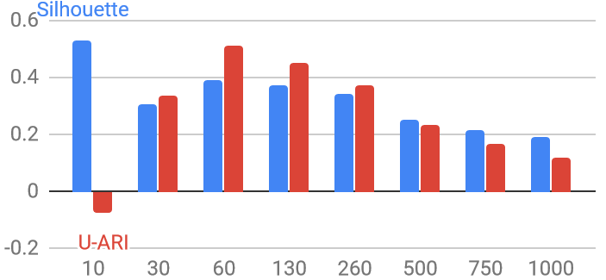
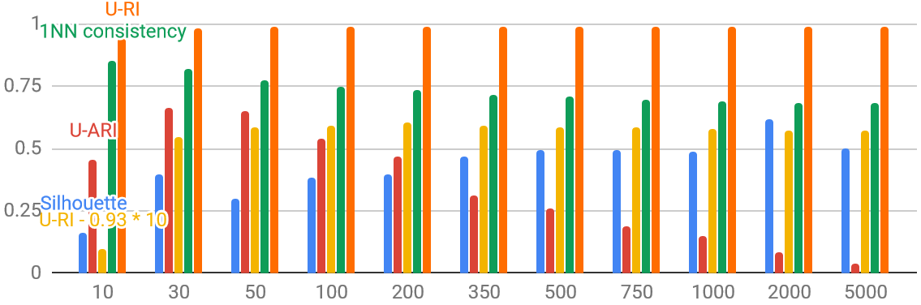
K-medoids Vocabulary Quality
Raw non-segmented data (hdm05-annotations_specific-coords_normPOS-fps12)
  Varying pivots 10-1000
Segmented 80, shift 16

Slide 10
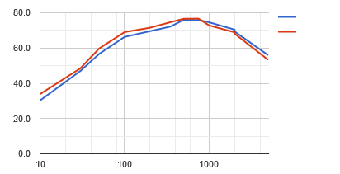
K-medoids Vocabulary Classification Precision
hdm05’s ground truth – 130 classes; kNN classifier used
  Segmented 80, shift 16
  Pivots 10 - 5000
1NN
5NN

Slide 11
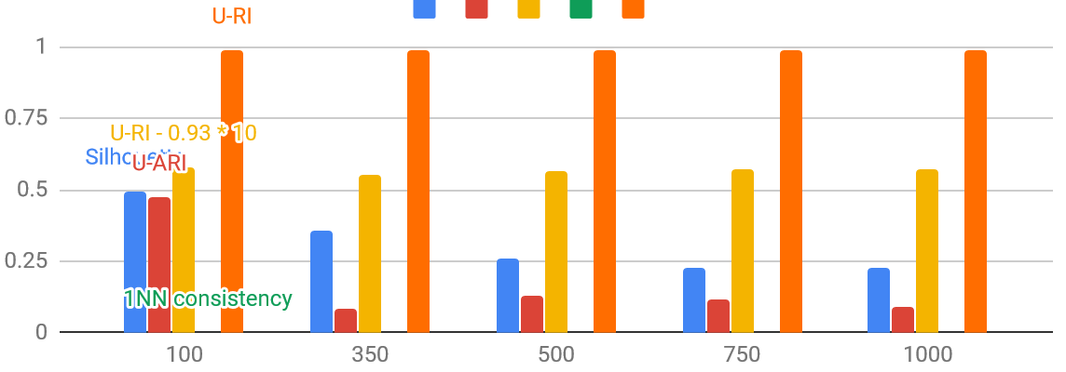
Voronoi Vocabulary Quality
Random pivots vs. incremental ones
  100-1000 random pivots; 500 incremental ones
Notes:
Incremental – silhouette 0.571379; U-ARI 0.26453263

Slide 12
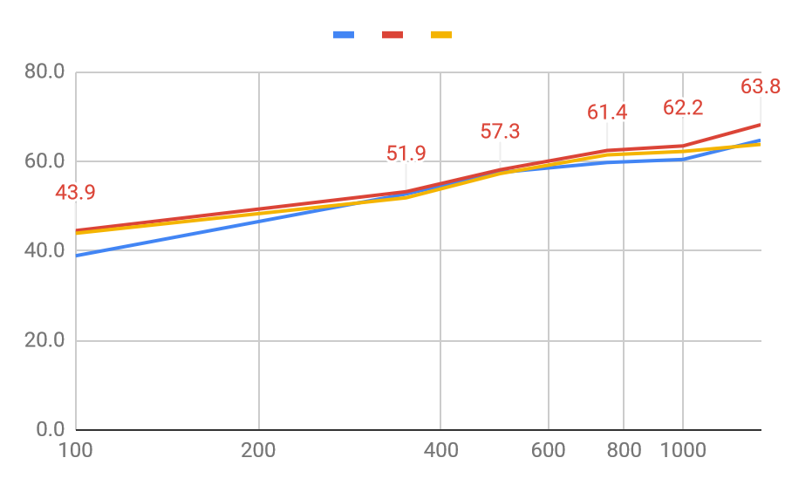
Voronoi Vocabulary Classification Precision
Random pivots vs. incremental ones
  100-1500 random pivots; 500 incremental ones
1NN 5NN 15NN
Notes:
Incremental – 74, 73, 67%

Slide 13
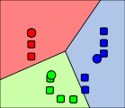
Creating General Motion Words
Motion word (generalized version)
  Diminish border problems by multiple independent “clusterings”
Quantization techniques
  k-medoids
  Voronoi partitioning with preselected cell centers
    Incremental (space outliers), random

Slide 14
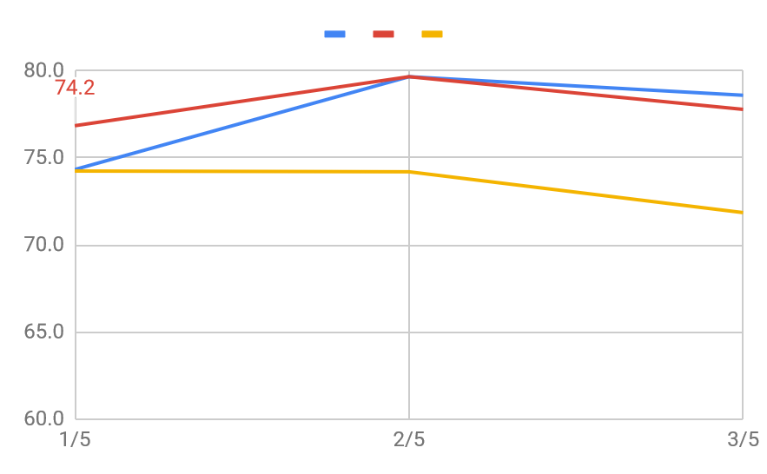
Voronoi Vocabulary Classification Precision
5 independent Voronoi partitionings over 500 incremental pivots
1NN 5NN 15NN
Notes:
Incremental – 74, 73, 67%

Slide 15
Motion Sequence Metrics
Raw data, 2345 sequences
  Segments quantized using different vocabulary
  Sequences from 1 to 52 segments (words)
Edit distance
Smith-Waterman
Needleman-Wunsch
DTW
…

Slide 16
Conclusions
More experiments to do…

Slide 17
Outline
WHY motion words?
  Challenges of motion data processing
  Limitations of existing approaches
  Inspiration from related fields
HOW can motions be represented by motion words?
  Overview of our approach
  Discussion of individual steps
  Preliminary results

Slide 18
WHY motion words?

Slide 19
Motion capture (MoCap) data
Continuous spatio-temporal characteristics of a human motion simplified into a discrete sequence of 3D skeletons
Many application domains: computer animation, medicine, sports, …
Standard motion analysis operations: classification, subsequence search, semantic annotation
  Common task: determining similarity of two motion sequences

Slide 20
Evaluating motion similarity
State-of-the-art: features trained for whole actions
  Advantages:
    High-precision neural networks can be trained
    Suitable for action recognition
  Disadvantages:
    Limited applicability e.g. for subsequence search
      Typically works for a limited range of segment sizes
      High memory requirements (data replication) and retrieval costs
<0, 0, 5.2, 8.1, 0, 2.3, -1.1, 0, …>, ….
raw MoCap data
Action-sized segments
High-dimensional segment features
  similarity of two motion sequences = similarity of the respective two features

Slide 21
Evaluating motion similarity (cont.)
Alternative: motion word approach
  Expected advantages:
    Applicable to a wide range of MoCap processing tasks
    Applicable for comparing motion sequences of any size
    Compact motion representation, lower memory requirements
    Efficient text-processing methods can be applied for indexing and retrieval
<4.3,…>, <0.5,…>; …
ABC MOP …
raw MoCap data
Short segments
High-dimensional
segment features
Low-dimensional
motion words
  similarity of two motion sequences = similarity of the sequences of motion words

Slide 22
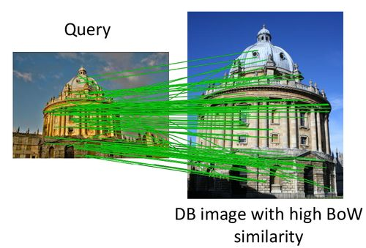
Inspiration: visual words
Around 2000, local image descriptors were very popular for image retrieval
  Effective, but not efficient: a high number (500-3000) of high-dimensional (128 for SIFT) features per single image!
Josef Sivic, Andrew Zisserman: Video Google: A Text Retrieval Approach to Object Matching in Videos. ICCV 2003.
  Use clustering to quantize feature descriptors into visual words
  Apply text-processing techniques
Many following works:
  Feature quantization:
    Trying to overcome efficiency problems:
      hierarchical k-means, approximate k-means, randomized methods
    Trying to minimize “border problems”:
      Fuzzy clustering (weighted combination of several visual words for each feature)
      Consensus clustering (multiple visual vocabularies, different levels of consensus)
  Spatial verification of candidates
p₃
p₁
a
b
p₂

Slide 23
Similar ideas in motion processing
Rongyi Lan, Huaijiang Sun: Automated human motion segmentation via motion regularities. The Visual Computer 31(1): 35-53 (2015)
  Cluster individual poses into motion words
    Agglomerative hierarchical clustering
  Apply probabilistic modeling to discover motion topics
Aristidou, A., Cohen-Or, D., Hodgins, J. K., Chrysanthou, Y., & Shamir, A. (2018). Deep Motifs and Motion Signatures. In SIGGRAPH Asia 2018
  Break motion sequences to short-term movements called motion words
  Cluster the motion words into motion motifs
    K-means clustering algorithm, mutually exclusive clusters
  The signature of a motion sequence S is defined as the normalized histogram of its words in all K clusters.
    For comparisons, use tf-idf weighting and Earth Mover’s Distance

Slide 24
Motion words – HOW?

Slide 25
Processing with MWs: overview
Similar?
…
…
…
…
segmentation
segmentation
raw MoCap data
raw MoCap data
feature extraction
feature extraction
<4.3,…>; <0.5,…>; <7.2,…>; <1.1,…>
<4.5,…>; <5.8,…>; <7.2,…>; <3.6,…>
Similar?
transformation to MWs
transformation to MWs
Match?
ABC
MOP
BBD
XVA
ABD
RRT
BBD
FGD
STEP 1: MW creation and matching
Similar?
STEP 2: similarity of MW sequences
STEP 3: complete motion processing

Slide 26
Our objectives
Demonstrate the viability of the MW approach
  Propose solutions for all phases
  Show that together they work in a real-world scenario
    With reasonable quality
    With high efficiency and scalability (at least in theory)
Identify problems, provide insight into individual steps using real data
  There are multiple phases where we can lose information
    Segmentation, feature extraction, quantization, matching
  We want to understand the influence of individual techniques, therefore we would like to evaluate each step independently

Slide 27
Step 1: MW creation and matching
Input: segment features and distance function
Output: motion words and MW matching function
What do we want?
  segments similar in the original feature space will be matched in the MW representation
  dissimilar segments will not be matched
<4.3,…>; <0.5,…>; <7.2,…>; <1.1,…>
<4.5,…>; <5.8,…>; <7.2,…>; <3.6,…>
Similar?
transformation to MWs
transformation to MWs
Match?
ABC
MOP
BBD
XVA
ABD
RRT
BBD
FGD
STEP 1: MW creation and matching

Slide 28
Towards formalization of MWs
Motion word (basic version)
  One-dimensional representation of MoCap data segment
  Obtained by disjoint quantization of the original MoCap data (features and distance measure)
    Each motion segment is associated with one MW
  Coarse approximation of the original MoCap similarity function by trivial MW matching function:
    segments that are mapped on the same MW have similarity 1
    segments that are mapped different MWs have similarity 0
Motion word vocabulary
  Set of available MWs defined by a particular quantization technique
  Can be seen as a set of equivalence classes over the original feature space
Problems:
  Assumes one optimal clustering – difficult to find
  Border problems are very likely to occur
p₃
p₁
a
b
p₂

Slide 29
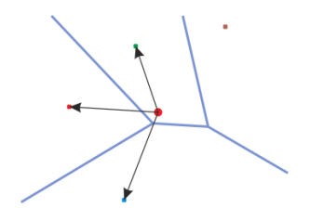
Towards formalization of MWs (cont.)
Motion word (generalized version)
  One-dimensional representation of MoCap data segment
  Obtained by soft (fuzzy, overlapping) quantization of the original MoCap data (features and distance measure)
    Each motion segment is associated with one or several motion words, potentially with confidences
      Segment s1 -> motion words {A,B,C}
      Segment s2 -> motion words {B,C,X}
      Segment s3 -> motion words {C,X,Y}
  Non-trivial MW matching function
    Motion segments are considered similar if all/some/at least k of their MWs match
      Not transitive, does not define equivalence classes
      Should provide better approximation of the original similarity between motion segments
Motion word vocabulary
  Set of available MWs defined by a particular quantization technique
  Motion words may not be equivalence classes over the original feature space
    Motion word A: {s1}
    Motion word B: {s1,s2}
    Motion word C: {s1,s2,s3}

Slide 30
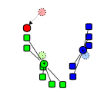
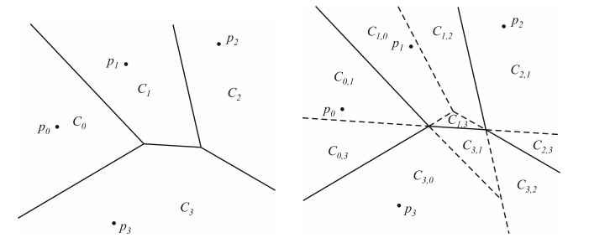
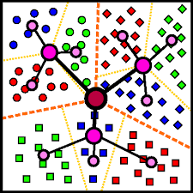
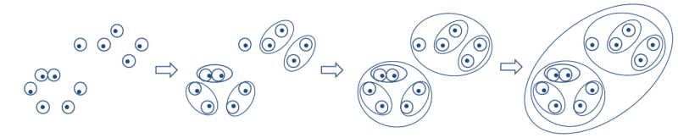
Quantizing features into MWs
Hard clustering
  Flat partitional clustering
    k-means clustering
  Hierarchical clustering
    Divisive
      Hierarchical k-means
      M-index
    Agglomerative
Soft clustering
  Fuzzy assignment to clusters
    k nearest clusters
    All clusters with close borders
  Consensus clustering
Things to consider:
  Vocabulary size = number of clusters
    Text retrieval: hundreds of thousands for full language dictionary
    Visual retrieval: hundreds of thousands or millions
    Motion retrieval: ???
      In Deep Motifs and Motion Signatures they use 100 motifs

Slide 31
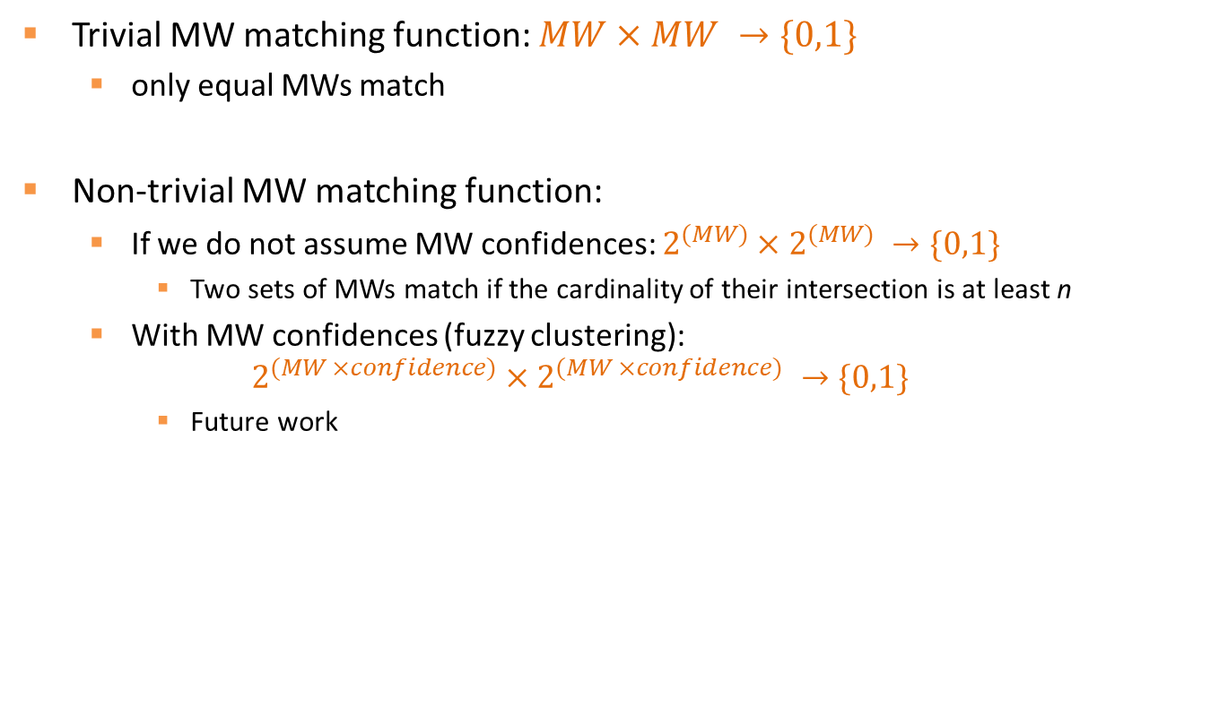
MW matching
Trivial MW matching function: $MW×MW →\{0,1\}$
  only equal MWs match
Non-trivial MW matching function:
  If we do not assume MW confidences: $2^{(MW)}×2^{(MW)} →\{0,1\}$
    Two sets of MWs match if the cardinality of their intersection is at least n
  With MW confidences (fuzzy clustering):
  $$2^{(MW ×confidence)}×2^{(MW ×confidence)} →\{0,1\}$$
    Future work

Slide 32
Evaluation of MW matching
Standard cluster evaluation
  External – compares given clustering C to GT clustering C_{GT}
    Rand index: probability that C and C_{GT} will agree on a random pair of objects
  Internal – no GT, uses intra- and inter-cluster distances
    Silhouette coefficient: measure of how similar an object is to its own cluster (cohesion) compared to the neighbor cluster (separation)
Unfortunately, there is no external GT for segment matching
  However, we can use the distribution of distances in the original feature space to define a partial approximate GT clustering C_{GT-approx}
    If dist(o₁,o₂) <= dist_{SIMILAR}, then o₁ and o₂ belong to the same cluster in C_{GT-approx}
    If dist(o₁,o₂) > dist_{DISSIMILAR}, then o₁ and o₂ belong to different clusters in C_{GT-approx}
  Using C_{GT-approx}, we can define “semi-external” evaluation measures
    E.g. Unsupervised Rand index

Slide 33
Step 2: similarity of MW sequences
Input: MW sequence and MW matching function
Output: MW sequence distance function
What do we want?
  Depends on application
    Find very similar motions different only in speed
    Find similar motions with gaps
    Detect longer sequences with similar subsequences
    …
  Common requirement: reasonable distribution of distances in the dataset
<4.3,…>; <0.5,…>; <7.2,…>; <1.1,…>
<4.5,…>; <5.8,…>; <7.2,…>; <3.6,…>
transformation to MWs
transformation to MWs
ABC
MOP
BBD
XVA
ABD
RRT
BBD
FGD
Similar?
STEP 2: similarity of MW sequences

Slide 34
Sequence similarity
Possible approaches:
  Set of words
    Jaccard similarity
  Bag of words (histograms, vectors)
    Euclidean distance
    Cosine distance
    Earth movers distance
  Sequence matching
    Edit distance
    DTW
    Sequence alignment
    Longest common subsequence
    Shingles + Jaccard similarity

Slide 35
Sequence similarity (cont.)
Things to consider:
  Word weighting
  Stop words
  Efficient indexing!
Evaluation
  Look at distance distribution of MW sequences

Slide 36
Step 3: complete motion processing with MWs
Similar?
…
…
…
…
segmentation
segmentation
raw MoCap data
raw MoCap data
feature extraction
feature extraction
<4.3,…>; <0.5,…>; <7.2,…>; <1.1,…>
<4.5,…>; <5.8,…>; <7.2,…>; <3.6,…>
Similar?
transformation to MWs
transformation to MWs
Match?
ABC
MOP
BBD
XVA
ABD
RRT
BBD
FGD
STEP 1: MW creation and matching
Similar?
STEP 2: similarity of MW sequences
STEP 3: complete motion processing

Slide 37
Complete motion processing with MWs
With respect to a given application, choose suitable segmentation, features, quantization, matching, sequence similarity
Segmentation
  Static or semantic?
    Now: static
    Future work: try semantic segmentation
  What is reasonable segment length?
  Disjoint or overlapping segments?
Segment features
  Now: original 3D data + DTW
  Future work: better segment features
    Train NN?

Slide 38
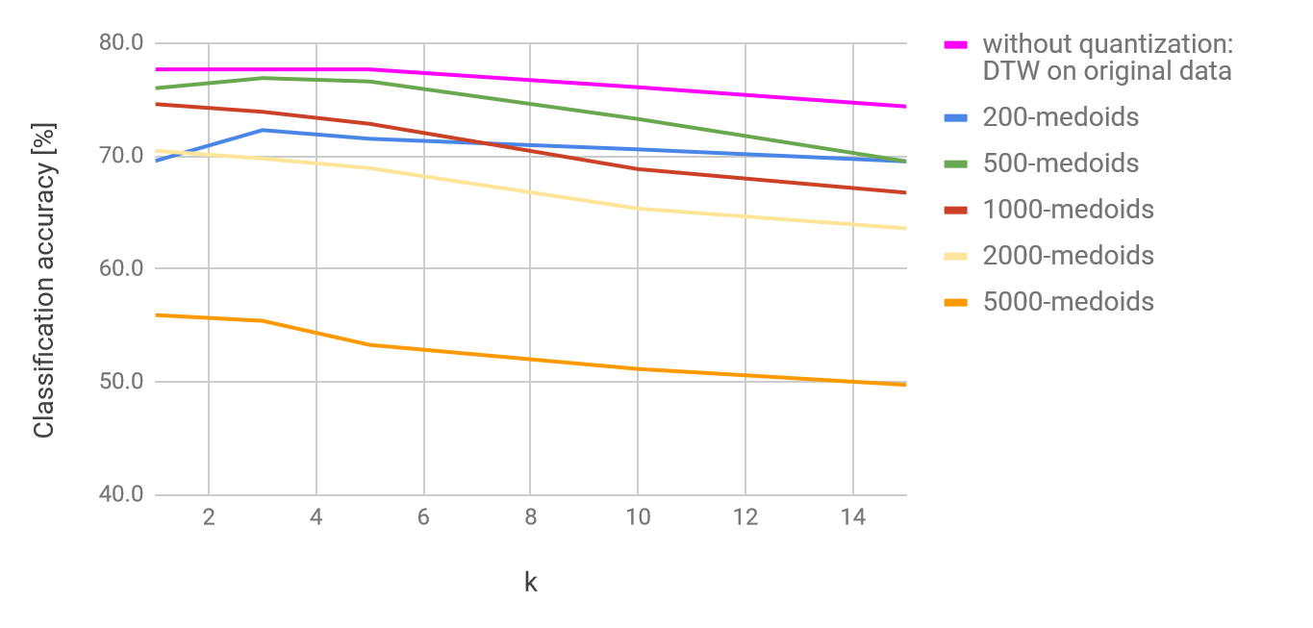
Preliminary results
Application: action recognition
  130 classes, 2345 actions
  kNN classifier
Settings:
  Static segmentation, segment length 80 frames, shift 16 frames
  Segment features: original 3D data + DTW
  Feature quantization: flat k-medoids
  Similarity evaluation: trivial MW matching, DTW for MW sequence similarity

Slide 39
The final slide (recap)
To make the MW idea work, we need to solve:
  Step 1: MW creation and matching
  Step 2: similarity of MW sequences
  Step 3: complete motion processing with MWs
What we have:
  First simple solution that provides not-so-bad results
  A lot of avenues to explore:
    Soft clustering methods
    MW sequence similarity measures
    Different segmentation strategies

