Slide 1
Masaryk Uni, Brno Intercultural Management 2
The work and influence of Geert Hofstede
Some other theoretical approaches to Culture
MU Brno 2018

Slide 2
Preamble: question 1
You are going to work in:
- Canada
- France
- Singapore
- Mexico…………..
Predict some of the deeper and less visible cultural differences which you might encounter in the workplace
MU Brno 2018

Slide 3
Preamble: question 2
You are working in Brno and a new colleague is coming from:
- Sweden
- USA
- China
- Brazil
Predict some of the deeper and less visible cultural differences between their culture and France which they might encounter in the workplace
MU Brno 2018

Slide 4
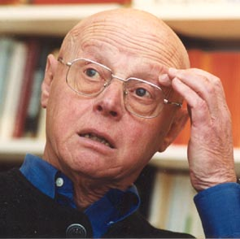
Hofstede’s Background
Born in Netherlands in 1928
Founded and managed the Personnel Research Department of IBM Europe
Co-founder of IRIC (Institute for Research on Intercultural Cooperation)
Most cited living non-American in the field of Management in the US Social Sciences Citation Index!
MU Brno 2018

Slide 5
Hofstede’s Dimensions of Culture
Geert Hofstede’s cultural typology is the most often used.
It is based upon a study (questionnaire) of 100,000 IBM employees who worked in IBM divisions throughout the world.
Here is a sample questionnaire – complete it carefully and we will then look at the results
MU Brno 2018

Slide 6
Hofstede’s Dimensions of Culture
Hofstede’s survey revealed four underlying dimensions of culture
Power Distance (PD)
Uncertainty Avoidance (UA)
Individualism/Collectivism (IND)
Masculinity/Femininity (MAS)
MU Brno 2018

Slide 7
Power Distance (PD)
Power Distance is the extent to which hierarchical differences are accepted in society and articulated in terms of deference to higher and lower social and decision levels in an organization.
Artifacts of high PD:
Centralization
# Org. Levels – steep organisational pyramid
# Supervisors – multi-layered pyramid
Differing Values, White & Blue Collar Work
MU Brno 2018

Slide 8
POWER DISTANCE
LOW PD culture HIGH PD culture
N+1
N+1
N
N
MU Brno 2018

Slide 9
POWER DISTANCE
LOW PD cultures
Subordinates expect to be consulted
Bosses are accessible
Initiative is expected
Inequalities should be minimised
Privilege & status symbols discouraged
MU Brno 2018

Slide 10
POWER DISTANCE
HIGH PD cultures
Subordinates expect to be told what to do
Privilege & status are normal
Superiors « inaccessible »
Inequalities accepted
MU Brno 2018

Slide 11
POWER DISTANCE
So what would you expect???
LOW PD HIGH PD
…………………? …………………?
…………………? …………………?
…………………? …………………?
MU Brno 2018

Slide 12
POWER DISTANCE
LOW PD HIGH PD
Denmark Malaysia
Sweden Mexico
Ireland France
MU Brno 2018

Slide 13
Power Distance: case 1
What problems might a manager from a low PD culture have working with an assistant from a high PD culture?
« Empowerment »
What problems might a manager from a high PD culture have working with a team from a low PD culture?
MU Brno 2018

Slide 14
UNCERTAINTY AVOIDANCE
The degree to which people feel threatened by uncertainty and ambiguity and try to avoid it = high UA
MU Brno 2018

Slide 15
Uncertainty Avoidance (UA)
Uncertainty Avoidance is the extent to which uncertainty and ambiguity are avoided/tolerated.
Artifacts of high UA:
Standardization
Structured activities
Written rules
Specialists
Low risk tolerance
Ritualistic behavior
MU Brno 2018

Slide 16
UNCERTAINTY AVOIDANCE
Weak/Low UA
Apparently relaxed environment, minimal stress
Initiative encouraged
Relatively few rules & regulations
Pragmatic
Tolerance of deviant, innovative ideas
People can seem quiet, easy-going or « lazy » to those from a different background
MU Brno 2018

Slide 17
UNCERTAINTY AVOIDANCE
Strong/High UA
Anxious, higher stress levels at work
Risk-averse – need to avoid failure
Need for rules & regulations
Resistant to change
Low tolerance of deviant, innovative ideas
People can seem busy, emotional, aggressive or unfriendly to those from a different background
MU Brno 2018

Slide 18
UNCERTAINTY AVOIDANCE
So what would you expect???
Weak UA Strong UA
Singapore Greece
Denmark Japan
UK France
MU Brno 2018

Slide 19
Uncertainty Avoidance
Strong (high) uncertainty avoidance vs. Weak (low) uncertainty avoidance
Uncertainty avoidance ~ ≠ ~Risk avoidance
Stress at work rises with higher UA
High UA = fear of “failure”
MU Brno 2018

Slide 20
Uncertainty Avoidance: case 2
What problems could affect a multi-cultural team composed of members from high & low UA cultures?
How could these problems be dealt with?
MU Brno 2018

Slide 21
INDIVIDUALISM /COLLECTIVISM
Individualism – ties between individuals are loose; people look after themselves and their immediate family
Collectivism – people are integrated into strong, cohesive groups in exchange for unquestioning loyalty
MU Brno 2018

Slide 22
INDIVIDUALISM /COLLECTIVISM
High Individualism
Identity is based on the individual
Task prevails over relationship
Work relationship – contract of mutual advantage
« self-respect » important
Correlates .82 with GNP
MU Brno 2018

Slide 23
INDIVIDUALISM /COLLECTIVISM
Collectivism (a low score on Hofstede’s index for IND)
Identity is based on social network
Relationship prevails over task
Work relationship – family model
« face » & maintenance of harmony
Management of groups not individuals
MU Brno 2018

Slide 24
INDIVIDUALISM /COLLECTIVISM
High IND High COLL
????????? ?????????
USA HK
UK Guatemala
NL Japan
MU Brno 2018

Slide 25
MASCULINITY / FEMININITY
The dominant values in society are:
MASC – material success, achievement,
FEM – quality of life, caring for others
MU Brno 2018

Slide 26
MASCULINITY / FEMININITY
High MAS
Ambition, assertiveness
Competition & performance important
« Live to work »
« Size matters »
Distinct gender roles
Managers are expected to be assertive
Note: High MAS often correlates positively with % of GNP spent on defence
MU Brno 2018

Slide 27
MASCULINITY / FEMININITY
High FEM (low score on MAS index)
Quality of life issues are important
Equality & solidarity are important
« Work to live »
« Small is beautiful »
Overlapping gender roles
Managers often strive for consensus
Note: High FEM often correlates positively with % of GNP spent on overseas aid
MU Brno 2018

Slide 28
Masculinity vs. Femininity
Masculinity
Earnings
Recognition
Advancement
Challenge
NOT…machismo
Femininity
Managing
Cooperation
Living space
Employment security
MU Brno 2017

Slide 29
MASCULINITY / FEMININITY
So what would you expect???
High MAS Low MAS=High FEM
Japan Sweden
USA NL
Germany France
MU Brno 2018

Slide 30
Long-Term Orientation (LTO)
Originally called Confucian Dynamism because of anchoring in the Confucian value system.
Represents such values as thrift, persistence, and traditional respect of social obligations.
Organizations likely to adopt longer planning horizon, with individuals ready to delay gratification.
MU Brno 2018

Slide 31
Confucian Dynamism
aka long-term vs. short-term orientation
5th dimension revealed through another study - Chinese value survey (CVS)
Administered to 100 students in 23 countries!
Findings of study
Related to economic growth
MU Brno 2018

Slide 32
Confucian Dynamism (Ratings)
Long-term orientation
Persistence
Ordering and observing relationships by status
loss of “face” = weakness
Save, be thrifty
Invest in real estate
Oriented towards future rewards
Short-term orientation
Change is encouraged
Emphasis on quick results
Personal steadfastness important
Spend
Invest in funds
Oriented towards present & near future
MU Brno 2018

Slide 33
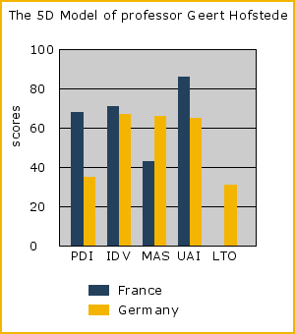
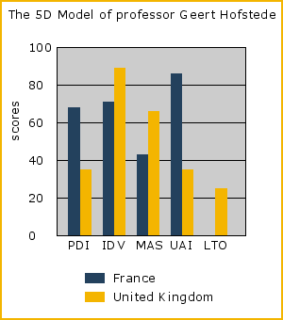
Some Examples 1
MU Brno 2018

Slide 34
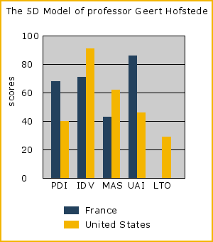
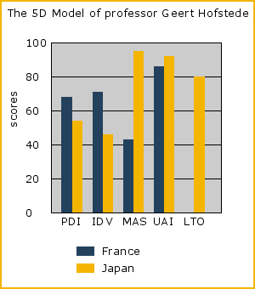
Some Examples 2
MU Brno 2018

Slide 35
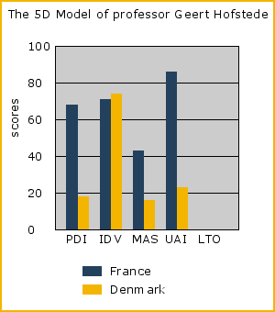
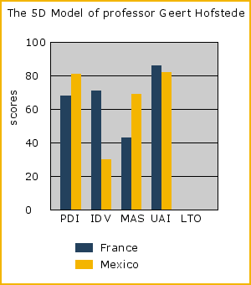
Some Examples 3
MU Brno 2018

Slide 36
What might happen when companies merge? Case 1: Renault-Volvo 1992
 | FRANCE | SWEDEN
PDI | 68 | 31
UA | 86 | 29
IND | 71 | 71
MAS | 43 | 5
MU Brno 2018

Slide 37
What might happen when companies merge? Case 2: ASEA Brown-Boveri 1988
 | SWEDEN | SWITZERLAND
PDI | 31 | 34
UA | 29 | 58
IND | 71 | 68
MAS | 5 | 70
MU Brno 2018

Slide 38
Discussion
What are the practical implications of these findings?
Do you think national values can change over time?
Do you think that increasing globalization and advancements in technology will lead to a narrowing of cultural differences?
Is it possible for someone to identify with more than one national culture?
MU Brno 2018

Slide 39
Criticism of Hofstede
In what ways can Hofstede’s classification be criticised?
MU Brno 2018

Slide 40
Criticism of Hofstede
Hofstede has been subject to broad criticism. Among the criticisms:
Focus on national culture
Single company data, with a large Multinational Enterprise having a strong corporate culture.
Time dependent results, which are an artifact of the time of data collection and analysis.
Business culture, not values culture, representing a reflection of business culture at IBM and not national culture of the countries IBM operates within.
MU Brno 2018

Slide 41
Criticism of Hofstede
Non-exhaustive, doesn’t identify all the cultural dimensions possible, but just a few.
Partial geographic coverages, cover only a portion of the world’s cultures and countries.
Western bias, which values western business ideals.
Attitudinal rather than behavioral measures, with no connection between employee attitudes and employee behaviors.
National level data generalized into individual behavior.
MU Brno 2018

Slide 42
Criticism of Hofstede
BUT, despite these criticisms (many of which I agree with):
Hofstede has been, and still is, very influential
(remember slide 4….most cited…)
MU Brno 2018

Slide 43
Some other models
National Culture Clustering
Civilisation clustering
Hofstede’s corporate culture definitions
Hall – Space, Time & Context (class 1)
Trompenaars variable’s (next class!)
MU Brno 2018

Slide 44
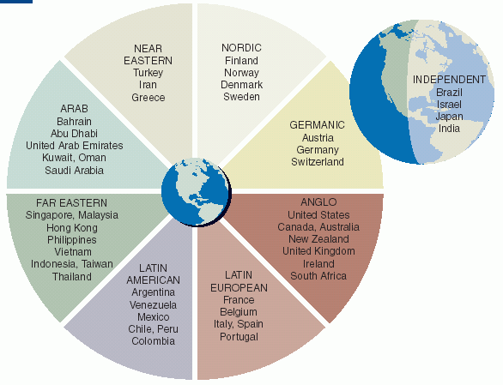
National Cultural Clustering
Ronen and Shenkar’s culture clustering
MU Brno 2018

Slide 45
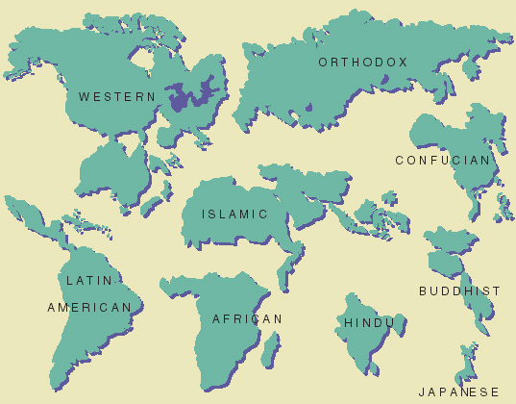
National Cultural Clustering
Huntington’s civilization clustering
MU Brno 2018

Slide 46
Corporate Culture
Corporate Culture is the culture adopted, developed and disseminated in an organization.
Corporate culture can deviate from national norms, but that depends upon the strength of culture and the values and practices tied to it.
MU Brno 2018

Slide 47
Classifications of Corporate Culture
Hofstede et al:
Value dimensions (factors)
Need for security
Work centrality
Need for authority
Practices
Process-oriented vs. results-oriented
Employee-oriented vs. job-oriented
Parochial vs. professional
Open system vs. closed system
Loose control vs. tight control
Normative vs. pragmatic
MU Brno 2018

Slide 48
Classifications of Corporate Culture
Trompenaars and Hampden-Turner
The Family – personal, hierarchical, power-oriented
The Eiffel Tower – specific relations, ascribed status, rational authority
The Guided Missile – egalitarian, impersonal, and task oriented
The Incubator – individual self-fulfillment, personal and egalitarian relations
MU Brno 2018

Slide 49
Other Layers of Culture
Ethnicity – significant ethnic communities exist in many countries; can affect a myriad of issues
Occupation – important layer of culture
Demographics – education, age, seniority and hierarchical level affect difference in values
Ideology – not always consistent with cultures, can vary with time and across regions
Social class – differences within cultures, similarities across cultures (Marxist analysis)
MU Brno 2018

Slide 50
Key Cultural Issues
Cultural Etiquette – the manners and behavior that are expected in a given situation
Cultural Stereotypes – our beliefs about others, their attitudes and behavior
Ethnocentric – looking at the world from a perspective shaped by our own culture
Auto-stereotypes – how we see ourselves as a group distinguished from others
Hetero-stereotypes – how we are seen by others.
MU Brno 2018

Slide 51
Key Cultural Issues
Cultural Distance
The extent to which cultures differ from each other
Hofstede stated that uncertainty avoidance was the most important dimension of FDI
Convergence and Divergence
Convergence hypothesis – assumes that the combination of technology and economics is making countries more alike
Divergence hypothesis – assumes that counties will continue to maintain their distinctive characteristics
MU Brno 2018

